Slide 1
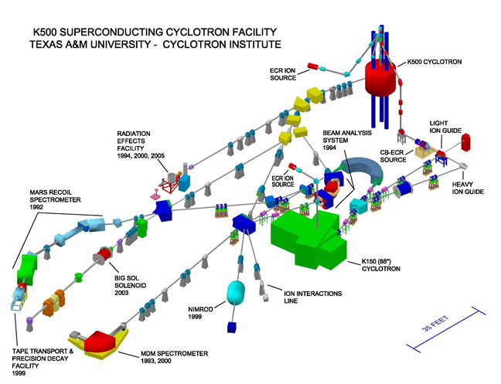
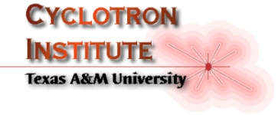
Why Nuclear Science was
and is Still
So Interesting to Me
Where Did The Time Go and How Did I Get To Be The Oldest Guy in the Room?
J. Natowitz
T-REX
[ TAMU
Reaccelerated
EXotics]

Slide 2
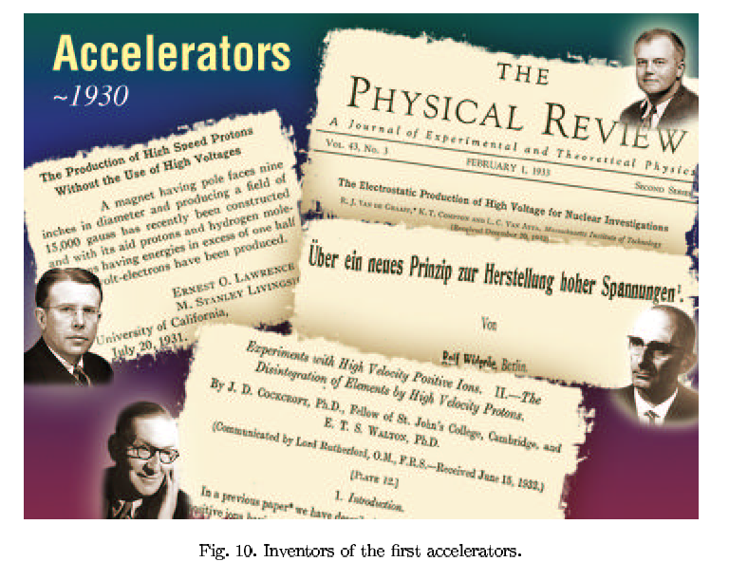
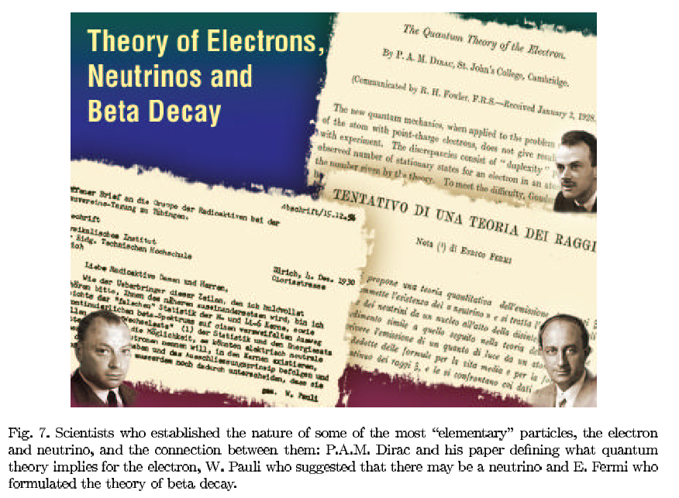
1930s

Slide 3
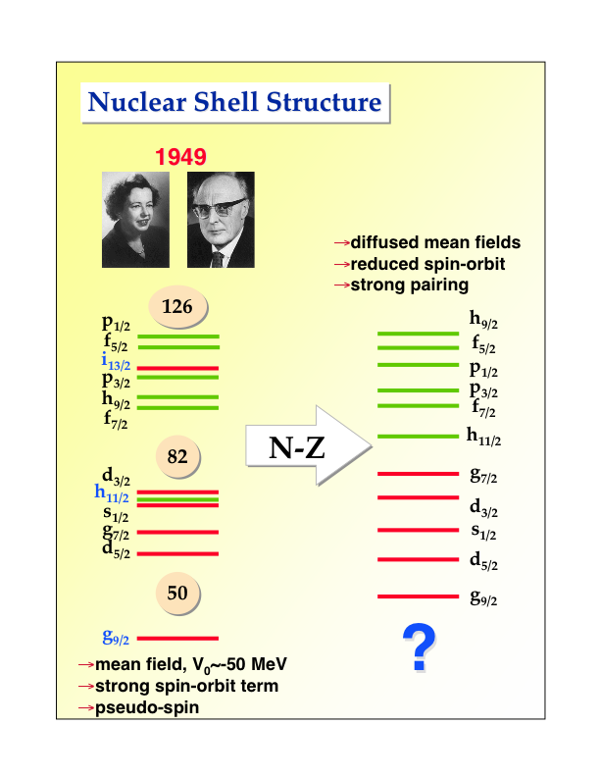
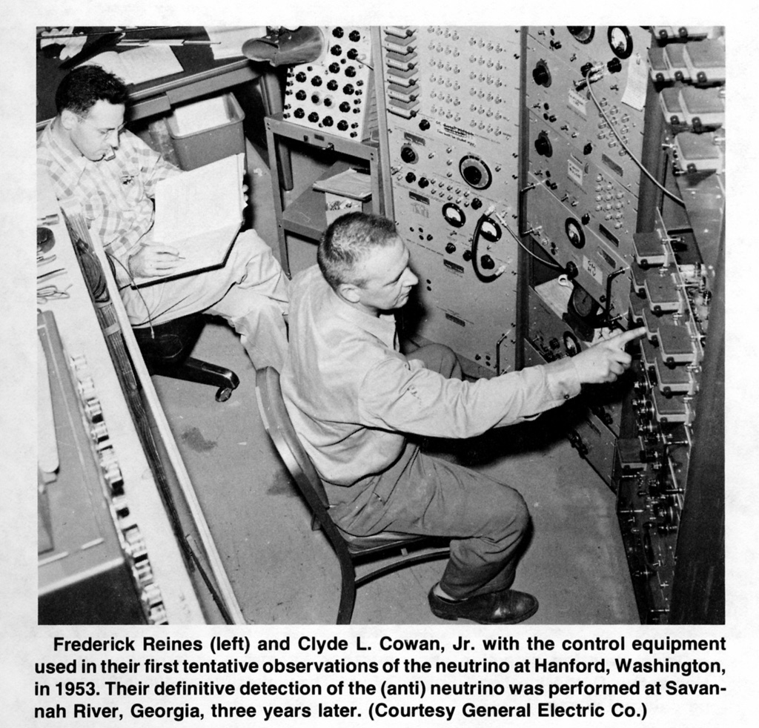
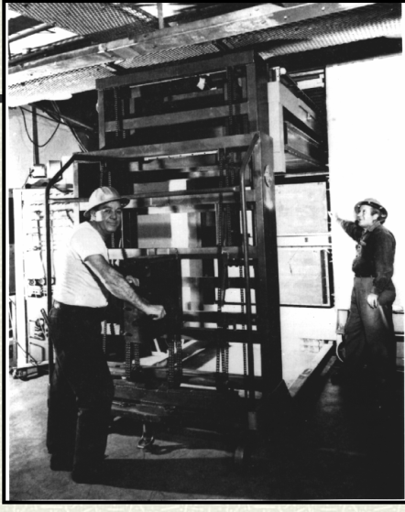
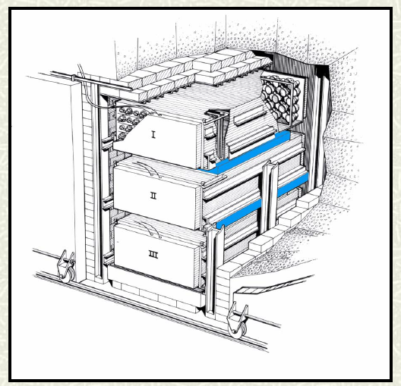
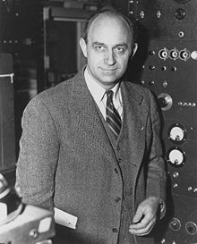
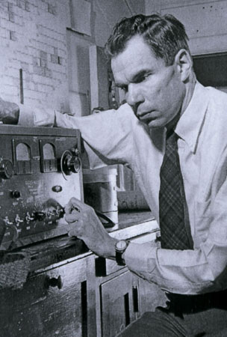
1940s 1950s
Neutrino Detection
NEW HEAVY ELEMENTS Np, Pu, Am …

Slide 4
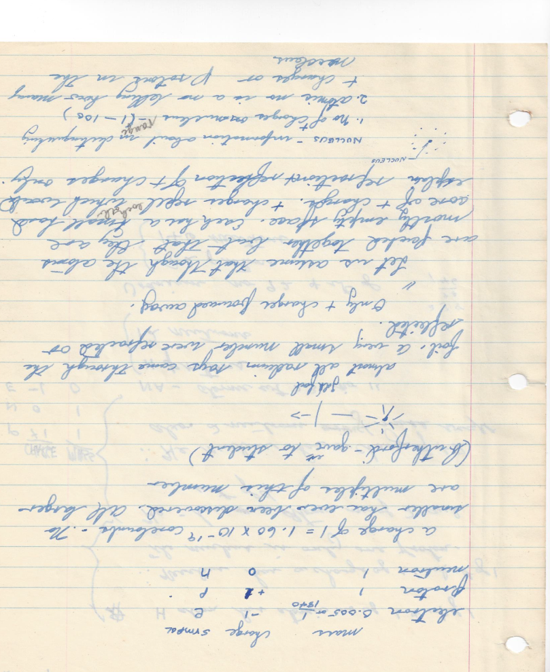
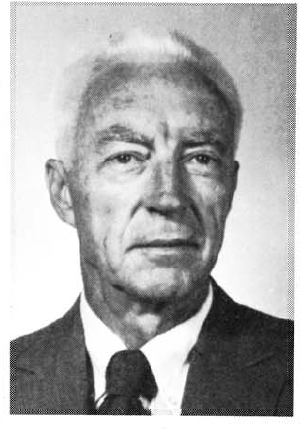
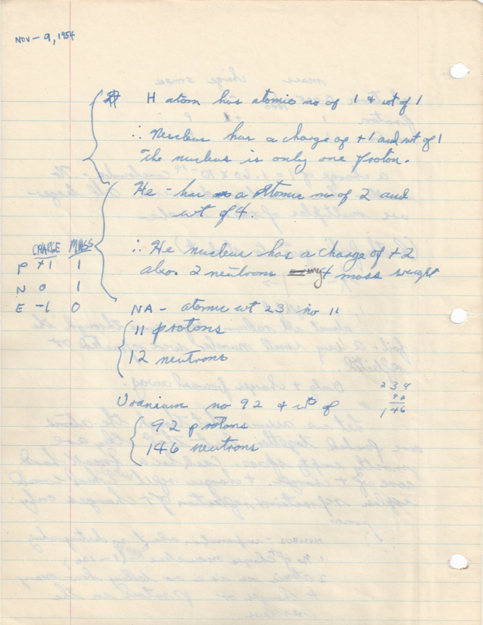
1954 – University of Florida
First Year Chemistry notes November 9
John F. Baxter

Slide 6
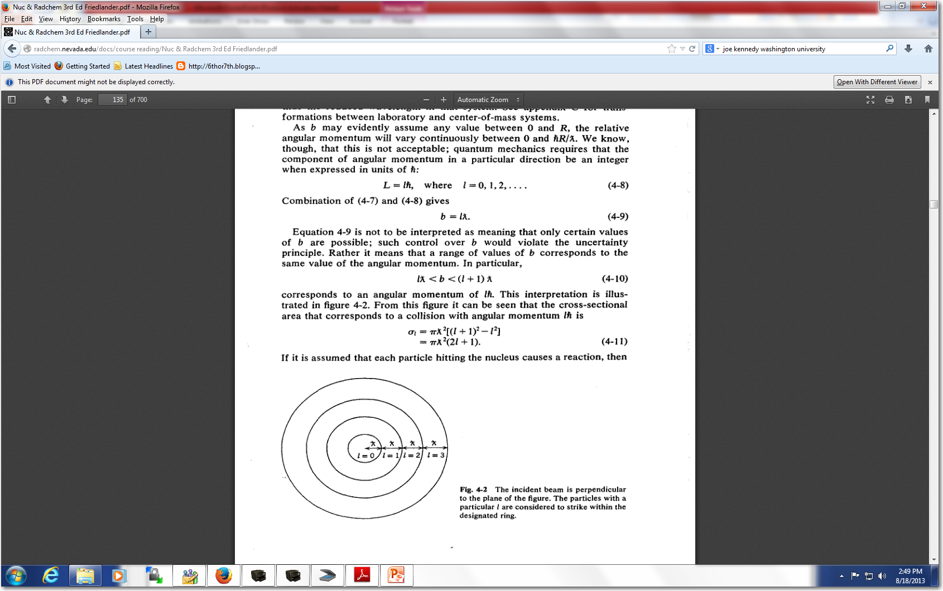
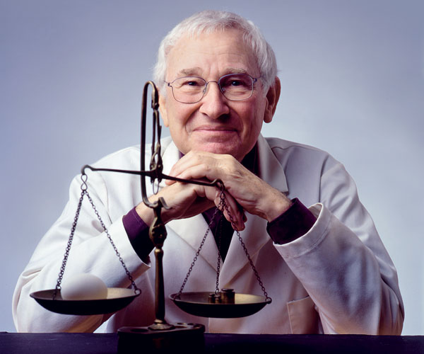
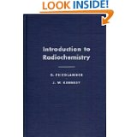
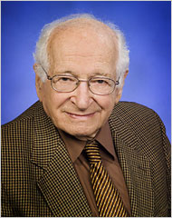
1958-My first course in nuclear chemistry
Robert Wolke,
University of Florida

Slide 7
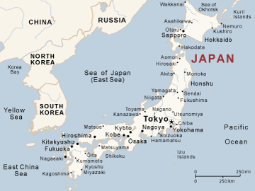
1958-59 US Air FORCE -UCLA
1959-61 Itazuke Air Base

Slide 8
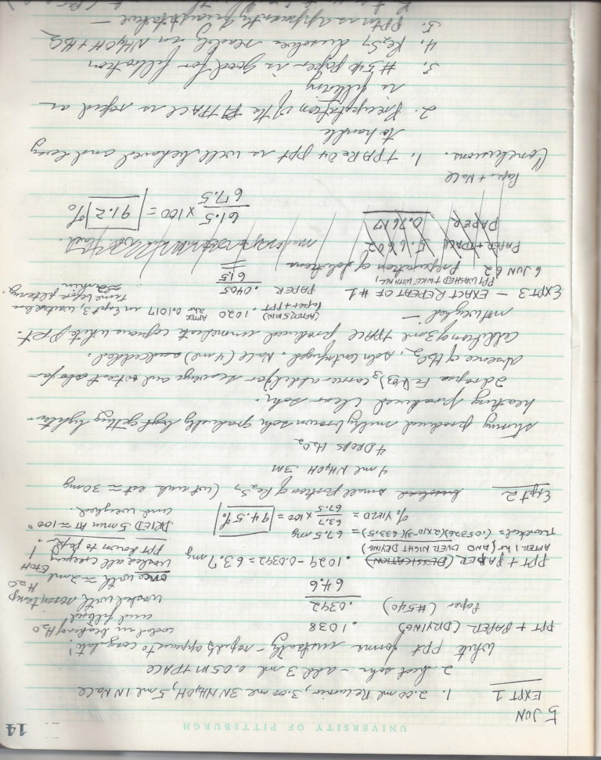
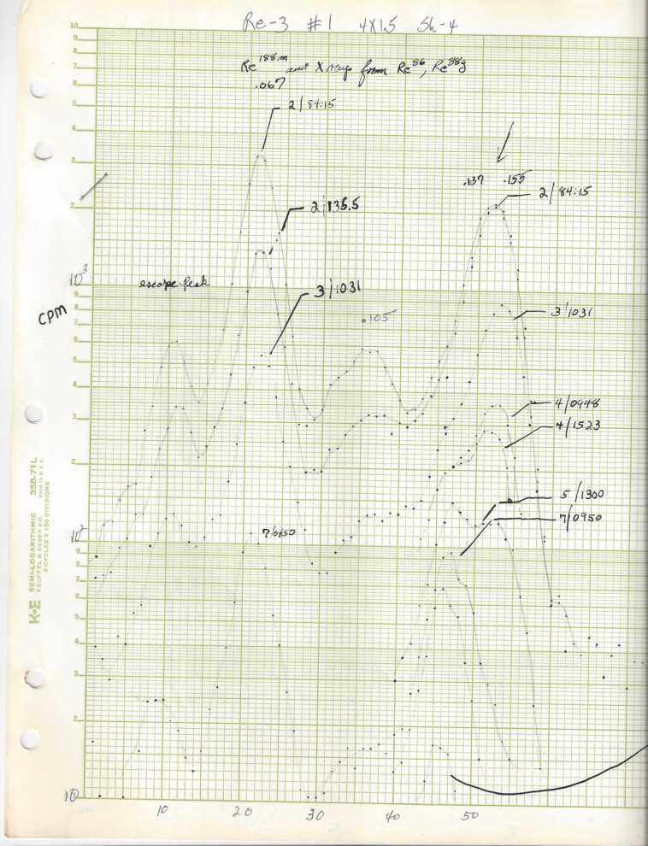
1961- 65 Graduate School
--- The Radiochemistry Years
Robert Wolke
University of Pittsburgh
5 Jun 1962
Thesis - 1965
Isomeric Cross Sections and Yield Ratios
of (d,p) Reactions below 15 MeV

Slide 9
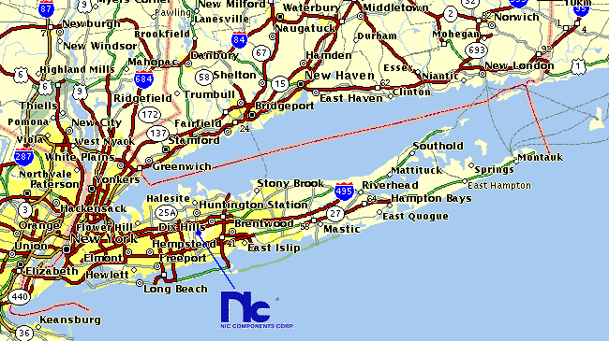
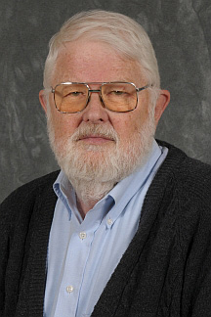
1965-67 Stony Brook -
Heavy Ion Reaction Mechanisms with Recoil Techniques
Heavy Ion Accelerators
Time Magazine -Monday, May 06, 1957
Last week the University of California at Berkeley put into operation a special machine for attacking atoms from a new angle. Its cost: $1,700,000. Called Hilac (heavy ion linear accelerator), the Berkeley machine is 112 ft. long and about 10 ft. in diameter. Instead of hurling protons, deuterons and other light bits of atomic chaff, it uses as its projectiles such comparatively heavy elements as nitrogen (atomic weight 14).
Duplicated at Yale in early 60s
Study of the Reactions Cd(Ar⁴⁰,xn)Dy JOSEPH B. NATOWITZ and JOHN M. ALEXANDER
Phys. Rev. 188, 1734 – Published 20 December 1969
Temperature of Dy Nuclei Excited to 40-150 MeV JOHN M. ALEXANDER and J. B. NATOWITZ
Phys. Rev. 188, 1842 – Published 20 December 1969
June 1967
TEXAS A&M UNIVERSITY
Dept. Of Chemistry
and Cyclotron Institute
Tom Sugihara
Ron Macfarlane
Rand Watson
Me
John Alexander, Stony Brook

Slide 10
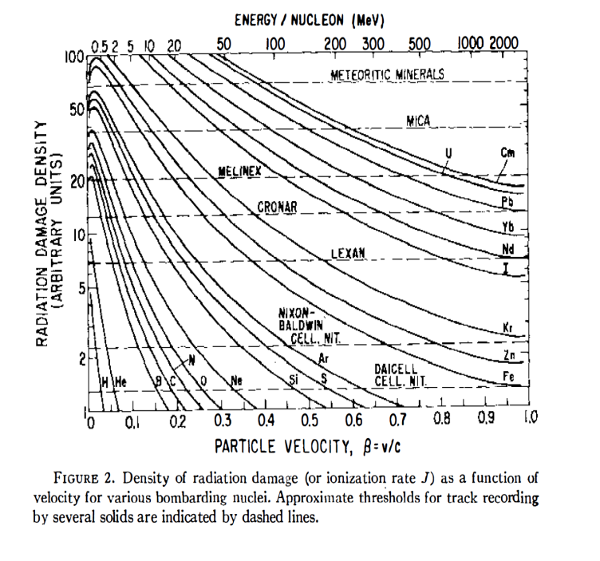
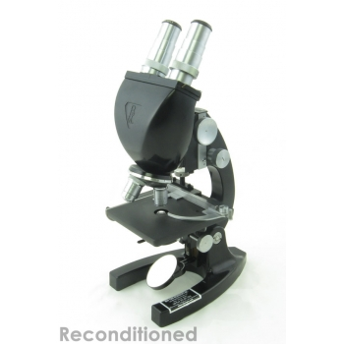
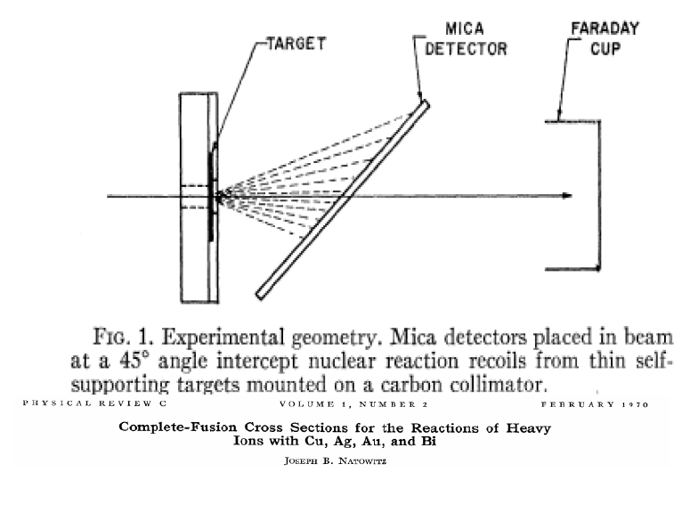
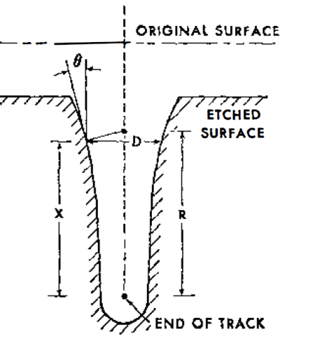
1967- TEXAS A&M UNIVERSITY
TRACK DETECTORS
Complete-Fusion Cross Sections for the Reactions of Heavy Ions with Cu, Ag, Au, and Bi Joseph B. Natowitz
Phys. Rev. C 1, 623 – Published 1 February 1970
50% of My Start-up Funds

Slide 11
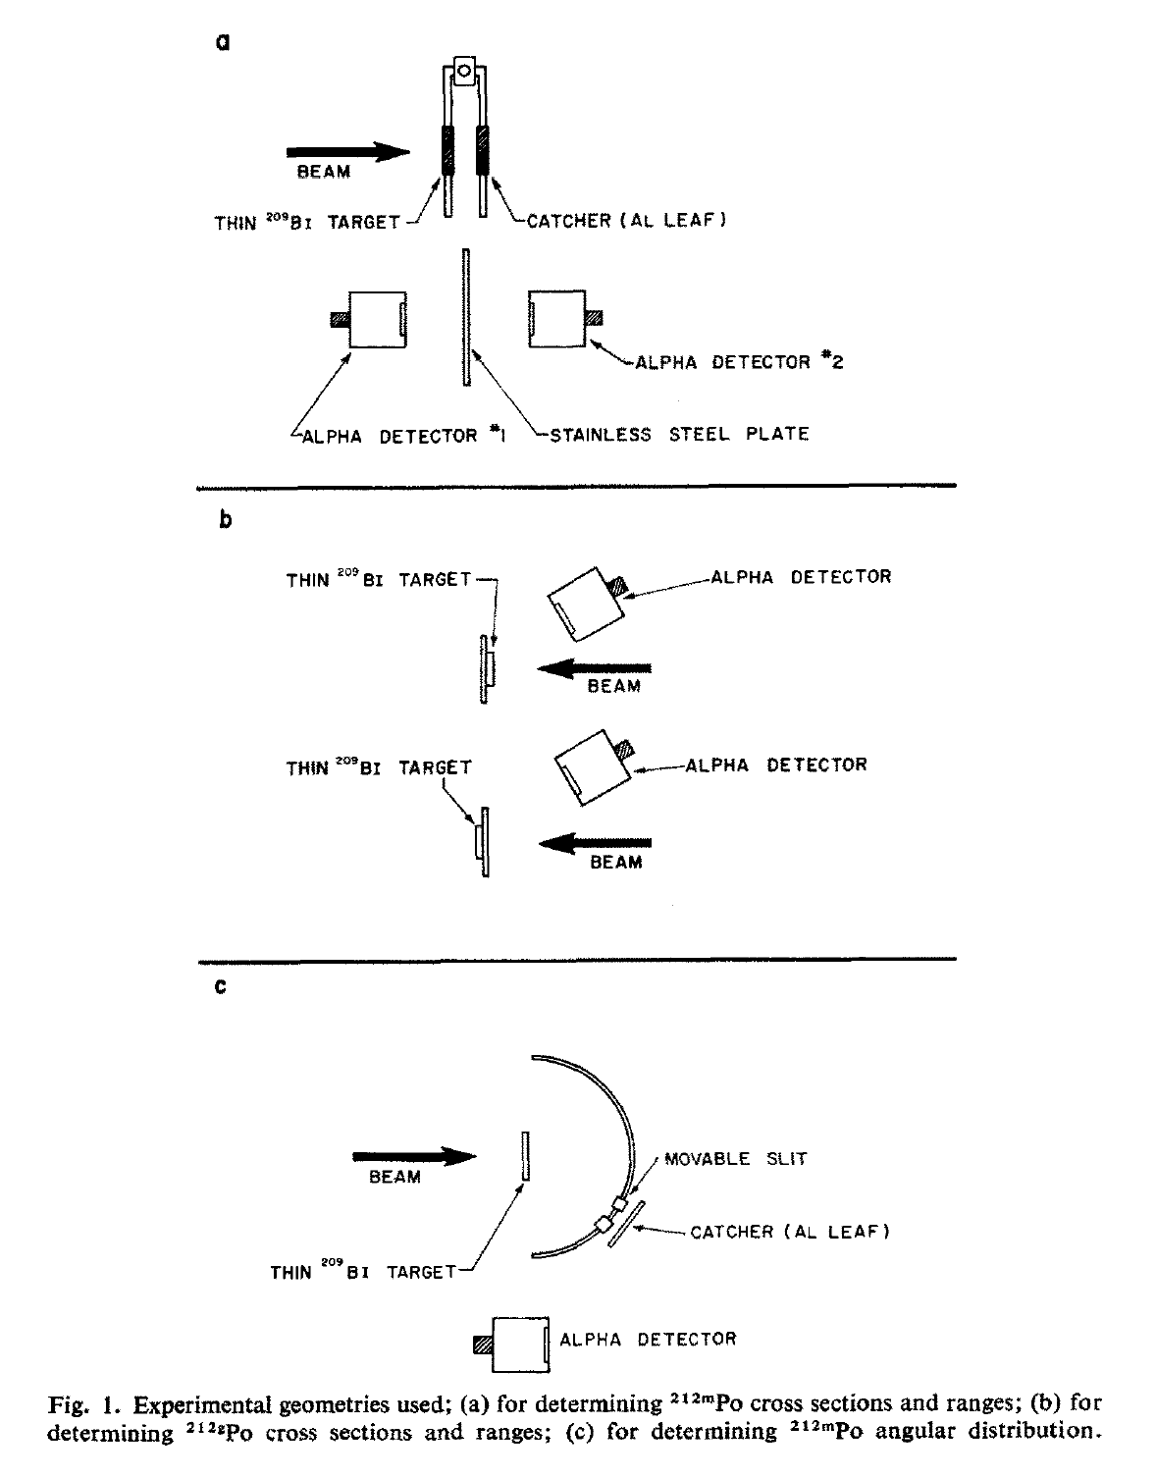
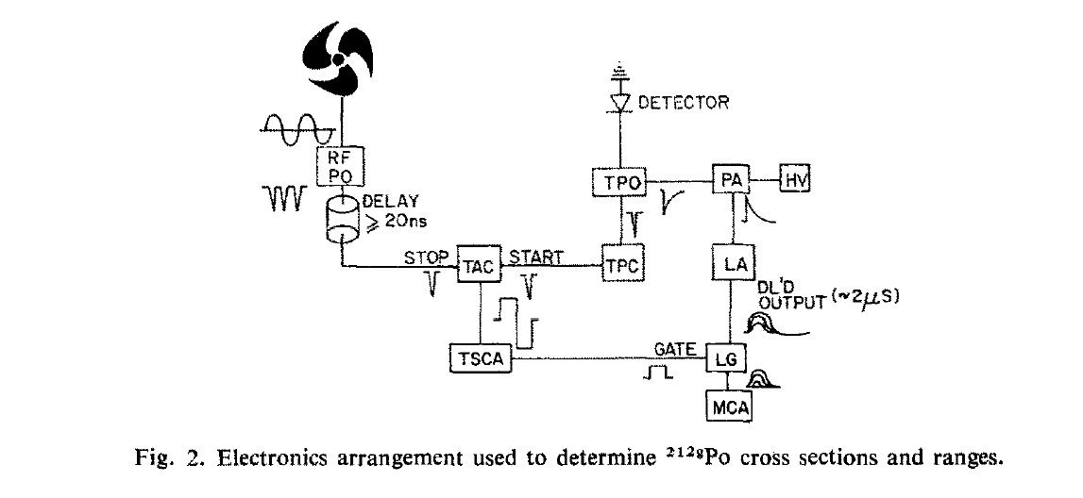
1970,71 Recoils- Pulsed Beam Counting
 | RECOIL STUDY OF BI-209(ALPHA,P)PO-212(M,G) REACTION MECHANISM CHULICK, ET; NATOWITZ, JB NUCLEAR PHYSICS A Volume: A173, 487 (1971)

Slide 12
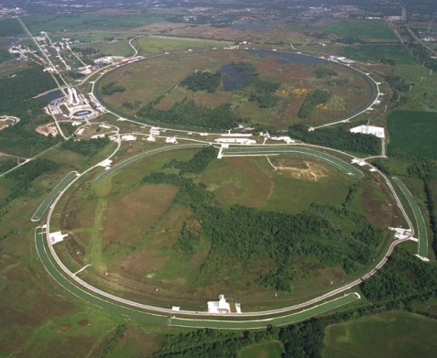
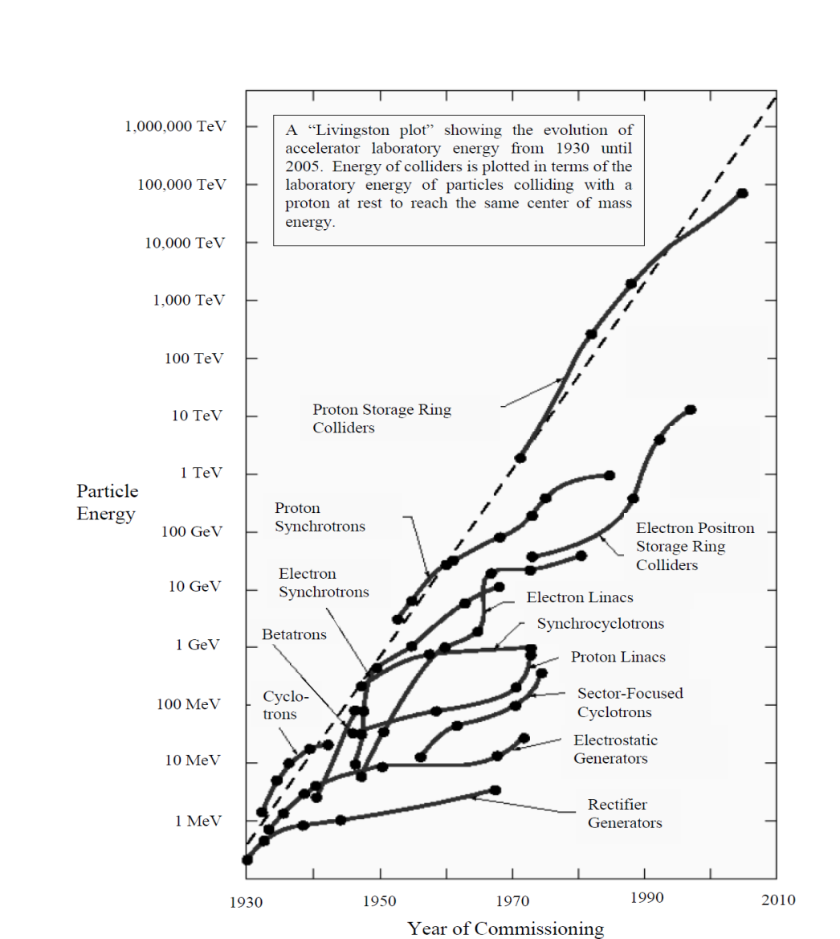
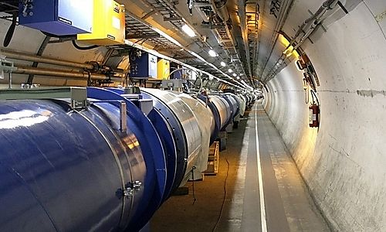
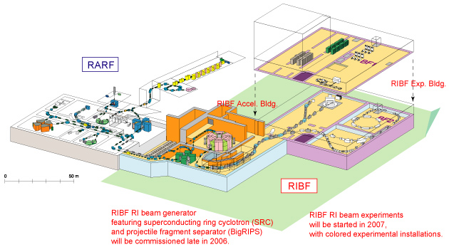
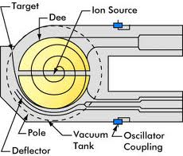
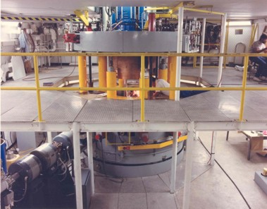
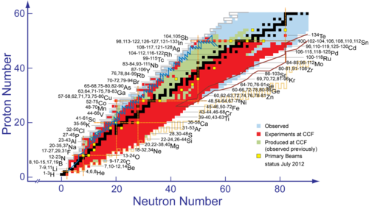
1971-2013 - NEW ACCELERATORS

Slide 13
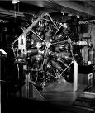
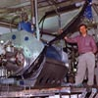
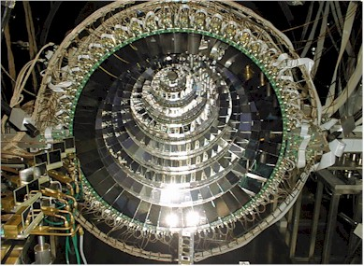

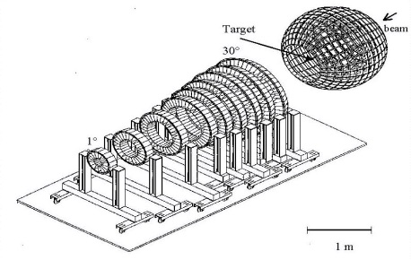
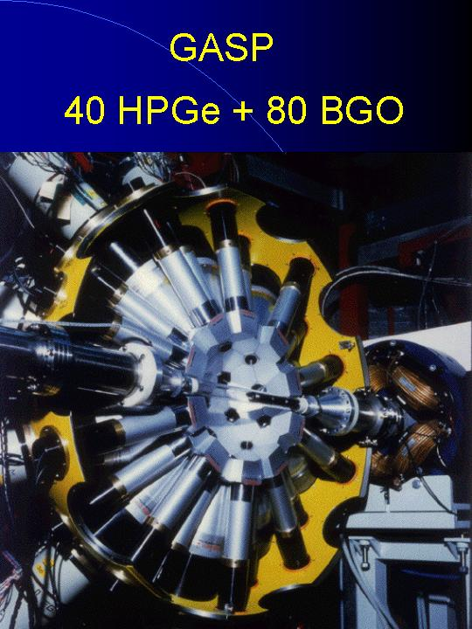
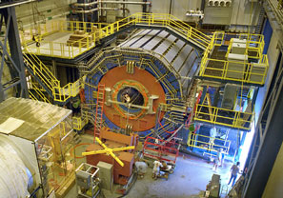
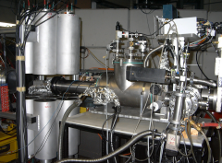
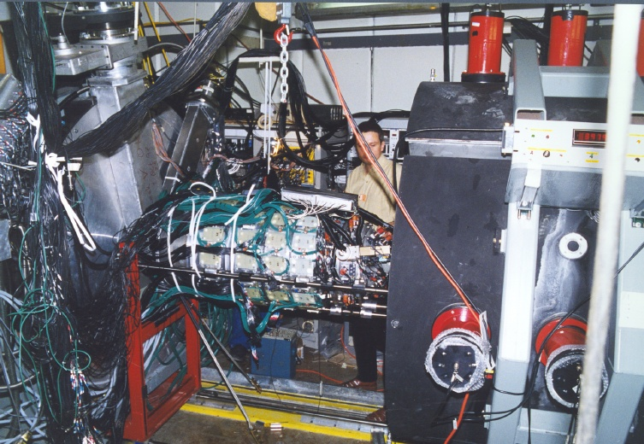


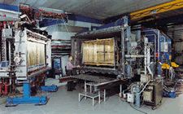
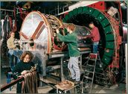
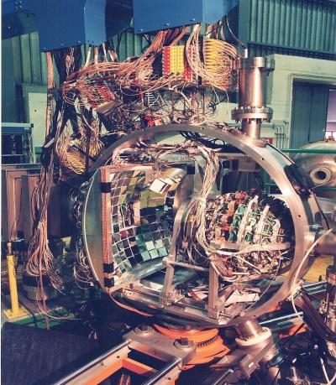
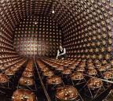
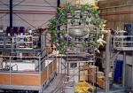
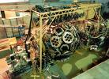
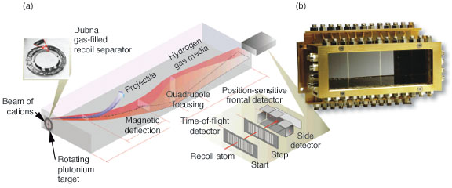





1971- 2013 -- NEW DETECTORS

Slide 14



NIMROD- ISiS 4 Pi Charged Particles
- 4 Pi Neutrons
14 Concentric Rings
Silicon-CsI (IC-2013 )
3.6-167 degrees
Neutron Ball
beam
S. Wuenschel et al., Nucl. Instrum. Methods. A604, 578–583 (2009).

Slide 15

1971-2013 SOME MORE TEACHERS , COLLABORATORS, FRIENDS

Slide 16
SOME MORE OF MY TEACHERS - And

Slide 17



















1971-2013 SOME MORE TEACHERS , COLLABORATORS, FRIENDS

Slide 18


40 Years Later –
Exploring The Nuclear Matter Equation of State
18 fm/c
Dynamic and Thermal Evolution
Excitation Energy ?
Temperatures ?
Degree of expansion?
Composition ?
Chemical and Thermal Equilibrium ?
Equation of State ?
phase transition?
281fm/c

Slide 19

1958-My first course in nuclear chemistry

Slide 21


Slide 22


Old paradigms must be modified
Near the drip lines nuclear structure may be dramatically different.
The halo nucleus ¹¹Li is almost as large as a ²⁰⁸Pb nucleus
No shell closure for N=8 and 20 for drip-line nuclei; new shells at 14, 16, 32…

Slide 23


Nuclei in the Cosmos

Slide 24
Neutrino Detection

Slide 25



NEUTRINO ASTRONOMY and ASTROPHYSICS

Slide 26


Neutrino sphere
Japanese amateur astronomer Koichi Itagaki of Yamagata discovered an apparent nova or “new star” in the constellation Delphinus the Dolphin just today, August 14. 2013.He used a small 7-inch (.18-m) reflecting telescope and CCD camera to nab it. Let’s hope its mouthful of a temporary designation, PNVJ20233073+2046041, is soon changed to Nova Delphini 2013!
Read more: http://www.universetoday.com/104103/bright-new-nova-in-delphinus-you-can-see-it-tonight-with-binoculars/#ixzz2c3chQO45

Slide 27

Few Body Syst.Suppl. 14 (2003) 361-366
Eur.Phys.J. A22 (2004) 261-269
Perfect
Liquid?
Perfect
Gas ?
Correlations – Cluster Formation
Bose Condensates
Efimov States
Superfluidity

Slide 28




Test of Astrophysical Equations of State
Equilibrium Constant, K_{α}
Many tests of EOS are done using mass fractions.
Various calculations include various different
competing species., if all relevant species are not
included, mass fractions are not accurate.
Equilibrium constants, e.g.,
should be independent of proton fraction and choice of
competing species.
Models converge at lowest densities, but many are significantly above data at higher density
Lattimer & Swesty with K=180, 220 show reasonable agreement with data
QSM with in-medium binding energy shifts works well
L. Qin et al.PRL 108 172701 (2012).
$$K_{c}\left(A,Z\right)= \frac{ρ(A,Z)}{ρ_{p}^{Z}ρ_{n}^{(A−Z)}}$$
T-REX

Slide 29
Why Nuclear Science was
and is Still
So Interesting to Me
HOW COULD I NOT LOVE WORKING IN A FIELD WITH THIS KIND OF FUNDAMENTAL IMPORTANCE, PROSPECT FOR SURPRISES,
ACCESS TO FANTASTIC TOYS,
FREEDOM TO FOLLOW MY IDEAS
AND THE OPPORTUNITY TO HAVE SUCH INCREDIBLE PEOPLE AS TEACHERS COLLABORATORS AND FRIENDS?

Slide 30
THANK YOU !
SOME MORE OF MY TEACHERS

