Slide 1
Fission Potential Energy Calculations for Collinear Cluster Tripartition
Vitaly V. Pashkevich | Joint Institute for Nuclear Research. Dubna, Russia
Anna V. Unzhakova | St. Petersburg State University. St. Petersburg, Russia

Slide 2
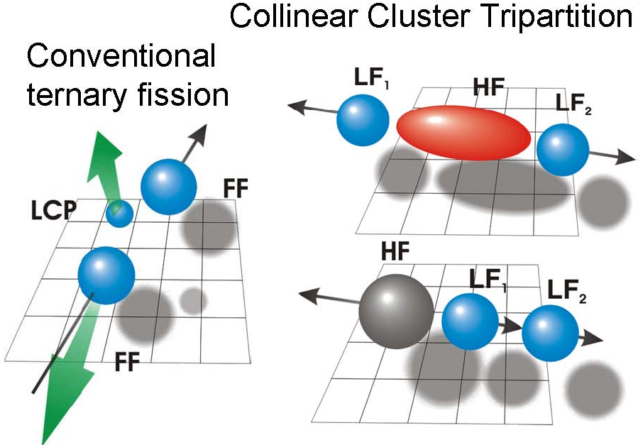
CCT Introduction

Slide 3
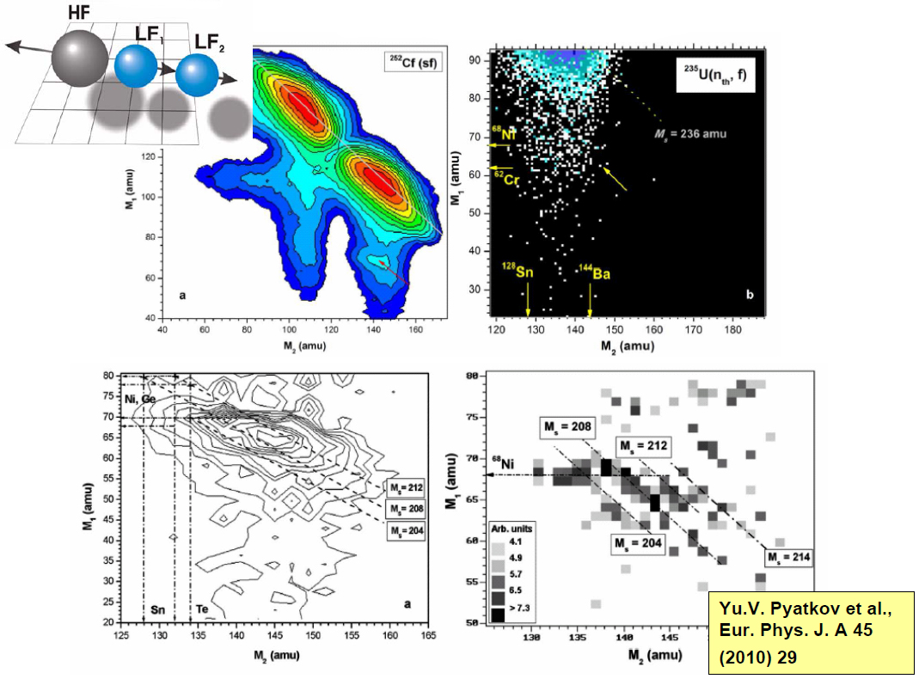
Experimental Background

Slide 4
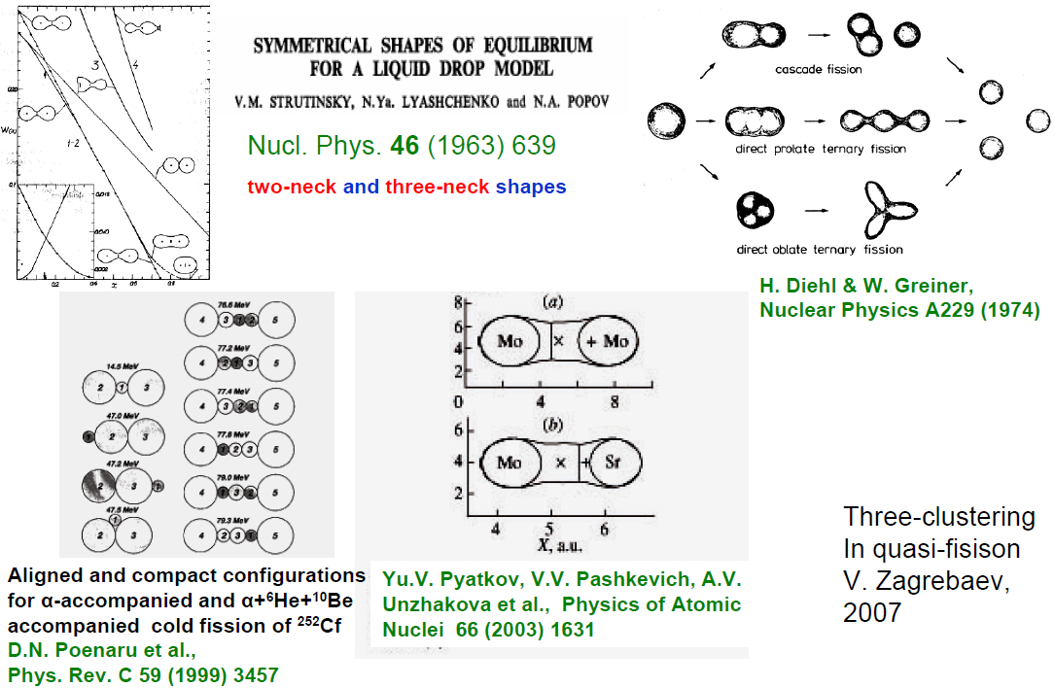
Theoretical background

Slide 5
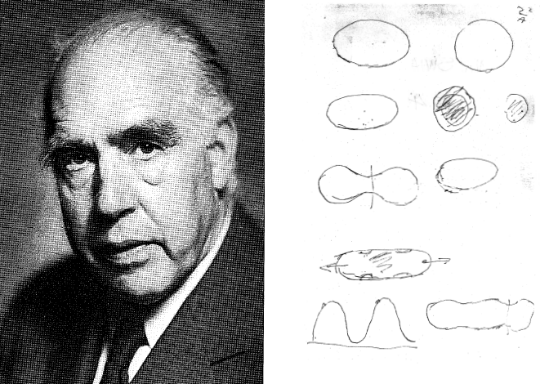
Niels Bohr’s notes, 7 Oct 1950
W.J. Swiatecki “Some Fission Problems circa 1950 and 2008”
XV Workshop on Nuclear Physics “Marie and Pier Curie”
Kazimierz Dolny, Poland 24-28 September 2008

Slide 6
Strutinsky Shell Correction Method
V.M. Strutinsky:
Shell effects in nuclear masses and deformation energies.
1967 Nucl. Phys. A 95, p. 420
‘Shells’ in deformed nuclei.
1968 Nucl. Phys. A 122, p. 1
V.V. Pashkevich:
On the asymmetric deformation of fissioning nuclei.
1971 Nucl. Phys. A 169, p. 275
Precision shapes of symmetrically fissioning very heavy nuclei.
1988 Nucl. Phys. A 447, p. 1

Slide 7
Main Features of the Dubna PES Model
Ten-Dimensional Deformation Spaces
Theoretical description of multimodality, exotic and rare fission processes requires more then five nuclear shape degrees of freedom.
Potential Energy Surfaces (PES)
Strutinsky shell correction model developed in Dubna was designed to make high dimensional calculations possible.
Accurate Shape Families
Detailed study of potential energy structures displays the influence of clustering on the fission modes formation.

Slide 8
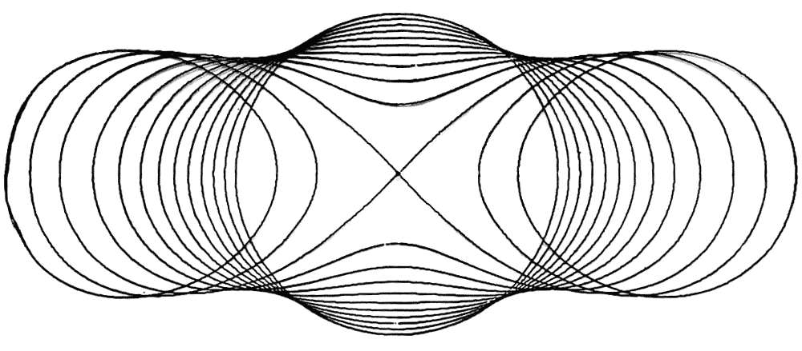
Shape Parameterization
Potential energy surfaces are calculated as a liquid drop component with the shell correction by using the single-particle potential of Woods-Saxon type. Nuclear shape is parameterized in the coordinate system associated with Cassini ovaloids with parameters (α, α_{n}).
Cassini ovaloids – the one-parameter set of curves effective for approximation of nuclear shapes in fission process.
The value of basic parameter ε = 0 corresponds to sphere, ε = 1.1 and 1.2 corresponds to the separated fission fragments after the scission point.
R(x) = R₀(1 + Σ_{n} α_{n} P_{n}(x))

Slide 9
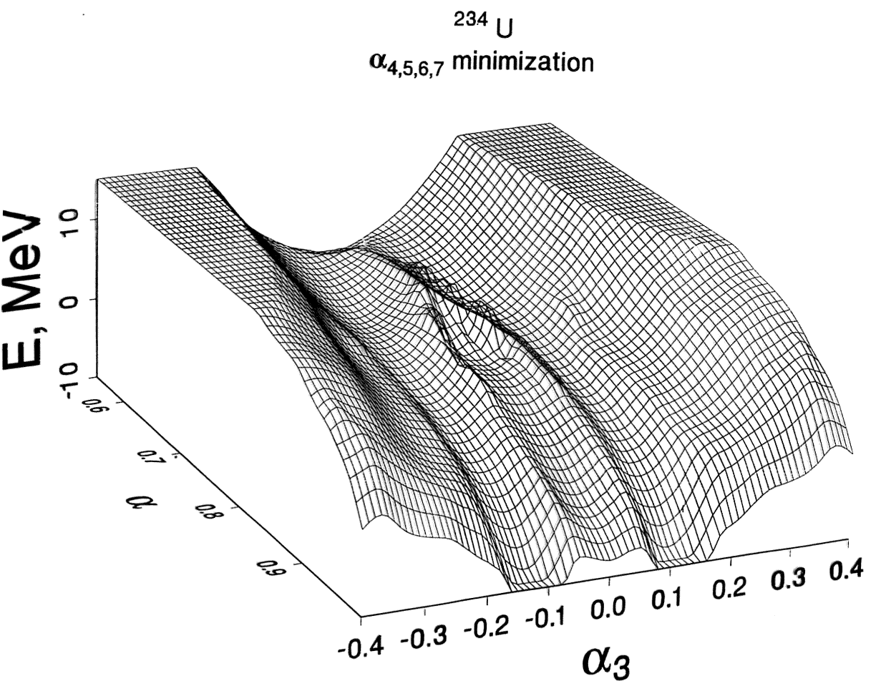
Fission barriers vs. elongation and asymmetry
PES calculation: symmetrical and two asymmetrical fission valleys

Slide 10
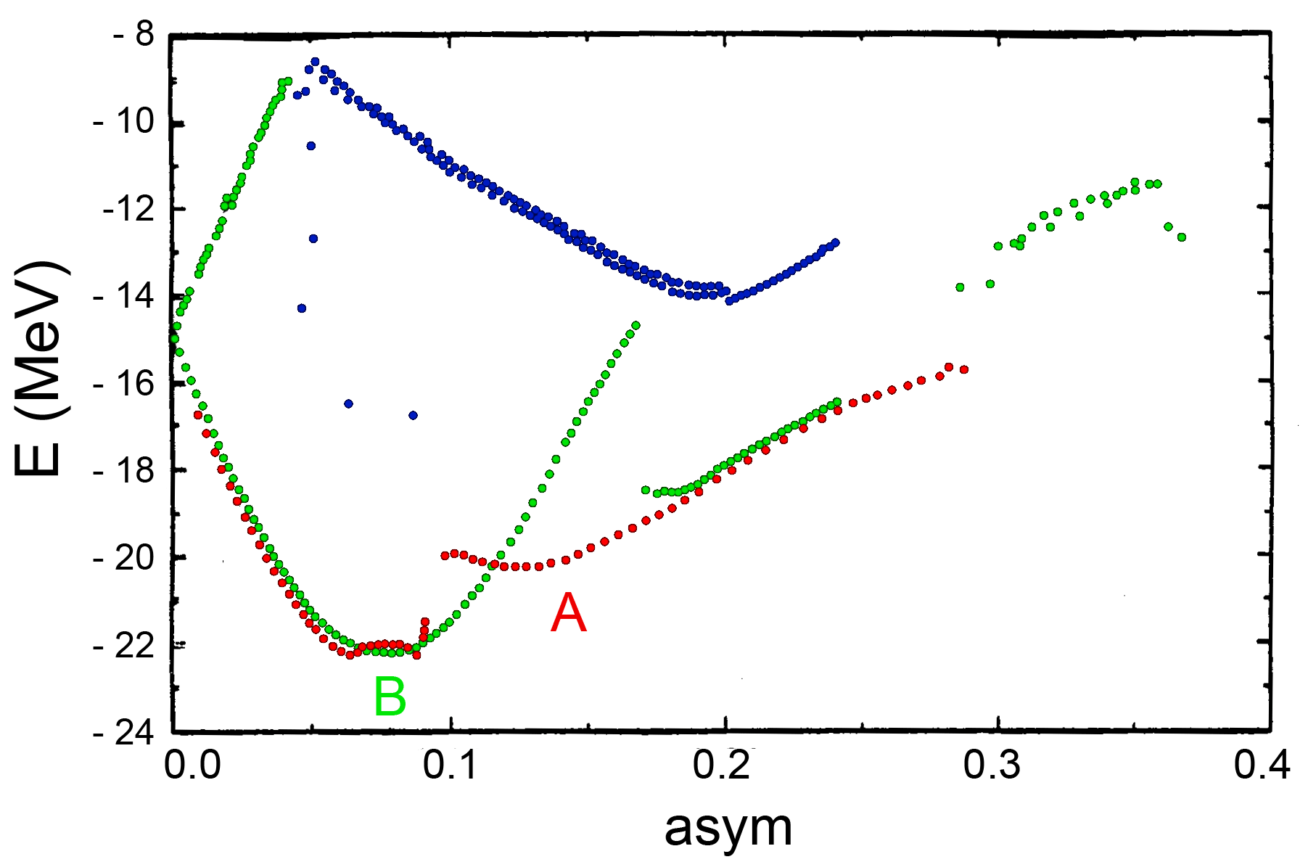
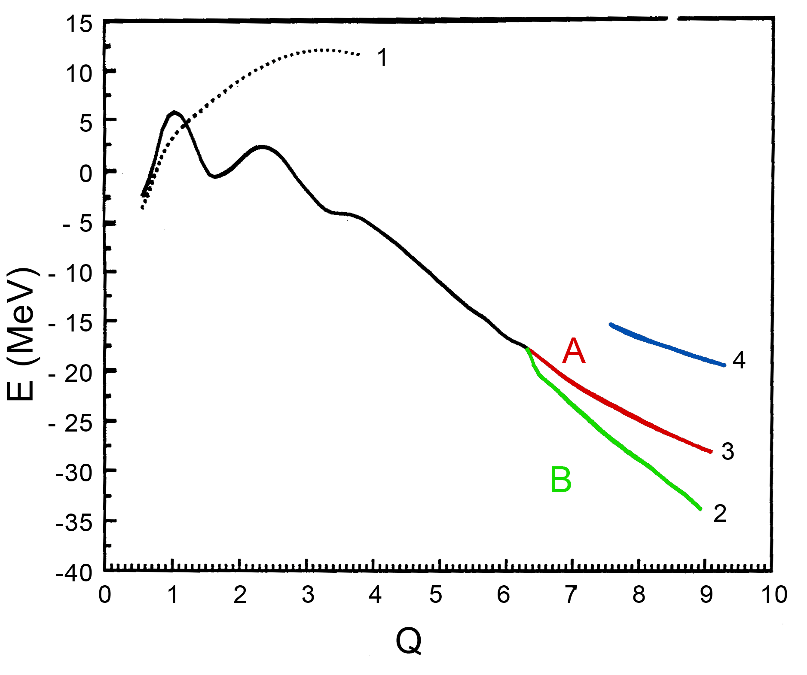
²⁵²Cf Potential Energy Surfaces
Calculation results in deformation space with ten parameters.
Cross-sections of the PES for different values of asymmetry.
η = (A_{H} - A_{L})/(A_{H} + A_{L})
Different curves correspond to the bottoms of the potential valleys as a function of quadrupole moment Q.

Slide 11
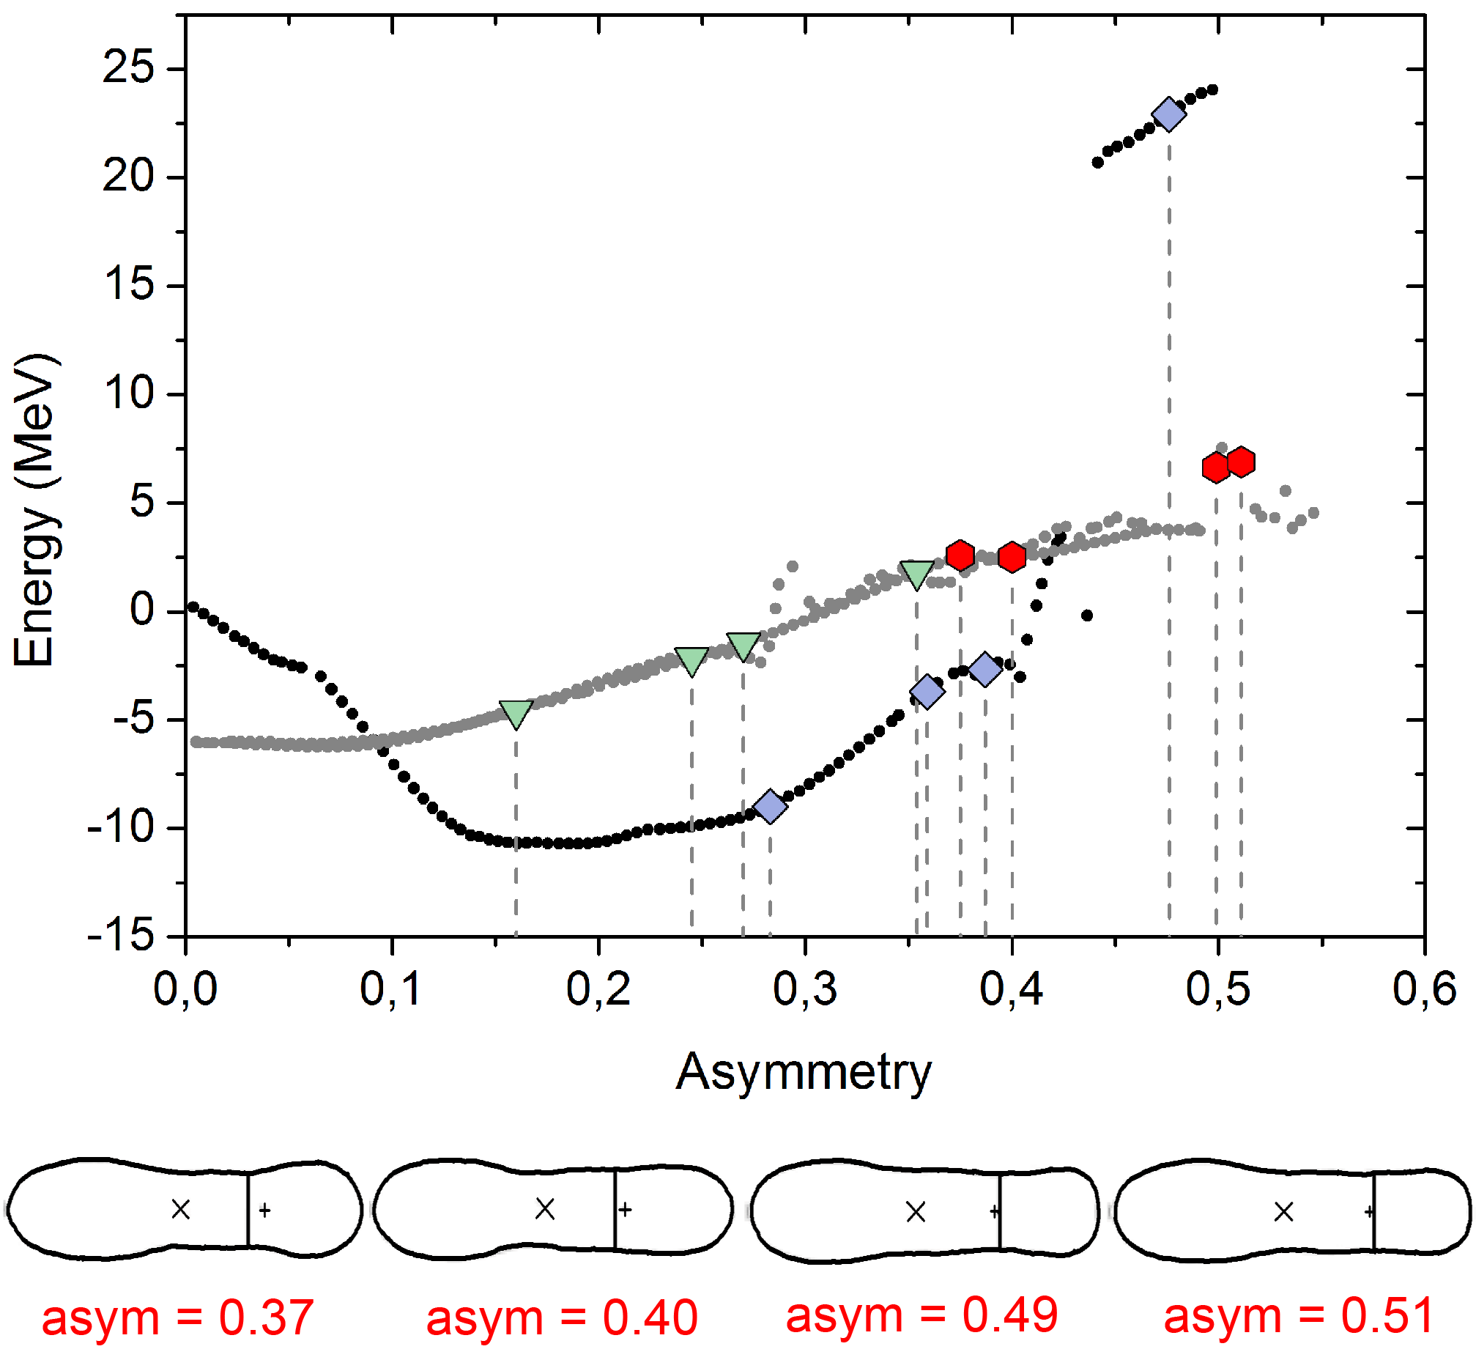
Calculations for ²³⁴U
The energy of the CCT local minima points of PES for different values of asymmetry.
η = (A_{H} - A_{L})/(A_{H} + A_{L})

Slide 12
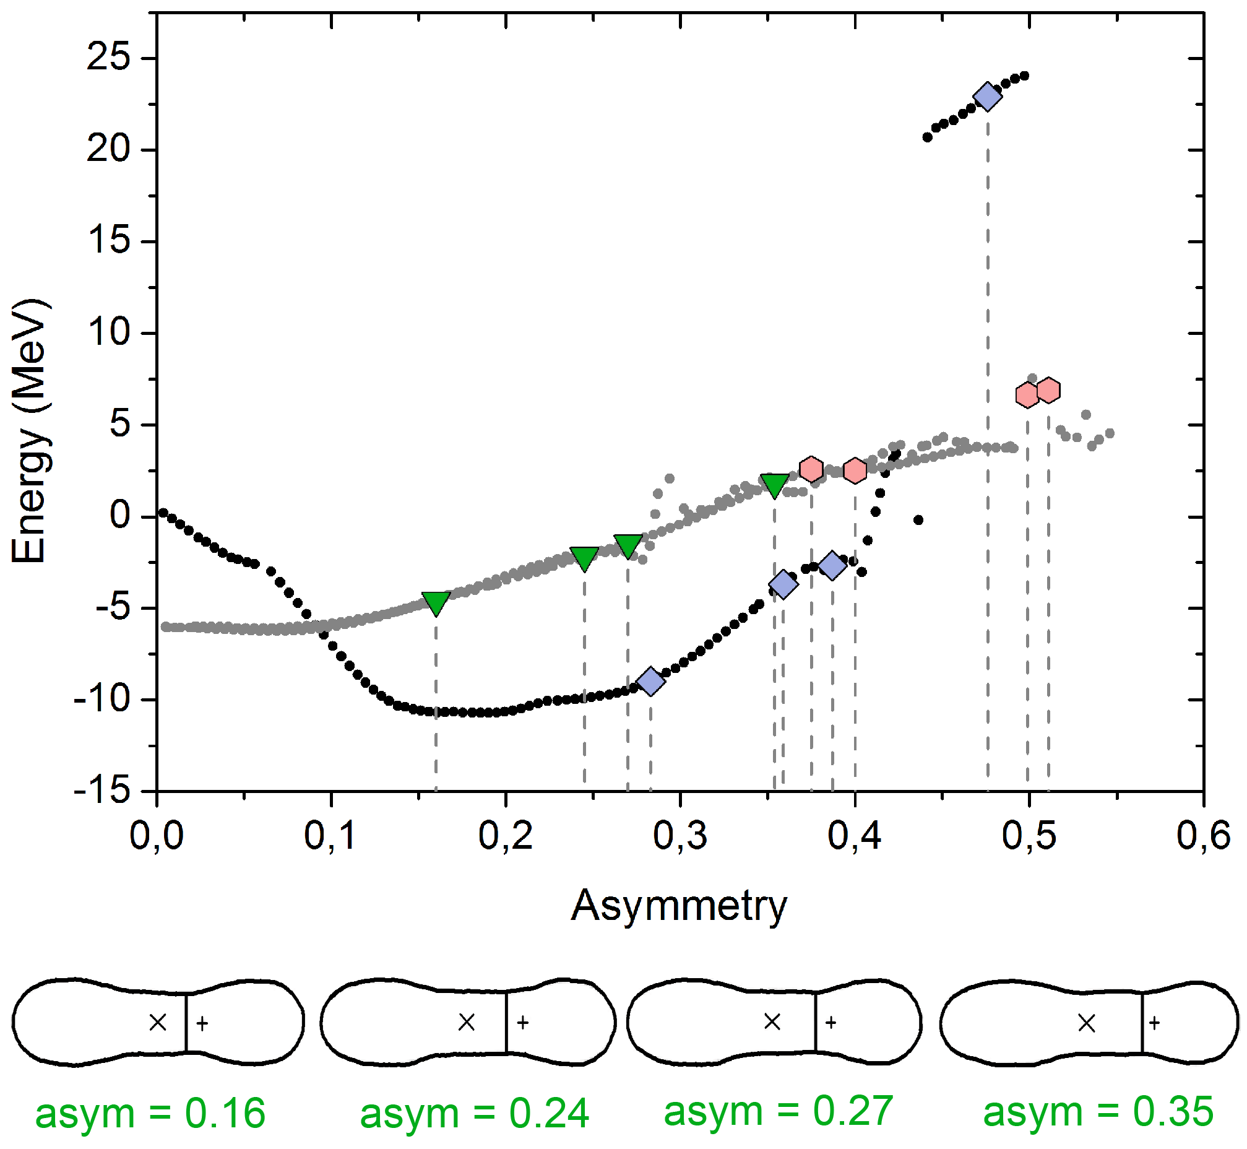
Calculations for ²³⁴U
The energy of the CCT local minima points of PES for different values of asymmetry.
η = (A_{H} - A_{L})/(A_{H} + A_{L})

Slide 13
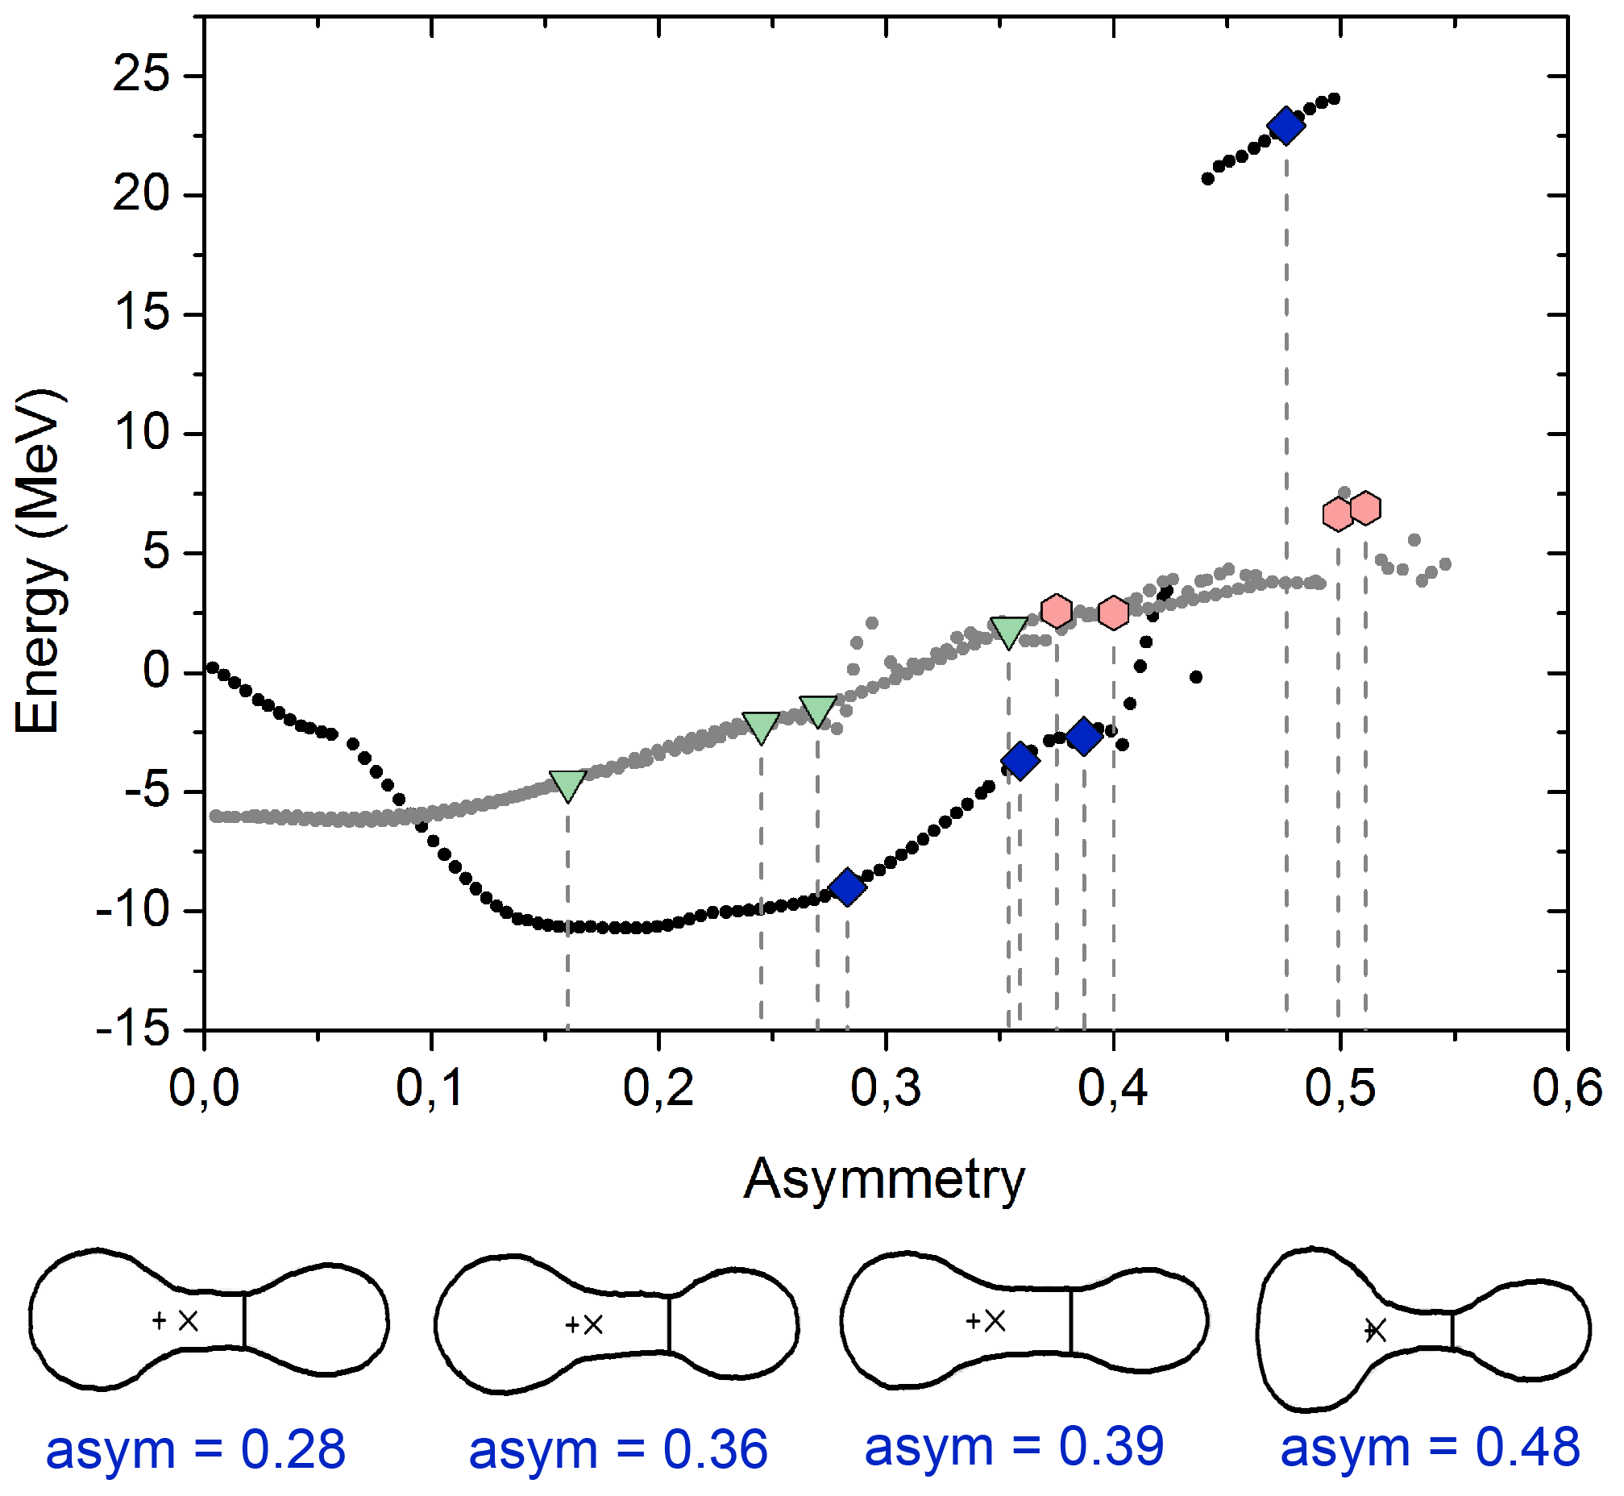
Calculations for ²³⁴U
The energy of the CCT local minima points of PES for different values of asymmetry.
η = (A_{H} - A_{L})/(A_{H} + A_{L})

Slide 14
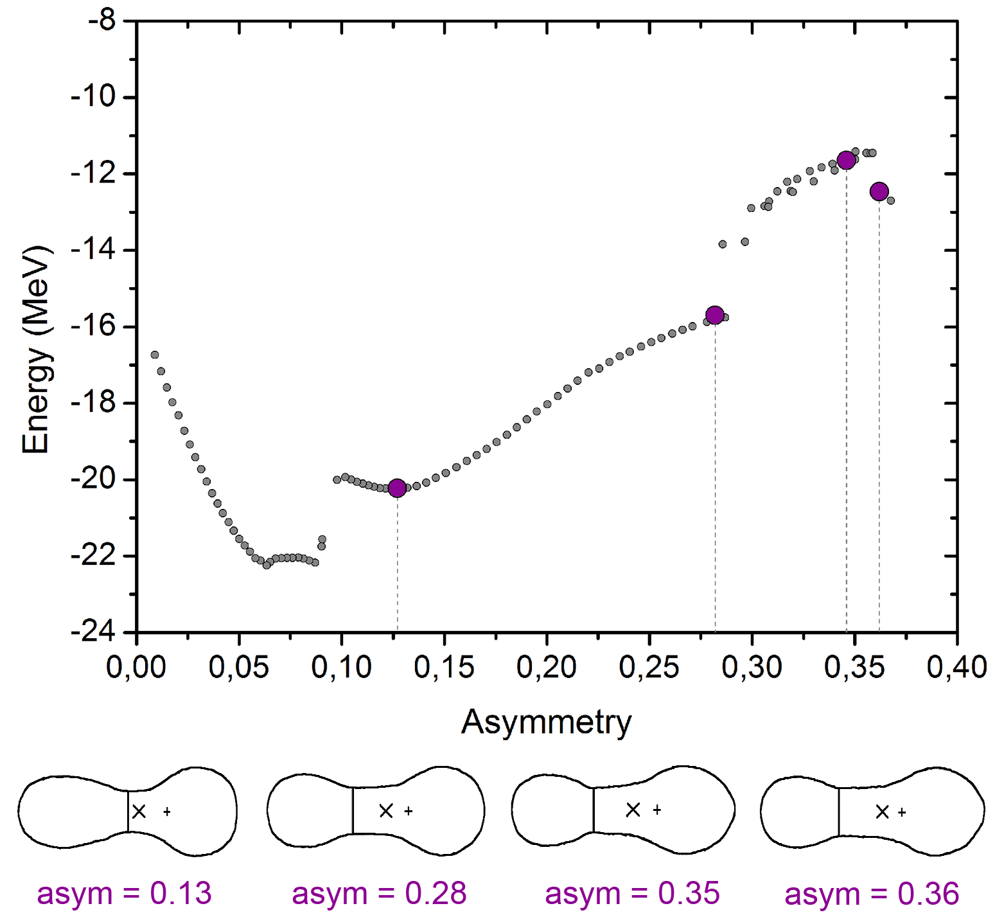
Calculations for ²⁵²Cf
The energy of the CCT local minima points of PES for different values of asymmetry.
η = (A_{H} - A_{L})/(A_{H} + A_{L})

Slide 15
Conclusions
Each dicluster or multicluster configuration produces an individual sheet of the PES.
In both Cf and U nuclei several local energy minima with high asymmetry value have been found at the PES.
They can be considered as the collinear cluster tri-partition shell correction minima and used as a theoretical basis for new experimental findings.

Slide 16
Thank you for your attention!

