Slide 1
Nuclear Temperature
Wolfgang Bauer
Michigan State University

Slide 2
Atomic Nucleus: Ultimate Many-Body Sandbox

Slide 3
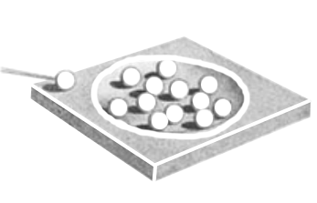
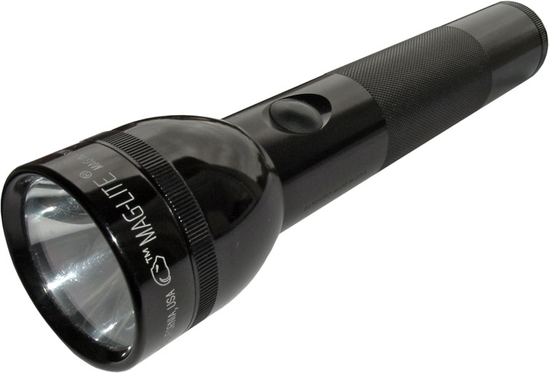

Slide 4
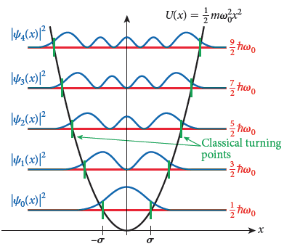

Slide 5
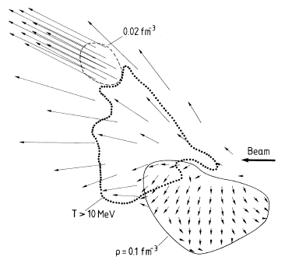

Slide 6
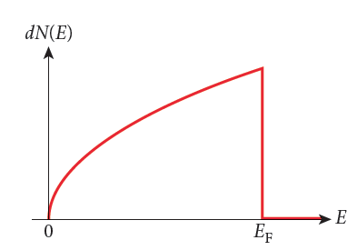

Slide 7
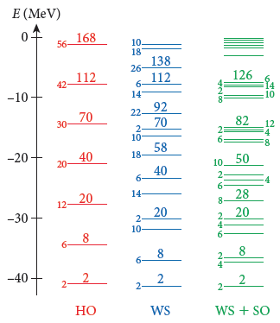

Slide 8
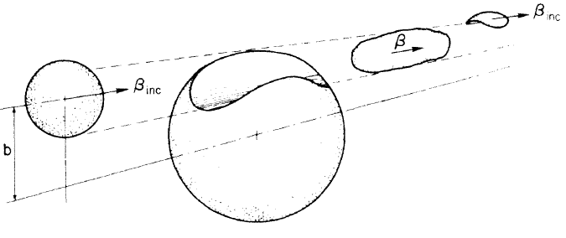

Slide 9
?

Slide 10
Joe Natowicz @ Google Scholar
“Quark–gluon plasma and color glass condensate at RHIC? The perspective from the BRAHMS experiment”, I. Arsene et al., NPA 757, 1 (2005) (1533 citations)
“Transverse-Momentum Spectra …”, I. Arsene et al. (BRAHMS), PRL 91, 072305 (2003) (365 citations)
“Evolution of the Nuclear Modification Factors …”, I. Arsene et al. (BRAHMS), PRL 93, 242303 (2004) (298 citations)
“Nuclear Stopping in Au+Au ...”, I. G. Bearden et al. (BRAHMS), PRL 93, 102301 (2003) (286 citations)
“Caloric curves and critical behavior in nuclei”, J.B. Natowitz et al., PRC 65, 034618 (2002) (254 citations)
…
“Temperatures and excitation energies of hot nuclei in the reaction of ³²S+Ag and ¹⁶O+Ag at 30 MeV/nucleon”, R. Wada et al., PRC 39, 497 (1989) (181 citations)
…

Slide 11
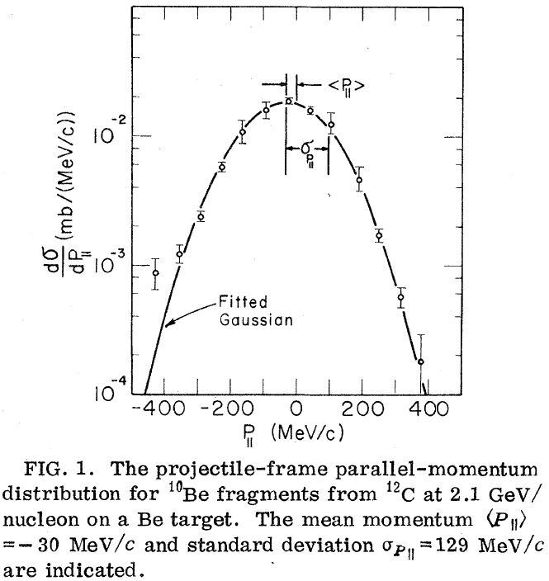
Projectile Fragmentation
Experimental observation: universal momentum distribution for fragments (pion mass???)
H.H. Heckman et al., LBL report 2052 (1973)
D.E. Greiner et al., PRL 35, 152 (1975)

Slide 12
Momentum Conservation
Insight of Feshbach & Huang:
Use cold Fermi Gas model with constraint of 0 total momentum
Removal of nucleons gives net momentum to remaining nucleons in fragment due to momentum conservation with from Fermi Gas ansatz.
H. Feshbach and K. Huang, PLB 47, 300 (1973)

Slide 13
Goldhaber Model
Similar to Feshbach and Huang, but with proper recoil correction
Explicit dependence on fragment mass number K: (no more reference to pion mass …)
A.S. Goldhaber, PLB 53, 306 (1974)

Slide 14
Meanwhile … also at LBL …

Slide 15
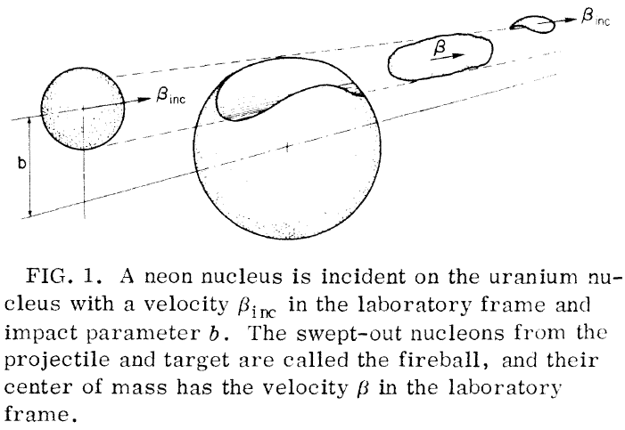
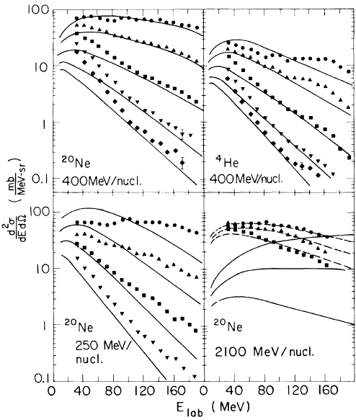
Fireball Model for Proton Spectra
Assume thermalization in overlap region and apply Hagedorn thermodynamics
“The surprising success of the simple model for proton inclusive spectra indicates the importance of the use of thermodynamic concepts in relativistic heavy-ion reactions.”
G.D. Westfall et al., PRL 37, 1202 (1976)

Slide 16
Proton spectra from central heavy ion collisions consistent with thermal picture
Fragment spectra also look thermal, but can be explained by cold fragmentation
Let’s combine both!

Slide 17
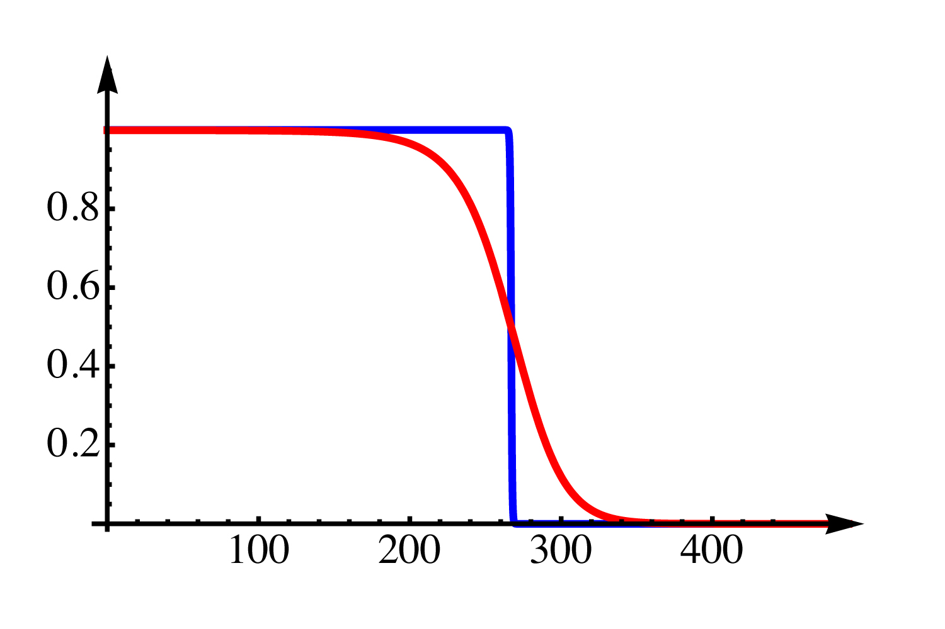
Single Particle Momentum Distribution
Sample nucleon from distribution
True Fermi Gas at temperature

Slide 18
Fragment Momentum Distribution
A_{f} nucleons (in spatial proximity) trapped in a fragment
No correlations!
Fragment momentum is the sum of nucleon momenta inside of it
Constraint:

Slide 19
Fragment Momentum Distribution
Single particle distribution has 0 mean and fixed variance
Pearson problem
Random walk in momentum space
Gauss’ central limit theorem (for large number of steps, A_{f})
Energy distribution with

Slide 20
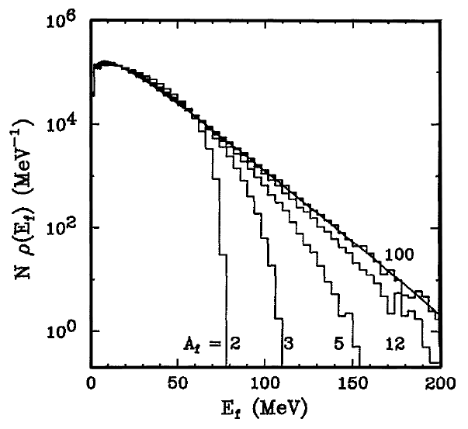
How Close to Central Limit?
Monte Carlo study
5 M random events each
Dependence on fragment mass A_{f} = number of steps in Pearson random walk
Result: even for A_{f} ~ 3 thermal distribution emerges
Quantum physics helps!
Large variance even at very low T due to Pauli Principle
Central Limit

Slide 21
Calculating T_{f}

Slide 22
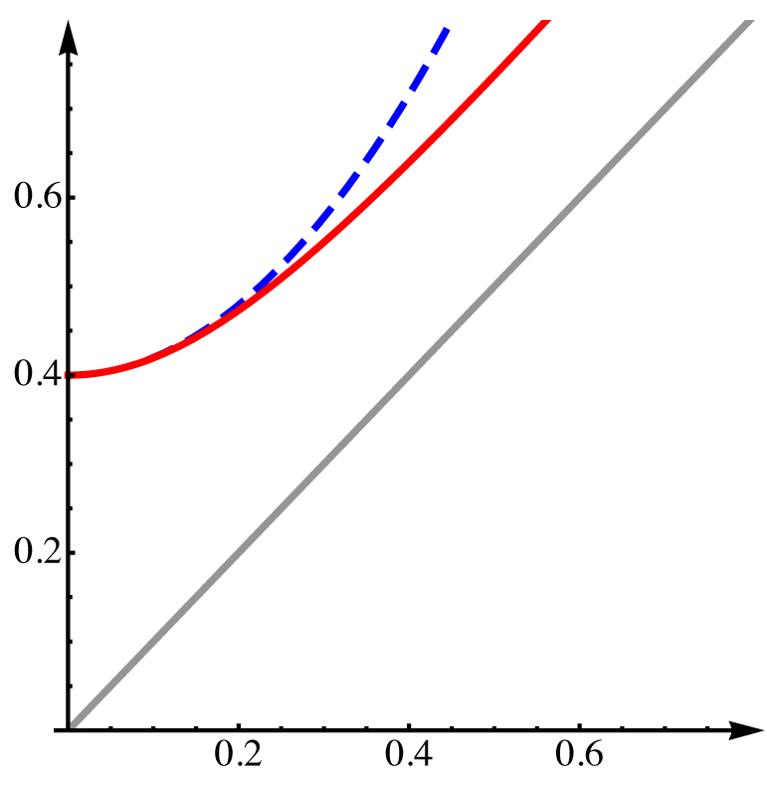
Fragment vs. Intrinsic Temperature
Main result: Fragment temperature is NOT equal intrinsic temperature, but intrinsic temperature can be deduced from fragment temperature
Blue approximation line: Sommerfeld expansion
Goldhaber result

Slide 23
Lower Limiting Temperature
Apparent fragment temperature has lower limit of
Fermi energy depends on freeze-out density
Sample numbers:

Slide 24
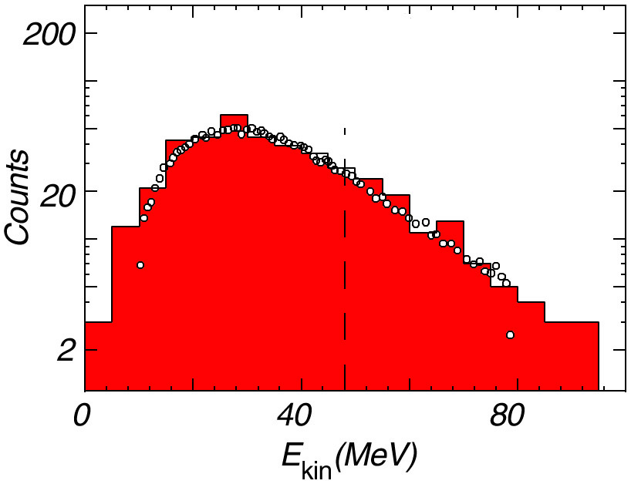
Complete Simulation
Complete multi-fragment decay calculation from percolation model
N-body Coulomb expansion
300 GeV p + Xe ➔ ¹²C + …
Touching spheres
Data: A.S. Hirsch et al., PRC 29, 508 (1984)
Theory: W. Bauer, NPA 787, 595c (2007)

Slide 25
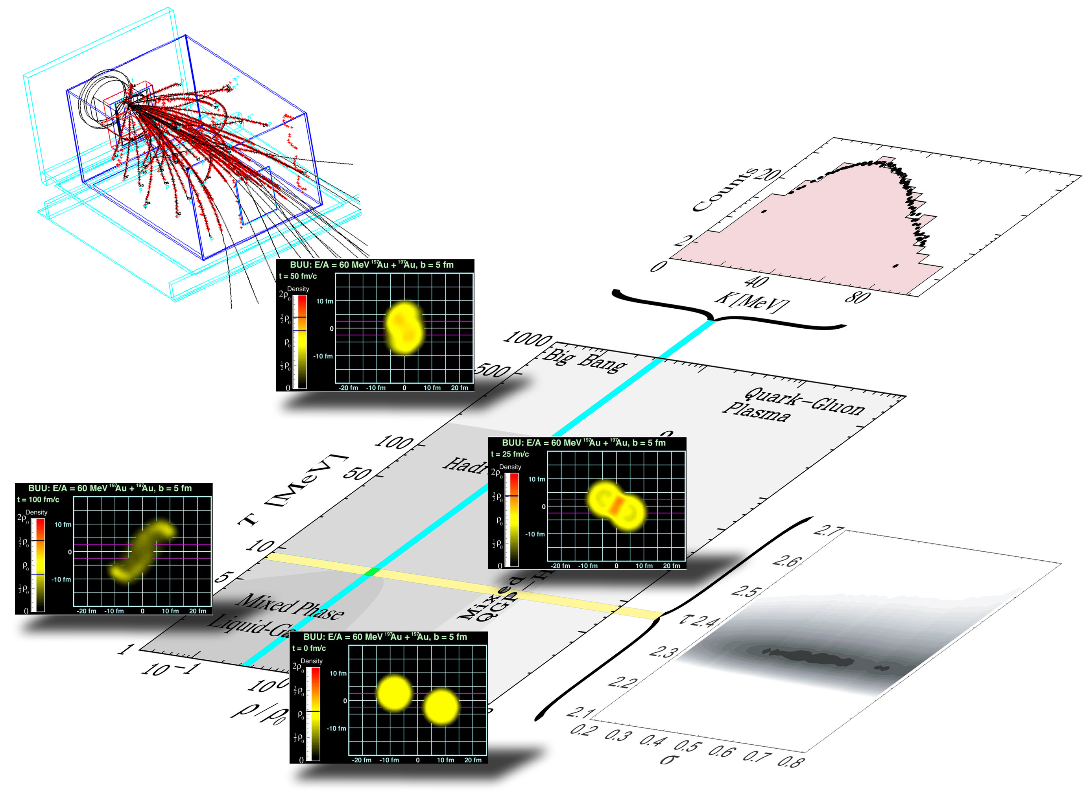
NUCLEAR PHASE DIAGRAM

Slide 26
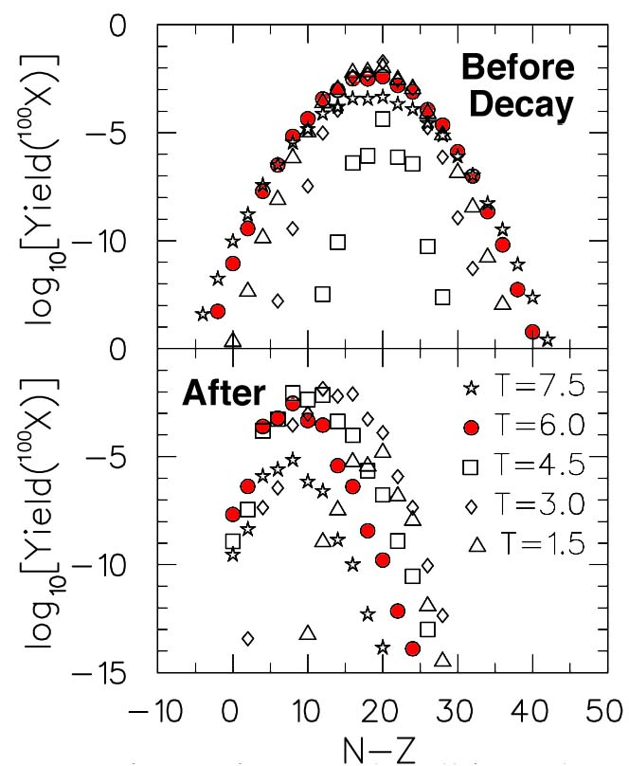
Comparing with Data: Sequential Decays
Predictions for width of isotope distribution are sensitive to isospin term in nuclear EoS
Complication: Sequential decay almost totally dominates experimentally observable fragment yields Pratt, WB, Morling, Underhill, PRC 63

Slide 27
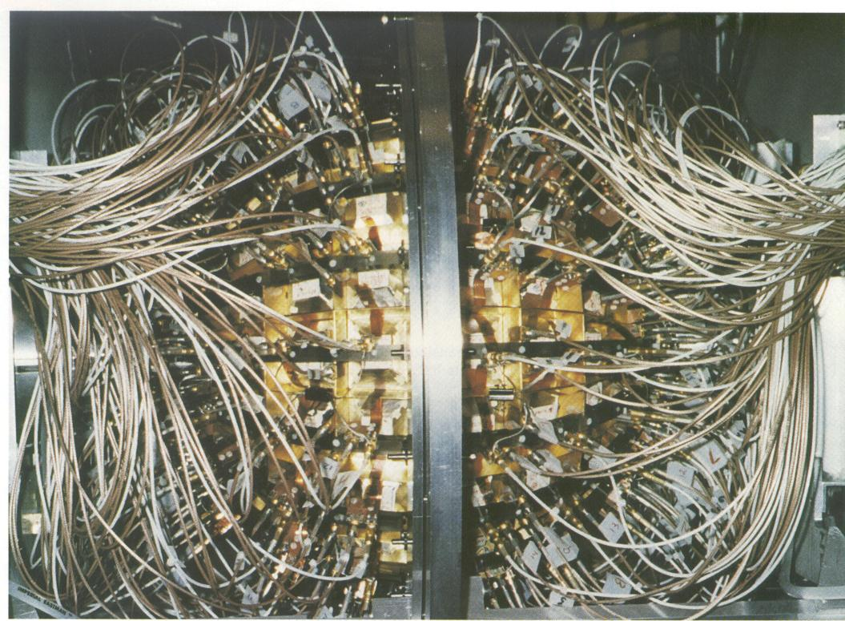
ISiS BNL Experiment
10.8 GeV p or π + Au
Indiana Silicon Strip Array
Experiment performed at AGS accelerator of Brookhaven National Laboratory
Vic Viola et al.

Slide 28
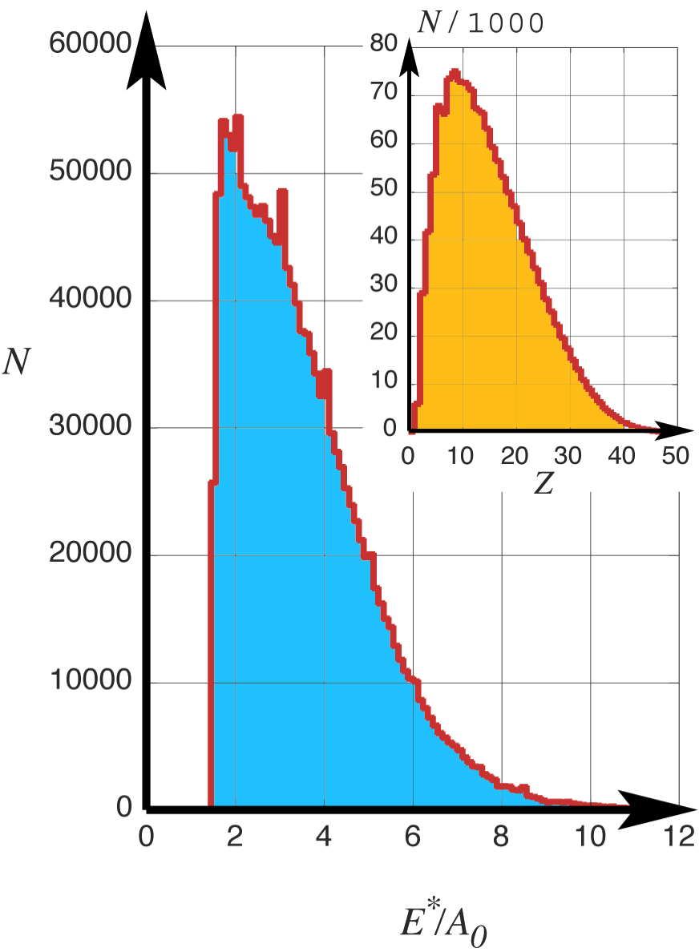
ISIS Data Analysis
Reaction: p, π+Au @AGS
Very good statistics (~10⁶ complete events)
Philosophy: Don’t deal with energy deposition models, but take this information from experiment!
Detector acceptance effects crucial
filtered calculations, instead of corrected data
Parameter-free calculations
Marko Kleine Berkenbusch
Collaboration w. Viola group

Slide 29
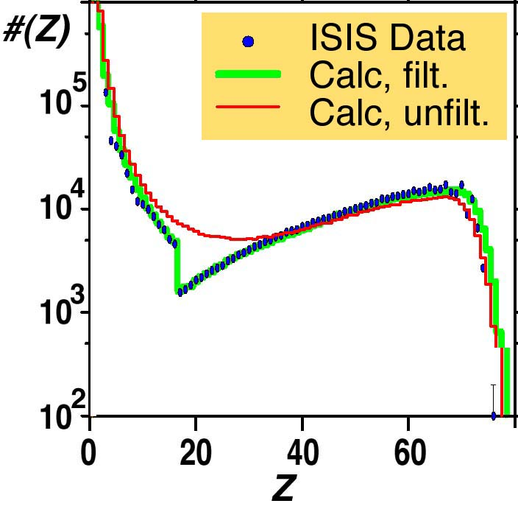
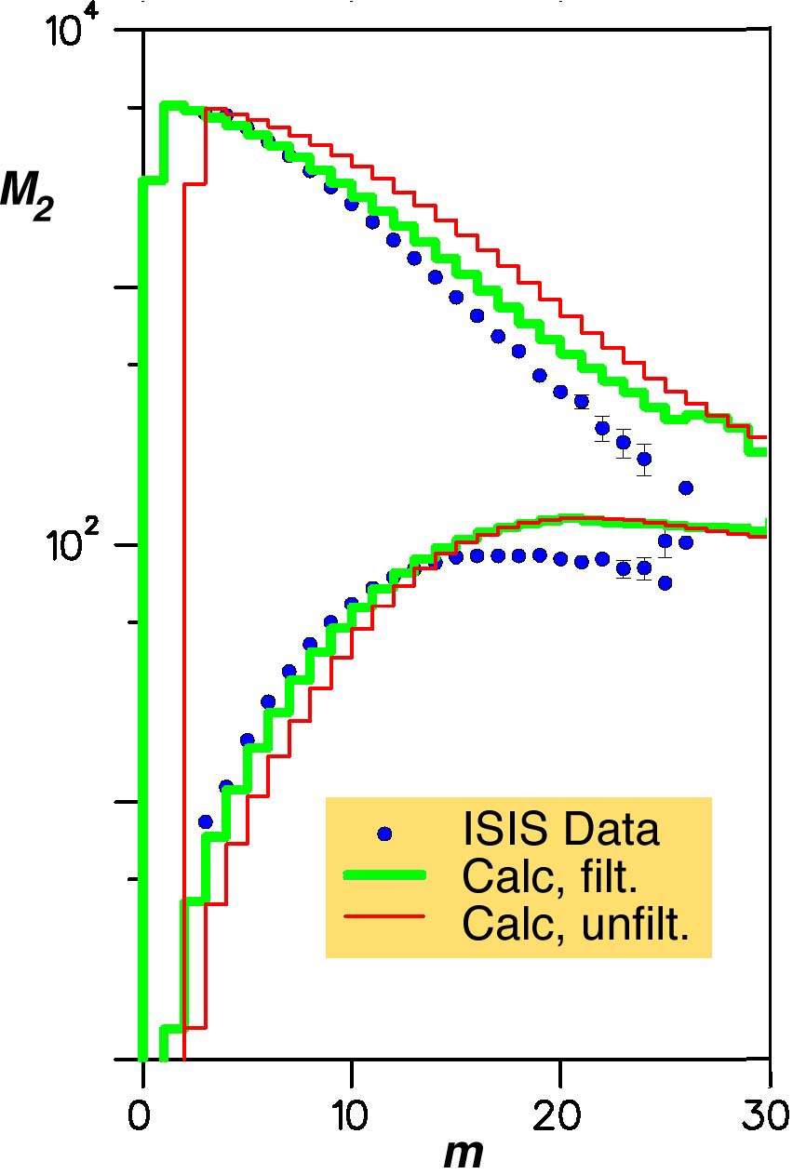
Comparison
Charge yield spectrum
Second moments
Very good agreement between theory and data
Filter very important
Sequential decay corrections huge

Slide 30
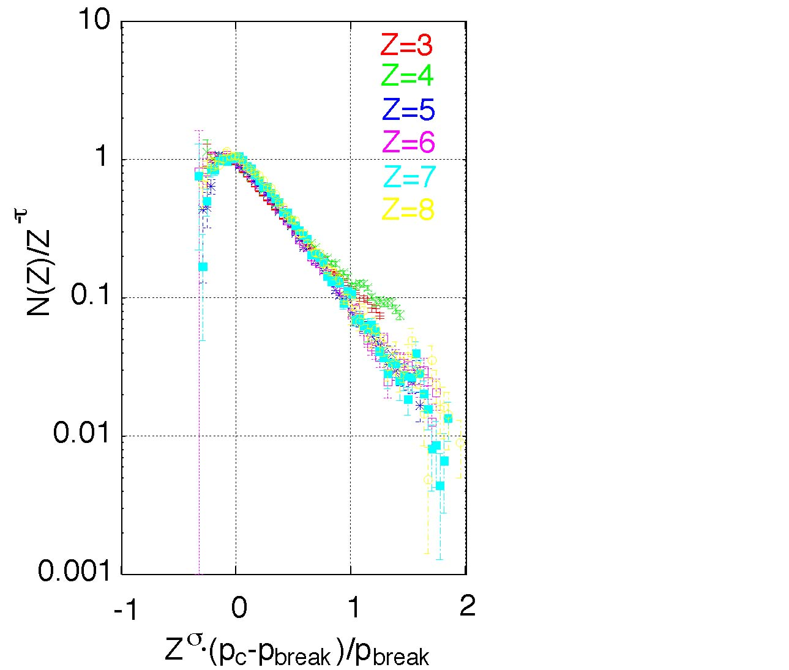
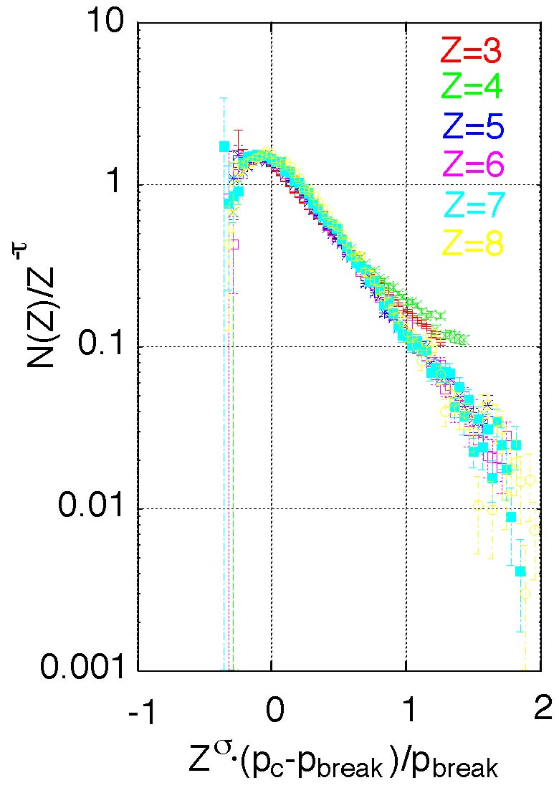
Scaling Analysis
Unfiltered Filtered
Idea (Elliott et al.): If data follow scaling function
with f(0) = 1 (think “exponential”), then we can use scaling plot to see if data cross the point [0,1] -> critical events
Notes:
Critical events present, p > p_{c}
Critical value of p was corrected for finite size of system

Slide 31
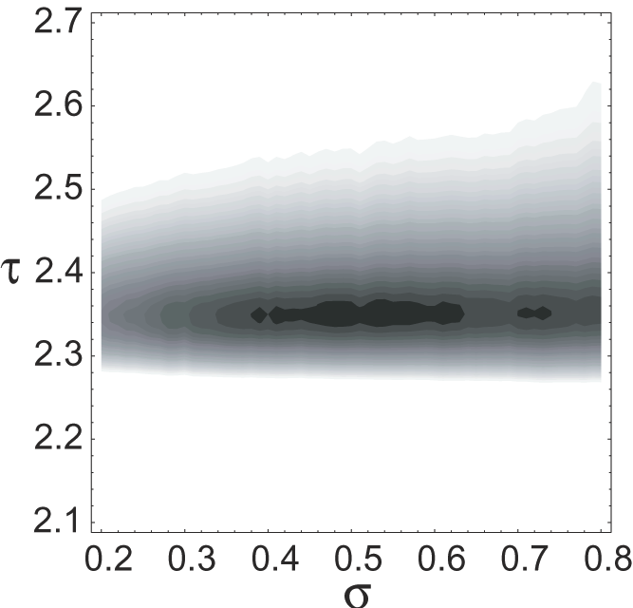
Scaling of ISIS Data
Most important: critical region and explosive events probed in experiment
Possibility to narrow window of critical parameters
τ: vertical dispersion
σ: horizontal dispersion
T_{c}: horizontal shift
χ² Analysis to find critical exponents and temperature
M. Kleine Berkenbusch et al., PRL 88
Result: β = 0.5 +- 0.1 γ = 2.35 +- 0.05 T_{c} = 8.3 +- 0.2 MeV
Scaled control parameter

Slide 32
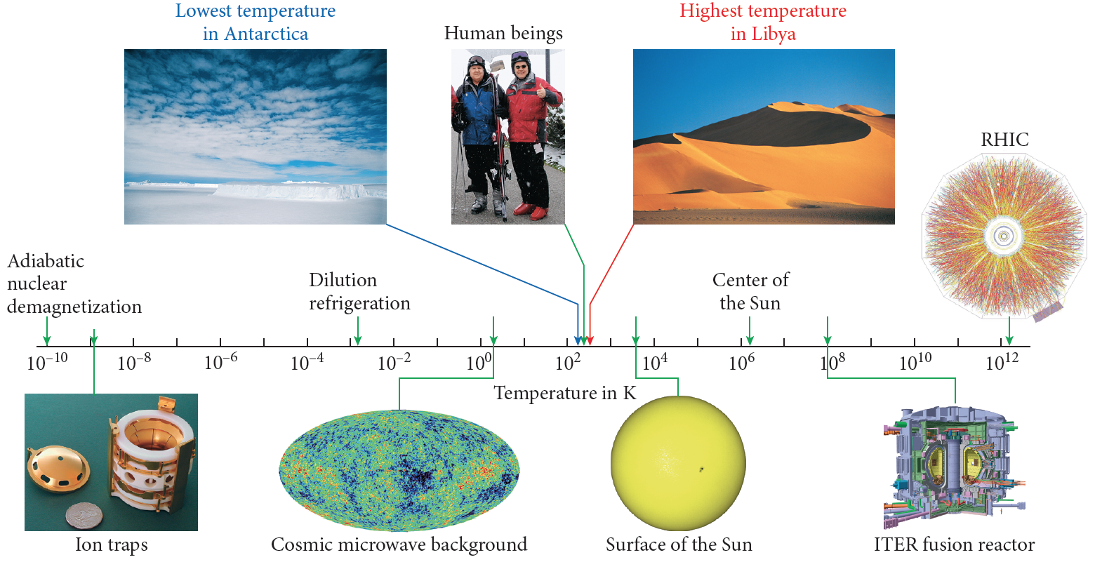
Bauer & Westfall University Physics (2nd Ed., McGraw-Hill, 2013)

