Slide 1

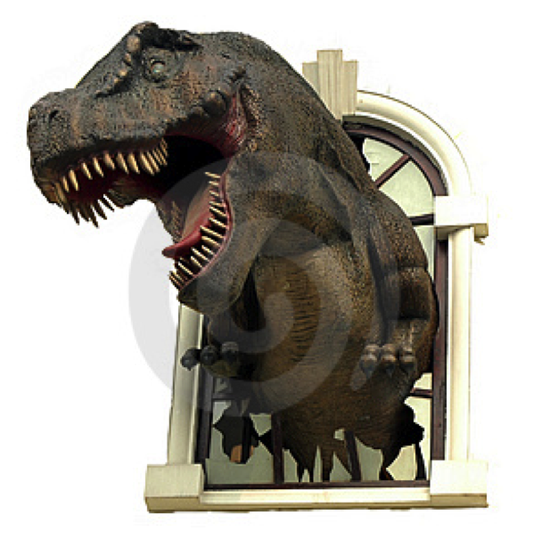


Rare Isotope Beam FACILITY at the TAMU Cyclotron Institute
(Project T-REX)
G. Chubarian
International Workshop on Nuclear Dynamics and Thermodynamics
Texas A&M University, College Station, Texas August 19-22, 2013

Slide 2
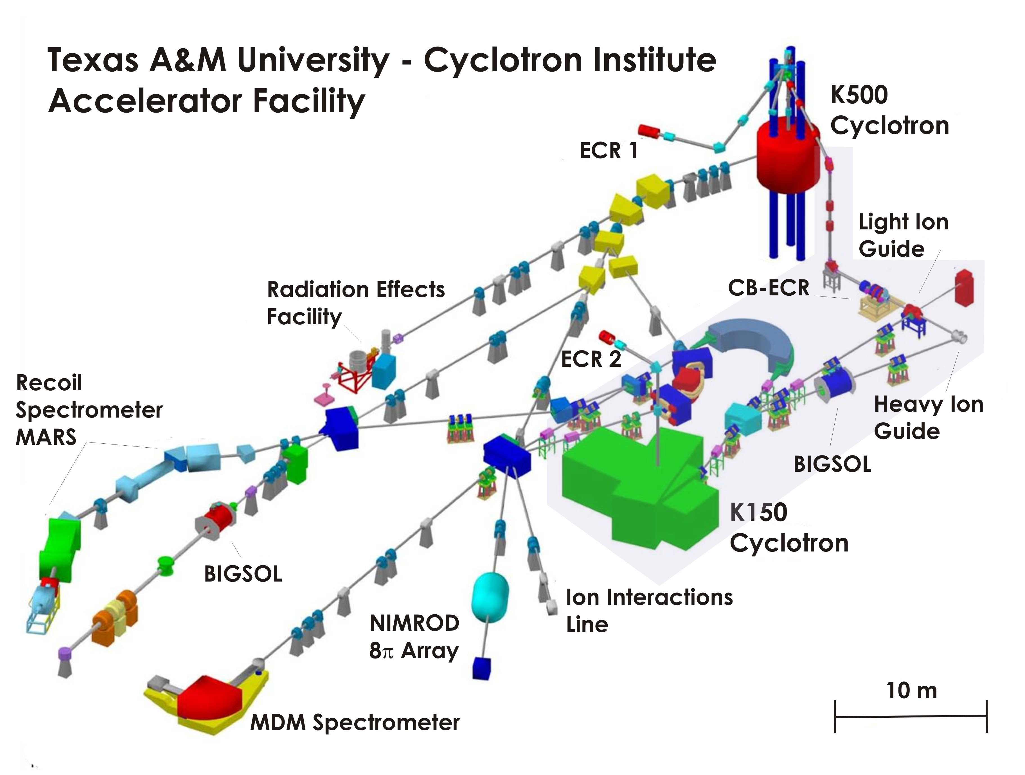


Slide 3
Project T-REX
Re-activate K150 (88”) Cyclotron
  Use K150 stand-alone and as driver for
  secondary rare-isotope beams.
Build ion guides and produce RIBs
  Light Ion Guide (JYFL, KU Leuven )
  Heavy Ion Guide (ANL Gas Catcher)
Recharge and Inject RIBs into K500 Cyclotron and reaccelerate them
Prepare low energy RIB beams

Slide 4
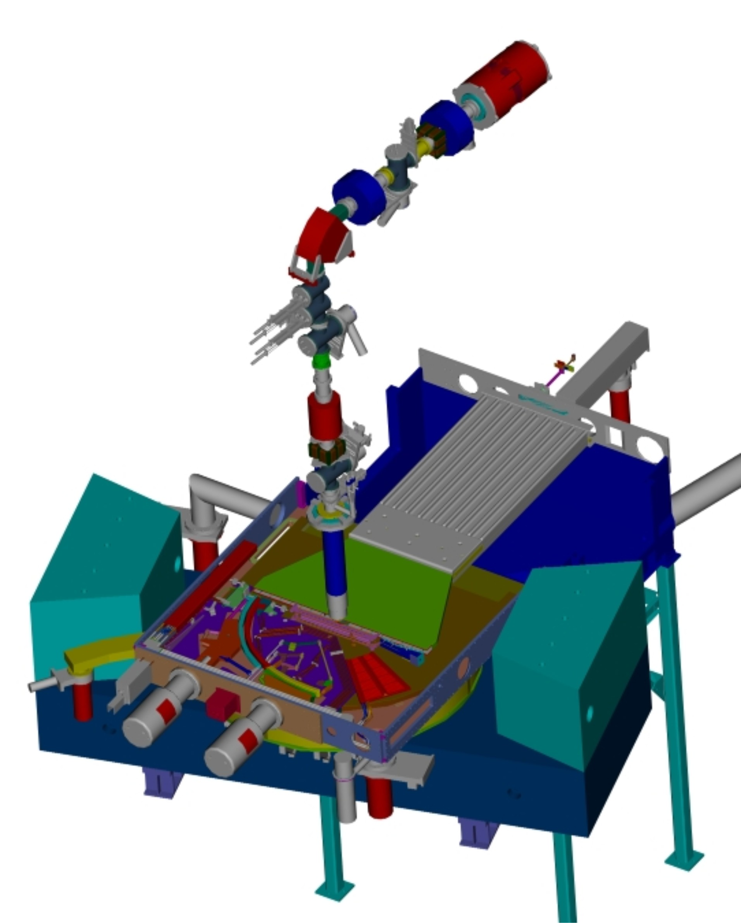
K150 (88”) Cyclotron
Original:
    Main Magnet
    Resonators
New:
    Vacuum System low 10⁻⁷ Tor
    RF System
    14.5 GHz ECR Source
    H⁻ Source
    Injection Line
    Beam Extraction
    (Electrostatic and Striping)
    Cooling System
    All Power Supplies
    Control System
    Safety System

Slide 5
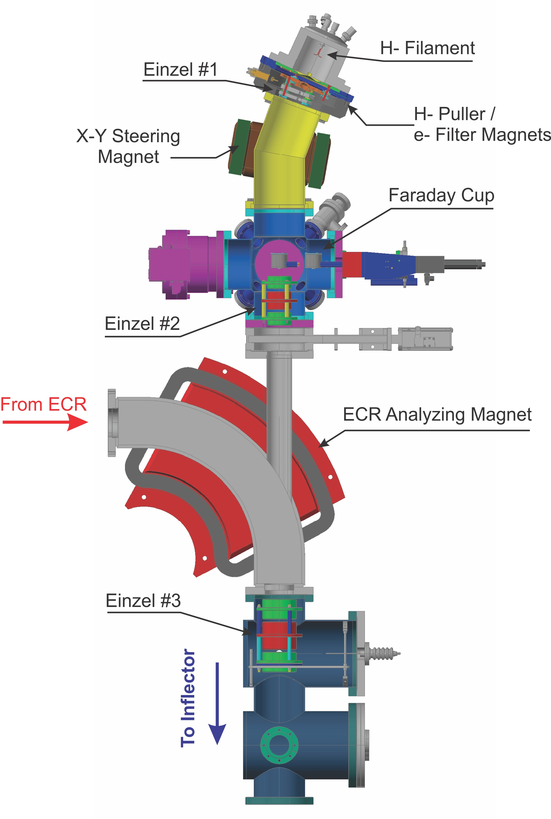

H⁻ (D⁻) Ion Source

Slide 6
Examples of K150 beam intensities and energies
assuming an ECR2 type source and 25% transmission.
The maximum intensity will be lower at the maximum
energy as the transmission typically drops to around 10%
for high K.
Isotope | Max. Energy MeV/A | Max. Intensity pμA |  | Isotope | Max. Energy MeV/A | Max. Intensity pμA
p | 55.0 | 14(27) |  | ²⁰Ne | 26.0 | 3
d | 32.5 | 9(21) |  | ²²Ne | 27.0 | 0.5
³He | 45.0 | 11 |  | ³⁴S | 19.0 | 0.7
⁴He | 32.5 | 5(10) |  | ⁴⁰Ar | 16.0 | 0.8(1.4)
⁶Li | 32.5 | 7 |  | ⁴⁰Ca | 16.0 | 0.8(1.5)
⁷Li | 24.0 | 7 |  | ⁵⁹Co | 11.0 | 0.9
¹⁰B | 32.5 | 3 |  | ⁷⁸Kr | 9.5 | 0.6
¹¹B | 27.0 | 3 |  | ⁸⁶Kr | 7.8 | 0.6
¹⁶O | 32.5 | 1.8(2.3) |  | ¹²⁹Xe | 5.3 | 0.5

Slide 7
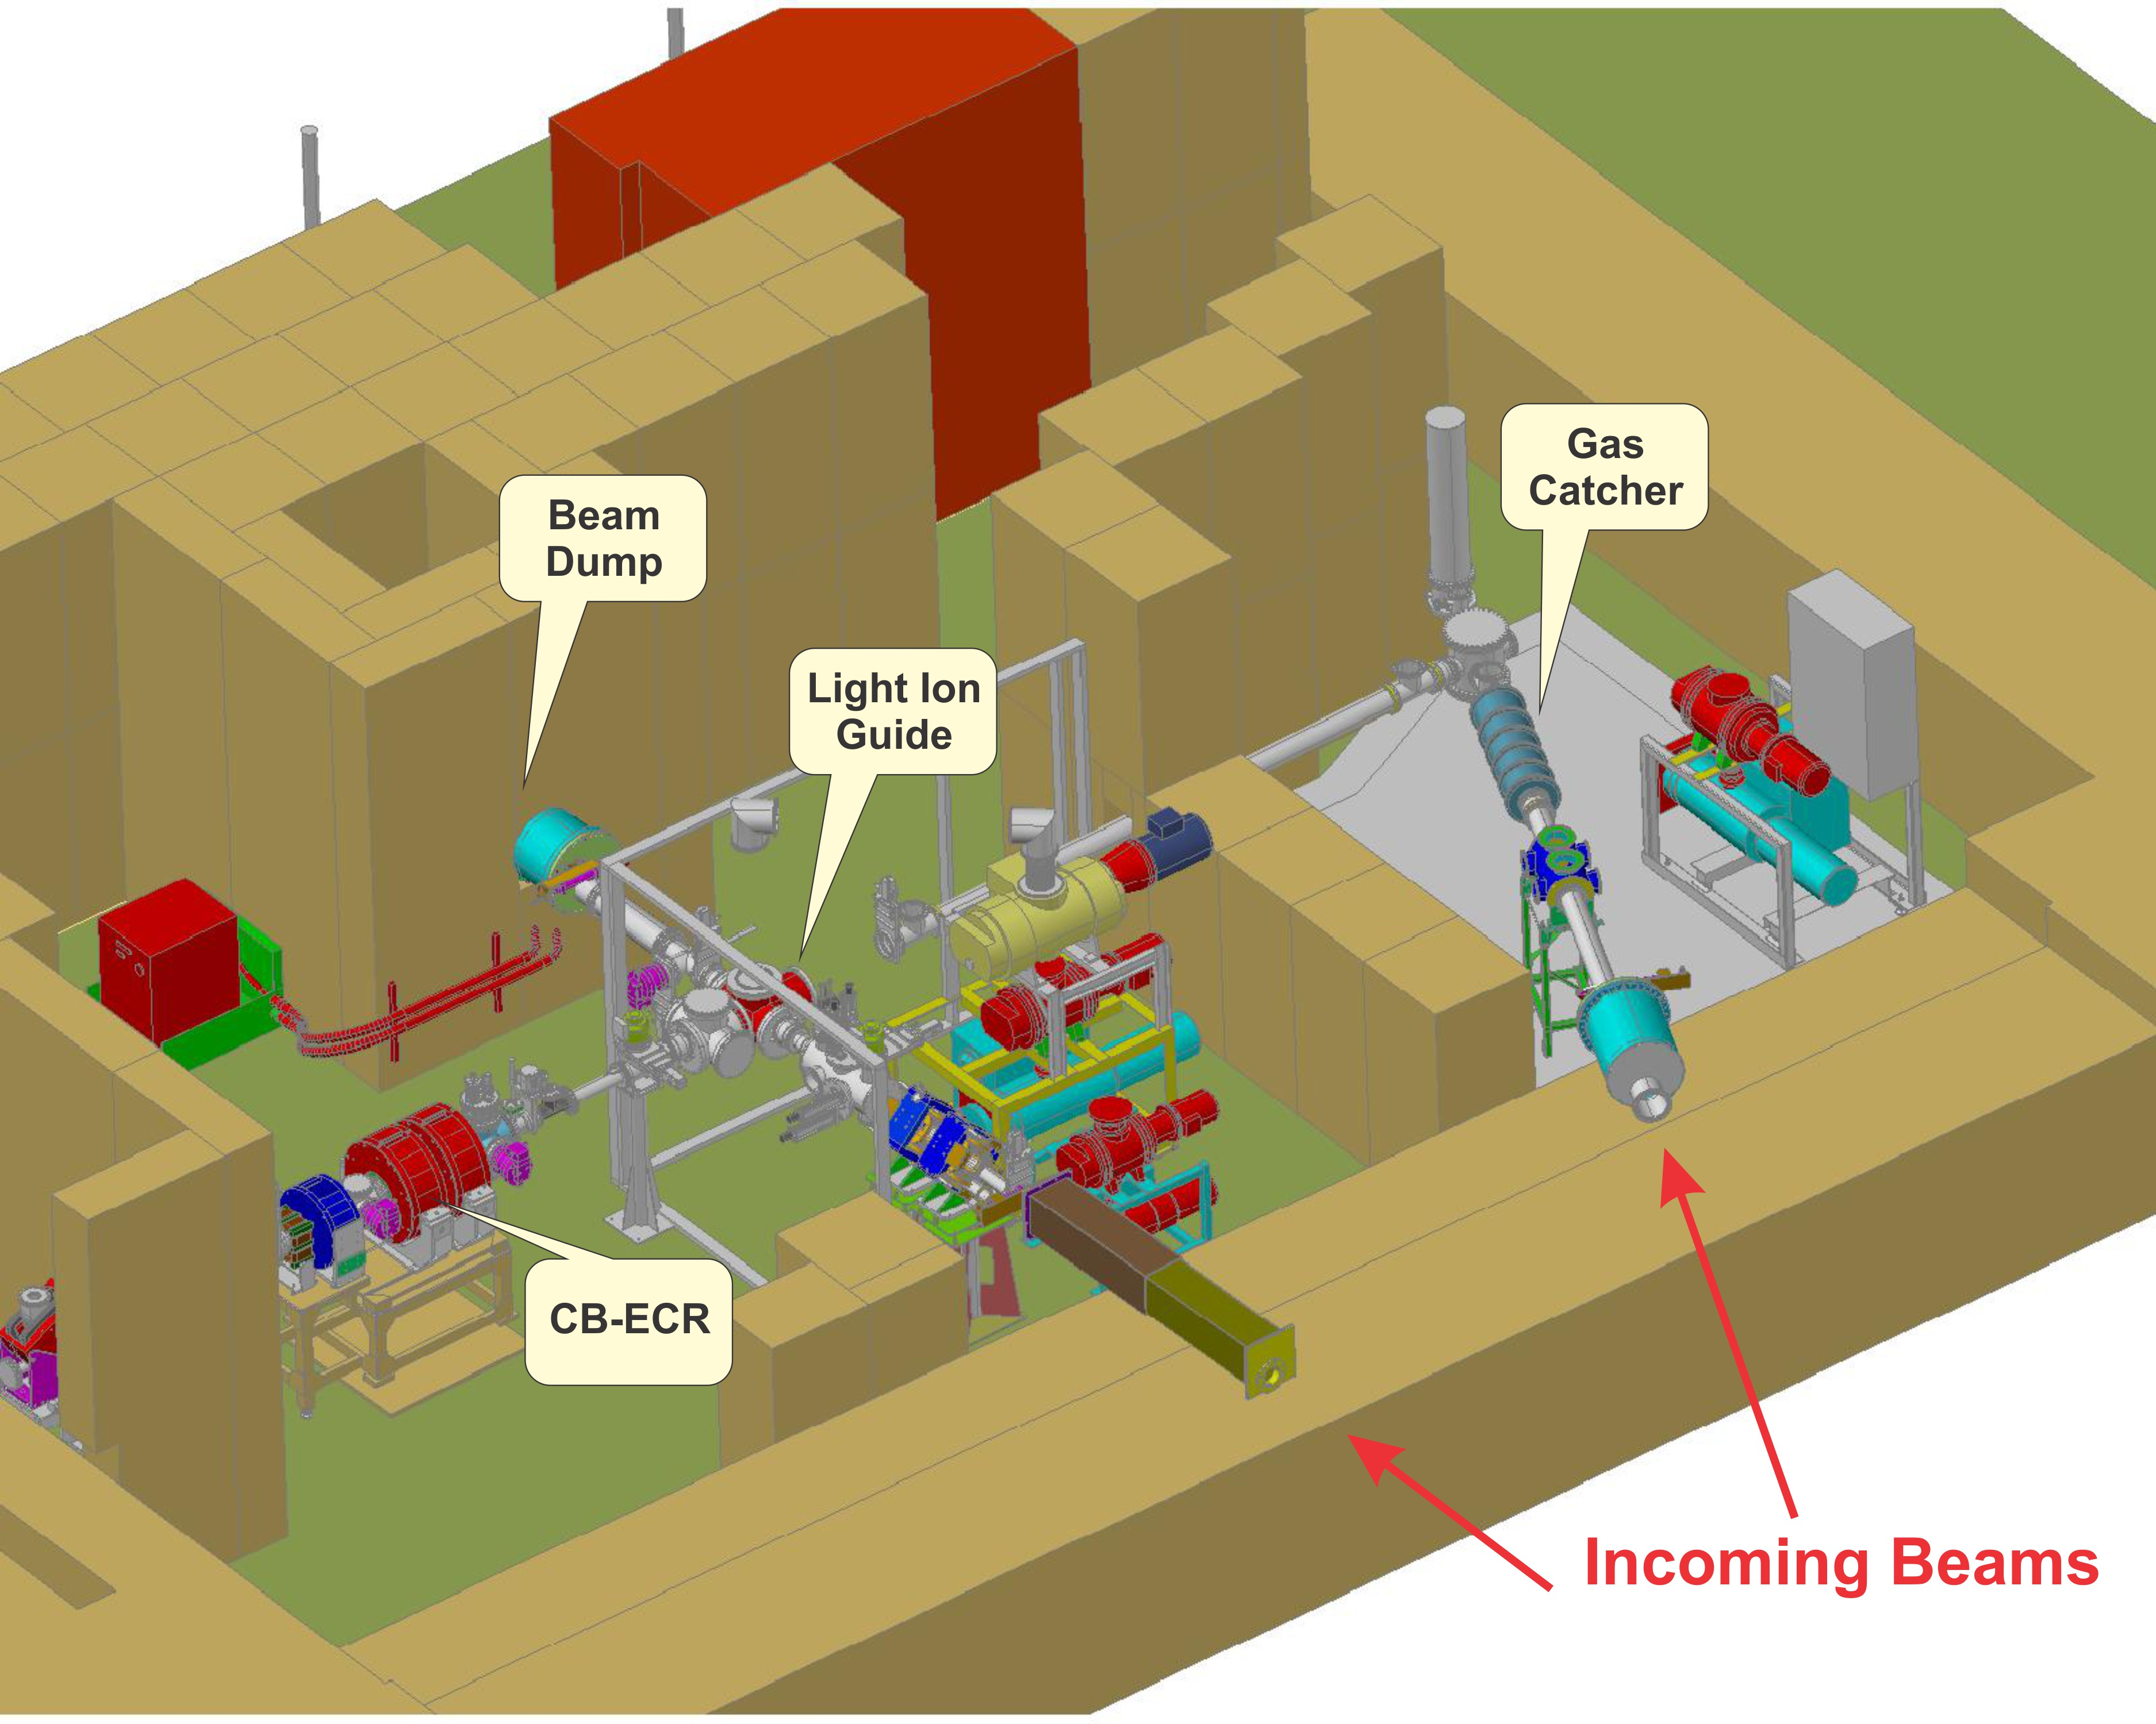
RIB Production Area

Slide 8
Light Ion Guide
Preparation of single charged radioactive species – atoms and molecules in A(p,xn)B and p+²³⁸U fission reactions
Transport them in to the Charge-Breeder ECR or low energy beam line
Injection into the K500 Cyclotron
RIB post-acceleration and delivery

Slide 9
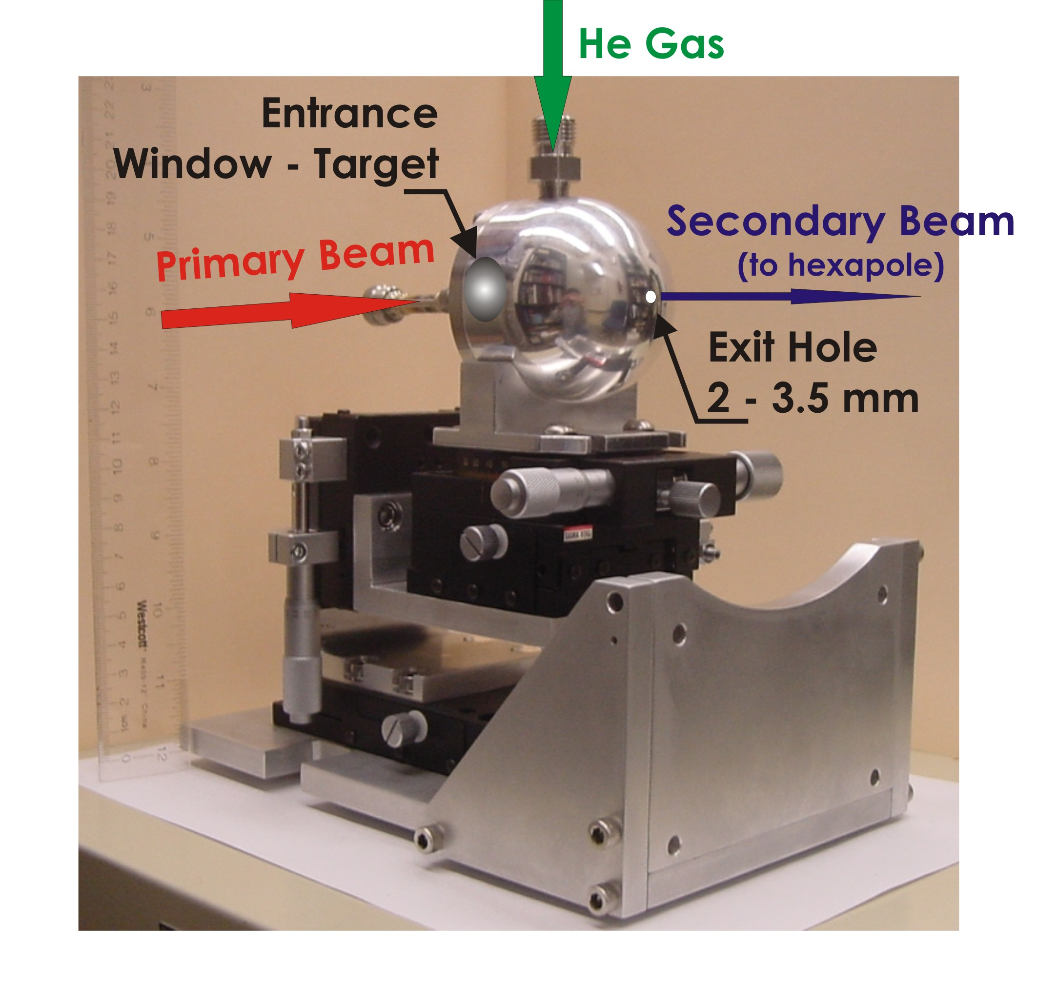
The Light Ion Guide

Slide 10
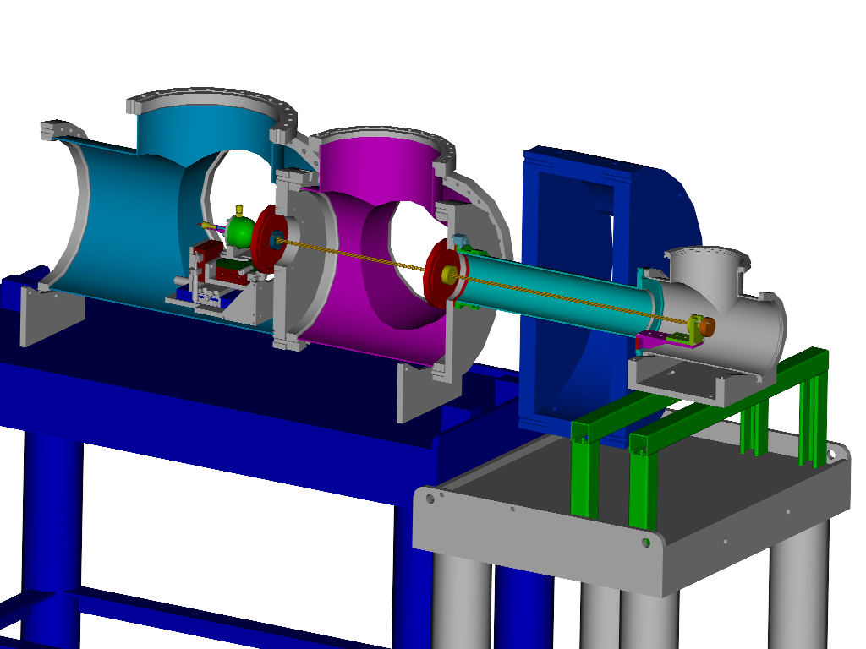
The Light Ion Guide
RF-only hexapole
Glaser lens
~ 1mbar
proton beam
~10⁻⁶mbar
~10⁻²mbar
To CB-ECR
Target Chamber
He ~ 300 – 500 mbar
In collaboration with J. Arje - Jyvaskyla

Slide 11
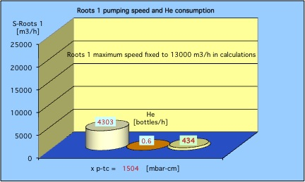
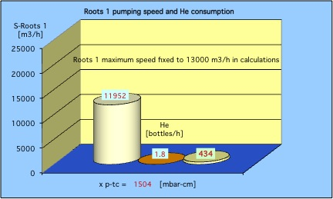
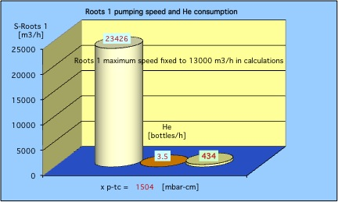
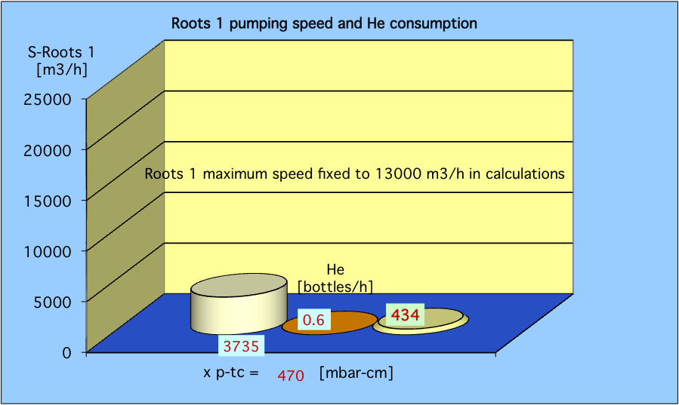
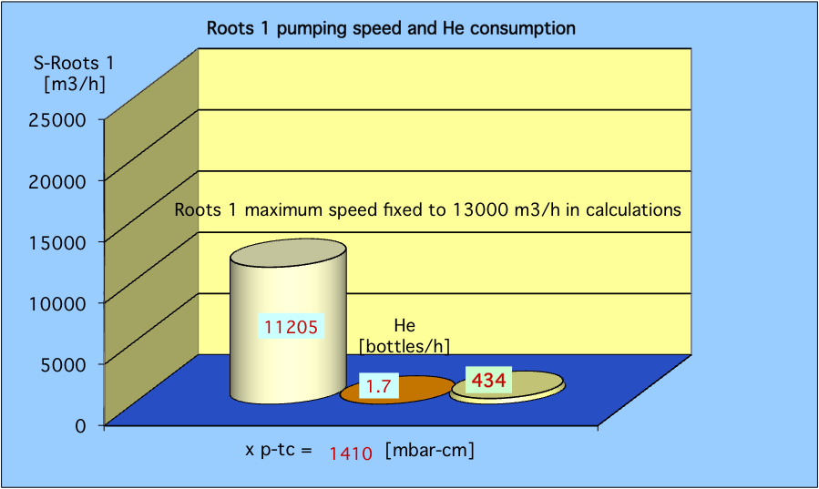
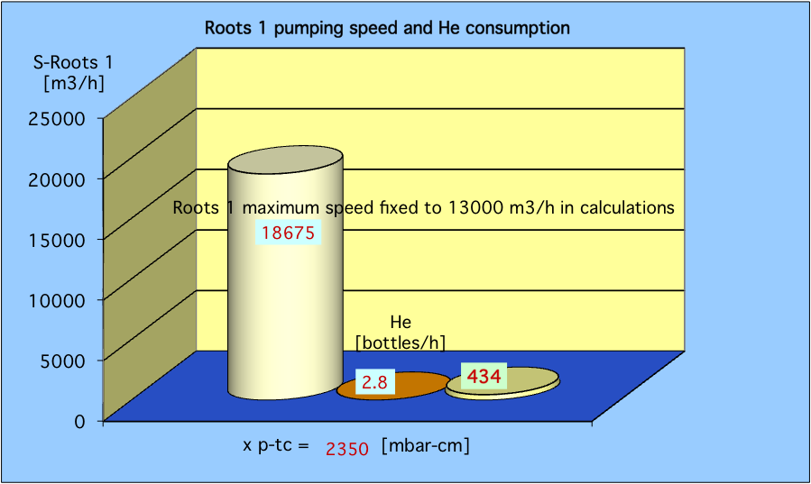
Pumping Requirements and He Consumption Rate
If He pressure in gas cell is 640 mbar and
Hole diameter is 1.5 mm
Hole diameter is 2.5 mm
Hole diameter is 3.5 mm
Pumping speed 4303 m³ / h
He consumption 0.6 bottle / h
Pumping speed 11952 m³ / h
He consumption 1.8 bottle / h
Pumping speed 23426 m³ / h
He consumption 3.5 bottle / h
If hole diameter is 2.5 mm and
He pressure is 200 mbar
He pressure is 600 mbar
He pressure is 1000 mbar
Pumping speed 3735 m³ / h
He consumption 0.6 bottle / h
Pumping speed 11205 m³ / h
He consumption 1.7 bottle / h
Pumping speed 18675 m³ / h
He consumption 2.8 bottle / h

Slide 12
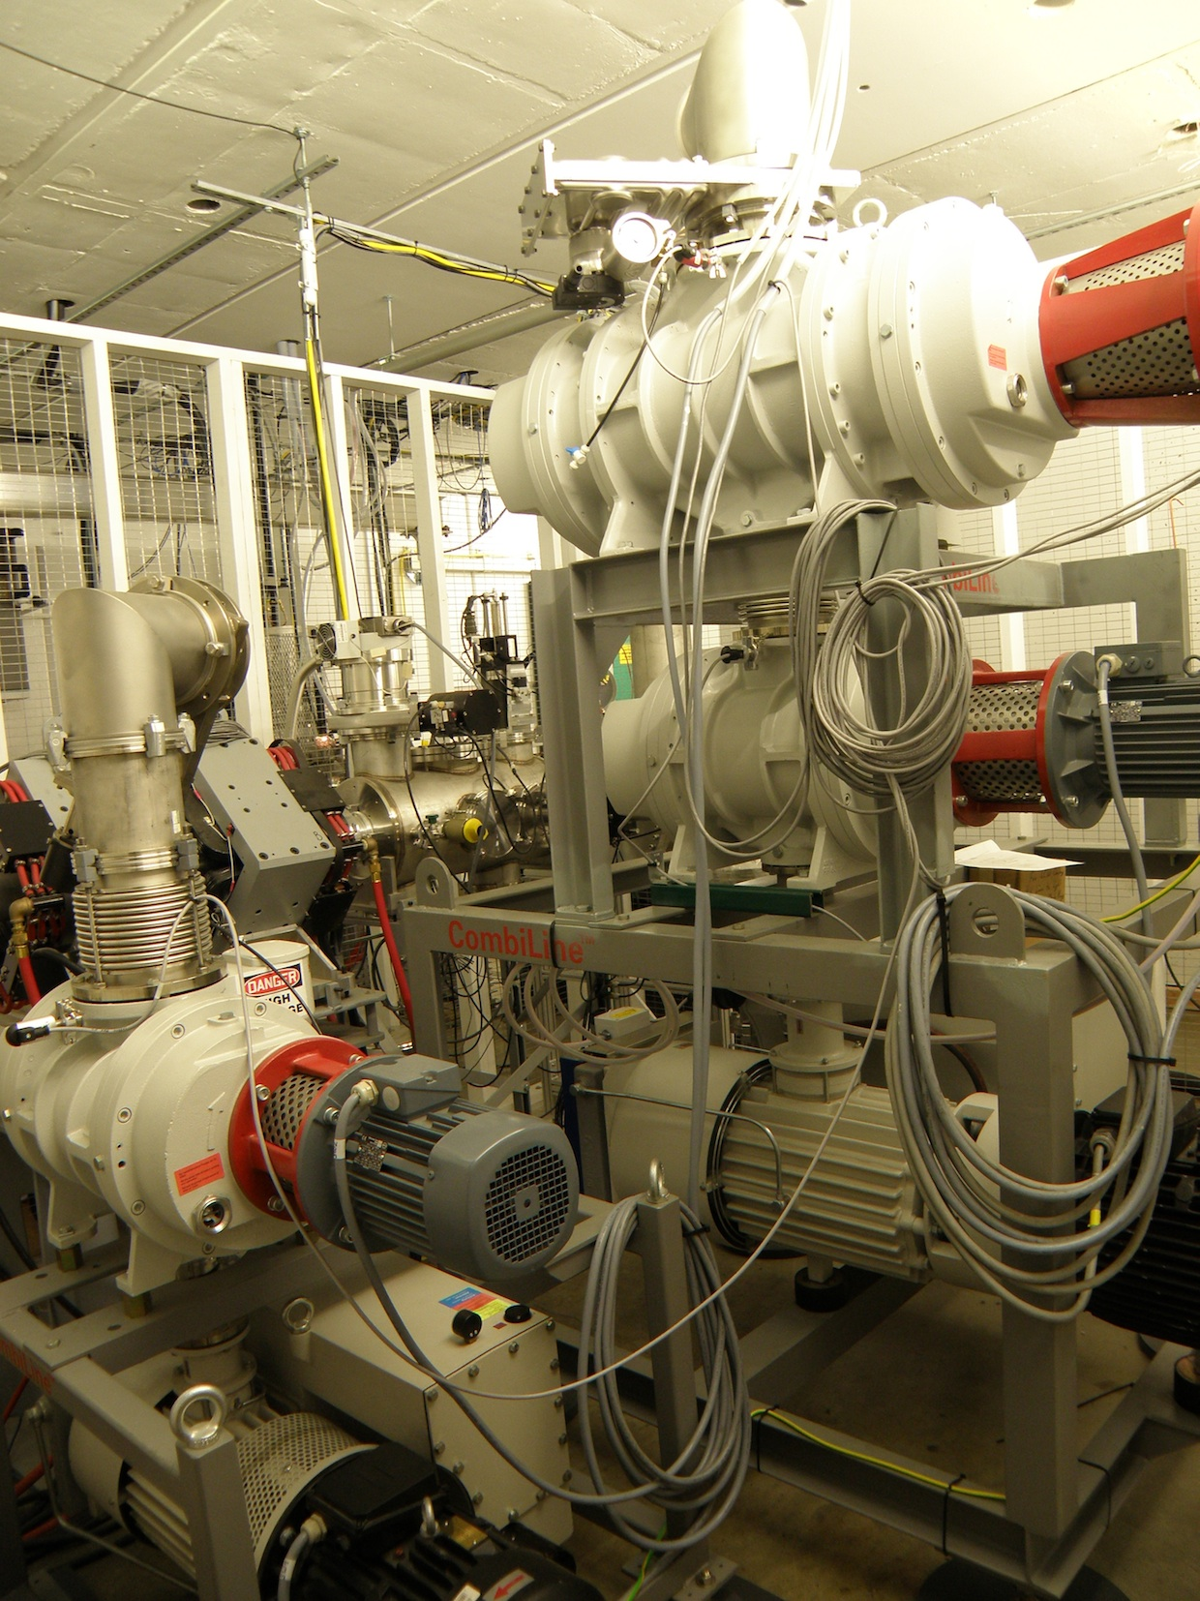
Light Ion Guide Pumping Station
6000 m³/h
2400 m³/h
1200 m³/h

Slide 13
Estimated beam intensities for reaccelerated
products of light ion induced reactions
A(p,1n)B | Max. Energy | Intensity
Product | MeV/A | part/sec
²⁷Si | 57 | 4 × 10⁴
⁵⁰Mn | 45 | 1 × 10⁵
⁵⁴Co | 45 | 4 × 10⁴
⁶⁴Ga | 45 | 2 × 10⁵
⁹²Tc | 35 | 2 × 10⁵
¹⁰⁶In | 28 | 4 × 10⁵
¹⁰⁸In | 28 | 2 × 10⁵
¹¹⁰In | 26 | 4 × 10⁵

Slide 14
Fission Fragment Yields

Slide 15
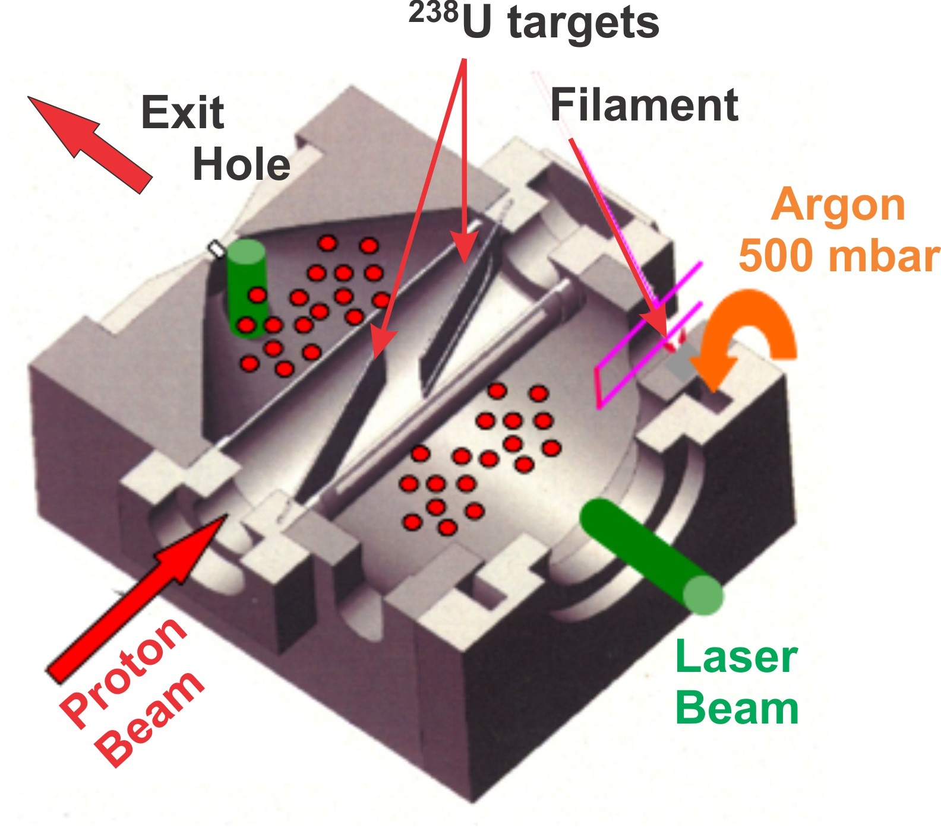
LISOL – Laser Ion Source
Yu. Kudryavtsev, NIMB 204, 336 (2004), M. Facina, NIMB, 226. 401 (2004)
Fission fragments will slow down and neutralize in 500 mbar Ar buffer gas cell
Z selection is possible by resonant laser ionization
Extraction by gas flow

Slide 16
Heavy Ion Guide
Preparation of radioactive species in DIC and fragmentation reaction
Separation of reaction products
Collection and slowdown of reaction products
Transportation them into the Charge-Breeder ECR or Low Energy Beam Line
Injection into the K500 Cyclotron
RIB post-acceleration and delivery

Slide 17
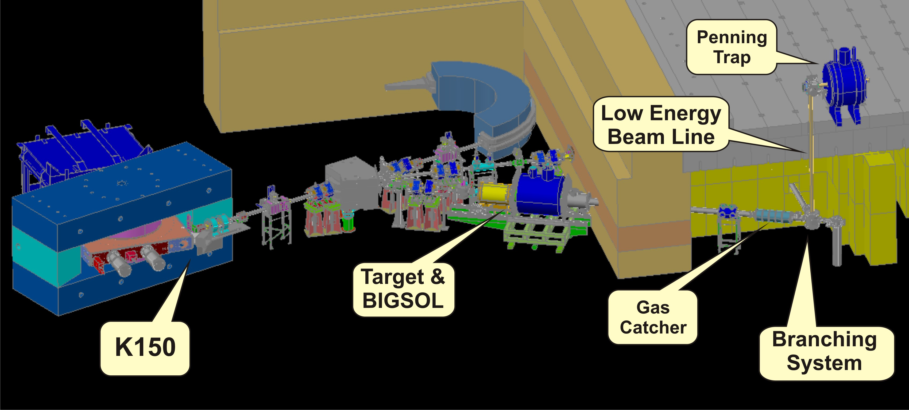
Heavy Ion Guide Beam Line

Slide 18
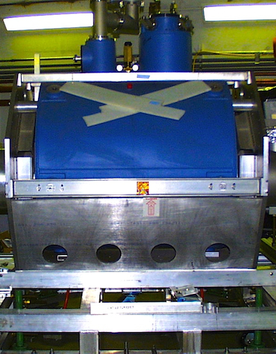
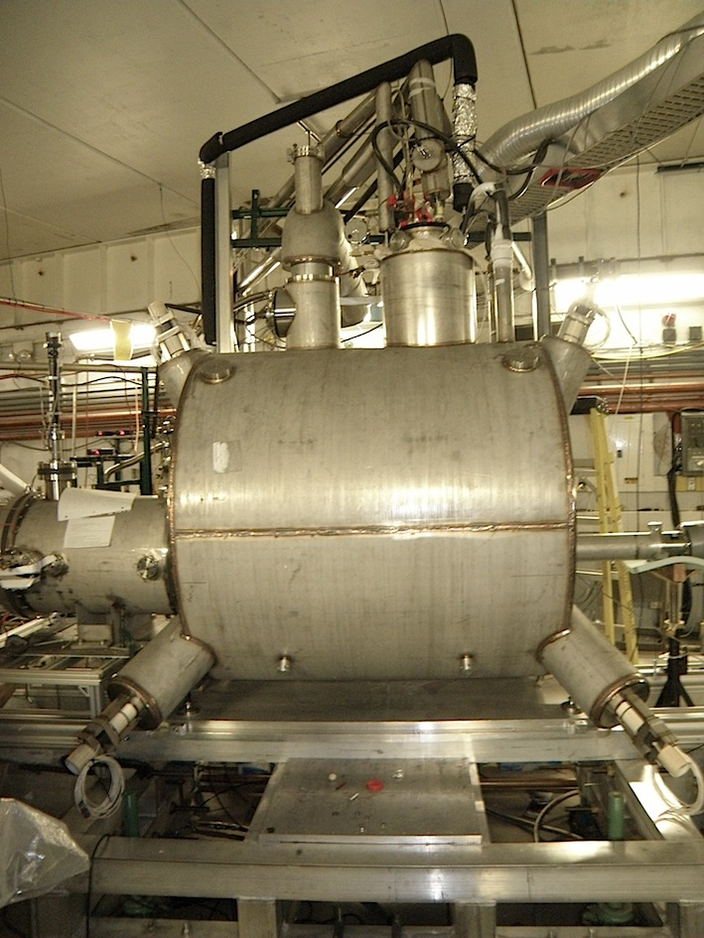
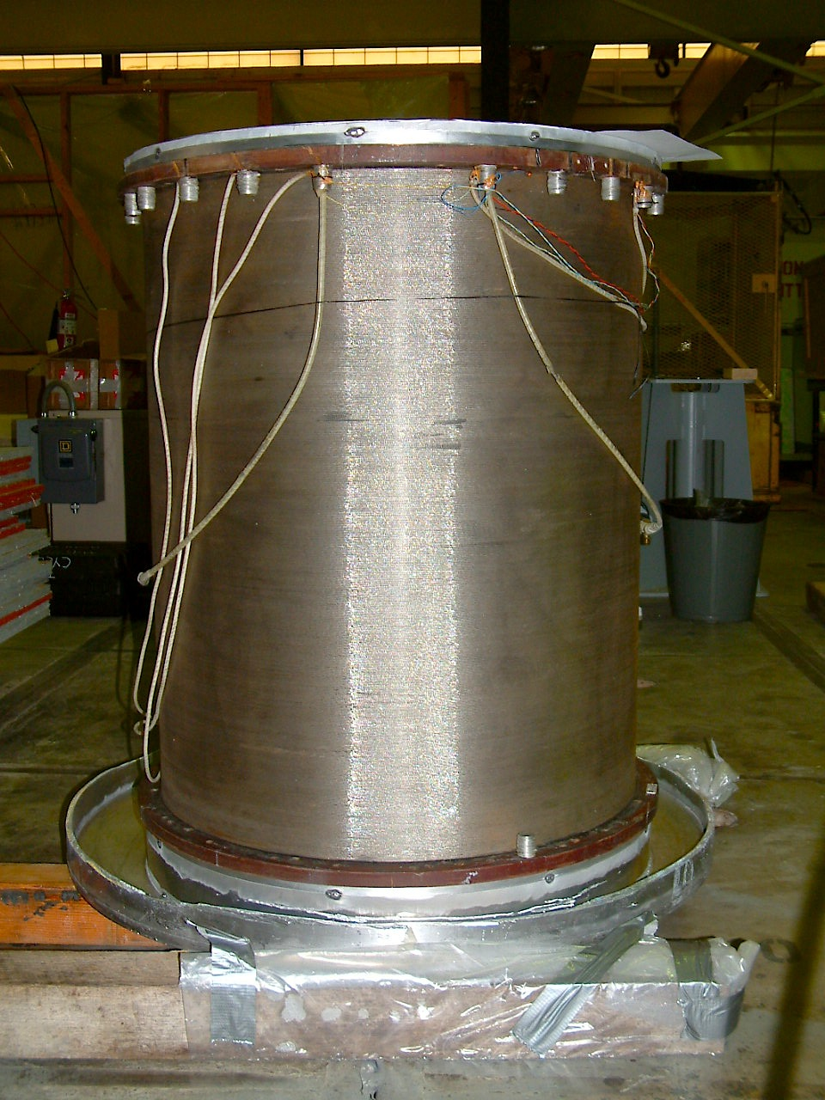
BigSol
7 Tesla Large-Bore Superconducting Solenoid

Slide 19
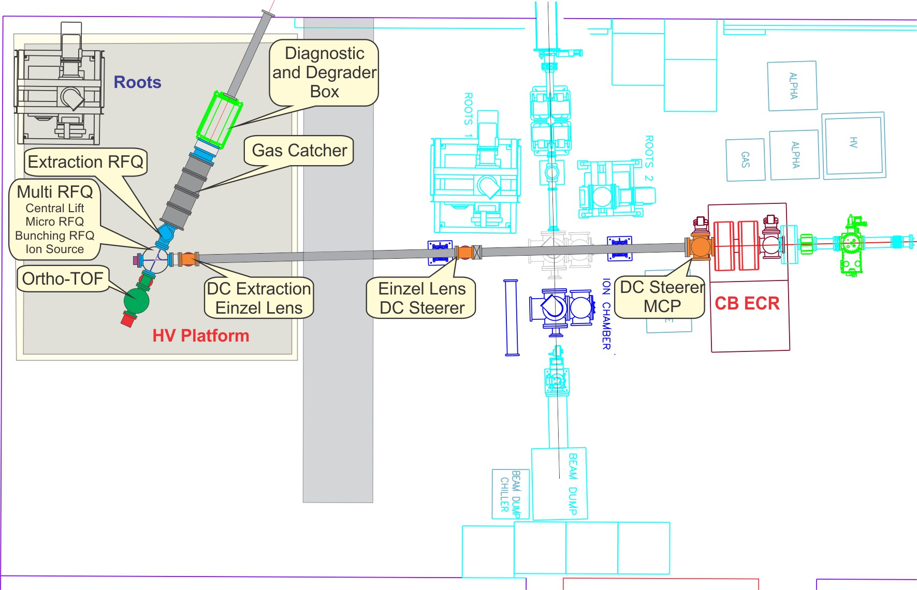
Heavy Ion Guide and Beam Delivery Layout

Slide 20
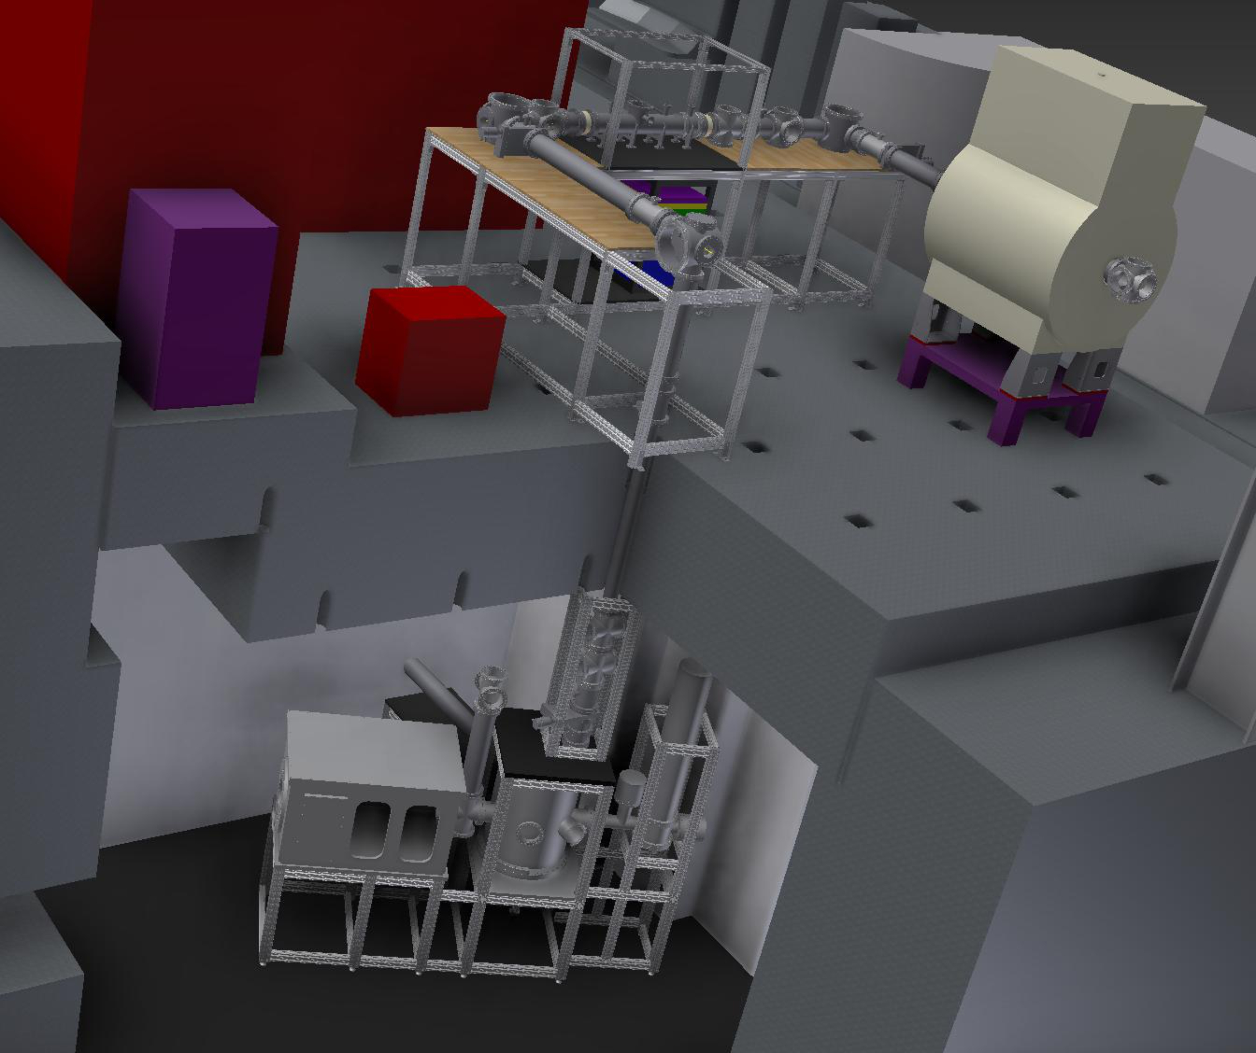
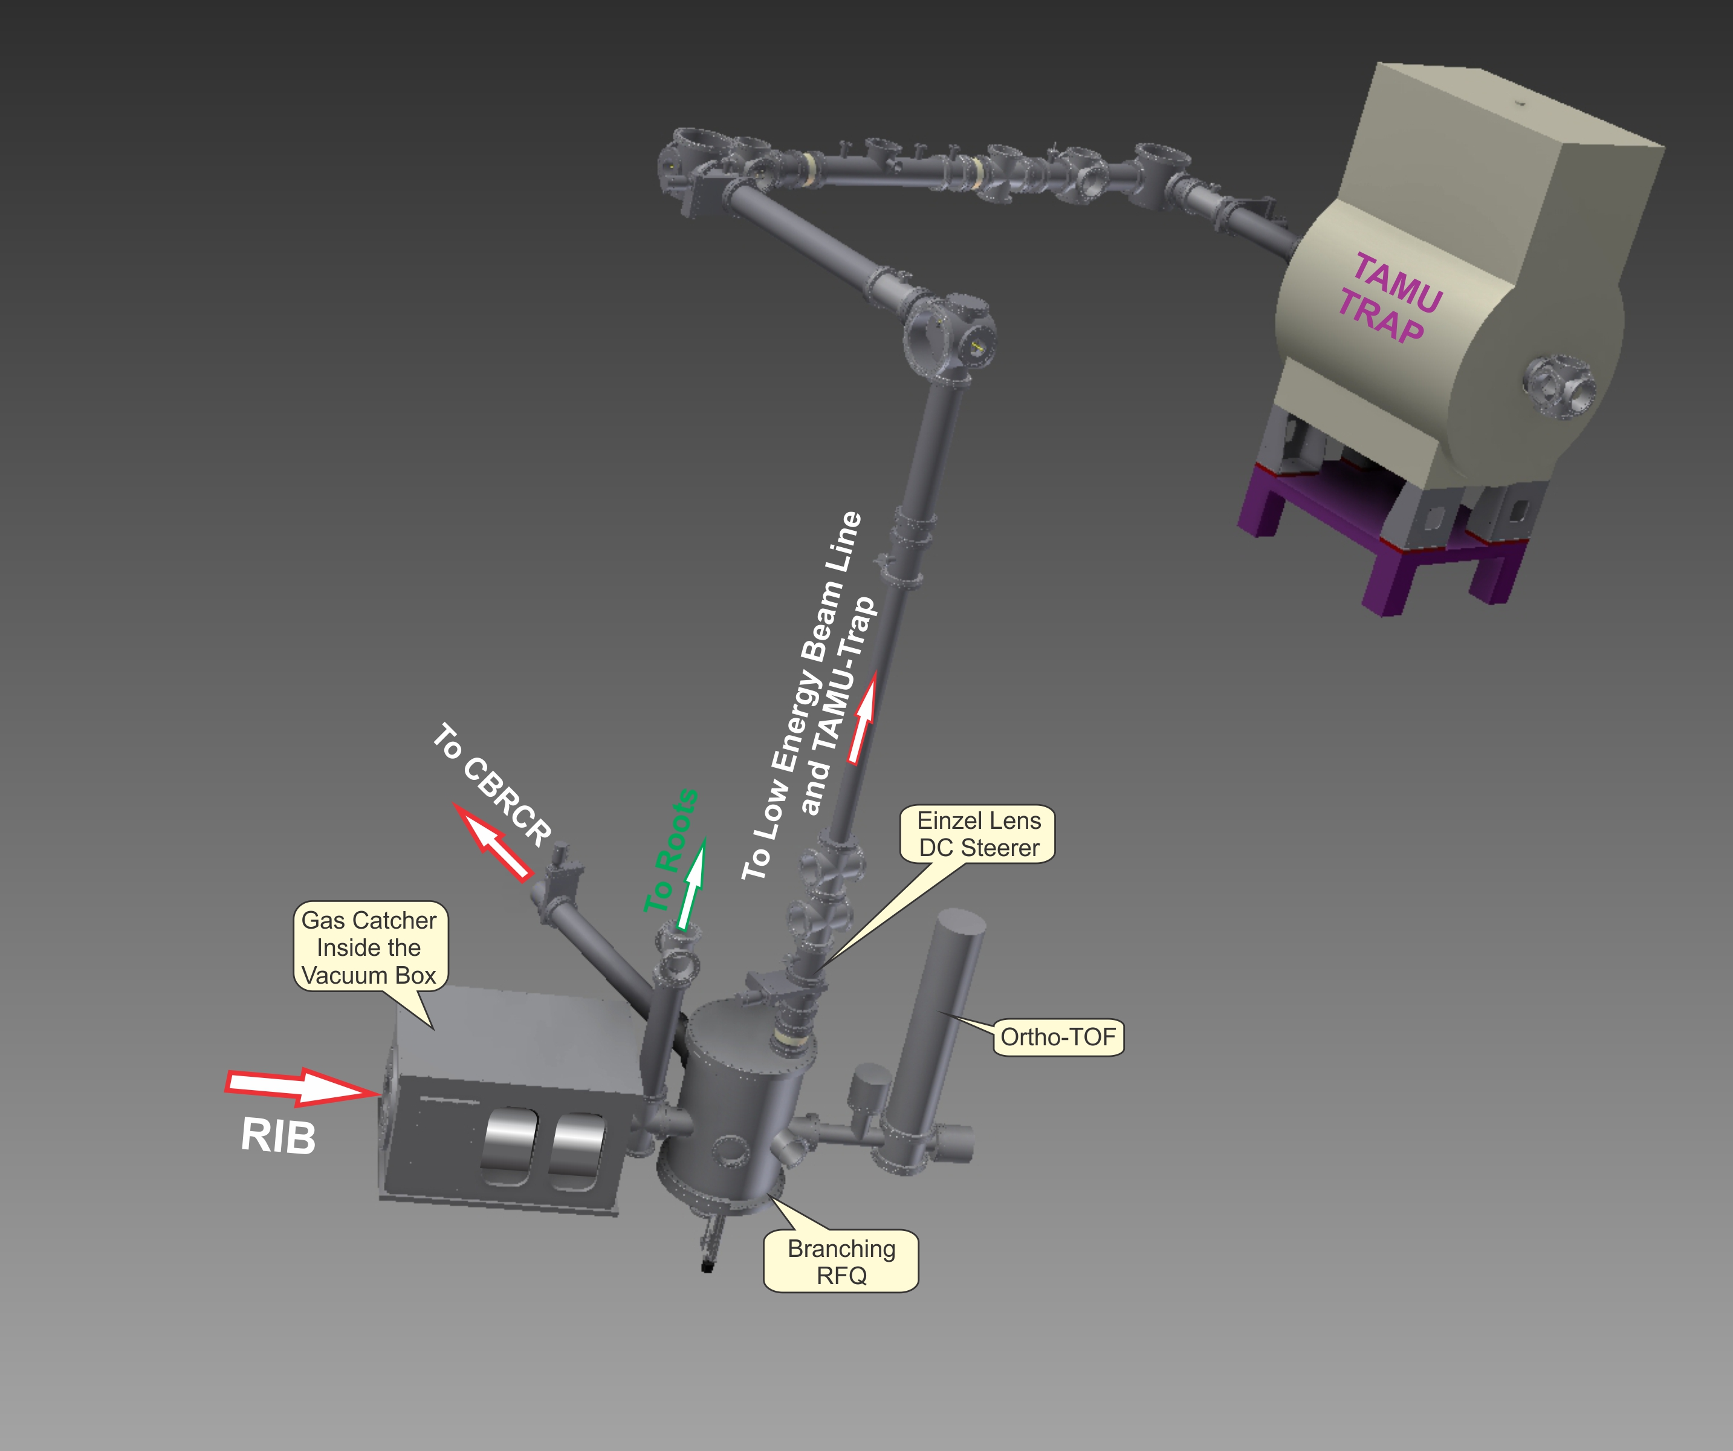
Heavy Ion Guide Beam Line
(Collection and Distribution)

Slide 21
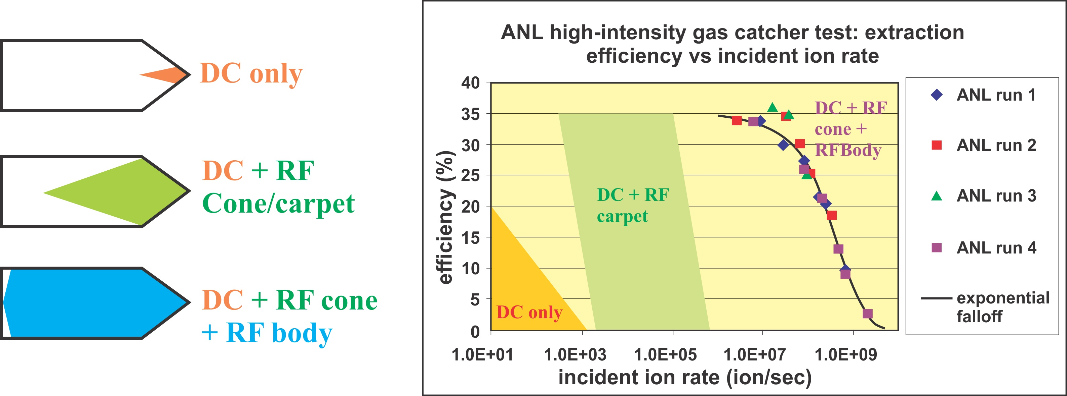
Working Principle of the Gas Catcher
G. Savard, Journal of Physics: Conference Series 312 (2011) 052004

Slide 22
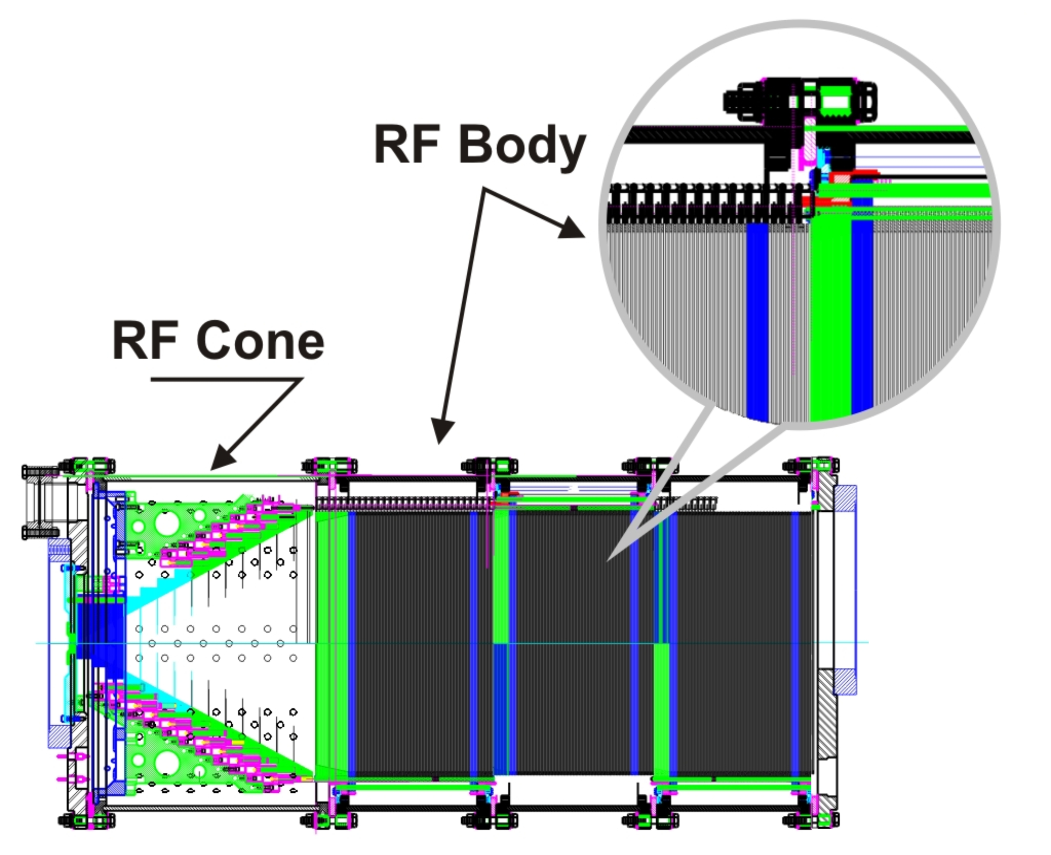
ANL Gas Catcher

Slide 23
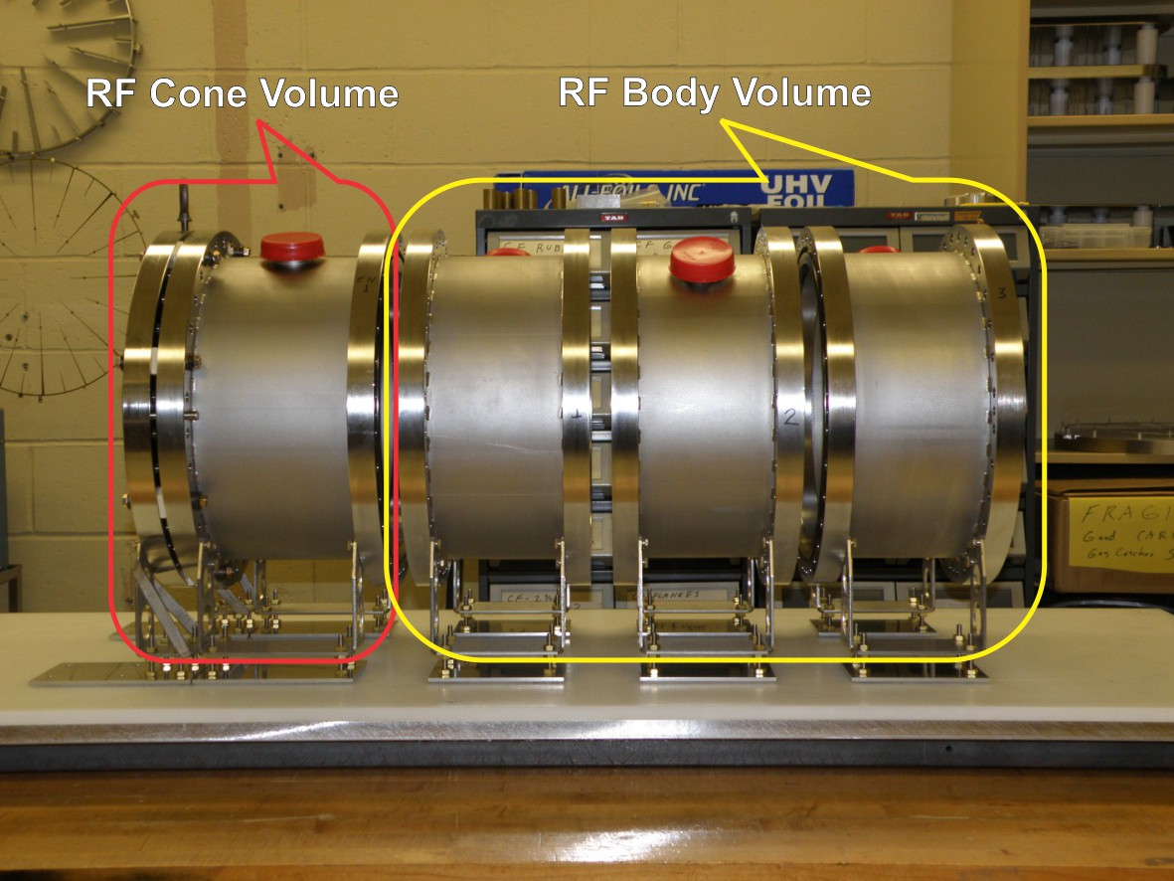
ANL Gas Catcher

Slide 24
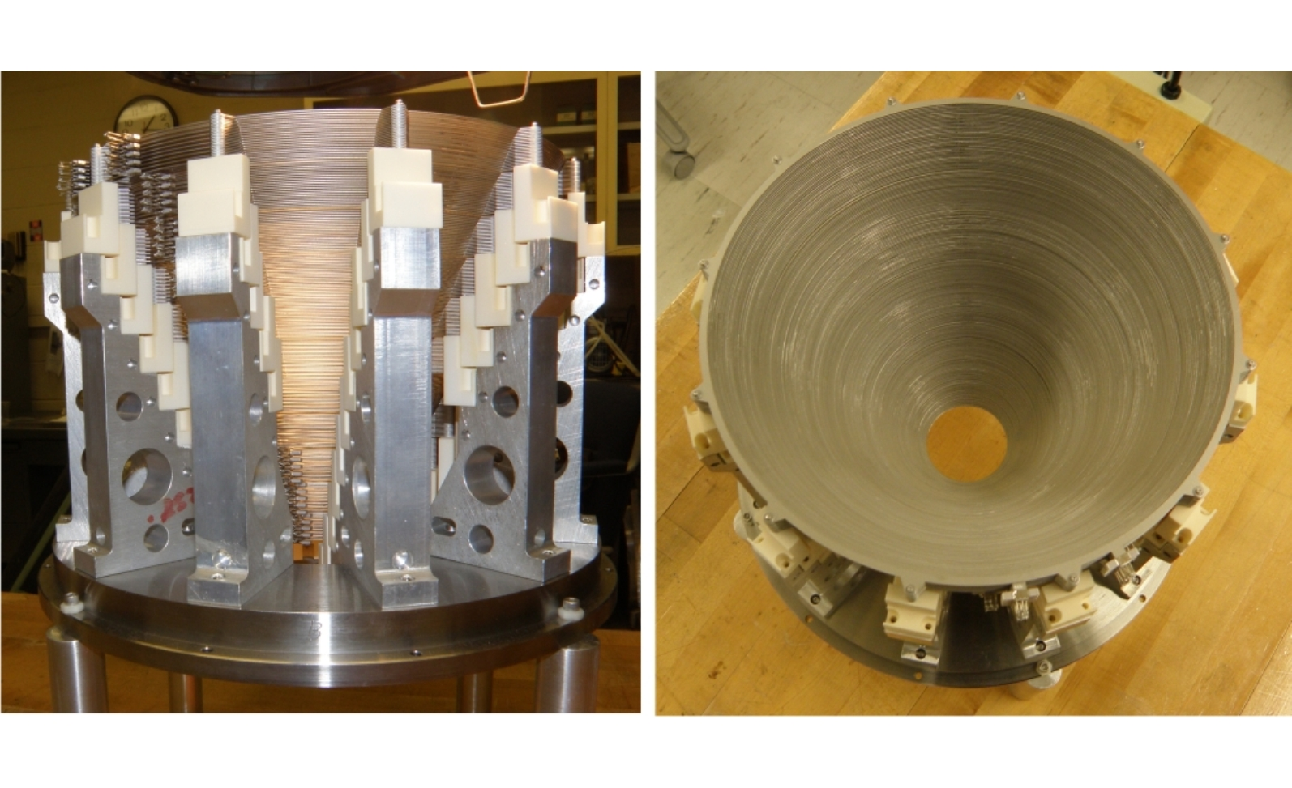
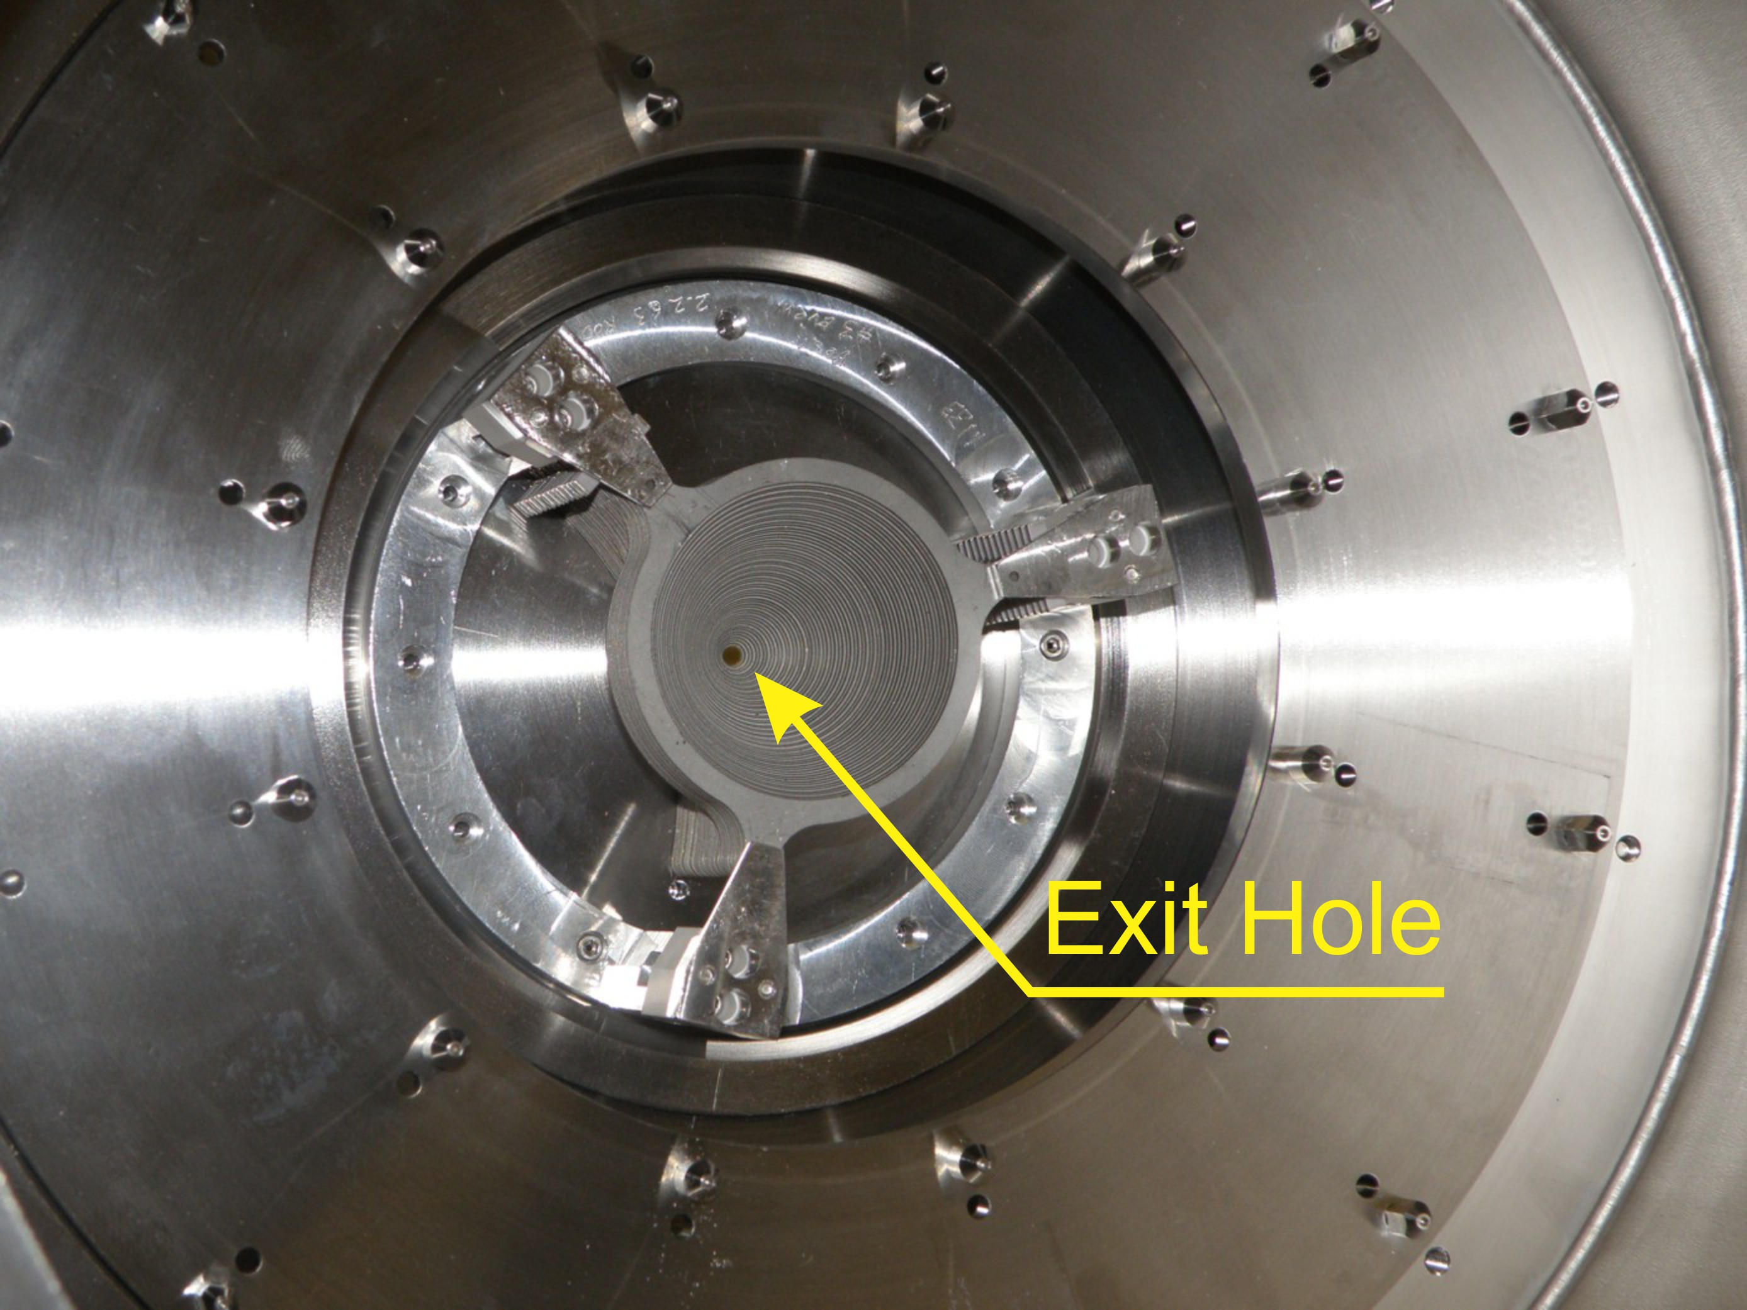
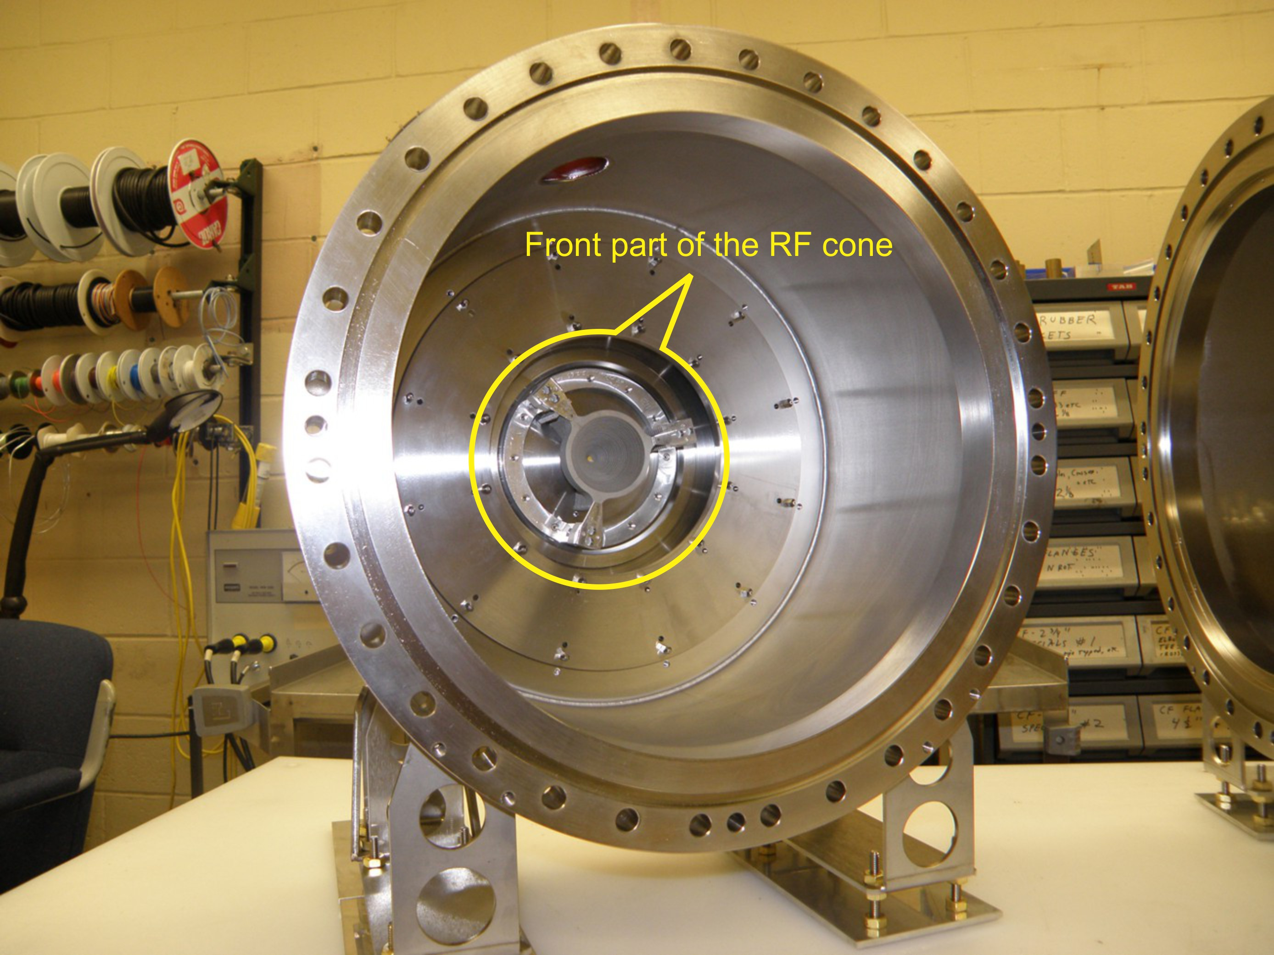
RF Cone

Slide 25
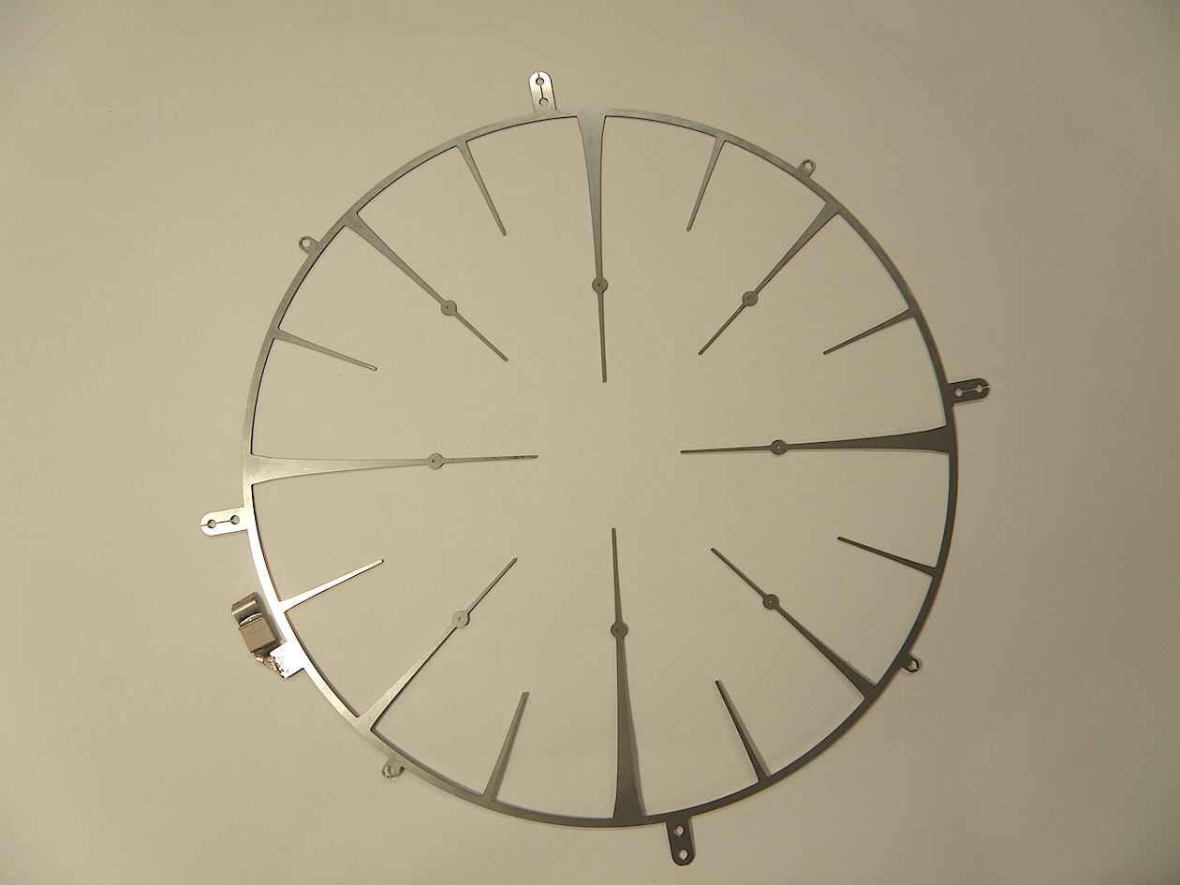
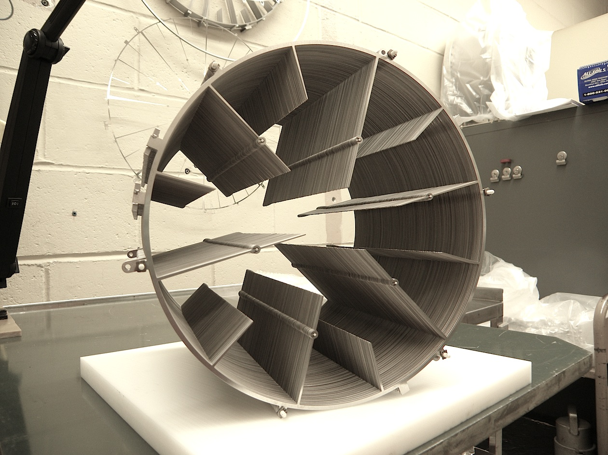
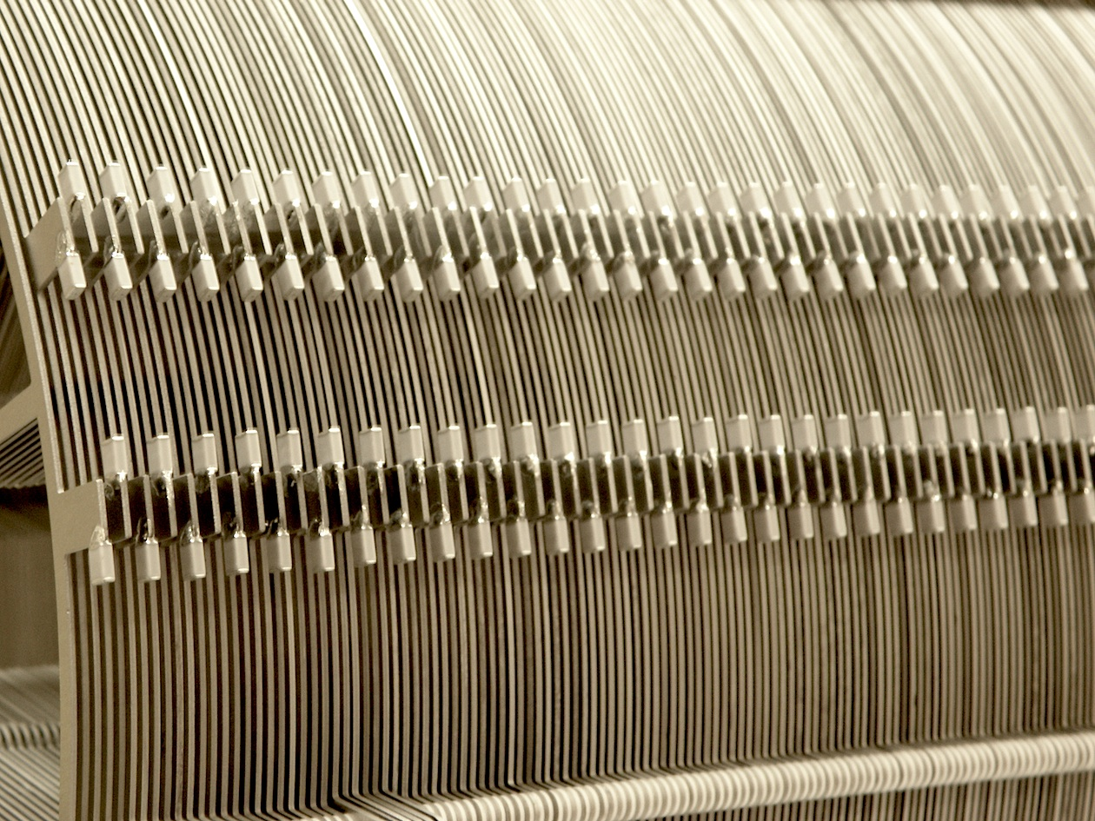
RF Body

Slide 26
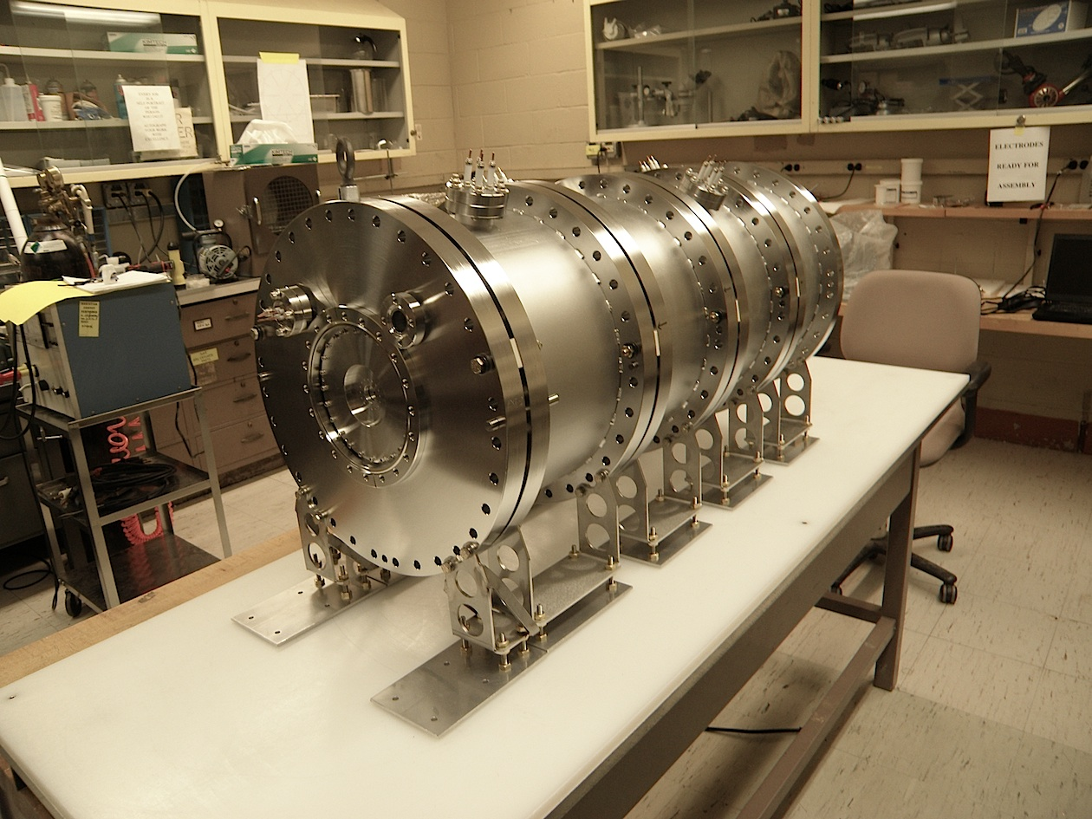
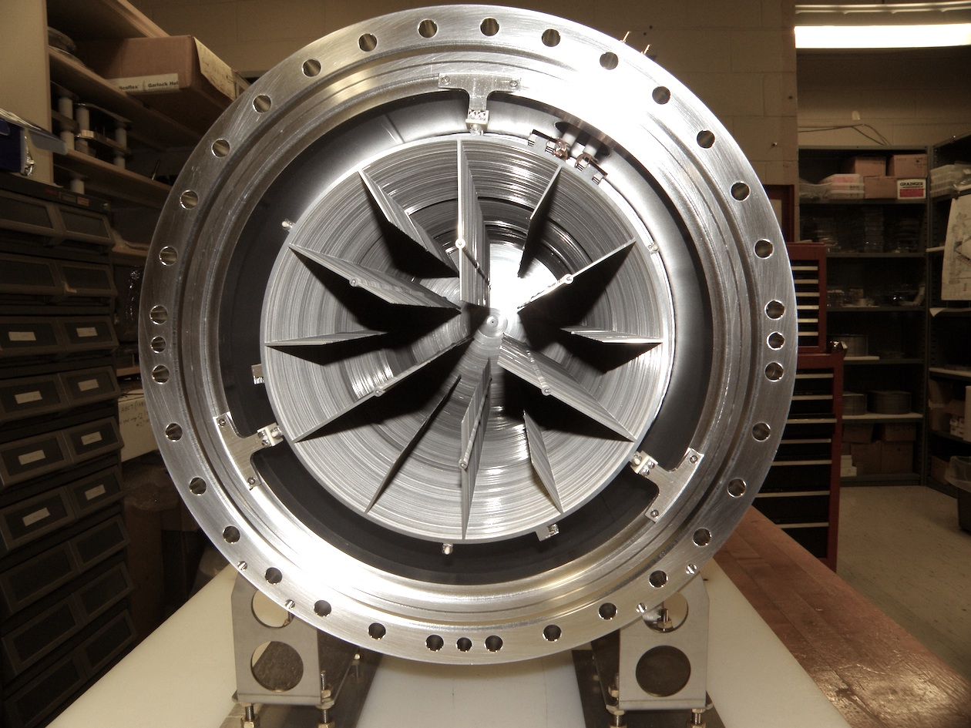
Gas Catcher
OVER 20,000 PARTS!

Slide 27
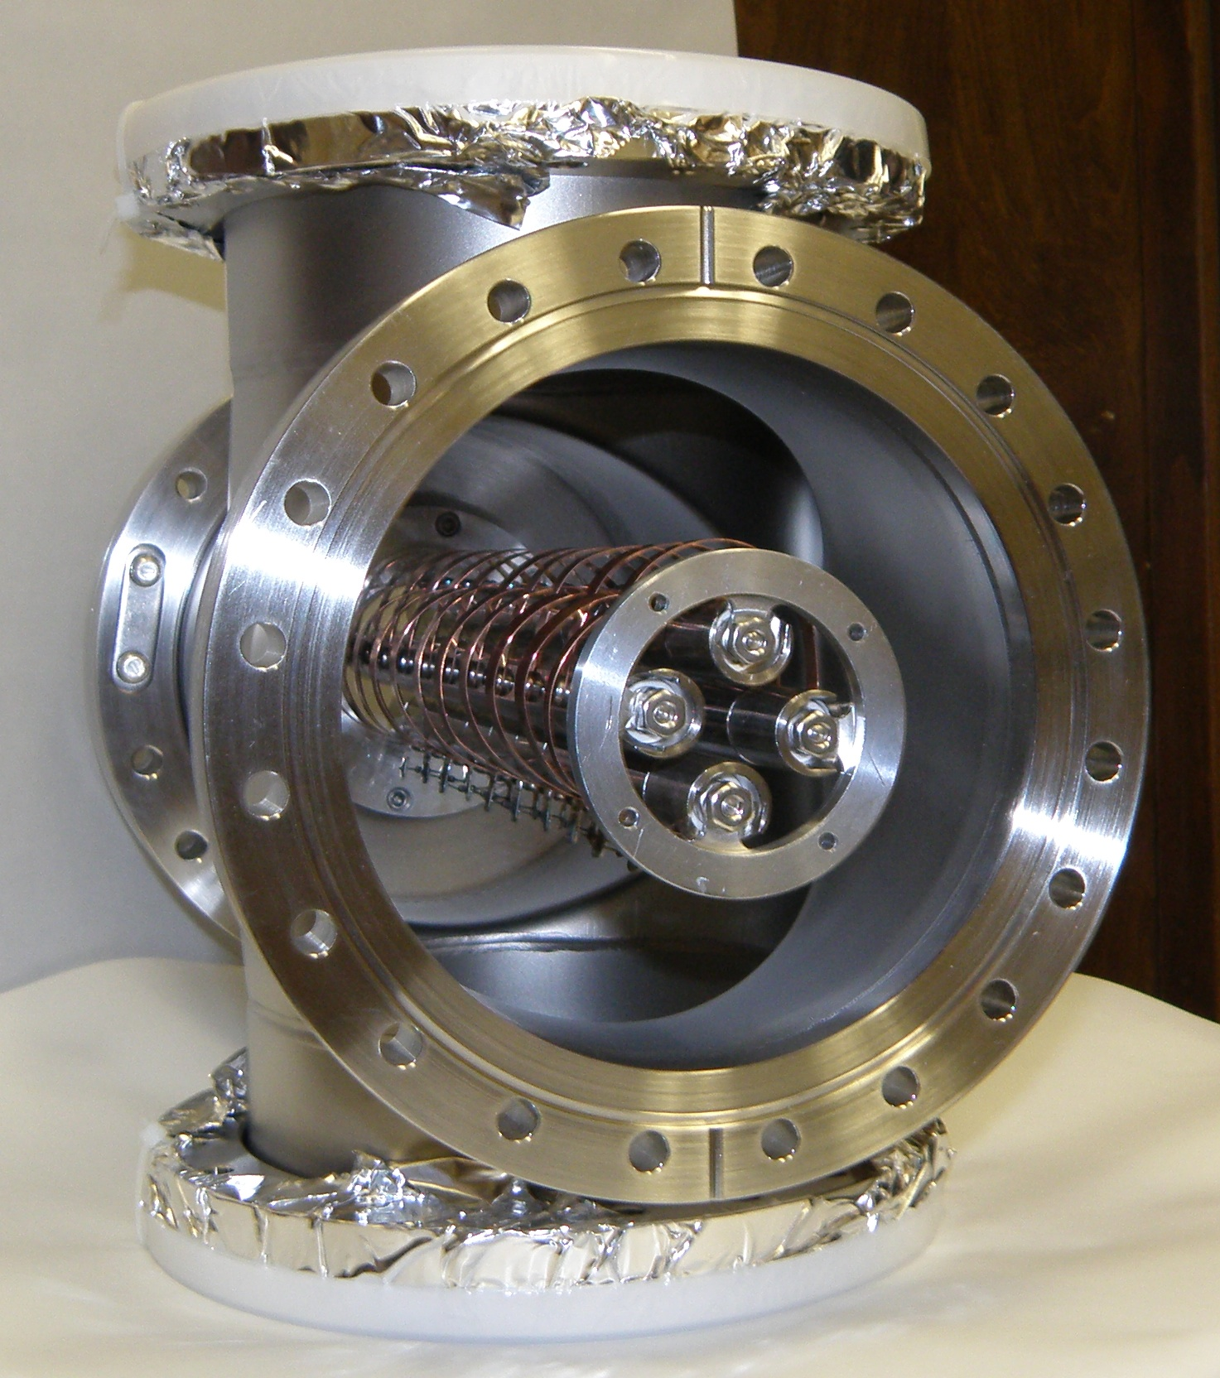
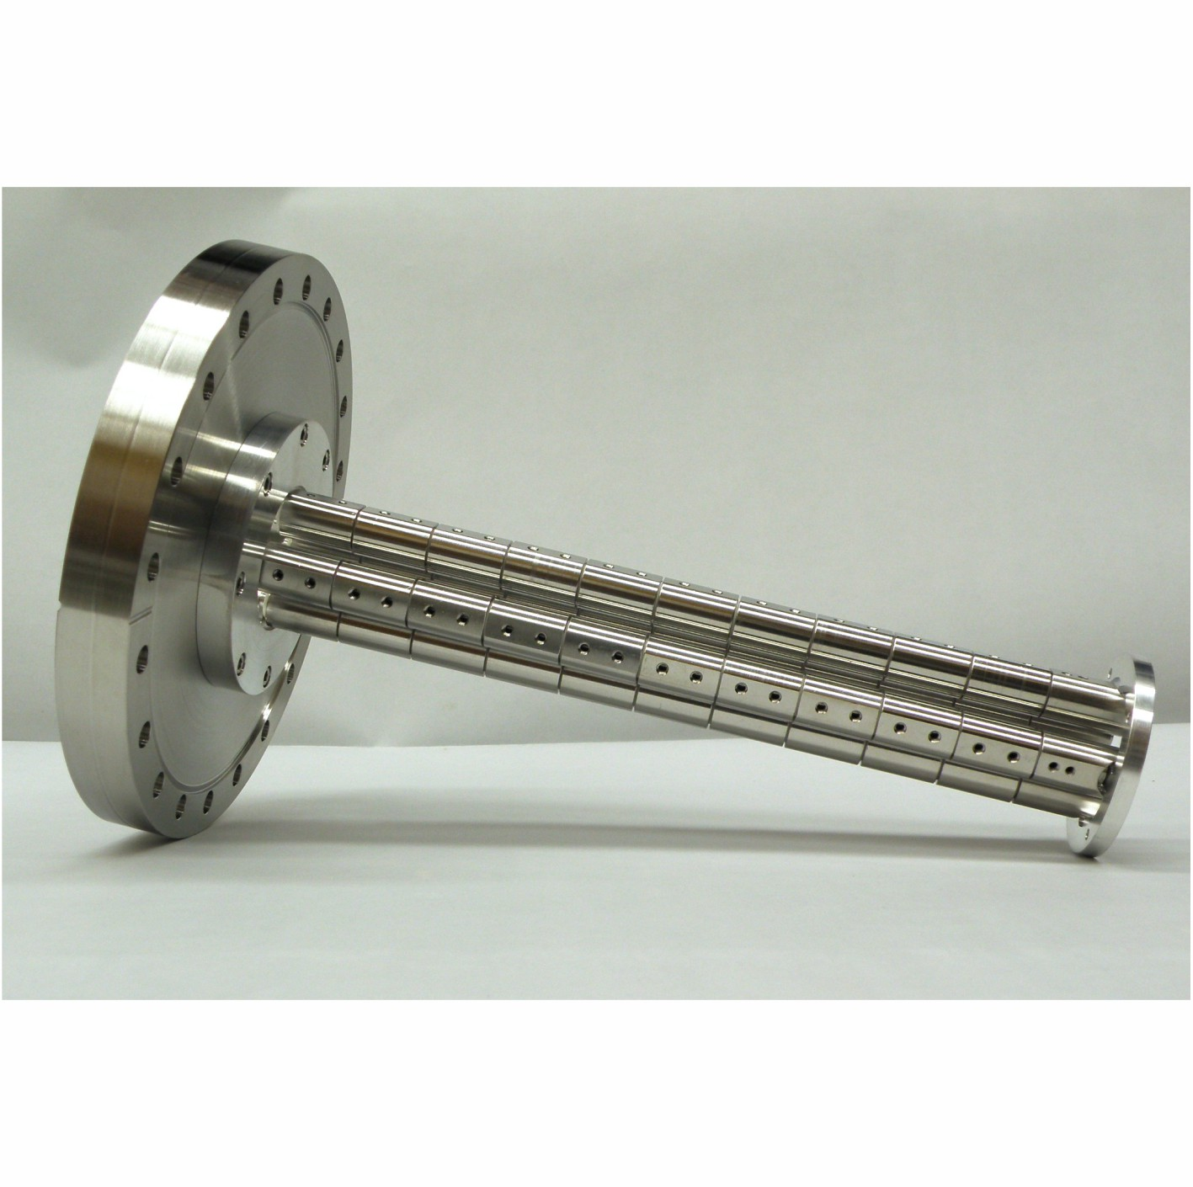
Extraction RFQ
Radial cooling with drag voltage ( 30 cm long)

Slide 28
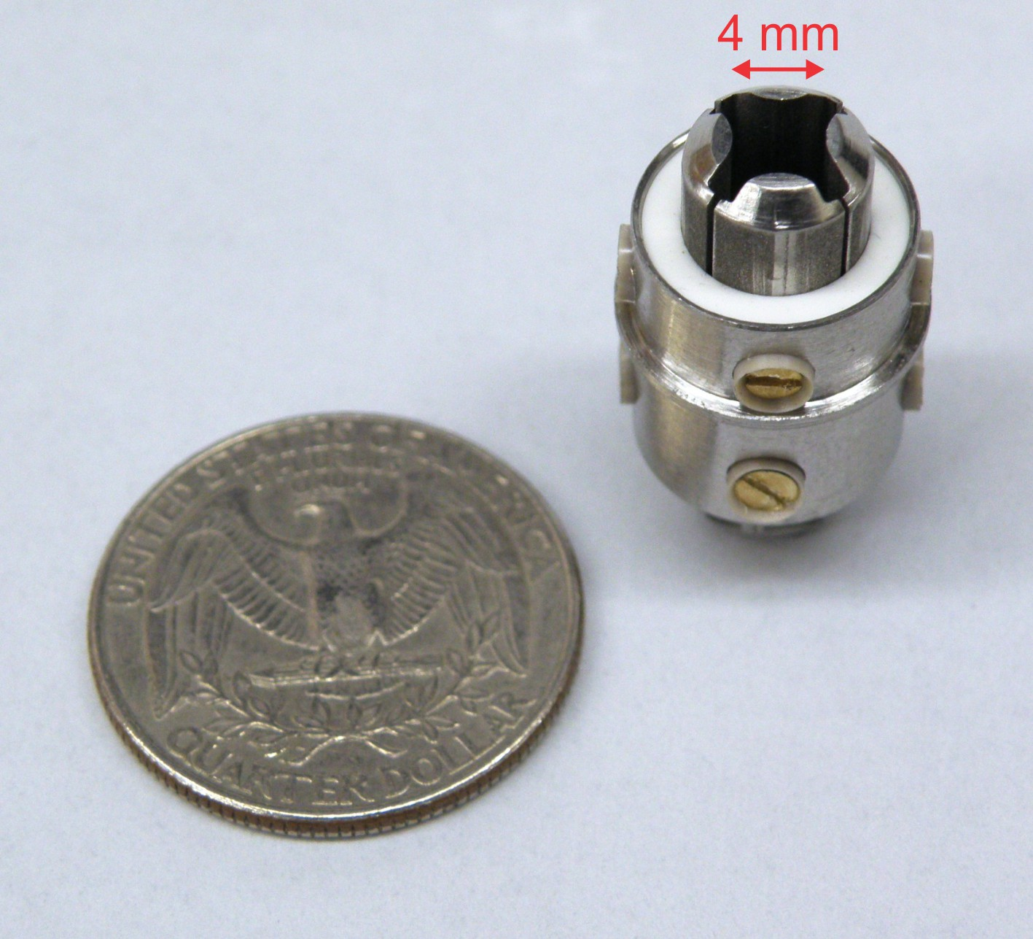
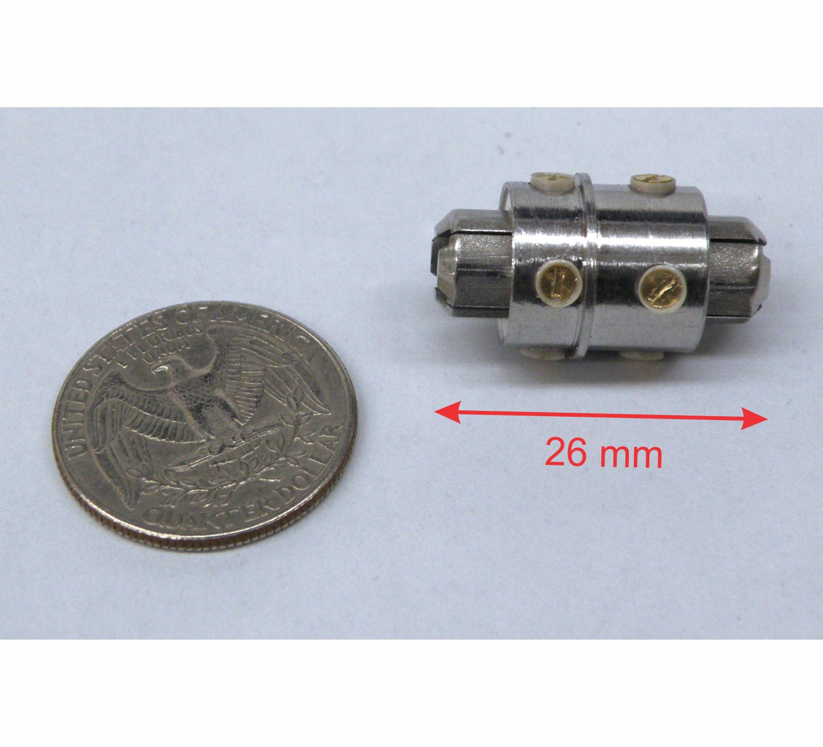
Micro RFQ

Slide 29
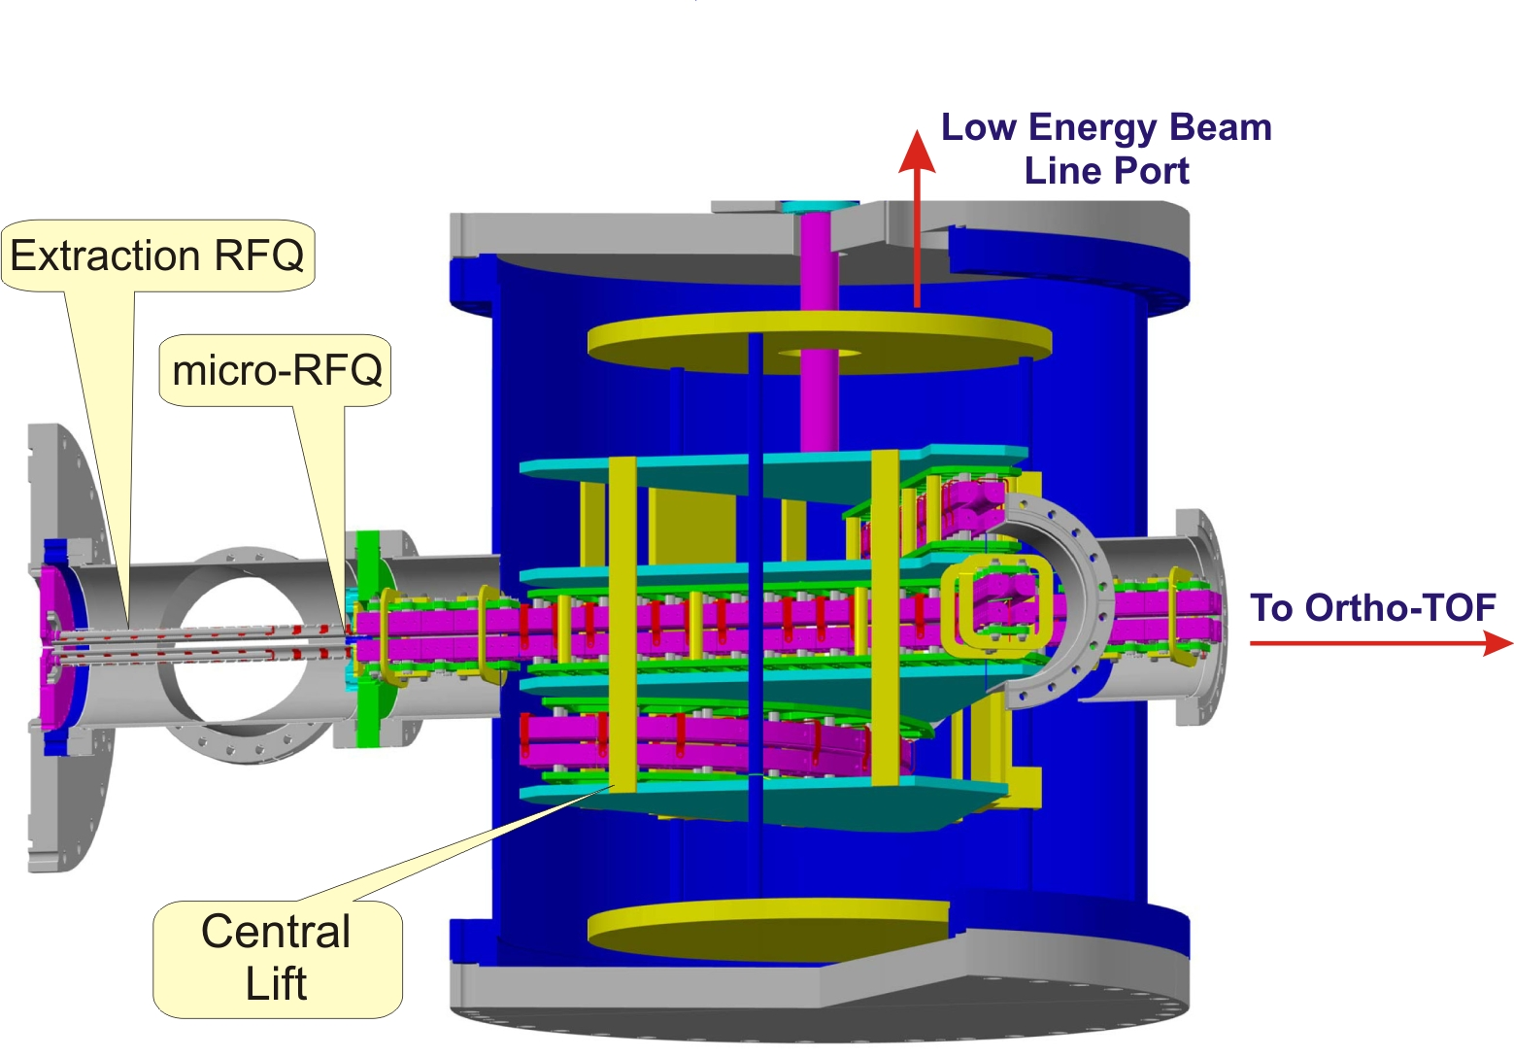
Multi RFQ

Slide 30
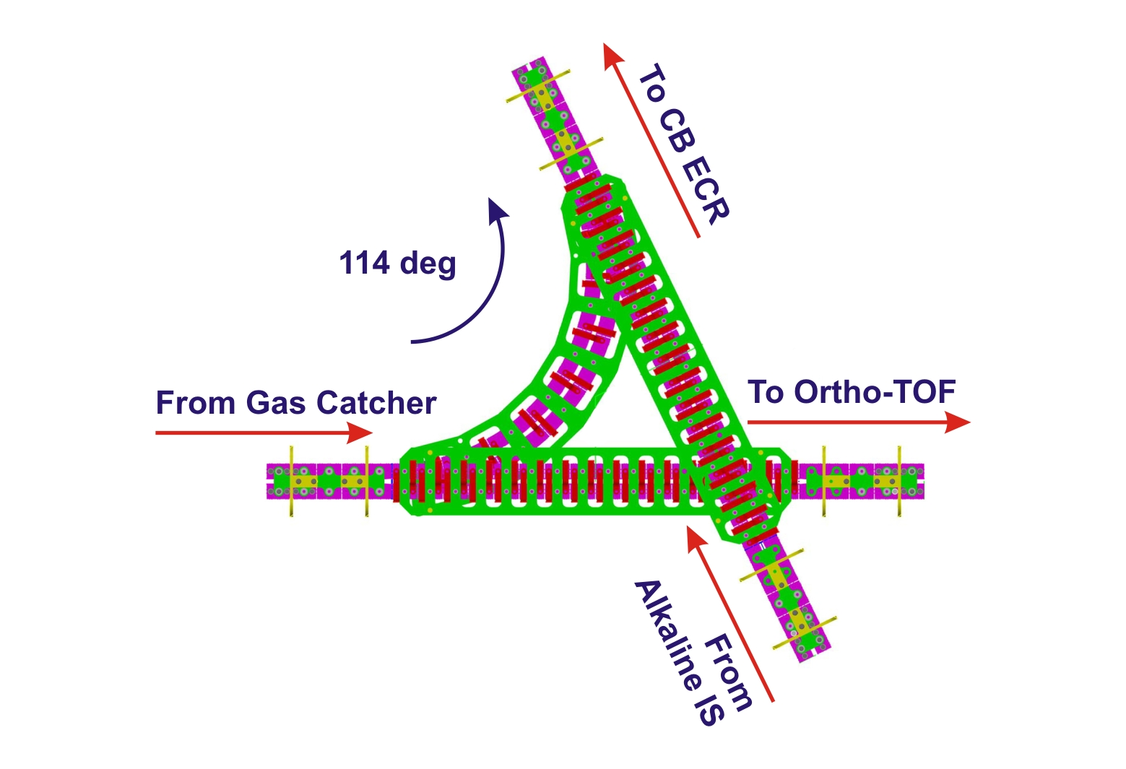
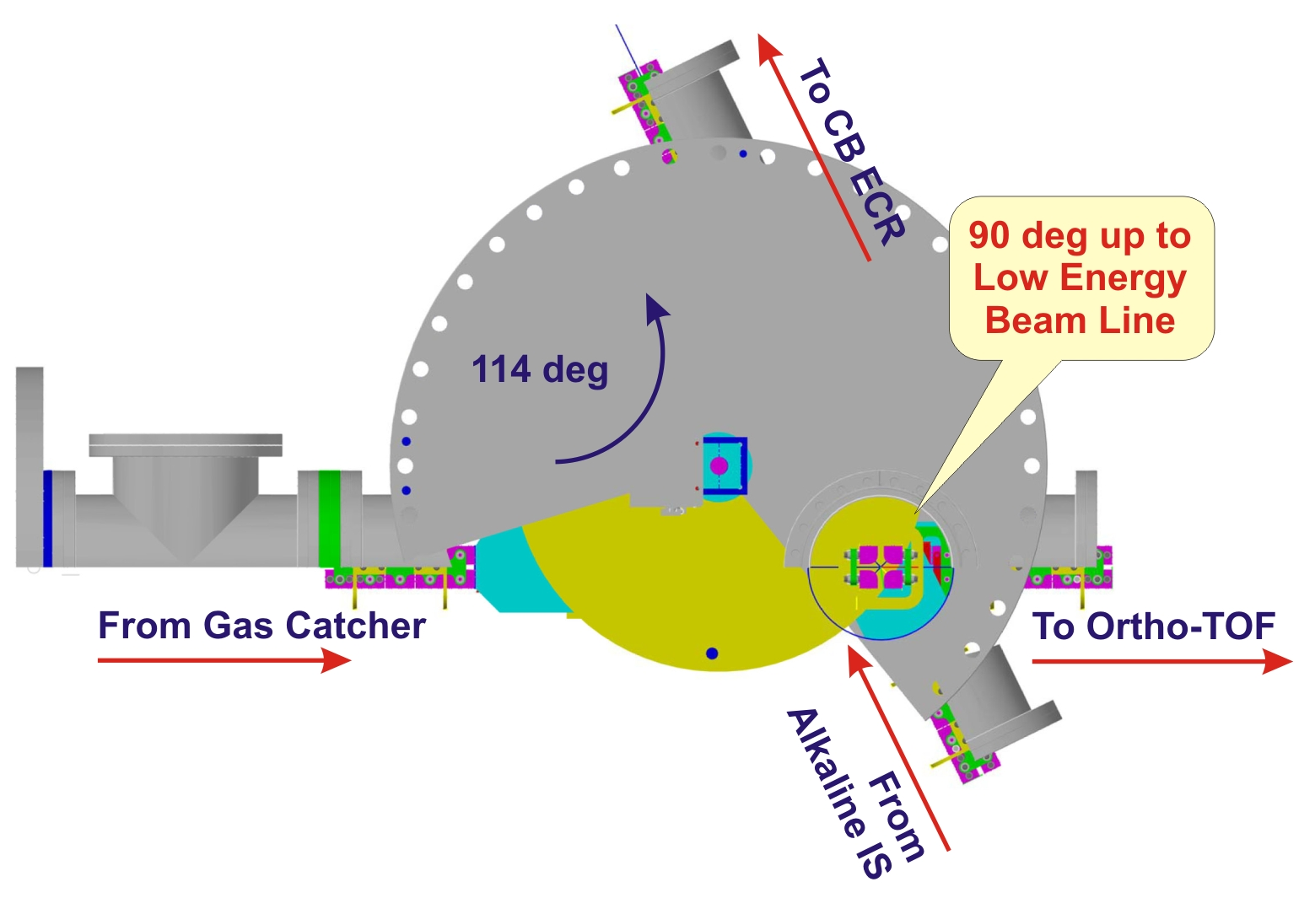
Multi RFQ
Beam Branching

Slide 31
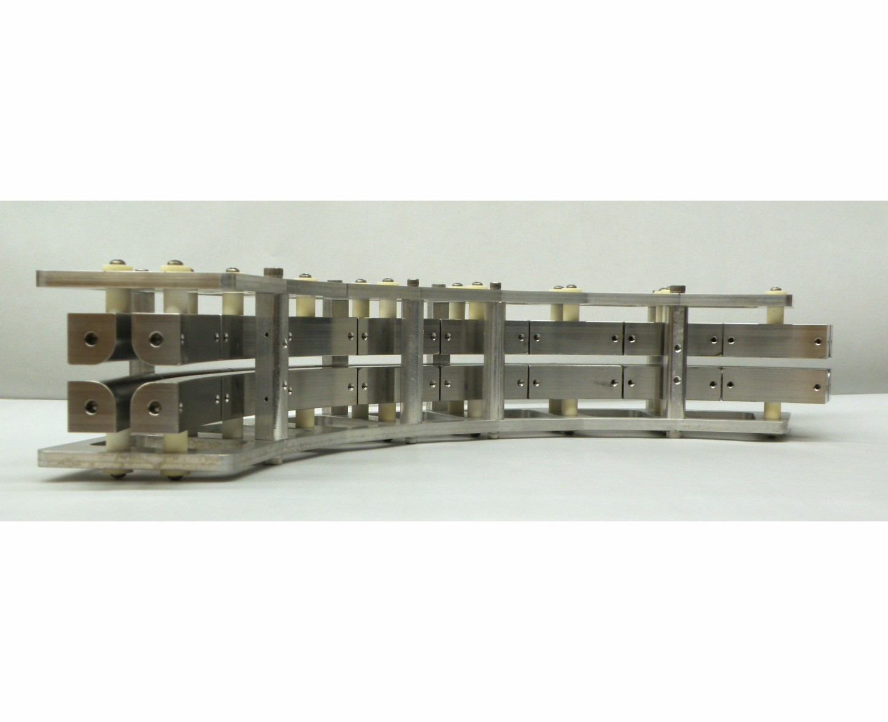
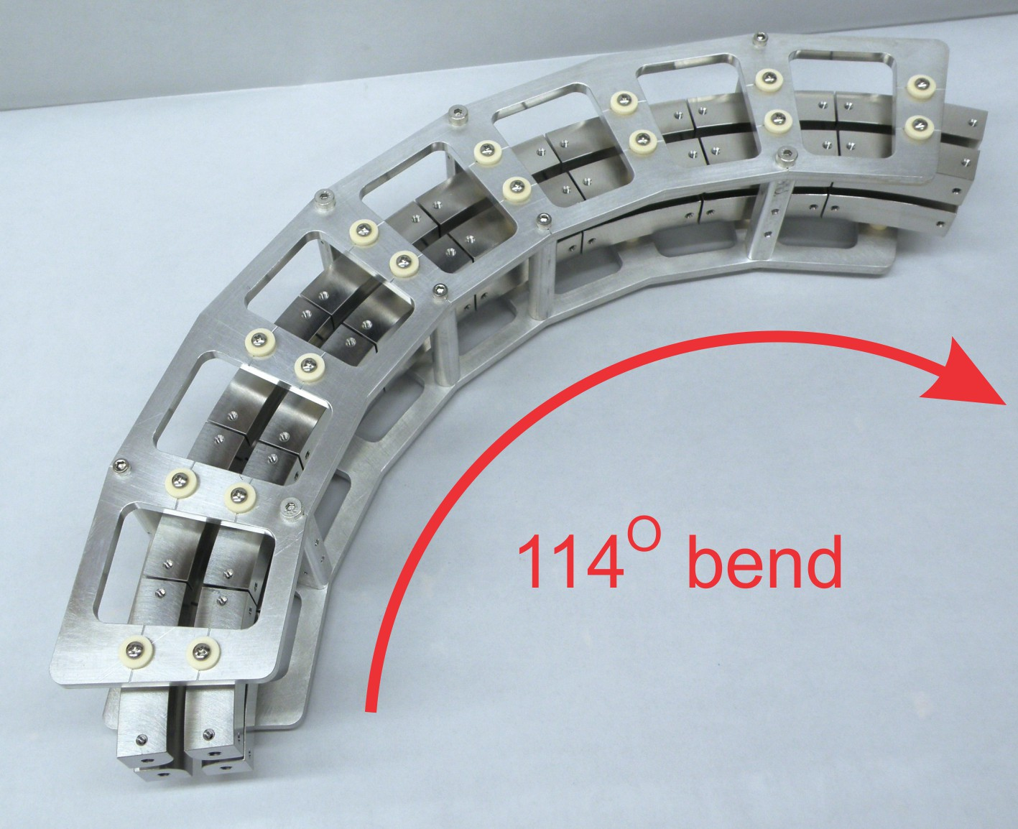
Multi RFQ
Central 114 degree bending section

Slide 32
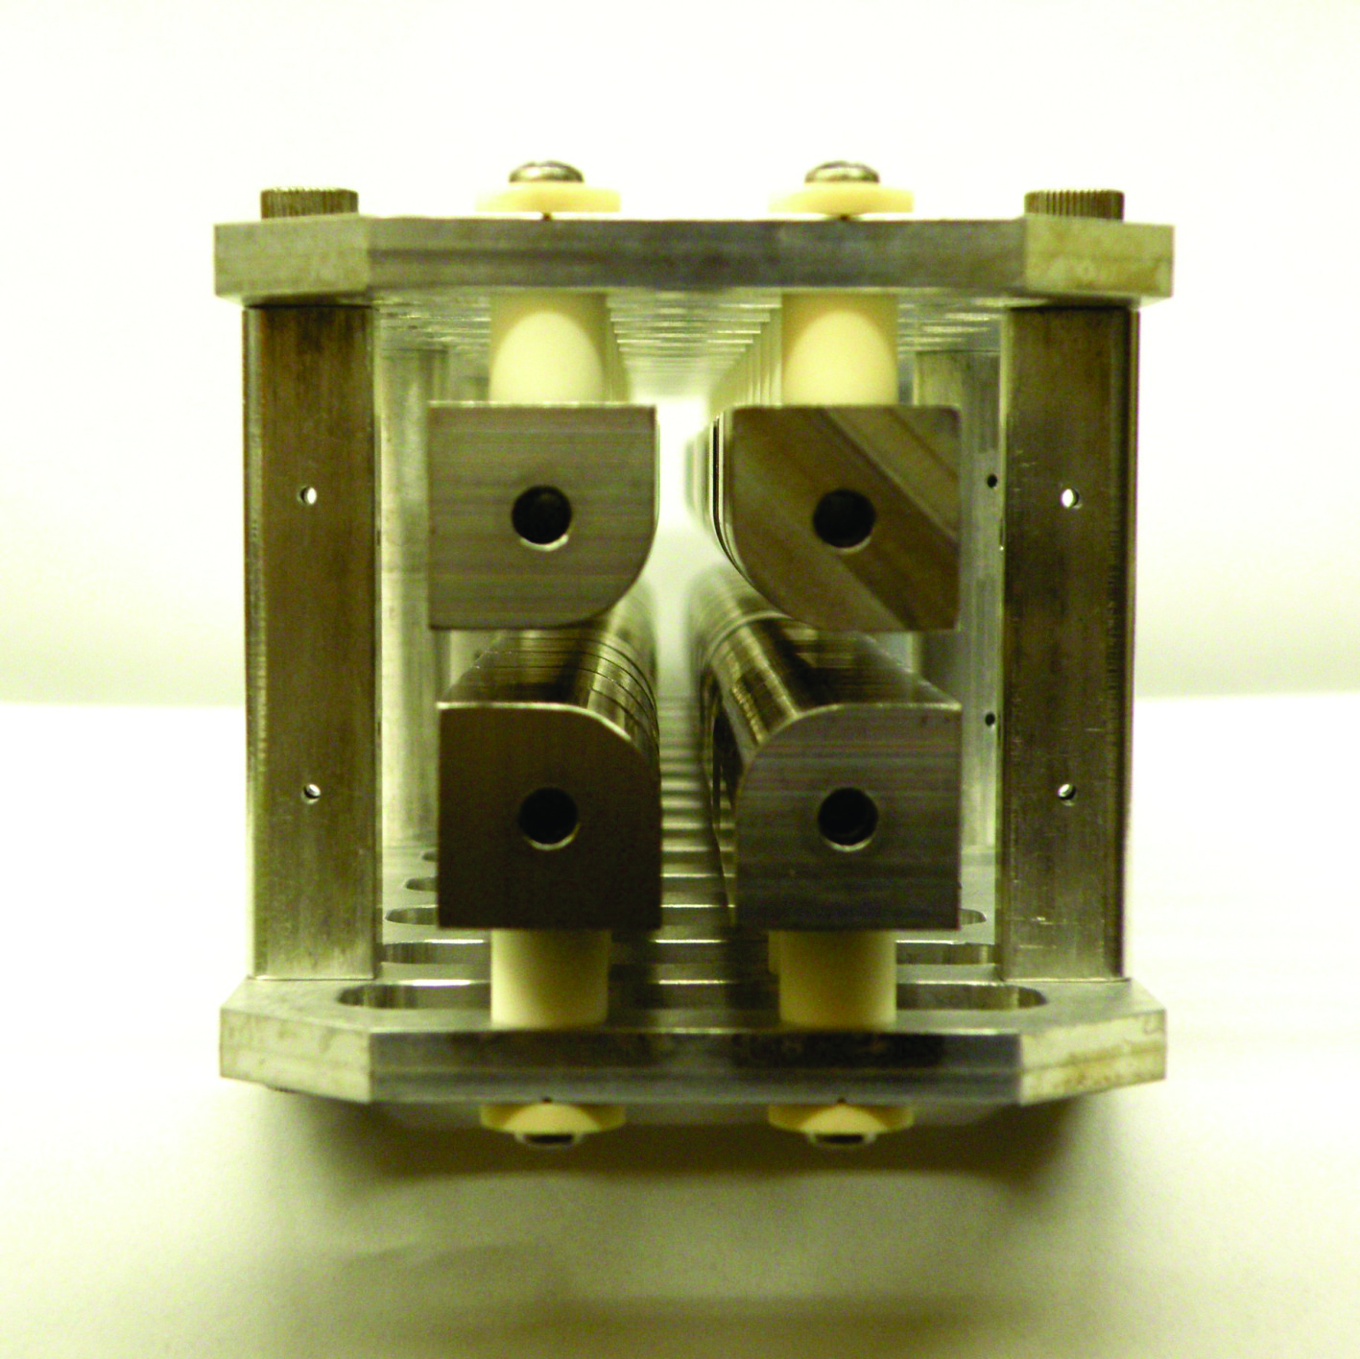
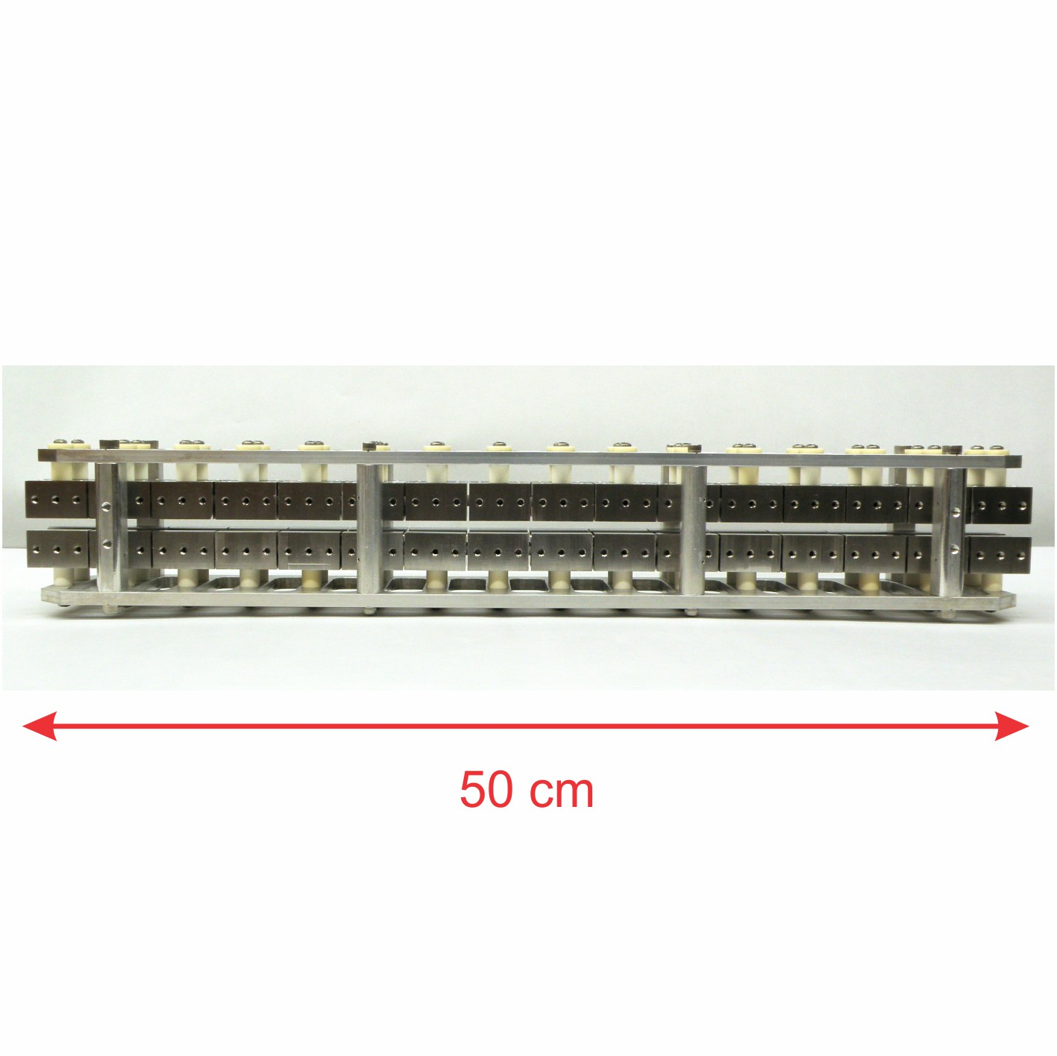
Multi RFQ
Straight central section

Slide 33
Example of RIB
³⁸S from ⁴⁰Ar (15MeV/A) + ⁶⁴Ni
⁴⁶Ar from ⁴⁸Ca (15MeV/A) + ⁶⁴Ni
Target ⁶⁴Ni
(20mg/cm2)
Axial Blocker
2º-6º
Energy Degrader
Al 40 mg/cm²
³⁸S, ⁴⁶Ar Energy
~2.0 MeV/A
(0.0-5.0 MeV/A)
Diameter 25 cm
100 cm Length
~ 25 mbar He
BIGSOL
ANL Gas-Catcher
K150 Beam:
⁴⁰Ar, ⁴⁸Ca (15MeV/A)
Range in the Gas-Cell (SRIM-2003)
³⁸S, ⁴⁶Ar @ 2.0 MeV/A : 35.0, 40.0 cm
@ 5.0 MeV/A : 100.0 cm

Slide 34
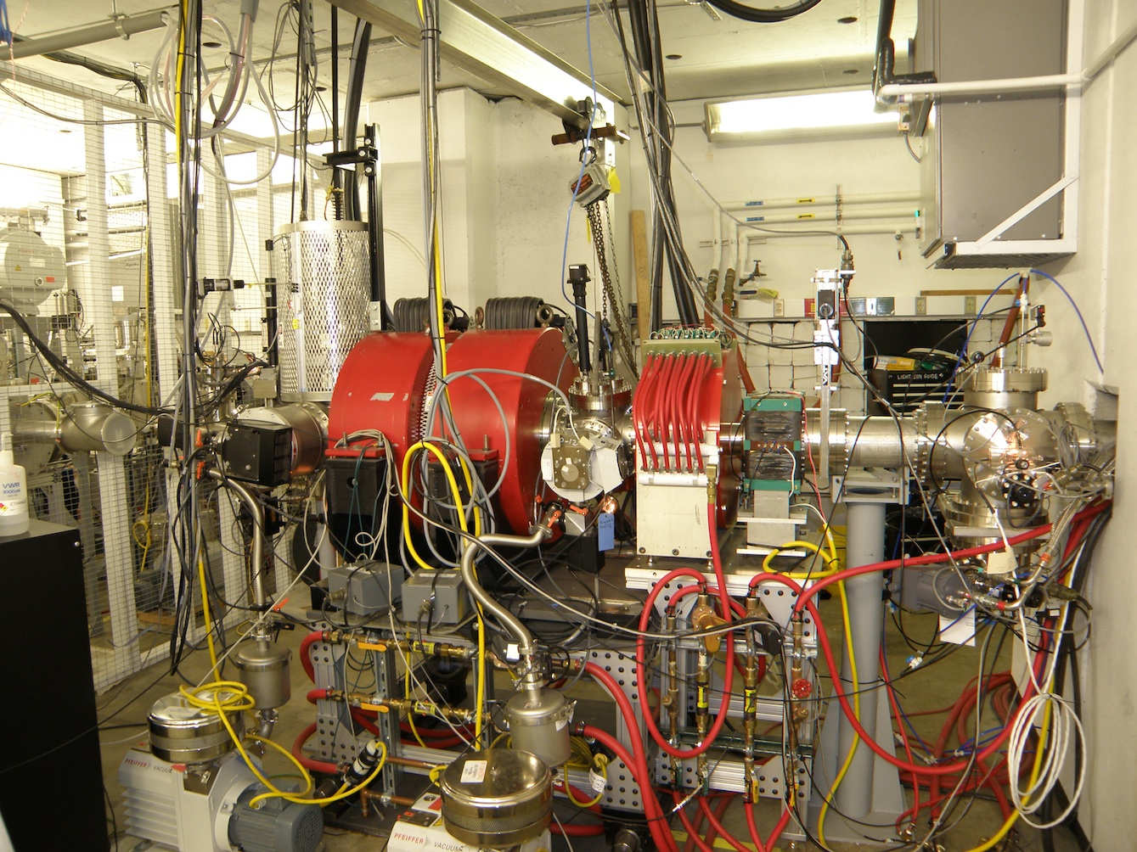
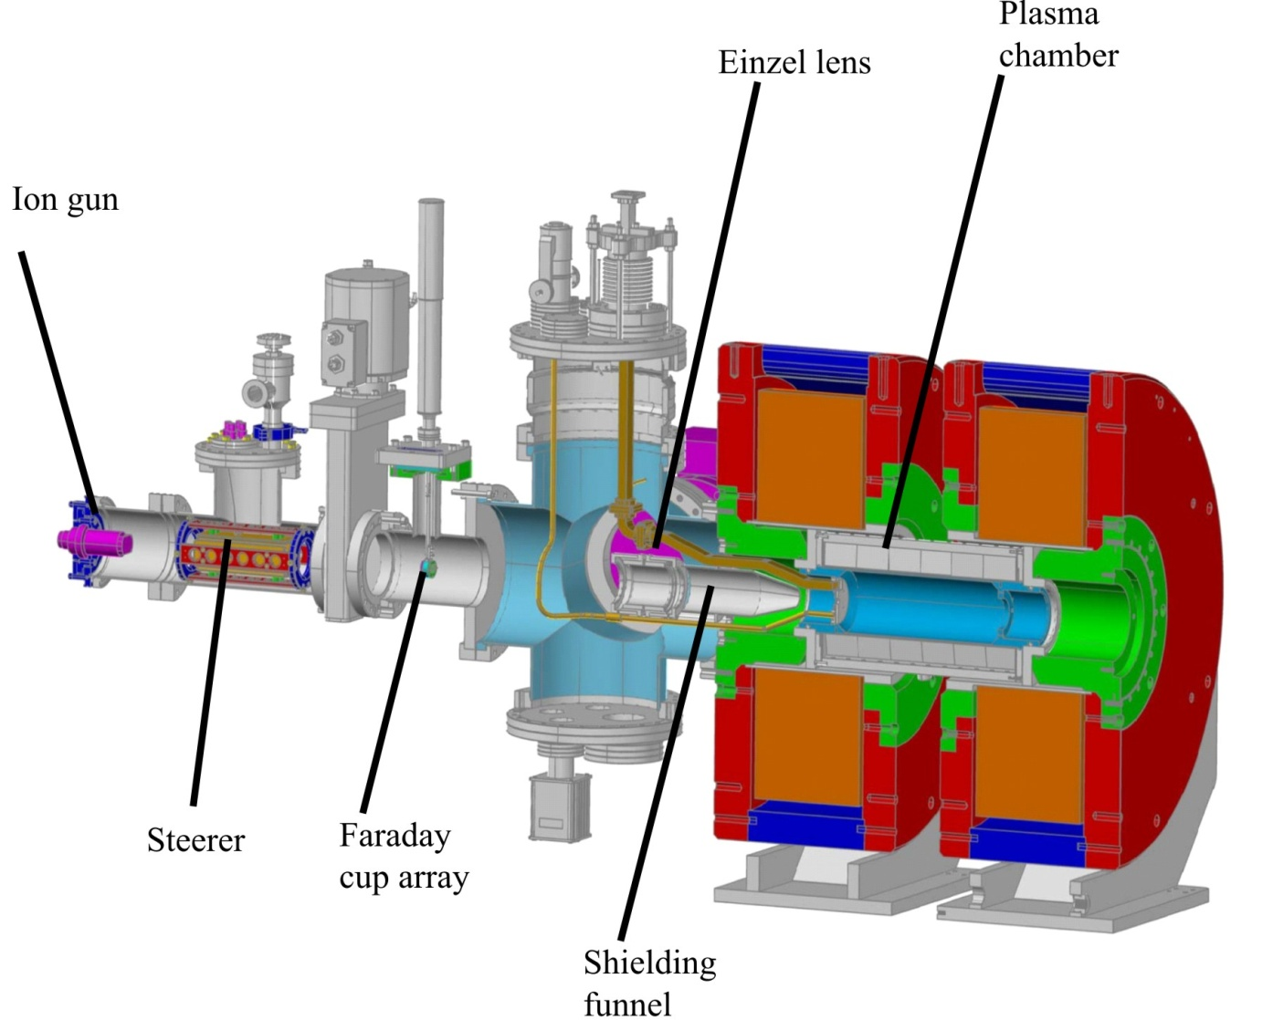
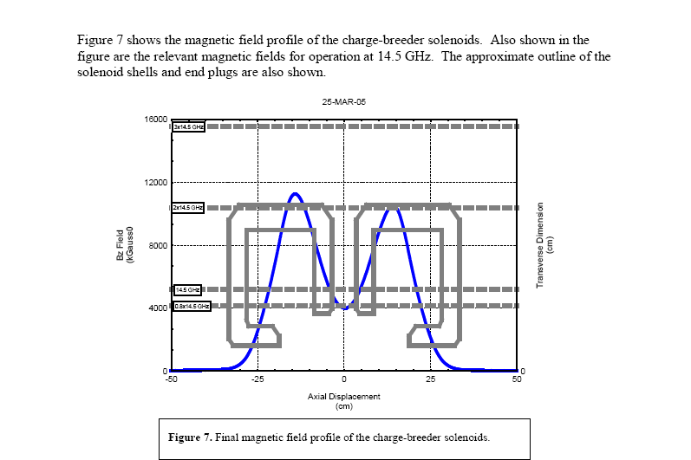
Charge Breeder ECR – First Results
14.5 GHz, closed hexapole ECRIS with multi-frequency capability

Slide 35
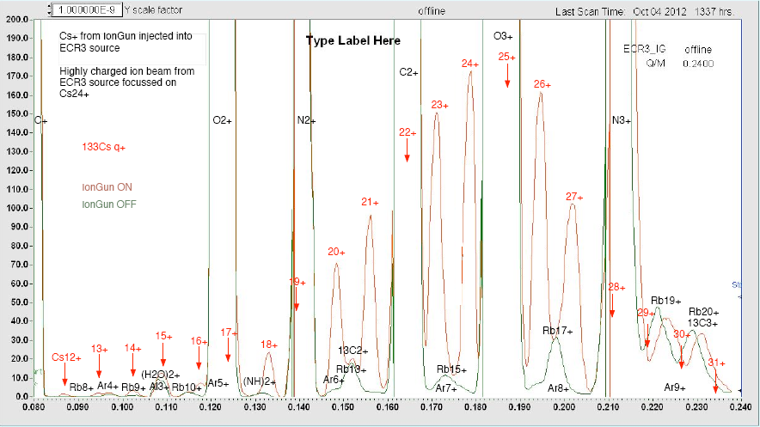
Charge Breeder ECR – First Results
Cesium Ions
Breeding efficiency for selected charge ~ 2 – 12 %
Injection and acceleration efficiency ~ 10%
Q/M

Slide 36
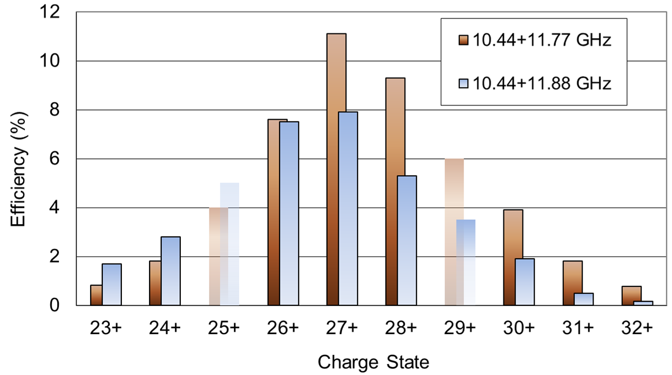
Rudimentary Comparisons
TAMU
ANL

Slide 37
Beam Optics
All beam optics (magnetic and electrostatic)
was build in house:
Dipole magnets – 6
Quadrupoles – 20
Magnetic X-Y Steerers – 22
Solenoids – 6
Glaser Lenses – 2
Einzel Lenses – 7
Electrostatic X-Y Steerers – 4

Slide 38
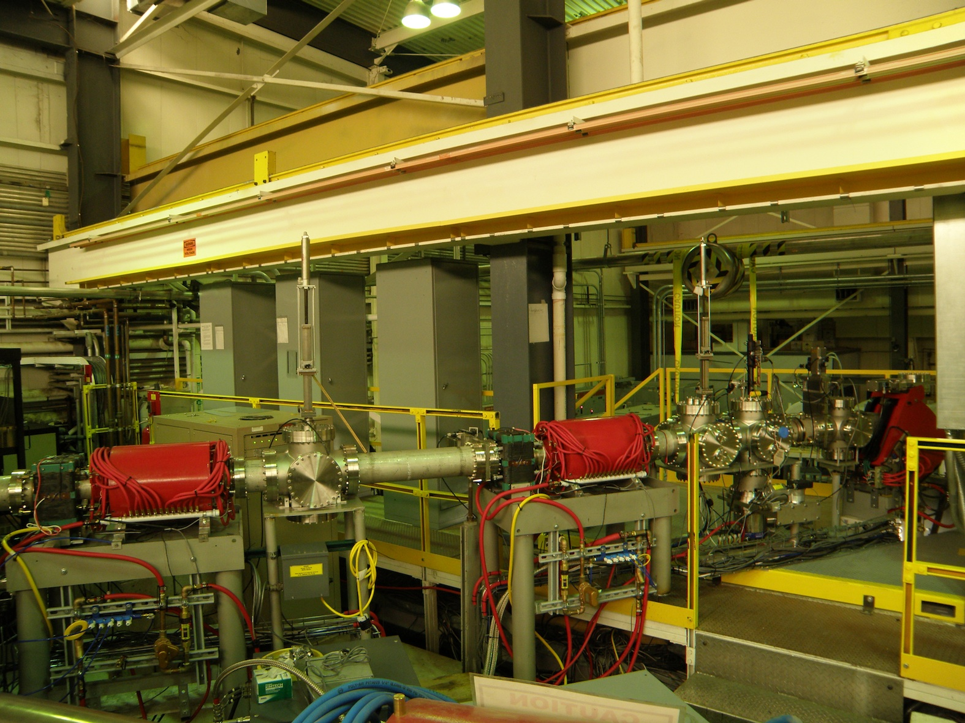

Low-energy beam line

Slide 39
TAMU TRAP
Fundamental Symmetry Tests Using Trapped Atoms and Ions
D. Melconian, M. Mehlman, P.D. Shidling,
R.S. Behling, B. Fenker

Slide 40
TAMU TRAP

Slide 41



Beta-Neutrino Correlations for search of possible scalar currents in T = 2 superallowed β-delayed proton decays
Measurements of correlation parameters place constraints on physics beyond SM
  a_{βν} limits presence of scalar currents in β-decay (not currently included in the SM)
a_{βν} related to distribution of angles between β, ν in β-decay:
T=2, 0⁺→0⁺ β-delayed proton decays
  Can extract a_{βν} from proton energy distribution
  ³²Ar already studied
  Other nuclides in series
ν
θ_{βν}
Daughter
β
-versus-
ν
β
Daughter
Notes:
Top can be used to test the SM
Why 32Ar: Well, Dan has already looked closely at this decay to measure the (proton branching ratio-> ft value) (corrected ft value can be used to test unitarity of CKM etc.)
Also, Adelberger has already done this measurement, but we think our technique will be much better
Beta and Neutrino go in same direction if abnu =1 and in the limit that it is completely relativistic. Otherwise still a distribution
a_{βν} = .9989 ± 0.0052 (stat) ± 0.0039 (syst) [2] (But .5502(60) for 37K decay)
So a_{βν} ≈ 1 means beta and neutrino likely go off together
And a_{βν} ≈ -1 means beta and neutrino likely go off back to back
And a_{βν} = 0 means beta and neutrino have no inherent preference
(scalar, vector, axial vector)
A~ is closely related to abnu. Something like Abnu/(1+b*gamma/E) but b is probably 0 (in absence of scalar current a~ = abnu)
Vector -> Fermi (beta and neutrino spins cancel)
Axial -> Gamov Teller (beta and neutrino spins add)
0+->0+ has no axial component because no nuclear spin involved (0 spin to 0 spin) which means Mgt = 0 so the axial and tensor currents don’t matter for these decays
So we care about the vector and scalar currents cs and cv
Standard model predicts cs=0 (no scalar currents) so Abnu = 1
We can look for the existence of scalar currents (problem with SM) by looking for abnu not equal 1
T=2 Refers to: Total isospin. Protons have +1/2, neutrons have -1/2. So 32Ar has (18*1/2)+(14*-1/2) = 2
0 -> 0 Refers to: Nuclear spin. Protons and neutrons pair up (with themselves) so if there are an even number of both there is 0 nuclear spin. So 32Ar has 18 protons and 14 neutrons and 0 spin. 0 -> 0 means no axial currents in this particular decay (Mgt=0) which means there is likely only vector currents which is a “PURE FERMI DECAY”
+ -> + Refers to: Parity. The odd nucleons contribute parity since a closed shell has positive parity (Parity is given by (-1)^L). Need to consider the parity of neutrons and protons individually… for 32Ar neutrons have 4 extra in d = positive parity and protons have 8 extra = in s and d (but s is full) so positive parity?
We will measure the proton energy and extract a_{βν} from the shape of the distribution
Using silicon detectors to be placed at endcaps of the penning trap
Trap depth is very shallow compared to energy of decay products
However, magnetic field and bore are sufficient to fully contain (radially) all decay products for the decays we are interested in, so that they will all reach the detectors
Ions have negligible initial energy, i.e. decays occur from rest (otherwise distribution would be smeared)

Slide 42


Open-Geometry Cylindrical Penning Trap System for β – ν Correlations
2 cylindrical traps within same Agilent 7T, 210 mm bore magnet:
Purification trap based of ISOLTRAP
A flexible measurement trap needs to be a new design:
  Large bore to contain decay products in β-ν correlation measurements
  Still suitable for precision mass measurements (harmonic, “tunable” , “orthogonalized”)
Proton of 4.28 MeV ≤ 42.7mm radius
Beta of 10 MeV ≤ ~5mm radius
Notes:
Nearly all previous trap designs use the SHIPTRAP/ISOLTRAP geometry

Slide 43



Measurement Trap
l/r₀=3.72
Expansion coefficients are compared for the
Optimized TAMUTRAP trap when tuned
Calculated tuning (C₄=0) condition: V_{c}/V_{o} = -0.371
Maximum machining precision ~0.03mm
SIMION Precision limited to ~3x10⁻³
Paper Submitted to NIM A http://arxiv.org/abs/1210.8434
Notes:
Say odd terms should be 0 by symmetry
Fields from SIMION
2 = HARMONIC TERM

Slide 44

TAMUTRAP Beam Line
5 Gauss
Agilent 7T
210mm ASR

Slide 45


RFQ Cooler/Buncher
Up to 187V AC
RF at 20W
0.7MHz frequency
Acceptance
up to 100u +
10⁻²-10⁻⁴mbar He
2-10 ms cooling time
28 Segments
0-8V DC drag
ΔE_{f} ≈ 5 eV
Δt_{f} ≈1.2μs
Notes:
Highlight how it works a little bit.
Temperature of gas = room temperature (293 ish Kelvin)
Energy of ions once thermalized = 0.04 eV according to E=3/2*kT
Frequency up to a few MHz (ask Praveen)
Gas pressure 10^-2 – 10^-4 mbar most likely helium at room temperature (Room temperature about .04 eV according to E=3/2*kT)
Based off a design used originally at ANL, since then here, but completely redone for our purposes (most importantly, larger)
Cooling time: 2-10ms
DeltaE: 5eV
DeltaT: 1.2 us

Slide 46

Work in Progress

Slide 47

Beam Diagnostics

Slide 48
Beam Diagnostics
Low Energy Beams (before K500)
Initial beam (after BIGSOL) diagnostics – XY PPAC
Mass analyses system after Gas Catcher – Ortho-TOF
Position sensitive MCP detector for UHV conditions for time-of-flight measurements
Ge γ-ray detector systems
High Energy Beams (after K500)
Position sensitive proportional counter
Si dE-E detectors and scintillators

Slide 49

Diagnostic Stations

Slide 50

Diagnostic Stations
γ

Slide 51




Position Sensitive Parallel-Grid Avalanche Counter
20cm x 20cm, δX, δY ~ 1mm and δT ~ 300ps

Slide 52

Mass Yields Due to Collision Induces Dissociation
Early spectrum obtained before extensive cleaning of the gas cell – many molecular ions !
Diagonal line –
Mass 1 = Mass 2
Off-diagonal –
Mass 1 > Mass 2
Generally lose a H₂O
D.J. Morrissey MSU NSCL 2006

Slide 53



Ortho-TOF Mass Spectrometer
Mass Resolving Power: 10⁴
Mass Measurement Accuracy: < 1·10⁻⁶
Overall Efficiency (Cooling, Bunching, Mass Analysis, Detection): ~ 1.. 3 %
Mass Measurement Cycle Duration: < 1 ms
W. Plaß et. al, Univ. Gießen

Slide 54



Position Sensitive MCP Detector δX, δY ~ 2mm and δT ~ 200ps

Slide 55


Position Sensitive MCP Detector
For UHV

Slide 56



Position Sensitive Proportional Counter
For rates up to 10⁶ part/sec cm²

Slide 57
Funding for Upgrade
Funding Sources (mostly capital)
  Department of Energy – $1.8 M
  Texas A&M University – $0.75 M
  CI (SEE Line sales + redirect) – $2.483 M
  Welch Foundation – $1.0 M
  Total: $6.033 M

Slide 58




T-REX Project Team
F. Abegglen, G. Chubarian, H. Clark, G. Derrig, G. Kim, D. May, G. Souliotis,
G. Tabacaru, R.E. Tribble
J. Arje (JYFL), G. Savard (ANL)
This project was carried out with strong support of our friends from:
ANL, USA
FLNR Dubna, Russia
Giessen University, Germany
GSI, Germany
LBNL, USA
JYFL, Finland
MSU NSCL, USA

