Slide 1
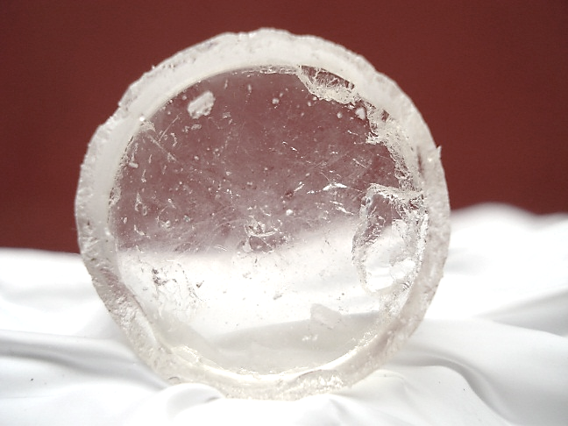
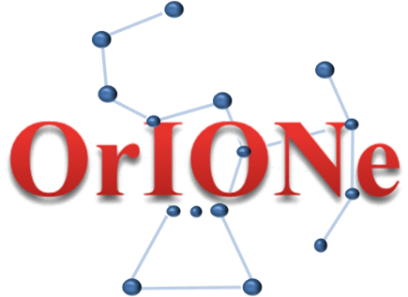

Neutron detectors: new detectors, innovative materials and new algorithms for Pulse Shape Discrimination
ORganic scIntillators fOr NEutrons
F. Gramegna
INFN
Laboratori Nazionali di Legnaro
International Workshop on Nuclear Dynamics and Thermodynamics
in Honor of Prof. Joe Natowitz
Texas A&M University, College Station, Texas, USA
August 19-22, 2013

Slide 2


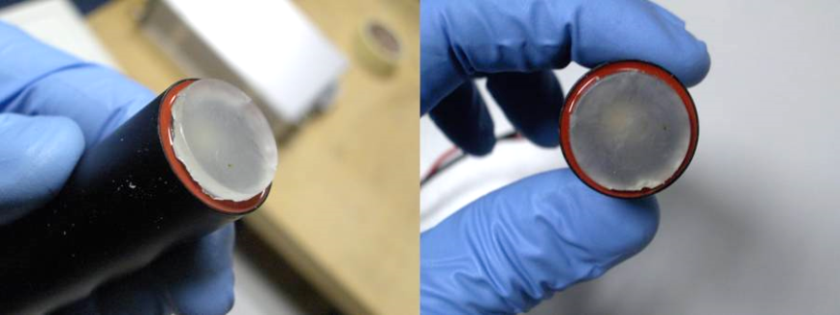
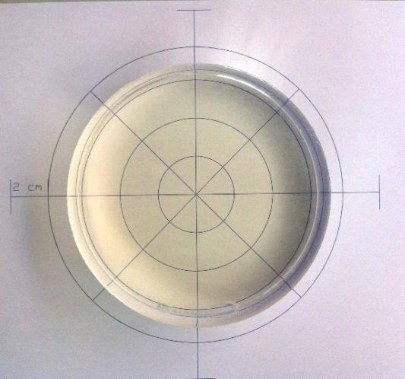
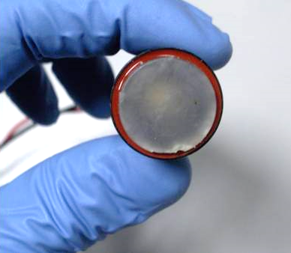
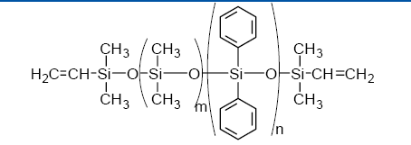
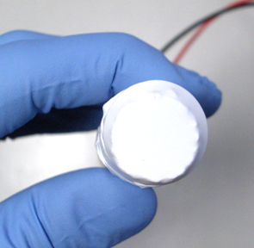
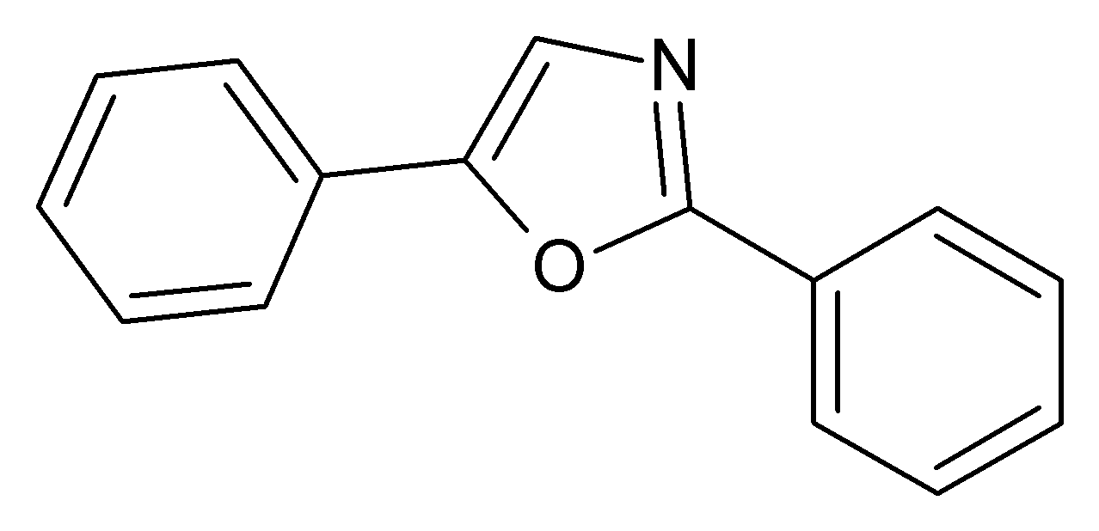
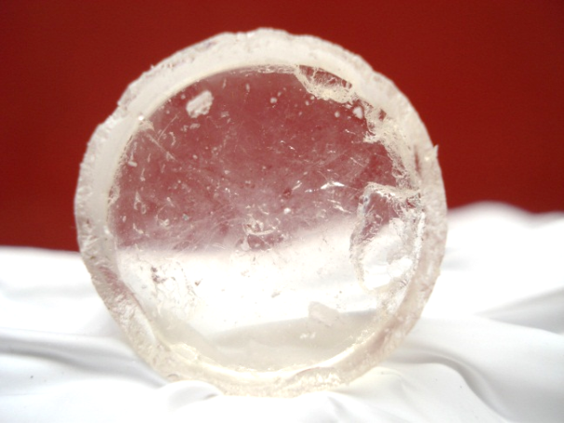
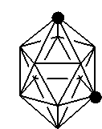
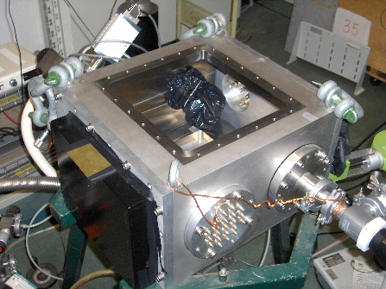
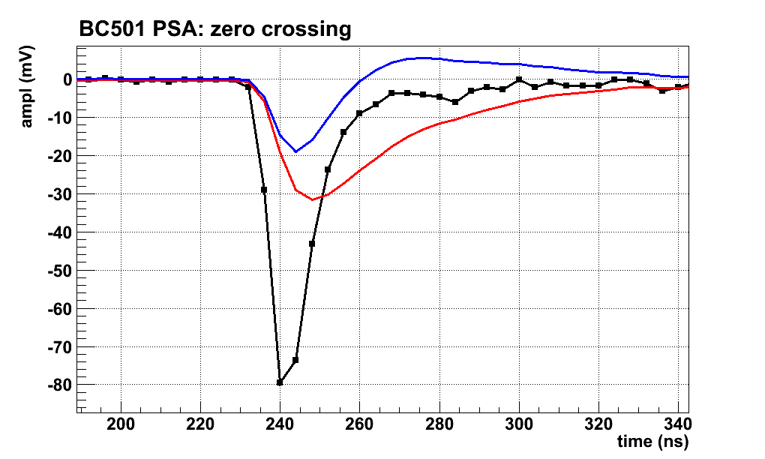
Summary
Why neutron detectors are important
Status of the art plastic and liquid scintillators advantages & drawbacks
Plastics vs Elastomers
Preparing new scintillators :
REVIEW OF FAILURES & SUCCESSES:
Selection of:
Luminescent silicone
rubber matrix
Luminescent Dye
molecules
Suitable organic compound
for B or Gd doping
Radiation hardness
Pulse Shape Discrimination

Slide 3


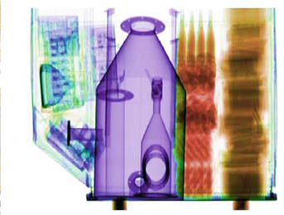

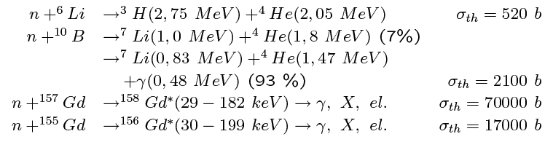

Scientific Motivation
A renewed interest in
Neutron Detectors development
has grown up again.
Applications:
Detectors in Nuclear Physics experiments
Monitors in high neutron flux environments (Nuclear Power Plants, Spallation Neutron Sources, RIB accelerators, Homeland Security …)
Detectors and Monitors for Nuclear Medicine. (BNCT, hadron therapy, …)
Material Analysis
High Energy Neutrons
(E>1 MeV)
Multiple scattering by Hydrogen and Carbon
Neutron Capture by B or Gd nuclei dissolved in the silicone rubber
Low Energy Neutrons (E<500 keV – 1 MeV)

Slide 4
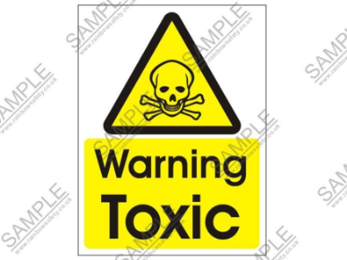
Liquids & Plastics
    STATUS of the ART
    Organic Scintillators:
    Liquid scintillators: high quantum efficiency, n-γ pulse shape discrimination, fast response (3÷4 ns)
    Toxic, corrosive, flammable, explosive, high volatility, sensitivity to Oxygen, needs of sealing, high cost...
    (es. BC501, EJ301 etc.)
    Plastic scintillators: good quantum efficiency, different shapes and volumes, low cost, fast response (2÷ 3 ns)
    Low radiation hardness, no pulse shape discrimination, sensitivity to organic solvents (crazing)
    (es. EJ212, NE102 etc.)

Slide 5
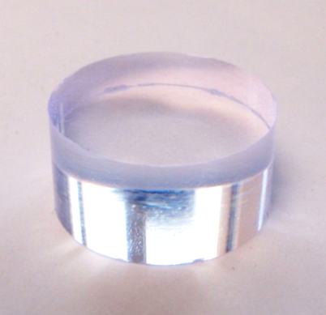
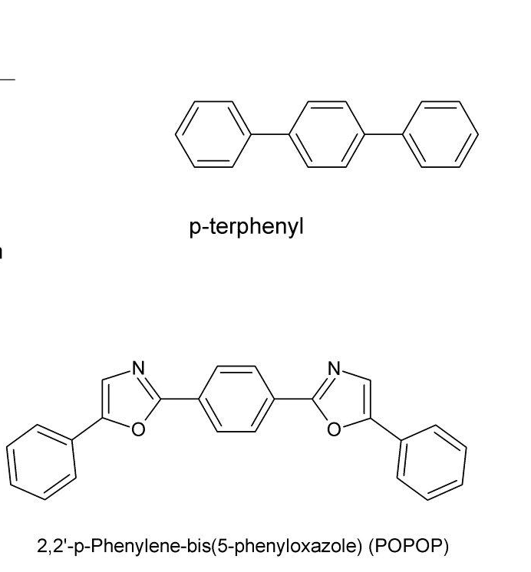
EJ-212
Commercial Plastic
Plastics
plastic base (polyvinyltoluene)
solute 1 p-terphenyl( 1-4 % wt.)
solute 2 POPOP (≤ 0.1% wt.)
Transparent (low re-absorption)
High Quantum Efficiency (10.000 photons/MeV)
Linear response to γ-radiation with energy
Fast response (low dead time)
Rigidity (not easy shaping)
Needs of optical glueing for Photo detector coupling
Undergoes radiation degrading (yellowing)
no Pulse Shape Discrimination

Slide 6


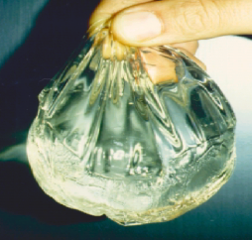
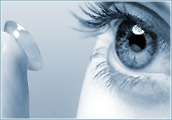
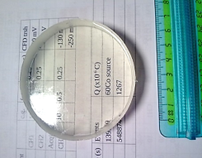
New Scintillators
  Avoid liquid scintillators → toxic, flammable and dangerous for the environment
  Overcome drawback of presently used plastic scintillators
  Production and characterization of new plastic scintillators based on silicone rubbers.
  Detection of low energy neutrons → doping with Gd and B also under study.
  Interest is focused on Polysiloxane based scintillators ( Z.W. Bell, et al. ., IEEE Trans. Nucl. Sci. 51 (2004) 1773- 1776. , Z.W. Bell et al., “Organic scintillators for neutron detection,” in X-Ray and Gamma-Ray Detectors and Applications IV, vol. 4784, Proc. SPIE, R. B. James, L. A. Franks, A. Burger, E. M. Westbrook, and R. D. Hurst, Eds., 2002, p. 150. ) : →
Eco-compatible
Constant physical properties →
wide range of temperature (-100 up to 250°C), while PS and PVT are plastic materials
with a glass transition temperature of about 90°C, hydrorepellent, permeable to O
Promising for the employment in harsh environments → they preserve their transparency even after 10 Mrad dose exposure, against the exposure limits (1-3 Mrad) of PS and PVT.
Physical properties can be tailored by varying the amount of phenyl groups in the chain → refractive index , thermal resistance , fluorescence
Provide fast response signals (2-3 ns)
Can be modeled in any solid shape.

Slide 7
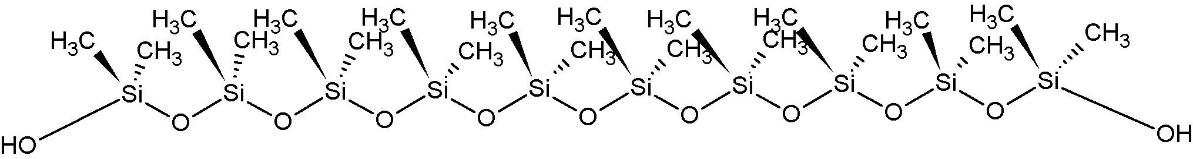
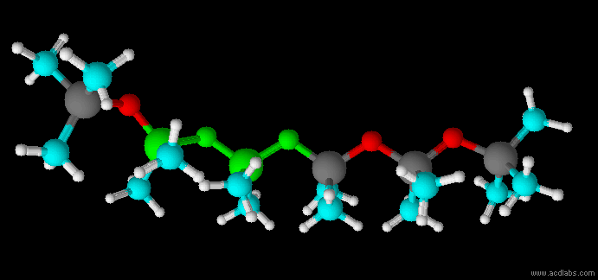
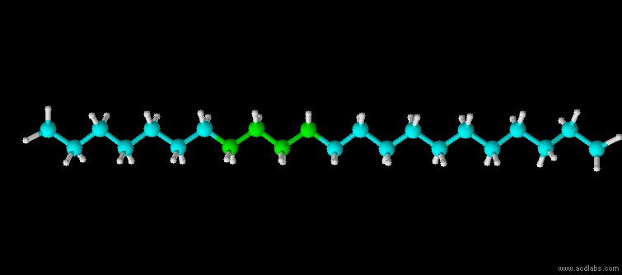
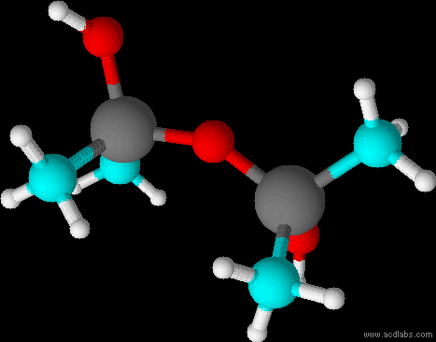
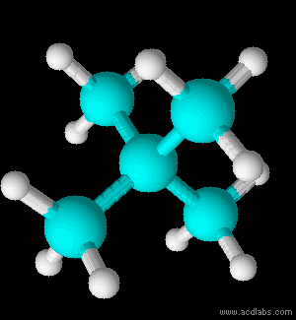
    Plastics vs Elastomers: comparing polymeric structures
    Si-O (Polysiloxane) e C-C (PVT, polyethilene)
poly-dimethyl-siloxane
Si-O
C-C
polyethylene
More radiation hard
    Energy (KJ/mol)
    452
    346
Stronger!!
    Bond Length (Å)
    1.63-1.66
    1.54
Longer!
    Angle (deg)
    130 - 150
    109.5
More Flexible!
    Torsional Barrier (KJ/mol)
    0!
    13
ELASTOMER!!!
    VARIABLE!
    FIX!
Courtesy of S. Carturan
Notes:
.

Slide 8
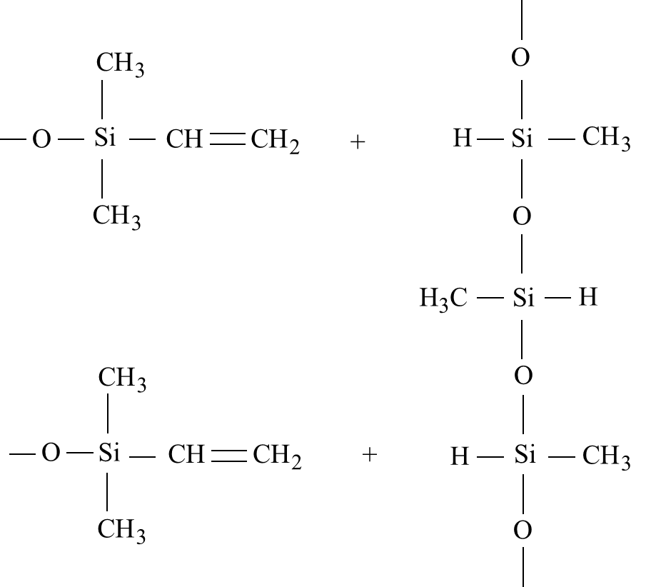
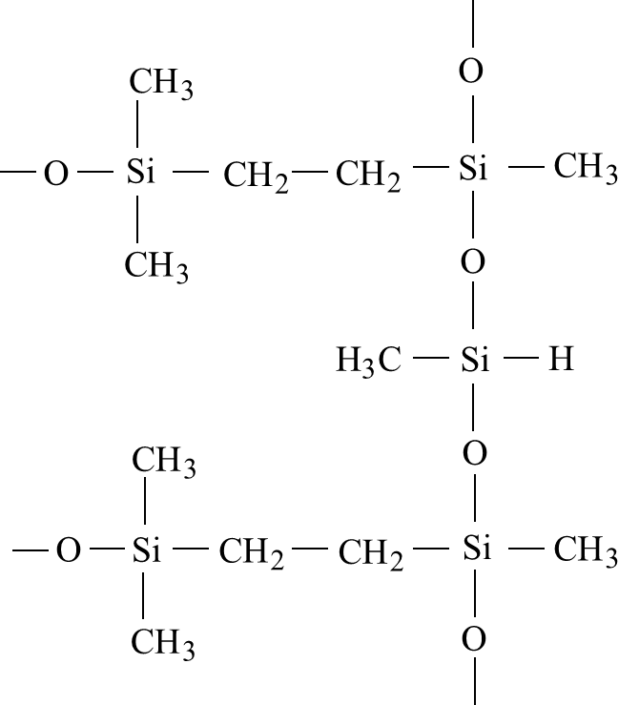
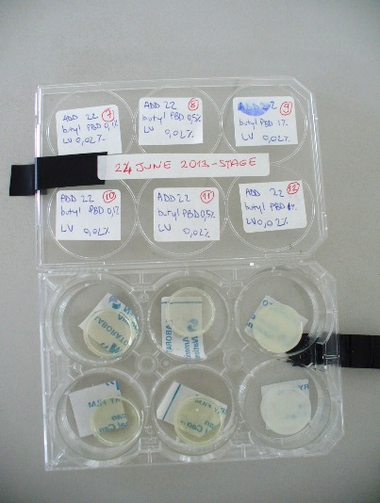


Polysiloxane based scintillators: Addition
Reactive terminal vinyl groups – double bond
Reactive Hydride Groups Si-H
polydimethyl-co-diphenyl siloxane vinyl terminated
Phenylmethylsiloxane Hydride terminated
Silicone RTV: room temperature Vulcanization
Polymethylphenylsiloxane vinyl terminated
Pt Catalyst → transition element → weakens the double bond

Slide 9
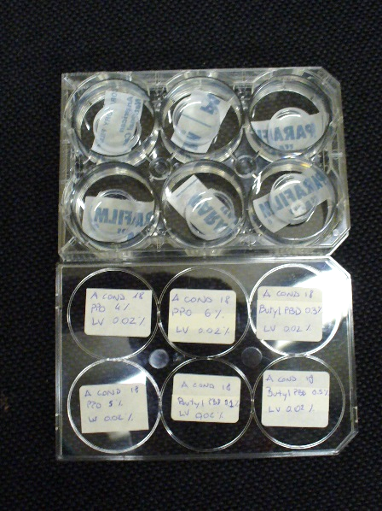
Polysiloxane based scintillators: Condensation
Hydroxyl Terminal Groups
Etoxy Terminal Groups

Slide 10
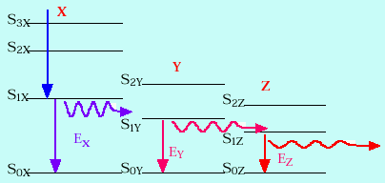
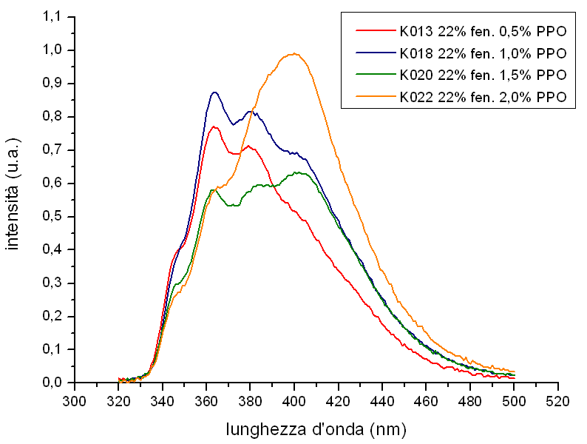
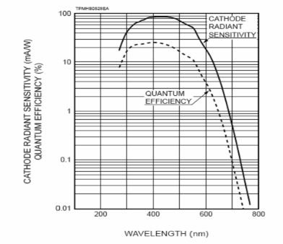
    Suitable Dye Molecules: 1st Dye
    Overlap between dye absorption spectrum and polymer
    fluorescence spectrum.
    Good solubility in the polymer matrix due to lateral phenil groups (PPO)
    Good radiation hardness
PPO
    2,5 diphenyloxazole
    or
butyl Phenylbutadiene
Fluorescence spectra of silicone and PPO
H6524 Hamamatsu (PMT R1450 (response spectra
350 – 600 nm))

Slide 11
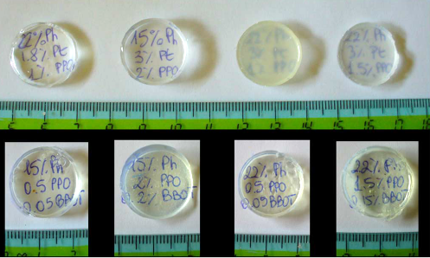
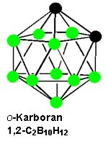
Red emitting polysiloxane based scintillators
Suitable Dye Molecules: photo-sensor coupling
Blu emitting polysiloxane based scintillators
A. Quaranta et al. Optical Materials 32 (2010) 1317–1320
PPO, bPBD etc.
Lumogen Violet (LV), BBOT, dPOPOP etc.
Naphtalimidi → LV/LR
Phenyl substituted polysiloxane resins
2,5-Diphenyloxazole (PPO)
Lumogen Violet (LV)
Lumogen Red (LR)
Luminescent dyes for promoting high luminescence yield at about 430 nm (PPO or bPBD)+(dPOPOP or LV), while
~ 600nm →LR.
Boron O-carborane or Gadolinium nitrate tributylsulfate: used as thermal neutron
sensitizer.

Slide 12
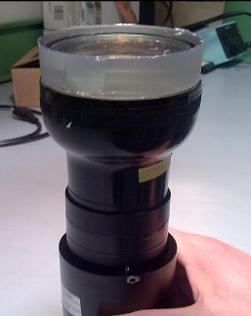
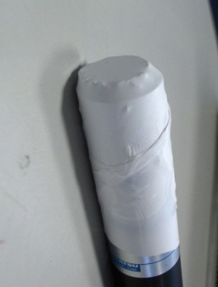
Sample production: Polysiloxane rubbers
Series | 1° dye | 2° dye
S1_1:3 | PPO (0.5% : 2,0%) | LV(0.01%:0.04%)
S2_1:3 | PPO (0,5% - 1,0%) | BBOT (0.01%:0.04%)
S2_4:9 | bPBD (0,25% - 0,5%) | LV(0.01%:0.04%)
S3_1:6 | PPO (1,0% -2,0%) | LV(0.01%:0.04%)
S3_7:9 | DMT (0,35% - 2,0%) | BBOT (0.01%:0.04%)
S3_10:12 | DMT (0,35% - 2,0%) | LV(0.01%:0.04%)
S4_1:3 | bPBD (0,2%) | BBOT (0.01%:0.04%)
S5 3cm | PPO (1,0%) | BBOT (0.02%)
S6_1:7 | PPO (1,0% -2,0%) | LV(0.01%:0.04%)
LV * | PPO (1,0% - 1,5%) | LV (0.01% : 0,05%)
dPOPOP* | PPO (1,0%) | dPOPOP (0,01% - 0,02)
²⁴¹Am- α
NE102
PPO/dPOPOP | 1/0,01 22-100 | 1/0,01 22-100 | 1/0,02 22-100 | 1/0,02 22-100
Am-241 L.O vs EJ212 | 51%±16% | 46%±15% | 46%±15% | 45%±15%
Co-60 L.O vs EJ212 | 66%±20% | 60%±18% | 72%±16% | 65%±22%

Slide 13
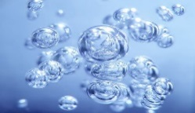

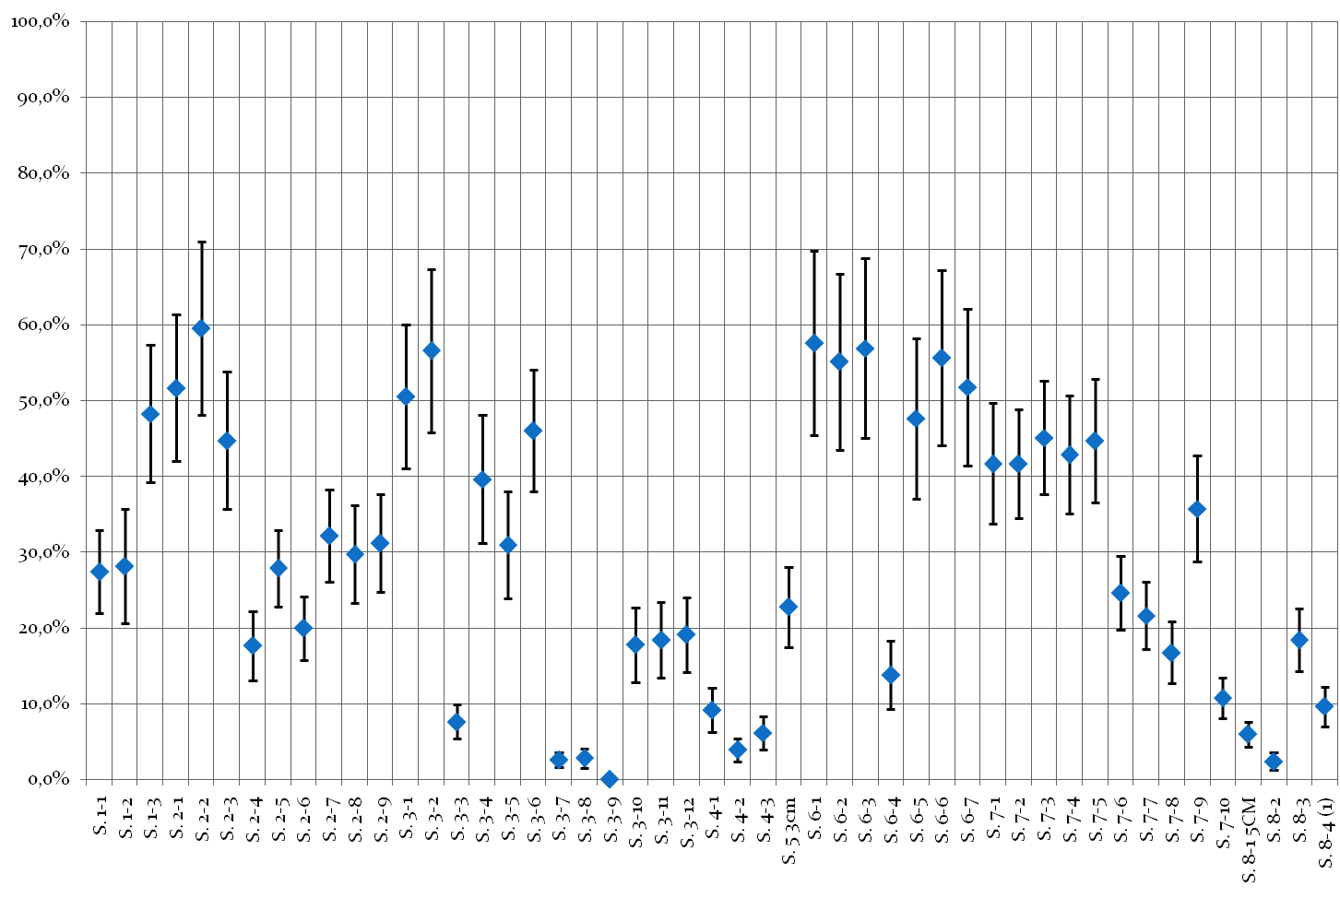
    Comparison between solid samples
Light output for ²⁴¹Am α-particles
PPO
PPO+BBOT
LV
BBOT
bPBD
DMT
LV
b-PBD
LV
BBOT
BBOT
Light output for ⁶⁰Co γ-rays
PPO
LV
bPBD
BBOT
DMT
LV
LV
b-PBD
BBOT
BBOT

Slide 14
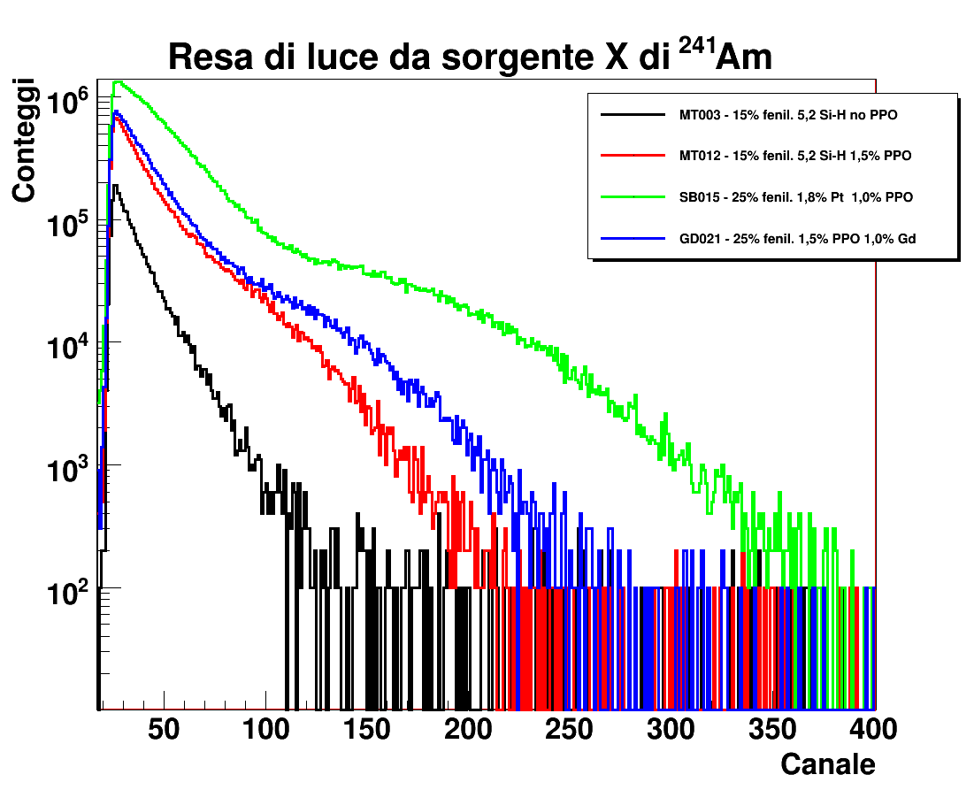
    Silicone Rubber : slow neutron detection
    Choice of new organic compounds for dispersing Gd and B in the silicone polymer.
Gadolinium and Boron
compound requirements:
Highly soluble in the siloxane fluids.
Inert to the cross-linking reaction and to the light yield.
Thermally resistant (up to 100°C, final annealing for the cross-linking completion).
Gadolinium nitrate tributylsulfate:
Low yield (10 - 25 % with respect to EJ212)
Yellowing of samples
²⁴¹Am – 60 keV γ-rays
MT003 15% Phenil no PPO
MT012 15% Phenil 1.5% PPO
SB015 25% Phenil 1.0% PPO
GD021 25% Phenil 1.5% PPO, 1.0% Gd
AmBe Source
25% Phenil 1.5% PPO, 3.0% Gd

Slide 15
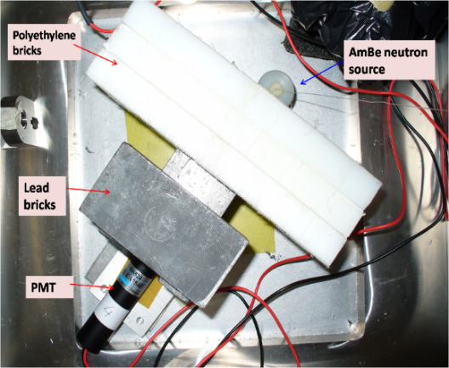
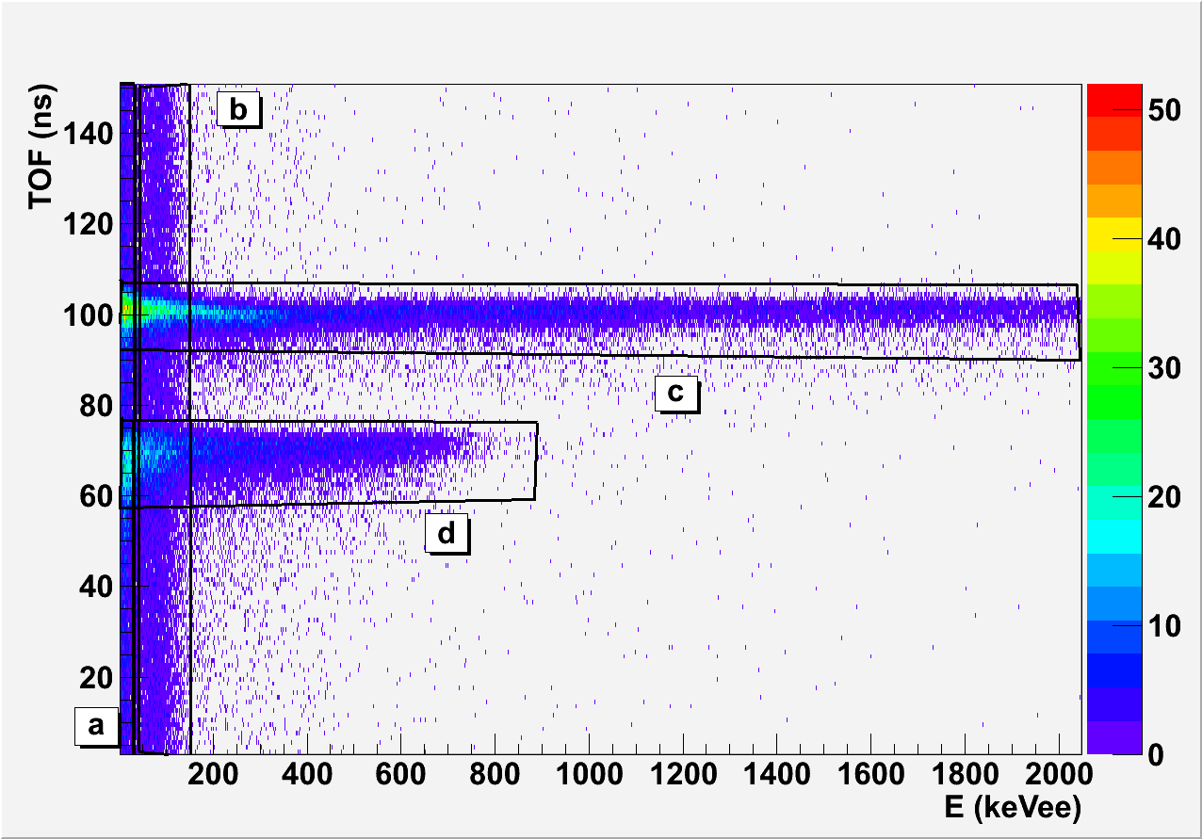
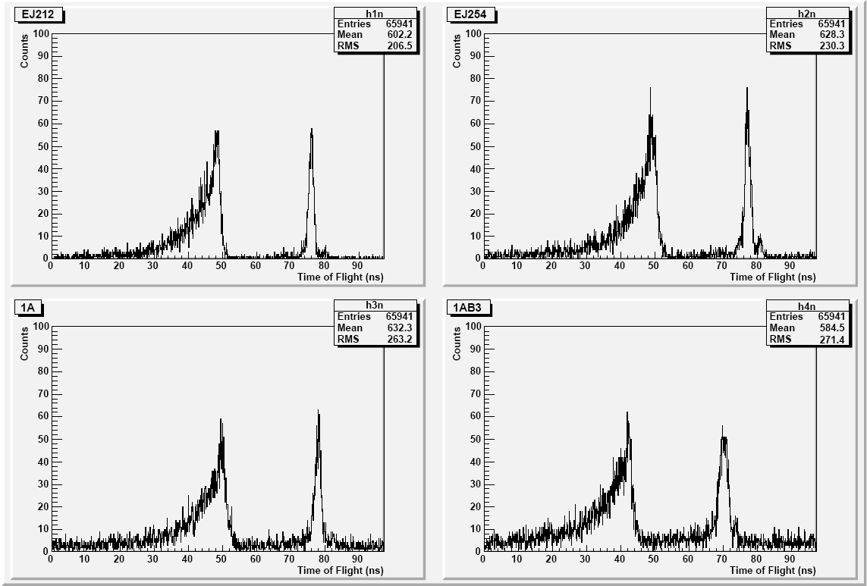
Boron Doped Polysiloxane scintillators properties:
Addition Resins results:
Mixing of A :Polydimethyl-diphenyl siloxane (22%ph groups)
with B: Polymethyl phenyl Siloxane
(100%ph groups)
A22_1%PPO_0.01%dPOPOP
with termalization
Boron O-carborane
% B | α – yield (% Ej-212) | γ – yield (% Ej-212) | α – yield (% Ej-254) | γ – yield (% Ej-254)
no | 65 ± 16 | 74 ± 15 | - | -
4 | 44 ± 13 | 49 ± 12 | 66 ± 22 | 69 ± 16
6 | 40 ± 14 | 48 ± 11 | 64 ± 24 | 69 ± 15
8 | 37 ± 13 | 41 ± 17 | 59± 20 | 62± 20
n
γ
PS_B6%
EJ254

Slide 16
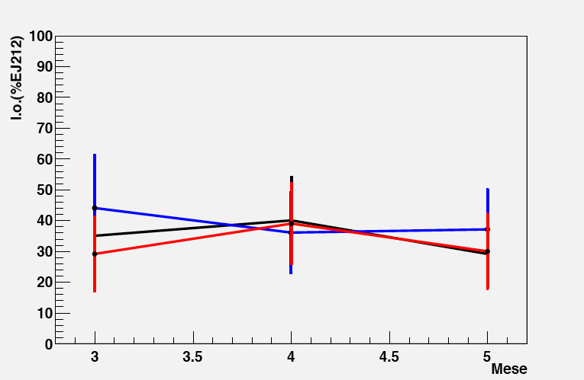
Boron Doped Polysiloxane scintillators properties:
Samples without B exhibit a scintillation yield 60-70% with respect to EJ-212.
Increasing the amount of B slightly affects the scintillation yield slightly less than the commercial (see EJ254).
Ageing effects
4% B
6% B
8% B
B concentrations higher (up to 8% than commercial systems (5% max. in EJ-254) can be attained, thus increasing the detection efficiency to thermal neutrons.
Light output with a- particles in % of EJ-212 as a function of time. No ageing effects are visible.
Base Resin | Acond 100:20:1 | Acond 100:20:1 | Acond 100:20:1 | Acond 100:20:1
PPO | 1 | 1 | 1 | 1
LV | 0,02 | 0,01 | 0,02 | 0,02
^{nat}B | NO | 4% | 5% | 6%
²⁴¹Am %L.O vs EJ212 %L.O vs EJ254 | 56±16 | 49±15 73±25 | 42±13 63±22 | 48±15 71±24
⁶⁰Co %L.O vs EJ212 %L.O vs EJ254 | 68±15 | 70±17 90±22 | 61±15 79±20 | 68±15 87±19
Condensation Samples
Light Output
A: 100 % resin Sylanole terminated
B: 20% polydiethoxysilane (PDS)
1% Sn catalyst

Slide 17
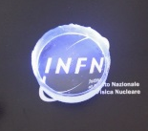
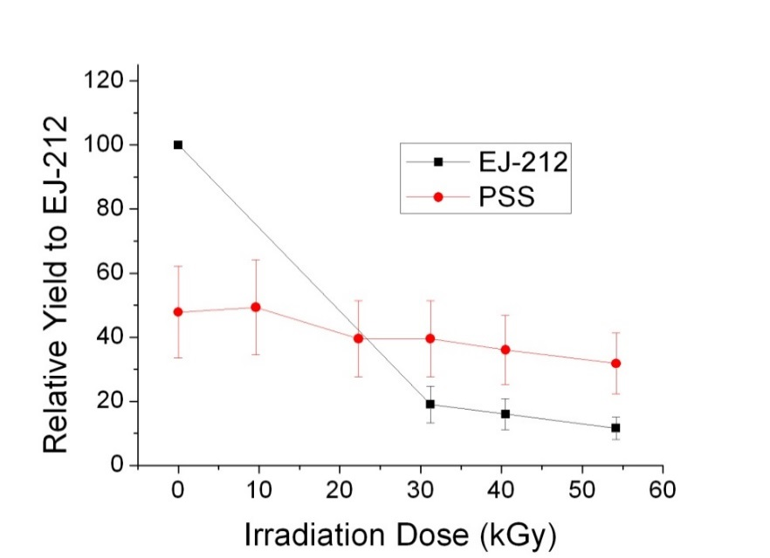
Polysiloxane based scintillators: performances
Good chemical and thermal stability
Manufacturability and low cost (about 1 €/g)
No volatile solvents
Low toxicity
Very good radiation hardness
stable from -100 to +200 °C
²⁴¹Am α-particle relative Yield
⁶⁰Co γ-rays irradiated polysiloxane scintillator
⁶⁰Co γ-rays irradiated commercial PVT based scintillator
Optical transmittance spectra for EJ212 and Polyphenyl Siloxane with dye (1%PPO. 0.02LV) before and after exposure to 54KGy dose
A. Quaranta, S. Carturan, et al., Mater. Chem. Phys., 137 (2013) 951.

Slide 18
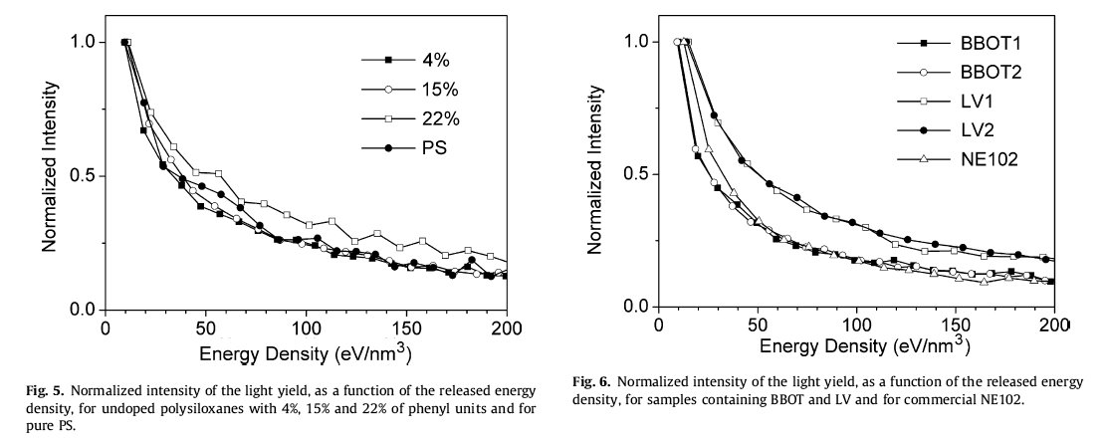
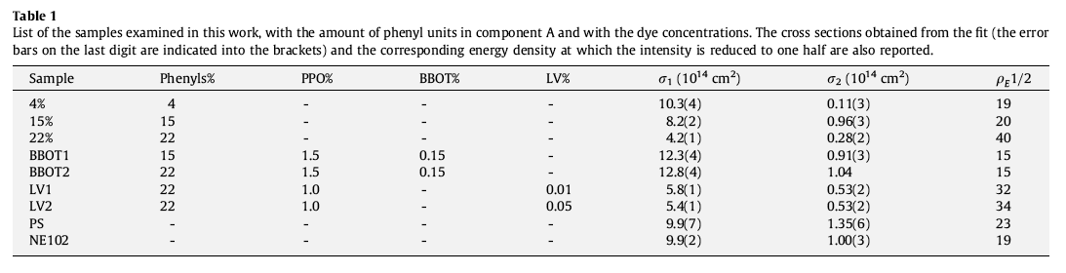
Radiation Hardness
Irradiation fluence He⁺ @1.8 MeV (1. 0 μA/cm²)
In doped polysiloxanes the radiation hardness depends on the dispersed dye.
Samples containing Lumogen Violet are intrinsically more resistant than EJ212 and BBOT containing scintillators.
A. Quaranta et al. Nuclear Instruments and Methods in Physics Research B 268 (2010) 3155–3159

Slide 19
Pulse Shape Discrimination
Light Output
Total
Fast Component
Slow Component
Time
PVT
N. Zaitseva et al., NIMA668(2012)88-93

Slide 20
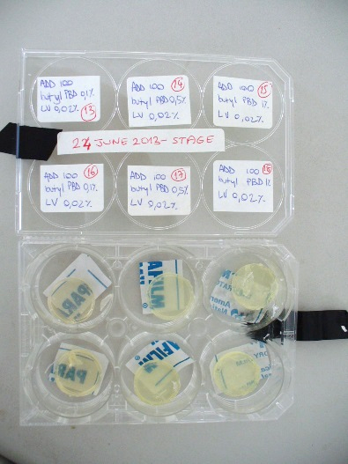
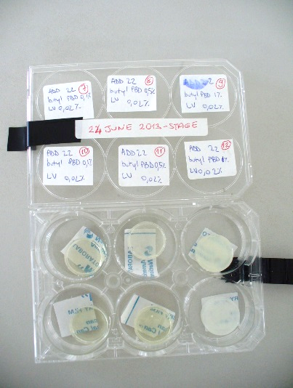
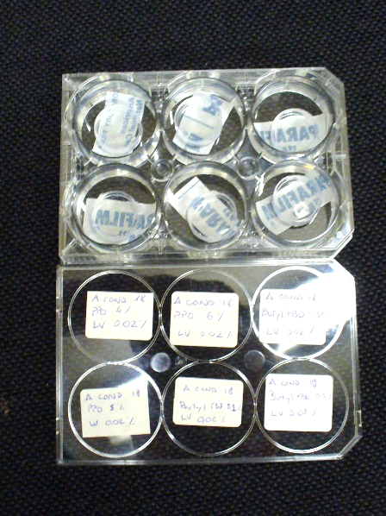
Sample production: Polysiloxane rubbers
Add-22
Add-100
Cond-18
Resin (A) | Dye | Resin (B) | Catalyst
Polymethylphenyl Siloxane (A-Add100) | LV 0,02% | Variable PPO 1%,2%,3%,4%,5%,6%. Variable bPBD 0,1%,0,2%,0,3%,0,5%,1% | Polymethylphenyl dimethyl siloxane (B-Add) | Platinum 1,2μL/g + Inhibitor 6μL/g
Polydimethyl diphenyl siloxane (A-Add22) | LV 0,02% | Variable PPO 1%,2%,3%. bPBD variabile 0,1%,0,2%,0,3%, 0,4%,0,5%,1% | Polymethylphenyl dimethyl siloxane (B-Add) | Platinum 1μL/g + Inhibitor 6μL/g
OH terminated Siloxane (A-Cond18) | LV 0,02% | Variable PPO 1%,2%,3%,4%,5%,6%. Variable bPBD 0,1%,0,3%,0,5%. | Polydiethoxysilane (PDS, B-Cond) | Tin 1,3%.

Slide 21


    Comparison between solid samples
b-PBD
Solubility limit
%YIELD (VS EJ212)
% b-PBD
%b-PBD
b-PBD
%YIELD (VS EJ212)
% B-PBD
%b-PBD

Slide 22

    Comparison between solid samples
%YIELD vs EJ212
%YIELD vs EJ212

Slide 23





Pulse Shape Analysis: using standard scintillators (BC501)
Neutron/gamma discrimination: Zero crossing method
CAEN Digitizers
Model | S. rate | D. Range | Res
V1720 | 250 MS/s | 2 V_{pp} | 12 bit
V1751 | 1 - 2 GS/s | 1 V_{pp} | 10 bit
Digital Electronics
target
PM1
n
Time
pickup
beam
PM2
$$γ$$
RC/CR emulation algorithm provided by L. Bardelli:
[L. Bardelli et al., Nucl. Instr. and Meth., A521 (2004) 480]

Slide 24





Pulse Shape Analysis: large samples (Ø=3”)
PS_PPO1(n-α γ)
PS_PPO8 (n- γ)
Average Shapes: neutron/Alpha/Gamma discrimination V1751 CAEN 1GS/s 10 bit 1V_{pp}
ToF Spectra CN measurement
PS_PPO1_B3(n-α γ)

Slide 25







Pulse Shape Analysis: small samples (Ø=0.8”)
EJ212-α ,EJ212 - γ
p-terphenyl( 1-4 % wt.)
α
PPO1,2,4,6,8%
PPO1,2,4,6,8%
γ-rays
Average Shapes small samples : Alpha/Gamma discrimination 1GS/s 10 bit 1V_{pp}
EJ212-α ,EJ212 - γ,
PS_PPO1 - α,PS_PPO1 - γ
EJ212-α ,EJ212 - γ,
PS_PPO8 - α,PS_PPO8 - γ
γ
α

Slide 26




Pulse Shape Analysis: large samples (Ø=3”) – fast vs slow
PS_PPO1(n- γ)
PS_PPO8(n- γ)
PS_PPO8(n- γ)
Average Shapes: neutron/Alpha/Gamma discrimination V1720 CAEN 250MS/s 12 bit 2V_{pp}
γ
γ
PS_PPO1(n- γ)
n
PS_PPO8(n- γ)
n

Slide 27




Sample production: liquid scintillators
Aim: substitution of Benzen (highly toxic, inflammable, dangerous handling)
Preliminary
Matrix | Viscosity | Dye
Polymethylphenyl siloxane (100%) | 10 cSt | PPO 1%,2% o p-TerPhenyl 0,1%,0,5% | LV 0,02%
Polymethylphenyl dimethyl siloxane(48%) | 125 cSt | PPO 1%,2% o p-TerPhenyl 0,1%,0,5% | LV 0,02%
Polymethylphenyl dimethyl siloxane(56%) | 500 cSt | PPO 1%,2% o p-TerPhenyl 0,1%,0,5% | LV 0,02%

Slide 28

Sample production: liquid scintillators
2% PPO
1% PPO
Growth as a function of n. of benzenic groups
%YIELD vs EJ212
Molar % of benzenic groups
Preliminary
2% PPO
1% PPO
%YIELD vs EJ212
Molar % of benzenic groups

Slide 29
SUMMARY
Development of blue and red emitting polysiloxane based scintillators → improved spectral matching with PMT & APD detectors
Energy transfer investigation and emission intensity optimization by fluorescence spectroscopy and scintillation measurements with/without optical filters with PMT under radiation sources or accelerated beams.
A22 & A100 with PPO & LV show optimum quantum efficiency (50-60% vs EJ212), optimum reproducibility, no ageing effects, radiation hard.
New solid samples: A18 COND optimum transparency, dye solubility, optimum light yield (up to 60-70% vs EJ212), also when B loaded.
Preliminary new liquid scintillators: Atoxic, optimum Dye solubility, light yield get better at the growing of Benzenic groups, optimum light output (up to 70% vs EJ212)
Preliminary PSA discrimination: average shapes are sensitive to incoming radiation at contrary of EJ212- Alghoritms still to be optimized

Slide 30



Outlooks: Hyde
    Fast n
scintillator
    Slow n
nitride
oxide
200 μm
10 μm
    ¹⁰B
    p
Si p-type
P diffuse (n⁺)
    α
No Silicone
Converter
Signal pick up
Electric contacts
(n⁺)
    3D silicon detector
    PS scintillator
with Silicone
Converter
SiPM

Slide 31


The ORIONE Collaboration:
The Collaborations
S. Carturan^{1,2}, F. Gramegna¹, M. Cinausero¹ , G. Collazuol^{1,2} , M. Dalla Palma^{1,3}, M. Degerlier⁴, T. Marchi^{1,2}, A. Quaranta^{1,3} .
¹ INFN, Laboratori Nazionali di Legnaro, Legnaro (Pd), Italy.
²Department of Physics and Astronomy, University of Padova, Padova, Italy.
³Department of Industrial Engineering, University of Trento, Trento, Italy.
⁴Department of Physics, University of Nevsehir, Nevsehir, Turkey .
NEutron DEtector developments for Nuclear Structure, Astrophysics and Applications (NEDENSAA) NuPNET - Network
The HYDE Collaboration
ORIONE Collaborators plus:
G. Dalla Betta¹ & Coworkers
M. Boscardin ² & Coworkers
G. Susinno³ & Coworkers
¹Department of Industrial Engineering ,
University of Trento, Trento, Italy.
²FBK (Bruno Kessler Foundation), Trento
³ INFN & Department of Physics, University of Calabria, Cosenza, Italy .
    Italy (INFN - LNL, LNS).
    Germany (TU Dresden).
    France (CNRS/IN2P3, CEA, DRT, LIST, DCSI, LCAE).
    Spain (CIEMAT, IFIC).
    Finland (Univ. Jyväskylä).
    Bulgaria (INRNE).
    Turkey (TUBITAK)
    Sweden (Univ. Uppsala).

Slide 32

Best Wishes JOE !!!!!!!!!!!!

Slide 33
BACKUP
SLIDES

Slide 34

X-ray diffraction patterns
NO sharp peaks → NO 3-D crystalline order
Negligible changes with aging
Negligible changes with polymerization routes
Two components: intense and sharp peak at 10.7° and a hump at about 19.7°
  19.7° Si-O-Si amorphous phase of silica-like structure in siloxane
  10.7° ordered domains (lamellae with folded chains) without close crystalline packing
Courtesy of G. Maggioni
Ribbon-like structure of PDMS with unit cell
J.J.H. Lancastre et al., Rad. Chem. Phys., 2012

Slide 35




Interaction processes→ a new working detector
High Energy Neutrons
(E>1 MeV)
Multiple scattering by Hydrogen and Carbon
Neutron Capture by B or Gd nuclei dissolved in the silicone rubber
Low Energy Neutrons (E<500 keV – 1 MeV)
Study and production of new polysiloxane organic scintillators (PSS) for neutrons detection.
Matrix
Luminescent dyes for promoting high luminescence yield at about 430 nm (PPO or bPBD)+(dPOPOP or LV, LR).
PPO
DMT
Dimethyltryptamine
Naphtalimidi
LV/LR
POPOP
Boron O-carborane or Gadolinium nitrate tributylsulfate: used as thermal neutron sensitizer.
Notes:
Our study is devoted to develop new detectors able to be used both for fast and for thermal neutron detection. Fast neutrons are known to interact with organic matrials through their elastic or inelastic interaction with the C or H atoms. On the contrary slow neutrons, especially in the thermal region, mainly interact by capture reactions with special materials which are interesting due to their high capture cross section: among them very common are the n-capture on 10B, with the emission of a correlated couple made by an alpha particle and a Li ion , while in the case of Gd (much higher cross section) the emission are gammas and a characteristic X rays of 42 keV.
To produce a scintillator the base organic resin must be a scintillator (emit light) and it must be added with different amounts of fluorophores to transfer the enrgy of the emitted radiation in the visible region. As primary dye organic composites like 2,5-diphenyloxazole (PPO) or butyl PhenilButadiene (bPBD) has been used, while dPOPOP or Lumogen Violet (registered Trademark of BASF) were used as wavelength shifter as I will discuss later. Ortho-carborane or Gadolinium nitrate tributylsulfate have been added as neutron sensitizer in the base resin before the cross-linking reaction for those samples to be used for thermal neutron detection.

Slide 36




From Shapes to parameters: fast vs slow with squared-root.
²⁴¹Am
PPO1%
⁶⁰Co
PPO8%
⁶⁰Co
1GS/s 10 bit
250MS/s 12 bit
PPO8%
PPO8%
PPO1%
PPO1%

Slide 38


BBOT
Assorbe 370 nm (UV)
Emette 430 nm (viola)
430 nm
370 nm

Slide 39
Conclusion
“transparency ”X ray detection
Low Energy Neutrons
Gd neutron capture and γ o X emission
B neutron capture and α emission
γ, X absorption
α absorption
Light emission and wl.-shifting (PPO/BBOT)
-Neutron Source tests.
-TOF measures.
-Light Yield measurements with α and γ sources.
-IBIL measures.
PPO/BBOT scitntillation
and light detection

Slide 40







Light Yield Measurement – γ sources
γ
γ
Tommaso Marchi – tommaso.marchi@lnl.infn.it
1-dec-2009: NEDA technical meeting

Slide 41

Scintillatori organici (solidi)
Gli scintillatori organici sono formati da idrocarburi aromatici (contenenti anelli benzenici) in forma di polimero.
In questi composti la fluorescenza deriva da transizioni degli elettroni delocalizzati dell’anello benzenico.

Slide 42

Light
UV
IR
400 nm
750 nm

Slide 43

Scintillation process
Primary Phase:
Radiation Absorption
excitation (or ionization) of molecules
Second Phase :
Internal conversion
energy transfer
Light emission (or quenching)

Slide 44
Decay
S₀
S₁
T₁
Absorption hν
Absorption hν
Emission hν
Emission hν
Vibrational De-excitation
Fluorescence (10 ns-100 μs)
Phosphorescence
(>100 μs)

Slide 45


Fluorescence

Slide 47


Slide 48
    Comparison between solid samples

