Slide 1
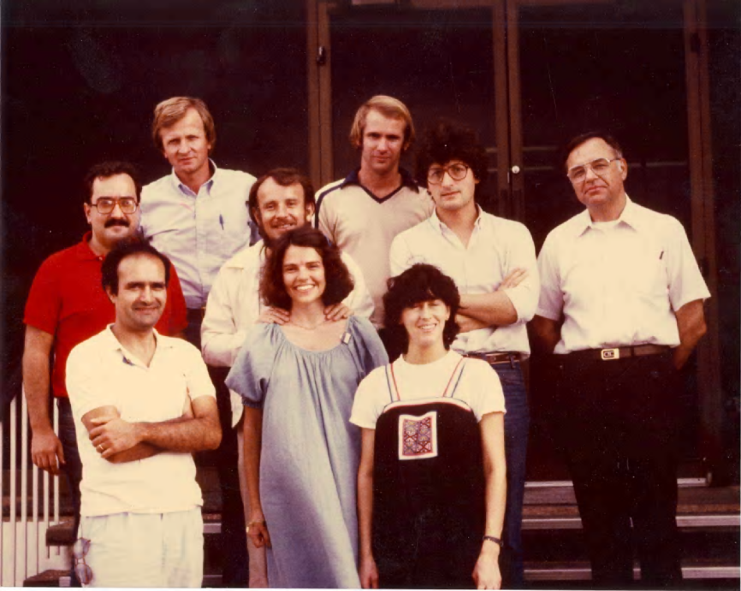
Coalescence of liquid drops by surface tension
A. Menchaca-Rocha
IFUNAM
México
International Workshop on Nuclear Dynamics and Thermodynamics
in Honor of Prof. Joe Natowitz
Texas A&M University, College Station, Texas, USA
August 19-22, 2013

Slide 2
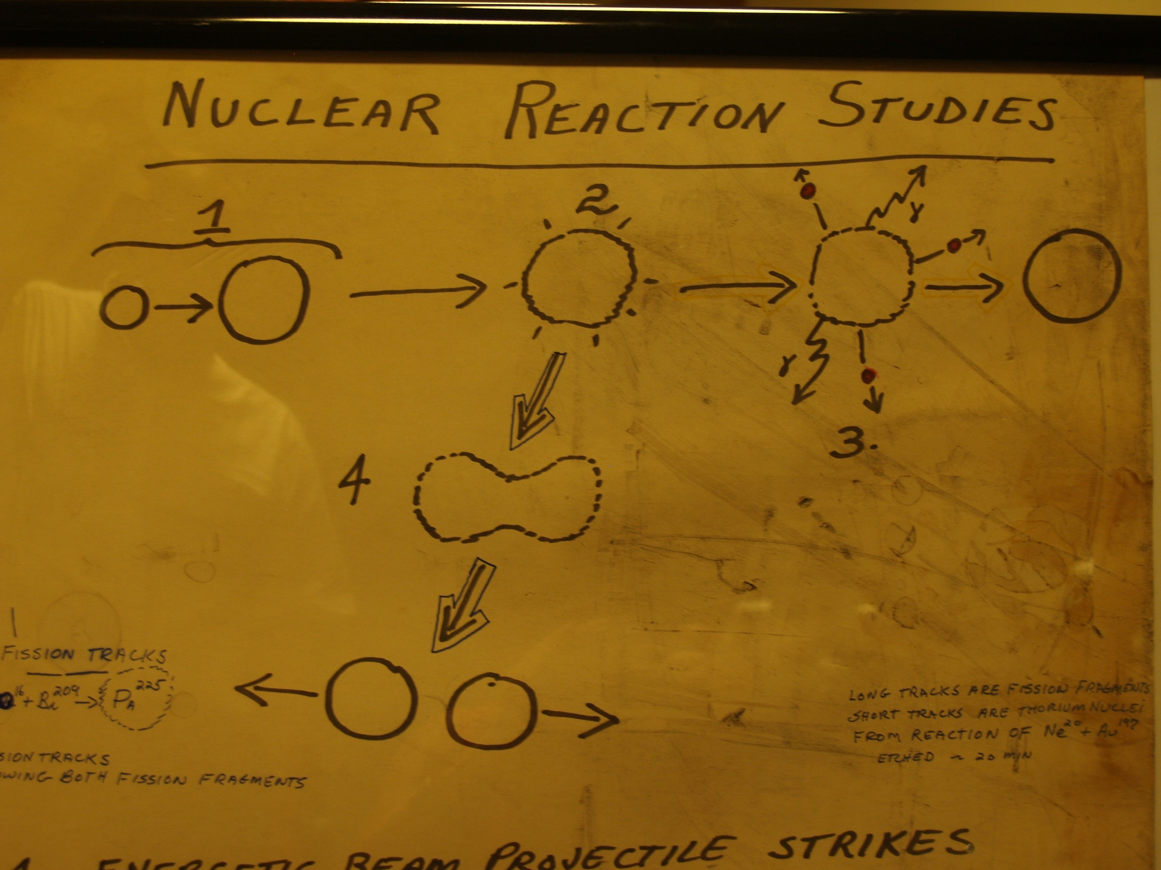

Slide 3
Outline
J.B. Natowitz & M.N. Namboodiri’s comment
Liquid drop collisions: to fuse or not to fuse
Mercury drop experiments
Surface tension-driven coalescence
Conclusion
Future

Slide 4
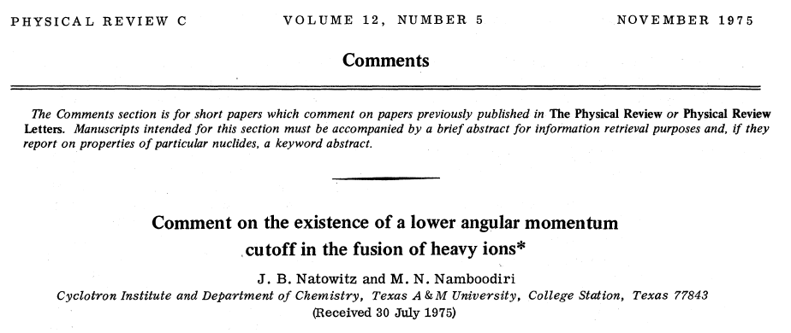

Slide 5
H. Gauvin, Y. Le Beyec, M. Lefort, and B. L.Hahn, Phys. Rev. C 10, 722 (1974)
Measured: Excitation functions for:
¹¹⁸Sn(⁴⁰Ar, xn)^{158-x}Er (asymmetric)
and
⁷⁴Ge(⁸⁴Kr, xn)^{158-x}Er (symmetric)
Found:
Symmetric fusion to be narrower and have higher excitation thresholds: i.e, less prone to fuse than the asymmetric case.
Conjectured: Angular momentum (L) window?

Slide 6
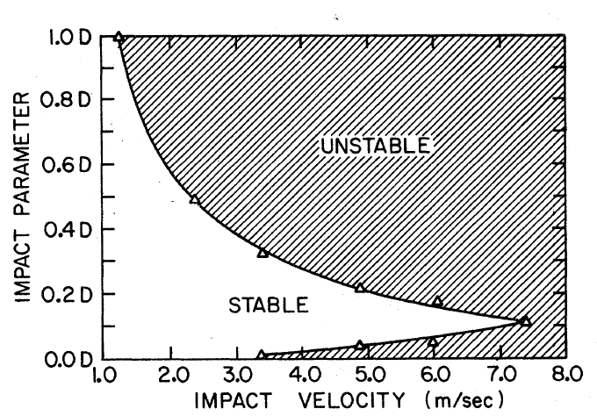
J.B. Natowitz & M.N. Namboodiri Phys. Rev. C12(1975)1678
L-window
D=300μm
Symmetric
From: J.R. Adam, N.R. Lindblad and C.D. Hendricks: J. App. Phys (1968)5173

Slide 7
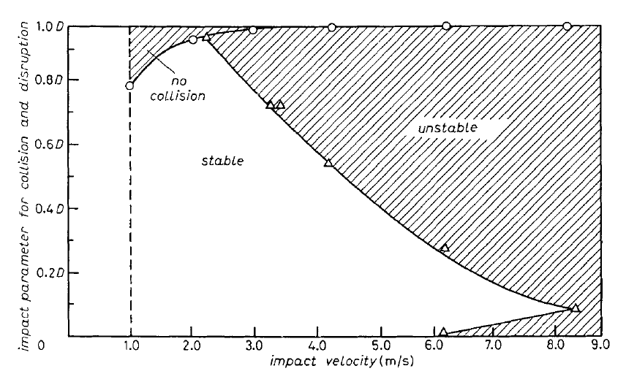
Low energy, L=0 collisions
Bounce off
Coalescence
D=60μm
Symmetric

Slide 8
Mid energy, L=0 collisions
Few-body disruption
Coalescence

Slide 9
L≠0 collisions

Slide 10
L≠0 (Mexican LHC)

Slide 11
L=0 (Mexican LHC)

Slide 12
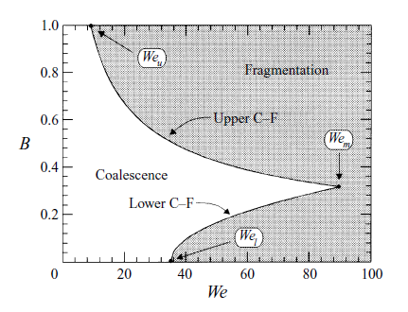
This talk
Question 1: rotation vs vibration
Question 2: effect of mass asymmetry?
?

Slide 13
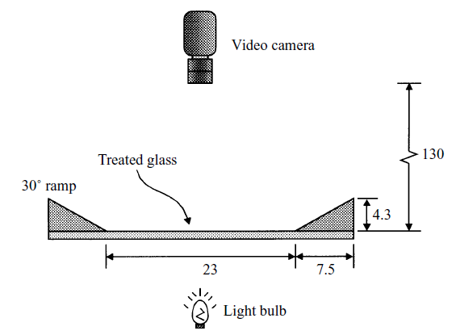
Gotatron-I
Bought while at TAMU

Slide 14
Gotatron-I
Bought while at TAMU

Slide 15
Gotatron-I
Bought while at TAMU

Slide 16
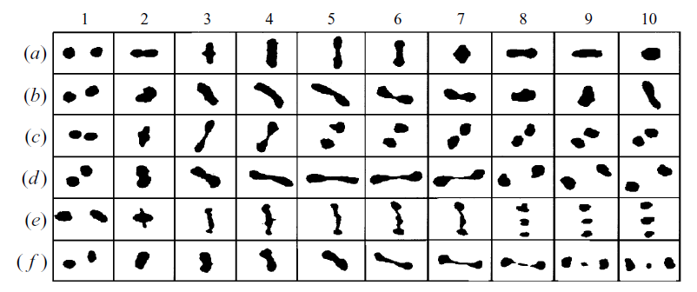
Collision examples

Slide 17
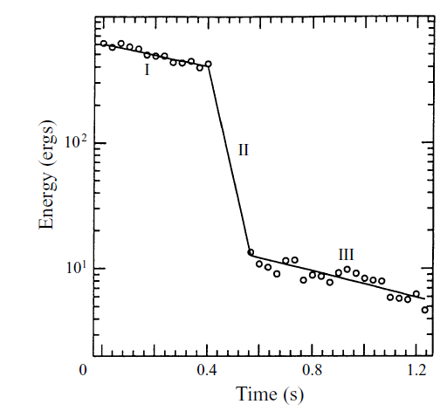
Influence of glass

Slide 18
Limiting angular momentum

Slide 19
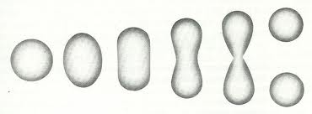
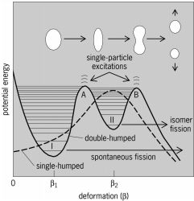
RLDM

Slide 20
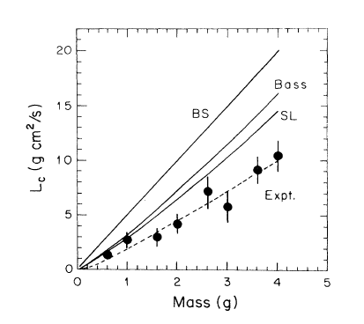
Entrance channel effects
Gyrostatic: J. Blocki and W.J. Swiatecki, LBL Report No. 12811-UC-34d, 1982.
Bass, PL 47B (1973) 139
Includes neck and friction
R. Schmidt and H.O. Lutz,
Phys. Rev. A 45, 7981 (1992)
More complex surface shapes

Slide 21
What about We=0 coalescence?

Slide 22
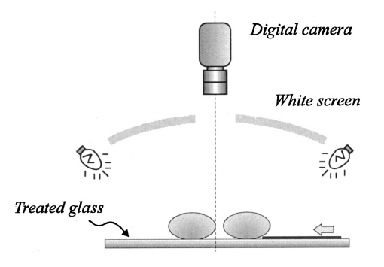
Instrument

Slide 23
Animation

Slide 24
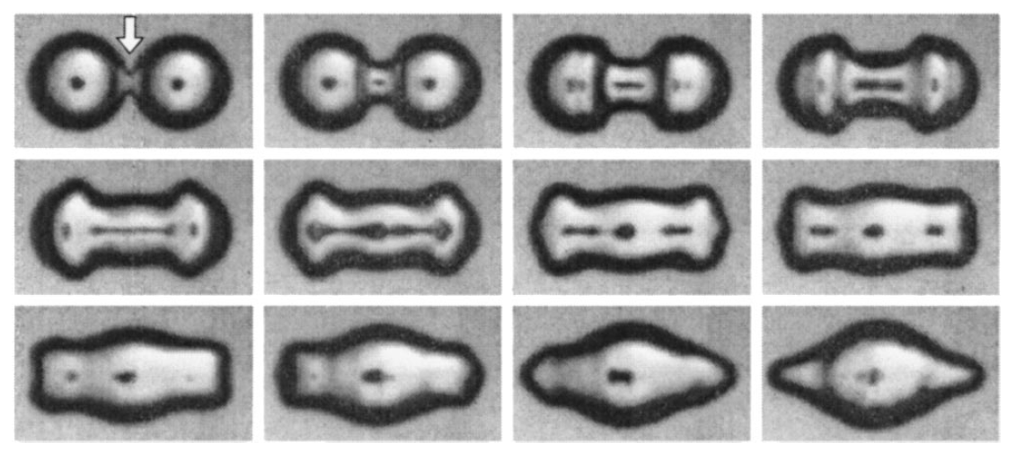
Neck formation

Slide 25
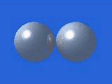
3D-Simulation

Slide 26
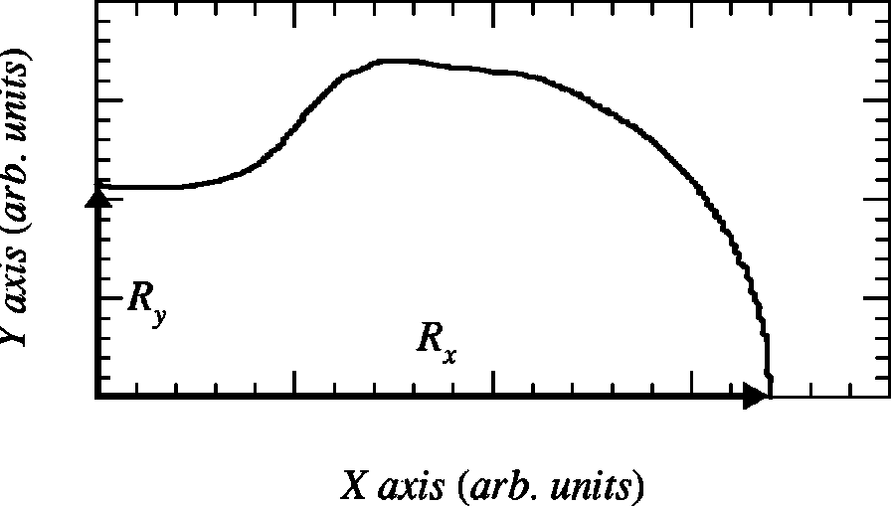
Shape parameters

Slide 27
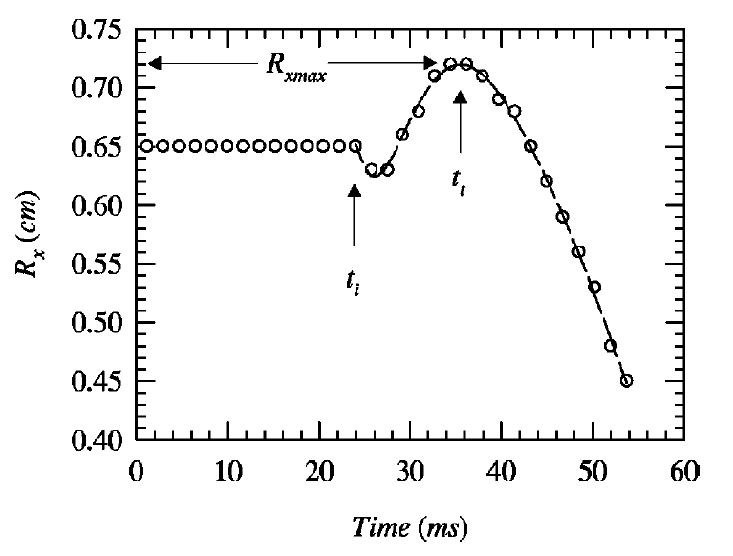
Stretching

Slide 28
Pressure pattern

Slide 29
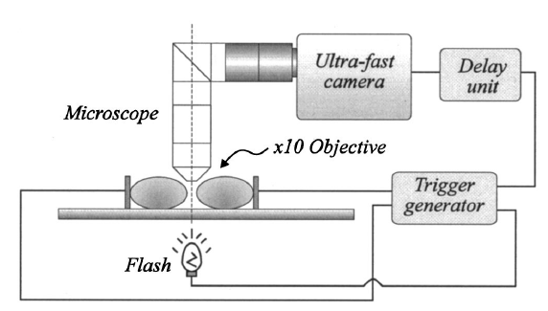
Zoom

Slide 30
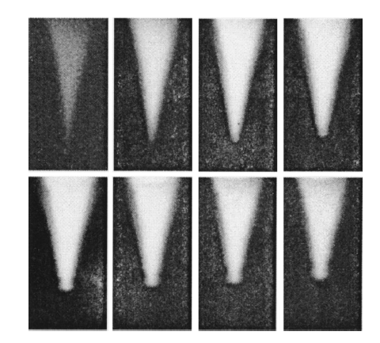
Capillary wave formation

Slide 31
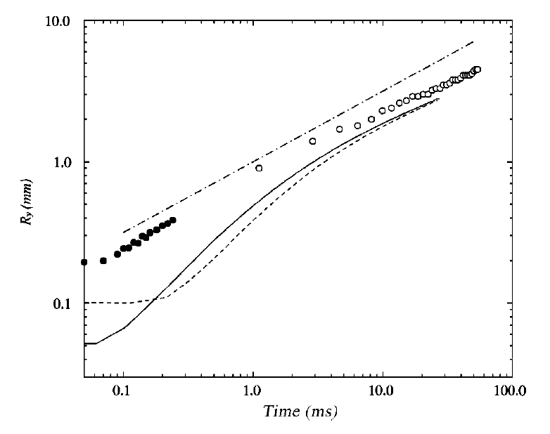
Neck growth models
J. Eggers, J. Fluid Mech. 401, 293 (1999).
Numerical simulations

Slide 32
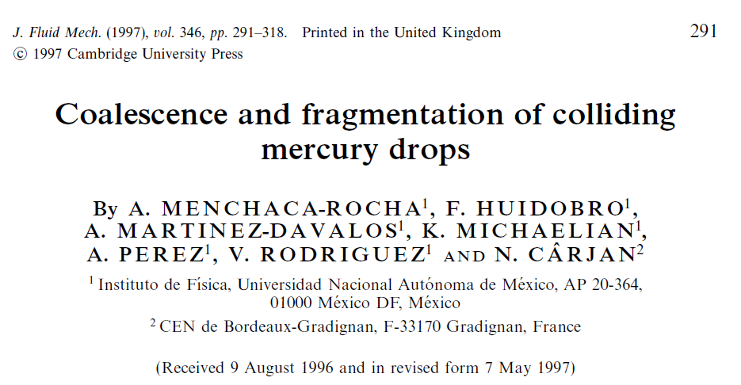

Slide 33
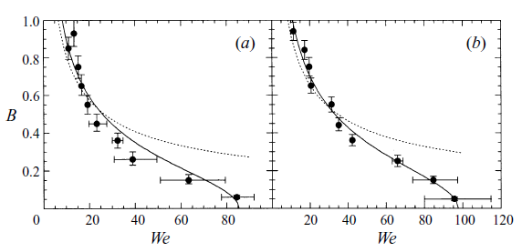
m_{t} = 2 g result
Symmetric
Asymmetric

Slide 34
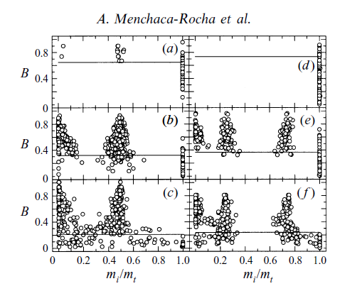
Asymmetric vs symmetric
We= 0-15
We= 15-60
We= 60-130
m_{t} = 2g
Asymmetric coalescence :favoured

Slide 35
Conclusions
Nuclear:
Gauvin et al.: Asymmetric Er CN-formation is favored over symmetric one: is this due to an L-window effect?
JBN: Symmetric liquid drops do show an L-window effect
Liquid Drops:
RLDM tested… on liquid drops. Complex vibrational modes reduce Lc values
Vibrational excitation isolated (We = 0): neck formation and capillary waves.
Asymmetric liquid drop coalescence IS more stable than symmetric one, even without an L-window effect
Applications?
Oh! Yes: narrow mass distributions in raindrops and sprays, for example.
Future: understanding shattering

Slide 36
Congratulations, Joe!
AMC Corresponding Member,

