Slide 1




Equation of State of Neutron-Rich Matter in the Relativistic Mean-Field Approach
Farrukh J. Fattoyev
My TAMUC collaborators: B.-A. Li, W. G. Newton
My outside collaborators: C. J. Horowitz, J. Piekarewicz, G. Shen, J. Xu
Texas A&M University-Commerce
International Workshop on Nuclear Dynamics and Thermodynamics
in honor of Prof. Joe Natowitz
Texas A&M University, College Station, Texas
August 19-22, 2013

Slide 2
Bethe-Weizsacker Mass Formula (1935)
Recall that there is an equilibrium nuclear density:
The parameters of the nuclear droplet model are extracted from a fit to several thousands masses of nuclear isotopes.
BW constrains these parameters at or about nuclear saturation density:
etc.
3. Gives a very good approximation for most of the nuclear masses (except light nuclei and magic nuclei);
4. Offers very little on the density dependence of these parameters.

Slide 3
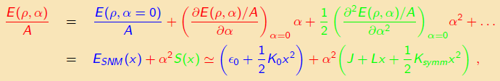
Infinite Nuclear Matter: Thermodynamic Limit of BW
1. In this limit N, Z, V all go to infinity, but their ratio remains finite:
2. One can turn off the long range Coulomb forces (at the mean-field level they average out to zero), and also neglect the surface term (no surface in this limit).
3. Expand the total energy per nucleon around :
where

Slide 4
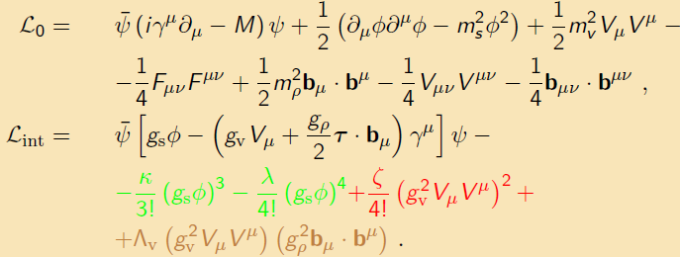
Relativistic Mean-Field Theory
(Improving the BW mass formula)
Parameters of this model is constrained by:
by ground state properties of finite nuclei;
by ground state properties of heavy neutron-rich nuclei;
by the isoscalar giant monopole resonance;
by the neutron radius of heavy nuclei;
by the maximum mass of a neutron star
Existent experimental data are not sufficient to constrain all of these parameters.

Slide 5
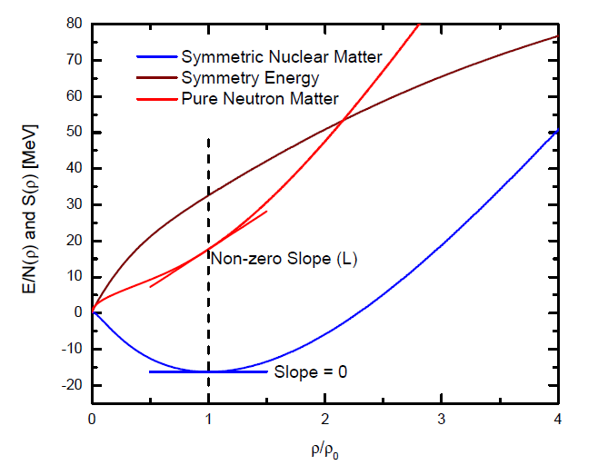
Symmetry Energy
Note: while EOS of SNM is more or less constrained by existing data, the EOS of PNM, hence the density dependence of the symmetry energy remains largely unconstrained.

Slide 6
Symmetry Energy Uncertainties
Binding energy and saturation density are constrained at a 5% level;
Density dependence of the SNM EOS is agreed at a 15% level;
Symmetry energy at saturation is more or less known (at a 20% level);
Density dependence of the symmetry energy is totally unconstrained (discrepancy is at the order of more than 100%)!

Slide 7
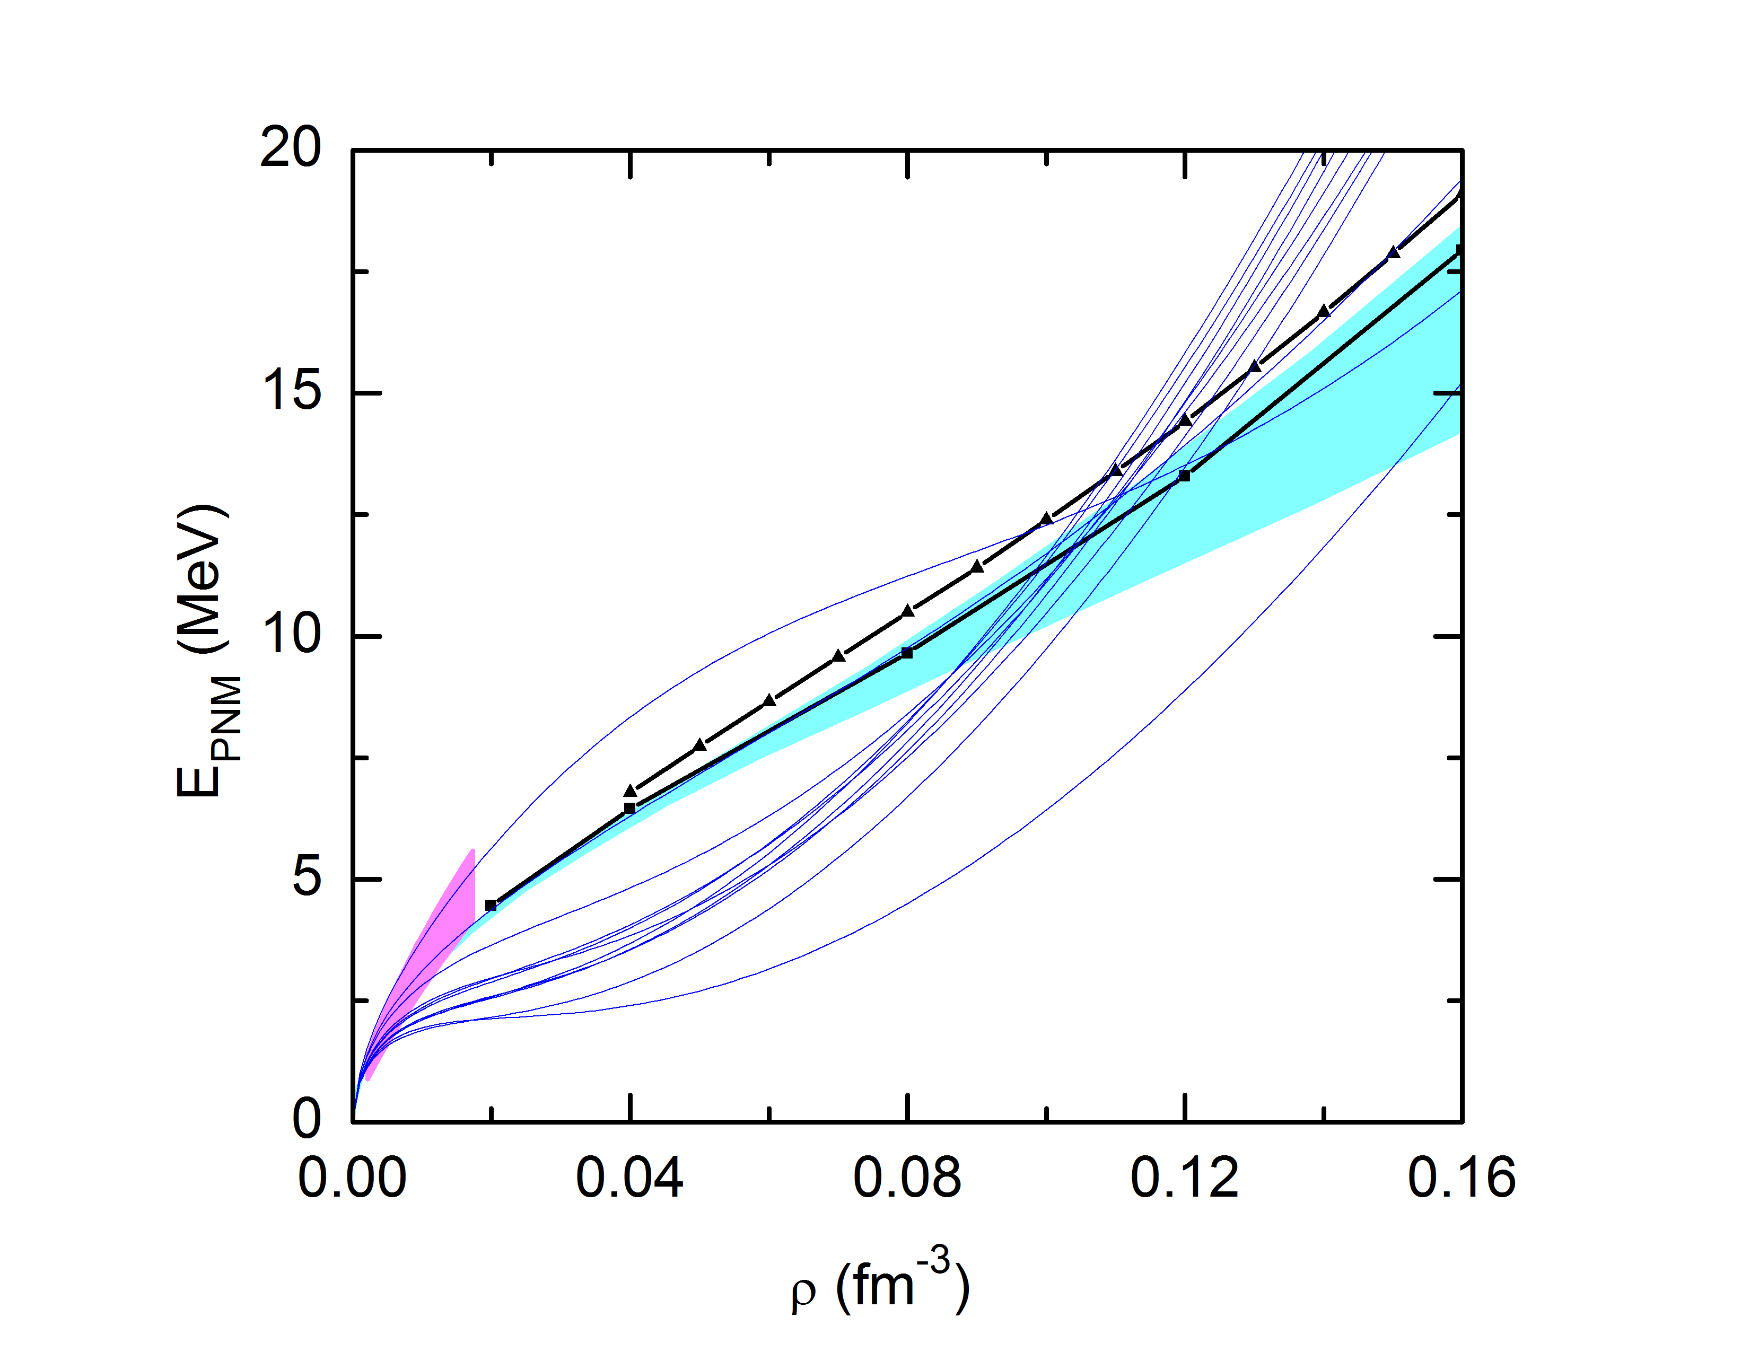
Symmetry Energy Uncertainties
Binding energy and saturation density are constrained at a 5% level;
Density dependence of the SNM EOS is agreed at a 15% level;
Symmetry energy at saturation is more or less known (at a 20% level);
Density dependence of the symmetry energy is totally unconstrained (discrepancy is at the order of more than 100%)!
chiral EFT
Fattoyev et al., J. Phys. Conf .Ser. 420, (2013)

Slide 8
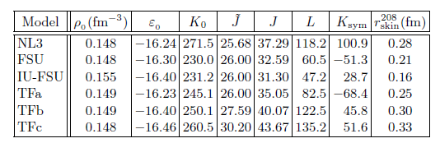
Ground State Properties
Fattoyev and Piekarewicz, arXiv: 1306.6034, (2013)
Abrahmanyan et al., PRL 108, 112502 (2012)

Slide 9
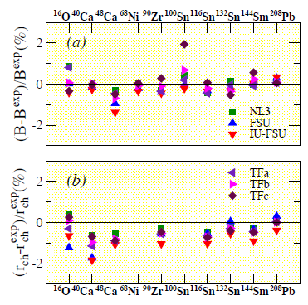
Ground State Properties
Fattoyev and Piekarewicz, arXiv: 1306.6034, (2013)
Abrahmanyan et al., PRL 108, 112502 (2012)
#1. G.S. properties are poor isovector indicators.

Slide 10
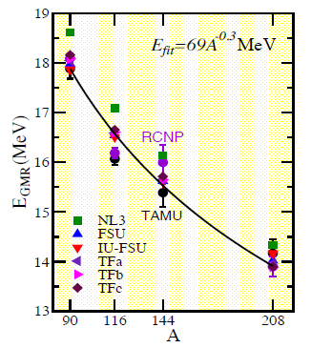
Ground State Properties
Fattoyev and Piekarewicz, arXiv: 1306.6034, (2013)
Abrahmanyan et al., PRL 108, 112502 (2012)
#1. G.S. properties are poor isovector indicators.
#2. GMR centroid energies place little constraint on L.

Slide 11
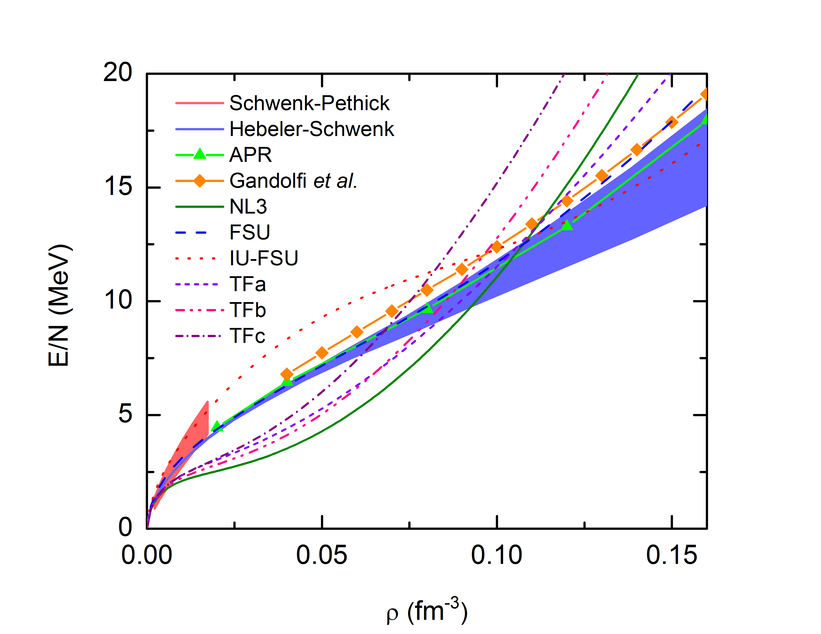
Pure Neutron Matter: Theoretical Constraints
Powerful Quantum Monte Carlo Calculations are becoming a standard tool to constrain the EOS of PNM.
Fattoyev et al., Phys. Rev. C. 87, 015806 (2012)

Slide 12
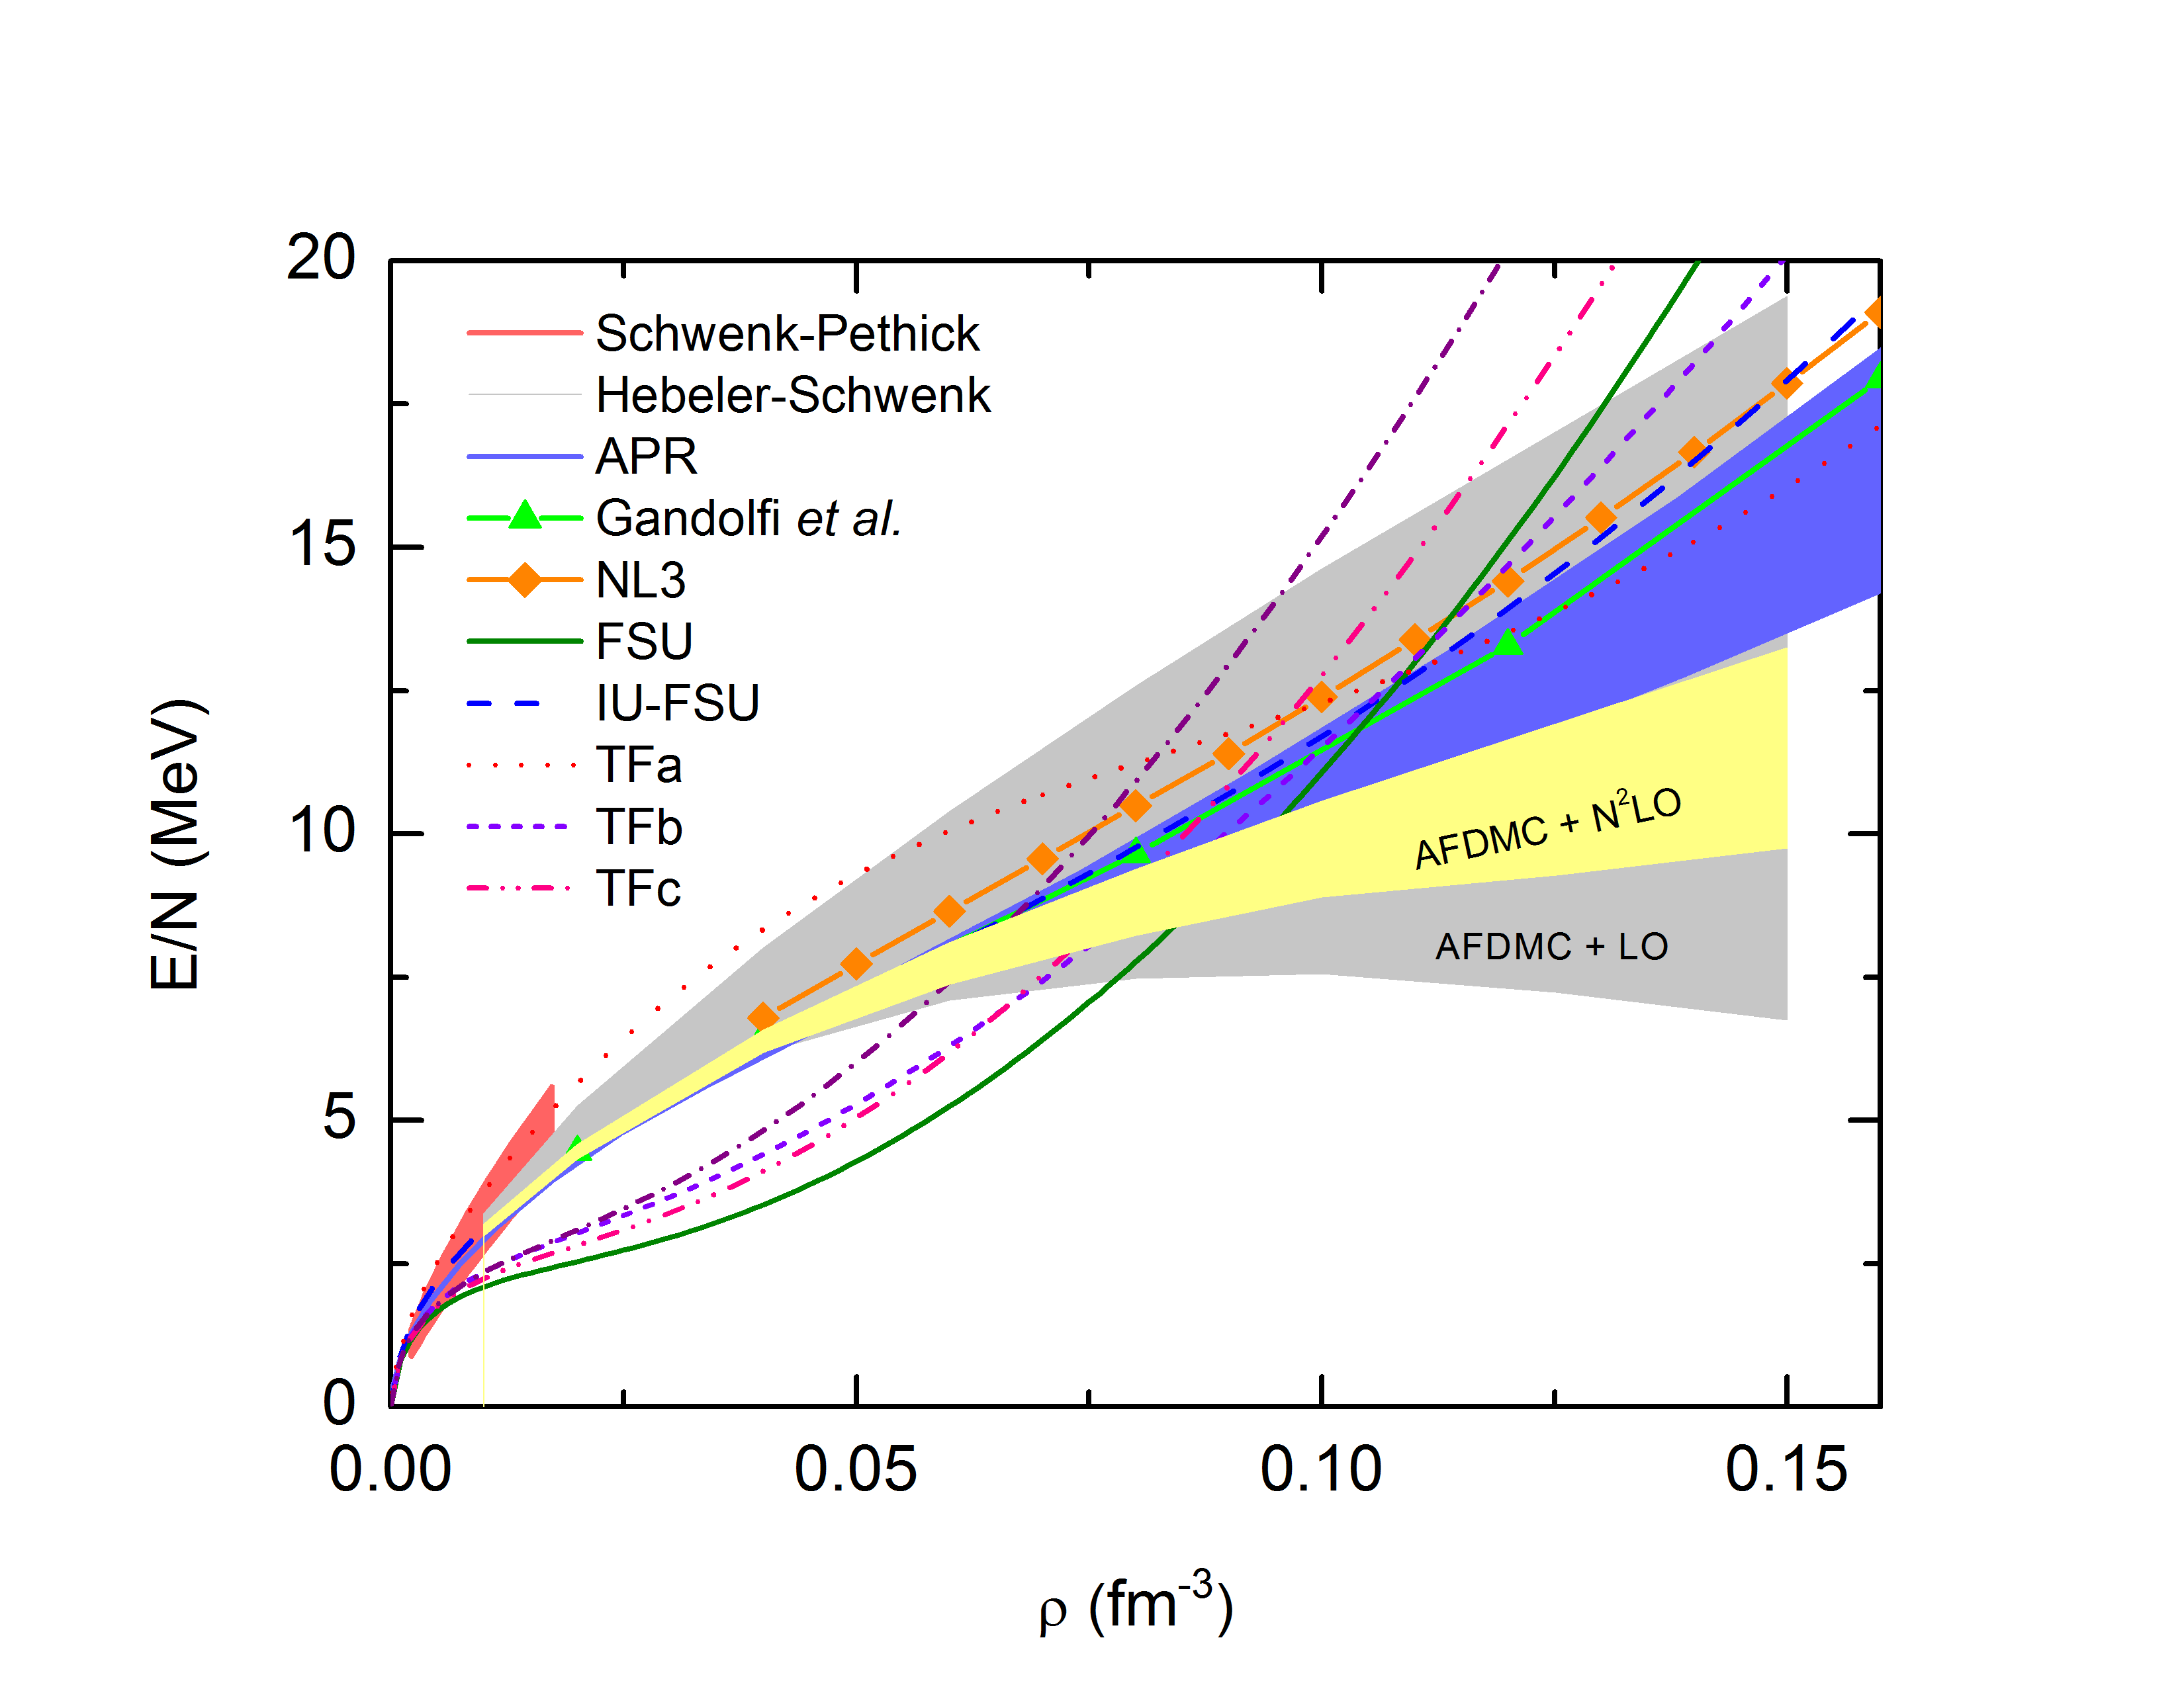
Pure Neutron Matter: Theoretical Constraints
Quantum Monte Carlo Calculations are becoming a standard tool to constrain the EOS of PNM.
Gezerlis et al., Phys. Rev. Lett. 111, 032501 (2013)
Error-bars can be found using powerful covariance analysis.
Hints towards softer symmetry energy
Reinhard & Nazarewicz, PRC 81, 051303 (2010), Fattoyev & Piekarewicz, PRC 84, 064302 (2011)
One can efficiently optimize the EOS by tuning only two parameters of the model.

Slide 13
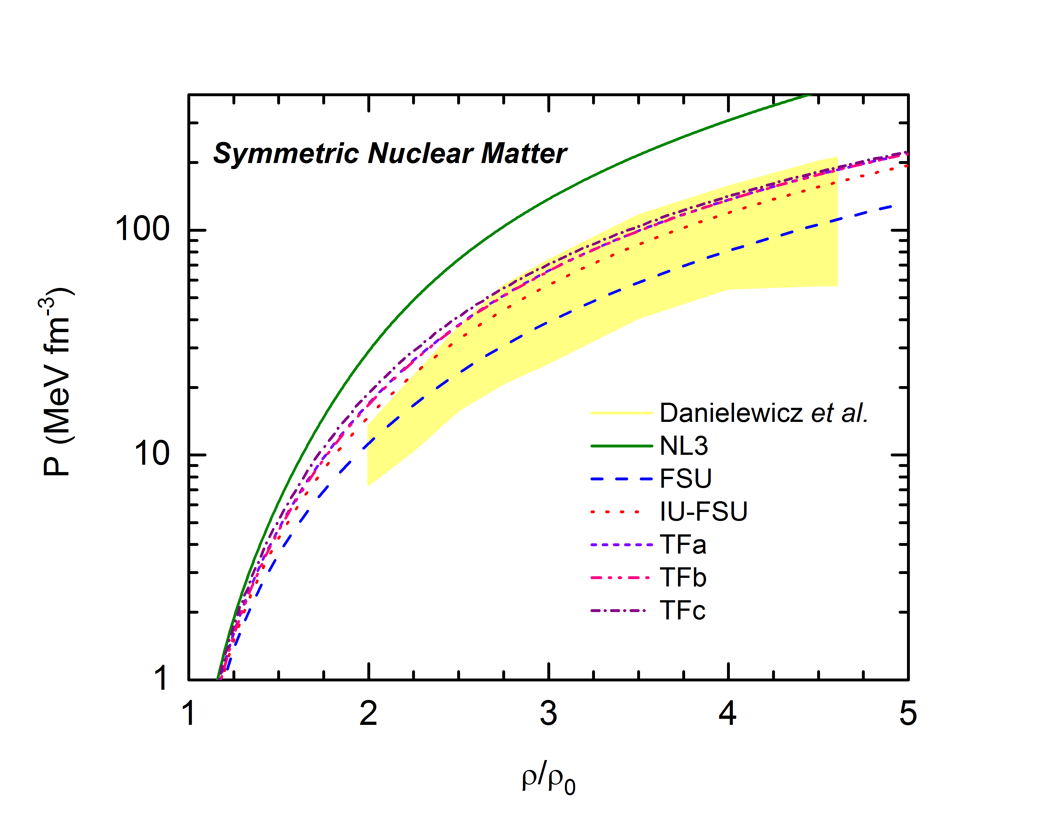
Heavy Ion Collisions
Nuclear matter can be compressed to reach several nuclear saturation densities.
EOS of SNM is constrained by the flow analysis:
The only available experiment on Earth. Can be used as a guide to constrain the high-density EOS.
Danielewicz, Lacey, Lynch, Science. 298, 1592 (2002)

Slide 14
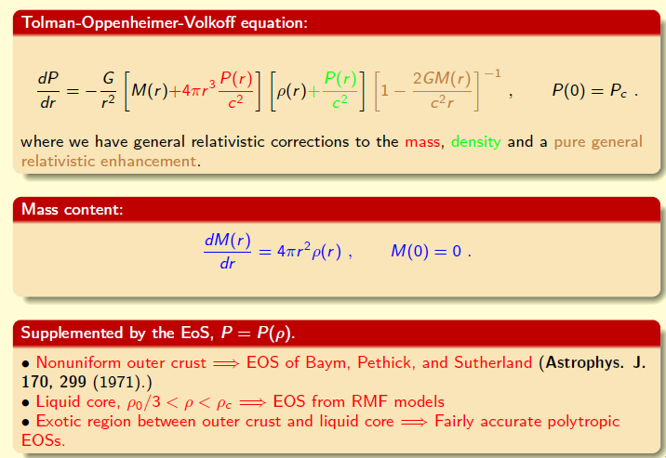
Neutron Stars: Mass versus Radius
Neutron Stars
RMF models conserve causality at high densities, i.e. the speed of sound is always
guaranteed to be smaller then the speed of light. Extrapolation is followed by DFT formalism.

Slide 15
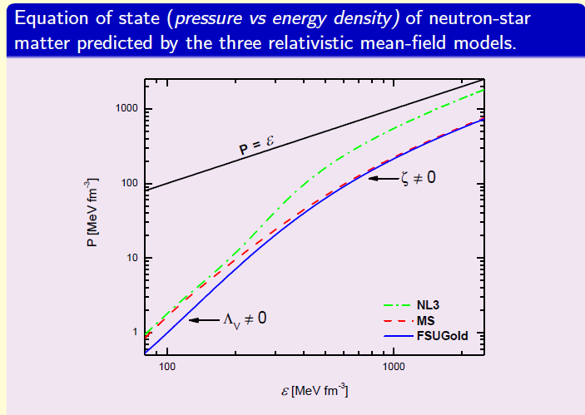
Neutron Stars: Equation of State
Neutron Stars

Slide 16
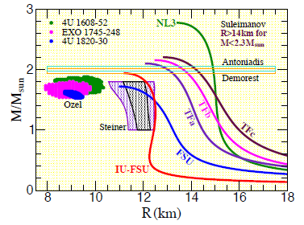
Neutron Stars: Mass versus Radius
Neutron Stars
A simultaneous mass and radius measurement of a single neutron star will constrain the EOS.
While masses are measured to a very high accuracy in binary systems, there is little agreement among different groups in the extraction of stellar radii.
Much works need to be done in both theoretical and observational front to constrain the EOS of neutron-rich matter.

Slide 17
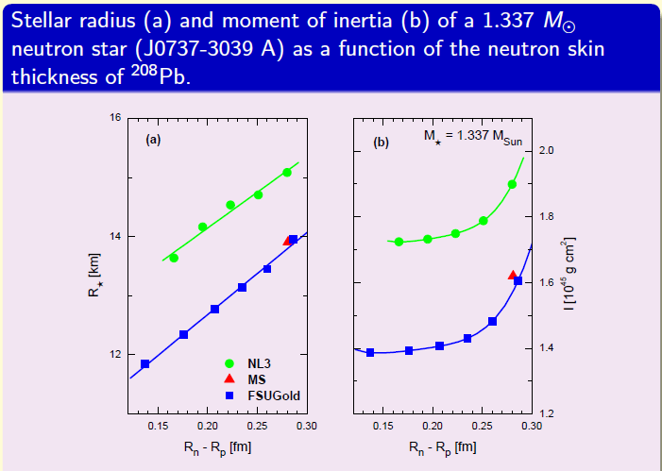
Neutron Stars: Moments of Inertia
Neutron Stars
Moment of inertia of PSR J0737-3039A can be measured with a10% accuracy –
APJ 629, 979 (2005)
MNRAS 364, 635 (2005)

Slide 18
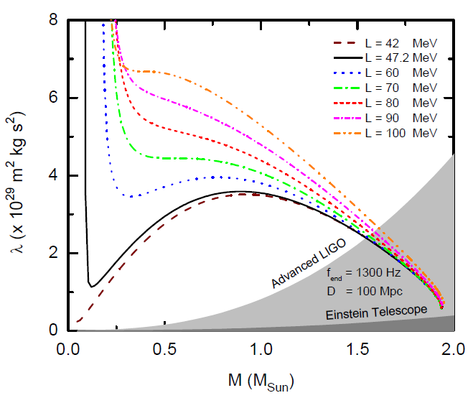
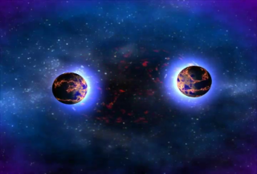
Neutron Stars: Gravitational Waves
At low frequency, tidal corrections to the GW waveforms phase depends on single parameter: Love number!
Fattoyev et al., Phys. Rev. C, 087, 015806 (2013)
Tidal polarizability is measurable at a 10% level –
Flanagan and Hinderer, Phys. Rev. D, 077, 021502 (2008)

Slide 19
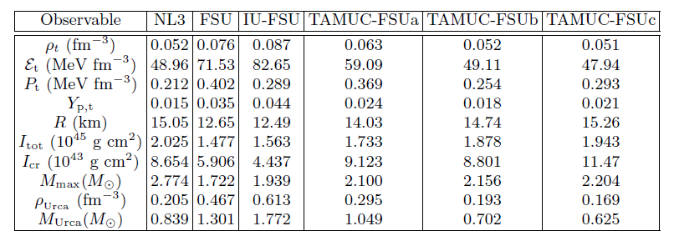
Neutron Stars: Other Observables
Stiff symmetry energy → larger proton fraction at high density (Urca process)
transition density is inversely correlated

Slide 20
Summary
1. RMF models is very useful in describing the EOS of neutron-rich matter. With a handful of model parameters (just 7!) one can describe the ground state properties of finite nuclei and their collective excitations.
2. Isovector sector of the model is little constrained due to the limited available experimental data on the EOS of neutron-rich matter (2 pure isovector parameters);
3. The high density component of the EOS is controlled by a single model parameter that can be tuned to pass the constraint extracted from heavy ion collision experiments, and to reproduce the maximum observed neutron star mass.
4. Additionally, the neutron skin measurement of neutron-rich nuclei will play decisive role in constraining the isovector sector and in providing tight constraints on the density dependence of the symmetry energy around saturation density.
5. The success of this model for the high density component of the EOS of neutron-rich matter can be tested by predicting various neutron star observations that can be (more precisely) measured in the near future.

Slide 21
Summary
1. RMF models are very useful in describing the EOS of neutron-rich matter. With a handful of model parameters one can describe the ground state properties of finite nuclei and their collective excitations.
2. Isovector sector of the model is little constrained due to the limited available experimental data on the EOS of neutron-rich matter;
3. The high density component of the EOS is controlled by a single model parameter that can be tuned to pass the constraint extracted from heavy ion collision experiments, and to reproduce the maximum observed neutron star mass.
4. Additionally, the neutron skin measurement of neutron-rich nuclei will play decisive role in constraining the isovector sector and in providing tight constraints on the density dependence of the symmetry energy around saturation density.
5. The success of this model for the high density component of the EOS of neutron-rich matter can be tested by predicting various neutron star observations that can be (more precisely) measured in the near future.
THANKS!

