Slide 2
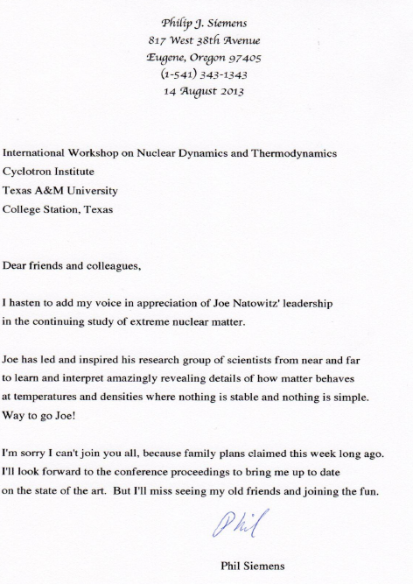
Celebrating Joe’s Journey
“you have done it all – excellent forefront research, classroom teaching, mentoring, major administrative duties and extensive service to the community. Moreover, you have been a perceptive voice of civility when arguments have become heated, a quality that has served to benefit our science greatly”

Slide 3
Celebrating Joe’s Journey
“Most of all that I have fully appreciated is his unfailing enthusiasm and dedication which have been a hallmark in all of his endeavors. One more thing is his constant drive to excel and set a higher goal than ordinarily achieved, in order to remain in the forefront of contemporary research.”
“Prof. Natowitz and his wife Karin gave my family (includes my wife Honglian Chen) a great help not only in work but also in life. After I came back to China, Prof. Natowitz continues to support my group.”

Slide 4
p
Celebrating Joe’s Journey
Two Reminders:
“Age is only a number, a cipher for the records. A man can't retire his experience. He must use it.”
Bernard Baruch
“We don’t stop playing because we grow old; we grow old because we stop playing.”
- George Bernard Shaw
We look forward to many more years of good science from you!

Slide 5
Beam Energy Dependence of the Viscous Damping of Anisotropic Flow
Roy A. Lacey
Stony Brook University
“The piano is able to communicate the subtlest universal truths by means of wood, metal and vibrating air”
Kenneth Miller

Slide 6
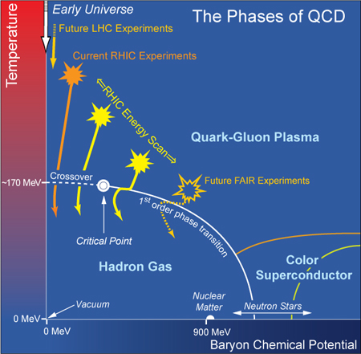
p
A Current Focus of our Field
Quantitative study of the QCD phase diagram
Conjectured Phase Diagram
Interest
Location of the critical End point
Location of phase coexistence lines
Properties of each phase
All are fundamental to the phase diagram of any substance
Spectacular achievement:
Validation of the crossover
transition leading to the QGP
→ Necessary for the CEP?
A major current focus is the characterization of the QGP produced
at RHIC and the LHC, as well as a search for the CEP at RHIC

Slide 7
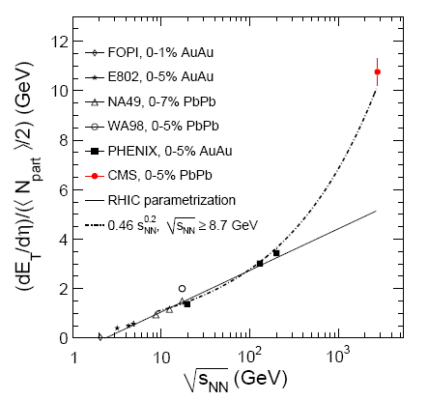
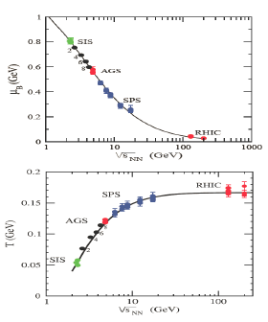
Current Strategy
Exploit system size and the energy density lever arm
($μ_{B}$,T) at freezeout
Energy scan
LHC → access to high T and small $μ_{B}$
RHIC → access to different systems and
a broad domain of the ($μ_{B}$,T)-plane
RHIC_{BES} to LHC → $\sim$360 $\sqrt{s_{NN}}$ increase
LHC + BES → access to an even broader domain of the ($μ_{B}$,T)-plane

Slide 8
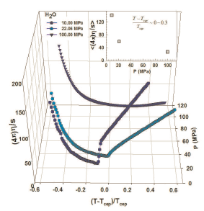
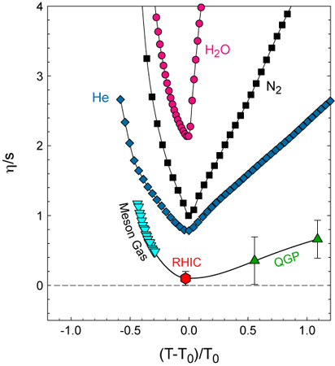
Essential Questions
Lacey et. al, Phys.Rev.Lett.98:092301
(${\text{T},μ}_{B}$)-dependence of transport
coefficients $\left\langle c_{s}\right\rangle$, $\left\langle \frac{η}{s}\right\rangle$?
The role of system size and
fluctuations?
Location of phase boundaries?
Indications for a CEP?
At the CEP or close to it, anomalies in
the dynamic properties of the medium can drive abrupt changes in transport coeﬃcients

Slide 9
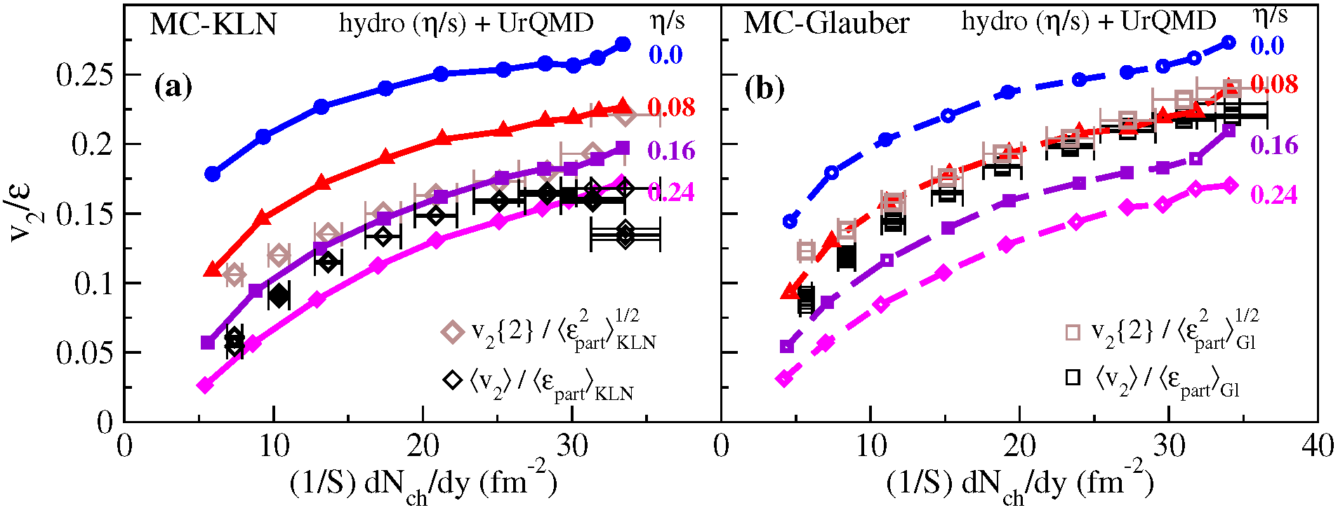
An Essential Question
Song et al
Does the value of $\frac{η}{s}$ depend on the initial geometry model or the method of extraction?

Slide 10
Take home message
The acoustic nature of flow leads to specific scaling patterns which :
Give profound mechanistic insight on viscous damping
Provide constraints for
($μ_{B}$,T) and R dependence of the viscous coefficients
Hints for a possible critical point?
initial state geometry and its fluctuations

Slide 11
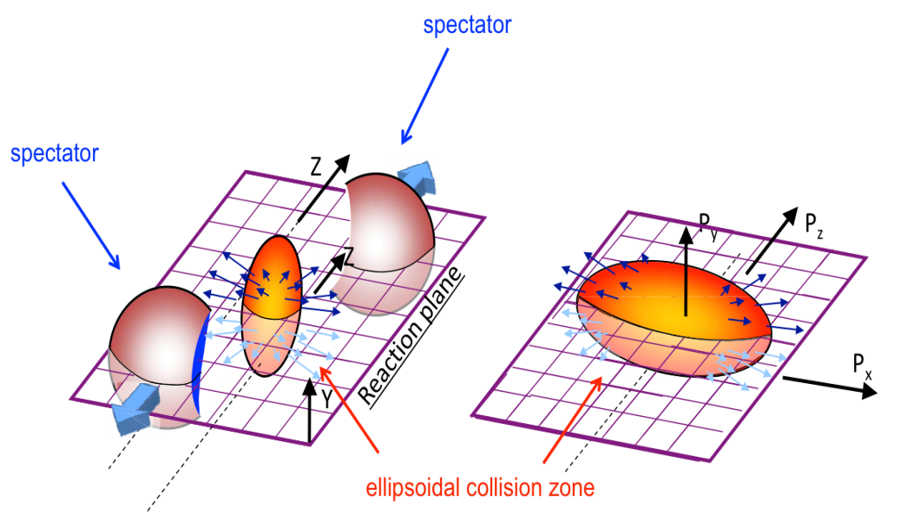
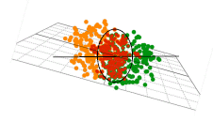
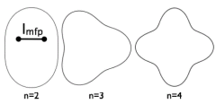
The Flow Probe
Anisotropic p
Idealized Geometry
Isotropic p
Yield(φ) =2 v₂ cos[2(φ−Ψ₂]
Crucial parameters
Actual collision profiles are not smooth,
due to fluctuations!
Initial Geometry characterized by many shape harmonics (ε_{n}) → drive v_{n}
Acoustic viscous modulation of v_{n}
Staig & Shuryak arXiv:1008.3139
Initial eccentricity (and its attendant fluctuations) ε_{n} drive momentum anisotropy v_{n} with specific viscous modulation

Slide 12
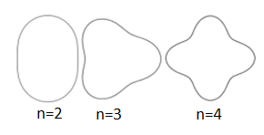
Scaling properties of flow
(II) Scaling properties of flow
Initial Geometry characterized by many shape harmonics (ε_{n}) → drive v_{n}
Acoustic viscous modulation of v_{n}
Staig & Shuryak arXiv:1008.3139
Scaling expectations:
n² dependence
v_{n} is related to v₂
System size dependence
Each of these scaling expectations has been validated
→ Reflects acoustic modulation NOT super horizon modulation

Slide 13
A quick review of the data?

Slide 14
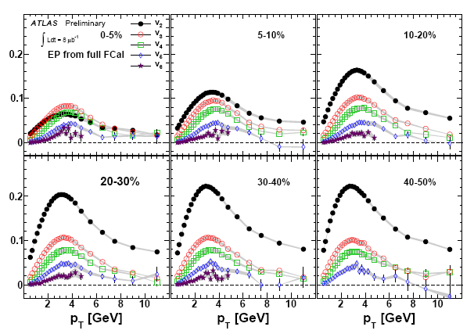
Anisotropy Measurements
ATLAS data - Phys. Rev. C86, 014907 (2012) & ATLAS-CONF-2011-074
High precision double differential measurements obtained for higher harmonics at RHIC and the LHC.

Slide 15
Anisotropy Measurements
arXiv:1305.3341
STAR - Phys.Rev.C86, 014904 (2012); Phys.Rev.C86, 054908 (2012)
CMS - Phys.Rev.C87, 014902 (2013)
An extensive set of measurements now span a broad range of beam energies (${\text{T},μ}_{B}$).

Slide 16
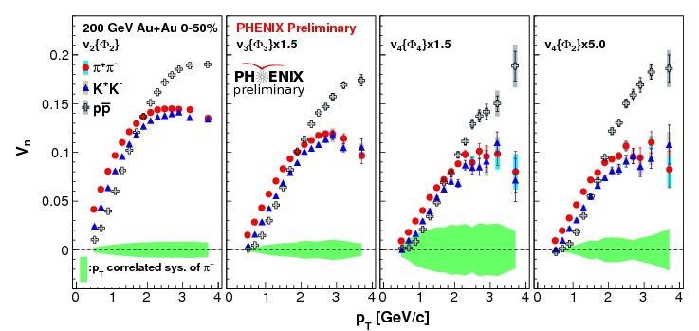
Anisotropy Measurements
High precision double differential measurements obtained for identified particle species at RHIC and the LHC.

Slide 17
Do the wealth of anisotropy measurements show a consistent scaling pattern?
What do we learn from these scaling patterns?

Slide 18
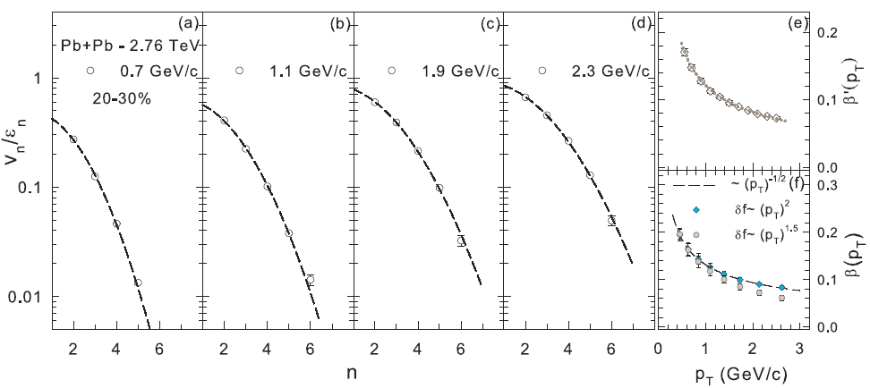
Acoustic Scaling – n²
ATLAS data - Phys. Rev. C86, 014907 (2012)
arXiv:1301.0165
Characteristic n² viscous damping validated
Characteristic 1/(p_{T})^{α} dependence of extracted β values validated
Constraint for η/s and δf

Slide 19
Data and calculated points from CMS PAS HIN-12-011
Viscous Hydro
n² scaling validated in viscous hydrodynamics; calibration → 4πη/s ~ 2

Slide 20
Flow is partonic & Acoustic?
arXiv:1211.4009
Note species dependence for all v_{n}
For partonic flow, quark number scaling expected
→ single curve for identified particle species v_{n}

Slide 21
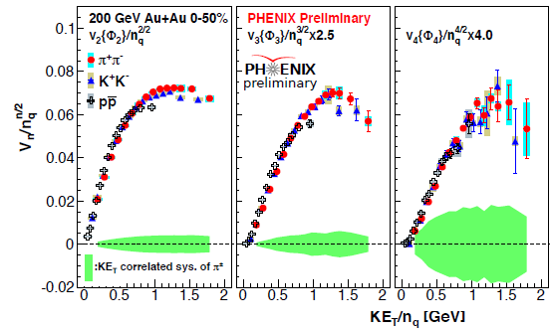
Scaling properties of flow
Acoustic Scaling – Ratios
v_{n} PID scaling

Slide 22
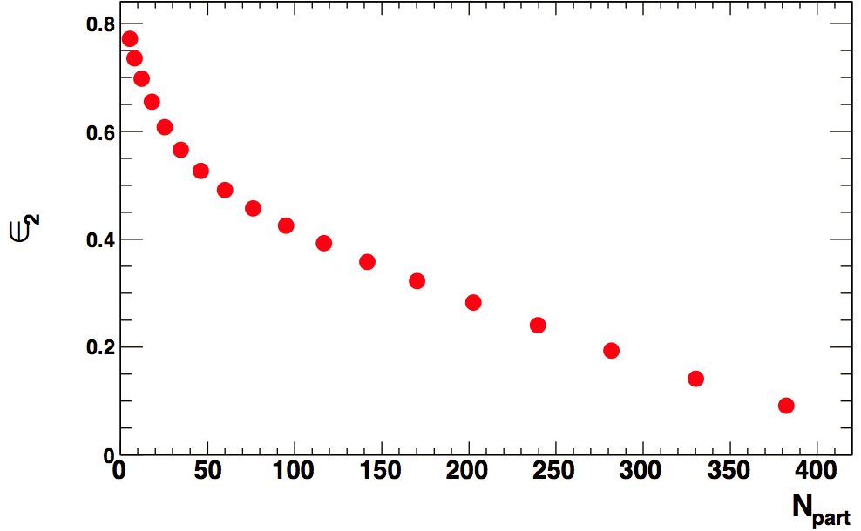
Scaling properties of flow
Acoustic Scaling – $\frac{1}{\overline{R}}$
Centrality
5-70%
Eccentricity change alone is not sufficient
To account for the N_{part} dependence of v_{n}
Transverse size ($\overline{R}$ ) influences viscous damping
Characteristic $1/\overline{R}$ scaling prediction is
non-trivial

Slide 23
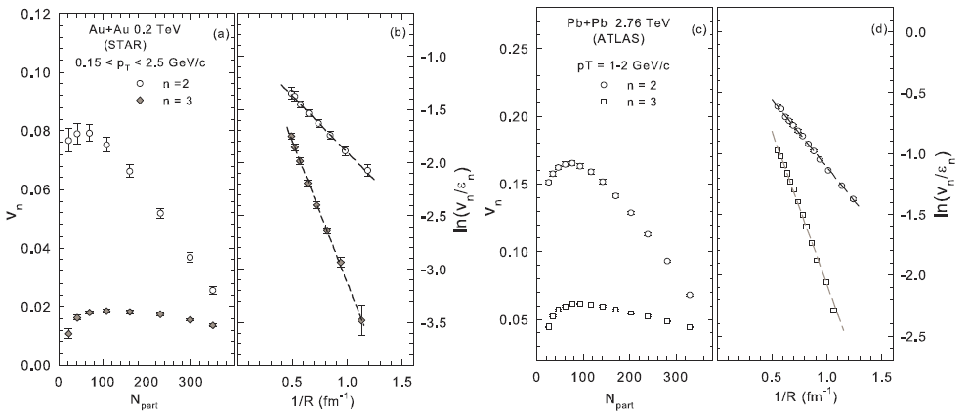
Scaling properties of flow
Acoustic Scaling – $\frac{1}{\overline{R}}$
Characteristic $1/\overline{R}$ viscous damping validated
at RHIC & the LHC
A further constraint for η/s

Slide 24
Song et al
Does the value of $\frac{η}{s}$ depend on the initial geometry model or the method of extraction?

Slide 25
Viscous Hydro
Viscous Hydro
Characteristic $1/\overline{R}$ viscous damping validated in viscous hydrodynamics; calibration → 4πη/s ~ 1.3

Slide 26
Acoustic Scaling – 1/R
Compare system size @ RHIC
Slope difference encodes viscous coefficient difference
Viscous coefficient larger for more dilute system

Slide 27
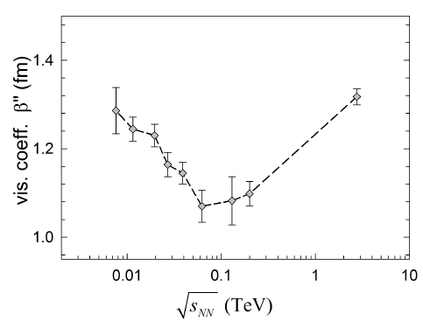
Scaling properties of flow
Acoustic Scaling – $\frac{1}{\overline{R}} Scaling for the Beam Energy Scan$
7.7 GeV
19.6 GeV
39 GeV
62.4 GeV
200 GeV
2.76 TeV
Characteristic $1/\overline{R}$ viscous damping validated across beam energies
First experimental indication for η/s variation in the $\left(T,μ_{B}\right)$-plane

Slide 28
Summary
Acoustic scaling observed for flow
They lend profound mechanistic insights, as well as new constraints for transport coefficients and the initial state
What do we learn?
Flow is acoustic – “as it should be”
Obeys the dispersion relation for sound propagation (n², (n²-4), $1/\overline{R}$) → constraints for ε, β, and δf
Clear system size dependence of β → sensitive to dilution!
Scaling across systems → including very asymmetric systems
Characteristic dependence of β [η/s(T)] on beam energy → constraints for:
(${\text{T},μ}_{B}$)-dependence η/s
η/s @ LHC larger than at RHIC
Indication for CEP??

Slide 29
End

Slide 30
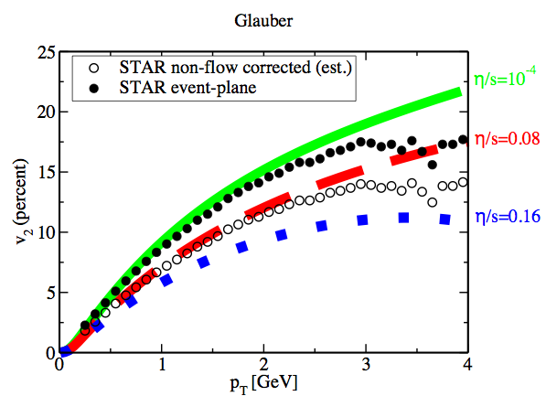
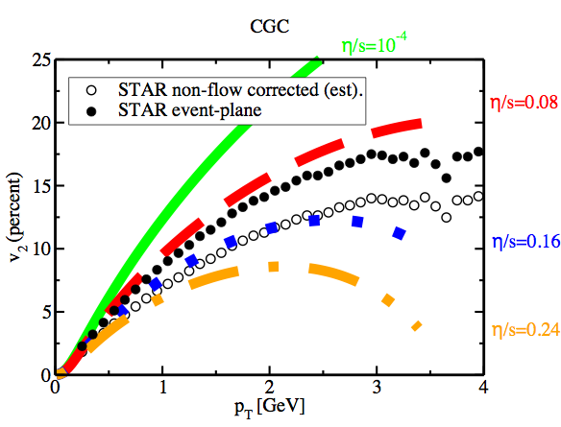
Essential Questions
Luzum et al. arXiv 0804.4015
LHC → access to high T and small $μ_{B}$
RHIC → access to different systems and
a broad domain of the ($μ_{B}$,T)-plane
RHIC_{BES} to LHC → $\sim$360 $\sqrt{s_{NN}}$ increase

Slide 31
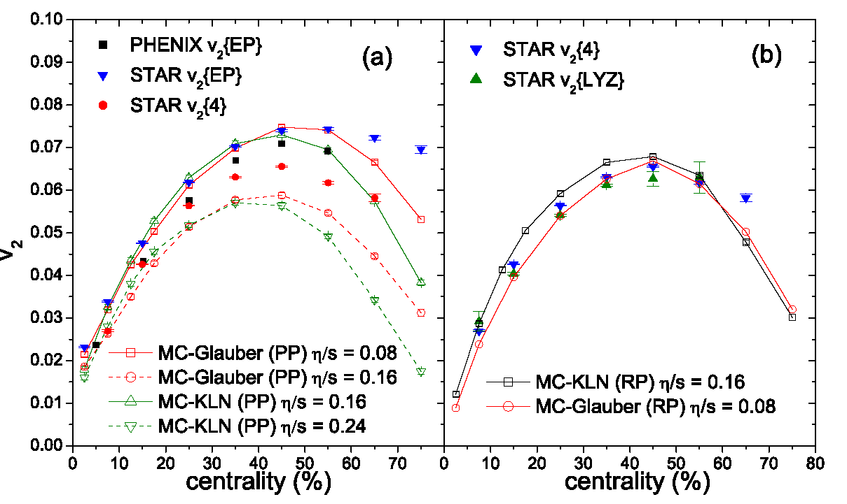

Slide 32
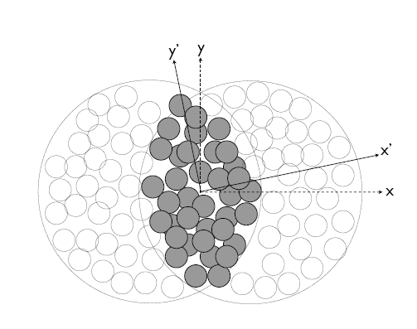
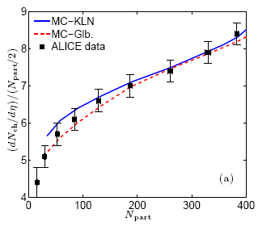
Recent Accomplishments & Near-term Opportunities
Geometry
Phys. Rev. C 81, 061901(R) (2010)
A
B
arXiv:1203.3605
σ_{x} & σ_{y} → RMS widths of density distribution
Geometric fluctuations included
Geometric quantities constrained by multiplicity density.

