Slide 1
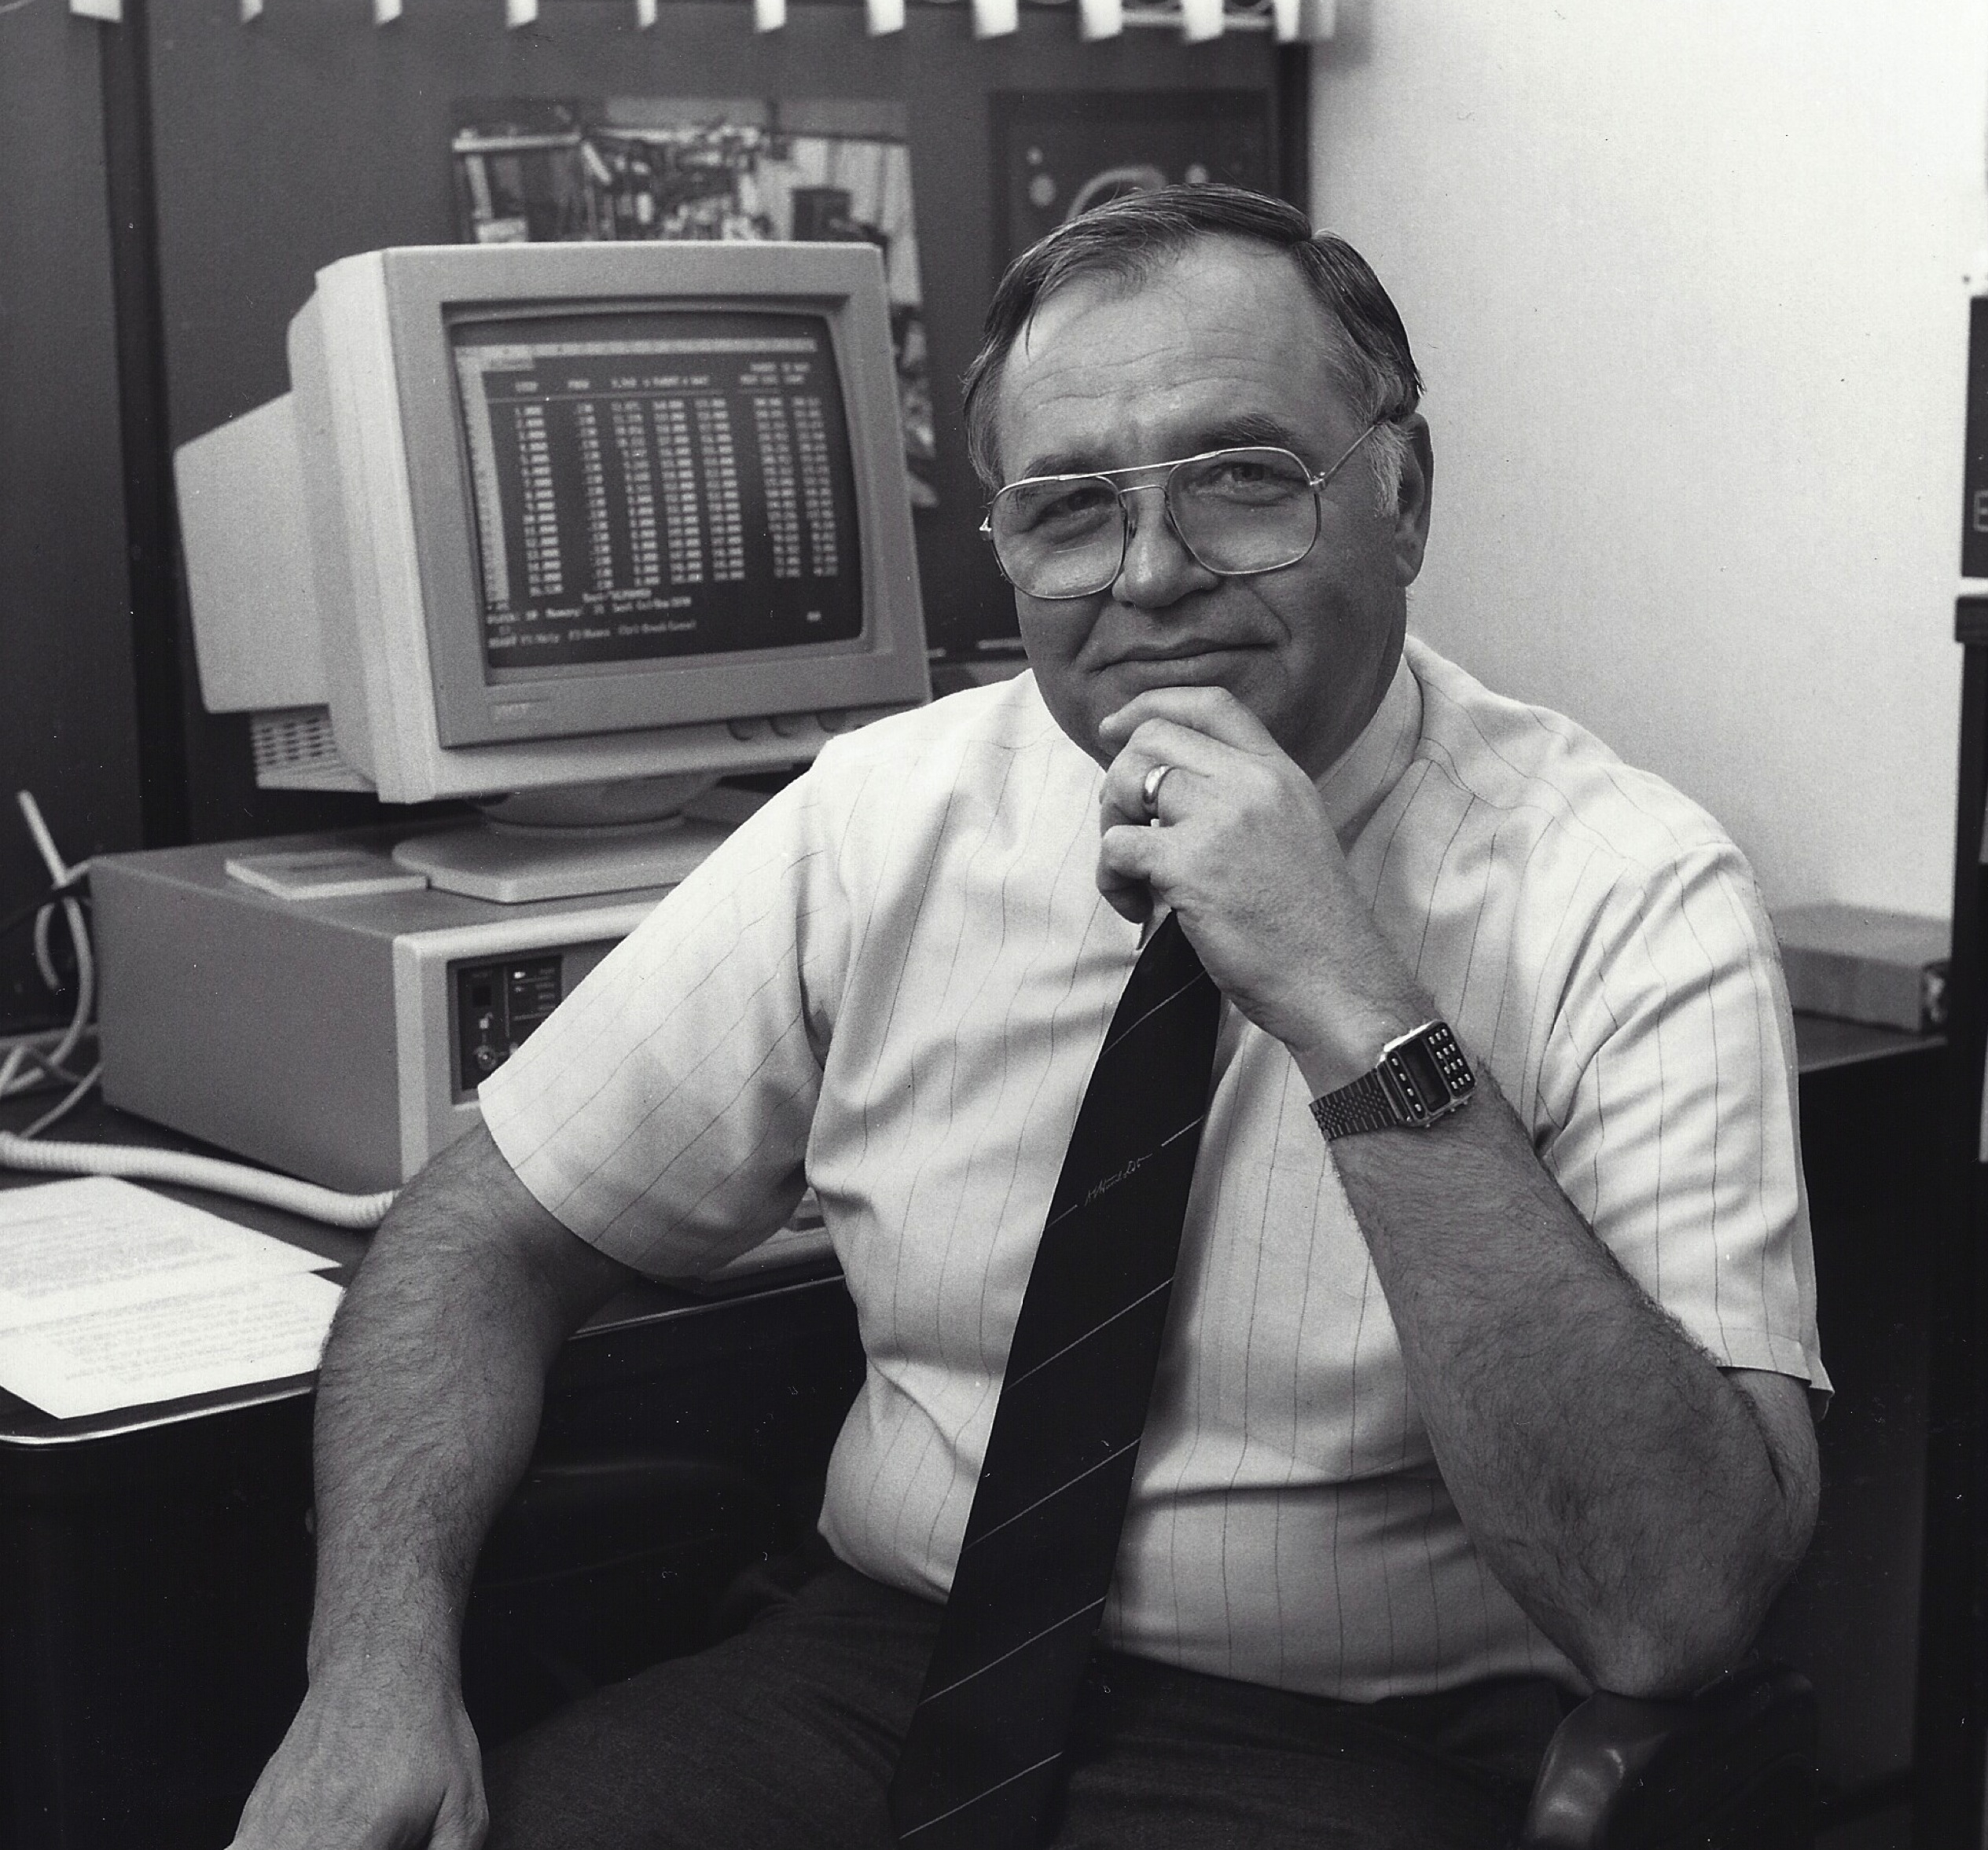
A Brief History of Nuclear Chemistry at Texas A&M

Slide 2
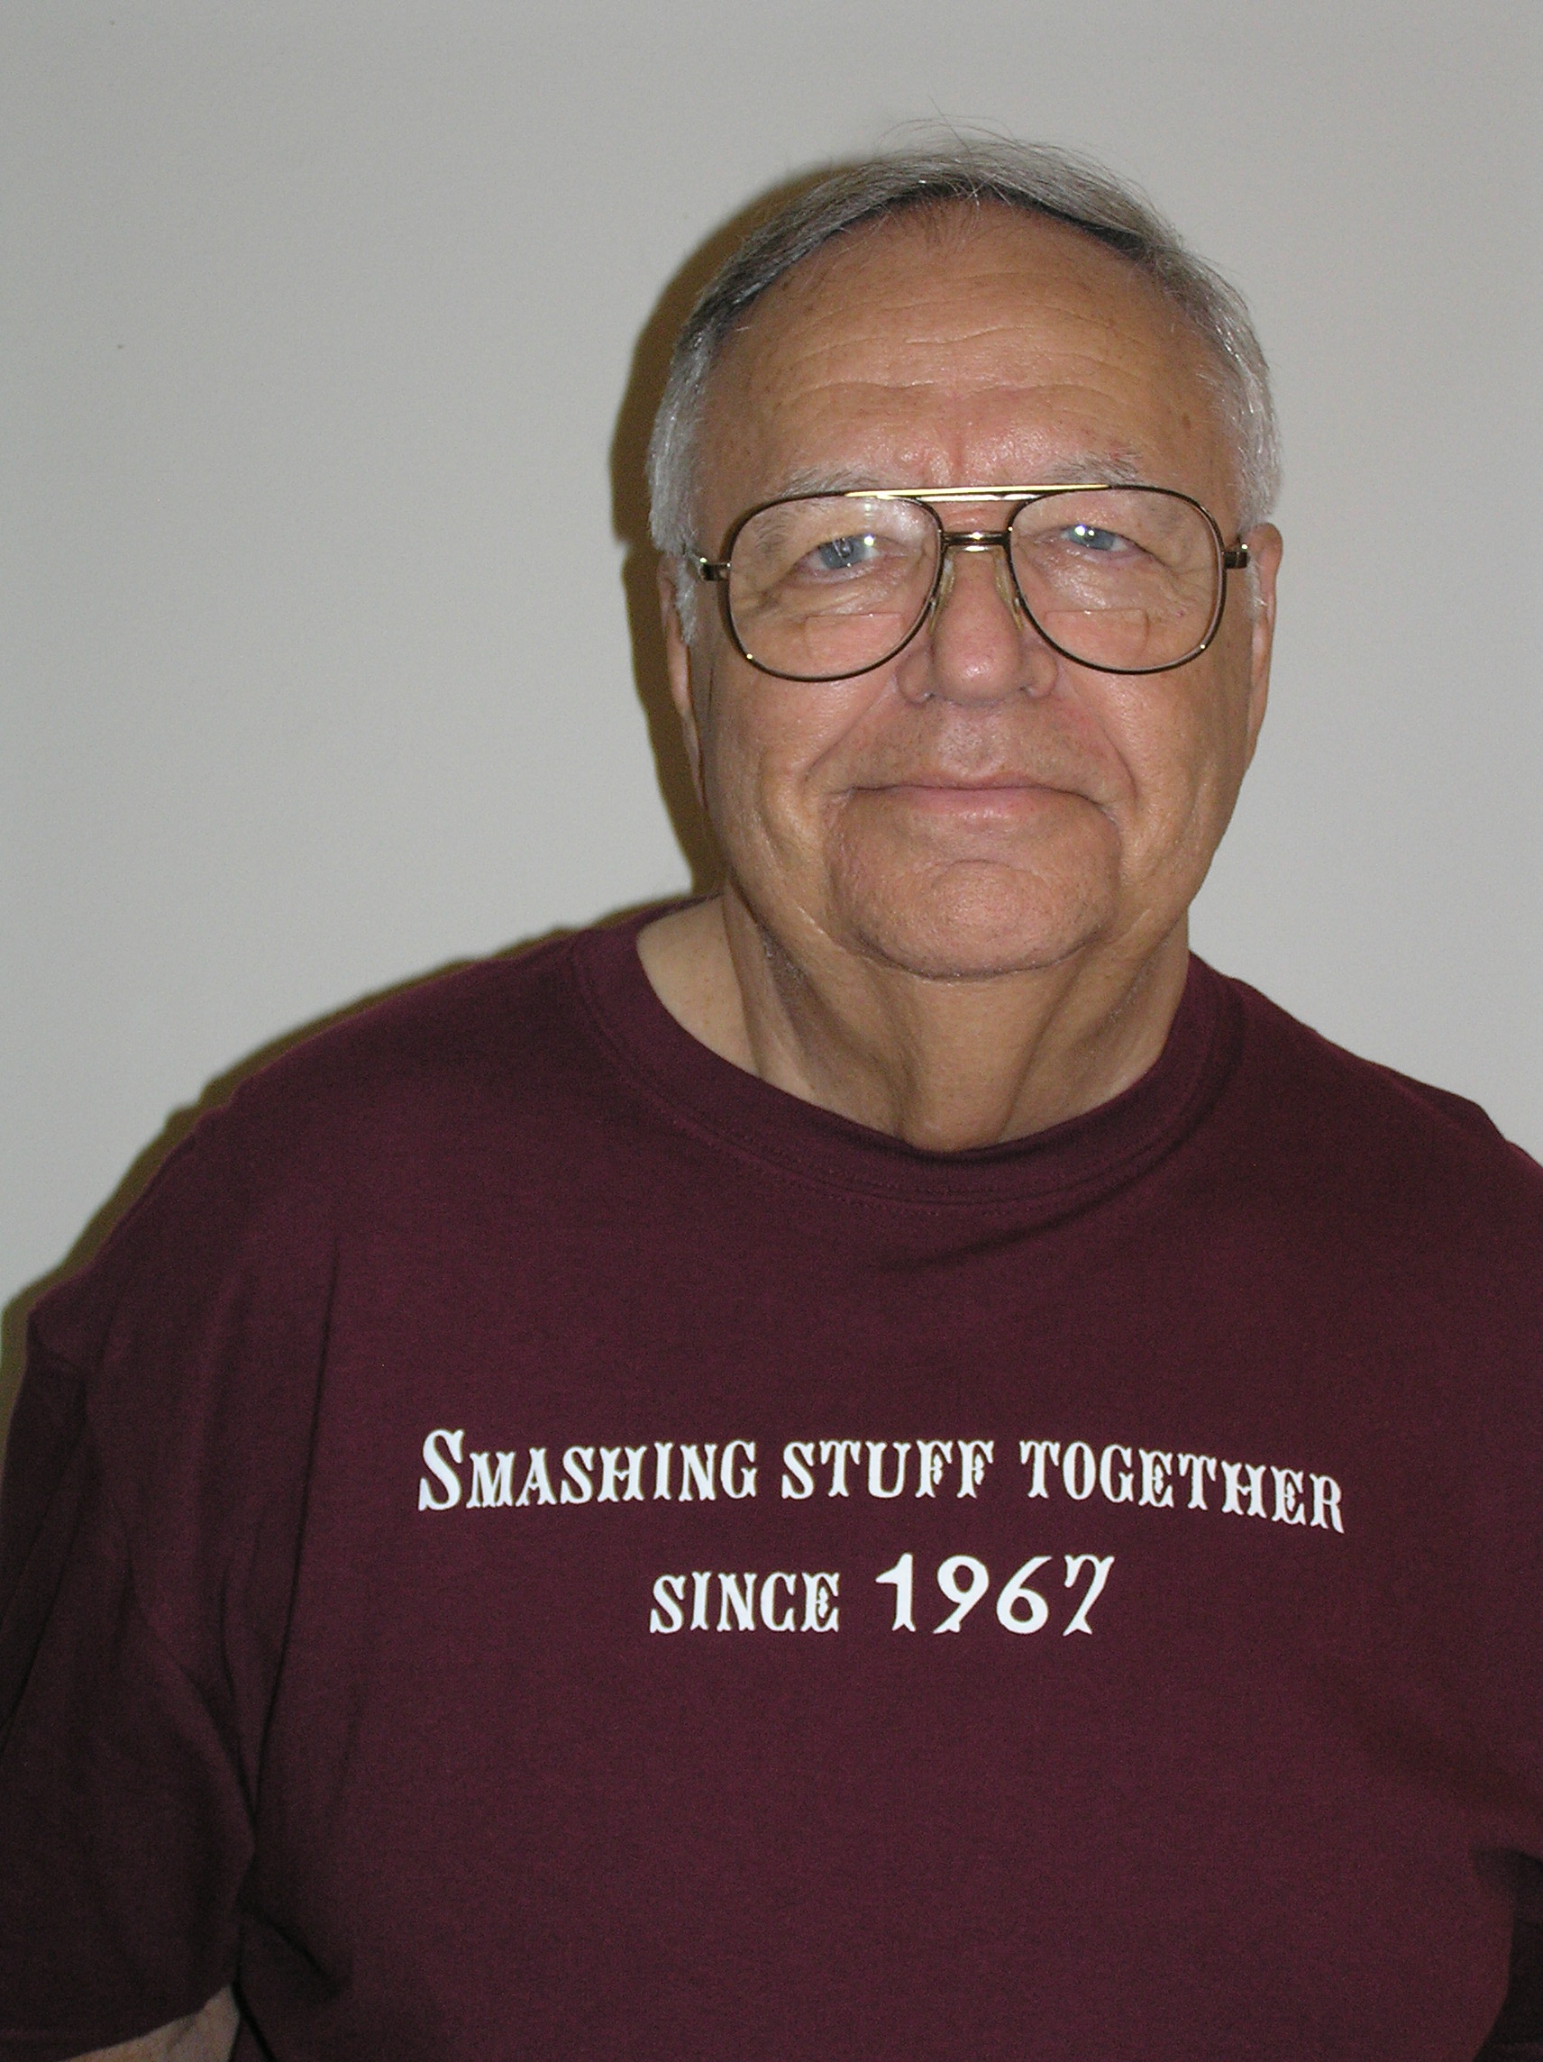

Slide 3
Sept 1961
W.O. Milligan, Welch Foundation Director
Proposal invitation to TAMU president Earl Rudder
“modern cyclotron for study, research and experiments in basic chemical research”

Slide 4
Feb 1962
W.T. “Doc” Doherty, (TAMU alumnus and Welch Foundation Board member) talked to Rudder
Rudder went to TAMU BOR $100K prelim expenses & plans
Board approved request to seek grant to build cyclotron and approved $2M in support
$1M Welch Foundation
Proposal to AEC to build 88in cyclotron

Slide 5
Spring 63
Hired Dwight Conway nuclear chemist from Purdue ( and a few physicists)
  George Igo (from LRL) named director
  John McIntyre ( from Yale) -> physics
  John Gammel ( LANL) theoretical physicist
Seaborg head of AEC

Slide 6
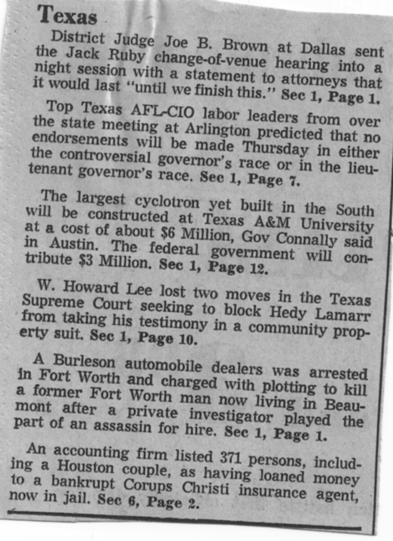
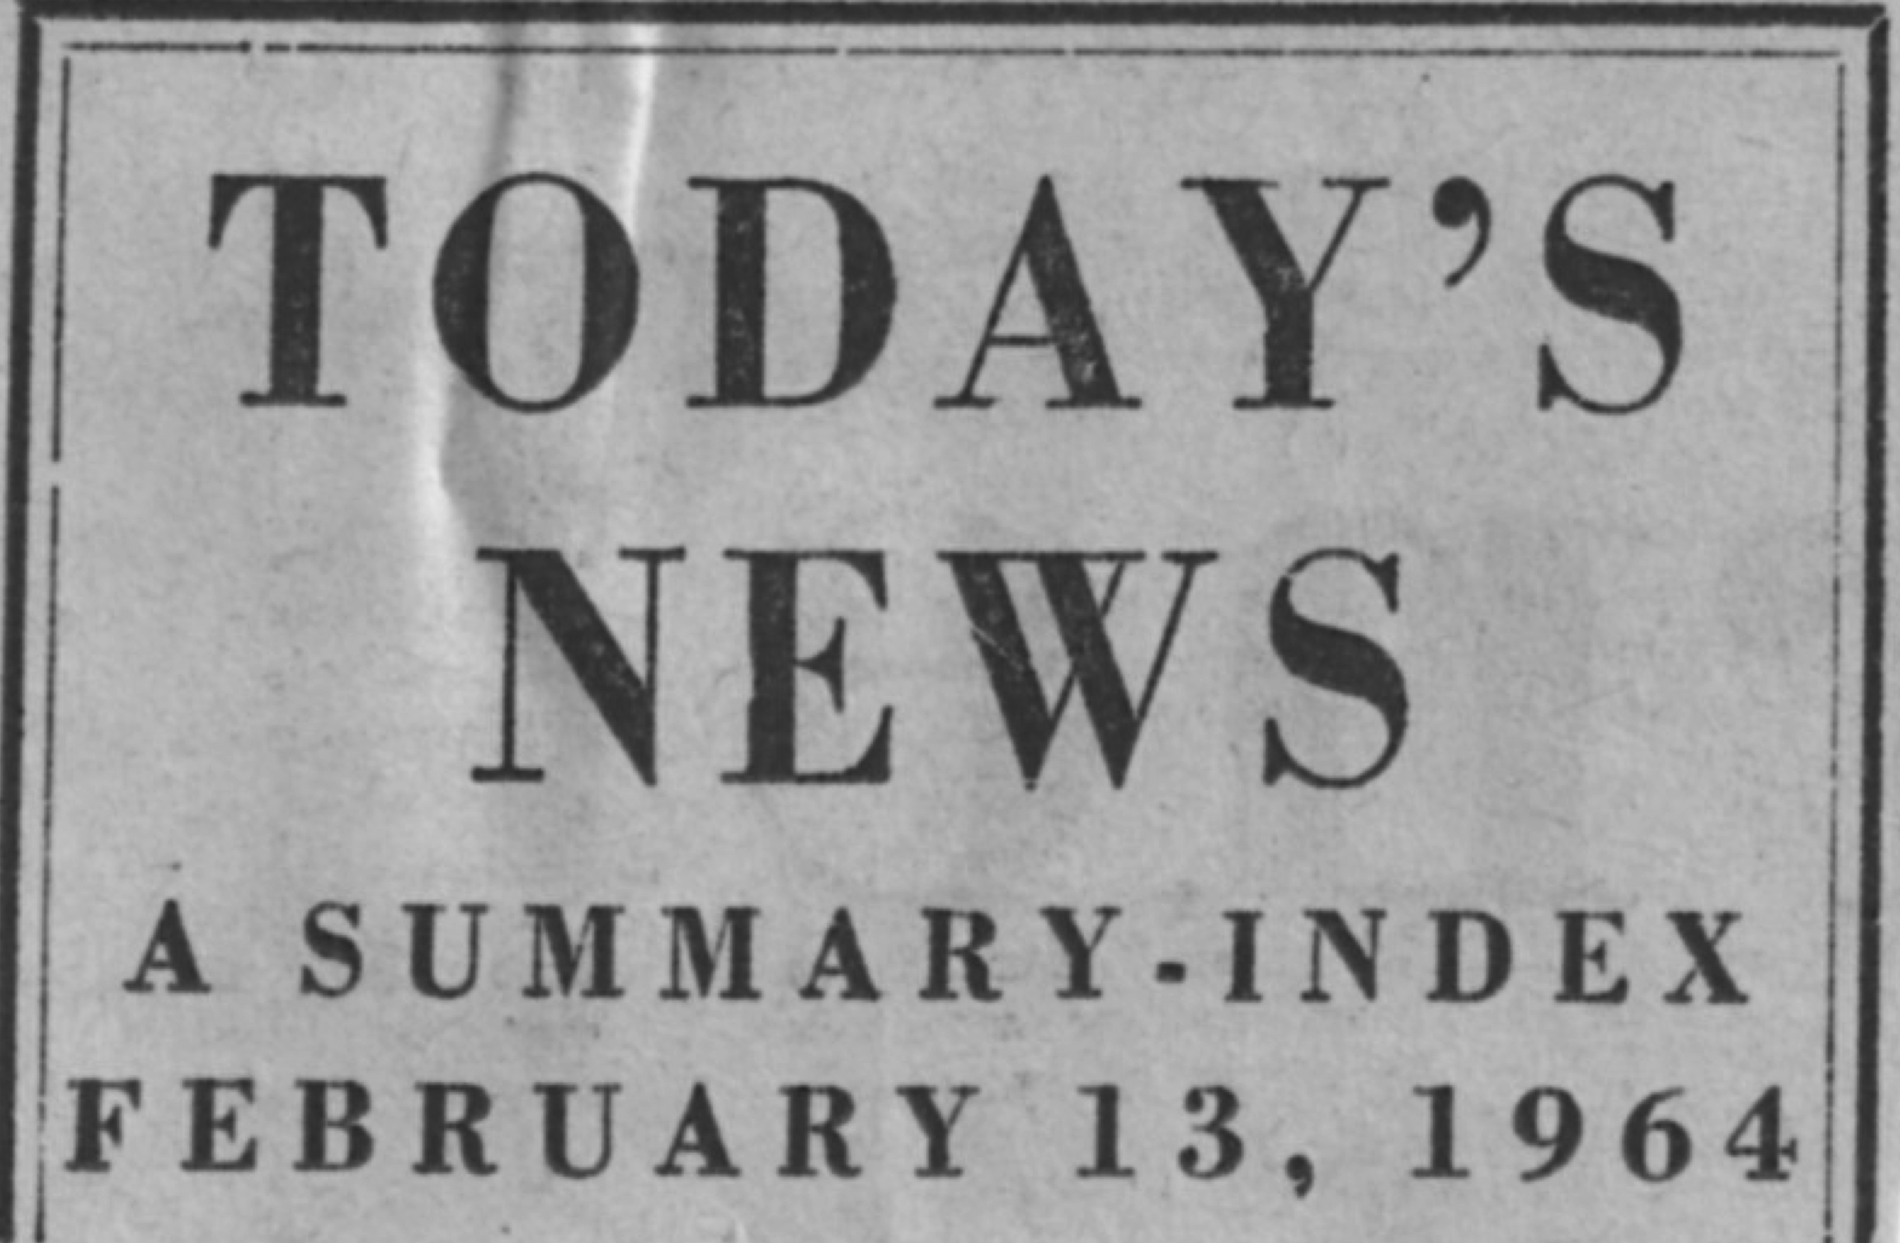
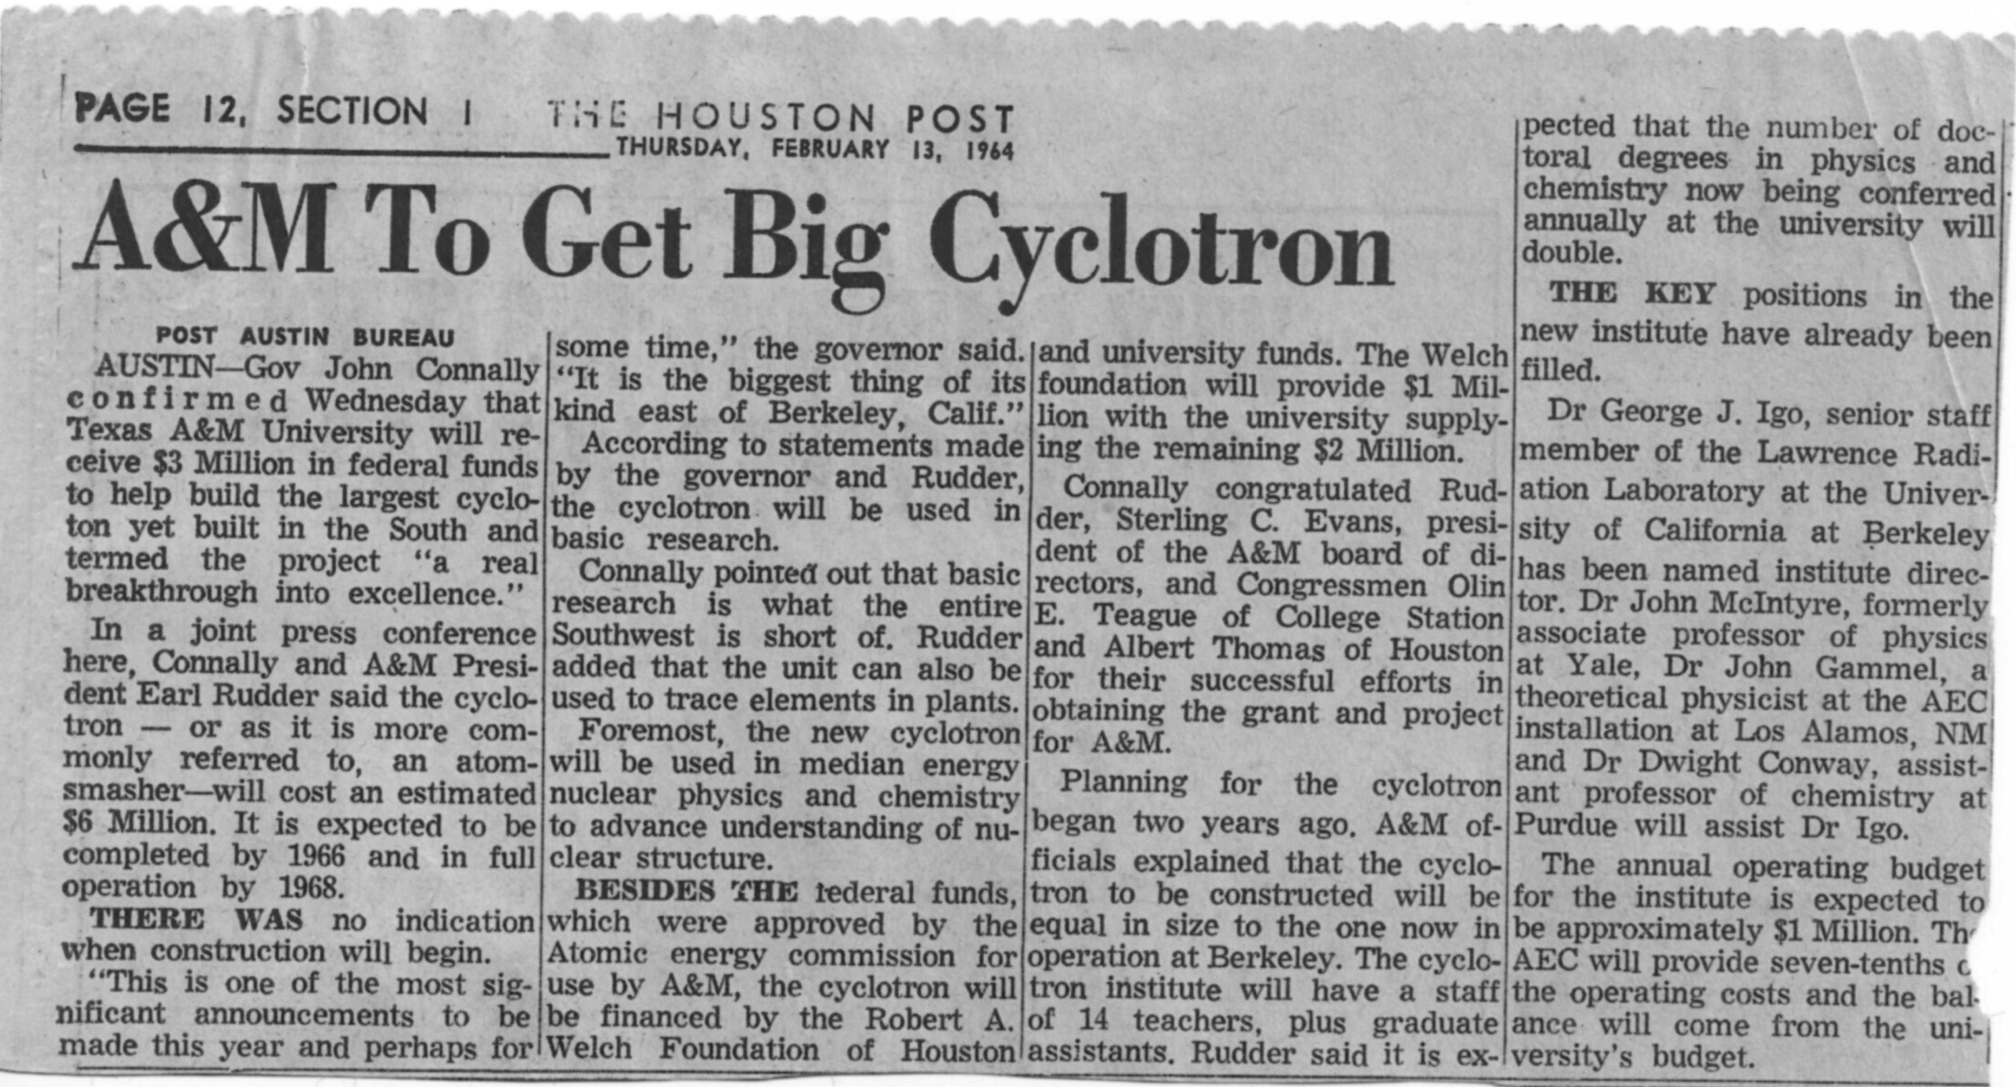
February 1964

Slide 7
Paul calaway – head of chemistry
Andrew suttle – VPR
Charles Squire assoc dean of science
George Igo (from LRL) nasmed director
John McIntyre ( from Yale) -> physics

Slide 8
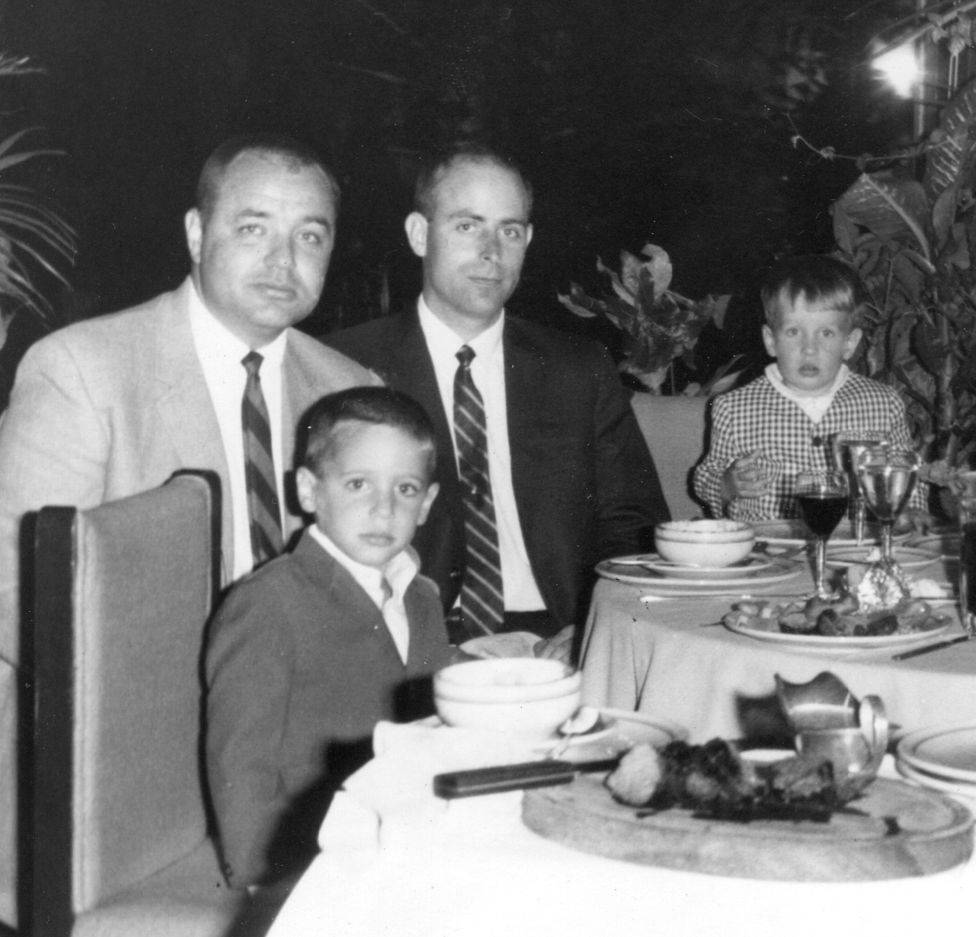
1967
Four Nuclear Chemistry Faculty hired
Joe Natowitz
Rand Watson
Tom Sugihara
Ron MacFarlane

Slide 9
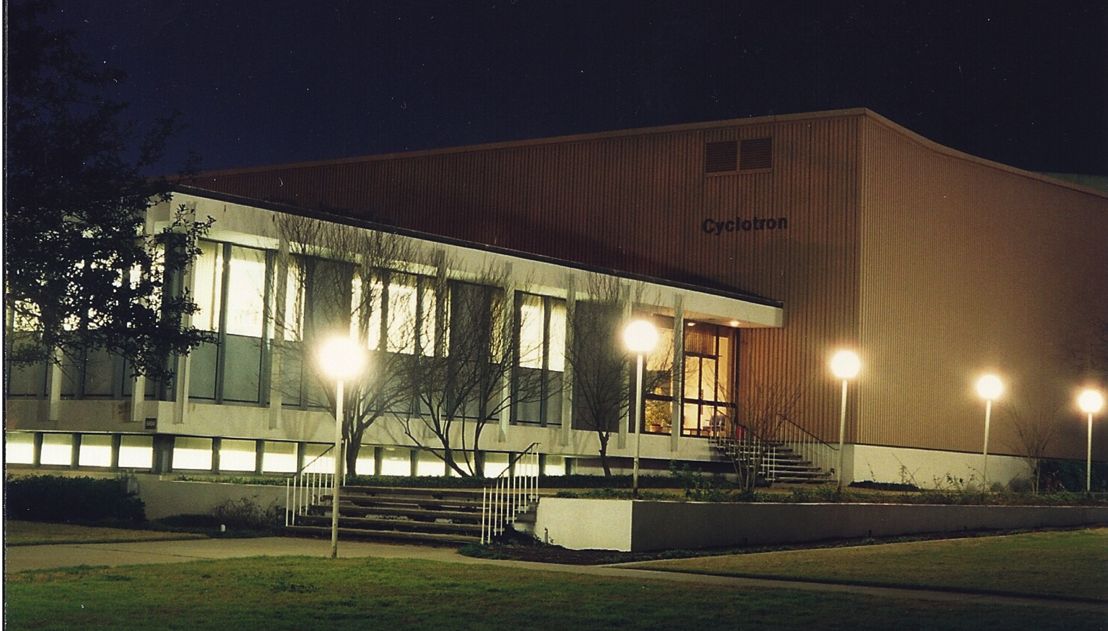
December 4th 1967
cyclotron dedication
“The contribution of nuclear science to chemistry”

Slide 10
July 1970
Ron MacFarlane - named Director of Research

Slide 11
March 15, 1971
Joe Natowitz, Rand Watson and Tom Sugihara were fired
“In order for the Cyclotron Institute to resolve its problems within the existing administrative structure, the members of the institute must be willing to work together in a spirit of mutual judgment [sic] that it is not possible to achieve this in your cases no matter what is done to improve the scientific atmosphere”

Slide 12
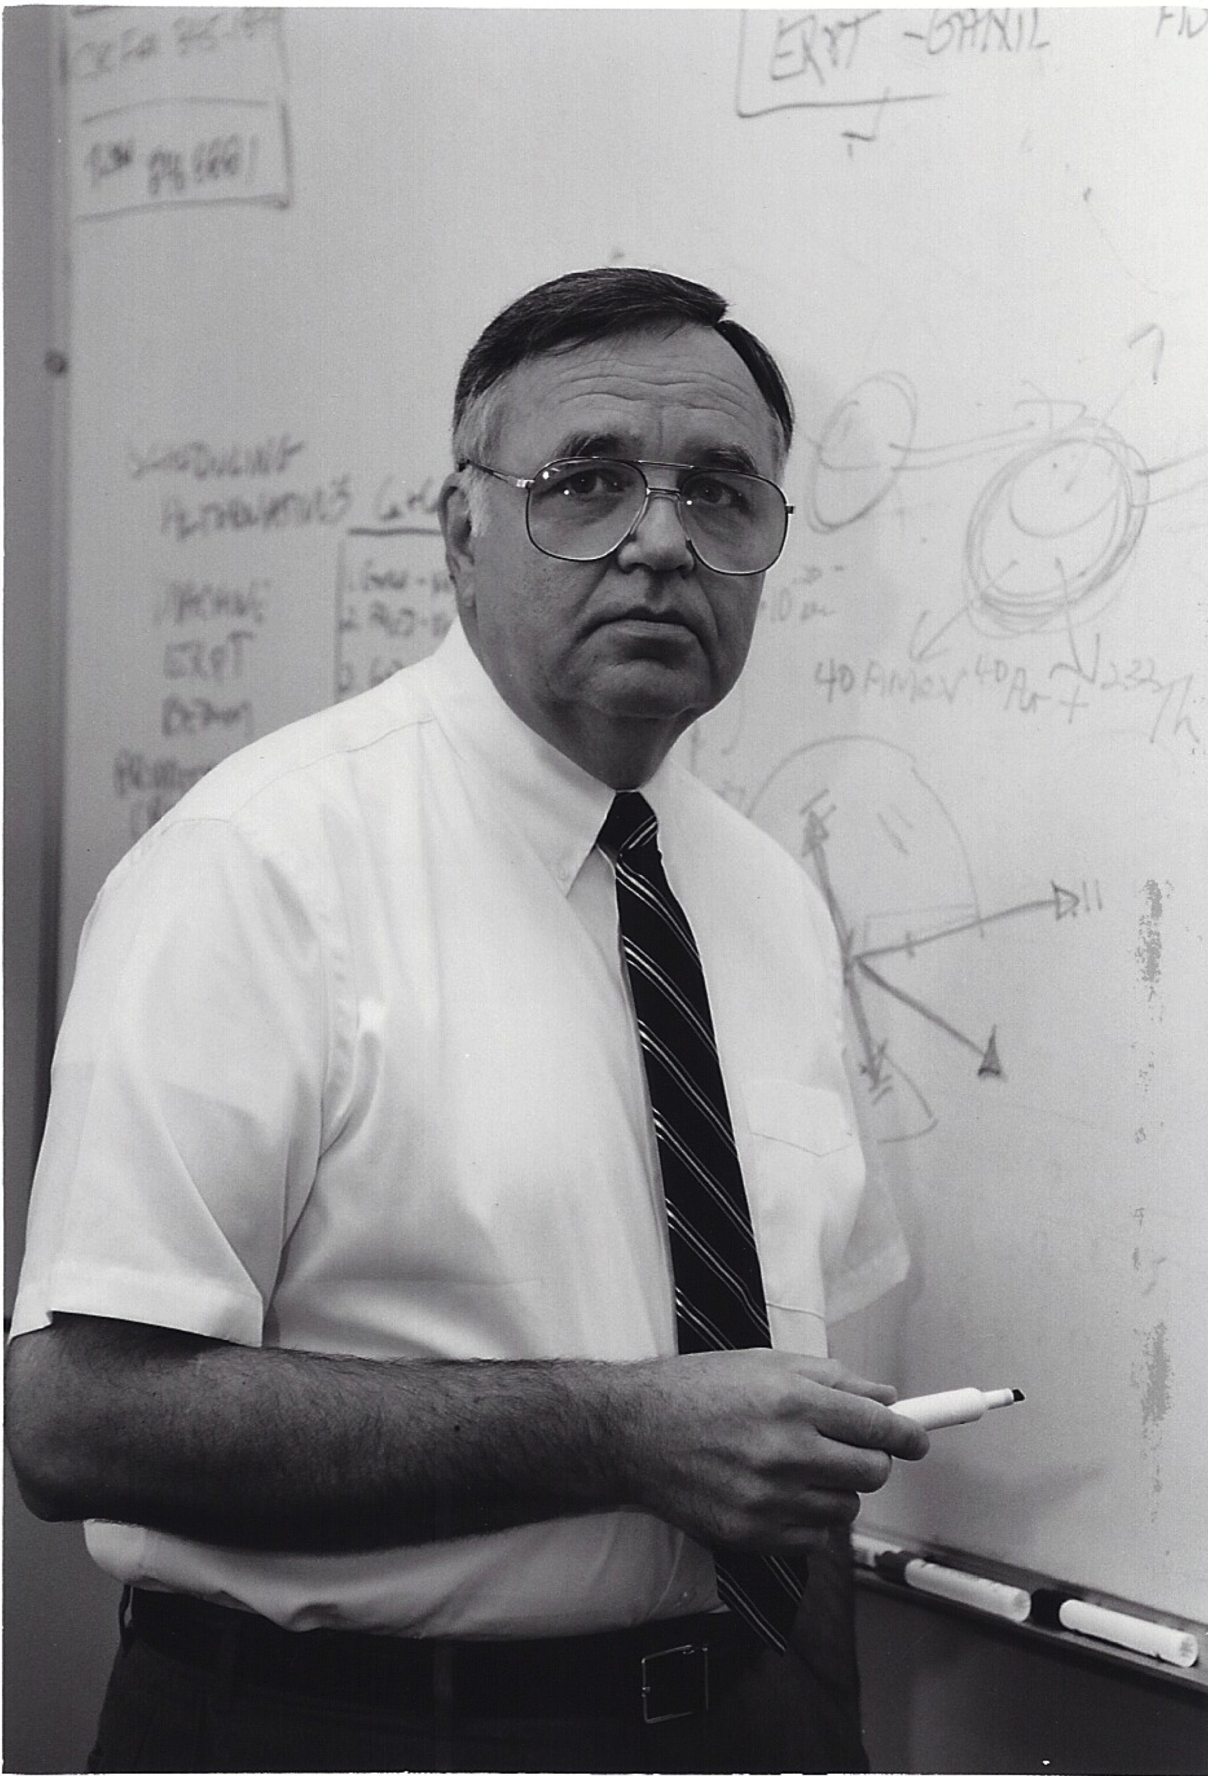
1 April 1971
Control of cyclotron given to Dean J.M. Prescott
Sugihara named Director
(and he overturned the firings of
Natowitz, Watson – and himself)

Slide 13
June 1971
NSF Review
President Jack Williams promised the NSF that the University would provide more space for nuclear chemists in the new chemistry annex on campus
- Joe – what ever happened to that????

Slide 14
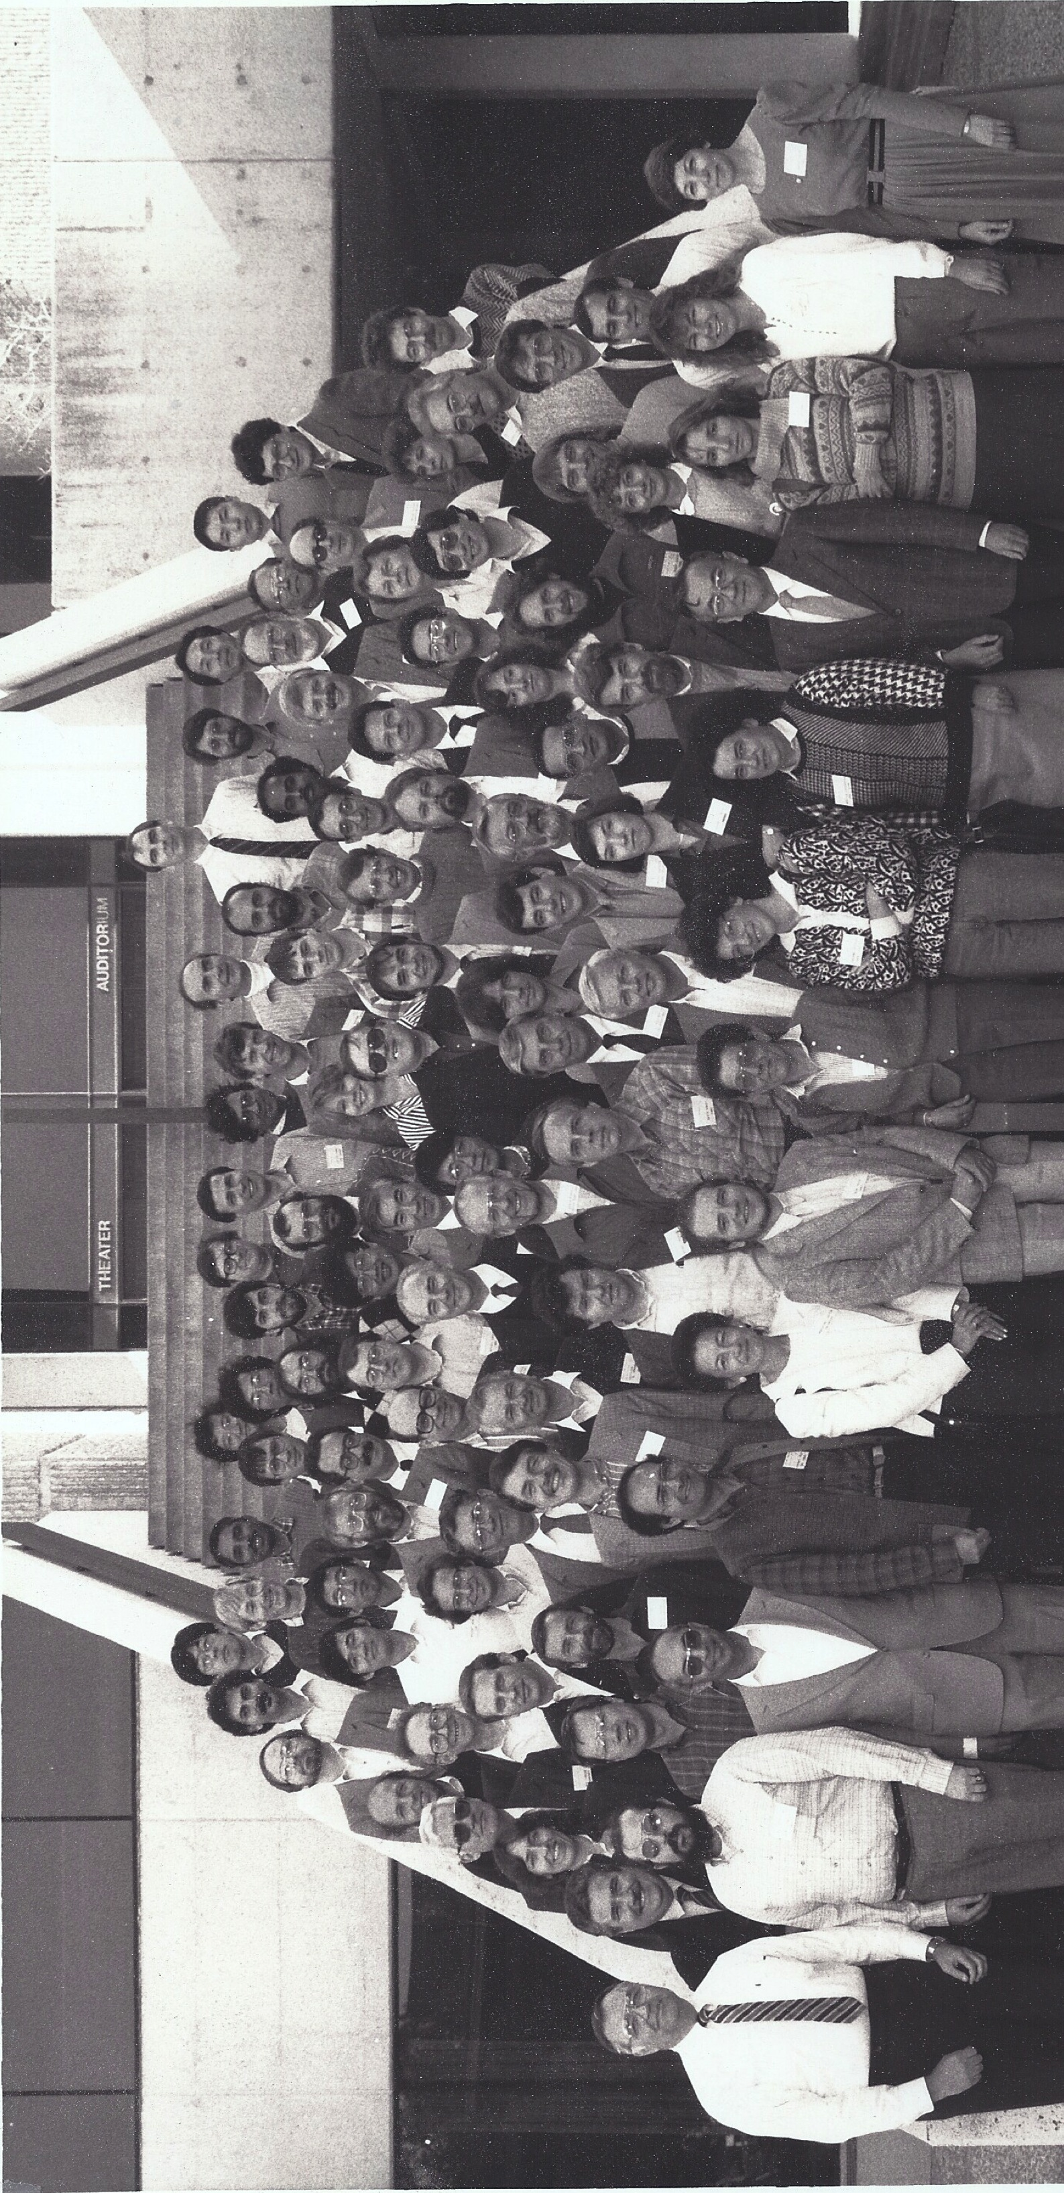
K500 dedication
December 1987
HOT nuclei symposium

Slide 15
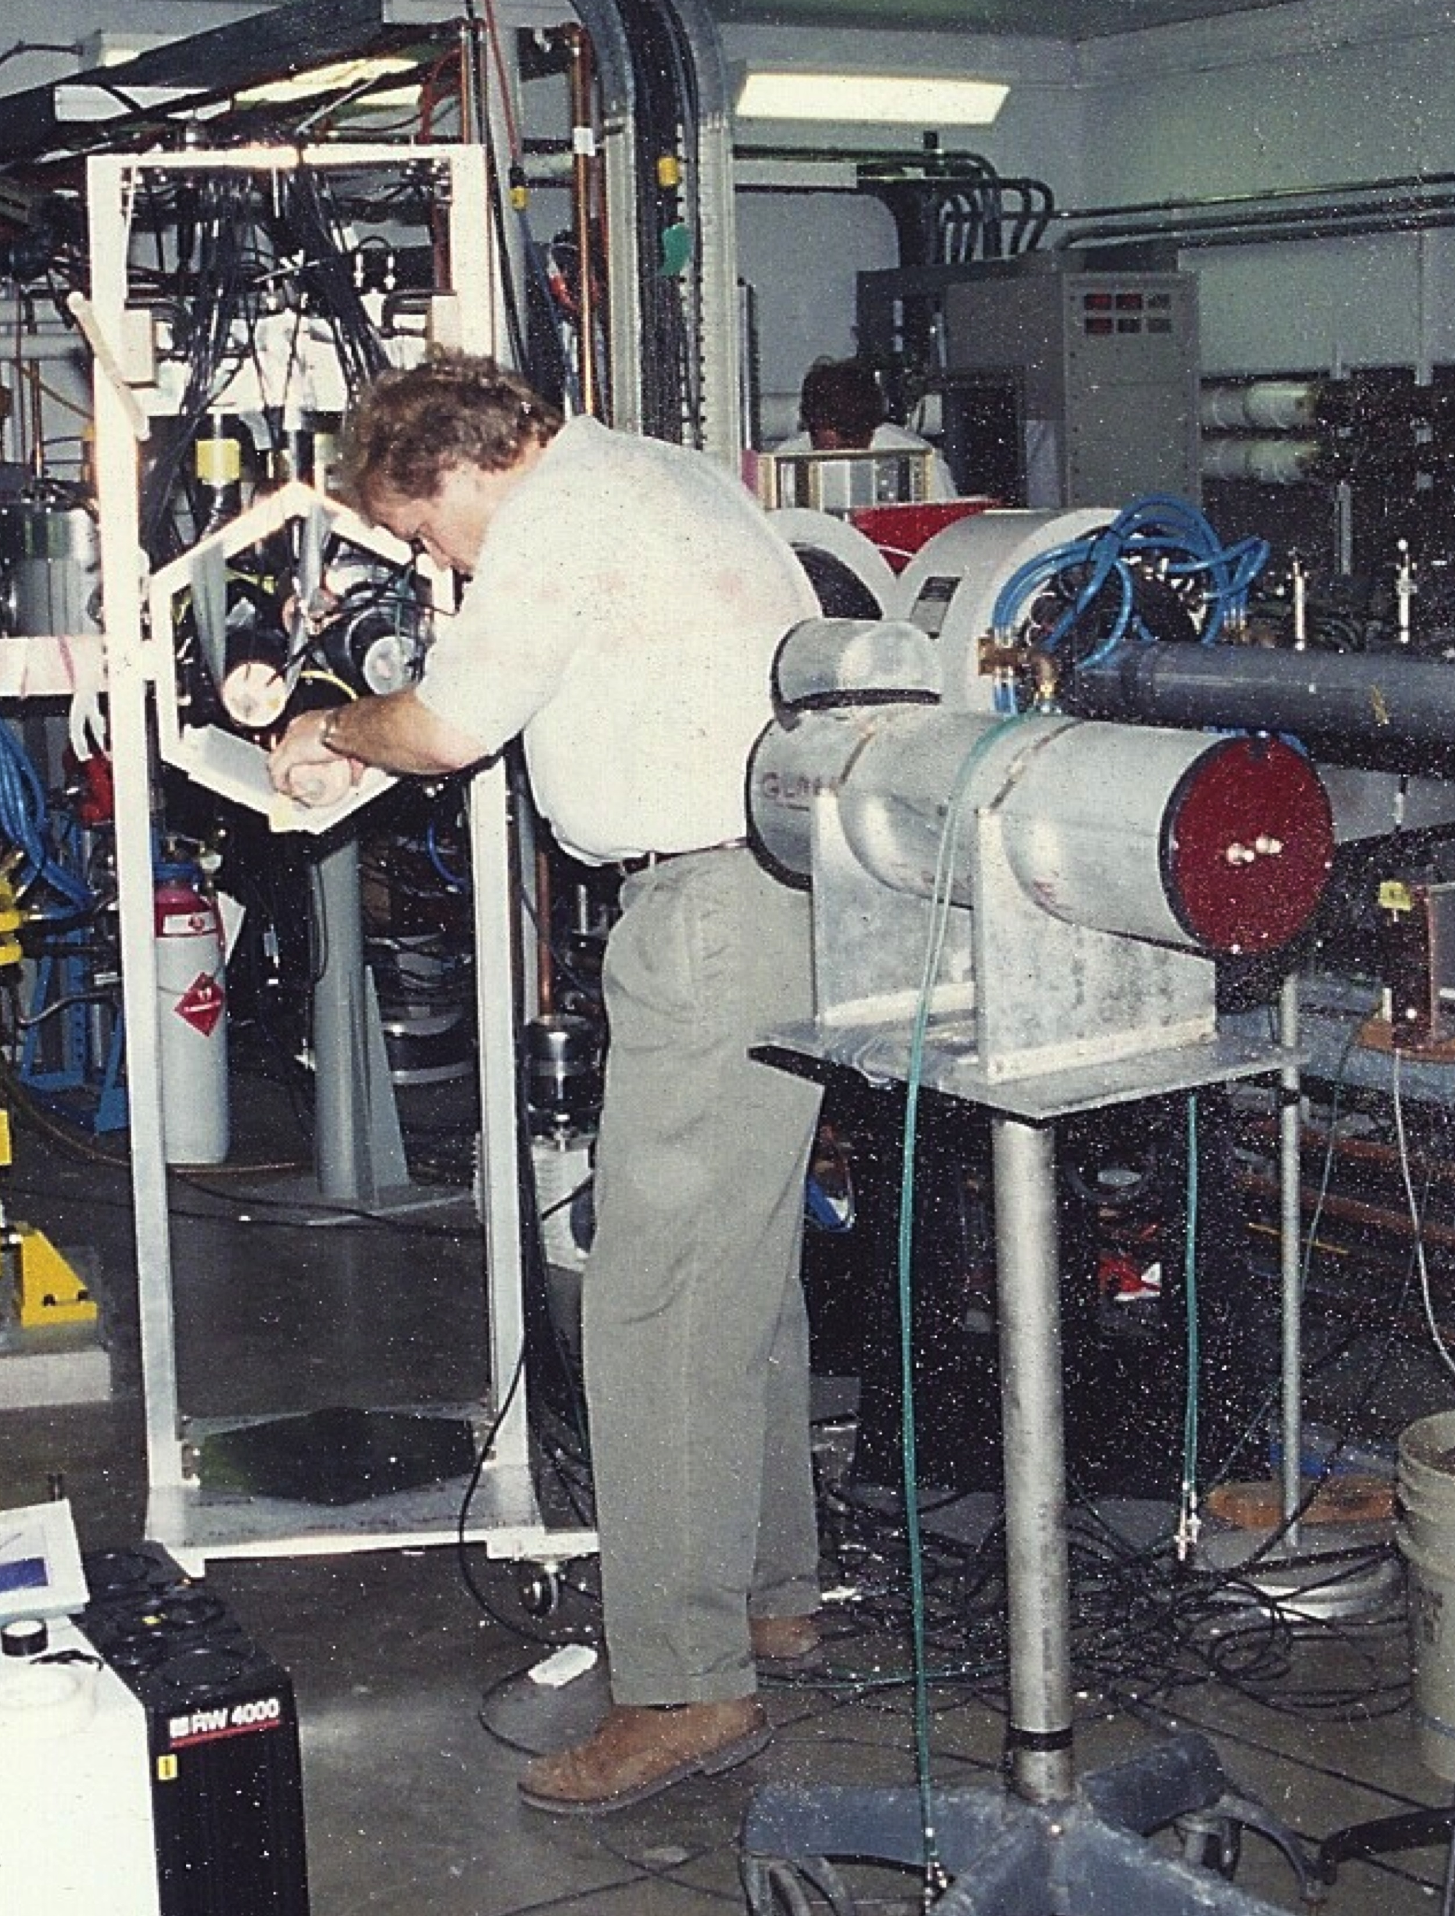
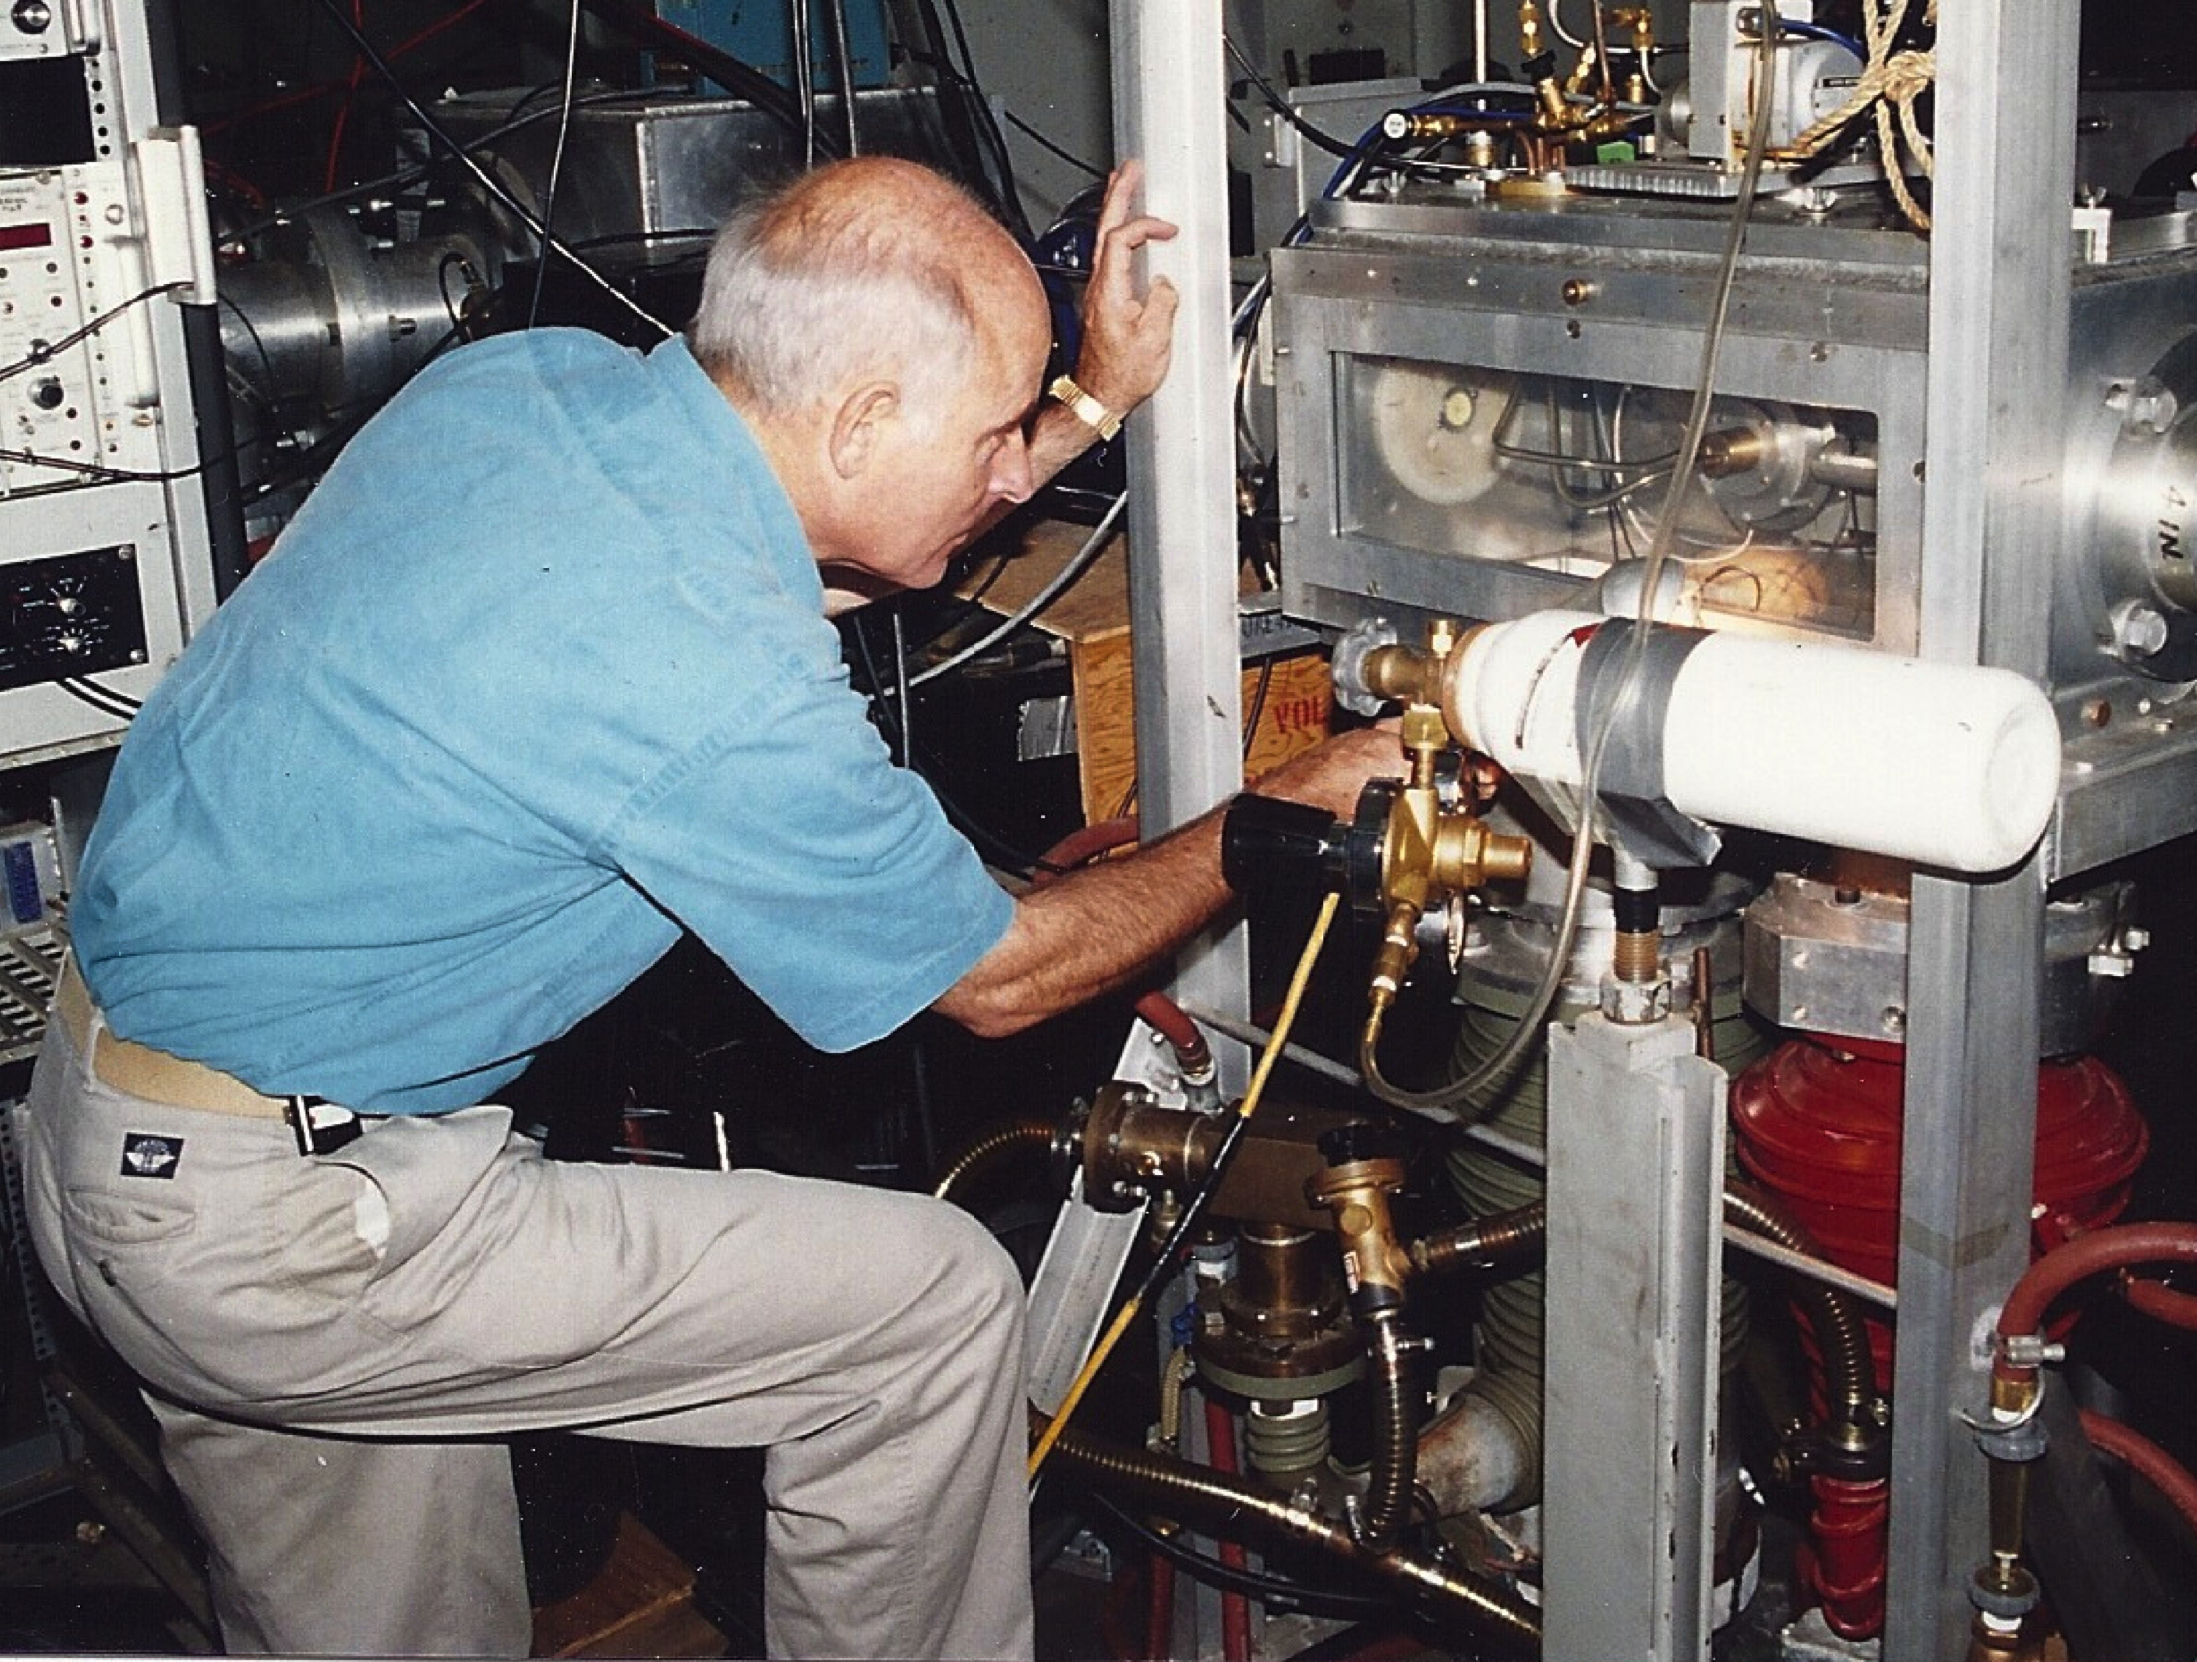
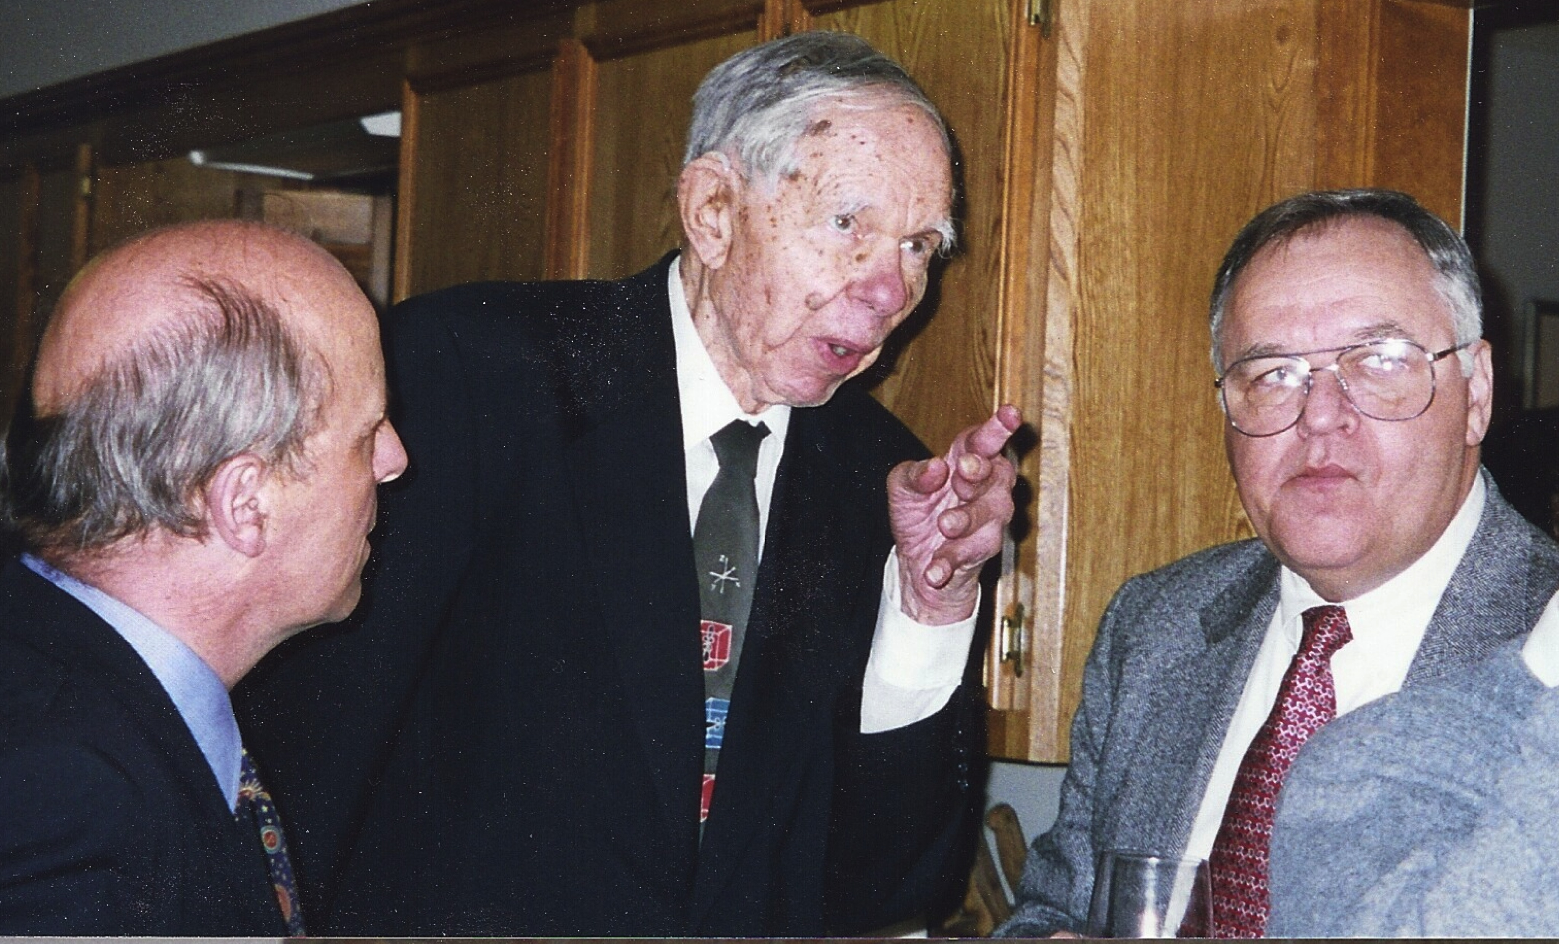
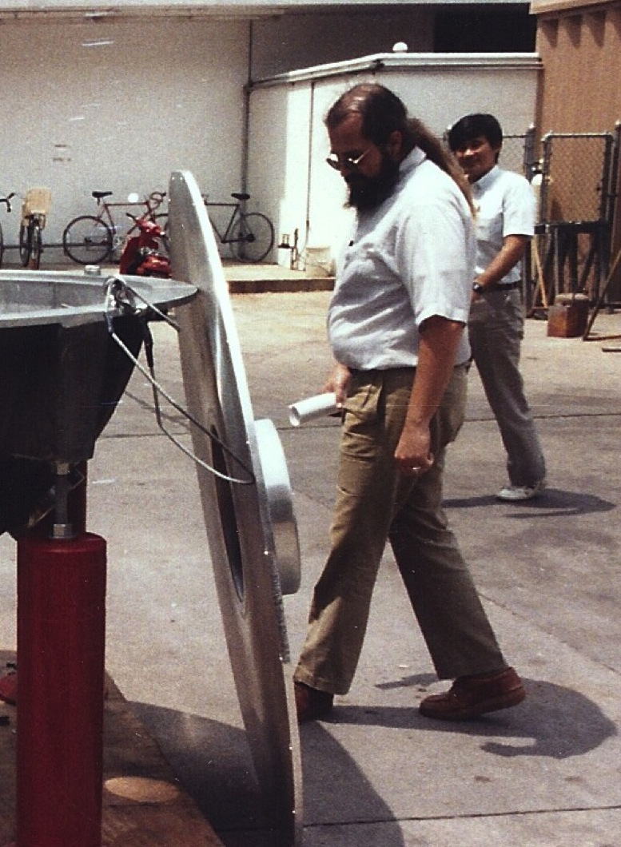
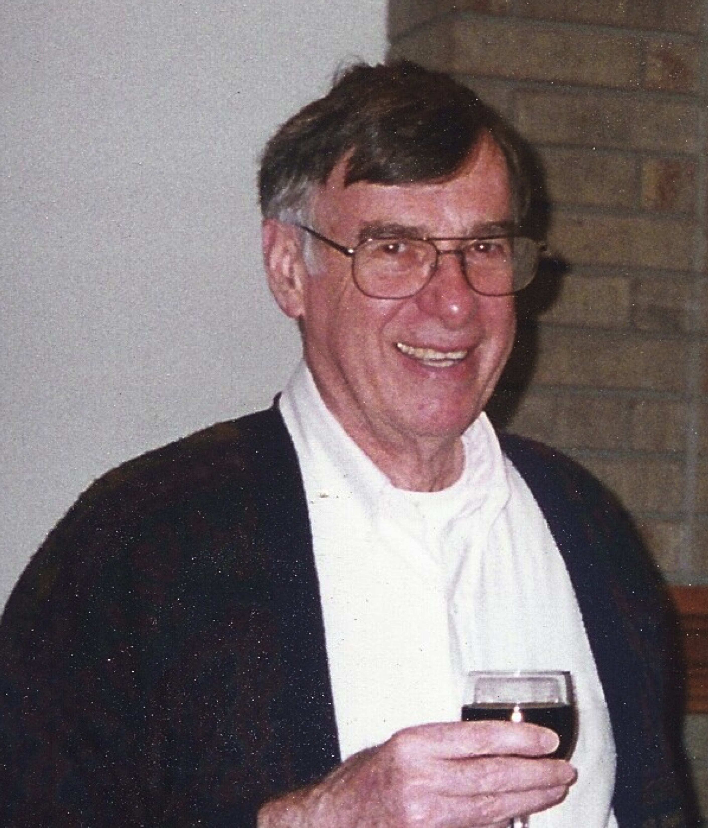
Nuclear Chemistry Faculty
Fred Sicilio
Dwight Conway
Joe Natowitz
Rand Watson
Ron MacFarlane
Tom Sugihara
Emile Schweikert
Rick Schmidt
Kevin Wolf
Sherry Yennello
Cody Folden

Slide 16
Nuclear Chemistry Graduates
Ph.D.
Zach Kohley
Sara Nicole Soisson
Sara Wuenschel
Lijun Qin
August Keksis
Yong Peng
Elizabeth Bell
Ananya Ruangma
Douglas Rowland
John M. Blackadar
Tye Botting
Bradley Hurst
Donna O’Kelly
Yunian Lou
William Turmel
Dennis Utley
Mei Gui
Gabriel Sampoll Ramirez
Jehanne Simon-Gillo
L. A. Quinones
Joe Bennett
B. B. Bandong
R. J. Maurer
J. A. Demarest
J. C. Hagel
W. R. Summers
L. M. Divis
P. Filpus-Luyck
L. A. Adler
D. J. Keith
J. R. Joyce
B. D. Lass
R. T. Sullins
P. Gonthier
S. A. Johnson
G. J. Stock
K. Geoffroy
M. B. Hughes
L. Zikovsky
J. B. Cross
M. D. Devous, Sr.
D. R. Haenni
T. L. Hardt
C. A. Hassell
R. P. Skowronski
J. R. McGinley
J. K. Archer
S. M. Kormali
T. K. Li
D. C. Riddle
H. L. Rook
M.S.
Jennifer Ann Iglio
Youxiong Zhao
Harry Jabs
Heather Johnston
Nader Mdeiwayeh
S. H. Simon
M. Vargas
R. J. Maurer
B. I. Sonobe

Slide 17
JBN Postdoctoral fellows
M. Barbui
Z. Chen
G. Chulick
R.K. Choudhury
J. Cibor
R. Eggers
D. Fabris
M. Gonin
P. Gonthier
F. Haddad
K. Hagel
J.H.K. Ho
T. Keutgen
Khodai
S. Kowalski
M. Murray
M. Lunardon
Y. G. Ma
Z. Majka
N. Marie
T. Materna
M. Namboodiri
G. Nebbia
M. R. D. Rodrigues
P. K. Sahu
K.J. Schmidt
H. Simon
R. Tezkratt
J. Wang
R. Wada

Slide 18
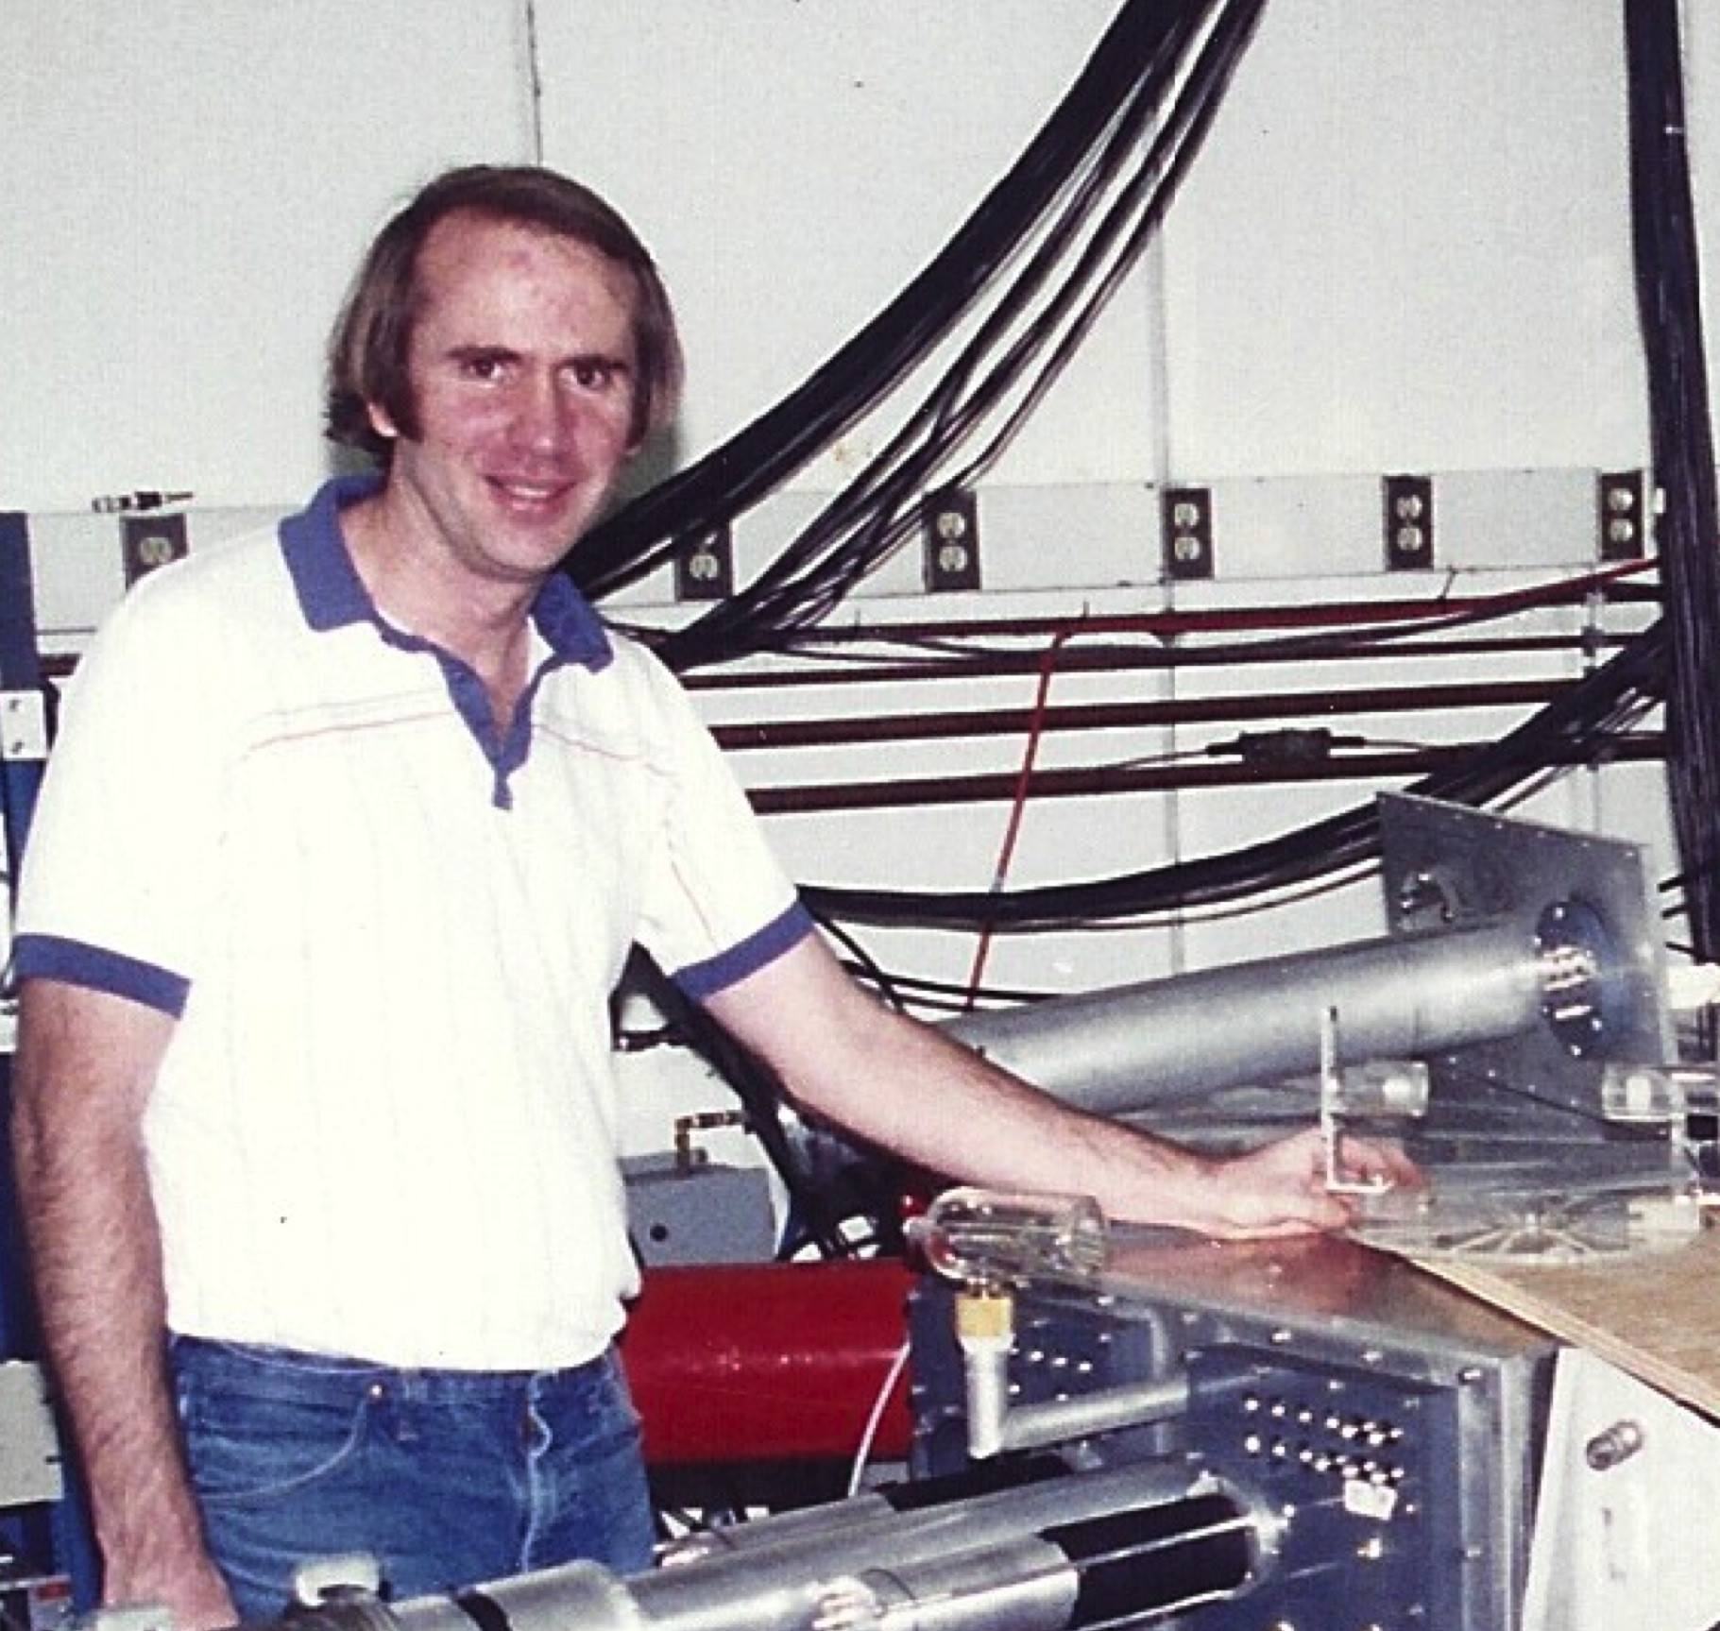
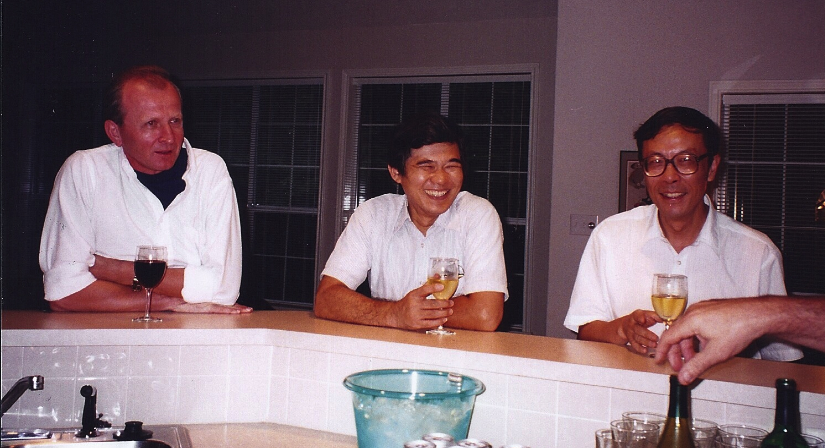
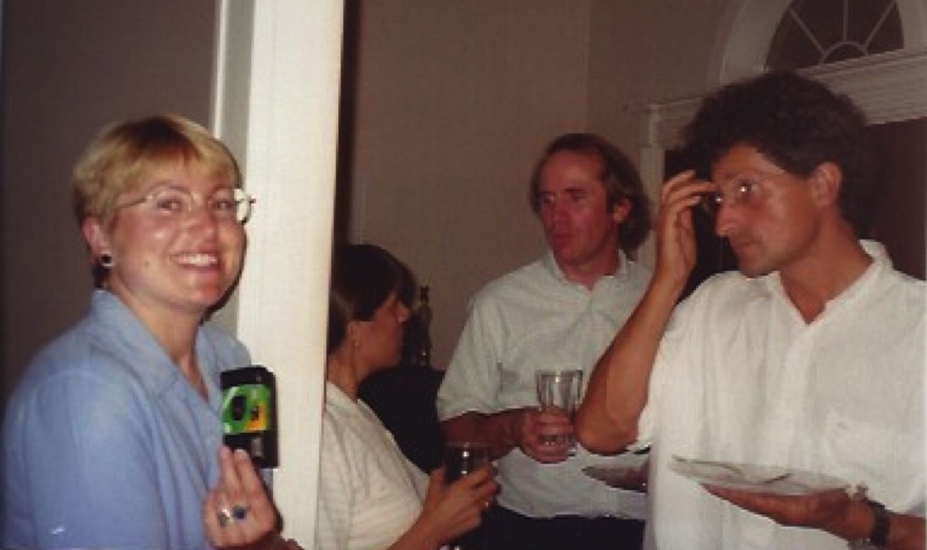
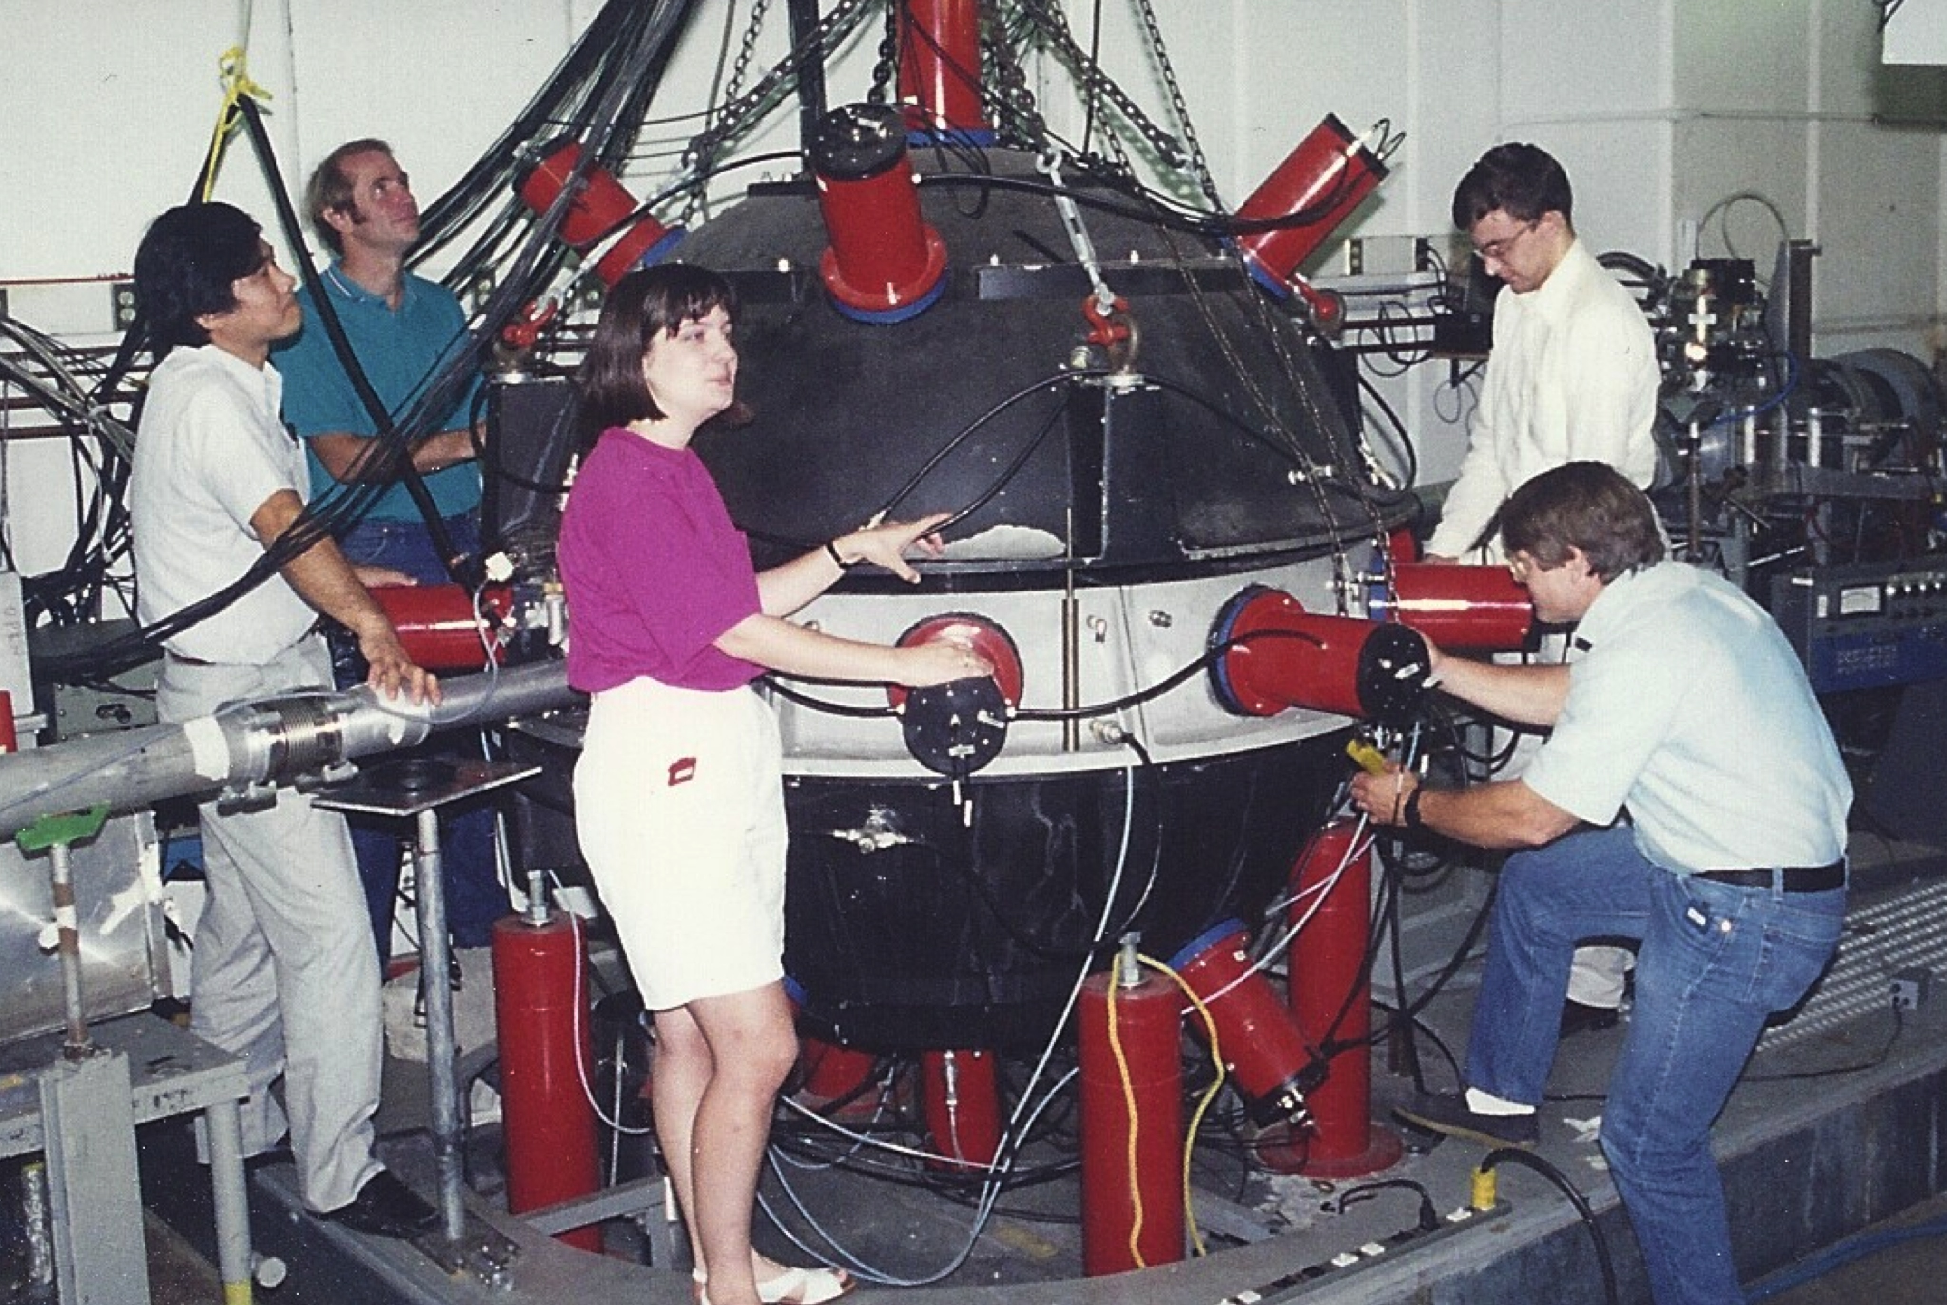
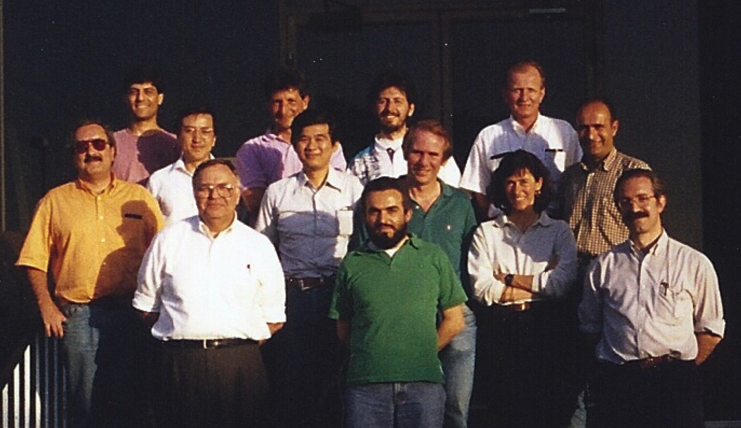
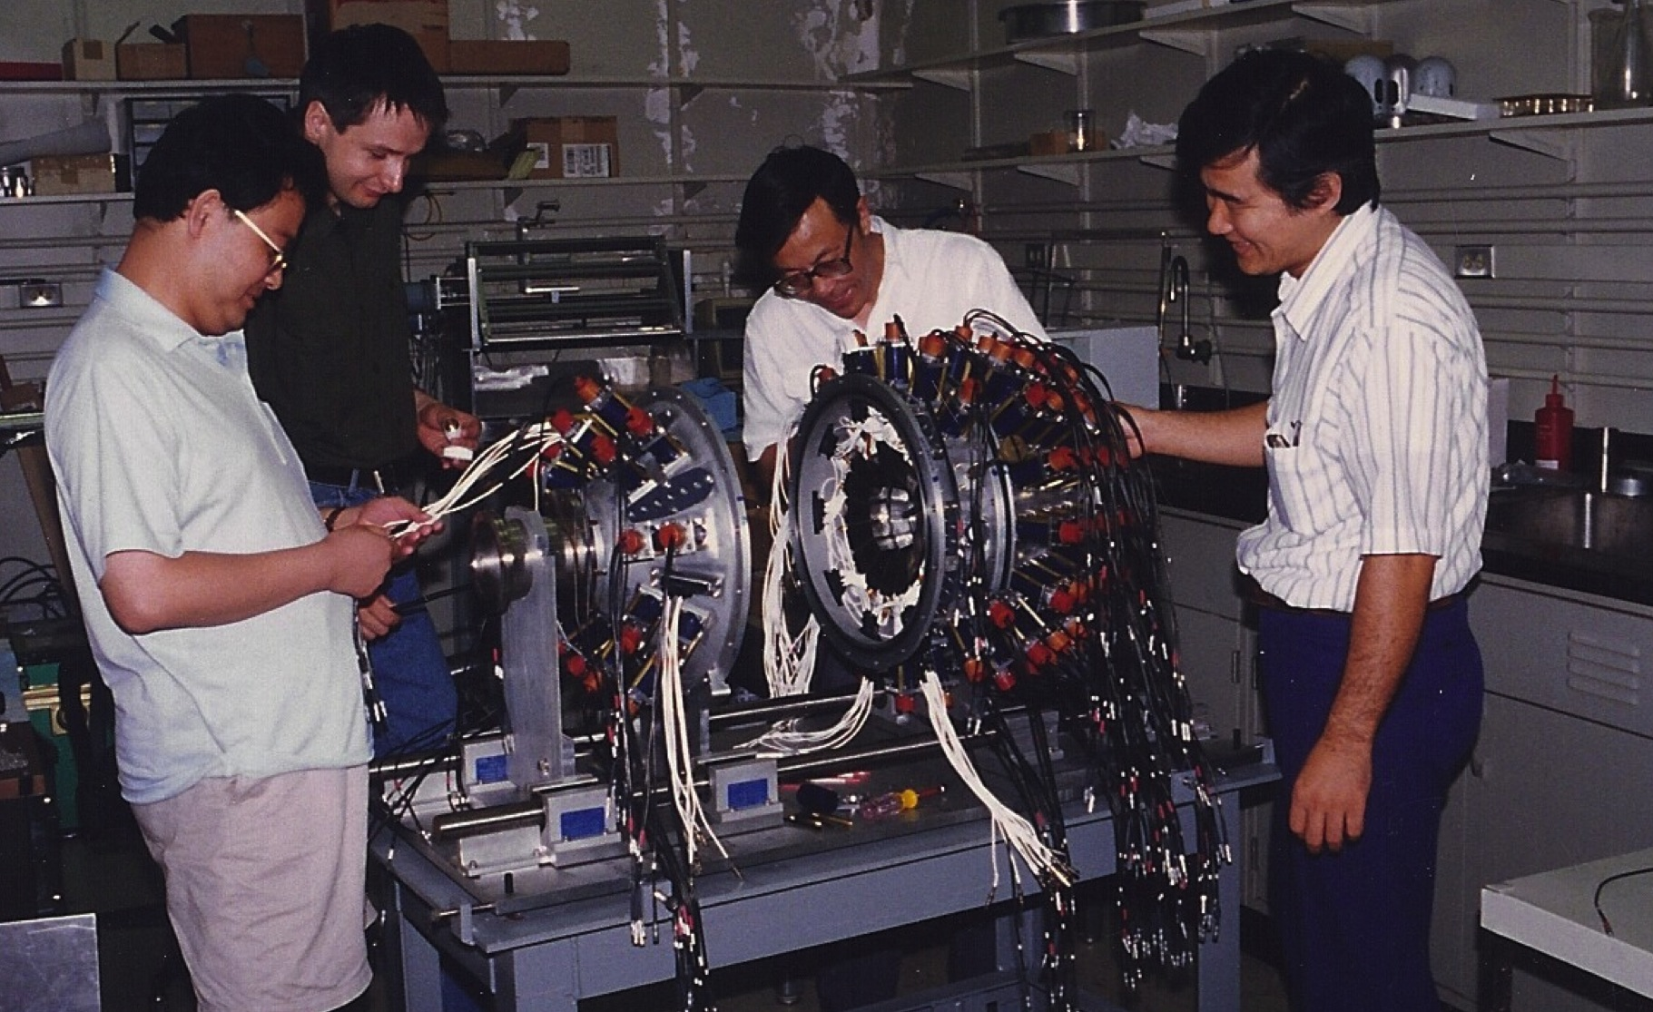
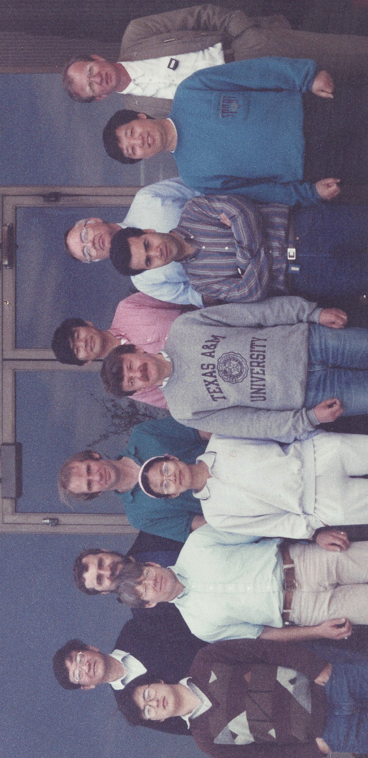
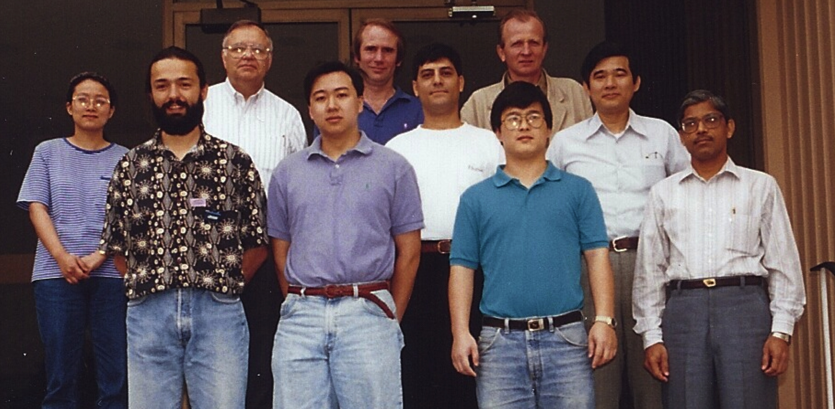

Slide 19
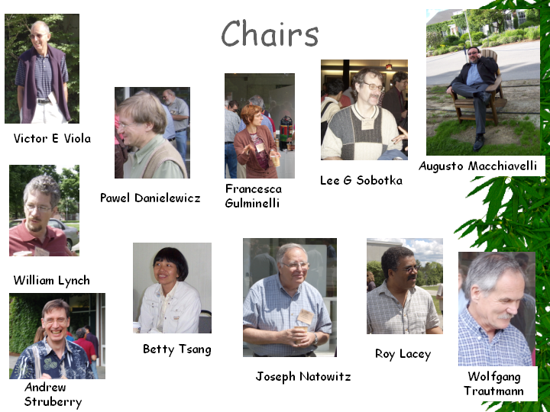
GRC Chairs

Slide 20
Welch Foundation Funding
$1M initially
Individual research grants to faculty
1971 power supply for new ion source
1978 five yr modernization grant ( new RF new deflector)
1982 $1M for K500 construction
$1M TRex
Notes:
In his will, Mr. Welch stated: “I have long been impressed with the great possibilities for the betterment of Mankind that lay in the field of research in the domain of Chemistry.” With his death in 1952, Mr. Welch left a generous portion of his estate to his employees and their families. The balance began what is now The Welch Foundation.

Slide 21
