Slide 1
International Workshop on Nuclear Dynamics and Thermodynamics Honoring the achievements of Joseph B. Natowitz
Robert E. Tribble
Texas A&M University
August 19, 2013
T-REX

Slide 2
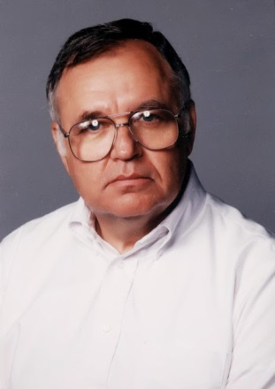
Joe’s (continuing) Career
Science – from the early days to today
T-REX

Slide 3
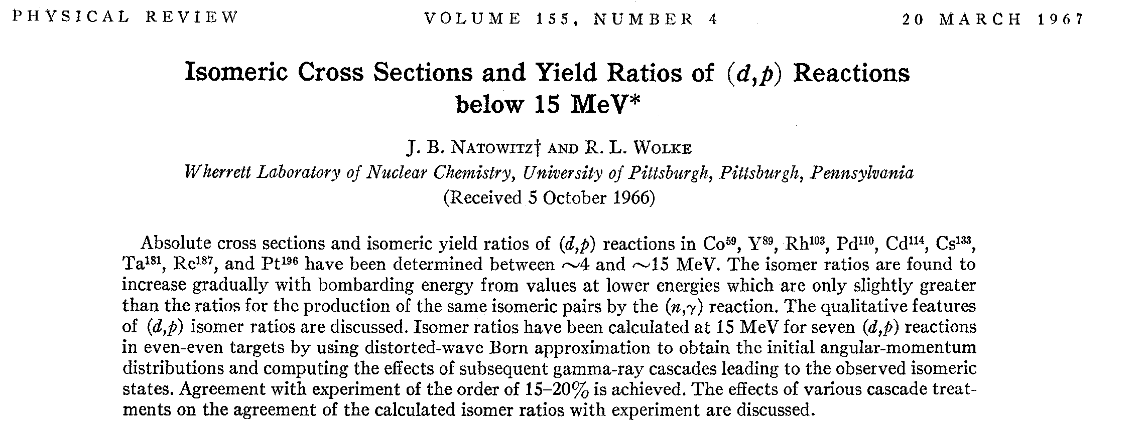
Science – in the beginning
After B.S. at Univ. of Florida (’58), then Air Force:
Ph.D. (’65), Univ. of Pittsburgh
First paper in Phys. Rev. (?) [from thesis work]
T-REX

Slide 4
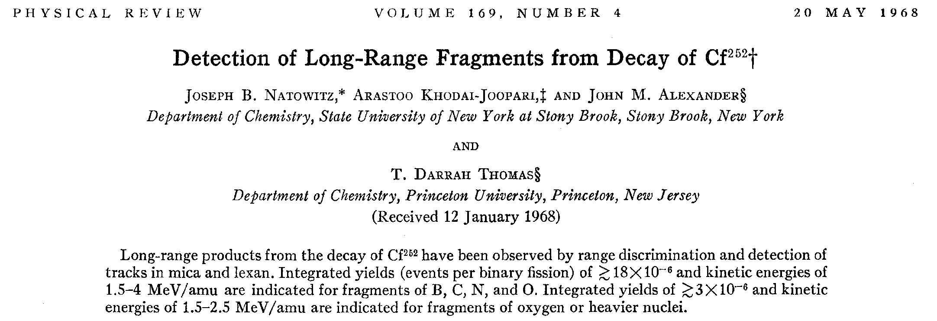
On to SUNY – SB Research Associate 1965-1967
Fission fragment studies
T-REX

Slide 5
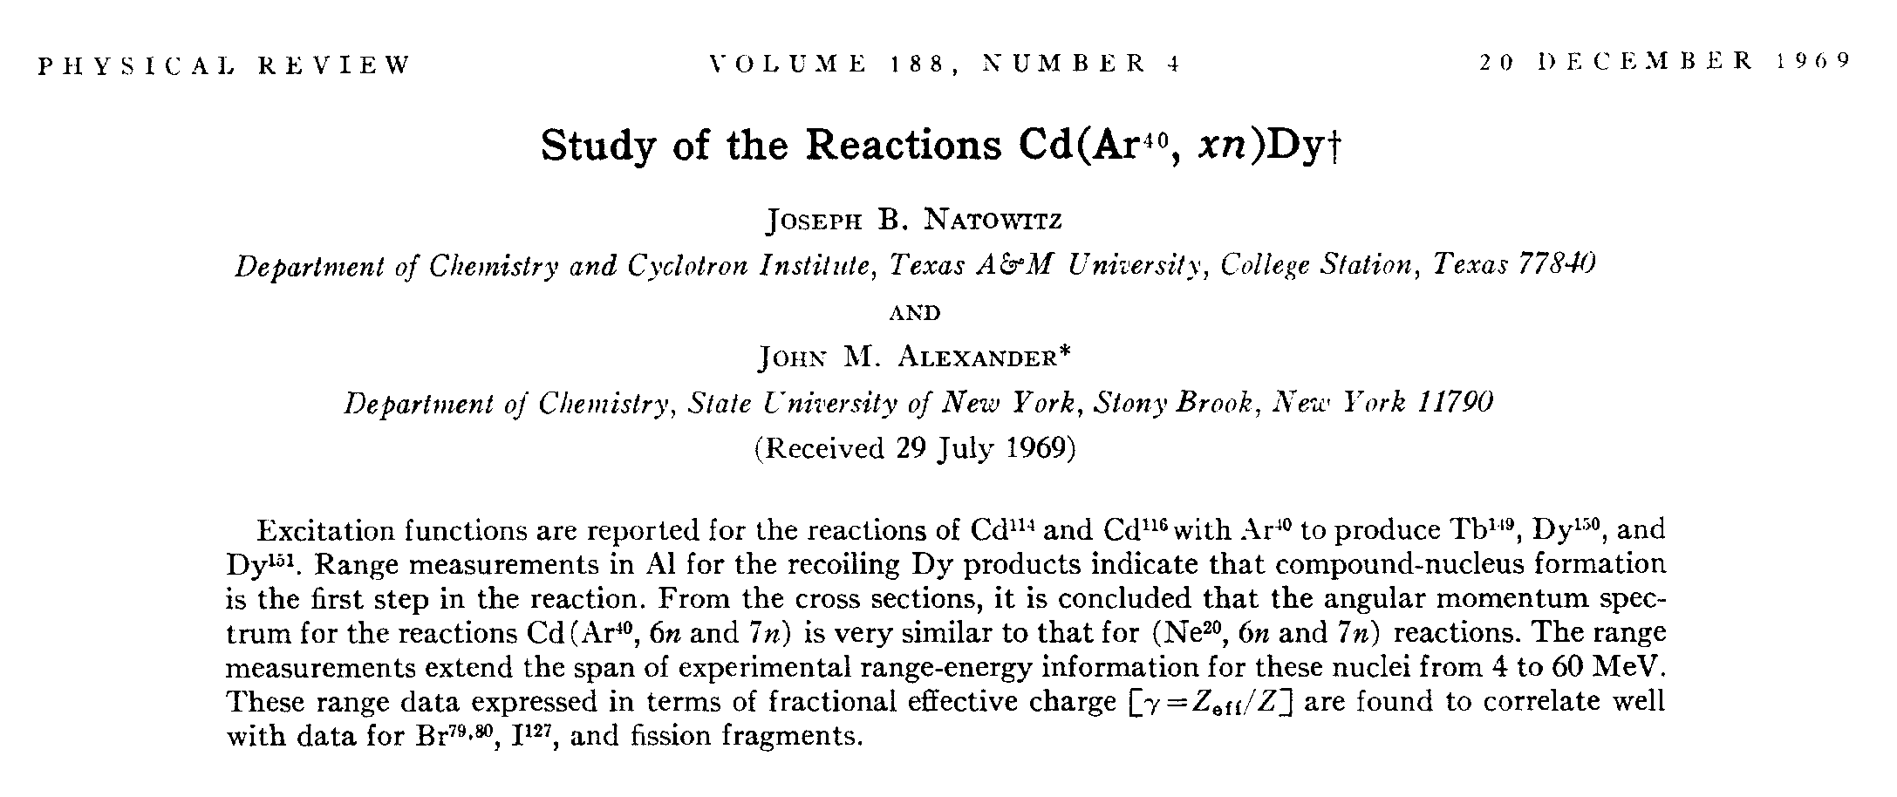
From SUNY SB time
Growing interest in Heavy-Ion Interactions
T-REX

Slide 7
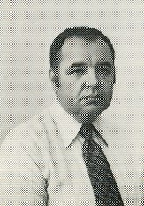
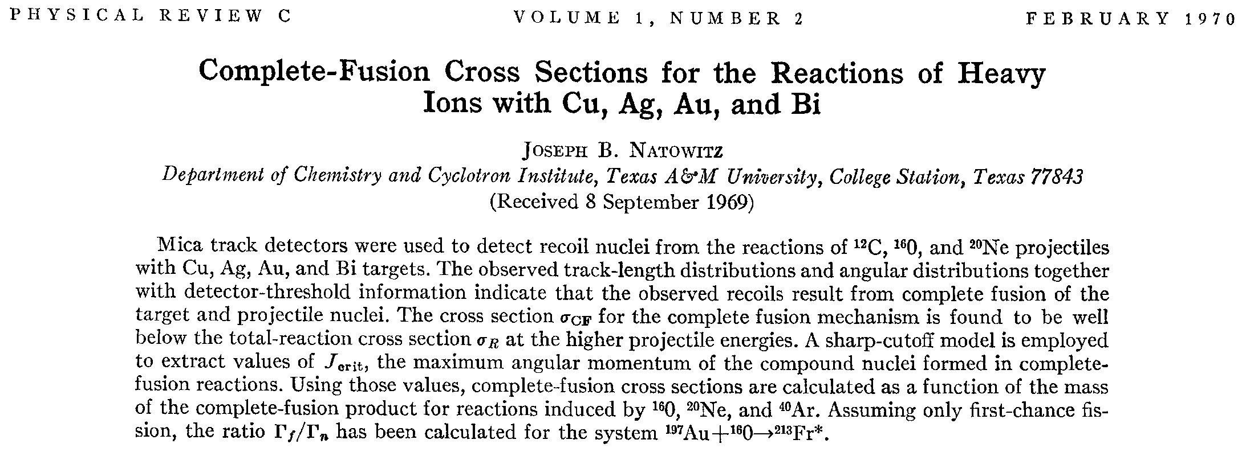
TAMU Assistant Professor in Chemistry 1967 – 1972
Continuing interest in Heavy-Ion Interactions:
publication in first volume of Phys. Rev. C
T-REX

Slide 8
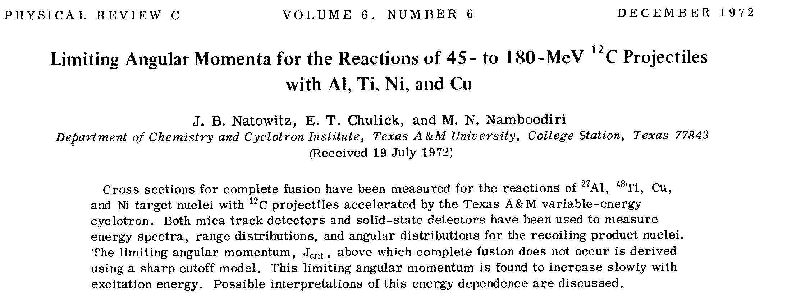
TAMU Associate Professor 1972 – 1976
First of many publications in PRC of TAMU work
Work from this period was major part of DOE
proposal that ultimately led to K500 cyclotron
T-REX

Slide 9
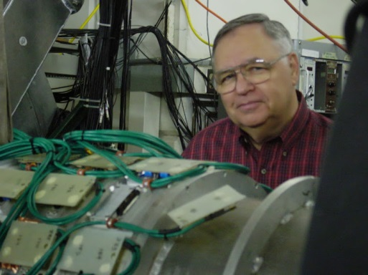
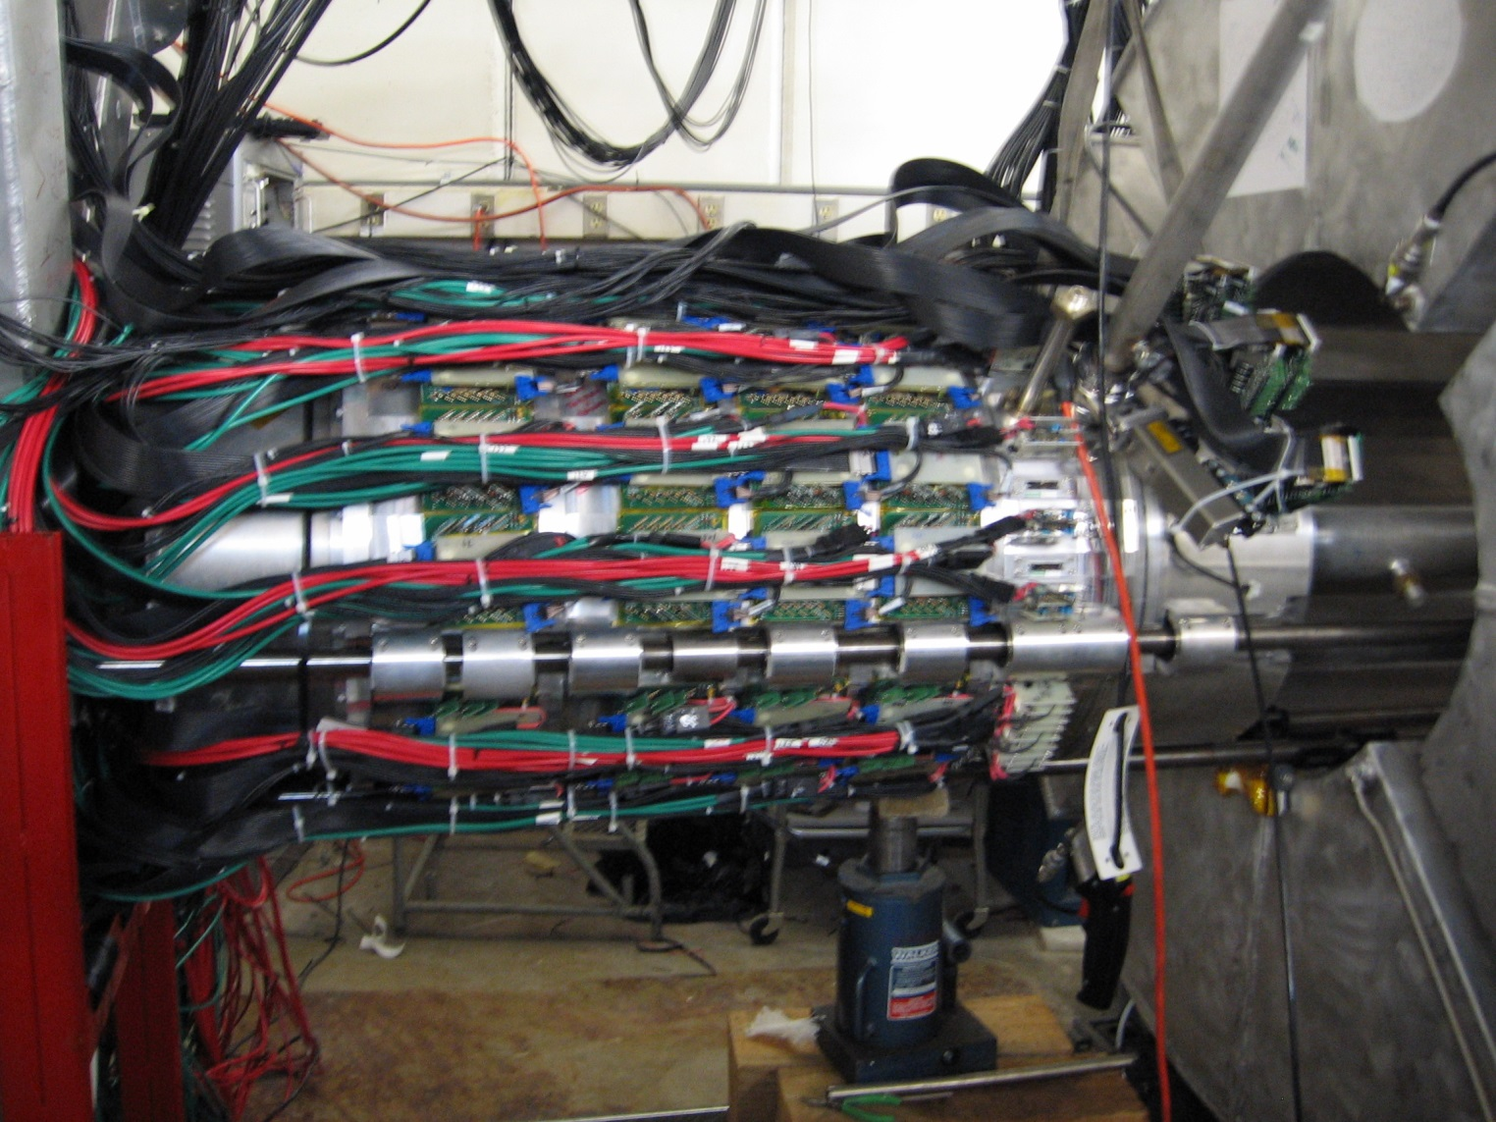
TAMU Professor 1976 – 2001
Developed new detector systems – NIMROD
T-REX

Slide 10
TAMU Professor 1976 – 2001
Many new results on a wide range of topics!
A chronology of interests (mostly abbreviated titles of papers)
Deep inelastic scattering
Limits to fusion reactions
From fusion to strongly damped collisions
Nuclear fragmentation
Level densities in deformed nuclei
Temperatures and excitation energies of hot nuclei
Dynamical effects in de-excitation of hot nuclei
Nuclear thermometers
Statistical thermodynamics of hot finite nuclear systems
Relativistic Heavy Ions – BRAHMS collaboration
. . .
T-REX

Slide 11
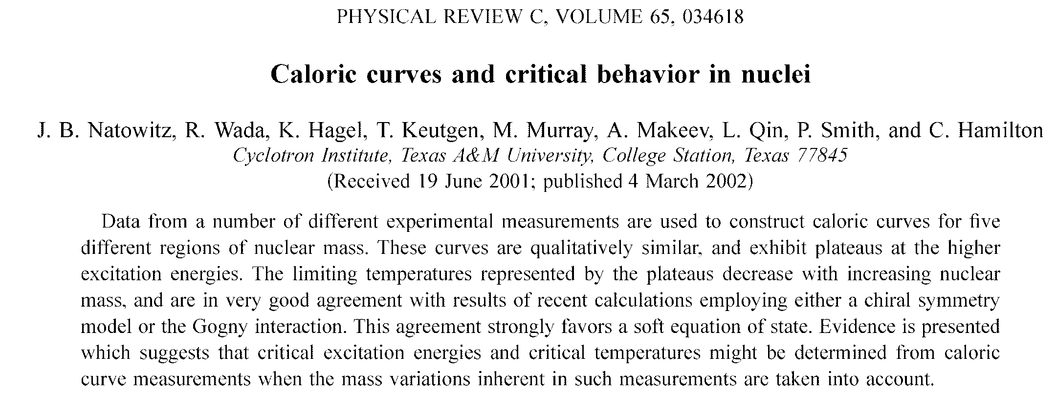
TAMU Distinguished Professor 2001 –
Expanding his interests and influence
Most cited paper from TAMU CI work
T-REX

Slide 12
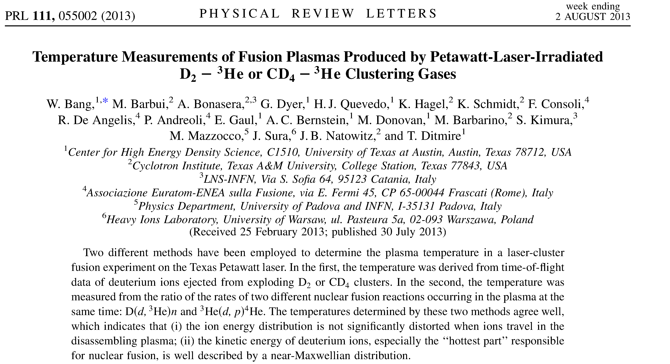
TAMU Distinguished Professor 2001 –
Very recent paper
T-REX

Slide 13
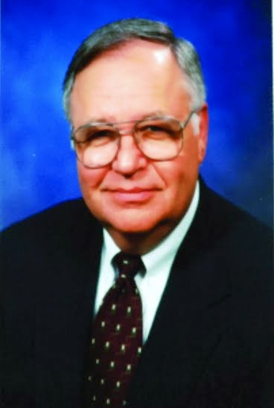
Joe’s (continuing) Career
Science – from the early days to today
Honors and awards
T-REX

Slide 14
Recognition of Joe’s Contributions
Alexander von Humboldt Award – 1977
AFS Distinguished Achievement Award for Research at TAMU – 1988
American Chemical Society Award in Nuclear Chemistry – 1995
American Chemical Society Southwest Regional Award – 2000
Bright Chair in Nuclear Chemistry – 2001
University Distinguished Professor – 2001
Fellow of the American Physical Society
Fellow of the American Chemical Society
. . .
T-REX

Slide 15
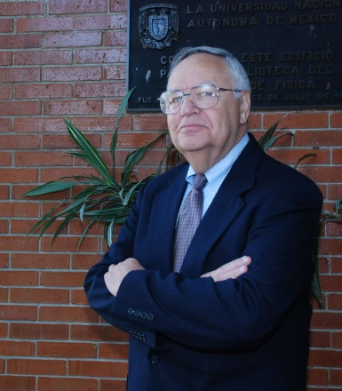
Joe’s (continuing) Career
Science – from the early days to today
Honors and awards
Administration
T-REX

Slide 16
Administration (mostly) at TAMU
Member of the CSISD school board ’70’s
Head, Chemistry – 1981 to 1985
Hired new faculty
Construction of lab space initiated
Director, Cyclotron Institute – 1991 to 2002
Major growth and development of commercial use of the K500 cyclotron
New instrument development
T-REX

Slide 17
T-REX

Slide 18
Administration (mostly) at TAMU
Member of the CSISD school board ’70’s
Head, Chemistry – 1981 to 1985
Hired new faculty
Construction of lab space initiated
Director, Cyclotron Institute – 1991 to 2002
Major growth and development of commercial use of the K500 cyclotron
New instrument development
Key to setting the path forward for the upgrade now underway at the CI
T-REX

Slide 19
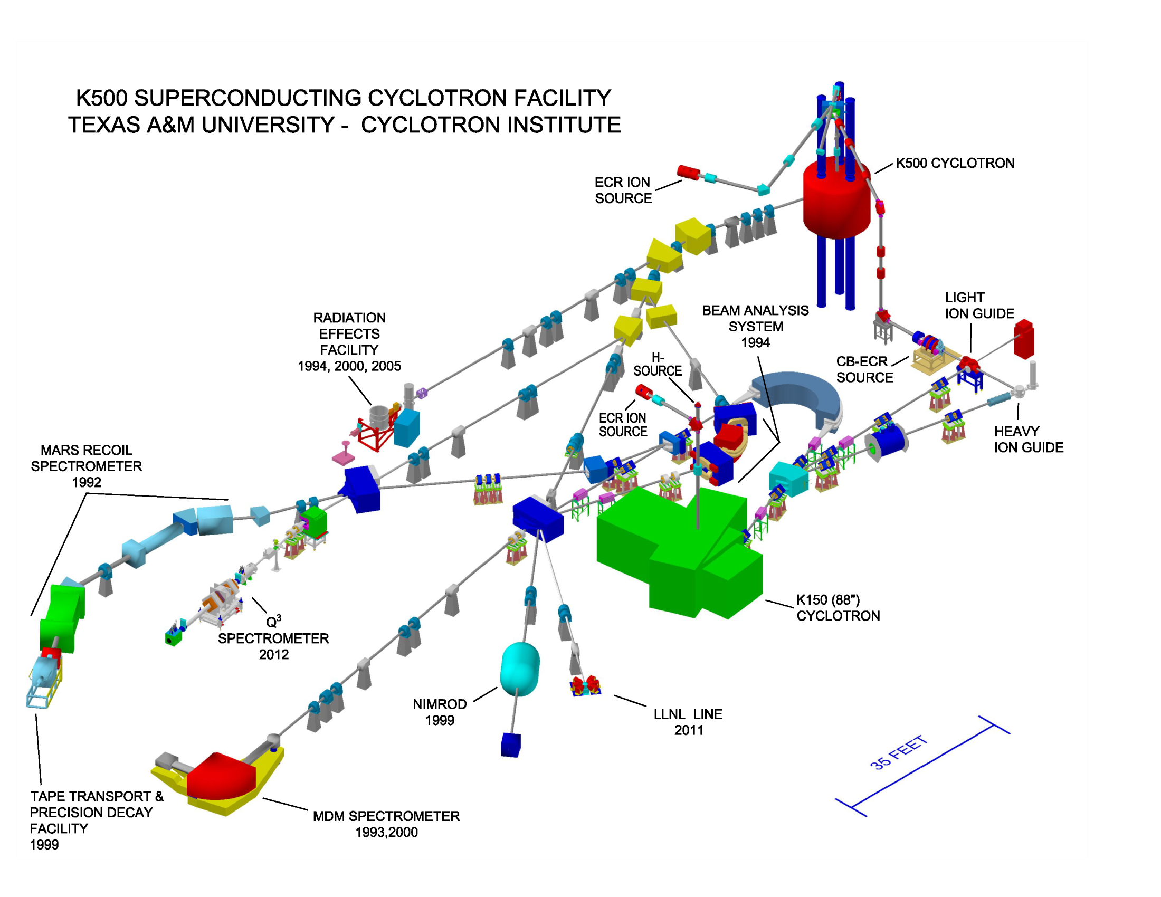
T-REX
[TAMU Reaccelerated Exotics]
T-REX

Slide 20
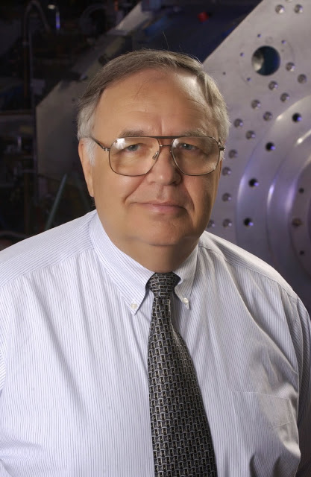
Joe’s (continuing) Career
Science – from the early days to today
Honors and awards
Administration
Looking to the future
T-REX

Slide 21
Joe’s Future Career
Science plans for the next few years
Use cluster structure to get information on equation of state
Symmetry energy studies at low nucleon density
Alpha clusters in alpha conjugate nuclei
Alternative production mechanisms for heavy elements
For details, just ask Joe!
T-REX

