Slide 1

Pre-equilibrium α-particle emission as a probe to study α-clustering in nuclei
D. Fabris
INFN Sezione di Padova
on behalf of Nucl-ex collaboration
International Workshop on Nuclear Dynamics and Thermodynamics
in Honor of Prof. Joe Natowitz
Texas A&M University, College Station, Texas
August 19-22, 2013
D. Fabris
College Station – August 2013

Slide 2

Contents
Introduction
Previous results :
    130, 250 MeV ¹⁶O + ¹¹⁶Sn
    Theoretical Model
Experimental set-up
Preliminary results:
    256 MeV ¹⁶O + ⁶⁵Cu
    304 MeV ¹⁹F + ⁶²Ni
Summary
D. Fabris
College Station – August 2013

Slide 3
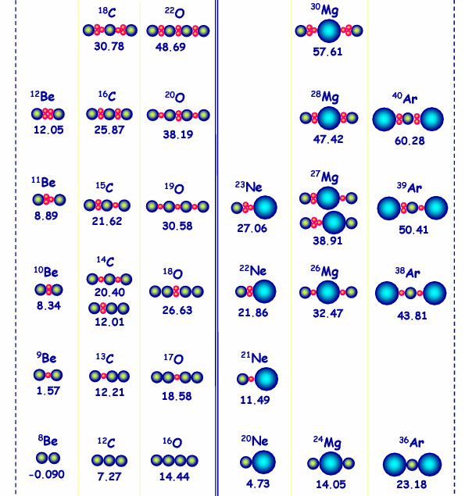
Nuclear α-clustering
Ikeda diagrams
W. Von Oertzen et al.
Phys. Rep. 432 (2006)43
In 1968 Ikeda suggested that α-conjugate nuclei are observed as excited states close to decay threshold into clusters
The interest in nuclear clustering has been pushed strongly due to the study of neutron-rich and exotic weakly-bound nuclei
Study of nuclear states built on clusters bound by valence neutrons in their molecular configurations -> Extended Ikeda diagram
D. Fabris
College Station – August 2013

Slide 4
In light nuclei at the neutron drip-line, clustering might be the preferred structural mode
Presently these structures are mainly described by theory, but must be experimentally verified at the new radioactive beam facilities
Particularly interesting is to confirm the existence of alpha clusterization in nuclei through a new generation of experiments
D. Fabris
College Station – August 2013

Slide 5
In a previous campaign, aimed to study the dependence on the entrance channel mass-asymmetry of the pre-equilibrium Light Charged Particles emission, the same CN has been formed through ⁶⁴Ni + ⁶⁸Zn and ¹⁶O + ¹¹⁶Sn reactions at different bombarding energies (5 MeV/u ÷ 16 MeV/u).
The comparison of the data with Hybrid Exciton Model calculations shows up an extra yield of alpha particles which can not be taken into account only by a pre-equilibrium component, but seems to be associated with the α-cluster structure of the ¹⁶O beam.
Idea to isolate cluster structure effects in this range of energies
studying the pre-equilibrium α-particles emission
D. Fabris
College Station – August 2013

Slide 6
Previous work
250, 130 MeV ¹⁶O + ¹¹⁶Sn
Protons and α-particles in coincidence with Evaporation Residues
using GARFIELD apparatus
p, α-particles Energy spectra for different θ angular ranges: 29° - 41°; 41° - 53°; 53° - 67°; 67° - 82°
The spectra have been compared with calculations that describe the evaporative plus the pre-equilibrium contribution of the particles emission. The Hybrid exciton model has been used which takes into account the angular distributions of non-equilibrium processes .
O.V. Fotina et al. Int. Journ. Mod. Phys. E19 (2010) 1134
D.O. Eremenkoet al. Phys Atom. Nucl. 65 (2002) 18
O.V. Fotina et al. Phys. Atom. Nucl. 73 (2010) 1317
D. Fabris
College Station – August 2013

Slide 7
Theoretical Model
Evaporative (statistical) emission:
Statistical decay of a Compound Nucleus is analyzed using modified PACE2 Monte Carlo code , with level density parametrization [A.V. Ignatyuk et al. Sov. J.Nucl. Phys. 29 (1979) 450] , decay competition probability (n, p, α, γ or fission), kinetic energy of emitted particles, binding energy, transmission coefficients, angular momentum.
  Insertion of non-equilibrium stage in the fusion reaction
  All the process probabilities are calculated within the Hauser-Feshbach model
Pre-equilibrium emission:
The relaxation process in the nuclear system after fusion reaction is described by the Hybrid exciton model based on Griffin model [J.J.Griffin Phys. Rev. Lett.17 (1966) 478].
The state of nuclear system produced in the collision is determined by the exciton number n = p + h, where p is the number of valence particles over the Fermi energy and h the number of holes located under the Fermi energy, and by excitation energy E*.
  The exciton number can be determined from the empirical trend [N.Cindro et al. Phys. Rev. Lett. 66 (1991) 868; E. Běták Fizika B12 (2003) 11]
Clustering:
Pre-formation probability of cluster and exciton energies for cluster/light ion induced reactions [M. Blann et al. Phys Rev. C 62 (2000) 034604]
For more detailed description of using method see O.V. Fotina et al. Phys. Atom. Nucl. 73 (2010)1317 and ref. therein.
D. Fabris
College Station – August 2013

Slide 8
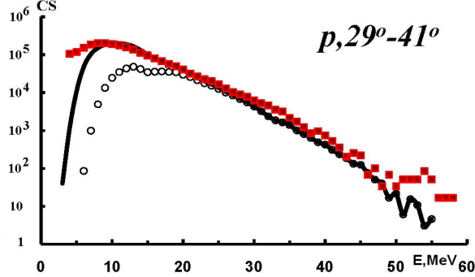
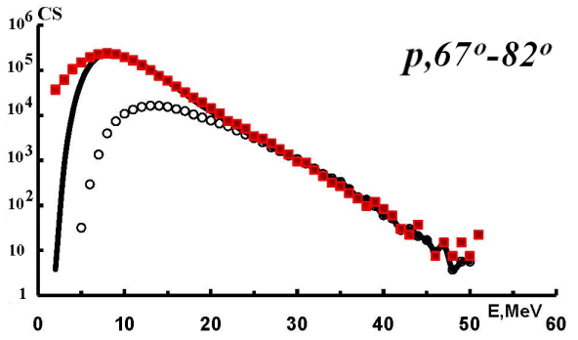
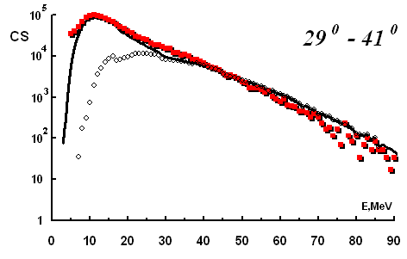
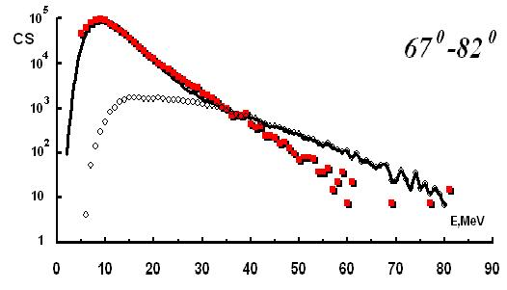
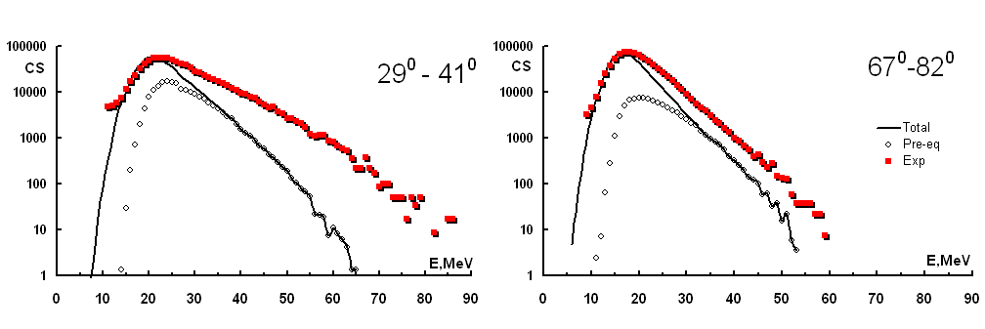
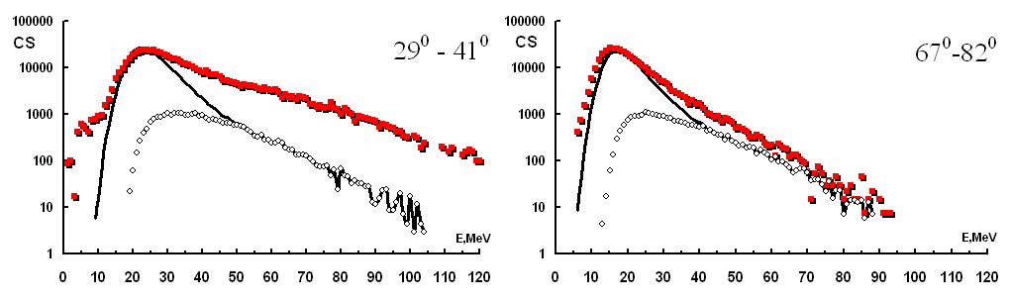
Protons spectra
130 MeV ¹⁶O + ¹¹⁶Sn
250 MeV ¹⁶O + ¹¹⁶Sn
α-particles spectra
130 MeV ¹⁶O + ¹¹⁶Sn
250 MeV ¹⁶O + ¹¹⁶Sn
α-particles spectra are not reproduced expecially at the most forward angles
Exp
Pre-eq
Total
D. Fabris
College Station – August 2013

Slide 9
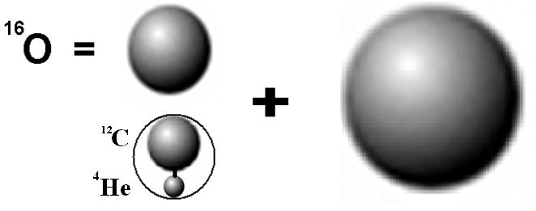
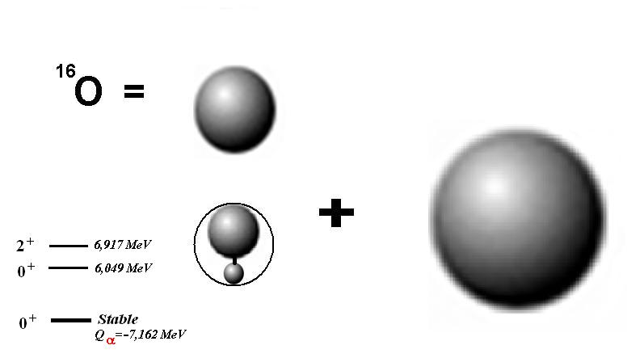
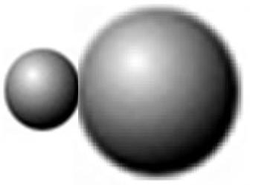
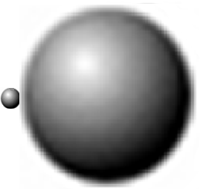
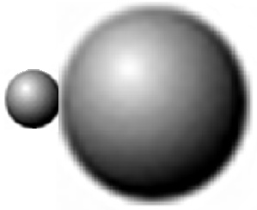
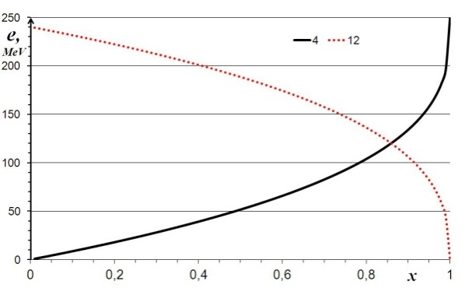


Start conditions
Possible α clustering configurations in ¹⁶O nucleus
?
100-N%
N%
nO=16p+0(1)h
nα=4p+0(1)h
nC=12p+0(1)h
e_{12C}
e – clusters energy
x – random number
e_{α}
D. Fabris
College Station – August 2013
Courtesy of O. V. Fotina

Slide 10
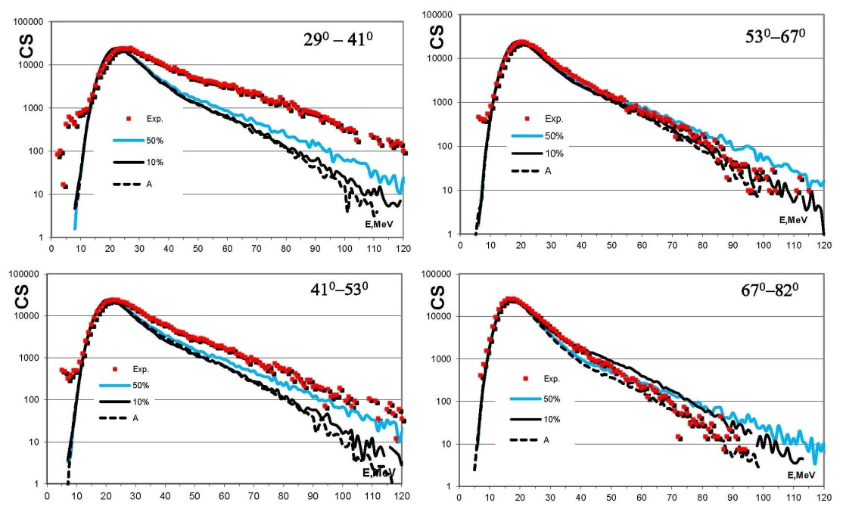
250 MeV ¹⁶O + ¹¹⁶Sn
α-particles spectra
--- No α-clustering in ¹⁶O
__ 10% α-clustering in ¹⁶O
__ 50% α-clustering in ¹⁶O
Exp
D. Fabris
College Station – August 2013

Slide 11
Extra production of α-particles at small angles can be ascribed to alpha clustering in the projectile nucleus (¹⁶O).
A confirmation of the existence of alpha clusterization in nuclei can be obtained in a model-independent way
Comparing the secondary alpha particles emitted in fusion reactions where an
α−cluster projectile (¹⁶O) and projectile without α clusterization (¹⁹F) are used.
D. Fabris
College Station – August 2013

Slide 12
¹⁶O + ⁶⁵Cu E_{b} = 256 MeV (16 MeV/u)
¹⁹F + ⁶²Ni E_{b} = 304 MeV (16 MeV/u)
CN ⁸¹Rb* E*(¹⁶O) = 209 MeV
E*(¹⁹F) = 240 MeV
Two systems with same projectile velocity -> from Cabrera et al. systematics the pre-equilibrium emission is almost entirely dependent on the projectile energy per nucleon [J. Cabrera et al. Phys. Rev. C68 (2003) 034613]
Light Charged Particles Angular distribution and Energy spectra in coincidence with Evaporation Residues
Set-up: GARFIELD 4π apparatus at Legnaro National Laboratory for Fragments and Light Charged Particles identification
D. Fabris
College Station – August 2013

Slide 13
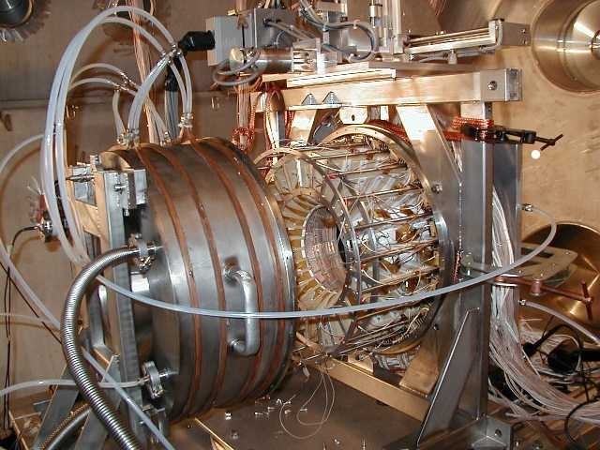
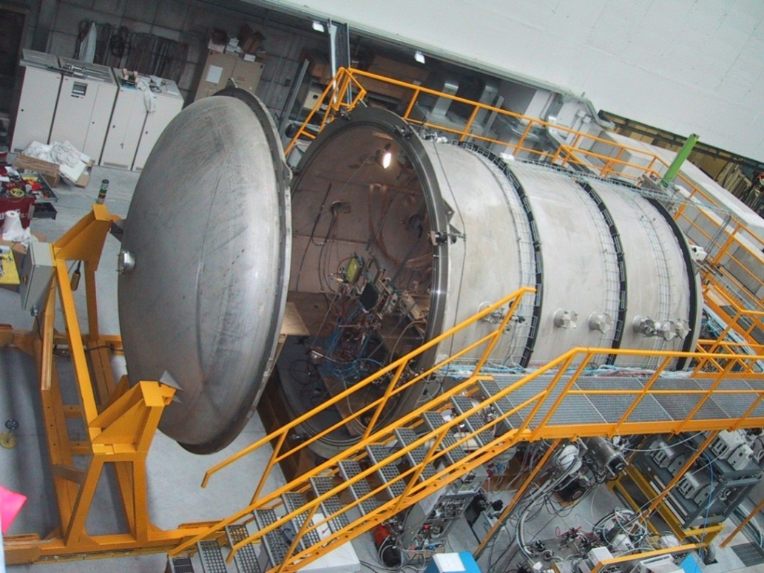
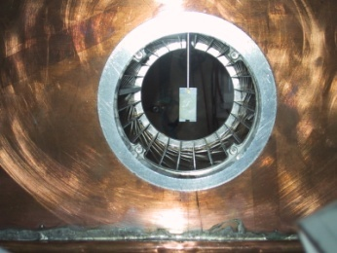
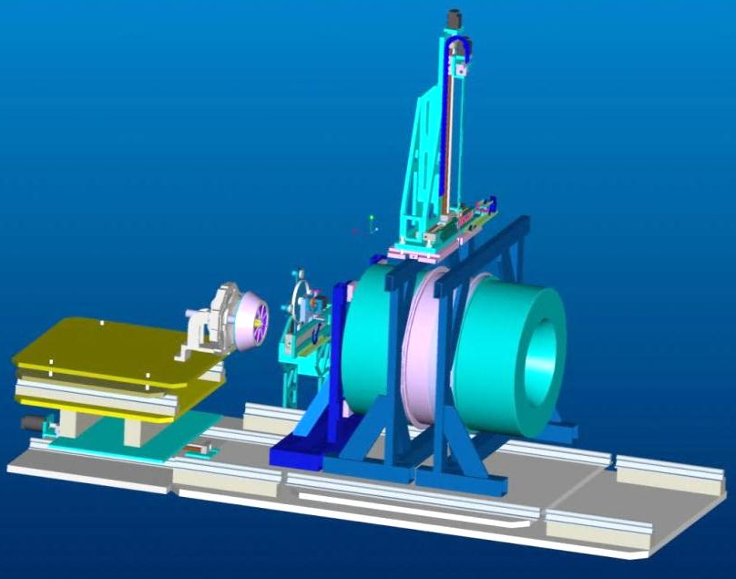
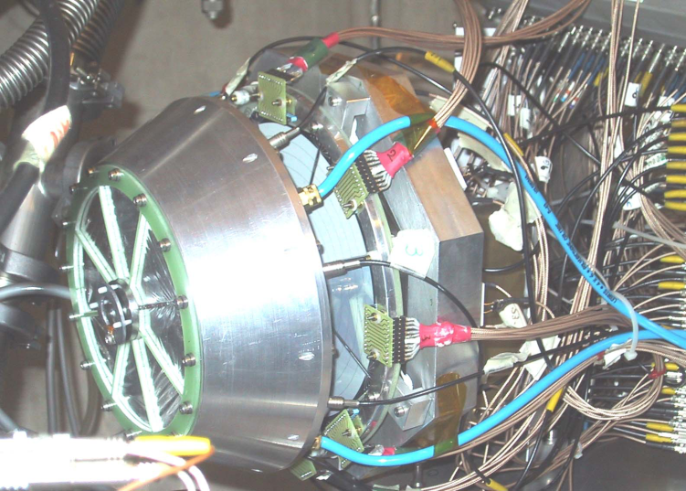
GARFIELD: geometry
GARFIELD
Scattering
Chamber
Length 6m
Ø 3.2m
2 Drift Chambers + RCo
Target between Drift chambers
F.Gramegna et al. NIM 389 (1997) 474
A. Moroni et al. NIM A556 (2006) 516
D. Fabris
College Station – August 2013
Notes:
Let me give you some few details about GARFIELD: It is made by 2 drift chambers as you can see in the slide. We have a rail system which permits to move the two chambers accordingly to the specific necessity. The Target is positioned in between the two chambers (when the two are used or, in any case on the center of the back of one the two.
The two drift chambers are essentially made by two alluminum cylinders which are containers for the gas and for the gas detector system. The two drift chambers give the DE signal for the energy loss of impinging particles. Inside the chambers as I will show we have also a number of Cesium iodide crystals for the residual energy information.
The front chamber is made by 24 sectors covering from theta 29 to 83 and 4pi in phi. The backward chamber has instead only 21 sectors as one regione have been left free for the insertion of different The empty region corrwespond to 45 degrees in phi.

Slide 14
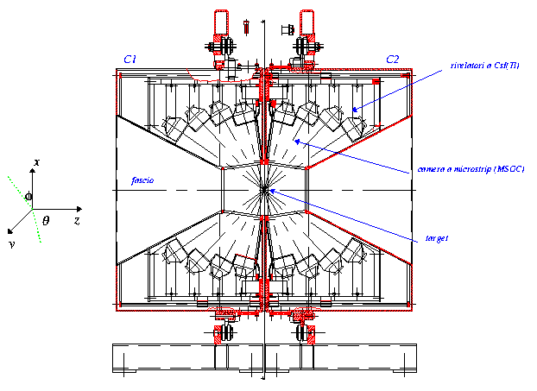
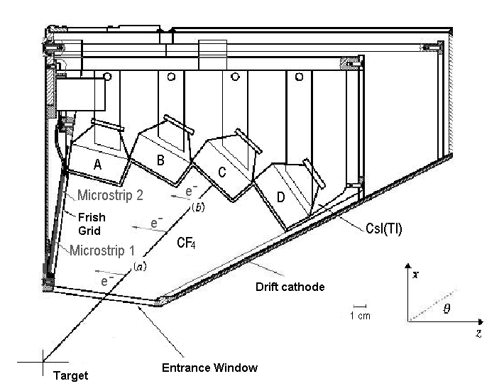
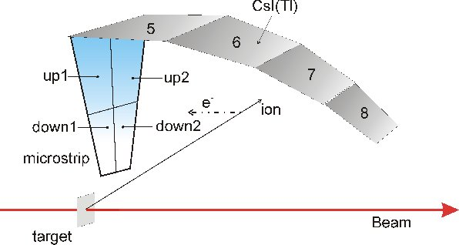
GARFIELD: geometry
2 Drift Chambers + CsI(Tl)
CsI(Tl)
beam
MSGS
target
Only one volume of gas for all sectors
Double stage ΔE-E: Micro Strip Gas Counter (MSGC)+ CsI(Tl) telescopes
(in total 180+180 for the 2 chambers)
1 Sector = 4 microstrips + 4 CsI(Tl)
Forward chamber = 24 sectors
Backward chamber = 21 sectors
Forward Chamber Backward Chamber
29°<θ<83° 97°<θ<147°
0°< φ<70° 0°<φ<360°
110°< φ<360°
Charge resolution: from Z=1 to Z=28
Energy resolution CsI(Tl) crystal : 3.0% for 5.5 MeV α. Identification threshold : 0.8-1 MeV/u
Detection Threshold : few tens of keV
Angular resolution θ=1°, φ=7.5°
Notes:
Here you can see a cross section of the two chambers together with the detail of each sector. The drift chambers in this dE-E configuration can identify ions from Z=1 to up to Z=28. The DE-E correlation are obtained through the utilization of CSI(Tl) residual energy signal toward the DE signal coming from gas microstrip detectors, that I will describe later. The CSI crystal s are 4 per sector and covers around 15 degrees in Theta and phi. In the forward chameber they are 96 while in the backward they are 84.
The DE signal is coming from gas microstrip detectors the details of which I will give you in my next slide. The particles produced in the studied reactions are emitted radially from the target, pass through the window of the drift chamber (made of few micro n of mylar) and then ionize the gas (normally we use CF4 at 50 -70 mbar) joining at the end (if theit energy iis large enough ) the Csi cristals. These last are geometrically positioned so that their front face are radially perpendicular with respect to the trajectory of the particles outcoming the target.

Slide 15
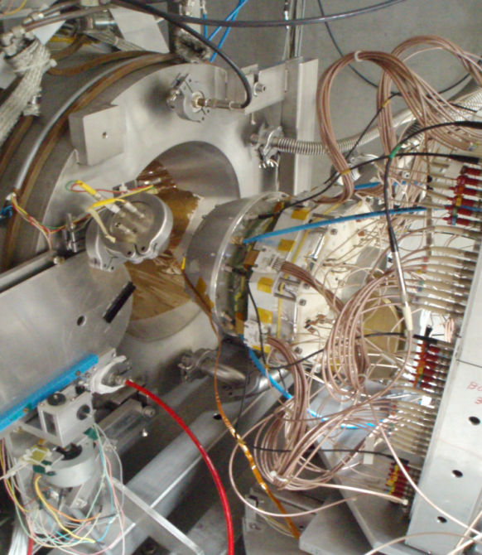
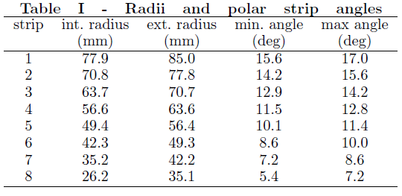
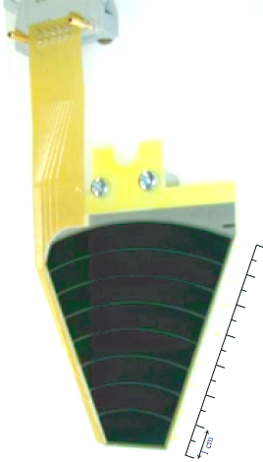
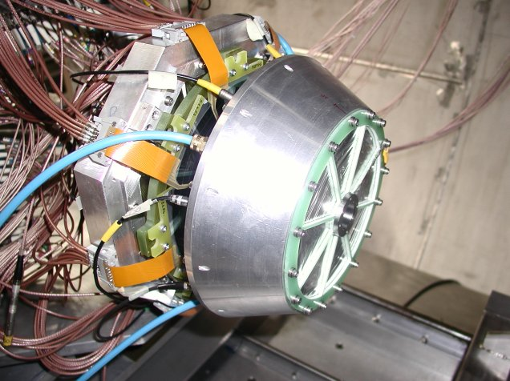
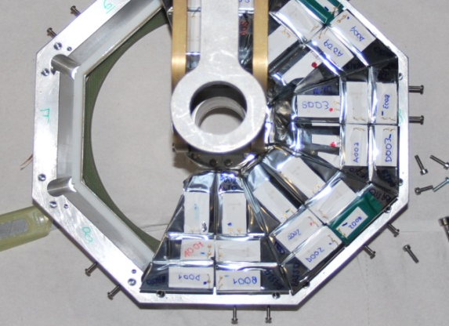
RING Counter (RCo)
Three stage telescope in forward angular region:
Ionization chamber (IC), Strip Silicon Detector (Si), CsI(Tl).
It is divided in 8 Sectors: 8 independent Ionization Chambers are working.
Each silicon detector, “Pie- shaped”, is segmented into 8 independent annular strips on one side (for a total of 64 Strips). In the present version they are nTD Silicon Reverse mounted detectors → Exploitation of the Pulse Shape Analysis based on Digital electronics. Improvement of the identification of fragments stopped in the detector.
The third stadium consists of 48 smaller CsI(Tl)crystals (6 per Silicon detector)→ good granularity for particle correlation function studies.
RCo
Notes:
Different detectors can be coupled to GARFIELD in the forward region: one of this is the RING COUNTER which is made by a triple telescope made by 8 ionization chamber, 8 300 micron silicon detector which has 8 strip in each sector, 48 small CSI(TL) crystals.
The RING COUNTER is completely digitized and analysed through pulse shape analysis- The RING counter is used at relatively high energies where the grazing angles are relatively small (so the silicon detectors are not damaged by elastic scattered particles. It cove from about 5 to 18 degrees.

Slide 16
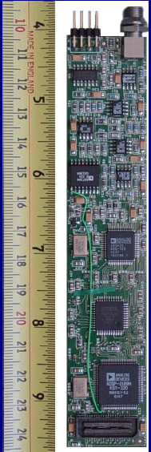
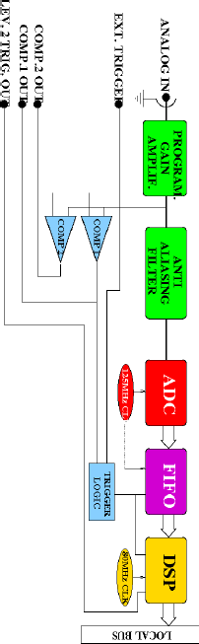

Electronics: system overview
DSP: The digital way
CsI(Tl)
24 x 4 = 96
21 x 4 = 84
tot 180 preamp
Microstrip det.
24 x 4 = 96
21 x 4 = 84
tot 180 preamp
Ancillary det. (es. RCo)
8 x 1 I.C.
6 x 8 CsI(Tl) tot 108 pre
8 x 8 Si det
Passive Splitter
Analogue chain
Digital chain
Trigger Unit
FAIR ADC
FAIR TDC
FAIR BUS
Digital Sampling
Processor
125MHz
12bit
mounted on VME mother board
Storage
On-line monitor
G. Pasquali et al. NIM A570 (2007) 126
D. Fabris
College Station – August 2013
Notes:
The electronic chain used

Slide 17
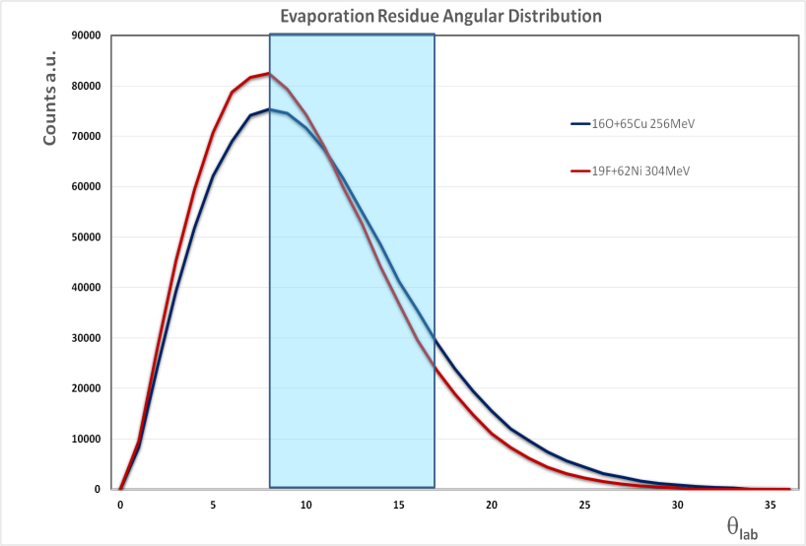
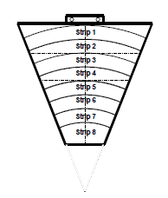
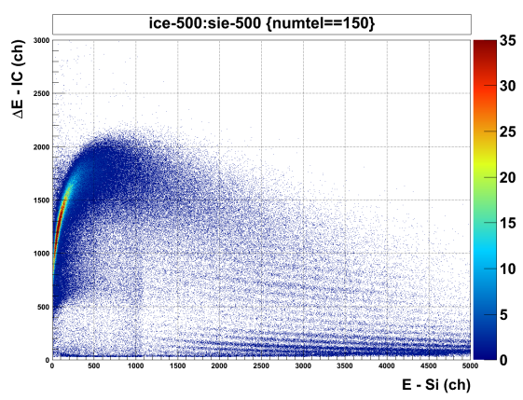
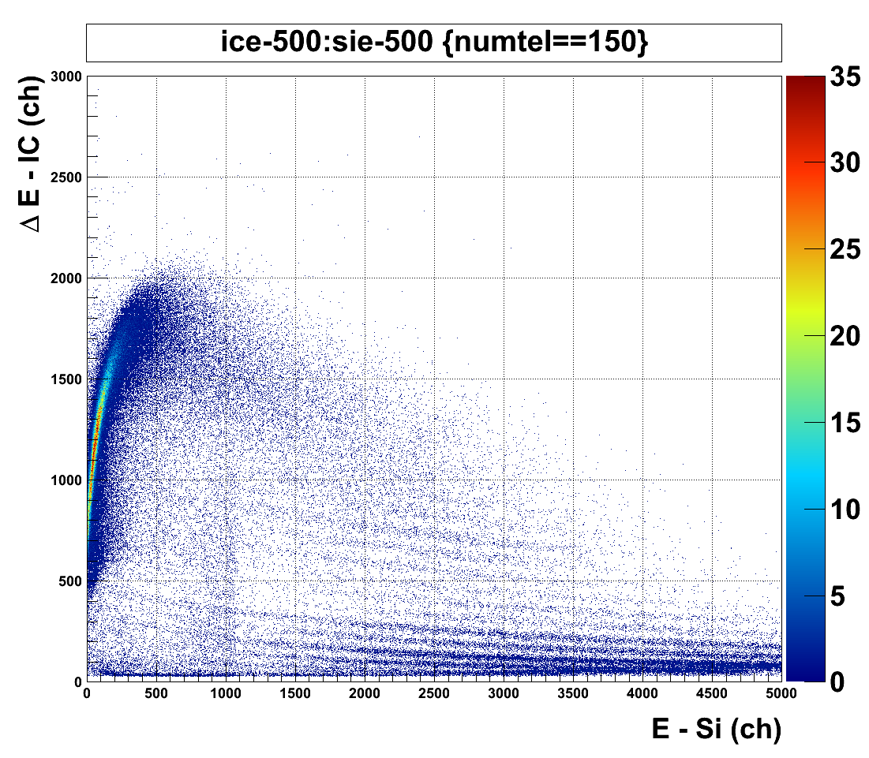
Evaporation Residues
Detected in the Ring Counter IC-Si
Δθ = 8.6° ÷ 17° at P = 25 mbar CF₄
Silicon Strip
256 MeV ¹⁶O + ⁶⁵Cu
θgr =8.2°
304 MeV ¹⁹F + ⁶²Ni
θgr =7.3°
D. Fabris
College Station – August 2013

Slide 18
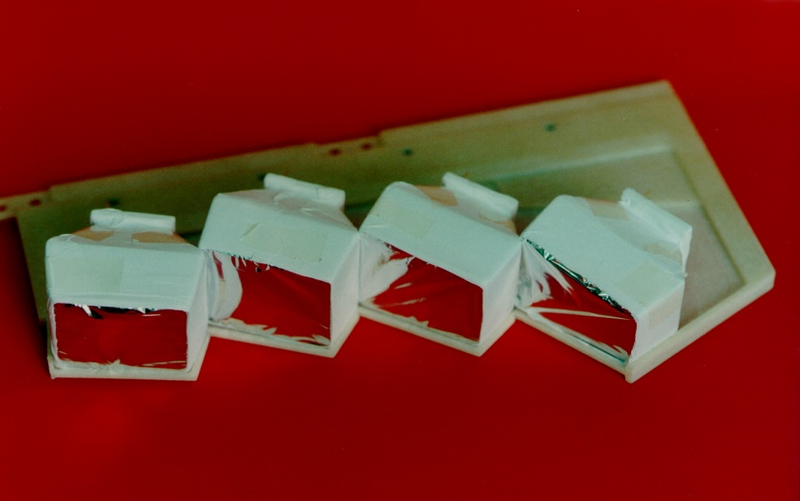
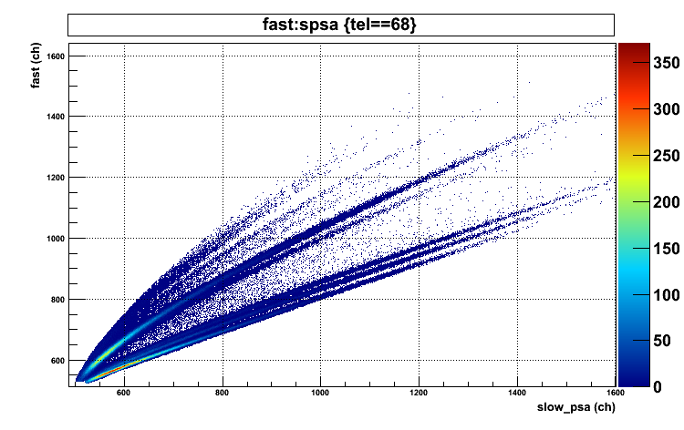
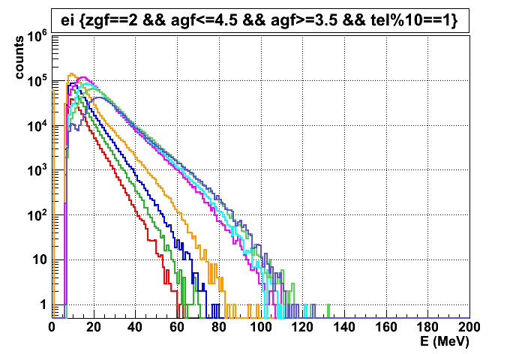
Light Charged Particles
Detected in GARFIELD CsI(Tl)
Δθ = 29° ÷ 151°
<θ_{C2}> = 133.1
<θ_{C1}> =74.6°
<θ_{C2}> = 145.3°
<θ_{C2}> = 119.9°
<θ_{C1}> = 60.1°
<θ_{C2}> = 105.4°
<θ_{C1}> = 46.9°
<θ_{C1}> = 34.7°
α-particles
³He, α
<θ> = 34.7° ÷ 145.3°
Fast (ch)
p, d,t
Slow (ch)
D. Fabris
College Station – August 2013

Slide 19
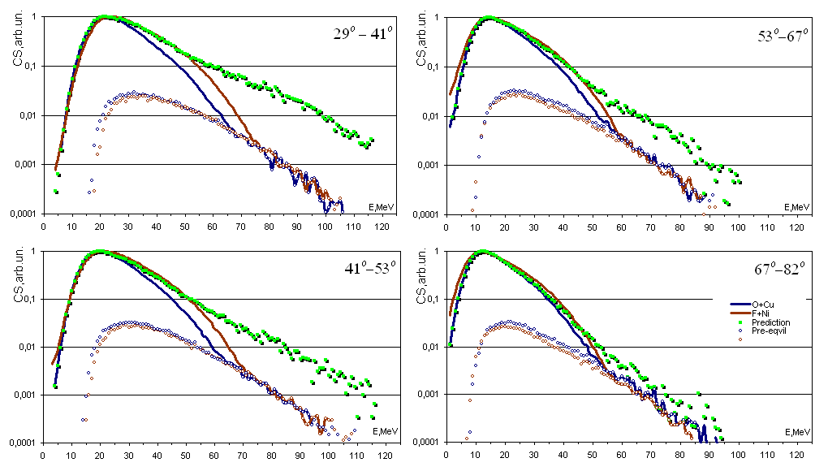
α,
¹⁶O+⁶⁵Cu→⁸¹Rb, E_{O}=256 MeV (16 MeV/u); E*=208,9 MeV
¹⁹F+⁶²Ni →⁸¹Rb, E_{F}=304 MeV (16 MeV/u); E*=239,9MeV
( in lab)
Unified Code, O.V. Fotina, Moscow State University
D. Fabris
College Station – August 2013

Slide 20
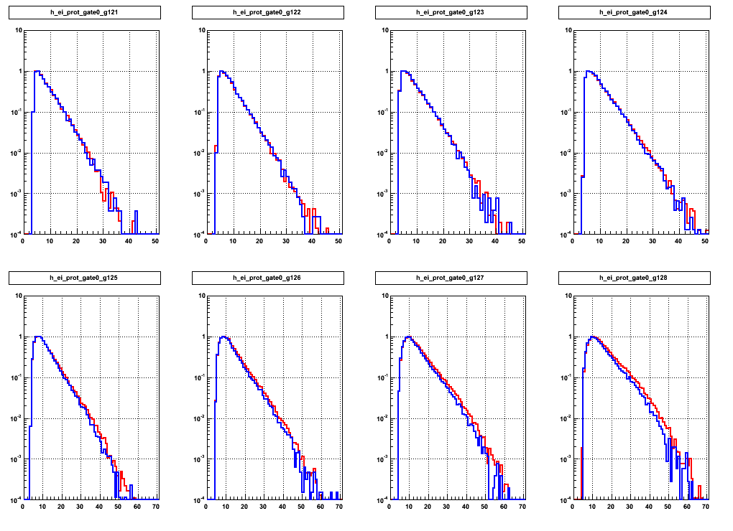
Proton spectra in Lab
___ ¹⁶O + ⁶⁵Cu
___ ¹⁹F + ⁶²Ni
PRELIMINARY
139°- 151°
127°- 139°
113°- 127°
98°- 113°
67°- 82°
53°- 67°
41°- 53°
29°- 41°
D. Fabris
College Station – August 2013
E_{lab} (MeV)

Slide 21
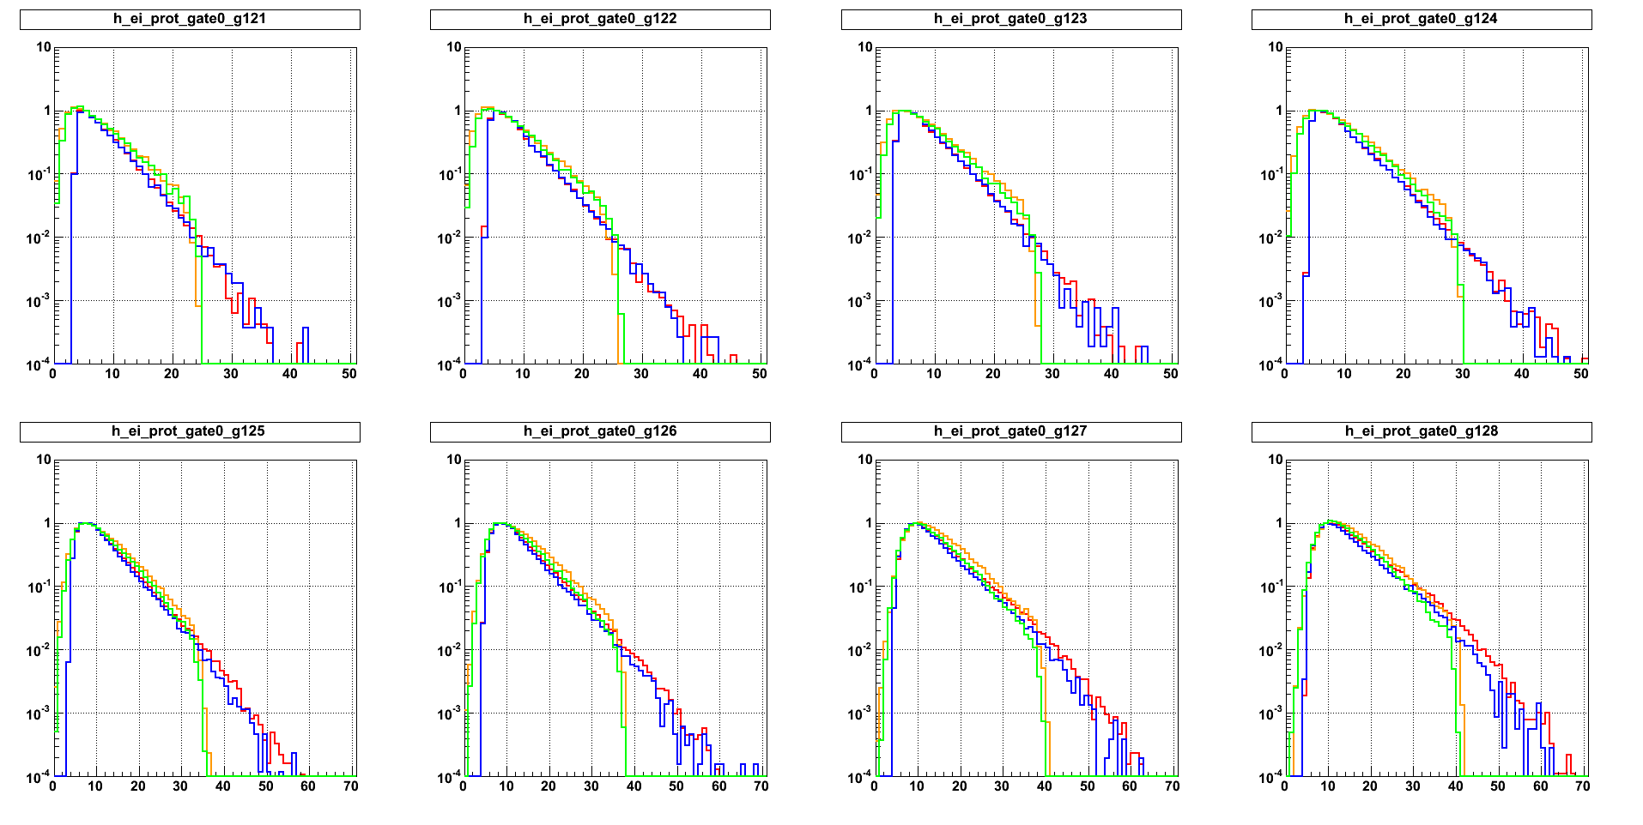
Proton spectra in Lab
___ ¹⁶O + ⁶⁵Cu
___ ¹⁹F + ⁶²Ni
___ ¹⁶O + ⁶⁵Cu PACE
___ ¹⁹F + ⁶²Ni PACE
139°- 151°
127°- 139°
113°- 127°
98°- 113°
67°- 82°
53°- 67°
41°- 53°
29°- 41°
D. Fabris
College Station – August 2013
E_{lab} (MeV)

Slide 22
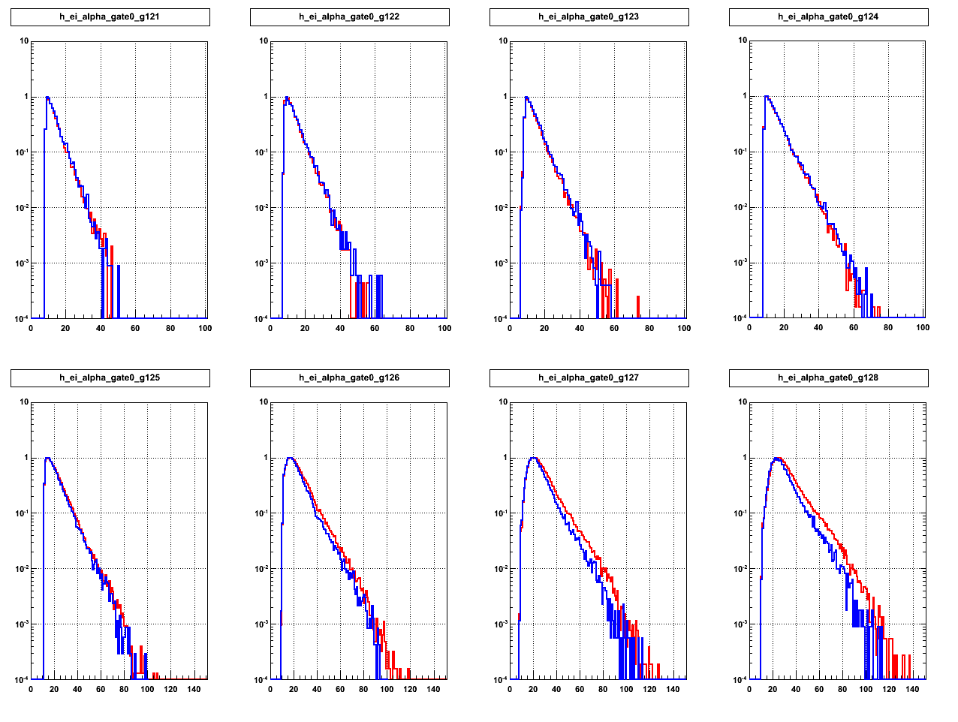
α spectra in Lab
___ ¹⁶O + ⁶⁵Cu
___ ¹⁹F + ⁶²Ni
PRELIMINARY
139°- 151°
127°- 139°
113°- 127°
98°- 113°
67°- 82°
53°- 67°
41°- 53°
29°- 41°
D. Fabris
College Station – August 2013
E_{lab} (MeV)

Slide 23
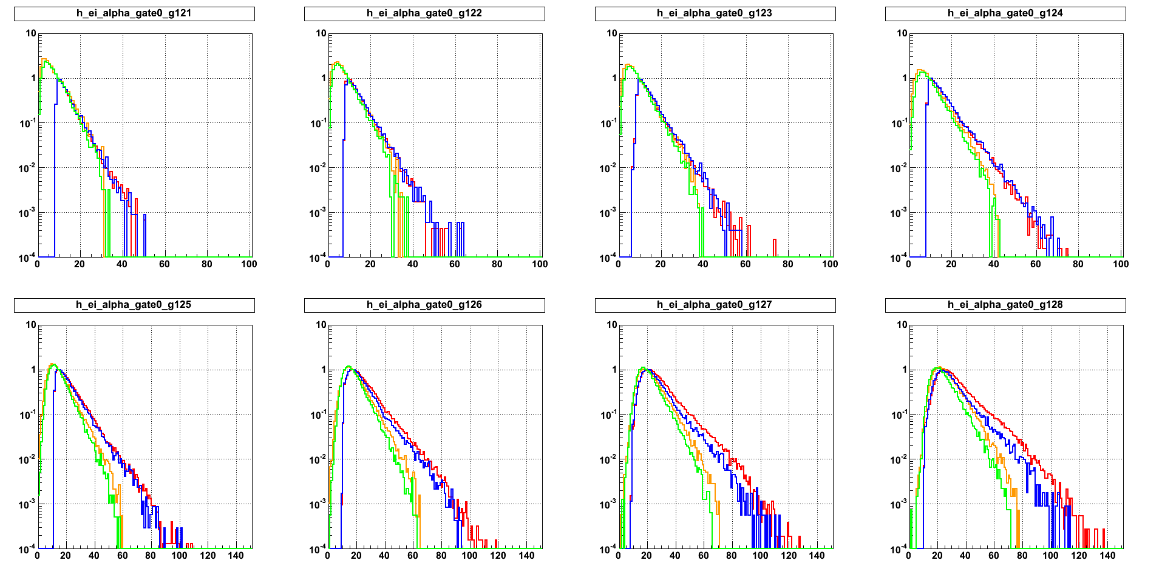
α spectra in Lab
___ ¹⁶O + ⁶⁵Cu
___ ¹⁹F + ⁶²Ni
___ ¹⁶O + ⁶⁵Cu PACE
___ ¹⁹F + ⁶²Ni PACE
139°- 151°
127°- 139°
113°- 127°
98°- 113°
67°- 82°
53°- 67°
41°- 53°
29°- 41°
D. Fabris
College Station – August 2013
E_{lab} (MeV)

Slide 24
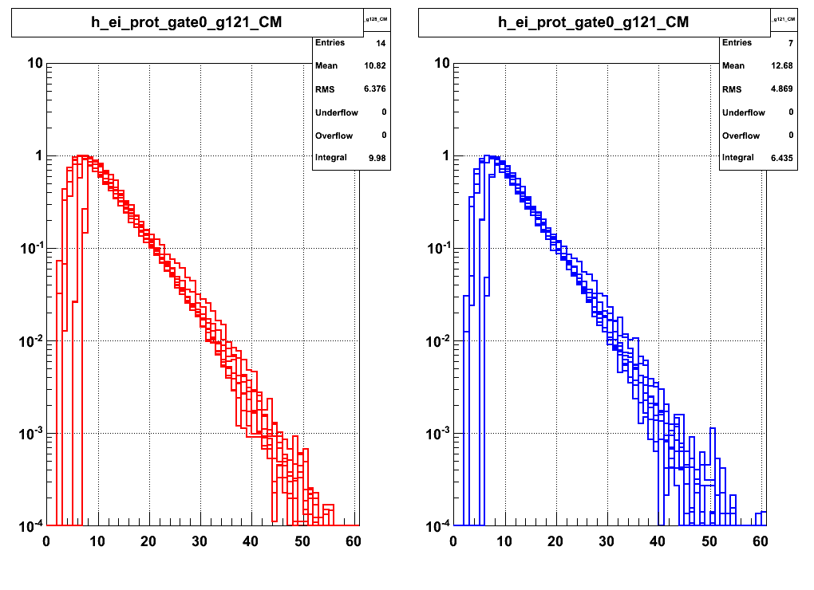
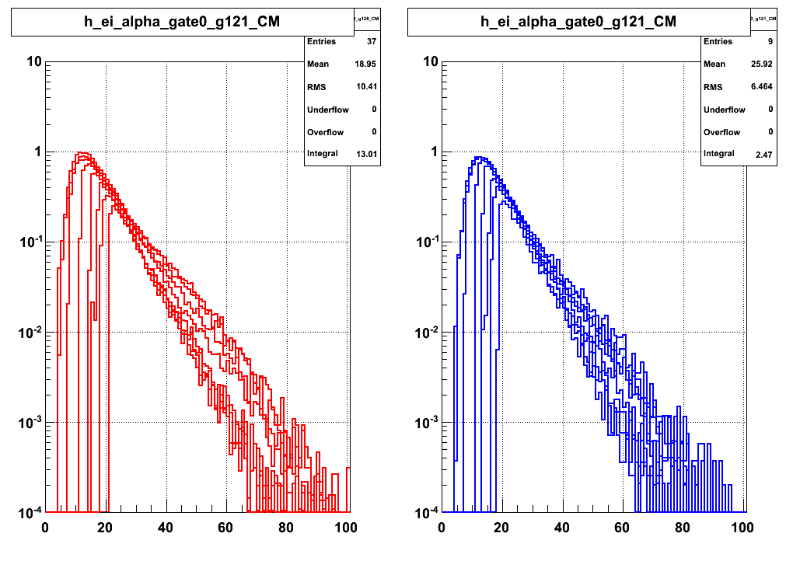
PRELIMINARY
CM Spectra at different angles
Proton in CM
Alpha in CM
¹⁹F + ⁶²Ni
¹⁶O + ⁶⁵Cu
¹⁹F + ⁶²Ni
¹⁶O + ⁶⁵Cu
E_{CM}
E_{CM}
D. Fabris
College Station – August 2013

Slide 25
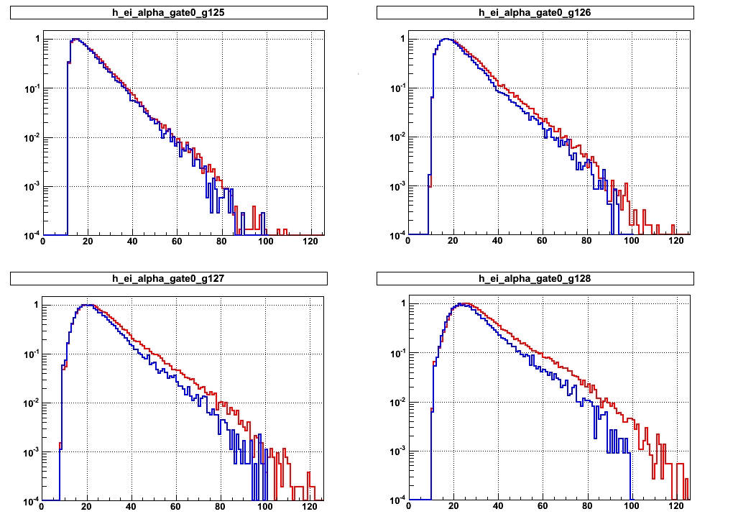
α spectra
in Lab
67°- 82°
53°- 67°
_
10⁻²
_
PRELIMINARY
10⁻³
Experimental
41°- 53°
_
29°- 41°
10⁻¹
_
10⁻²
___ ¹⁶O + ⁶⁵Cu
___ ¹⁹F + ⁶²Ni
_
10⁻²
_
Calculated
Hybrid Exciton Model
10⁻³
_
10⁻¹
10⁻²
_
D. Fabris
College Station – August 2013

Slide 26
Summary
    The Pre-equilibrium particles emission in the systems 256 MeV ¹⁶O + ⁶⁵Cu and 304 MeV ¹⁹F + ⁶²Ni has been studied to probe the α-cluster structure in nuclei
Preliminary results of Protons and Alpha particles in coincidence with Evaporation Residues have been extracted
Protons : The comparison with PACE calculations shows a small Pre-equilibrium component, very similar for the two systems
Alpha :
  Experimental spectra are similar for the two system, but the Pre-equilibrium component is bigger for the ¹⁹F + ⁶²Ni system, not expected from previous studies
  A first comparison with Hybrid Exciton Model calculations shows an understimation of Pre-equilibrium alpha in both system (forward and backward) and the shapes of the spectra are similar to the one where the cluster is included
D. Fabris
College Station – August 2013

Slide 27
Outlook
Preliminary results seem NOT to confirm the predicted difference between the two systems
An overproduction of alpha particles, at the most forward angles, by respect the Hybrid Exciton Model predictions is confirmed.
This overproduction has to be explaned…
What next
To extract energy spectra for all particles p, d, t, ³He, α also for the most
forward angles of the RCo.
To study possible angular and energy correlations events-by-events.
To make more selective coincidences with evaporation residues, as a function
of their energies and of the detected angles.
To complete the Hybrid Exciton Model calculations for all particles and for all
the measured angles.
D. Fabris
College Station – August 2013

Slide 28
NUCL-EX collaboration
V.L. Kravchuk¹, F. Gramegna², M. Cinausero², T. Marchi², D. Fabris³, M. Bruno⁴, M. D’Agostino⁴, G. Baiocco⁴, L. Morelli⁴, G. Vannini⁴, G. Casini⁵, S. Barlini⁵, M. Bini⁵, S. Carboni⁵, A. Olmi⁵, G. Pasquali⁵, S. Piantelli⁵, G. Poggi5, O.V. Fotina⁶, S.A. Goncharov⁶, D.O. Eremenko⁶, O.A. Yuminov⁶, Yu.L. Parfenova⁶, S.Yu. Platonov⁶, V.A. Drozdov⁶, M. Degerlier⁷
¹National Research Center “Kurchatov Institute”, Moscow, Russia
²Laboratori Nazionali di Legnaro, Legnaro (PD), Italy
³INFN sezione di Padova, Padova, Italy
⁴Dipartimento di Fisica, Universita’ di Bologna and INFN sezione di Bologna, Bologna, Italy
⁵Dipartimento di Fisica, Universita’ di Firenze and INFN sezione di Firenze, Firenze, Italy
⁶Skobeltsyn Institute of Nuclear Physics, Moscow State University, Moscow, Russia
⁷University of Nevsehir, Science and Art Faculty, Physics Department, Nevsehir, Turkey
D. Fabris
College Station – August 2013

Slide 29
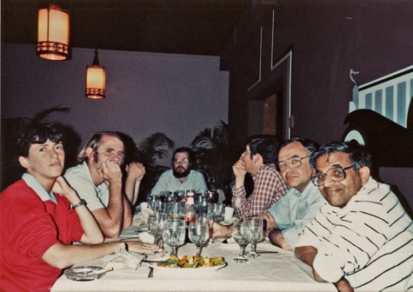

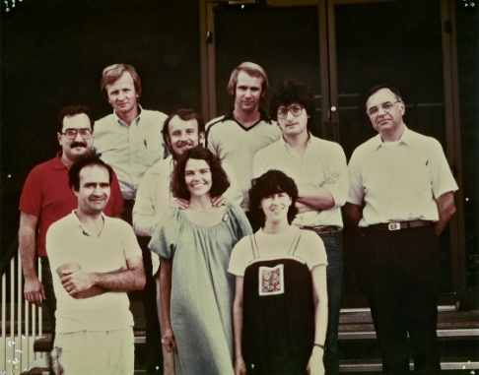
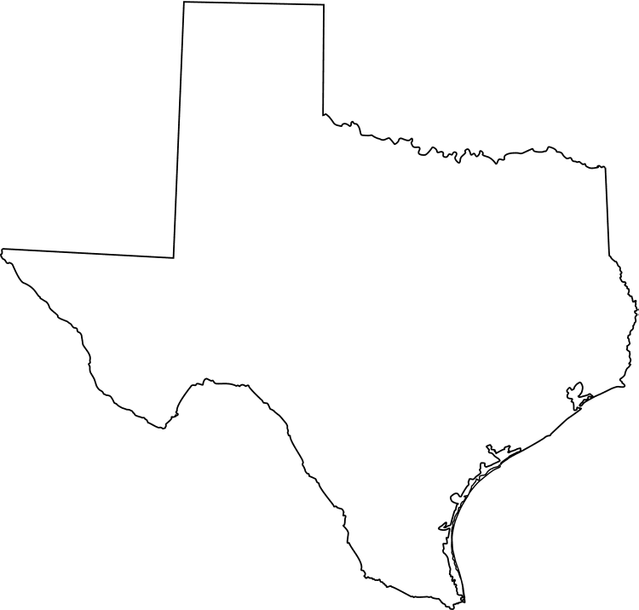

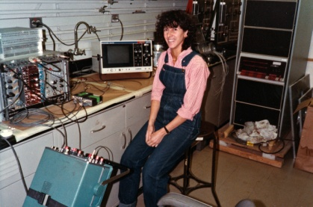
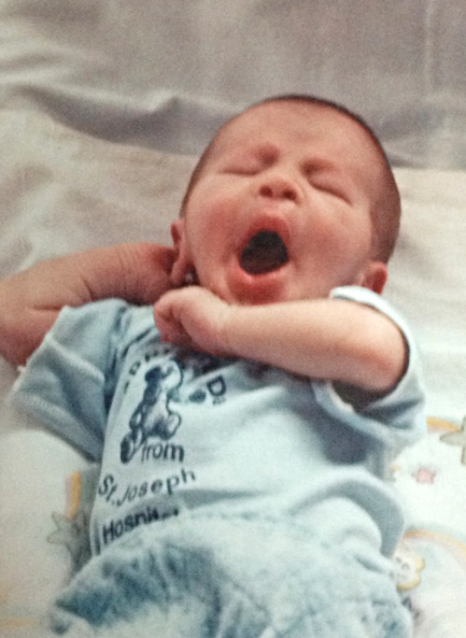
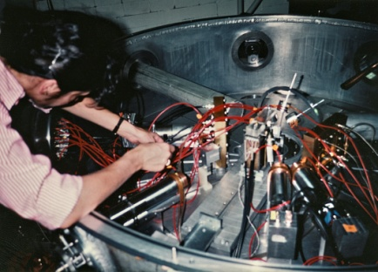



1983
1984
1987
Thank you JOE !!!....

Slide 30
Spares

Slide 31


PRELIMINARY
Proton in CM
E_{CM} (MeV)
___ ¹⁶O + ⁶⁵Cu
___ ¹⁹F + ⁶²Ni
Alpha in CM
D. Fabris
College Station – August 2013
E_{CM} (MeV)

