Slide 1
Exploring the alpha cluster structure of nuclei using the thick target inverse kinematics technique for multiple alpha decays. The ²⁴Mg case
Marina Barbui, August 19th, 2013

Slide 2
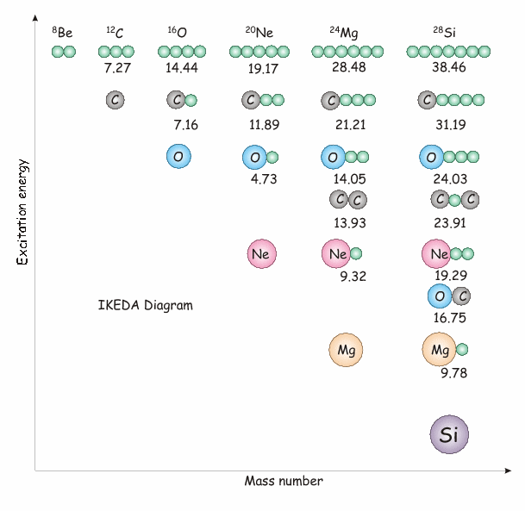
Alpha clustering in nuclei
Estimated limit N = 10α for self-conjugate nuclei(Yamada PRC 69, 024309)
Ikeda diagram (K. Ikeda, N. Takigawa, and H. Horiuchi, Prog. Theor, Phys. Suppl. Extra Number, 464, 1968.)
Many theoretical works since then have brought to the picture of alpha cluster nuclei described as a diluted gas of alphas in the lowest S state. (PRL 87, 192501; PRC 75, 037303).
Many experimental works have explored the ⁸Be and ¹²C cases, fewer are available on the heavier systems.
We have investigated the ²⁴Mg case with ²⁰Ne+α at 2.9 and 9.7 AMeV using the Thick Target Inverse kinematics Technique (K. Artemov et al., Sov. J. Nucl. Phys. 52, 406 (1990))

Slide 3
The thick target inverse kinematics technique
Allows covering a large range of incident energies in the same experiment.
In the inverse kinematics, the reaction products are focused at forward angles.
Allows measuring reaction products emitted at 0º.
This Method (K. Artemov et al., Sov. J. Nucl. Phys. 52, 406 (1990)) has been used several times to measure the resonant elastic scattering (Eur. Phys. J. A (2011) 47: 73; Eur. Phys. J. A (2011) 47: 96; AIP Conf. Proc. 1213, 137 (2010) ) and is used here for the first time to detect multiple alpha decays.

Slide 4
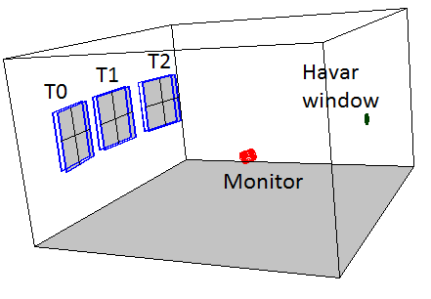
Experimental setup
²⁰Ne beam from the K150 cyclotron at TAMU
@ 3.7 AMeV, 2.9 AMeV after the window
@ 11 AMeV, 9.7 AMeV after the window
14º
3º
11º
9.6º
0º
6.6º
48 cm
Reaction chamber filled with ⁴He gas at a pressure sufficient to stop the beam before the detectors
10.3 PSI with ²⁰Ne beam @2.9 AMeV
and
50 PSI with ²⁰Ne beam @9.7 AMeV
Measured quantities:
-Energy signals form every detector pad.
-Time from the cyclotron radiofrequency.

Slide 5
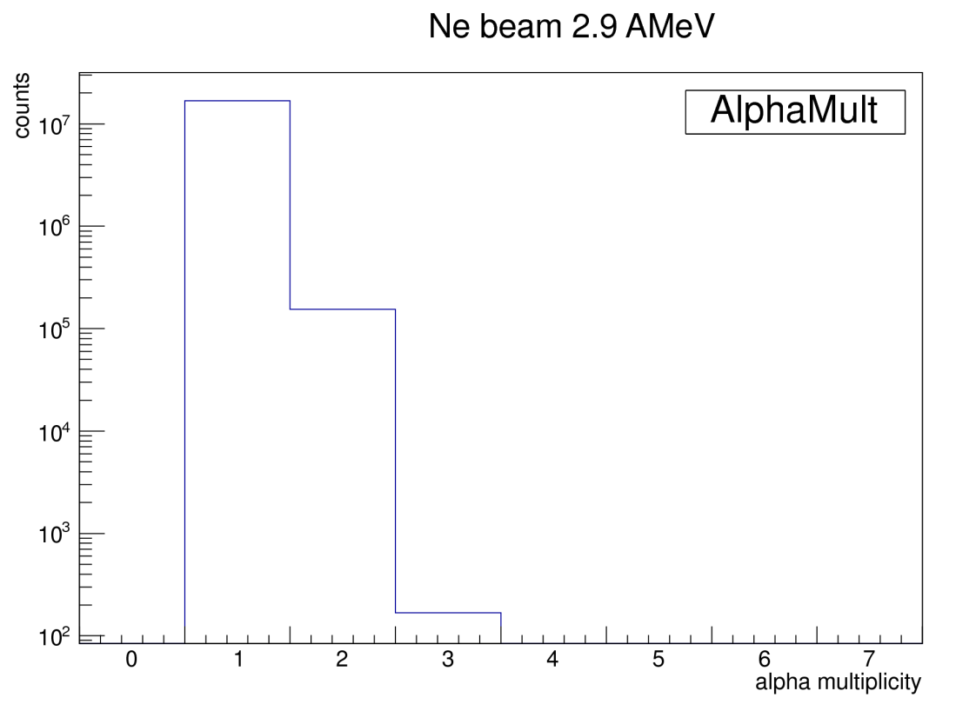
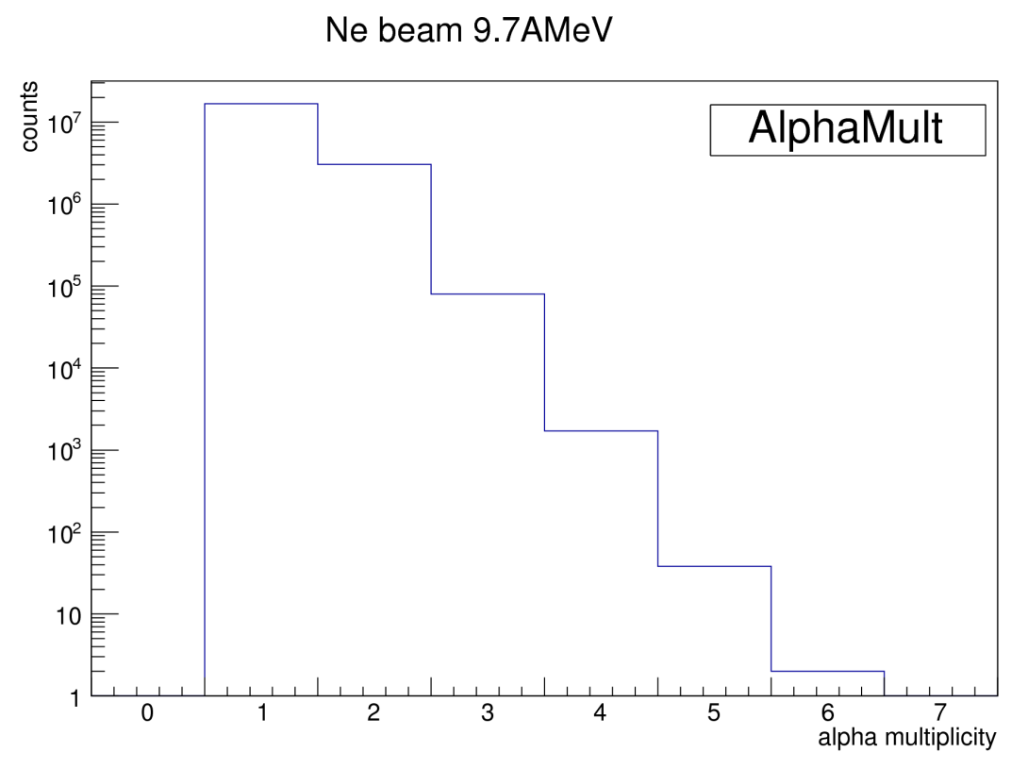
Preliminary analysis
Energy calibration.
Time calibration.
Particle identification with gates on ΔE-E and E-Time.
Selection of the events with alpha multiplicity 1 and 2 for further analysis.
Reconstruction of the interaction point in the gas using the kinematics, the measured alpha energies and the energy-range tables from SRIM (double check with the measured time).
Reconstruction of the excitation energy of the ²⁴Mg.

Slide 6
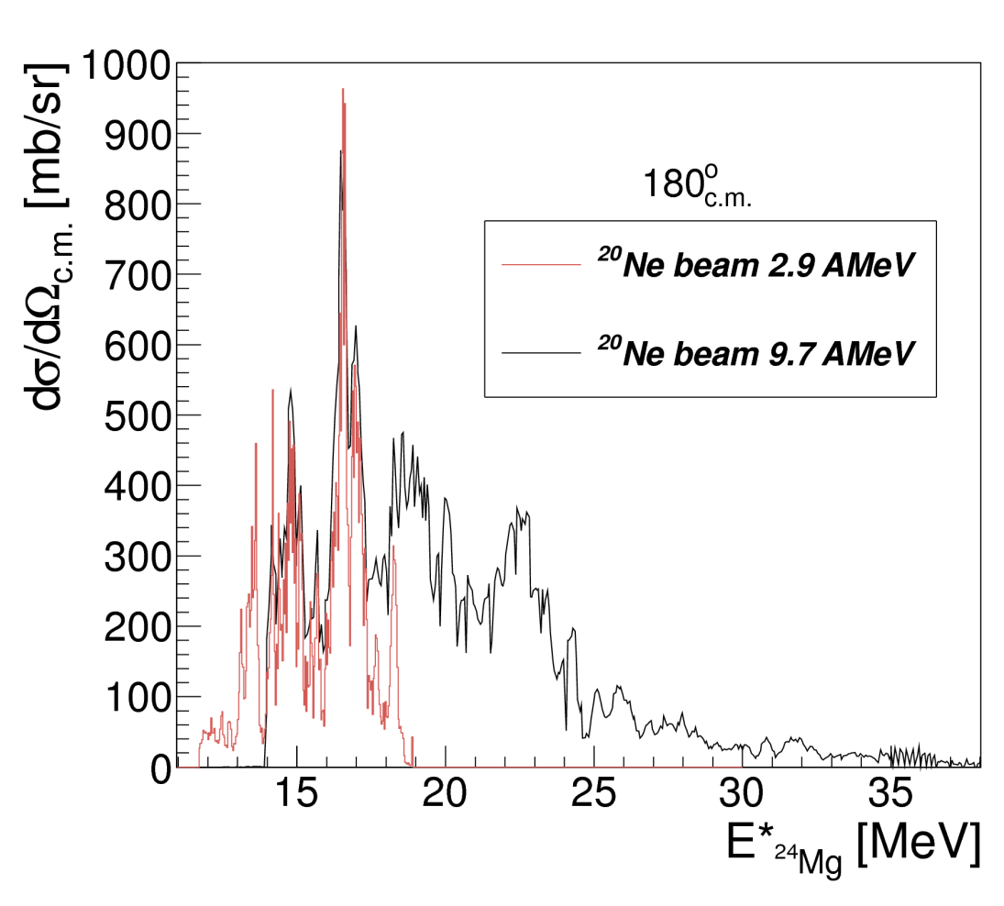
Events with Alpha Multiplicity 1
4-5º
⁻⁻⁻⁻⁻ ²⁰Ne beam 2.9 AMeV
⁻⁻⁻⁻⁻ Abegg
0º
6 alphas thresh.
Comparison with the excitation function measured in 10-15 keV energy steps in normal kinematics at 168º in the center of mass By R. Abegg and C.A. Davis PRC 43(1991)2523
Nice energy resolution (about 30 keV at 0º) worsening as we move away from the beam direction
Possibility to measure the whole excitation function in the same experiment.

Slide 7
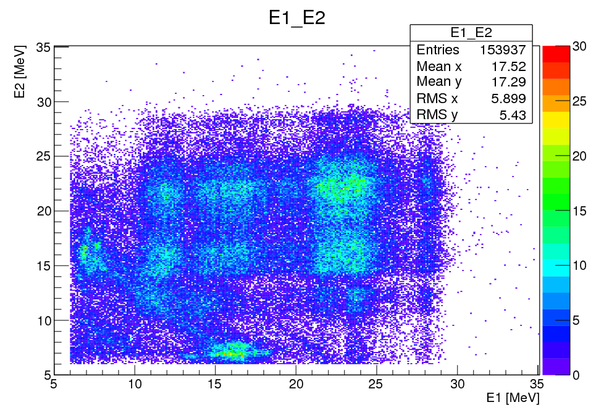
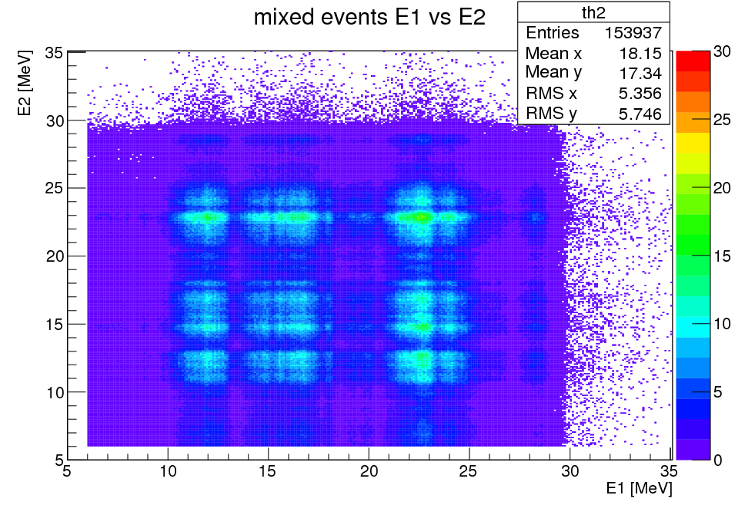
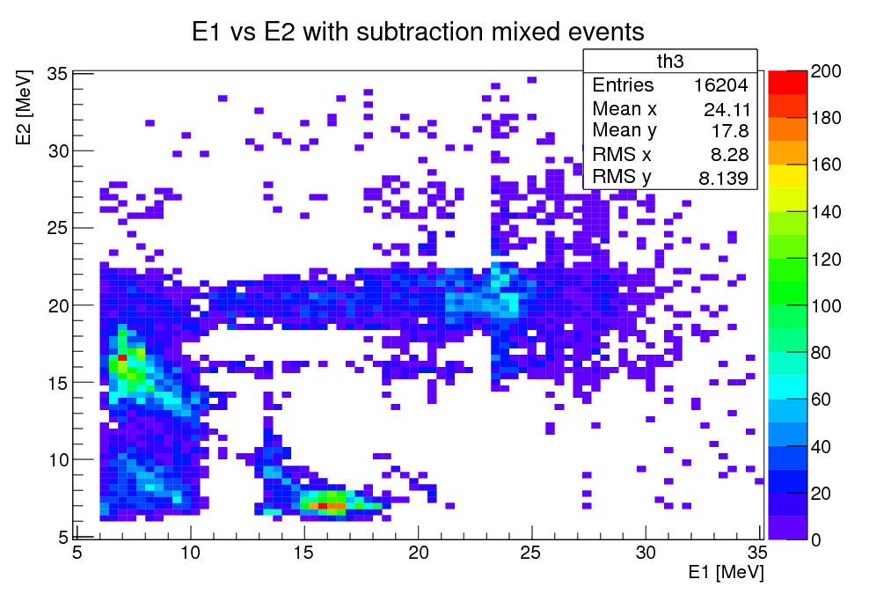
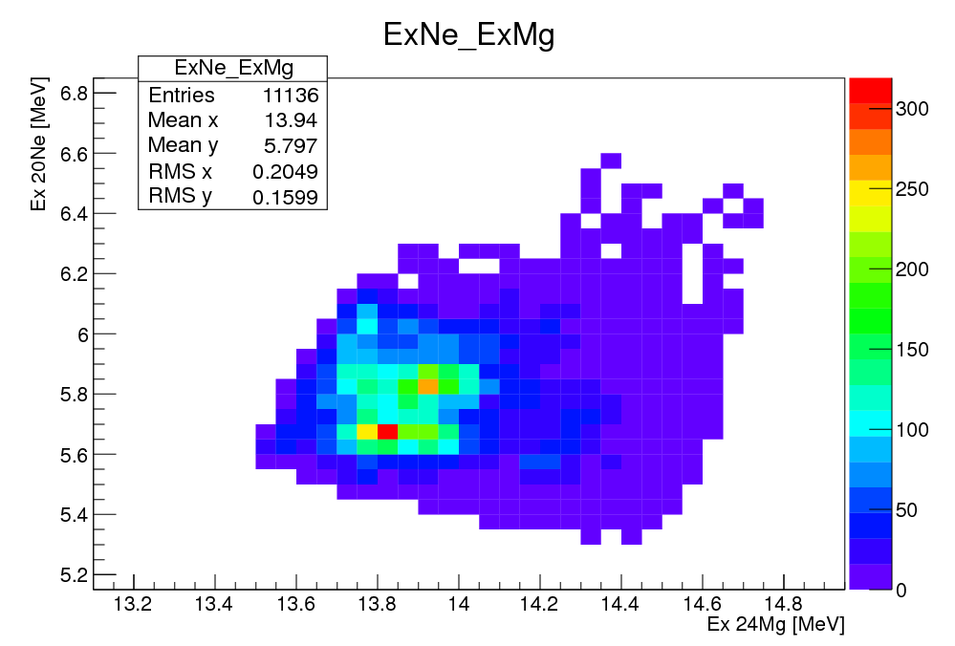
Events with alpha multiplicity 2
²⁰Ne @ 2.9 AMeV
Estimate of the uncorrelated events by randomly mixing 2 events with multiplicity 1
Threshold energy for ¹⁶O +2α
After subtraction of the uncorrelated events
²⁴Mg*
α₁
²⁰Ne*
α₂
¹⁶O g.s.

Slide 8
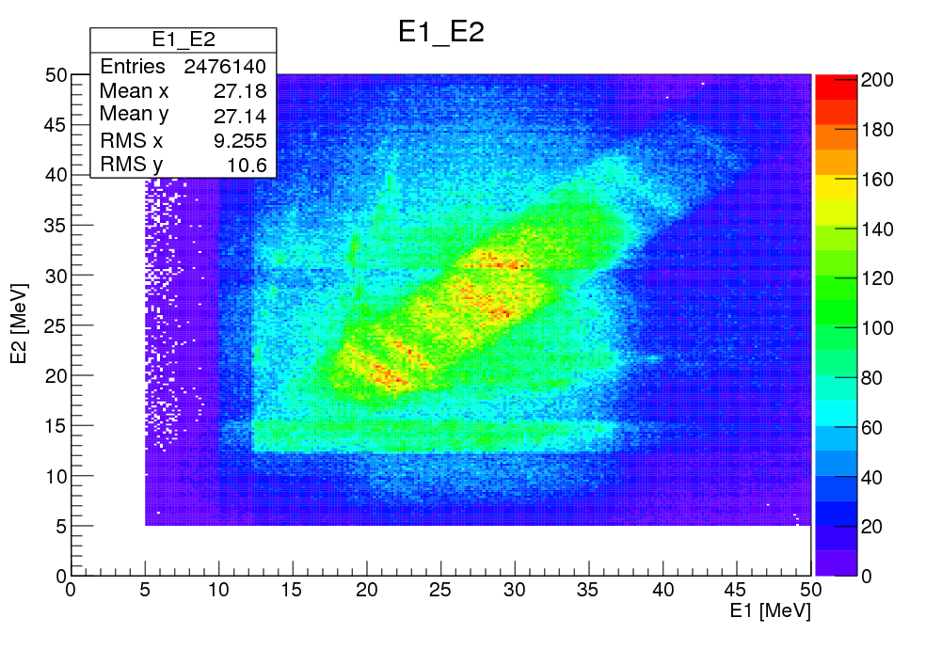
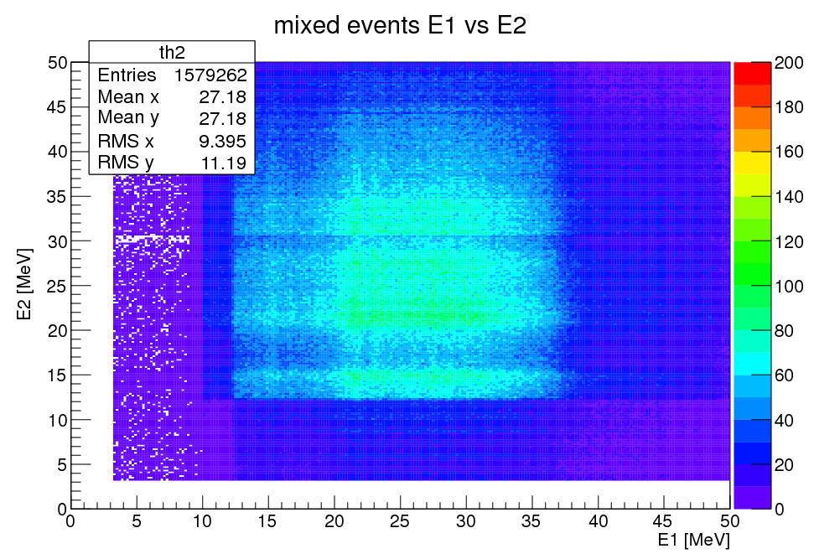
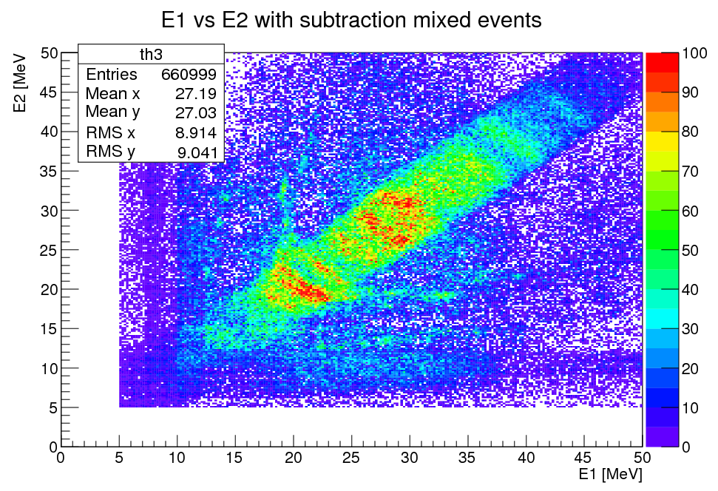
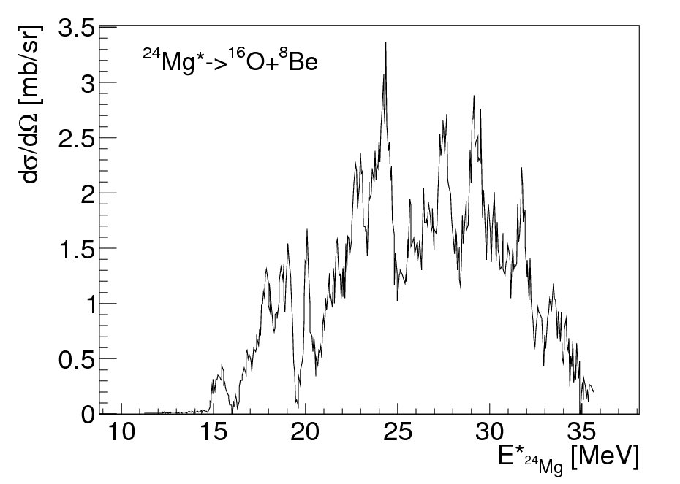
Events with alpha multiplicity 2
²⁰Ne @ 9.7 AMeV
Estimate of the uncorrelated events
Threshold for
6α decay
After subtraction of the uncorrelated
⁸Be
²⁴Mg*
¹⁶O

Slide 9
Summary and conclusions
The complex shape of the excitation function of ²⁴Mg requires further analysis to be fully explained.
The peaks at about 28 and 32 MeV observed when ²⁴Mg*decays into ¹⁶O+⁸Be are particularly interesting because they lie very close to the energy threshold for the splitting of ²⁴Mg into 6 alphas.
At the beam energy of 9.7 AMeV we observed few events with multiplicity 4 and 5 probably related to the decay of ²⁴Mg in 6 αs, the analysis of those events is still in progress.
Another experiment with an improved experimental setup is planned for the near future. A better time resolution is necessary in order to have a better reconstruction of the events. Moreover a larger angular coverage at forward angles is necessary to increase the detection efficiency for events in which the ²⁴Mg decays in 6 alphas.
Heavier systems can be studied with the same thechnique

Slide 10
Thank you for your attention!
M. Barbui¹, K. Hagel¹, V.Z. Goldberg¹, J.B. Natowitz¹, H. Zheng¹, G. Giuliani¹, G.Rapisarda¹, S. Wuenschel¹, E.J. Kim¹ and X.Q. Liu^{1,2}
¹ Cyclotron Institute, Texas A&M University, MS3366 College Station, TX
² Institute of modern physics, Chinese Academy of Sciences, Lanzhou, China

