Slide 1



SPES Project
Selective Production of Exotic Species
α
γ
β
δ
Gianfranco Prete LNL-INFN
On behalf of the SPES Collaboration
In honor of Joe Natowitz
International Workshop on Nuclear Dynamics and Thermodynamics
Texas A&M University, College Station, Texas
August 19-22, 2013
Notes:
Thanks to the organizing committee for the opportunity to present the SPES project.

Slide 2
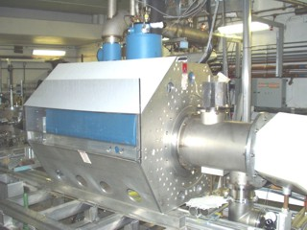
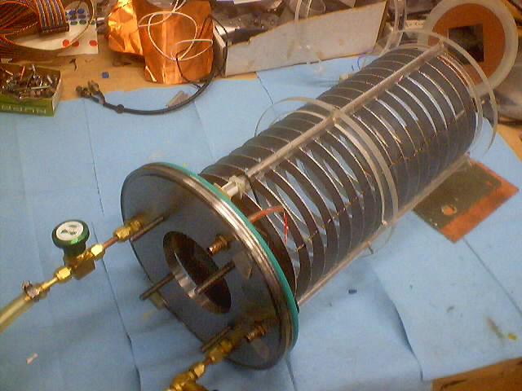
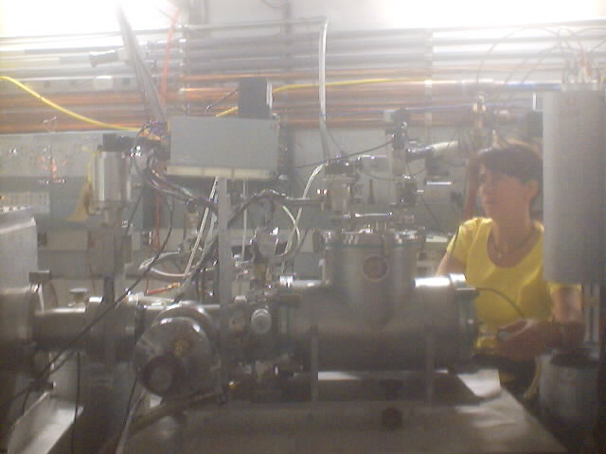
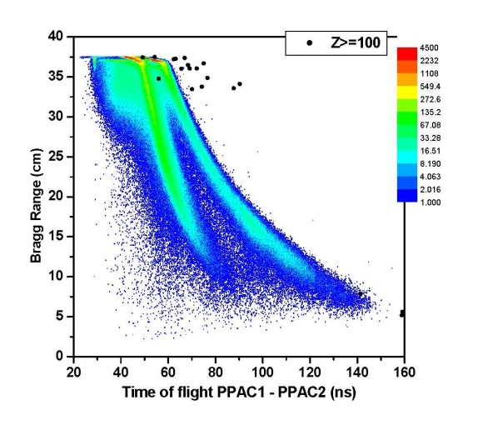
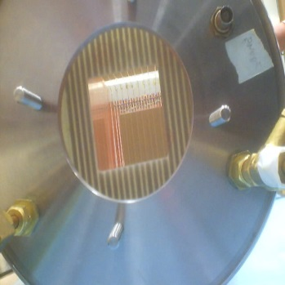
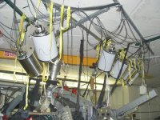
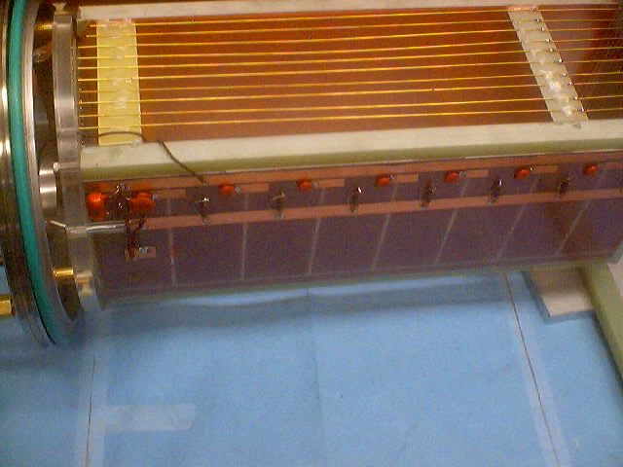
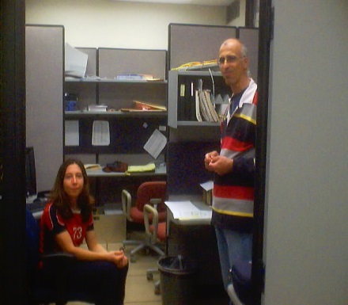
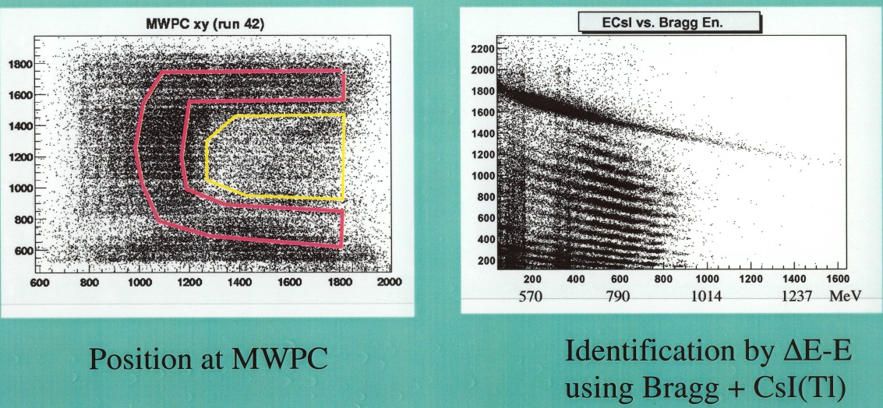
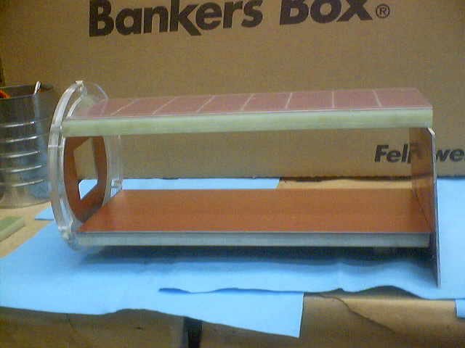
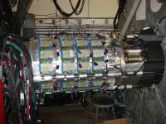
BIG SOL and Focal detectors
More than 30 years of Padova-Legnaro and JBN group collaboration.
(mainly in summer !!!)
Neutron detectors
NIMROD
Notes:
Before to start
I would like to acknowledge the long collaborative work performed with Joe and his group (mainly during the summer) and the always warm hospitality at Cyclotron Institute.
Some pictures of the instruments of our works at Cyclotron.

Slide 3
BIG SOL and Focal detectors
Thanks to Joe for the long
friendship.
Thanks to Roy, Kris and the Cyclotron staff for patience and helping me
In developing several detectors
Neutron detectors
NIMROD
Notes:
I would like to say thanks to Joe

Slide 4
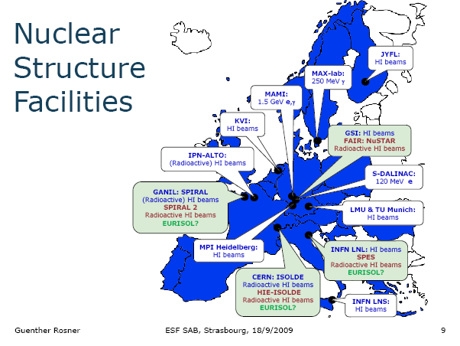




The Framework for SPES
The Framework for SPES
Nuclear Physics European Coordination Committee
The European Commission funds, within its Seventh Framework Programme (FP7), the ENSAR project
Its core aim is to provide access to seven of the complementary world-class Large-Scale Facilities: GANIL (F), GSI (D), joint LNL-LNS (I), JYFL (FI), KVI (NL), CERN-ISOLDE (CH) and ALTO (F). These facilities provide stable and radioactive ion beams of excellent qualities ranging in energies from tens of keV/u to a few GeV/u.
ELI
Notes:
In Europe the nuclear physics initiatives are coordinated by NUPECC.
The EU dedicate funds within the FP to provide access to the LSF

Slide 5
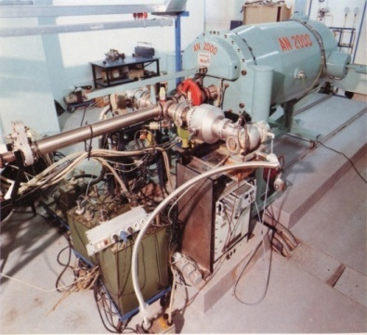
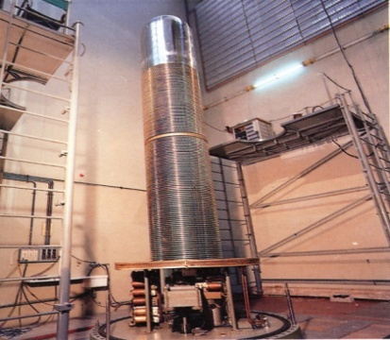
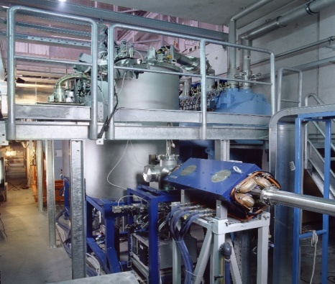
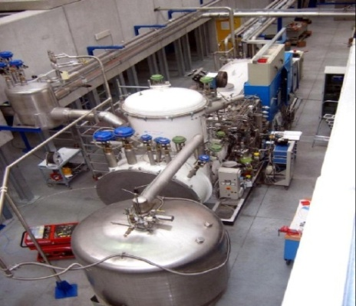
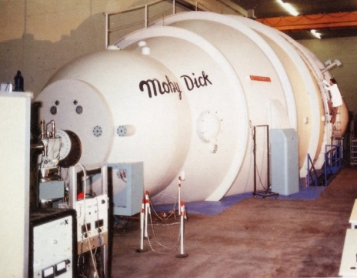
INFN-LNL
Laboratori Nazionali di Legnaro
AN2000 2 MV
CN 7 MV
PIAVE HI Injector
SPES AREA
ALPI Linac 40 MVeq
Tandem XTU 15 MV
Accelerators at LNL
Notes:
Legnaro is one of the european LSF. It is a Nuclear Physics laboratory operated by INFN equipped with two Van De Graaff mainly used for applied physics and a XTU Tandem and a superconductive Linac for nuclear physics.

Slide 6
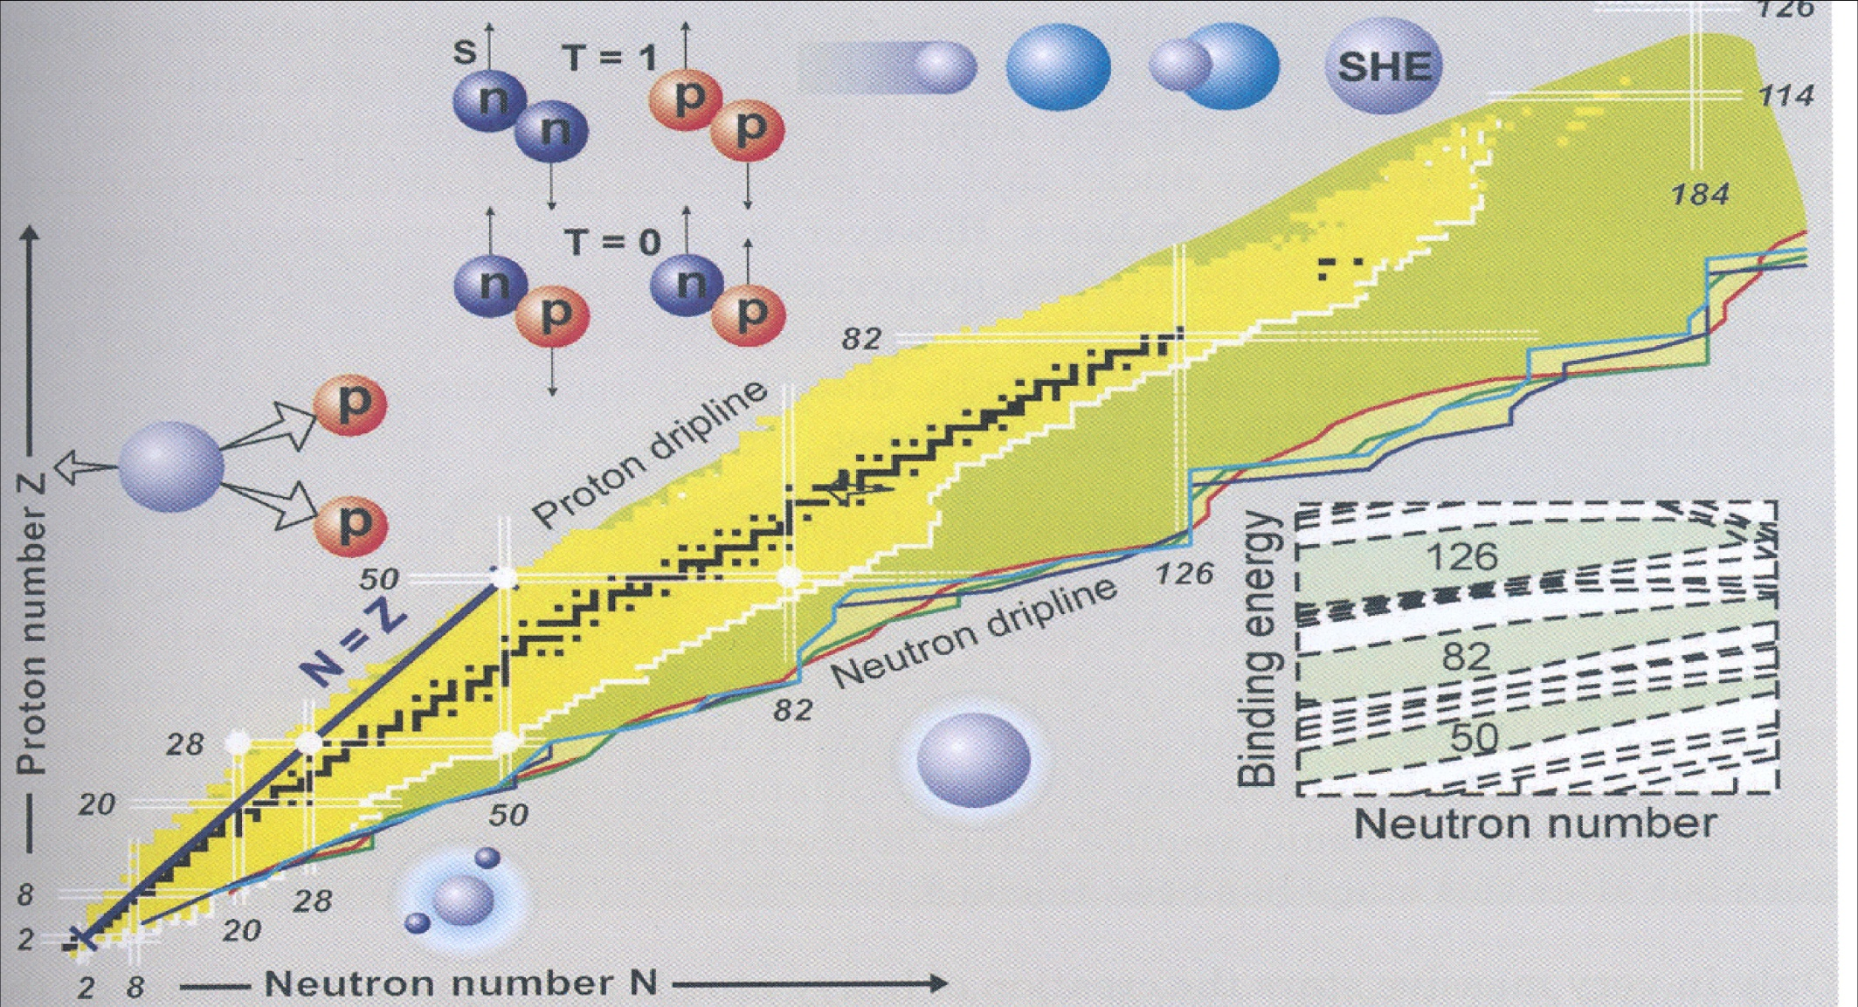
Radioactive Ion Beams: the Nuclear Chart and Challenges
SHE
Proton - neutron pairing
2-Proton radioactivity
r-process path
U fission
Halo nuclei and weakly bound quantistic systems
Neutron-rich ions are produced by FISSION of U, Th, Cf, …
Notes:
The actual challenge of the nuclear physics is to Extend the knowledge of the Nuclear properties by the use of RIB’s (300 → 3000 nuclei), studing Nuclei at their limit of existence and Heavy nuclei produced in cataclysmic cosmic events
New fenomena are discovered approcing the drip lines: 2p radioactivity, p-n pairing on one side, on the n-rich side: halo nuclei, weakly bound systems, evolution of the shell structure (new magic numbers?)
This is a region with most unknown nuclei and of interest for stellar evolution due to the presence of the r-process nuclei.
The n-rich beams are produced by fission (U, Th, Cf, ….)
Radioactive Ion (Rare Isotope) Beams have transformed the landscape of Nuclear Structure over the last 20 years.
To understand the property of nuclei requires a multifaceted approach and the study of regions of the nuclear chart.
Two complementary methods, fragmentation and ISOL, allow the production of radioactive beams.

Slide 7
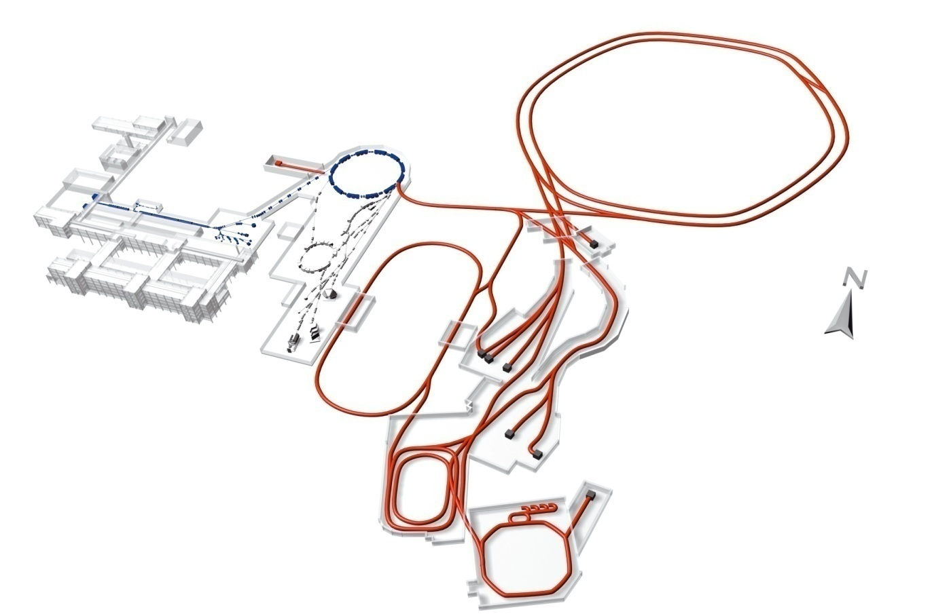


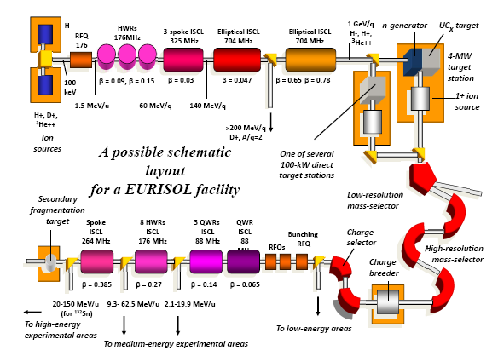
Strategy for Radioactive Beams
European ISOL
facility
ISOL production and secondary fragmentation
Adronic physics
RIB’s by fragmentation and in flight separation
European In Flight facility
Notes:
To perform the neclear physics program, the construction of an in-flight and an ISOL facilities was proposed at european level.
FAIR is the european in-flight facility and it is under construction in Germany at GSI.
EURISOL, the european isol facility, is at design level. To develop the necessary technology an intermediate step is needed: the construction of few second generation ISOL facilities.

Slide 8



ISOL Roadmap in EUROPE
Second generation 2014-2025 | 10¹³⁻¹⁴ fission/s 10 MeV/n (A=130) | Effective Mass resolution 1/20000
> 10¹⁵ fission/s
100 MeV/n (A=130)
Mass resolution 1/20000
FROM 2025
First generation ISOL facilities in EUROPE | Effective Mass resolution 1/4000 | RIBs AMeV | Reaccelerator
IGISOL Jyvaskyla | Gas catcher (New ISOL technique) |  | No reacc.
ALTO Orsay | Photo-fission on UCx target (5 10¹¹ f/s, n-rich beams) |  | No reacc.
CRC Louvain-la-Neuve | ⁶He, ⁷Be,¹⁰C, ¹¹C, ¹³N, ¹⁵O, ¹⁸Ne, ¹⁹Ne, ³⁵Ar | 0.2 - 10 | CYCLONE110
EXCYT LNS_Catania | ^{8, 9} Li, ^{20, 21}Na | 2 - 7 | TANDEM
SPIRAL_1 GANIL | HI fragmentation on graphite, about 50 beams | 2 - 20 | CIME _cyclotron
ISOLDE CERN | 1.4GeV proton induced spallation Fission. (UCx target, 4 10¹² f/s, neutron-rich beams) | 2 - 3 | REX_linac
Notes:
Taking as reference the number of fission inside the target, the second generation facilities ask to produce 1-2 order of magnitude more fissions than first generation.
The goals are: 10 to 13-14 fissions/s, beam energy: 10AMeV, more clean beams (mass separation 1/20000)

Slide 9
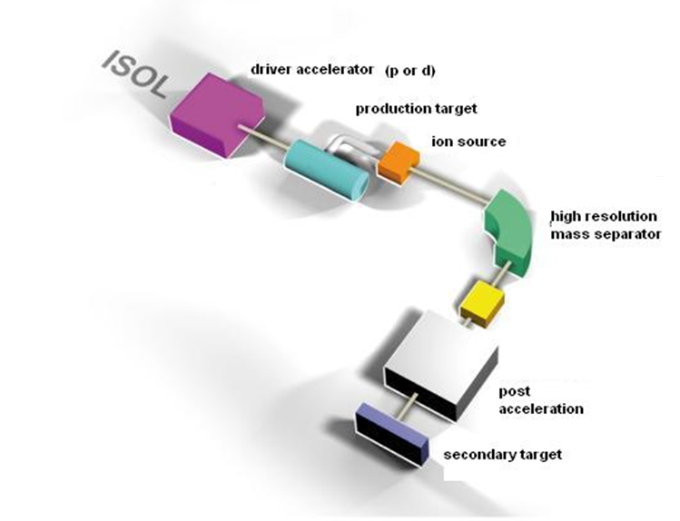
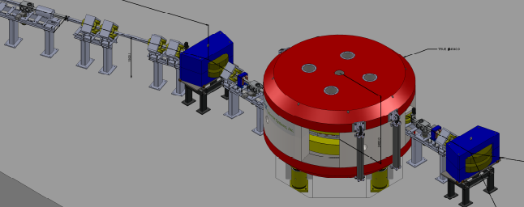
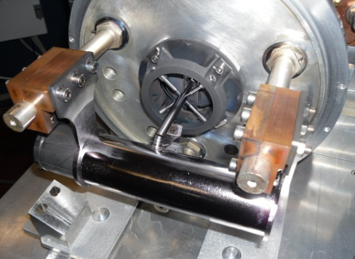
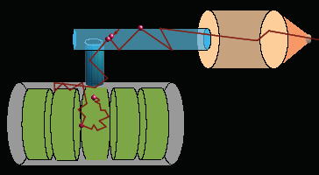
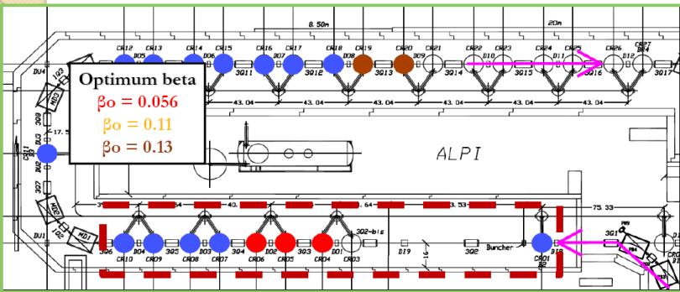
The SPES choice for the ISOL facility
Define a cost-effective facility in the order of 40-50 Meuro
Proton driver: 70MeV 0.75 mA 2 exit ports
‘Commercial’ cyclotron
Cyclotron 10
Building 10
RIB production 5
RIB transport 15
Re-acc 10
ALPI superconductive LINAC
2000ºC
Ion Source
Proton beam
NEW CONCEPT
direct target
Multi-foil UCx designed to reach 10¹³ f/s
Experimental target
SPES: DIRECT TARGET ISOL facility

Slide 10
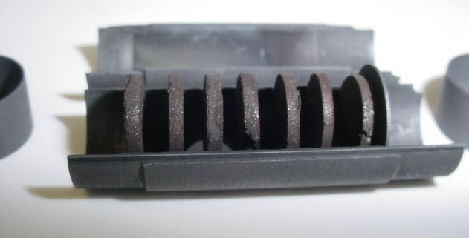
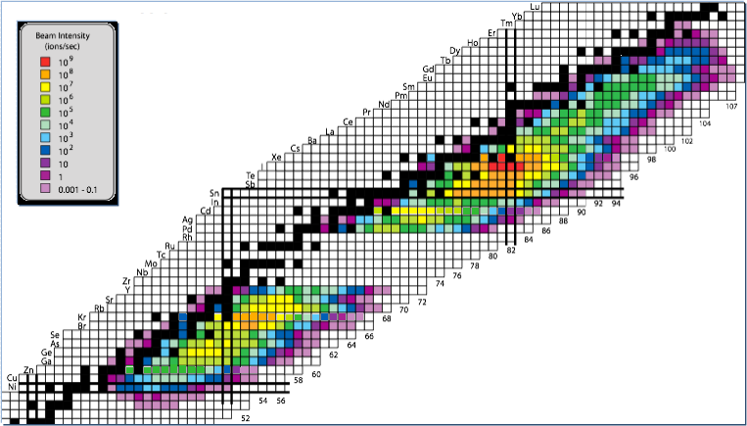
“Neutron-Rich” beams at SPES
UCx target, SPES design, irradiated at ORNL
Proton induced fission of U
Intensities expected for reaccelerated beams
In-beam tests performed at ORNL with 40MeV protons on UCx SPES target
Notes:
Reaction mechanisms for the formation of superheavy nuclei
Collective properties in extended neutron radii: Coulomb excitation near 96Kr
Evolution of structure: Coulex, moment measurements, transfer at 132Sn & beyond
Evolution of structure near 78Ni: Transfer reactions, Coulex, moment measurements

Slide 11
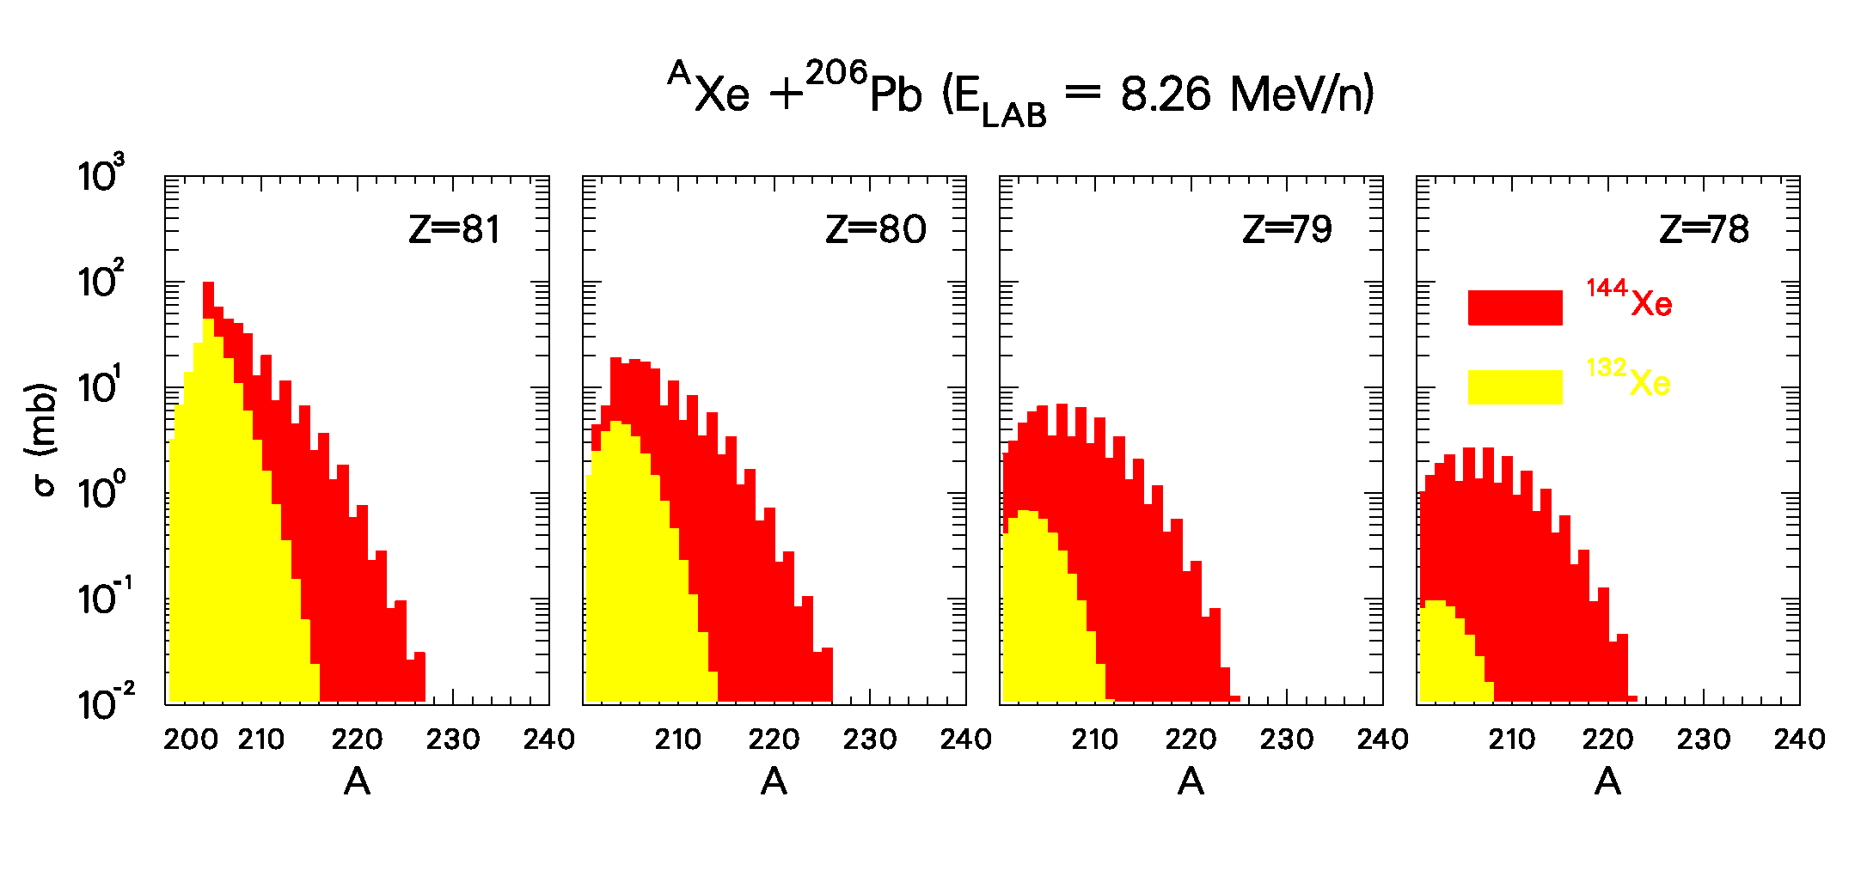
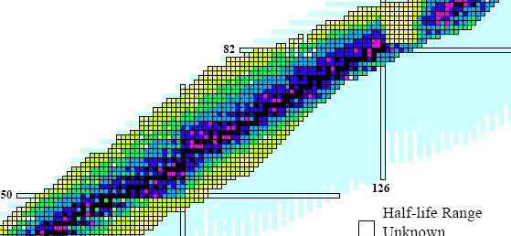
neutron-rich radioactive beams and transfer reactions: a tool to investigate nuclei far from stability
¹⁴⁴Xe
¹³²Xe
Target ²⁰⁶Pb
Coupled channel calculations (Grazing). G. Pollarolo
Population with ¹⁴⁴Xe
Beam
¹³²Xe ¹⁴⁴Xe

Slide 12

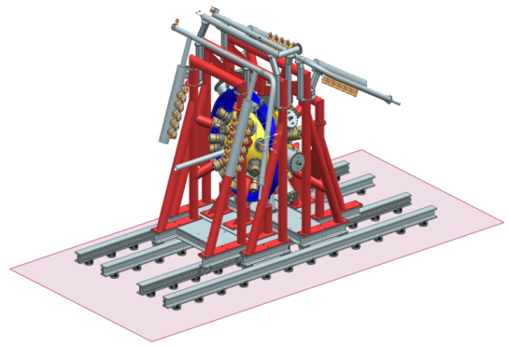

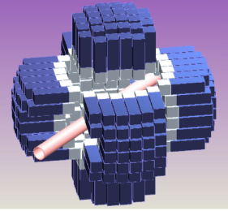
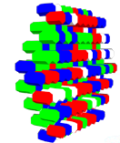
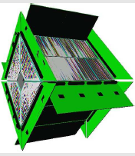
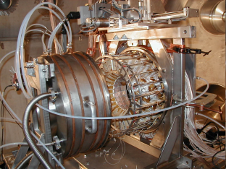
Letters of Intent for SPES
PRISMA
SPES2010 Workshop
(LNL- November 15th-17th, 2010)
24 LoI’s for reaccelerated exotic beams
International
collaborations:
Italy
Bulgaria
Hungary
France
Poland
Spain
Great Britain
Turkey
USA
Slovakia
Romania
Croazia
Russia
India
Germany
Canada
Transfer reactions with RIBs
Coulomb excitation with RIBs
Collective excitations of exotic nuclei (DDR, Pygmy resonances)
Effects of isospin in neutron-rich nuclei
Fusion-evaporation reactions with RIBs
GALILEO
*AGATA
Requested beams
*PARIS
*NEDA
RIPEN
**CHIMERA
TRACE
Definition of First Day Experiments:
Scientific priorities
Instrumentation development
RIB production
*Fazia
GARFIELD
*SPES-SPIRAL2 or european collaboration
** part of Chimera installed at SPES
http://web2.infn.it/spes/
Notes:
As a first call for the SPES physics, 24 letters of intent were presented by international collaborations focusing on transfer reactions, coulomb excitation, isospin effects and fusion-evaporation reactions with radioactive beams.
Up-to-date detectors are proposed for experiments, reshaping actual detectors at LNL like the PRISMA spectrometer or new gamma array like GALILEO, or performing campaign of measurements with new complex detectors under construction in European collaborations as AGATA, NEDA, PARIS and FAZIA.
The most requested beam is the 132Sn with the aim to study the shell evolution around the double magic numbers Z=50, N=82
A number of dedicated mini-workshop are on the way to define the First Day Experiments according to scientific priorities, instrumentation development and radioactive beam preparation.

Slide 13
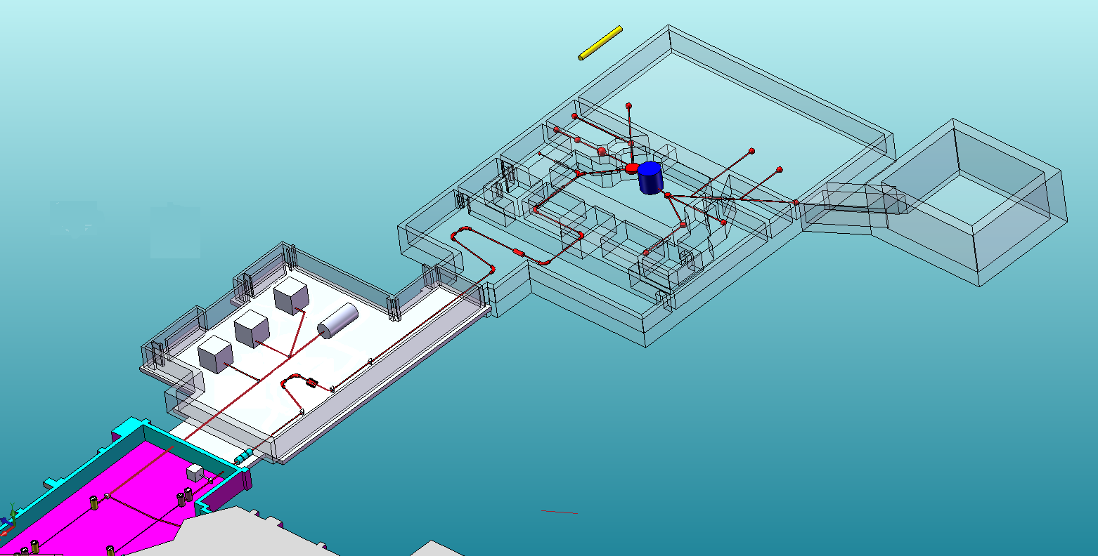

SPES layout
Laboratori Nazionali di Legnaro
NEW infrastructure
10m
- 35-70 MeV variable energy
750 μA total p-current
two independent exits
Radioisotopes for medical applications
CYCLOTRON
Experimental hall
Proton and neutron irradiation areas
Possible expansion for ADS to study GEN4 reactor
Two ISOL targets
High Resolution Mass Separator
DM/M= 1/40000 (physics design)
ECR-Charge Breeder & Medium Resolution Mass Separator DM/M=1/1000
ISOL FACILITY
Reaccelerated RIBs
To ALPI Linac
Radioactive Ion Beams are reaccelerated by the superconductive linac ALPI. A normal conductive RFQ placed before ALPI will match the input acceptance beam parameters.

Slide 14
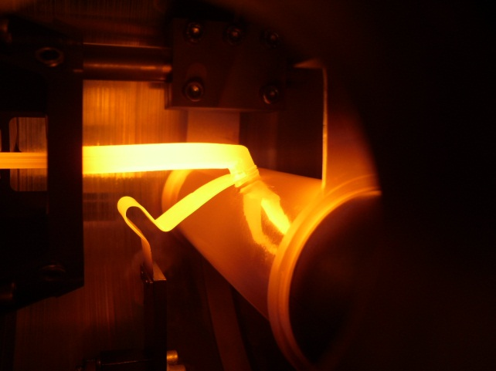
NEW DIRECT TARGET CONCEPT to operate with 10kW proton beam
The SPES choice: optimize the Direct Target design and material production to reach 10¹³ fissions/s
UCx= 7 disks, 4 cm dia, 1.3 mm (~30g total)
In target proton beam = 200 μA 40MeV
UCx target completely developed
Target under operation at 2000ºC
Collaboration: LNL, ENEA-Bologna, Padova University (Eng, Chem)
Notes:
One of the most critical components of SPES is the ISOL target. It si made by 7 UCx disks 4cm diameter and 1.3 mm thick followed by a graphite dump. The system is carefully designed by the thermo-mechanical point of view to sustain about 10kW of proton beam reaching the goal of 10^13 fission rate.

Slide 15
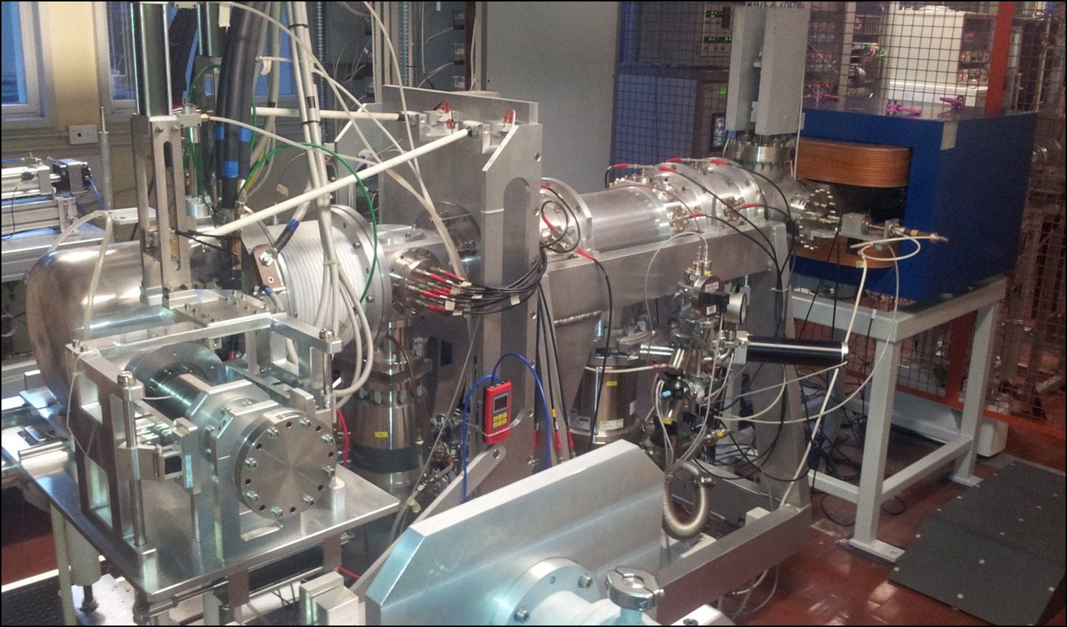
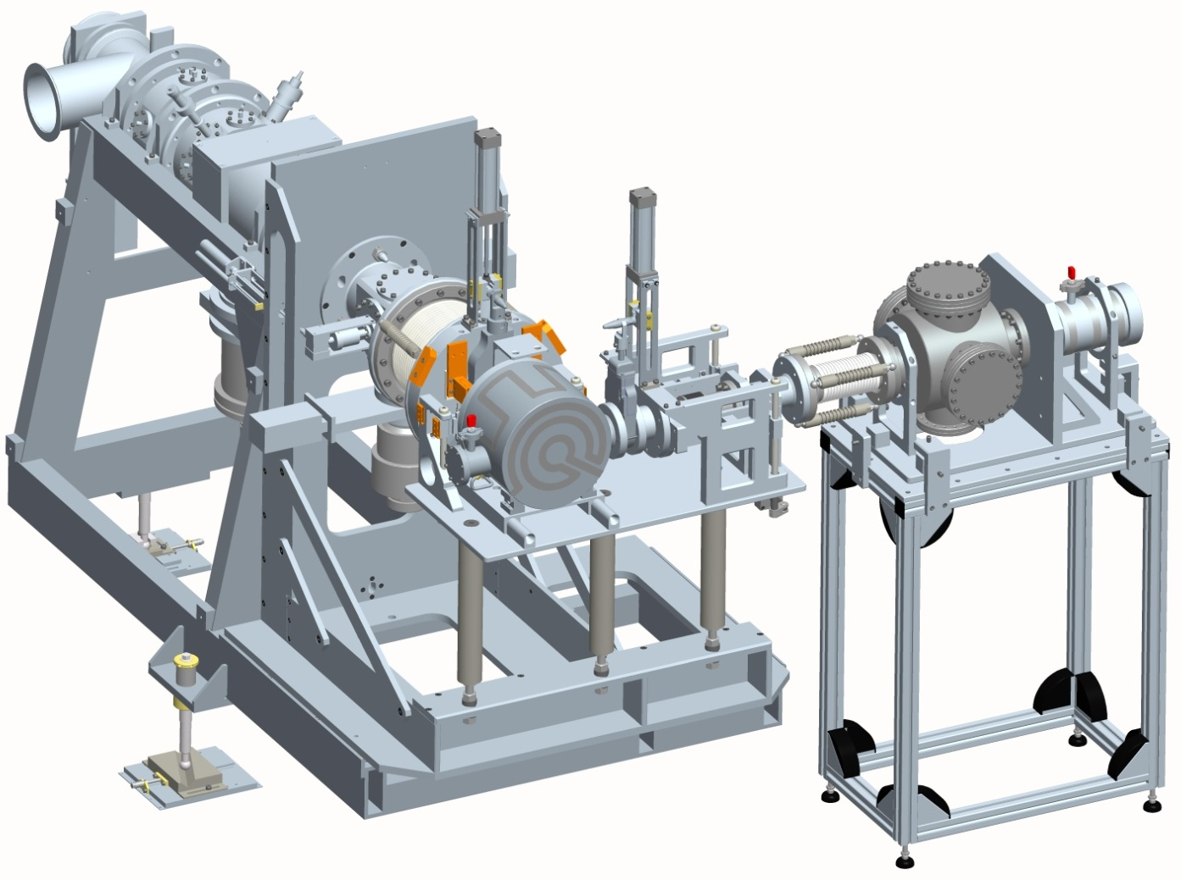
The SPES off-line Front end
(working since 2010)
Designed following updated version of ISOLDE front-end
Radioactive ion beam
30-40 kV platform
Wien Filter
Proton beam
Target
& Ion Source
Insulator
(30 kV)
Electrostatic
Steerer
Electrostatic
Quadrupoles
Beam Diagnostic 1
Notes:
The front-end was developed following the last version of the ISOLDE design with some modifications to allow the coupling with the proton beam. A Wien Filter, just after the first electrostatic quadrupole triplet, allows to contain the larger part of radioactivity inside the ISOL bunker.
The fron-end is completed and under operation in the SPES off-line laboratory.

Slide 16
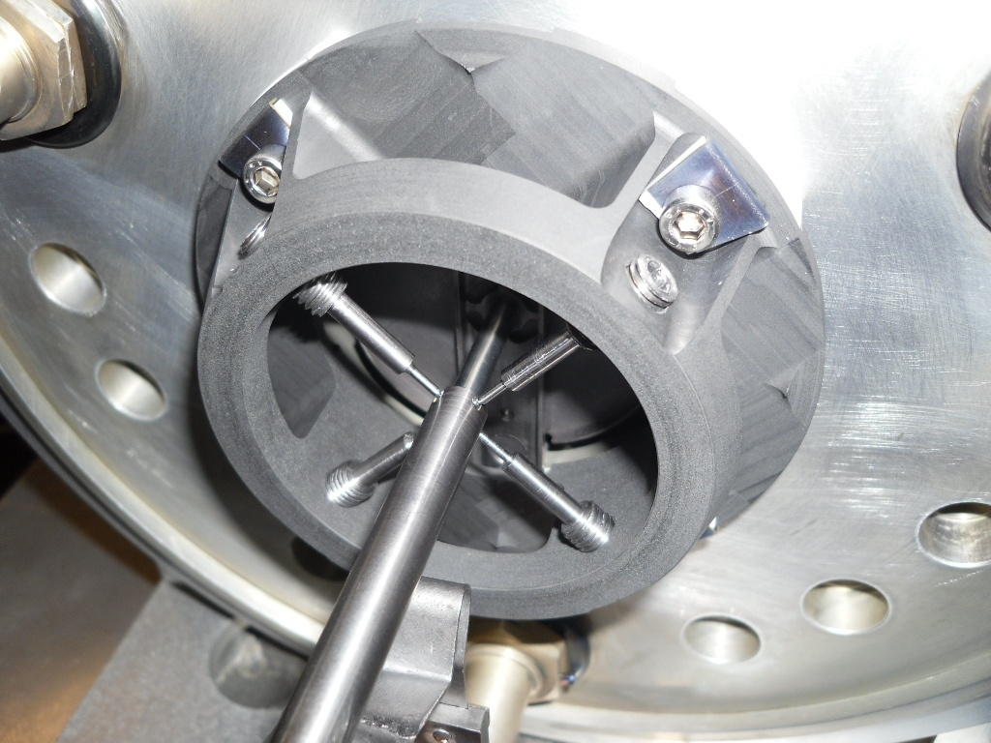
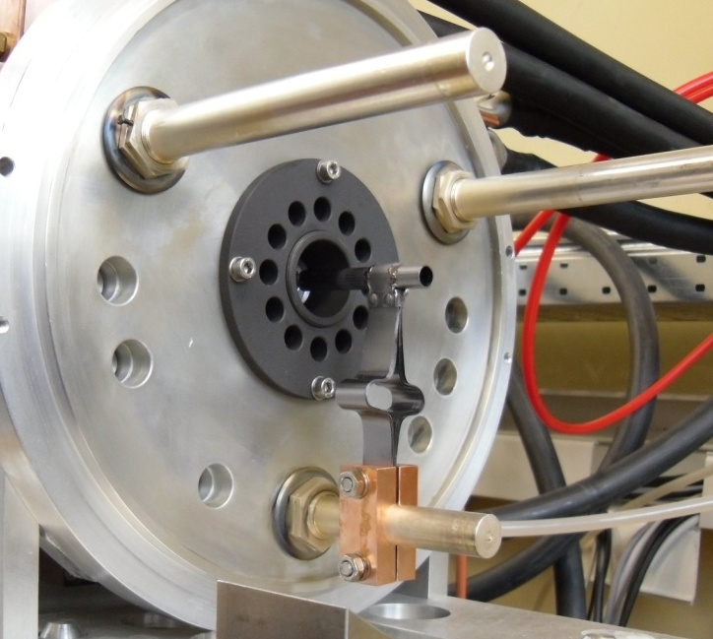
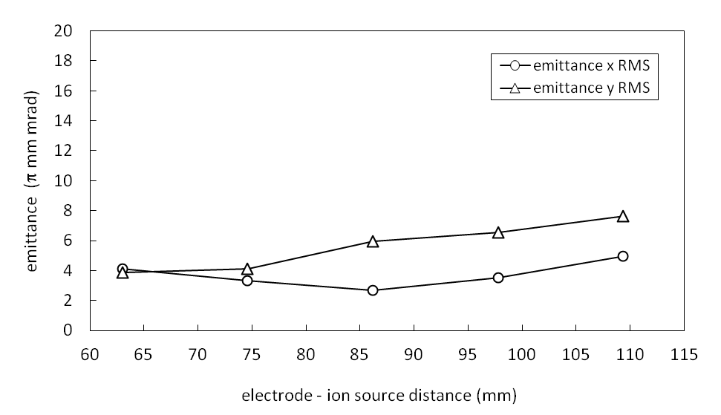
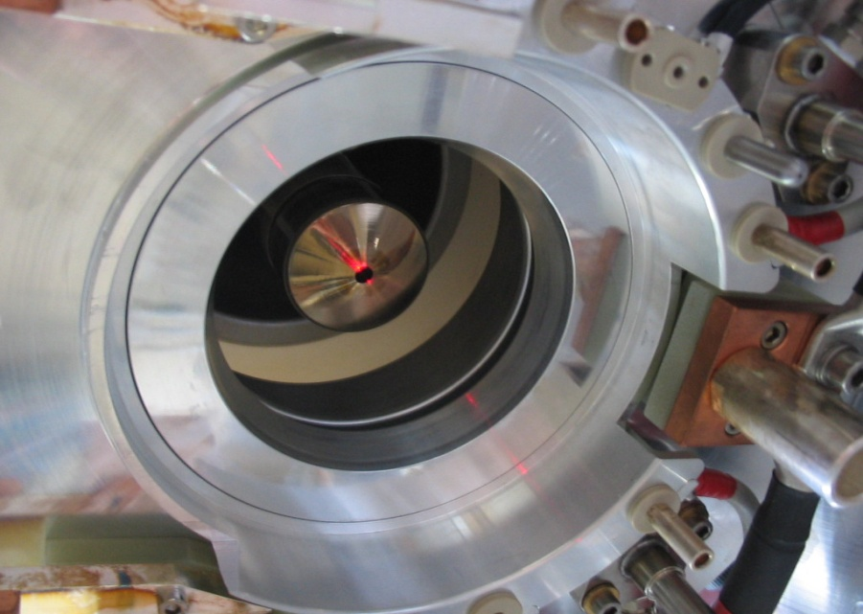
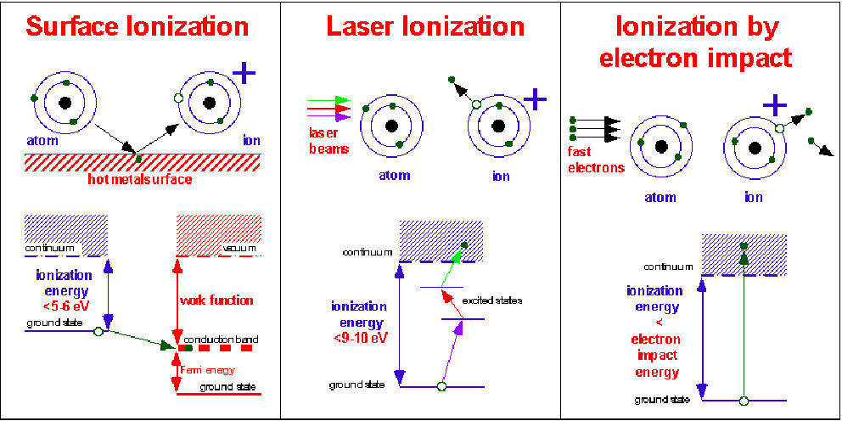
The SPES Ion Sources
Surface Ion Source (SIS)
Plasma Ion Source (PIS)
Bad volatility (NOT EXTRACTED)
Surface Ionization
H
1
He
2
3
4
Photo Ionization
5
6
7
8
9
10
Li
Be
B
C
N
O
F
Ne
11
12
Plasma Ionization
13
14
15
16
17
18
Na
Mg
Al
Si
P
S
Cl
Ar
K
19
Ca
20
Sc
21
Ti
22
V
23
Cr
24
Mn
25
Fe
26
Co
27
Ni
28
Cu
29
Zn
30
Ga
31
Ge
32
As
33
Se
34
Br
35
Kr
36
Rb
37
Sr
38
Y
39
Zr
40
Nb
41
Mo
42
Tc
43
Ru
44
Rh
45
Pd
46
Ag
47
Cd
48
In
49
Sn
50
Sb
51
Te
52
I
53
Xe
54
SIS (Cs beam)
Cs
55
Ba
56
La
57
Hf
72
Ta
73
W
74
Re
75
Os
76
Ir
77
Pt
78
Au
79
Hg
80
Tl
81
Pb
82
Bi
83
Po
84
At
85
Rn
86
Fr
87
Ra
88
Ac
89
Rf
104
105
106
107
108
109
110
111
112
Db
Sg
Bh
Hs
Mt
350 A
Collaboration with ISOLDE and Jyvaskyla
LASER Ion Source (LIS)
LNL and Pavia University
LPX200 XeCl excimer laser
Pulse. 15 ns λ=308 nm
Notes:
To provide the ionization of large part of isotopes, Surface ionization ion source and plasma source have been developed. To improve the selectivity a laser source is under development in collaboration with Pavia University. The sources are under chatacterization in emittance and efficiency in the ISOL laboratory.

Slide 17
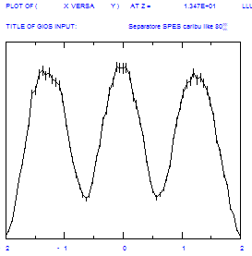
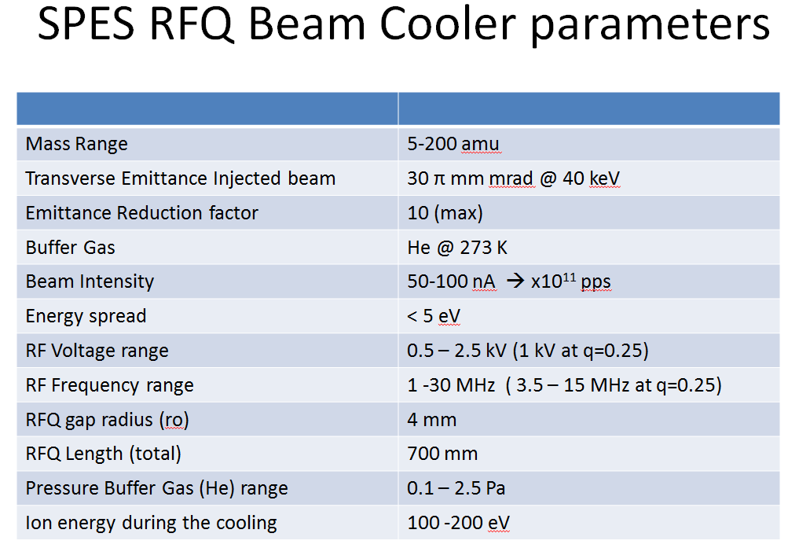
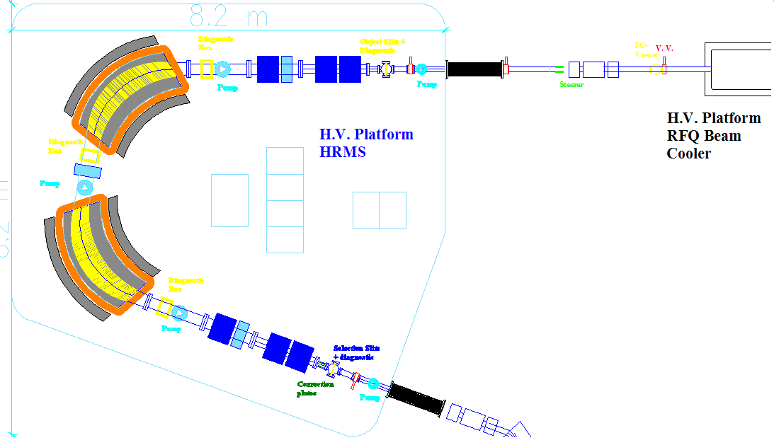
HRMS physics design
A scaled-up version of the separator designed by Cary Davids for CARIBU, Argonne
DM=2.5 10⁻⁵
3º order effects analysis (LNS-LNL)
Input parameters:
Energy= 260 KeV
Δθ=4 mrad
ΔE= ± 1.3 eV
Emittance=3π mm mrad
Mass resolution: 1/40000 (eng. design: 1/25000)
1.3 mm
Typical voltage fluctuation frequency 200-300 Hz, <<10kHz
Plates to correct the voltage ripple of the H.V. platform
20 cm
10 cm
Plates gap 6 cm,
± 750 V to correct
± 5 V platform ripple

Slide 18
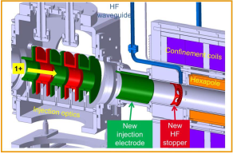
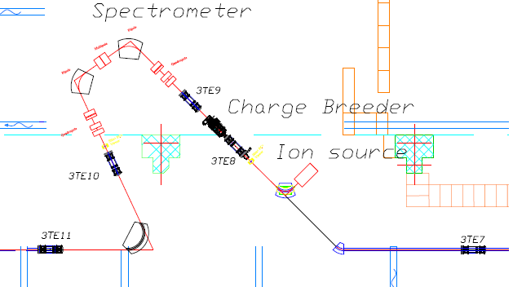


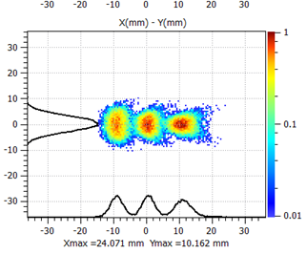
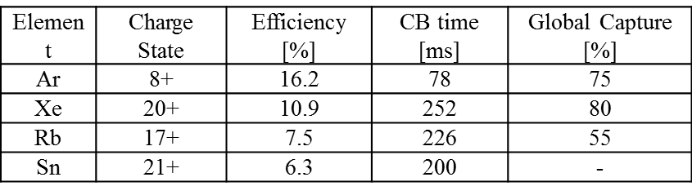
Charge Breeder
CB based on ECR technique
Developed by LSPC in the framework of LEA collaboration
Design 2013, construction 2014
DM/M~ 1/1000
Charge Breeder and Medium Resolution Mass Separator

Slide 19

Upgraded ALPI layout
All Cavities from CR03 to CR07 at 4.5 MV/m.
Medium beta CR07 to CR18 at 4.5 MV/m.
High beta 6.5 MV/m for CR19-CR22.
Final Energy of 10 MeV/A (A/q=7)
Increase energy
Optimize transfer efficiency
Additional cryostats:
Increase total Energy
Cryostats relocated from PIAVE: reduce losses from 40% to 20%

Slide 20


70 MeV p Cyclotron
Main Parameters
Accelerator Type | Cyclotron AVF 4 sectors
Particle | Protons (H⁻ accelerated)
Energy | Variable within 30-70 MeV
Max Current Accelerated | 750 µA (52 kW max beam power)
Available Beams | 2 at the same energy (upgrade to different energies)
Max Magnetic Field | 1.6 Tesla
RF frequency | 56 MHz, 4th harmonic mode
Ion Source | Multicusp H⁻ I=15 mA, Axial Injection
Dimensions | Ф=4.5 m, h=1.5 m
Weight | 150 tons
Extraction scheme: stripping process (H⁻ → p)
Ottawa (Canada), April 2013

Slide 21

Cyclotron Schedule (2013-2014)
 | 2013 |  | 2014
 | II | III | I | II | III
Final Assembly and Testing
Factory Commissioning
Disassembly and Shipping
Installation at LNL
Commissioning at LNL
The Contract with BEST Theratronics provides for:
Cyclotron
Two exit channels
High power beam transport line (up to SPES target)

Slide 22


LARAMED project
radionuclides for medicine
SPES cyclotron is similar to the ARRONAX one. It is well suited to produce innovative radioisotopes for medicine.
Aim is the production of
innovative radiopharmaceutical (e.g. Sr-82, I-124 Cu-64/Cu-67)
traditional radiopharmaceutical with new approaches (Tc-99m)
Partnership with industry is under discussion
LARAMED is under evaluation for dedicated funding by Italian Ministry of Research in the framework of the call “Progetti Premiali 2012”
Radionuclide | Target nucleus | Nuclear Reaction | Cross section (mbarns) | Needed energy (MeV)
⁶⁴Cu | Ni | ⁶⁴Ni(p,n) | ≈ 675 | 15
⁶⁸Ge | Ga | ⁶⁹Ga(p,2n) | ≈ 550 | 30
⁸²Sr | RbCl | ^{nat}Rb(p,4n) | ≈ 98 | 70
⁶⁷Cu | ZnO | ⁶⁸Zn(p,2p) | ≈ 10 | 70
⁴⁴Sc | Ca | ⁴⁴Ca(p,n) | ≈ 700 | 12
⁴⁷Sc | Ti | ⁴⁸Ti(p,2p) | ≈ 20 | 70
Notes:
The delta phase has the aim to develop a facility for the research and production of radionuclides for medicine. The SPES cyclotron has characteristics similar to the ARRONAX one (Nantes, F) and can produce innovative radioisotopes due to the 70 MeV energy and the quite large current. This activity is not the core of INFN and the project needs an industrial partnership that is under discussion.
A request for dedicated funding was presented at the Italian Ministry of research.

Slide 23
SPES Schedule May 2013
 | 2012 | 2013 | 2014 |  | 2015 | 2016 | 2017
Authorization to operate and safety | UCx 5μA
ISOL Target-Ion Sources development
ISOL Targets construction and installation
Building Construction | Executive project
Cyclotron Construction & commissioning | in | schedule
RFQ development and Alpi up-grade
Design of RIB transport & selection (HRMS, Charge Breeder, Beam Cooler)
Construction and Installation of RIBs transfer lines and spectrometer
Complete commissioning and first exotic beam
Full UCx authorization

Slide 24
Current status and overview
SPES is under construction
Letters of Intent: under discussion to select first-day-exp.
ISOL Target and Ion Source: working in off-line laboratory.
The Authorizations procedures for cyclotron operation is completed.
Contract for cyclotron: signed November ‘10, final design accepted (June ’11), cyclotron under machining.
Building: financed (June ‘12), ground braking started.

Slide 25

19/08/2013

Slide 26

July 27, 2001
The real conclusion is the dinner, as usual !
Thanks, Joe and Karin!

Slide 28























The FAIR Project:
Facility for Antiproton and Ion Research
Special Features:
50ns Bunched beams
Electron cooling of secondary beams
SC magnets fast ramping
Parallel operation
SIS 100/300
Nuclear Matter Physics with
35-45 GeV/u HI beams,
CBM
HADES
HESR
Rare Isotope
Production Target
Hadron Physics
with antiprotons
of 0 - 15 GeV
Super
FRS
Antiproton
Production Target
Plasma Physics: higher target energy density 600kJ/g
FLAIR
Nuclear Structure & Astrophysics
with rare isotope beams,
and excellent cooling
CR-
RESR
Evaluated cost: ~ 1000 Meuro
Without low energy cooling rings
NESR
High EM Field (HI) _
Fundamental Studies (HI & p)
Applications (HI)
100 m
Austria
China
Finland
France
Germany
Greece
India
Italy
Poland
Romania
Russia
Slovakia
Slovenia
Spain
Sweden
U K
Saudi Arabia
US
Mexico

Slide 29
H-
HWRs
176MHz
1 GeV/q
H-, H+,
³He++
n-generator
UC_{x} target
RFQ
176 MHz
3-spoke ISCL
325 MHz
Elliptical ISCL
704 MHz
Elliptical ISCL
704 MHz
4-MW
target
station
100
keV
β = 0.09, β = 0.15
β = 0.03
β = 0.047
β = 0.65
β = 0.78
1+ ion
source
1.5 MeV/u
60 MeV/q
140 MeV/q
H+, D+,
³He++
>200 MeV/q
D+, A/q=2
Ion
sources
A possible schematic layout
for a EURISOL facility
One of several
100-kW direct
target stations
Secondary
fragmentation
target
Low-resolution
mass-selector
Spoke
ISCL
264 MHz
8 HWRs
ISCL
176 MHz
3 QWRs
ISCL
88 MHz
QWR
ISCL
88 MHz
Bunching
RFQ
Charge
selector
RFQs
High-resolution
mass-selector
Charge
breeder
β = 0.385
β = 0.27
β = 0.14
β = 0.065
20-150 MeV/u
(for ¹³²Sn)
9.3- 62.5 MeV/u
2.1-19.9 MeV/u
To high-energy
experimental areas
To low-energy areas
To medium-energy experimental areas

Slide 30



SPES Area
INFN-Laboratori Nazionali di Legnaro
Highway
Notes:
The SPES facility is located at the National Laboratory of Legnaro, an INFN nuclear physics laboratory in north Italy near to Venice.

Slide 31


SPES Facility Layout
Exp. Halls
1&2
~ 54 x 67 m²
Tandem
CB
NC RFQ
Exp. Hall 3
ALPI
Notes:
The new building has a surface of almost 3600 mq with an underground level connected to the third experimental hall and the ALPI building. The beam transport, together with the CB and the Medium Resolution Mass Separator, will be mounted inside the third exp hall and the RFQ will be inside the ALPI building.

Slide 32


Istituto Nazionale di Fisica Nucleare
(National Nuclear Physics Institute)
I.N.F.N. is strongly connected to University
4 National Laboratories
19 Divisions located inside Italian Universities
Personnel: I.N.F.N. ~ 2000 persons
Associated from University ~ 2000 persons
Students, PHD, temporary positions ~ 1700
120 staff
More than 400 users mainly international

Slide 33



Radioactive Ion Beams:
ISOL production methods
2 step
High Power target
(n-induced reactions)
Decoupling the power of the driver beam from the RIB production target
Direct target
Proton –induced reactions
Secondary particles
Secondary particles
Primary beam
Primary beam
Converted n
RIBs
d beam
SPES direct target-ion source
50x50x50 cm3
25 kg
ISOLDE-type target

Slide 34
Second generation ISOL facilities in Europe
(UCx target)
Production and study of neutron-rich nuclei
 | Primary beam | Power on target | UCx target (UCx grams) | Fission s-1 | Reaccelerator | Nominal energy AMeV A=130
HIE ISOLDE upgrade | p 1-1.4 GeV - 2 μA | 0.8 kW | Direct (150g) | 4·10¹² | SC Linac | 5-10
SPIRAL2 | d 40 MeV 5mA | 200 kW | Converter (4000g) | 10¹³ 10¹⁴ | CIME Cyclotron | 5
SPES | p 40 MeV 200 μA | 8 kW | Direct (30g) | 10¹³ | ALPI SC Linac | 10
Synergy & complementarity
will offer to the Nuclear Physics community up-to date facilities to improve the knowledge of nuclei

Slide 35





SPES Target
On-line Test experiment at HRIBF
Expected beam on target
Data scaled to: 200 microA proton current 2-5% transport efficiency
Proton energy = 40MeV
ISOL target operated at 2000ºC.
Ionization and extraction with 1+ Plasma Source.
Isotopes measured at tape system.
SPES target conceptual design
Proton beam
Target assembly
Windows
UCx targets
25 gr
dump
Notes:
Expected beam on target can be roughly evaluated considering a scaling factor for the current to 200 microA and a total trasport efficiency of 2% (5% charge breeder,50% linac transport).

Slide 36


Target materials & ion source development
Targets developed for SPES ISOL facility allow to produce a variety of beams in the proton-rich and neutron-rich area
UCx
The BAD VOLATILITY elements are produced and trapped in the target. These elements are highly required for nuclear medicine applications.

Slide 37

The SPES elements
215 meters
Two ISOL targets
Cyclotron
ALPI Linac
RFQ
83 meters
N+ RIB line
1+ RIB line
Charge Breeder & Medium Resolution Mass Separator DM/M=1/1000
(DX=8mm)
High Resolution Mass Separator
DM/M= 1/40000
(DX=1.3 mm)
To allow this configuration the actual beam lines will be reshaffled. Works will start in September.
Four experimental areas will be available in experimental hall 3. RIBs can be transported in the other two halls too .
Notes:
The new building will host the cyclotron, two ISOL bunkers and the high resolution selection system (Beam cooler and HRMS with resolution 1/40000). The 1+ beam line, equipped with electrostatic transport systems, will drive the RIBs to the Charge Breeder followed by the 1/1000 separator. The new RFQ will be mounted just before the ALPI linac. Four experimental areas will be available in experimental hall 3. The RIBs can be also transported in the other two halls. To allow this configuration the actual beam lines will be reshaffled. Works will start in September.

Slide 38


NEW RFQ injector for ALPI
Energy 5.7 –> 727.3 [β=0.0395] KeV/A (A/q=7)
Beam transmission >95%, low RMS longitudinal emittance at output: 0.15 ns*keV/u.
Length 695 cm (7 modules) intervane voltage 63.8 – 85.8 kV
RF power (four vanes) 100 kW.
Mechanical design and realization, taking advantage of IFMIF experience (LNL, INFN_Pd, Bo, To).
First prototype construction: end 2013
Parameter (units) | Design Value
Operational mode | CW
Frequency (MHz) | 80.00
Injection Energy (keV/u) | 5.7 (β=0.0035)
Output Energy (keV/u) | 727 (β=0.0395)
Accelerated beam current (μA) | 100
Charge states of accelerated ions (Q/A) | 7 – 3
Inter-vane voltage V (kV, A/q=7) | 63.8 – 85.84
Vane length L (m) | 6.95
Average radius R₀ (mm) | 5.33 – 6.788
Synchronous phase (deg.) | -90 – -20
Focusing strength B | 4.7 – 4
Peak field (Kilpatrick units) | 1.74
Transmission (%) | 95
Output Long. RMS emittance (mmmrad) / (keVns/u)/(keVdeg/u) | 0.055 / 0.15 / 4.35
Mechanical layout of the RFQ tank module of about 1 meter.

Slide 39



The ALPI Superconductive-Linac
Superconductive linac based on QW resonators
(since 1995)
Up graded to
Veq ~ 50 MV
Pb/Cu to Nb/Cu spattered cavities (or bulk Nb cavities)

Slide 40

SPES collaboration network
KoRIA-KOREA
iThemba Labs

Slide 41
SPES CYCLOTRON load work per year
Expected Beam on target:
10600 hours per year.
Over 5000 hours/year of proton beam available for RIB production and 5000 hours/year for applications.
2 weeks per shift
Beam preparation 2 days
Beam on target 12 days
Beam on target →280 hours per shift
Each bunker will cool down for 14 days after target irradiation.
Beam sharing skeme
 | Proton beam | N.rs of SHIFTS | Beam on target: Total 10600 hours
ISOL 1 | 300μA 40MeV | 10 | 2800
Irradiation 1 | 500 μA 70MeV | 9 | 2500
Irradiation 2 | 500 μA 70MeV | 10 | 2800
ISOL 2 | 300 μA 40MeV | 9 | 2500
Maintanance |  | 7 | 7x14x24= 2350
Cyclotron Operation |  | 19 | 19x12x24= 5462 esperiment 19X2x24= 912 beam preparation

Slide 42


Radiation protection
FLUKA simulations
Protons 70MeV 300 μA on UCx target
Shielding: 3.6 m concrete
Sever safety problem with air activation
X [cm]
Z [cm]
After one hour the activation is under the legislative limit of 1 Bq/g.
“Need ” to storage the Air for one hour.
Recirculation of Air

Slide 43






SPES-cyclotron neutron facility
Union for Compact Accelerator-based
Neutron Sources
Integral neutron production at SPES Cyclotron
Proton beam= 70 MeV, 500 μA Target = W 5mm
Energy region (MeV) | Sn (n/s) ~ 6∙10¹⁴ s⁻¹ | Φ_{n} @ 2.5 m (n cm⁻² s⁻¹) | Φ_{n} @ 1 cm (n cm⁻² s⁻¹)
1 < E < 10 | ~ 5∙10¹⁴ s⁻¹ | 5×10⁸ | 3×10¹³
10 < E < 50 | ~ 1∙10¹⁴ s⁻¹ | 1×10⁸ | 6x10¹²
moderated n-spectra
Φ_{n}= ~ 1.0∙10¹¹ cm⁻²s⁻¹
p-beam 50MeV, 0.5mA
Single Event Effect facility
Quasi mono energetic n-spectra
Simulate terrestrial neutron flux (* 3 10⁸ )
p-beam: 70MeV 3μA
3 10⁵ n cm⁻²s⁻¹ p-beam: 70MeV 50μA
70 MeV protons on Pb-Be rotating composite target
Rotating target prototype
Notes:
The gamma phase is pointing to use the proton beam of the cyclotron to produce neutrons. A production rate larger than 10^14 n/s is expected.
Several applications are under discussion for the cyclotron- based neutron facility:
simulation of fast reactor spectra to study cross sections and material activation of interest for generation four reactors.
Production of quasi-mono energetic neutron beams and partial simulation of the atmospheric neutron spectra at 10^8 acceleration factor to be applied in Single Event Effects in electronic chip damage study.
FARETRA, (FAst REactor simulator for TRAnsmutation studies) è mirato alla realizzazione di un dispositivo in grado di riprodurre uno spettro neutronico tipico di un reattore a fissione veloce (da qualche KeV a qualche MeV). (di un sistema ADS o dei futuri reattori veloci GenIV). Tale sistema permetterebbe di eseguire misure integrali di sezioni d’urto di fissione e di cattura, sia su attinidi minori (MA), sia su frammenti di fissione (FF) a breve vita media, o per misure di attivazione di parti strutturali e materiali per raffreddamento per i reattori veloci di IV Generazione
LIFAN (Legnaro Intense FAst Neutron facility) per la produzione di fasci di neutroni per irraggiamento di dispositivi elettronici con la realizzazione di un fascio per SEE (Single Event Effect) e per irraggiamenti diretti con fasci di protoni da 70 MeV. La facility produce un fascio simile allo spettro atmosferico (limitato a 70 MeV) e permette di studiare il comportamento di sistemi complessi sottoposti a danneggiamento neutronico. Queste misure sono di estremo interesse per l’avionica, la strumentazione nucleare e in genereale per la componentistica elettronica.
LINCE: Legnaro Italian Neutron CEnter
Il fascio di protoni del ciclotrone permette di generare neutroni con uno spettro energetico non disponibile ai reattori nucleari e con caratteristiche spettrali che possono essere calibrate con moderatori opportuni o agendo direttamente sul fascio di protoni.
SPES partecipa a UCANS (Union for Compact Accelerator-driven Neutron Sources). L’Unione per le sorgenti compatte di neutroni basate su acceleratori è nata nel 2010 ed ha lo scopo di dare supporto e coordinamento ad una comunità in via di rapida espansione soprattutto in USA, Cina e Giappone.

Slide 44


