Slide 1

Proximity Splitting/Breakup in MEHIR
(Frustrated Massive Transfer ?)
W. Udo Schröder
University of Rochester, Rochester, NY
International Workshop on Nuclear Dynamics and Thermodynamics
Honoring
Joseph B. (“Joe”) Natowitz
College Station (TX), August 2013

Slide 2
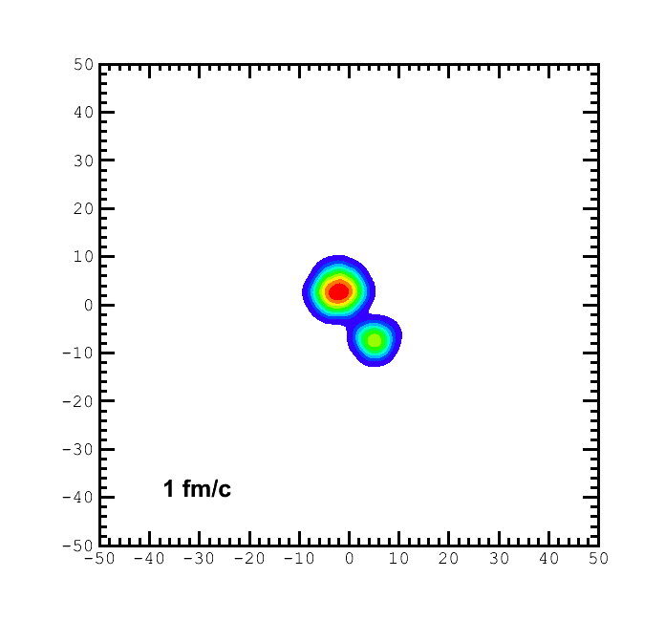
Basic Questions and Challenges in HIR Dynamics
Influence of mean field vs. residual interactions (scattering)
→ EOS/isoEOS compatible with interactions/decay of finite nuclei
Method: Statistical vs. dynamical particle emission (η, E*/T/ρ ).
Outline:
Challenges
Mechanical (in)stability, tensile strength
Simple expectations
Expt example: ⁴⁸Ca+^{112,124}Sn @45A MeV
Conclusions
⁴⁸Ca+¹²⁴Sn Reaction. E/A=45 MeV, b= 5 fm, QMD simulation, soft EOS
M.J. Quinlan, PhD Thesis, U. Rochester, 2011
M.J. Quinlan, H. Singh, E. Henry, J. Tõke, WUS and CECIL/CHIMERA Collaboration (Univ. Rochester, LNS/Catania,…)
Notes:
The basic question to be addressed is one concerning quantum correlations in the nuclear A-body system, their temperature and density dependence.
Obviously, that question has applications for the isovector part of the EOS.
We have heard yesterday about the complications and difficulties associated with the task, as far as supra-normal densities are concerned. I am listing a few of the problems.
In the following, I wish to concentrate on the domain of sub-normal densities, which can be addressed within an expanded compound nucleus decay model.
Right at the beginning I would like to give credit to my Chinese collaborator, Ye Wei, who did many of the calculations.

Slide 3
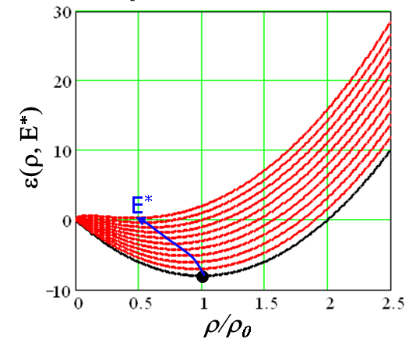
Challenges to Studies of “the” EOS/isoEOS
Preparation (A, Z, E*, J) of highly excited, equilibrated systems at limits of stability.
Understanding of EOS-driven expansion and decay mechanism of finite nuclei.
Interest in bulk mean field (EOS), …. But exotic clusters (=instability) evaporated from surface.
Competing reaction mechanisms produce similar phenomena (e.g. isotopic distributions), fission, neck rupture, but different sensitivity/response.
Superposition of effects of mean field with those of residual interactions (in-medium scattering, “pre-equilibrium”).
Secondary evaporation effects/”side feeding.”
Q: Are there additional useful processes, observables?
→ dynamical processes: aligned dynamical fission/breakup
proximity splitting (→ a number of recent works, here example Ca+Sn).
What can be learnt from dyn. fission/breakup

Slide 4
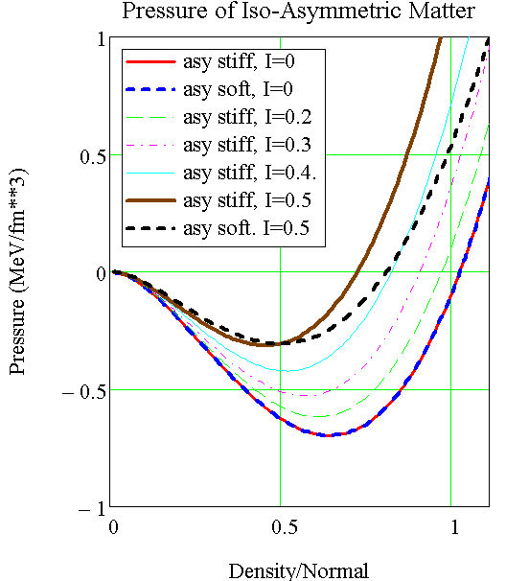
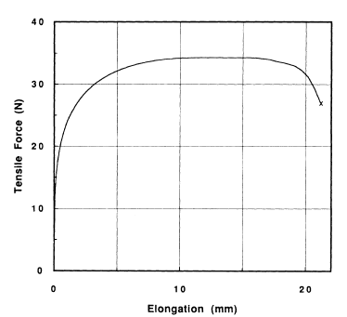
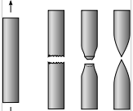
EOS and Tensile Strength
Ductile Metal
Fracture
Force required for nuclear breakup depends on T, A/Z and on transitional nuclear shapes (light vs. heavy nuclei). Available forces: centrifugal, nucleus-nucleus interactions, thermal pressure.
J. R. Davis, Tensile Testing, ASM Intern., 2004
F=Load

Slide 5
EOS and Tensile Strength
Ductile Metal
Fracture
Force required for nuclear breakup depends on T, A/Z and on transitional nuclear shapes (light vs. heavy nuclei). Available forces: centrifugal, nucleus-nucleus interactions, thermal pressure.
J. R. Davis, Tensile Testing, ASM Intern., 2004
F=Load
Centrifugal-Force Effect

Slide 6
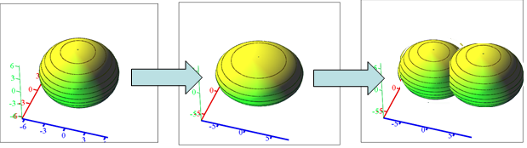
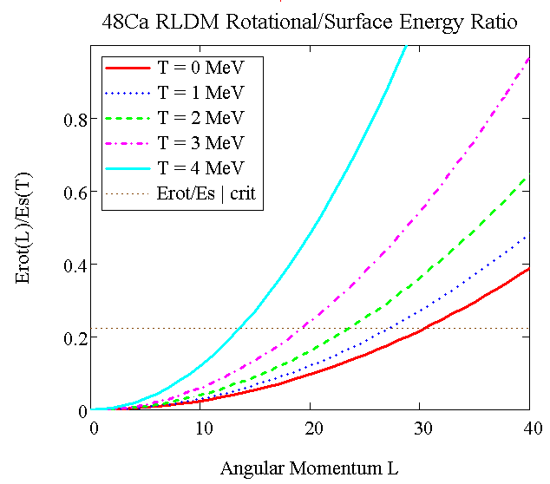
Dynamical (Centrifugal) Instabilities
Spherical Triaxial Binary
Rotating-liquid drop model (g.s.) (Cohen, Plasil, Swiatecki, Ann. Phys. 82 (1974))
Instability = f (shape, J), specific families of nuclear shapes.
Stability criteria for dynamical system, state= {density profile ρ(r), shape par’s, E*,J}
Estimate trends: RLDM at T≠0,
Scale E_{surf} with
(E_{rot}(J)/E_{surf})_{crit} = f(T)
But: No expansion d.o.f. !!
Angular Momentum J

Slide 7
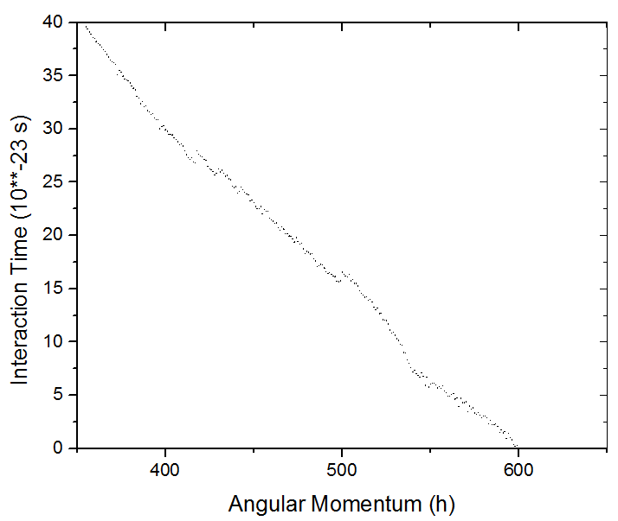
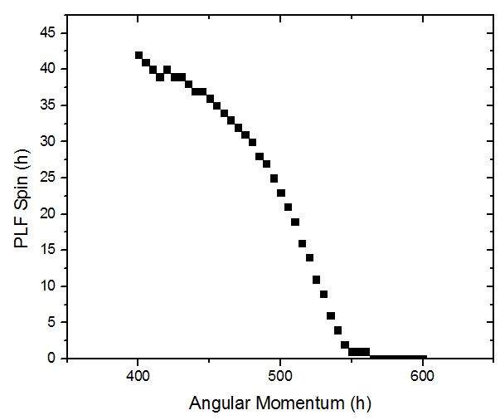
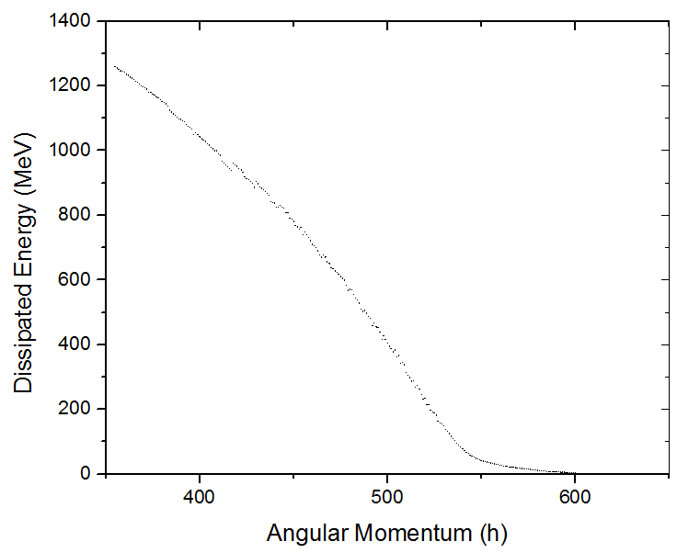
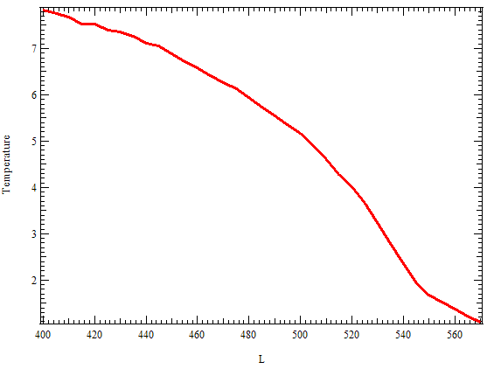
Expectations for Peripheral Ca+Sn Collisions
Interaction Time (L)
Classical transport model (NEM) calculations.
Proximity +Coulomb interactions, one-body dissipation.
Ca+Sn 45 A MeV typical ranges
PLF Mean Spin (L)
Dissipated Energy (L)
PLF Temperature (L)
Temperature (MeV)
Can projectile (PLF) sustain E*,J ?
Angular Momentum (h)

Slide 8
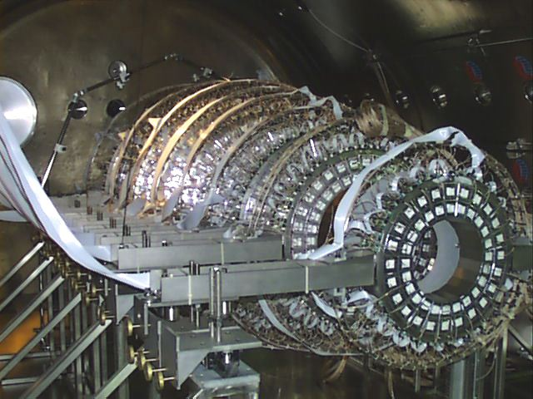
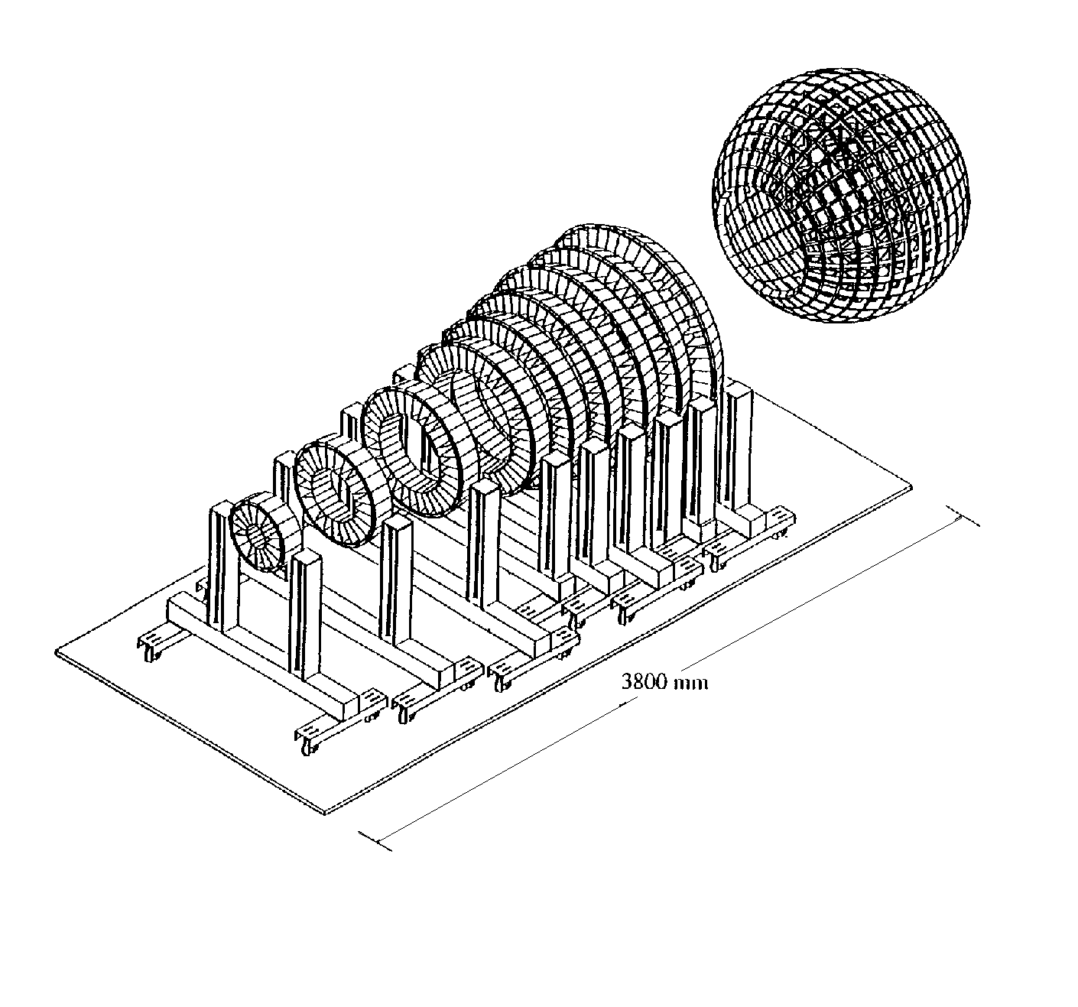
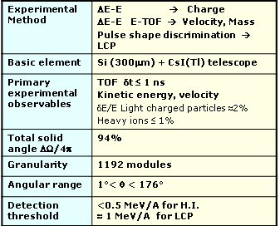
Experiment: ⁴⁸Ca + ^{112,124}Sn @ 45 A MeV
^{40,48}Ca+^{112,124}Sn Reaction. E/A=45 MeV
M.J. Quinlan, PhD Thesis, U. Rochester, 2011
CHIMERA Multi-Detector Array (LNS Catania)
Cone: 688 telescopes
TARGET
30°
BEAM
Sphere
1°
Cone
1m
No neutrons

Slide 9
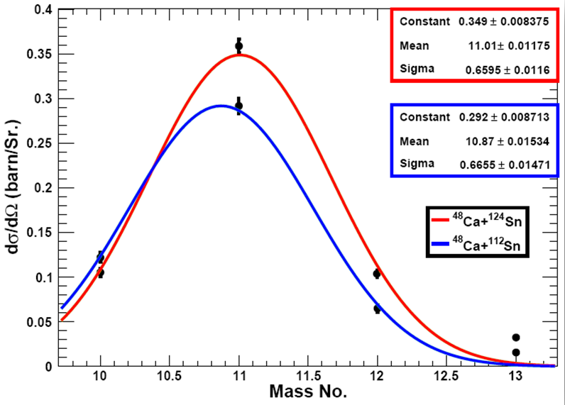
⁴⁸Ca + ^{112,124}Sn @ 45 A MeV
ΔE(Si)-E(CsI) correlations for different elements for ⁴⁸Ca + ¹²⁴Sn at laboratory angle θ = 19º.
Angle-integrated isotopic distributions for both targets are approximate Gaussians with similar widths.
Heavier target → n rich PLF

Slide 10
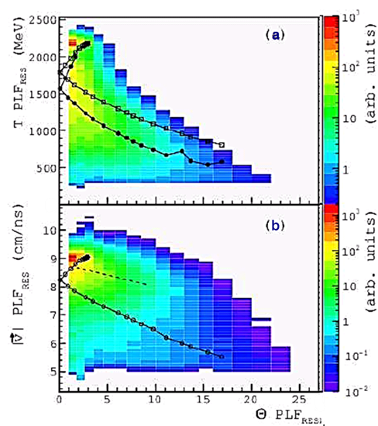
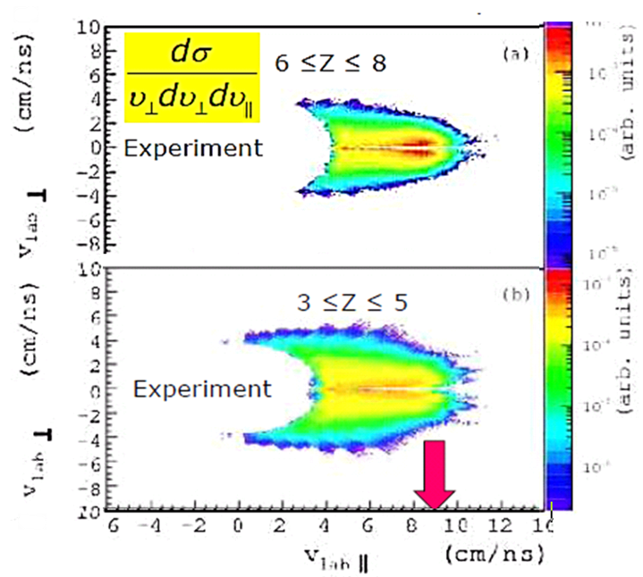
Dynamic Splitting of PLF* after Dissipative Rxns
⁴⁸Ca+^{112,124}Sn, E/A = 45 MeV
Wilczyński Plots
Experimental Wilczyński contour diagrams for ⁴⁸Ca+¹¹²Sn @E/A=45 MeV.
Top: PLF energy vs. angle,
Bottom: PLF velocity vs. angle.
Nucleon exchange model (CLAT). Sequential evaporation: GEMINI.
Invariant Velocity Plots
Galilei invariant cross sections
a) for heavier PLF remnants
b) for lighter remnants (IMFs).

Slide 11
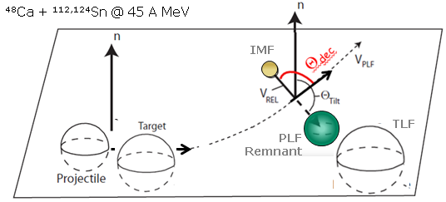
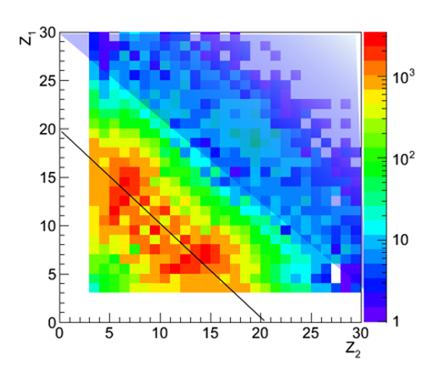
Proximity Splitting of PLF* after Dissipative Rxns
Prompt projectile splitting in proximity (under the influence) of target. Nuclear surface interactions → aligned asymmetric breakup
Reaction Plane
Evidence for dynamics:
Alignment of breakup axis
in plane, in direction of flight
F/B of heavy/light.
Relative velocity ≈2x systematics.
Anti-correlation Z: Z₁ + Z₂≈ Z_{PLF*}
⁴⁸Ca+^{112,124}Sn
Notes:
ń

Slide 12
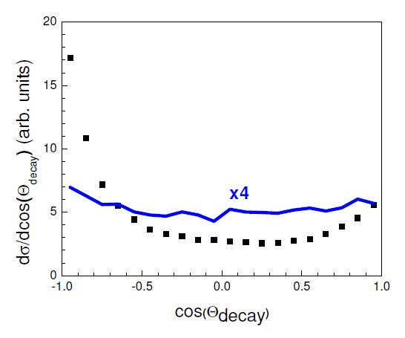
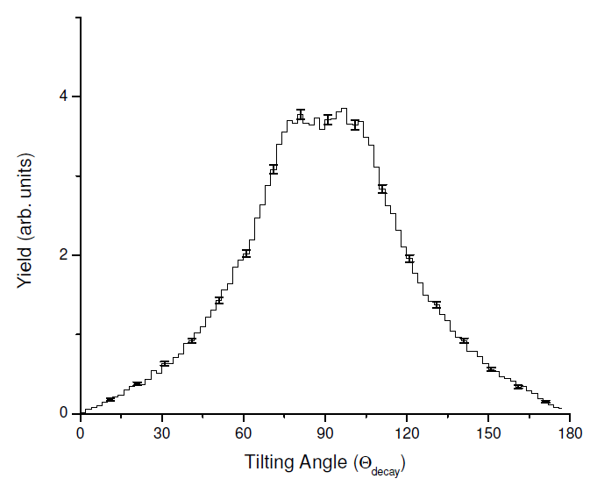

Angular Alignment and Coplanarity
Angular Distribution of light IMF clusters
Distribution of Tilt Angles (of Split-Axis)
Statistical x 4
Θ_{tilt} (deg.)
Orientation of the PLF scission axis Θ_{Tilt}≈ 90⁰±25⁰.
→ Coplanarity
Preferred orientation of deformed pre-scission PLF: lighter IMF backwards (towards TLF) → Minimizing energy/L
Relative IMF/PLF_{rem} velocity

Slide 13
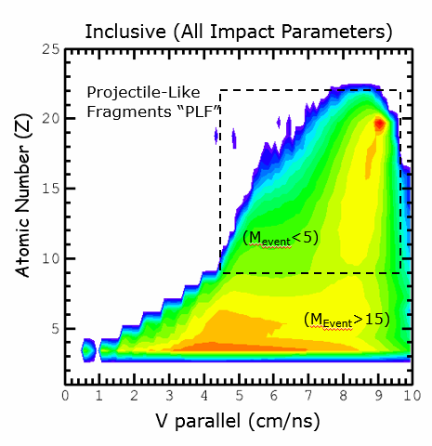
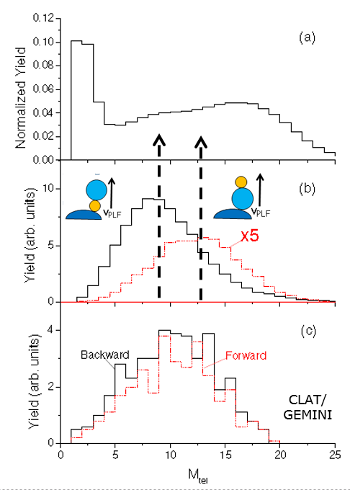
⁴⁸Ca + ¹²⁴Sn E/A =45 MeV Multiplicity Correlations
Charged-Particle Multiplicity Distributions
Projectile velocity v||= 9 cm/ns
Multiplicity distributions indicate semi-peripheral (fast) reactions for
More central (smaller L) if IMF is emitted forward
Relative IMF/PLF_{rem} velocity

Slide 14
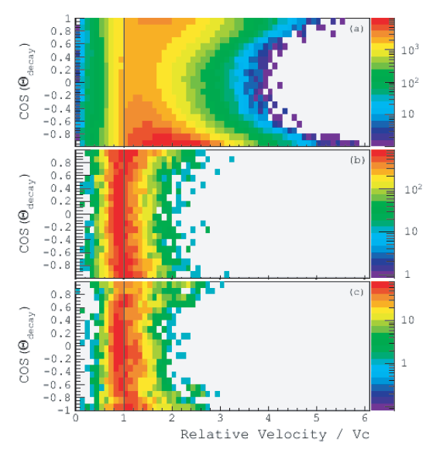
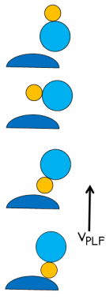
IMF/PLF_{rem} Angle-Velocity Correlations
Experiment
v_{rel}
NEM & QMD simulations:
Fragment emission is sequential (via GEMINI) or late in collision.
Simulation
NEM/GEMINI
Centrifugal energy boost
Centrifugal energy boost: Required J values are consistent with J stability limit for Ca.
But does not explain F/B alignment and yield asymmetry.
Simulation
QMD/GEMINI
v_{C} = Viola Systematics
TLF-(IMF+PLF_{rem}) Int ?

Slide 15
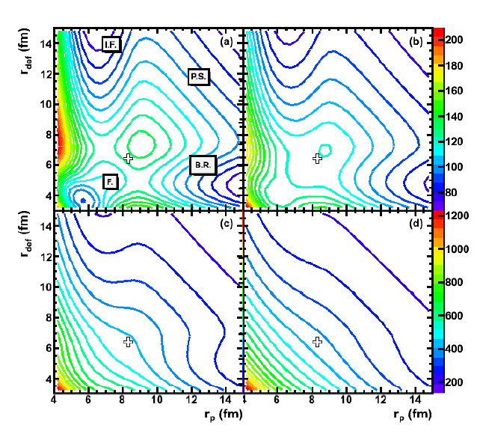
3-Body Driving Potential (Proximity + Coulomb)
L=0
L=80
r_{def}
r_{P}
L=160
L=300
B.R. Binary Reaction
Complete Fusion
I.F. Incomplete Fusion
P.S. Projectile Splitting

Slide 16
3-Body Driving Potential (Proximity + Coulomb)
L=0
L=80
r_{def}
r_{P}
L=160
L=300
B.R. Binary Reaction
Complete Fusion
I.F. Incomplete Fusion
P.S. Projectile Splitting

Slide 17
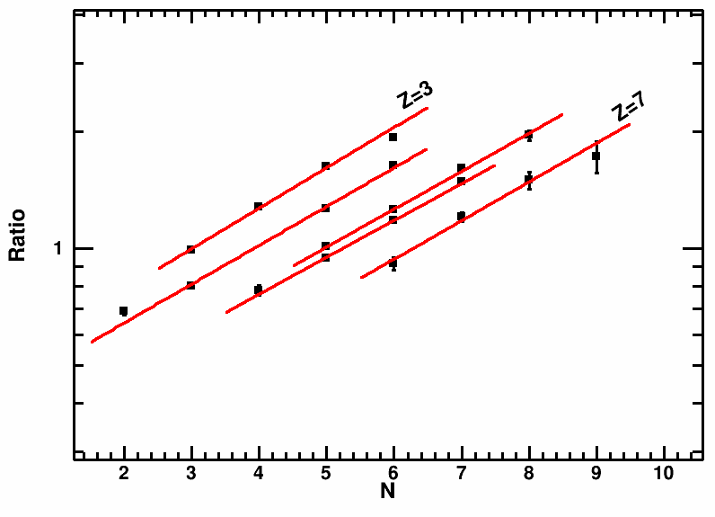
Isoscaling in Dynamic PLF* Splitting (⁴⁸Ca+^{112,124}Sn)
PLFs from 2 dissipative reactions split dynamically. Compare cluster yields → ratios.
Isoscaling Plot Li, Be, B, C, N Isotones
R₁₂
Apparent
Apparent
?
Ambiguity due to uncertain reconstruction → Isoscaling due to interaction of breakup fragments?
Need reaction model to simulate simultaneous observables.
Need realistic model to relate {α, β } ←→ C_{sym}(r)
Notes:
This plot shows a typical isoscaling plot from our work’ The yield ratios R₁₂ of a cluster emitted from two different sources (1 and 2) are plotted vs. the neutron number (or the p number) of the cluster, for different cluster-Z values. On a logarithmic scale, these ratios follow parallel straight lines, which can be fitted by adjusting parameters alpha and beta. These coefficients are believed to be directly related to the symmetry energy C_{sym} at the matter density of the emitter, as given by the formulas in the inset.
These results are noteworthy, because they show isoscaling for clusters emitted, not from an equilibrated CN system, but in the dynamical breakup of PLFs following a dissipative reaction. Values are calculated are defined in the equation for R₁₂.
These results caution against a summary analysis of emission data without clear identification of the nature of emitter and emission process.
In addition, our results demonstrate significant ambiguity inherent in the isoscaling analysis. Due to uncertainties in the A and Z of the emitters, deduced symmetry energies can be uncertain by factors of 2. These data and other published results are actually consistent with ground-state masses.
Even if the emitter is well characterized, a model is still needed to relate the data to a density-dependent symmetry energy. As of now, no such theory is available. However, our model has progressed towards a realistic description of the emission process and its relation to the isoEOS.

Slide 18
Summary & Conclusions
Experimental observations (Ca+Sn, 45A MeV)
Reaction mechanism changes for semi-peripheral collisions from
binary (PLF+TLF) to PLF* splitting in TLF proximity.
Estimates: J_{PLF}~ (20-25)ħ, T_{PLF}~ 5 MeV.
Relative velocity augmented by centrifugal boost.
Breakup instability suggests softening of surface, γ → 0 for T → (5-6) MeV
Breakup alignment indicates influence of underlying PES (TLF proximity).
Potential of dynamical breakup processes to image bulk EOS, tensile strength. Process much faster than (collective) shape evolutions.
Isoscaling observed also for competing mechanisms (dynamic splitting).
Ground state masses explain isoscaling phenomena.
Progress in thermodynamics of finite nuclei (expansion, surface, caloric).
Theoretical work needed to derive more rigorous/direct connection between EOS (hot RLDM?) and dynamic processes.

Slide 19
Thank You!
(Joe, keep up the good work!)

