Slide 1
Probing the isospin dependence of nucleon effective mass with heavy-ion reactions
Z. Chajecki, D. Coupland, W. Lynch, M. Tsang, M. Youngs
Work performed at NSCL and Department of Physics and Astronomy
Michigan State University
Momentum dependence of mean field/
  Origins and expectations for the momentum dependence
  Experimental observables
Experimental results
Notes:
Thank the of this workshop for opportunity to present results of our work to participate in the interesting discussions.
Acknowlege collaborators
Read outline

Slide 2
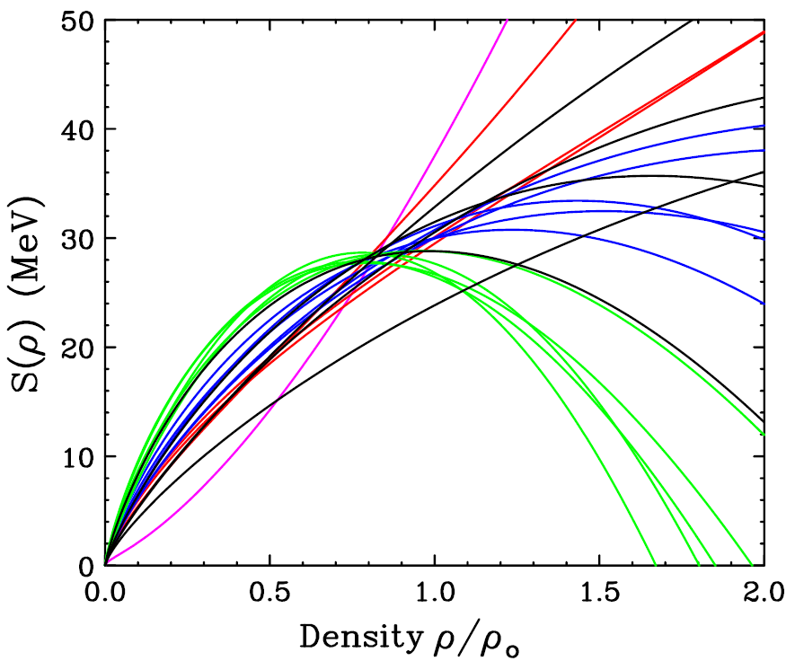
Central question: How does EoS depend on ρ and δ?
B_{A,Z} = a_{v}[1-b₁((N-Z)/A)²]A - a_{s}[1-b₂((N-Z)/A)²]A^{2/3} - a_{c} Z²/A^{1/3} + δ_{A,Z}A^{-1/2} + C_{d}Z²/A,
δ=0
Symmetry energy at
δ=1
Brown, Phys. Rev. Lett. 85, 5296 (2001)
ρ₀
O
E/A (ρ,δ) = E/A (ρ,0) + δ²⋅S(ρ)
δ = (ρ_{n}- ρ_{p})/ (ρ_{n}+ ρ_{p}) = (N-Z)/A
Symmetry energy calculated here with effective interactions constrained by Sn masses
This does not adequately constrain the symmetry energy at higher or lower densities
Notes:
Today we will be discussing the EOS and in particular its isospin dependence.
We focus on the potential energy contribution to the EOS and not on its temperature dependence, because is most uncertain.
If we express the EOS as an energy functional, we can isolate the isospin dependence of the EOS by decomposing it into symmetric matter EOS and a symmetry energy term that depends quadratically on the asymmetry.
The symmetric matter EoS describes how the bulk term of the liquid drop mass formulae depends on density.
The symmetry energy describes how the symmetry energy of the liquid drop mass formulae depends on density
The symmetric matter EOS has minimum at saturation density. The curvature about the minimum largely dictates the monopole resonance energy.
The symmetric matter EOS shows a selection of different models to illustrate the questions concerning the density dependence, some more realistic than others.
The Symmetry energy are predictions using 17 Skyrme intereaaction adjusteed to reproduce the masses of Sn isotopes
The symmetry energy does not have a stable minimum that we know of, is increasing at saturation density
Both are uncertain away from saturation density, with the largest uncertainty at high density.
.

Slide 3
Key uncertainty:
What is the potential energy of nuclear matter?
EoS (T=0): E/A ≡ ε(ρ,δ) = <KE>/A + <V>/A:
In the mean field approx., <V> is obtained from mean field potentials for the nucleons. e.g. in a semiclassical approximation
  local two body interactions → ~ linear dependence on ρ; local three –body int. → ~ ρ² term.
  p (momentum) dependence can come from:
    range of NN force
    exchange (Fock) term
    intrinsic mom. dep. of NN interaction.
    ...
  p (momentum) dependence implies an additional density dependence

Slide 4
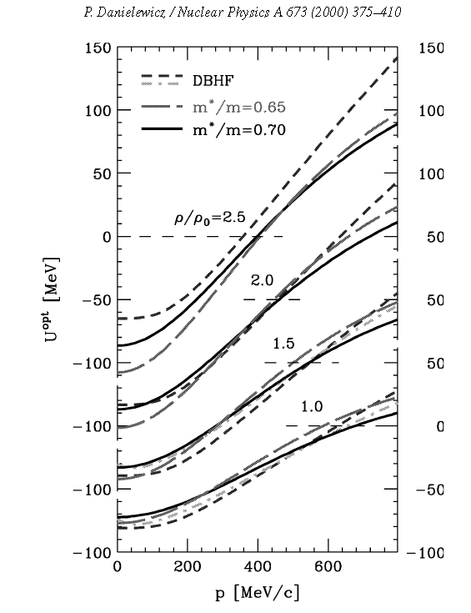
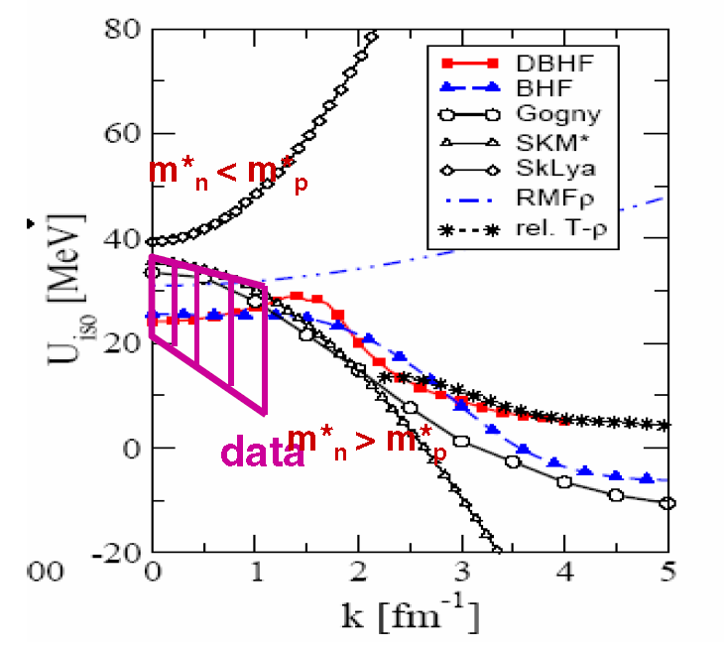
Momentum dependence of mean fields
Momentum dependence of the mean field (real part of optical potential) is well established for symmetric matter.
  At low energies, it can be described by effective mass, m*:
  Momentum dependence increases with ρ, is maximal at p=p_{F} and vanishes as p→∞.
Is the symmetry potential mom. dependent?
U_{SM} (MeV)
U_{n}-U_{p} (MeV)
H. Wolter Nusym13 (2013)

Slide 5
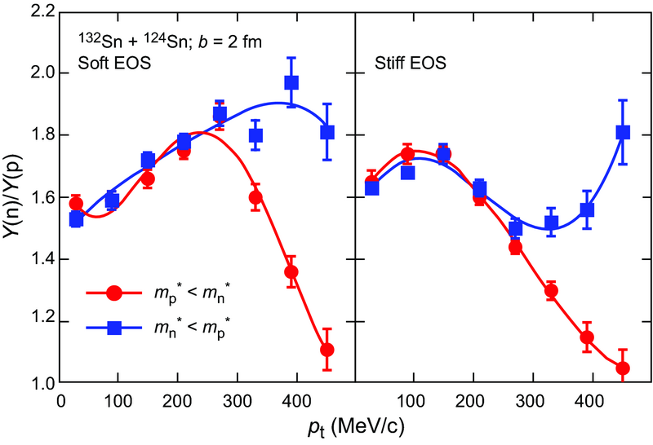
Consequences of momentum dependence of isovector mean fields
Kinetic Esym +
Mom. Dep.
For an expanding and statistically emitting source, it is easy to show that that the n/p ratio depends on μ_{n} and μ_{p}, at low T (in the effective mass approx. and neglecting V_{Coul}).
  The effective mass effects dominate at early higher energies, corresponding to early emission times when density is higher.
Trend is well supported by transport theory and by simple dynamical arguments.
Symmetry
potential
Rizzo et al., PRC 72, 064609 (2005)

Slide 6
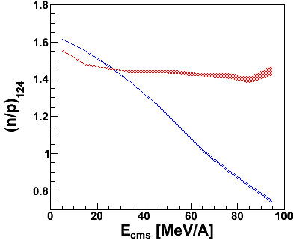
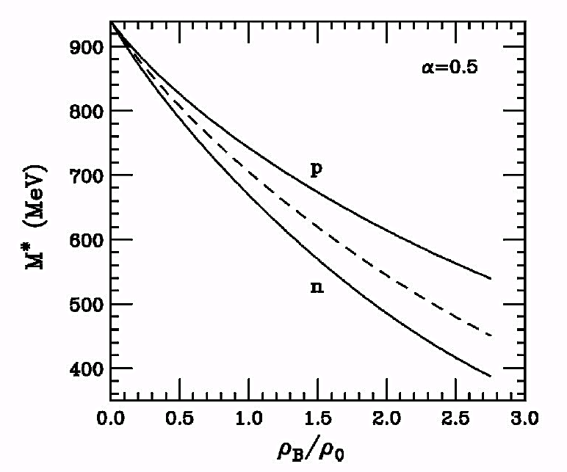
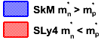
From dynamical point of view
Central ¹²⁴Sn+¹²⁴Sn Collision
E/A = 120 MeV/A
m*_{n}<m*_{p} - neutrons more easily accelerated to high energies
R_{n/p}= Y(n)/Y(P)
p
n
Y. Zhang., private comm. (2013)
B. Liu et al. PRC 65(2002)045201
n
p
m*_{p}<m*_{n} – protons more easily accelerated to high energies
Notes:
Not only symmetry energy can be important.
When we have an isovector dependence of the mean-field, the effective mass can be a dominant effect - stronger than the symmetry energy
This figure shows how the n and p effective mass changes with the nuclear density. Keep in mind that this is a low energy approximation. Clearly the effect is getting more important at higher densities -> thus higher energies of the collision.
Although it is not clear at what energies this effect will be more important as it has to compete with a shorter time scale of the collisions.
This figure shows the energy dependent of the n to p ratio. The red line represent the calculations where mn*<mp* while the blue line represent the calculations where mn*>mp*.
The left panel figure shows calculations for the soft and the right one for the stiff parameterization of the symmetry potential. Clearly, the changes of the efffective mass has a larger effect on those ratios that the symmetry energy.
We also understand the differences between both lines. In case where mn*<mp* more neutrons are being accelerated to high energies (because of the lower mass) and thus n/p is larger while in the other case , where mn*>mp* more protons are accelerated to higher energies and thus the n/p ratio is smaller.
So we want to study the effect of the symmetry energy and the effective mass experimentally…. (next slide)

Slide 7
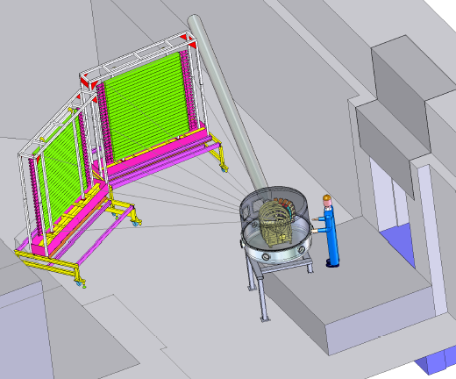
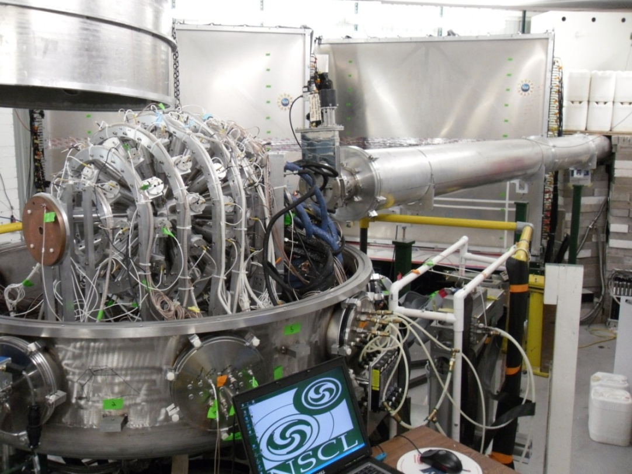
Experimental Layout
PhD theses: Daniel Coupland & Michael Youngs
Wall A
LASSA – charged particles
Miniball – impact parameter
Wall B
Courtesy Mike Famiano
Neutron walls – neutrons
Forward Array – time start
Proton Veto scintillators
Notes:
The new data I will now discuss was obtained from this setup. It is complicated. and has to be precise as well so we make use of the double ratios to cancel out systamic uncertainties.

Slide 8
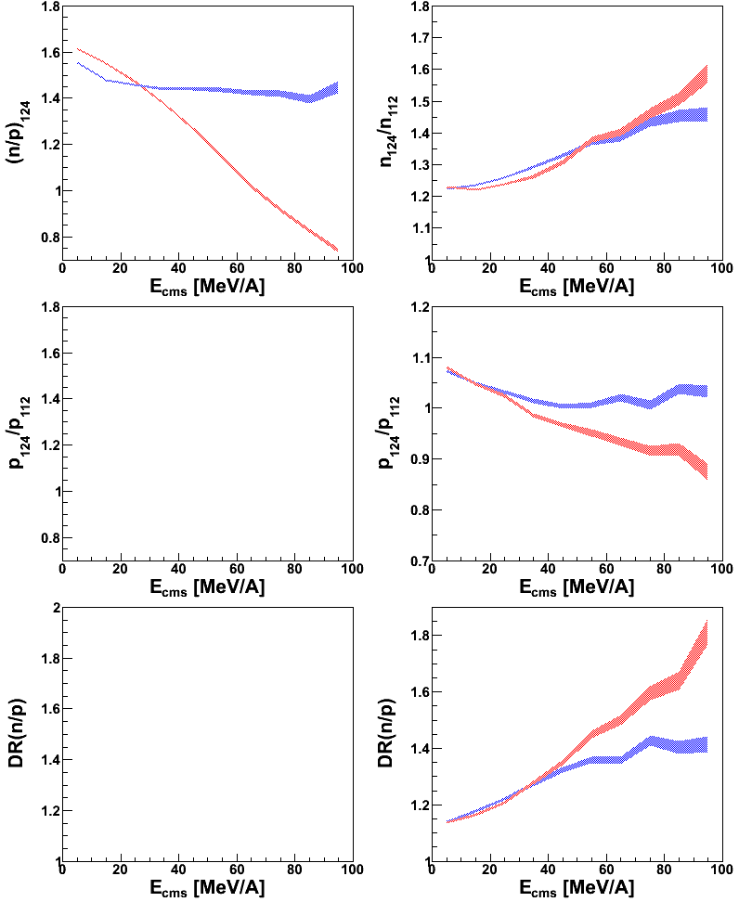
Experimental observables
Y. Zhang, Z. Chajecki. Private comm. (2013)
R_{n/p}(¹²⁴Sn+¹²⁴Sn)
DR_{n/p}
R_{p}(124/112)
More robust:
reduces systematic uncertainties
reduces differences in energy calibration
Coulomb “cancels out”
Somewhat problematic:
- neutron measurements have known efficiency ~10%
- Effects we are going to measure are often of the same order
Notes:
So what is our choice of experimental observables. As I showed you before, it’s natural to look at isospin multiplets as both the symmetry energy and the effective mass affect their production in different ways. It also helps studying the differences between their spectra which distributions can cover few orders of magnitude. What is shown here is thus, a ratio of neutrons to protons plotted versus their kinetic energy.
Experimentally, n/p single ratio is not the best observable to look at. The reason is that we usually know the neutron efficiency within 10% while the effects we measure are usually subtle.
Thus, a better experimental observable is the double-ratio (ratio of ratios for two systems) as it cancels our a lot of systematic uncertainties
Another useful observable is the single particle ratio. Even though we don’t look at isospin multiplets then but we the change to the particle spectra for different systems is also sensitive to the sym en and or effective mass

Slide 9
Predicted incident energy dependence
Skyrme | S0(MeV) | L (MeV) | m_{n}*/m_{n} | m_{p}*/m_{p}
SLy4 | 32 | 46 | 0.68 | 0.71
SkM* | 30 | 46 | 0.82 | 0.76
ImQMD05_sky: incorporates Skyrme interactions
Y. Zhang, private comm. (2013)
Possible explanation: Decrease of symmetry energy effects with incident energy may be the effect of increasing temperature.

Slide 10
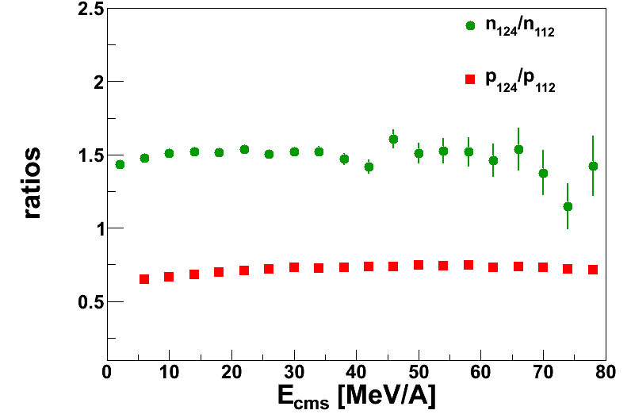
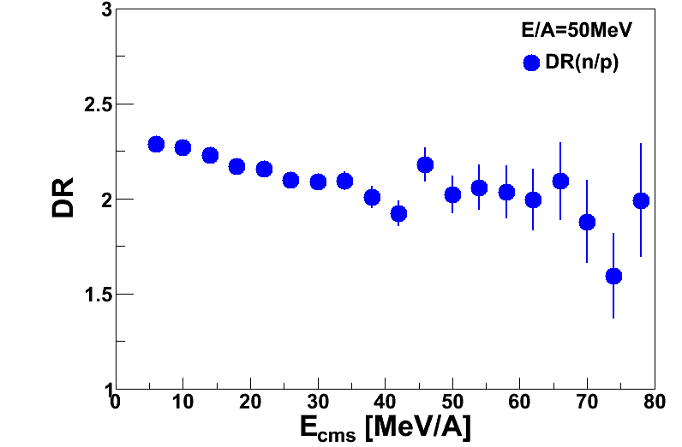
Experimental results
D. Coupland, M. Youngs , Ph.D. (2013)
E/A=50 MeV
E/A=50 MeV
R_{i}(124/112)
DR_{n/p}
R_{i}(124/112)
Coalescence and thermal models → t/³He is derivable from n/p
Is t/³He a surrogate for n/p?
Notes:
Now, I’d like to discuss the experimental results. This figure shows the energy dependence of the n and p ratio from neutron rich system 124Sn and less asymmetric system 112Sn at 50MeV/A. As shown, and expected, more neutrons are produced in n-rich system what reduces the number of produced protons. Then, we can also look at our other observables – double ratio that is around 2.2 and decreases slightly with kinetic energy.
We all know that measuring neutrons is not an easy task so it would be much better if we could study the effect of symmetry energy using charged particles. Natural choice would be to look at tritons and helium-3 as t/he3 is derivable from n/p in the simple coalescence model.
Here, we’re going to test to what extend it is true.
Independently of whether the coalescence holds at any energy or not we still have to understand what influences n/p and t/3he ratios.
While we see that the ratio of helium-3 is in good agreement with proton ratio we cannot say the same thing about tritons. The difference is about 10% but please keep in mind that the total effect of the SymEn is usually within 10-20%.
As a consequence, t/He3 double ratio is lower than n/p ratio.
We can also look at the same observables but for collisions at higher energy 120MeV/A where coalescence should work better.
However, we still see the same difference between the production of neutrons and tritons.
Now, we would like to compare our results to the theoretical models. We chose transport models for this comparison

Slide 11
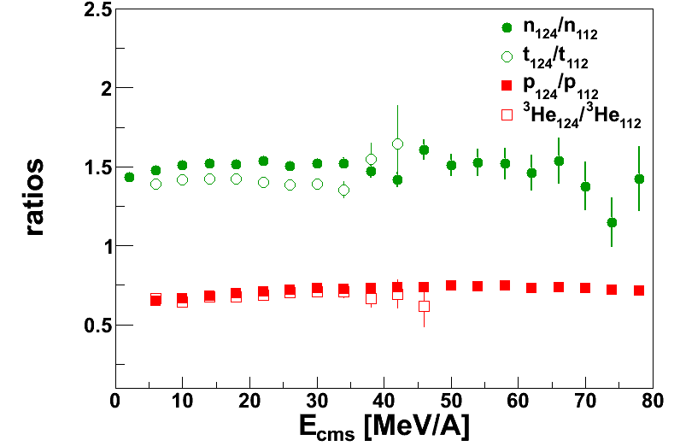
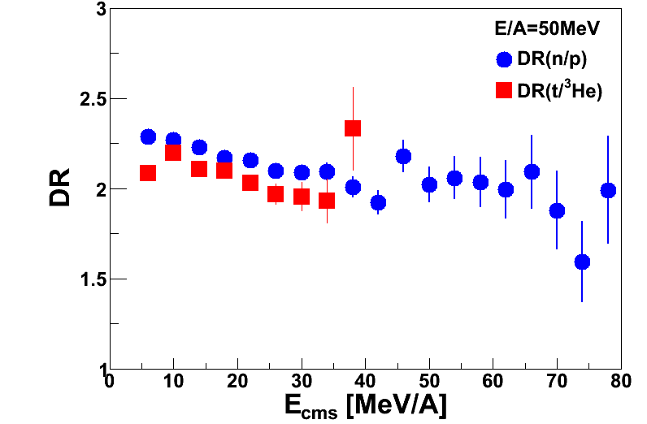
Comparison of (n,p) to (t,³He) observables
D. Coupland, M. Youngs , Ph.D. (2013)
E/A=50MeV
E/A=50MeV
R_{i}(124/112)
DR_{n/p}
0

Slide 12
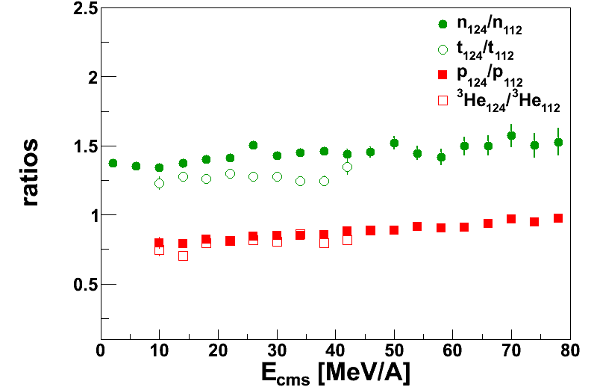
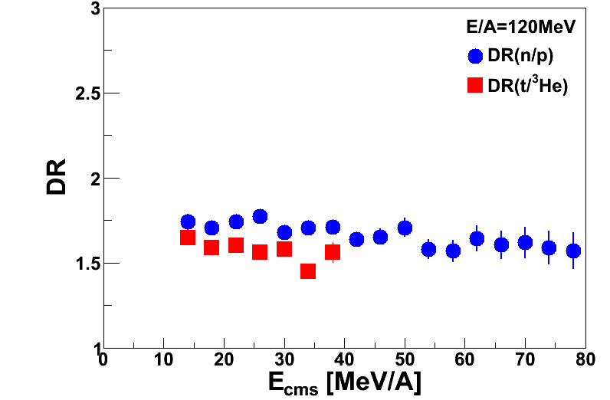
Comparison of (n,p) to (t,³He) observables
D. Coupland, M. Youngs , Ph.D. (2013)
E/A=50MeV
E/A=50MeV
R_{i}(124/112)
DR_{n/p}
E/A=120MeV
E/A=120MeV
R_{i}(124/112)
DR_{n/p}

Slide 13
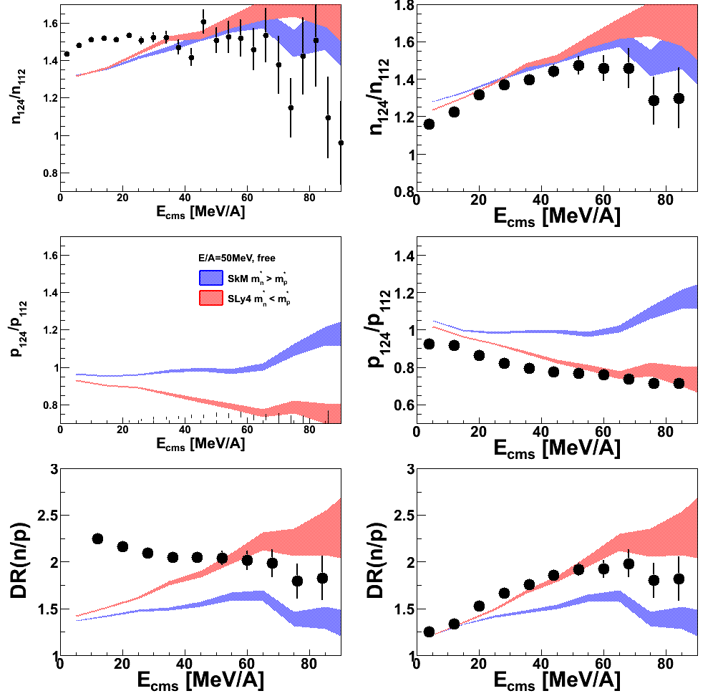
Comparisons with transport theory: n,p
Coalescence invarient n/p
Free particles
ImQMD:
Cluster production does not have the correct binding energies for light fragments.
Test semi-classical dynamics by constructing “coalescence invariant” nucleon spectra, which represent flows prior to clusterization.
E/A=50MeV
E/A=50MeV
Coalescence invariance:
Coalescence protons or neutrons spectra include both free neutrons and protons and those within clusters. This is done for both experiment data and theoretical calculations. It is essentially an observable constructed from measured spectra.
ImQMD05_sky: incorporate Skyrme interactions
Y. Zhang (2013) Private Communication
Tsang (2013) Private Communication
D. Coupland, M. Youngs (2013)
Notes:
Cluster production for alphas is not realistic
Clusterization is relatively a general process comparing to dynamics of putting clusters/particles at a given velocity
So I don’t want to care how they come up in clusters but instead I will take all the light particles at a given velocity
Explain coalescence invariance
What does it mean for the single particle ratios
- Density is changing

Slide 14
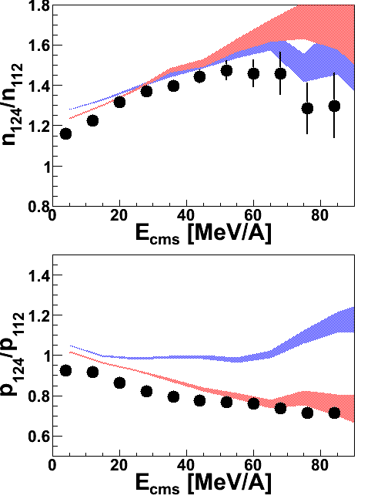
Comparison of independent particle ratios
D. Coupland, M. Youngs , Ph.D. (2013)
D. Coupland, M. Youngs , Y. Zhang. (2013)
E/A=50MeV
E/A=50MeV
R_{i}(124/112)
R_{n}(124/112)
DR_{n/p}
ImQMD:
Soft sym energy approaches free data at high energies, but differs at low energies where clusters contribute.
Including free and bound nucleons in the observable reduces the discrepancies
R_{p}(124/112)

Slide 15
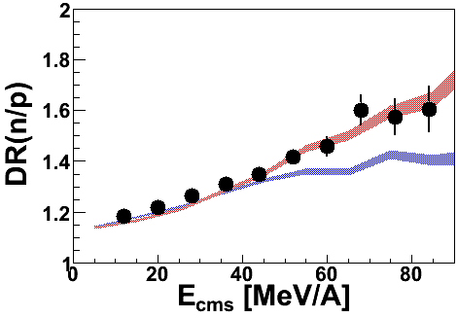
Comparisons of n/p double ratios
Coalescence particles
Free particles
Energy dependence
ImQMD:
Cluster production for alphas is not realistic
Possible solution: Ignore the cluster production mechanism and look all the light particles (neutrons and protons) at a given velocity
E/A=50MeV
E/A=120MeV
D. Coupland, M. Youngs , Y.Zhang. (2013)
E/A=50MeV
E/A=50MeV
Coalescence invariance:
Coalescence protons (neutrons): Include protons (neutrons) from within clusters with the free proton (neutron) spectra
Possibly a better match between simulation and experimental data
Y(n)/Y(p); ¹²⁴Sn+¹²⁴Sn
Y(n)/Y(p); ¹¹²Sn+¹¹²Sn
DR(n/p)=
ImQMD05_sky: incorporate Skyrme interactions
Y. Zhang (2013) Private Communication
Tsang (2013) Private Communication
Notes:
Cluster production for alphas is not realistic
Clusterization is relatively a general process comparing to dynamics of putting clusters/particles at a given velocity
So I don’t want to care how they come up in clusters but instead I will take all the light particles at a given velocity
Explain coalescence invariance
What does it mean for the single particle ratios
- Density is changing

Slide 16
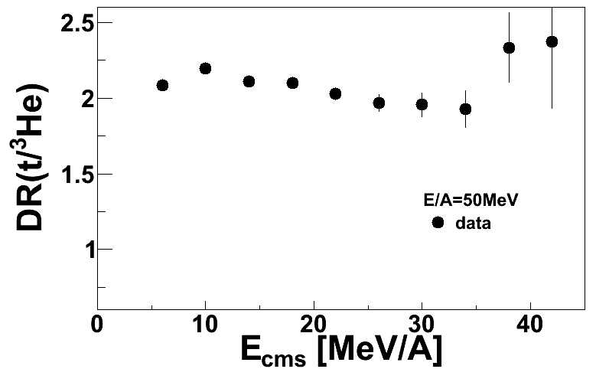
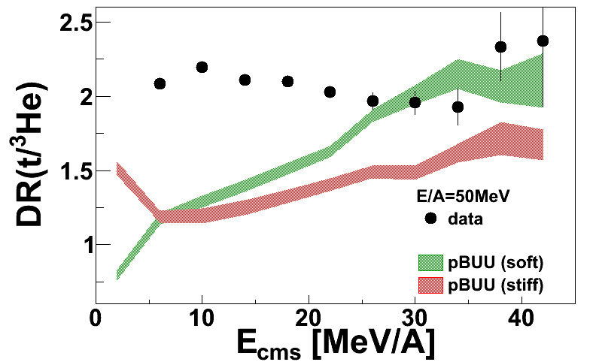
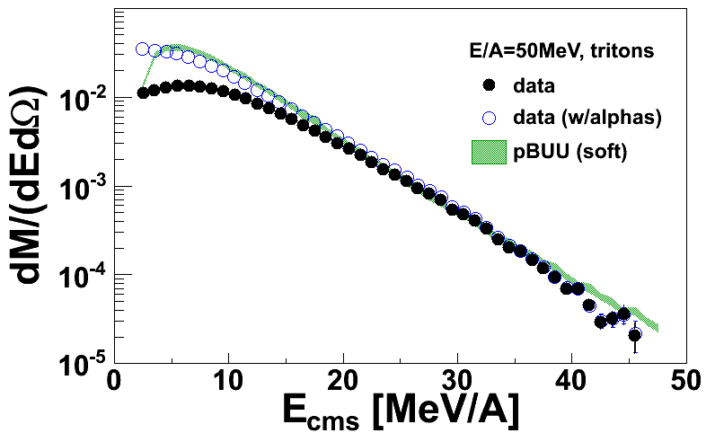
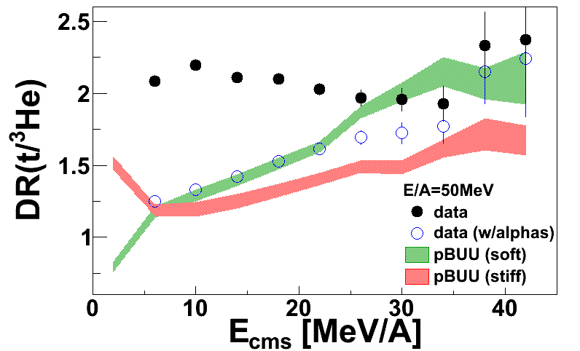
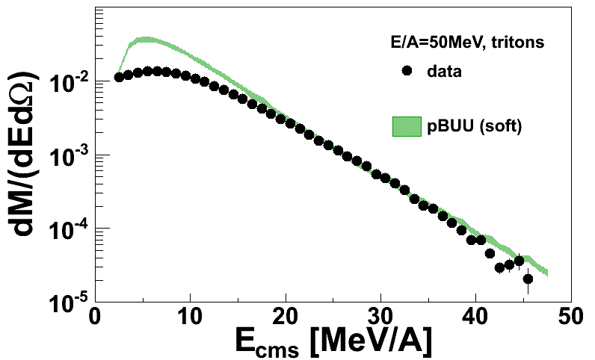
Comparison with transport theory: clusters
M. Youngs, Z. Chajecki (2013)
N
N
Includes dynamical production of clusters up to A=3 (but not beyond)
m*=0.7m₀, m*_{p}= m*_{n}
Calculations underpredict the double-ratio
p
n
α
t
t
n
p
p
n
n
Alpha production not included in the model => alpha ends up being t or ³He
Solution: combine experimental alpha spectra with tritons and helium-3 and compare to the model predictions
Notes:
Proton scatters into triton state to produce alphas – alphas consisted as tritons and helium-3
Illustrates the importance of cluster production (and their dynamics)

Slide 17
Summary
Momentum dependence can be expected. It will influences dense mater within neutron stars.
Calculations show that n/p and t/³He ratios are sensitive to momentum dependence and symmetry energy.
There is a clear connection between n, p, t and ³He spectra that can is qualitatively similar to behavior expected from chemical potentials and from transport theory.
n/p observables are cleanest at high kinetic energies where cluster production can be neglected. At lower energies, the trends are consistent with coalescence invariant analyses. Improved cluster production would allow more careful comparisons at lower energies or using t/³He ratios.

Slide 18
Cluster comparisons for ^{40,48}Ca reactions
^{48,40}Ca+^{48,40}Ca @ 80MeV/A
^{112,124}Sn+^{112,124}Sn @ 50MeV/A
M. Youngs, Z. Chajecki (2013)

