Slide 1
Experimental Reconstruction of
Primary Hot Fragment at Fermi Energy Heavy Ion collisions
R. Wada, W. Lin, Z. Chen
IMP, China
1986.6 – 2010.12 in JBN group
2011.3 IMP
Notes:
Let’s me talk a little bit about my history with Joe. My relation to Joe started at summer 1985. I was a post-doc in GSI and that was the third year, so I needed to find a position some where. So I visited here to give a seminar and told Yongblood, the director at that time that I was looking for a position. A month later I got a letter from Joe. I did not remember him at that time, but he was interested in my talk and want to interview me. And he said he will be at Ganil from September for one year and asked me to come to Ganil. So I drove to Ganil from Darmstadt to see him. That was the first time I met him. He provided a position here and started to work with him June 1986 for the next 24 years.
In 2011, I moved to IMP, China and started my research without Joe. Then I realized that how much I owe him during my stay in College Station and I did not appreciate enough for his leadership when I was here. In this occasion I like to express my appreciation to Joe. It becomes very late, but still not too late. Thank you Joe for your leadership and especially for your patience for many years.

Slide 2
Intermediate Heavy Ion Reaction – Central collisions
Primary
Secondary
Experiments
Reaction time
Notes:
This is a picture I often use to explain the intermediate heavy ion reaction. Pre-equilibrium emission, fragment formation at a freeze-out stage, separation and secondary decay process. In the experiments we can only measure the final products at this stage. To extract physics from the observed fragments, we often use AMD + Gemini calculation and compare the results with them. GEMINI is a well established statistical decay code, but when we try to combine it to AMD, there are still some ambiguities. For example the primary fragments AMD calculates often have very odd shapes and we don’t know how to handle them. So put these fragments to GEMINI as spherical nuclei.

Slide 3
Kinematical focusing
n
IMF
IMF Detector
Uncorrelated LP
Correlated LP
v

Slide 4
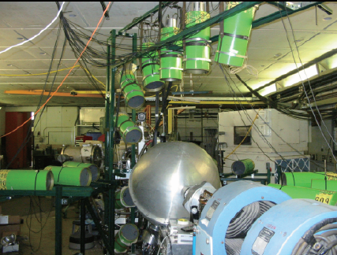

Slide 5
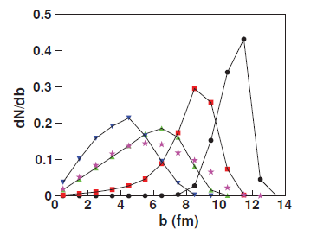
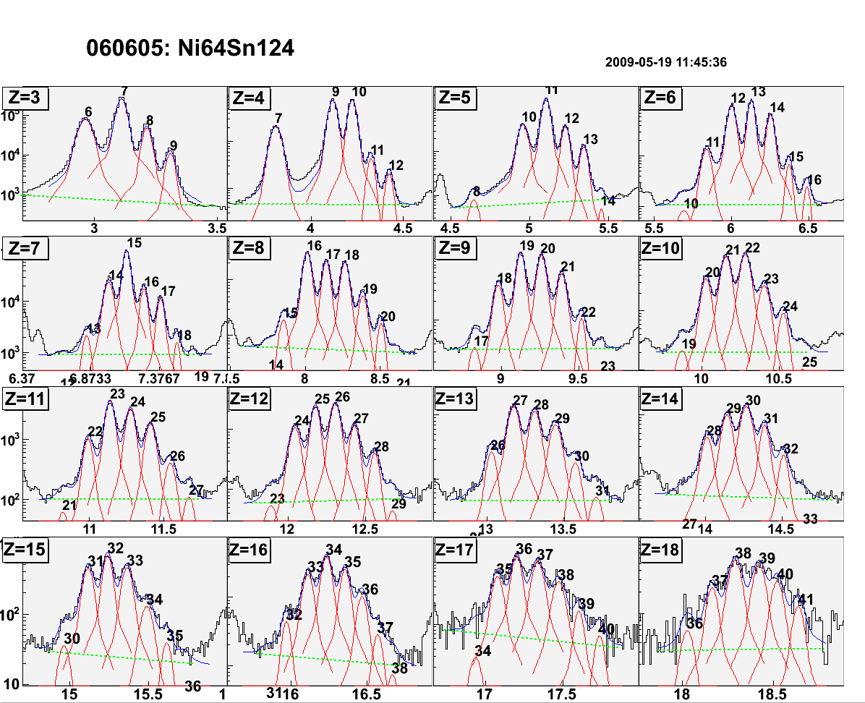
Isotope Identification
Black Histogram: Exp.
Red: individual isotope
Green : linear BG
Blue: total
IMF @ 20º
⁶⁴Zn+¹¹²Sn at 40 A MeV @ 20º
@ 20º

Slide 6
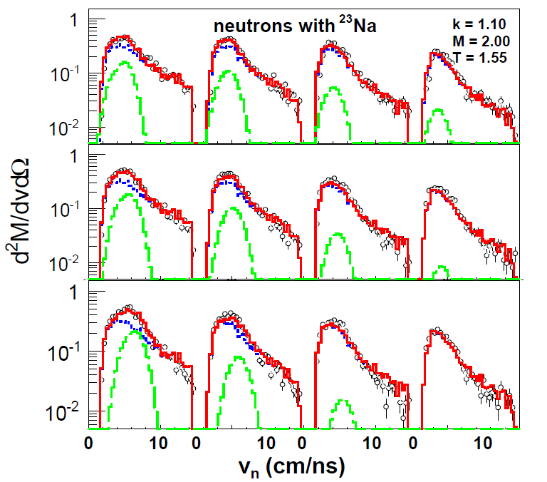
Neutrons with ²³Na
data
θ_{IMF-n} =15º
25º
35º
45º
Total
Uncorr(kM_{n}(Li))
Corr(M_{n}(²³Na))
3.5≤V_{IMF}<4.5 cm/ns
4.5≤V_{IMF}<5.5 cm/ns
5.5≤V_{IMF}<6.5 cm/ns

Slide 7
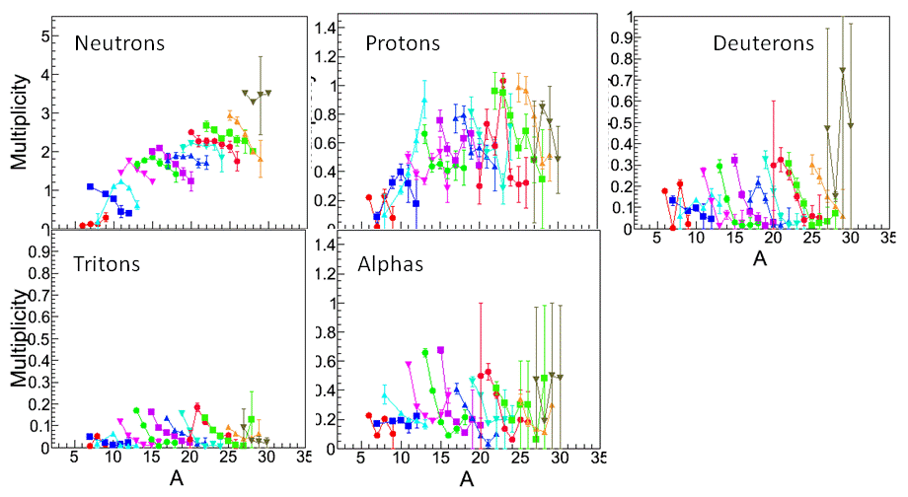
Extracted Multiplicities
Neutrons

Slide 8

A. Excitation energy of the primary fragments is reconstructed by
(i =n,p,d,t,α)
< E_{i} > = 2T, (surface type Maxwellian)
M_{i} is generated by a Monte Carlo method, using
the multiplicity distribution from GEMINI simulation.
E_{γ} (energy carried away by gamma emissions) is evaluated
by GEMINI simulation.

Slide 9
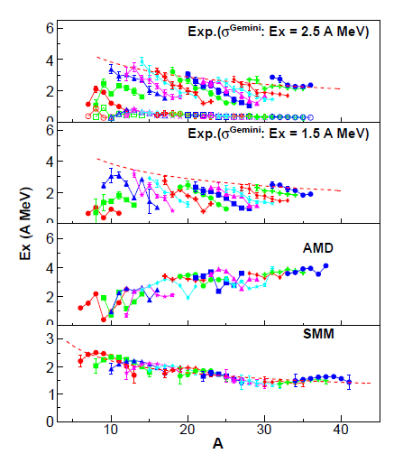

Reconstructed Ex (Exp.) and Ex of primary fragments (AMD,SMM)
Exp
S
Be
A^{-1/3}
Ex(A MeV)
A^{-1/3}

Slide 10
A. Excitation energy of the primary fragments is reconstructed by
(i =n,p,d,t,α)
< E_{i} > = 2T,
M_{i} is generated by Monte Carlo method, using
the multiplicity distribution from GEMINI simulation.
E_{γ} (energy carried away by gamma emission) is evaluated
by GEMINI simulation.
B. Mass and charge of the primary fragments is reconstructed by
A_{hot} =
A_{i}
M_{i} + A_{cold}
(i =n,p,d,t,α)
Z_{hot} =
Z_{i}
M_{i} + Z_{cold}

Slide 11
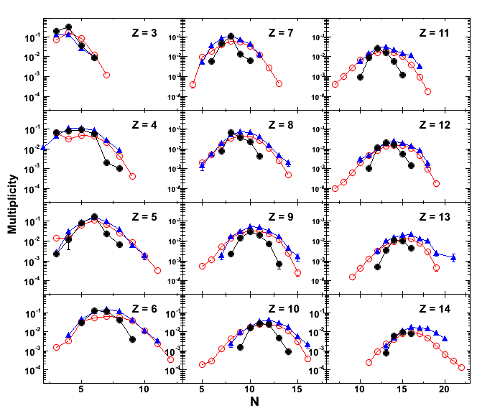
Reconstructed multiplicity distribution
⁶⁴Zn + ¹¹²Sn @ 40A MeV
Exp.
Reconstructed
AMD primary

Slide 12
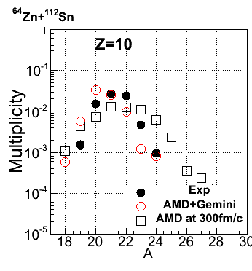
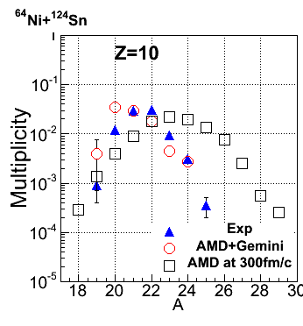
Z=10
⁶⁴Zn+¹¹²Sn
⁶⁴Ni+¹²⁴Sn
0
Predicted associated neutron multiplicity

Slide 13
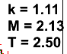
Neutrons with ²³Na (5.5 <v_{IMF} <6.5 )
⁶⁴Zn+¹¹²Sn
15º
25º
35º
45º
⁶⁴Ni+¹²⁴Sn
-1
-2

Slide 14
⁶⁴Zn+¹¹²Sn
⁶⁴Ni+¹²⁴Sn
Neutrons
Neutrons

Slide 15
Reconstructed Ex (Exp.) and Ex of AMD primary fragments
⁶⁴Zn+¹¹²Sn
Exp
Ex (A MeV)

Slide 16
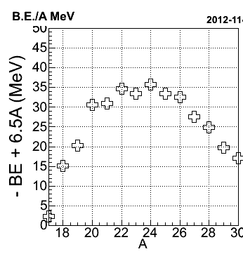
Coalescence technique :
d²(I,j) = ν(r_{i}-r_{j})² + ((1/2Ћ)²/ν)(p_{i}-p_{j})² < Rc ²
ν = 0.16 fm⁻²
Z=10
Z=10
20
Exp.
00
AMD
15
00
Ex (A MeV)
Sn (MeV)
0
0
00
10
00
0
0
0
00
00
00
00
5
20 30
0
A

Slide 17
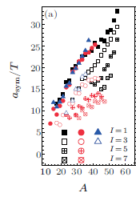
⁶⁴Zn+¹¹²Sn
Exp
Ex (A MeV)
C.W.Ma et al., CPL Vol. 29, No. 6 (2012) 062101

Slide 18
Summary
1. Excitation energy and multiplicity of the primary hot fragments
are reconstructed using a kinematical focusing technique.
2. Reconstructed Multiplicity distributions are well reproduced by
the AMD primary isotope distributions.
3. Reconstructed excitation energies are not well reproduced by
the AMD primary nor SMM prediction.
Reconstructed excitation energy show a significant decrease
as a function of isotope mass A for a given Z.
4. Coalescence method may need to take into account the effect of
neutron (or proton) separation energy for neutron rich ( or
proton rich) isotopes.
5. Very neutron rich isotopes may provide a good probe to study
the hot nuclear matter in a point of least sequential decay
disturbance.

Slide 19
W. Lin (IMP)
R. Wada (IMP)
M. Huang (IMP)
Z. Chen (IMP)
X. Liu (IMP)
M. Rodorigus (Instituto de Fisica,
Universidade de São Paulo)
J. B. Natowitz (TAMU)
K. Hagel (TAMU)
A. Bonasera (TAMU)
M. Barbui (TAMU)
C. Bottosso (TAMU)
K. J. Schmidt (Silesia Univ. Poland)
S. Kowalski (Silesia Univ. Poland)
Th. Keutgen (Univ. Cathoric de Louvain,
Belgium)
Thank you for your attention

Slide 21
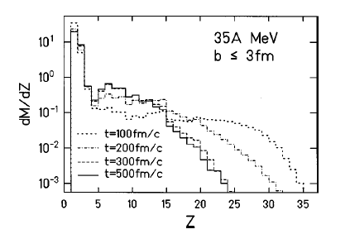
⁶⁴Zn+⁵⁸Ni,

Slide 22
History to work with Joe
1986.3 Join JBN group – 2010.12
ANL : CN decay
SARA- AMPHORA : Multifragmentation, Caloric curve
TAMU K-500 : Reaction dynamics, Caloric Curve, Symmetry
energy
BRAHMS : RHIC physics
publications in major journals : 65 + 20 (BRAHMS)
2011.3 - present IMP, LANZHOU

Slide 23
Kinematical focusing
n
IMF Detector
LP Detectors
n
IMF

Slide 24
Kinematical focusing
Correlated LP
Correlated LP
Uncorrelated LP
v

Slide 25
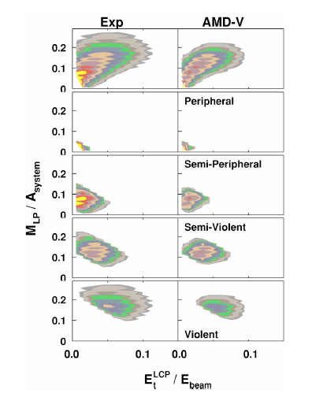
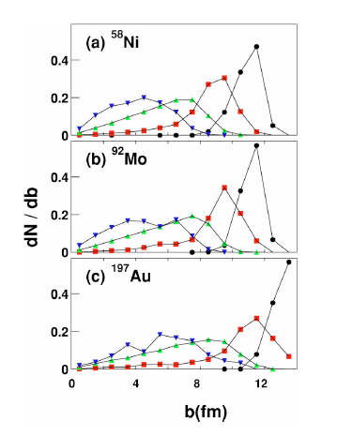
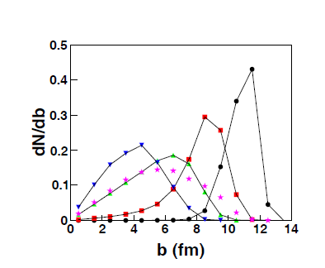
Experiment
Target : ^{58,64}Ni, ^{112,124}Sn, ¹⁹⁷Au, ²³²Th
Projectiles:
⁶⁴Zn,⁶⁴Ni,⁷⁰Zn
at 40 A MeV
20⁰
129-300-1000-1000 μm
⁶⁴Zn 47 A MeV
⁶⁴Zn+¹¹²Sn at 40 A MeV
IMF 20º

Slide 26
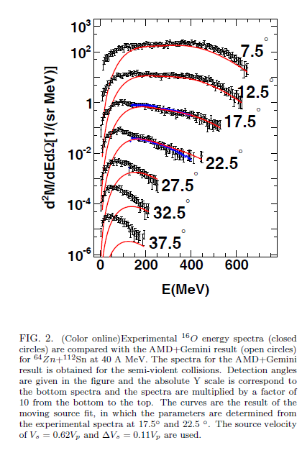
Exp. vs AMD-Gemini Semi-violent collisions
¹⁶O

Slide 27
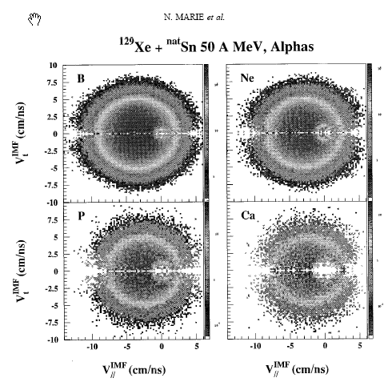
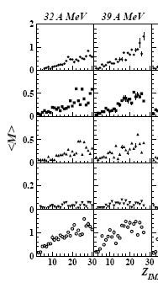
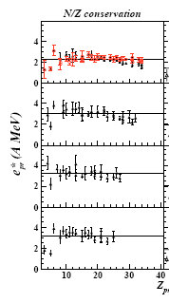
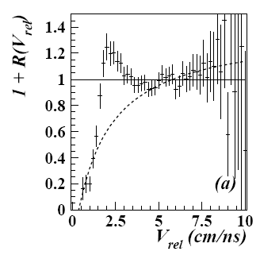
N.Marie et al., PRC 58, 256, 1998
S.Hudan et al., PRC 67, 064613, 2003
p
Gemini
d
t
h
32 A MeV
α
39 A MeV
45 A MeV
50 A MeV
Exp

Slide 28
data
Total
Uncorr(kM_{n}(Li))
Corr(M_{n}(²³Na))
3.5≤V_{IMF}<4.5 cm/ns
15º
25º
35º
θ_{IMF-n}
45º
4.5≤V_{IMF}<5.5 cm/ns
5.5≤V_{IMF}<6.5 cm/ns

Slide 29
T (MeV)

Slide 30
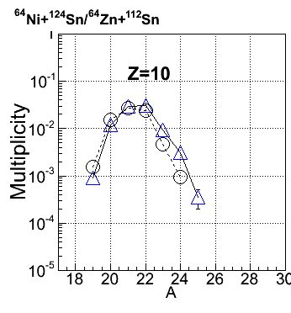
⁶⁴Zn+¹¹²Sn :
⁶⁴Ni+¹²⁴Sn
Exp.
⁶⁴Zn+¹¹²Sn
⁶⁴Ni+¹²⁴Sm
⁶⁴Zn+¹¹²Sm
⁶⁴Ni+¹²⁴Sn

Slide 31
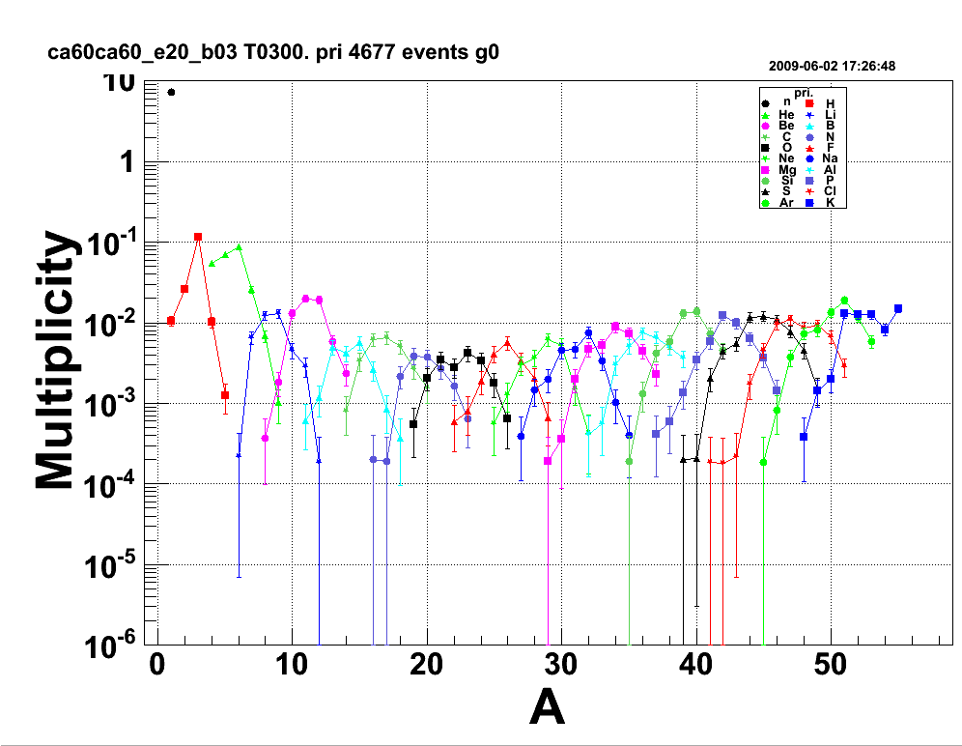
Isotope distribution at 300fm/c
He
¹⁷C
³⁴Mg
Be
Ar
Li
Mg
Si
S
C
Ne
B
O
Note: All isotopes are generated in very
neutron rich side

Slide 32
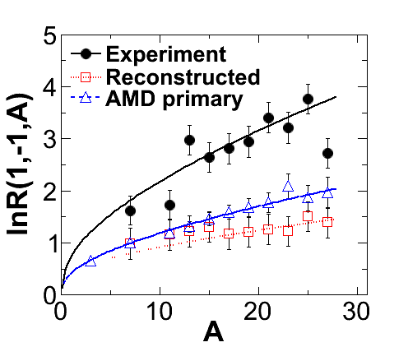
(μ_{n}- μ_{p})/T and Coulomb parameters
R(I+2,I,A) = exp{ [2a_{c}·(Z-1)/A^{1/3} – a_{sym}·4(I+1)/A– δ(N+1,Z-1) + δ(N,Z)]/T } · exp[(μ_{n}- μ_{p})/T]
I = ̶ 1 : even-odd:
R(1,-1,A) = exp{ 2a_{c}·(Z-1)/A^{1/3}/T } · exp[(μ_{n}- μ_{p})/T]
ln[R(1,-1,A)] =
2a_{c}·(Z-1)/A^{1/3}/T + (μ_{n}- μ_{p})/T
(μ_{n}- μ_{p})/T a_{c}/T
Exp. 0.71 0.35
AMD Primary 0.40 0.18
Reconstructed (0.40 ) 0.12

Slide 33
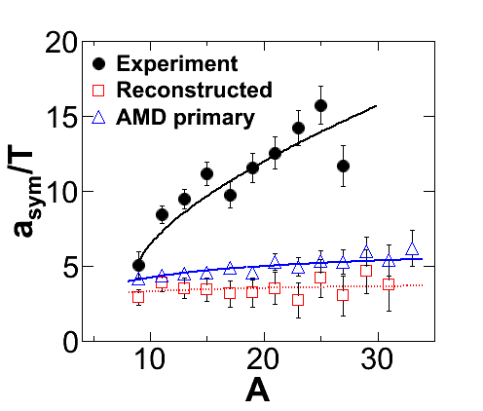
a_{sym} = c^{(V )}_{sym}(1 − c^{(S)}_{sym}/c^{(V )}_{sym}A^{1/3} ):
= c^{(V )}_{sym}(1 − κ_{S/V} /A^{1/3} )
c^{(V )}_{sym} c^{(V )}_{sym} κ_{S/V}
AMD primary 7.9±0.9 8.0±2.1 1.01
(T=5) 39.5 MeV 40 MeV
Reconstructed 4.4±2.0 2.4±4.9
3.5 ± 2.0
(T=5) 16.5 MeV
------------------------------------------------------
g.s. BE 32±2.0 72.3± 1.2 2.26
(H. Jiang et al. PRC85,024301 (2012) )

Slide 34
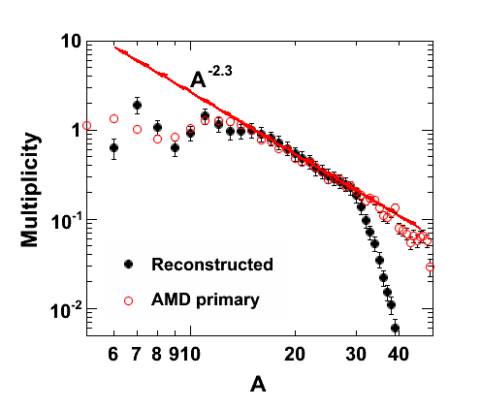
Power law behavior of the reconstructed fragments

Slide 35
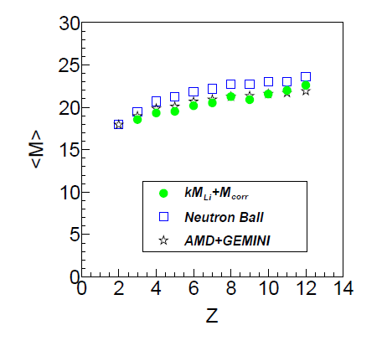

Slide 36
Summary
1. Excitation energy and multiplicity of the primary hot fragments
are reconstructed using a kinematical focusing technique.
2. Reconstructed Multiplicity distributions are well reproduced by
the AMD primary isotope distributions.
3. Reconstructed excitation energies are not well reproduced by
the AMD primary nor SMM prediction.
Reconstructed excitation energy show a significant decrease
as a function of isotope mass A for a given Z.
4. Coalescence method may need to take into account the effect of
neutron (or proton) separation energy for neutron rich ( or
proton rich) isotopes.
5. Very neutron rich isotopes may be in a very low excitation energy
when they are formed and less disturbed by the sequential
decay effect. This suggests that neutron rich isotopes provide a
good probe to study the hot nuclear matter in a point of least
sequential decay disturbance.

