Slide 1
Years at TAMU: 1997-2001/2:
Université Laval Participants
GRADUATES WHAT THEY DO NOW
Luc Gingras Medical Physicist
Djamel Ouerdane Res. assistant
Ghyslain Boudreau College Teacher
Josiane Moisan College Teacher
Dany Thériault Medical Physicist
Simon Turbide Res/Dev Agent
Yves Larochelle Phylosophy Professor
Frédérick Grenier Federal Nuclear Control Agent
Three undergraduates:
- One is researcher in Medical Physics
- One is a development agent in photonics

Slide 2
Joe’s secret to a long and productive career (or why he has been doing nuclear chemistry for so long)
Address (or at least work on) questions of fundamental importance
Play with really cool toys
Learn from and work with great people from all over the world.

Slide 3
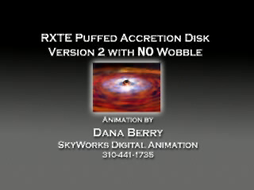

Fusing exotic nuclei below the barrier
Outer crust of an accreting neutron star
Density
depth
~10⁵ g/cm³
Atmosphere:
Accreted H/He
5 m
Ocean:
Carbon + heavy elements
~10⁹ g/cm³
heavy elements
30 m
~10¹⁰ g/cm³
Indiana University: T. Steinbach, M.J. Rudolph, Z.Q. Gosser, K. Brown✼, D. Mercier, S. Hudan
GANIL: A. Chbihi, B. Jacquot
ORNL: J.F. Liang, D. Shapira
Western Michigan: M. Famiano
Crust
100 m
The crust of an accreting neutron star is a unique environment for nuclear reactions
This work was supported by the U.S. DOE Office of Science under Grant No. DEFG02-88ER-40404
Romualdo deSouza, IWNDT, College Station 2013

Slide 4
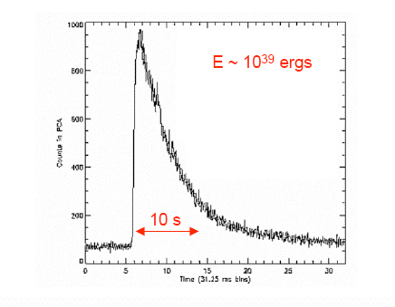
Motivation
Nuclear astrophysics: Nuclear reactions in outer crust of a neutron star
Nuclear physics: dynamics of fusing two neutron-rich nuclei
Fusion reactions in the outer crust result in X-ray bursts and superbursts
Problem: At the temperature of the crust, the Coulomb barrier is too high for thermonuclear fusion of carbon – another heat source is needed.
First proposed (Horowitz et al.) that ²⁴O + ²⁴O or ²⁸Ne + ²⁸Ne might be the heat source. More recently mid-mass nuclei have been suggested.
Romualdo deSouza, IWNDT, College Station 2013

Slide 5
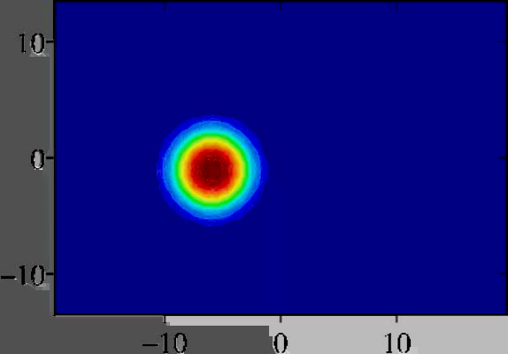
Is fusion of neutron-rich light nuclei enhanced relative to β-stable nuclei?
Density constrained TDHF calculations
3D cartesian lattice without symmetry restrictions
Skyrme effective nucleon-nucleon interaction
Neutron transfer channels for N/Z asymmetric nuclei enhance the fusion cross-section at and below the barrier.
R.T. deSouza, S. Hudan, V.E. Oberacker, S. Umar Phys. Rev. C88 014602 (2013)
Romualdo deSouza, IWNDT, College Station 2013

Slide 6
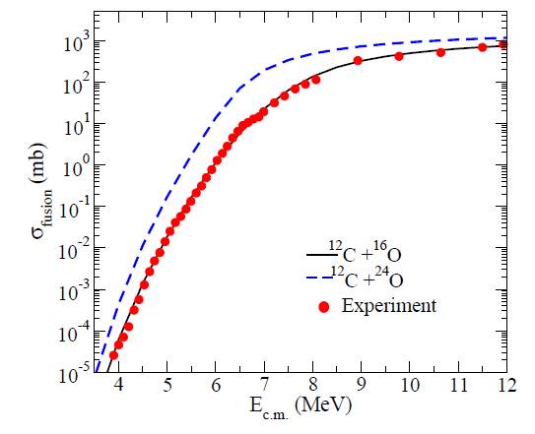
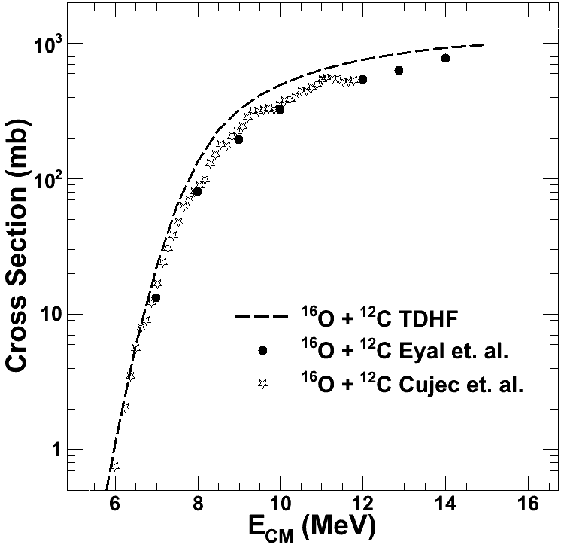
DC-TDHF does a decent job of describing ¹⁶O + ¹²C
It predicts a substantial enhancement for ²⁴O + ¹²C
Closer examination shows that DC-TDHF slightly overpredicts fusion in ¹⁶O + ¹²C due to its inclusion of breakup channels.

Slide 7
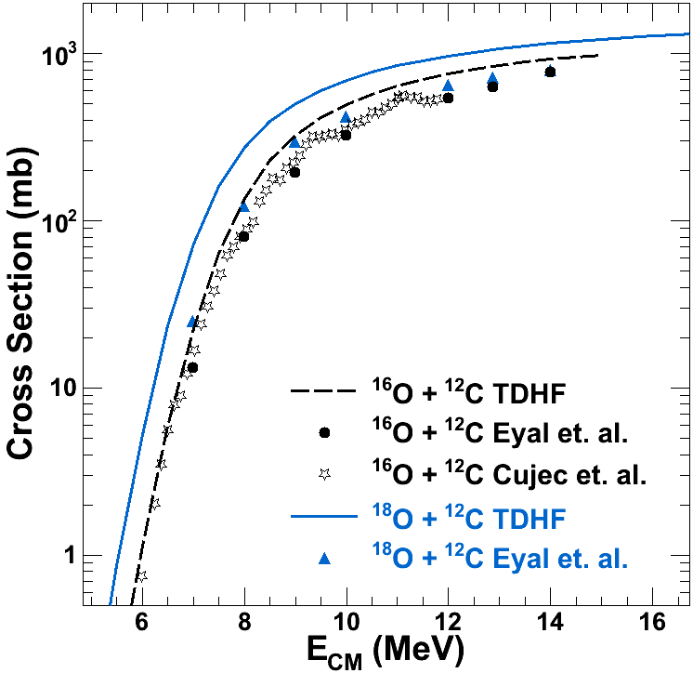
When comparing ¹⁸O + ¹²C to ¹⁶O + ¹²C DC-TDHF predicts a larger increase as compared to the experimental data.
What happens (in reality) to the fusion cross-section as the oxygen nucleus becomes increasingly neutron-rich?
Systematic fusion data to address this question is necessary!

Slide 8
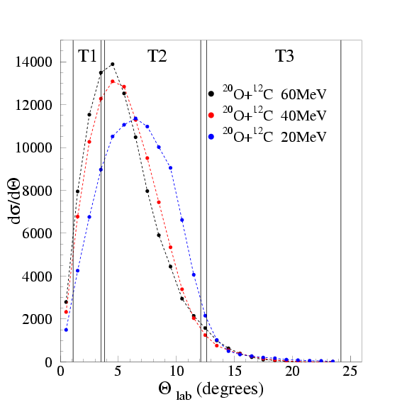
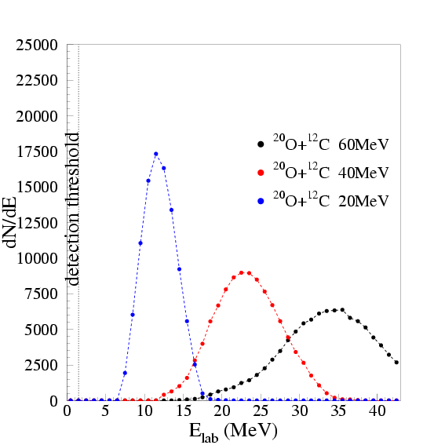
Fusion of neutron-rich radioactive beams with light targets
³²Si* ➔²⁹Si + 3n
²⁰O + ¹²C ➔ ³²Si* (E* ~ 50 MeV)
³²Si* ➔²⁹Al + p + 2n
³²Si* ➔²⁶Mg + α + 2n
Energy and angular distributions predicted by Bass model + PACE2
Romualdo deSouza, IWNDT, College Station 2013

Slide 9
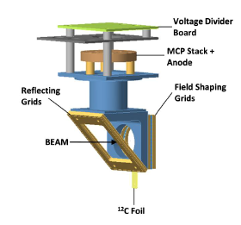
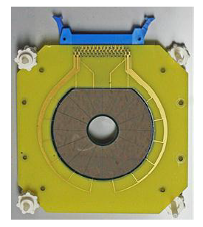
Experimental Details
Microchannel plate detector
Silicon detectors
Advantages:
compact
Simple construction
good time resolution (200 ps)
Inner hole 20 mm diameter
48 concentric rings; 16 “pies”
Particle entry on ring (junction)
Fast timing extracted from “pie” side
Time resolution 425 ps (6 MeV alpha)
Disadvantages:
Wire planes (4/det.) in path of beam
R.T. deSouza et al., NIM. A632, 133 (2011)
Romualdo deSouza, IWNDT, College Station 2013

Slide 10
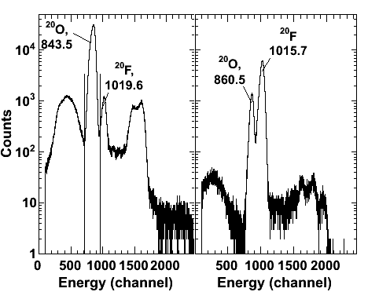
Experimental Setup: GANIL E575S (Summer 2010)
SBD
Zero Degree Ion
Chamber
Active Collimator
Degrader Ion
Chamber
T3
T2
²⁰O BEAM
ΔE1 ….. ΔE6
1st Timing
Detector
and target
2nd Timing
Detector
ΔE1 ….. ΔE5
M.J. Rudolph et al., PRC85, 024605 (2012).
Incident Beam: ^{20,16}O + ¹²C @ 3 MeV/A
Intensity of ²⁰O: 1-2x10⁴ pps
Degrader ion chamber (CF₄) reduces energy
to1-2 MeV/A and identifies particle (ΔE)
Target: 100 µg/cm² carbon foil
T2: θLab = 3.5 - 10.8°; T3: θLab = 11.3 - 21.8°
Time-of-Flight (TOF) between target-MCP and Si (T2, T3)
Romualdo deSouza, IWNDT, College Station 2013

Slide 11
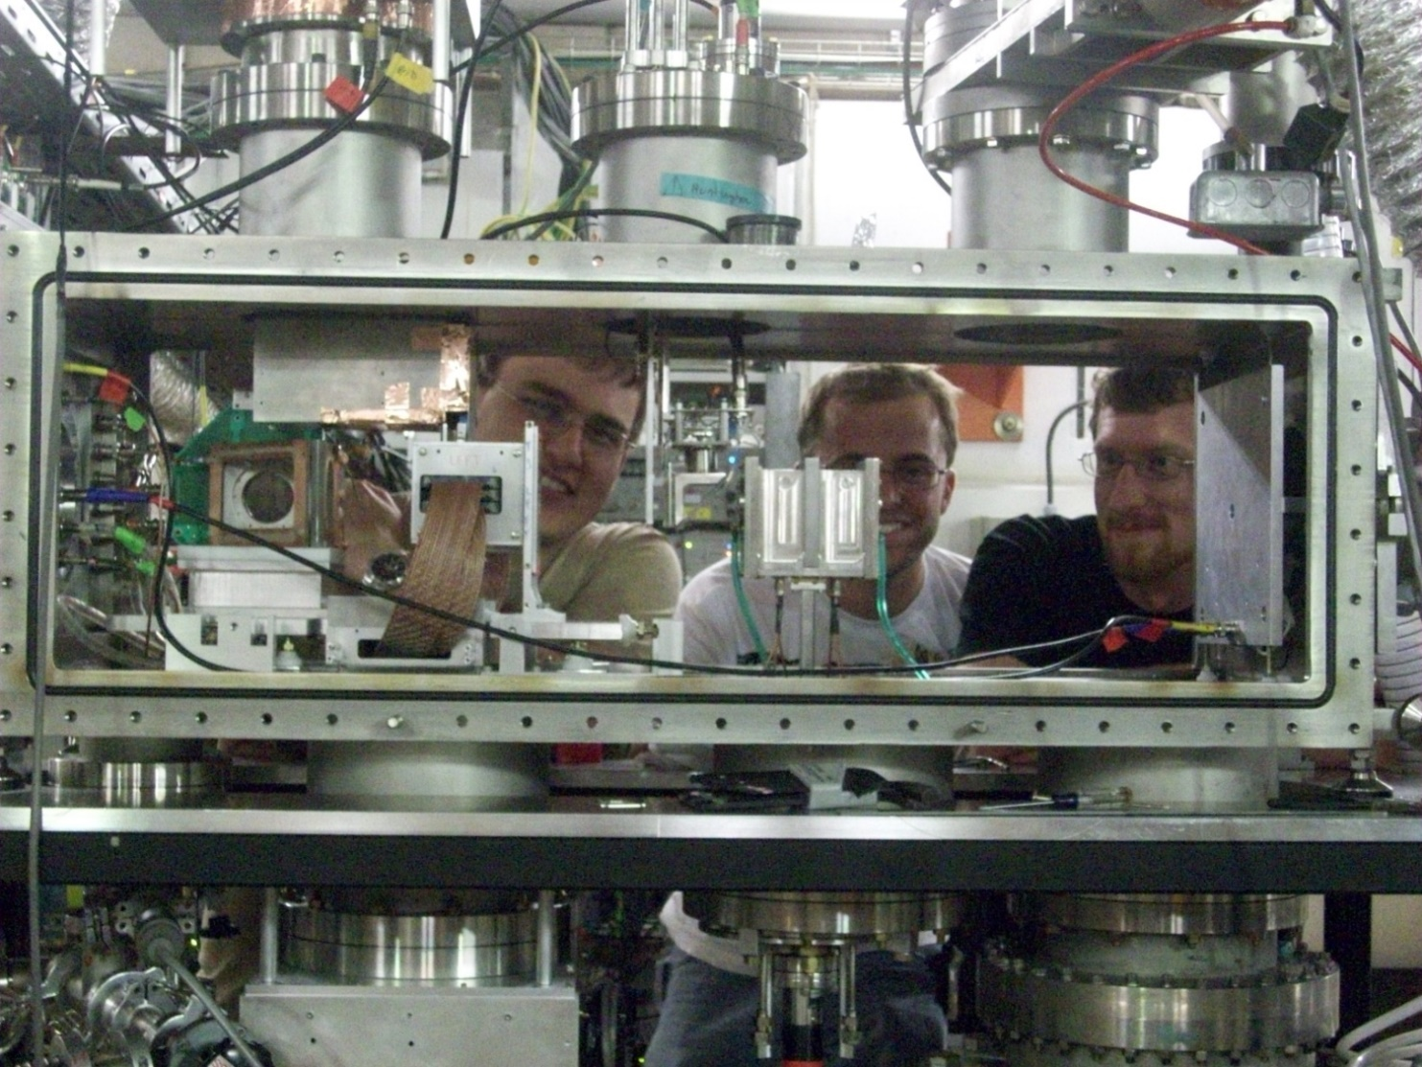
Experimental Setup: GANIL E575S (Summer 2010)
Setup is compact, transportable and provides efficient detection of evaporation residues (>70%).
L to R: Kyle Brown, Mike Rudolph, and Zach Gosser at GANIL
Romualdo deSouza, Nucleus Nucleus 2012

Slide 12
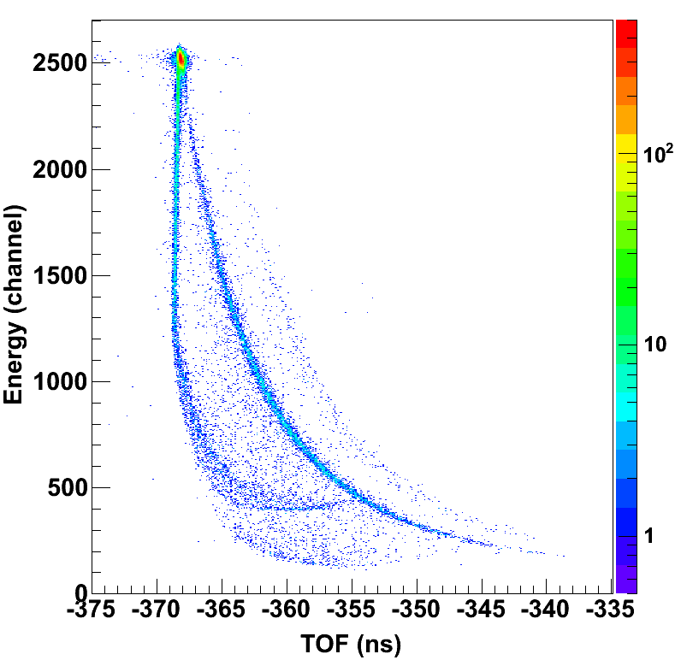
Energy-TOF spectrum has many features
Slit-scatter ridge extending from elastic peak to lower energies (expected)
Incomplete charge collection ridge (same TOF as elastic); ~20% of elastic yield!
“ghost” line in same region as residues but x-section ~70b! (atomic process)
Elastic peak
Slit scatter line
“ghost” line
incomplete charge collection line? NOT Underbiased!
M.J. Rudolph et al., Phys. Rev. C85, 024605 (2012).
Romualdo deSouza, IWNDT, College Station 2013

Slide 13
Ghost line is due to atomic scattering from wires resulting in an early false start signal
Remove wires from beam path ➔ gridless MCP
Incomplete charge collection due to high segmentation of silicon detector
Reduce segmentation of Si detector ➔ new Si design
Can some useful information be extracted from the existing dataset?
Use detection of a coincident light charged particle to eliminate atomic scattering!

Slide 14
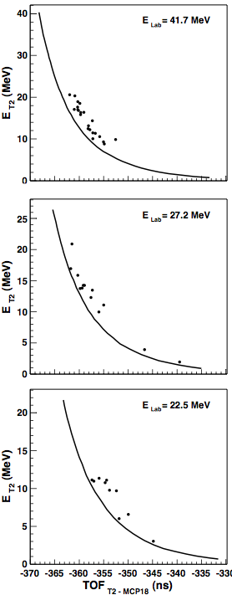
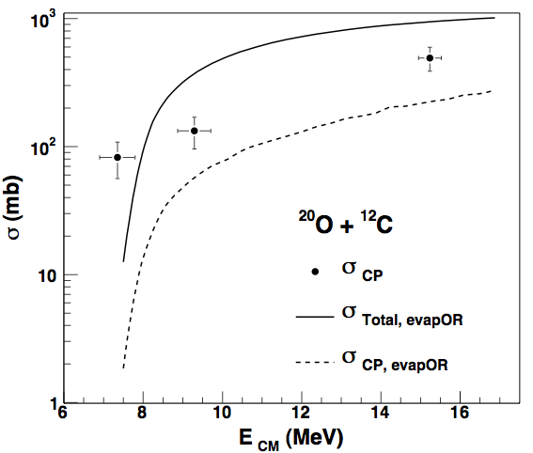
Reference slit-scatter line
total
Fusion-evaporation model (evapOR)
Fusion stage: Bass model
Evaporation stage
residues
Associated with CP emission
Measured cross-section exceeds that predicted by fusion-evaporation model
Is σ_{fusion} > σ_{Bass} ?
Does evapOR handle competition between CP and neutron only decay correctly?
M.J. Rudolph et al., Phys. Rev. C85, 024605 (2012).
Romualdo deSouza, Nucleus Nucleus 2012

Slide 15
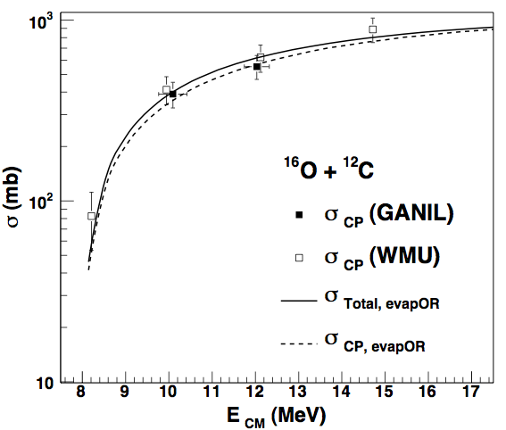
Bench-mark reaction: ¹⁶O + ¹²C
Measurement made in same expt. (E575S)
Measurement subsequently at WMU
Measured cross-section in both expts. is in good agreement with evapOR predictions
¹⁶O + ¹²C ➞ ²⁸Si* ➞
²⁷Si + n
²⁷Al + p
²⁶Al + p + n
²⁶Mg + 2p
²⁴Mg + α
²³Na + α + p
²⁰Ne + 2α
Bottom line: We can have confidence in our observation of a fusion enhancement for the charged particle channels of ²⁰O + ¹²C.
Romualdo deSouza, IWNDT, College Station 2013

Slide 16
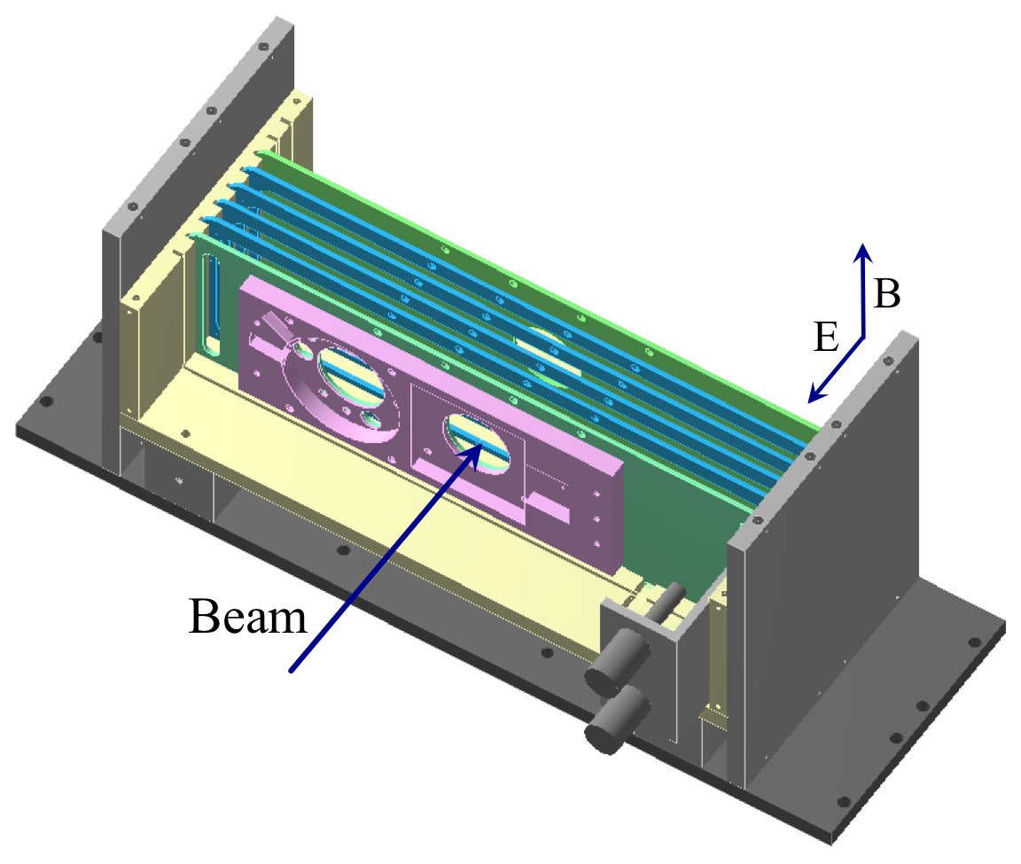
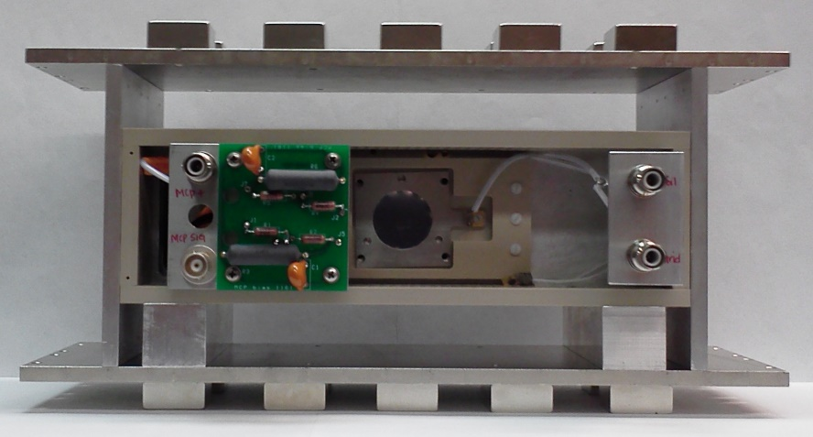
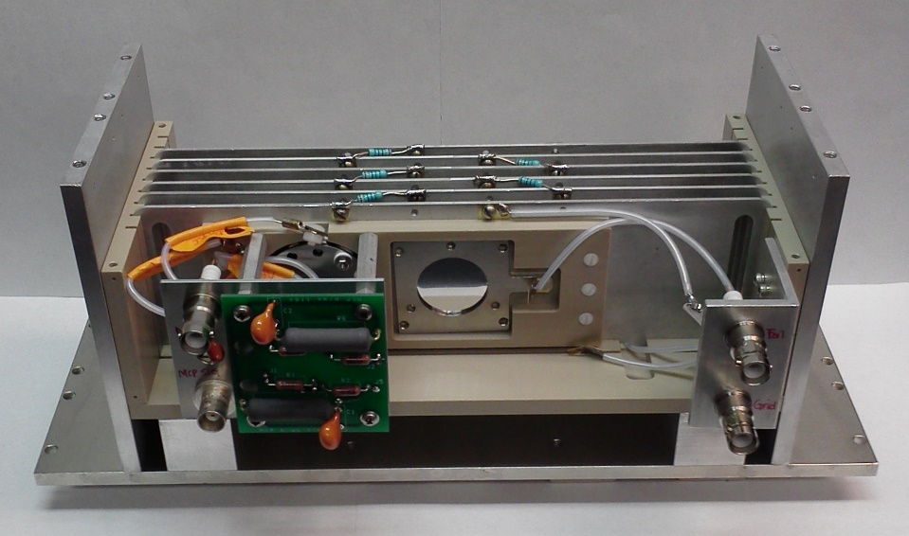
The path forward : Development of a gridless MCP
Crossed E and B field design:
J.D. Bowman et al., NIM 148, 503 (1978).
Time resolution for a single MCP ~ 350 ps
More than sufficient for measurement
Romualdo deSouza, IWNDT, College Station 2013

Slide 17
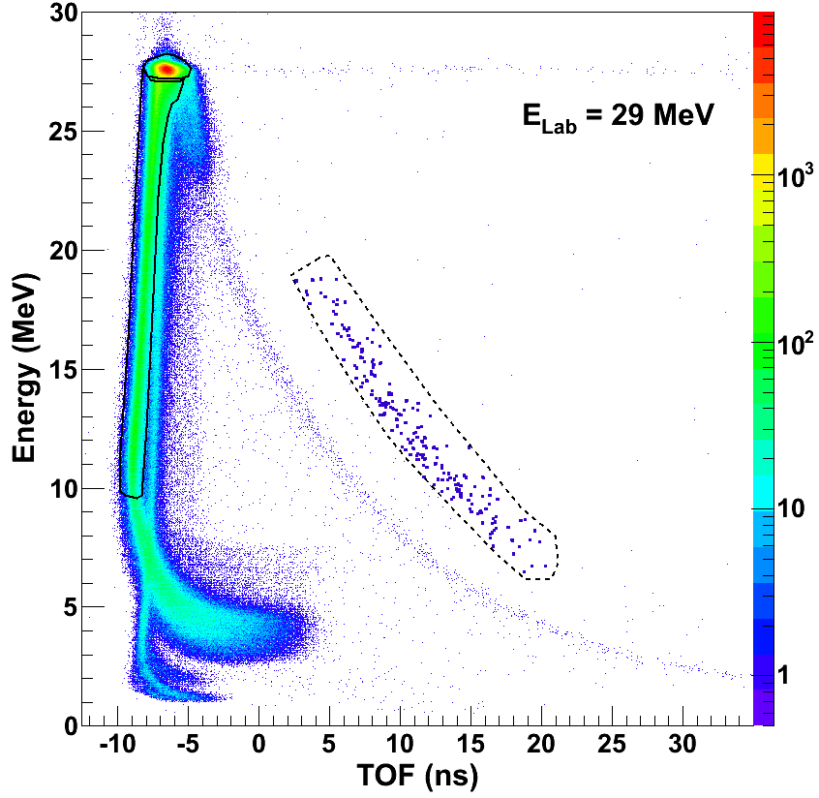
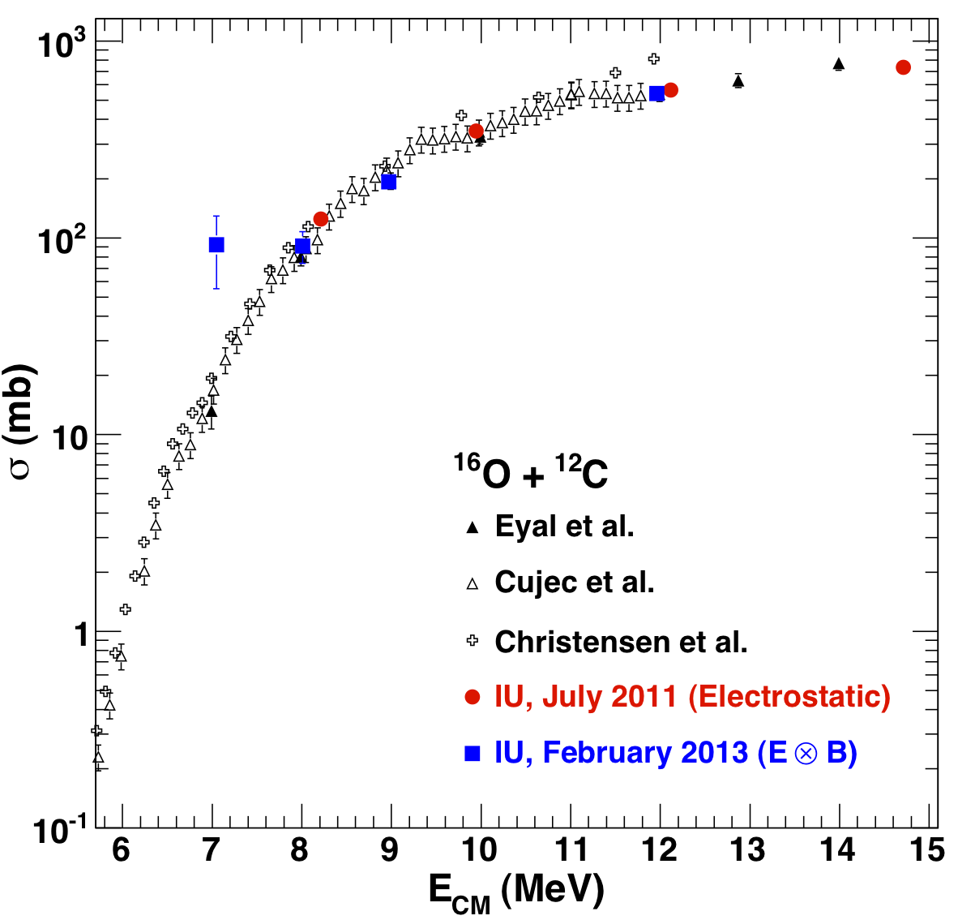
Western Michigan test with gridless (Feb. 2013)
Large cross-section for fusion measured at lowest incident energy (E_{cm}=7 MeV) due to large random background (poor beam tune, DC accelerator etc.)
Romualdo deSouza, IWNDT, College Station 2013

Slide 18
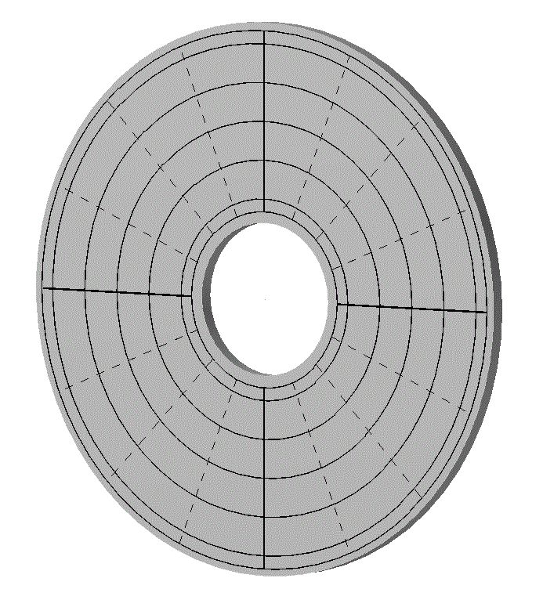
The path forward : new Si detector design (Micron S5)
To resolve the problem of incomplete charge collection / trapping :
16 pies sectors on ohmic side
6 rings sub-divided into quadrants on junction side
Thin entrance window of ~0.1 μm (4-5 times less than prior S2 design used)
Romualdo deSouza, IWNDT, College Station 2013

Slide 19
Conclusions
Extraction of fusion cross-section for ²⁰O+¹²C followed by charged particle emission indicates an enhancement as compared to TDHF and Bass (+evapOR). Two possibilities:
  Increase in the total fusion cross-section
  Competition between charged particle emission and neutron only decay in de-excitation phase differs from evapOR prediction
By implementing a gridless MCP, σ_{fusion} for ¹⁶O + ¹²C was measured in agreement with the literature.
Implementation of a low segmentation silicon is underway to resolve the incomplete charge collection / trapping problem.
Measure fusion excitation functions for neutron-rich light nuclei
FSU: ^{18,19}O + ¹²C ; GANIL: ²⁰O + ¹²C; ReA3@MSU: heavier nuclei
Romualdo deSouza, IWNDT, College Station 2013

Slide 20
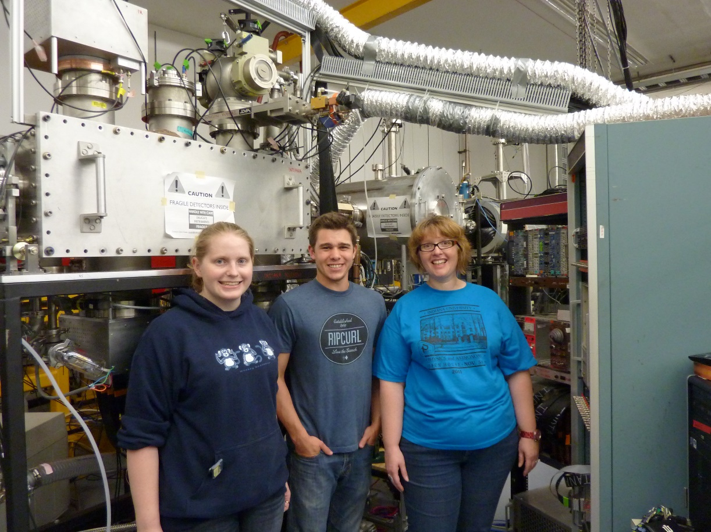
Thanks Joe ! Best wishes for the second stage of your scientific career.

Slide 21
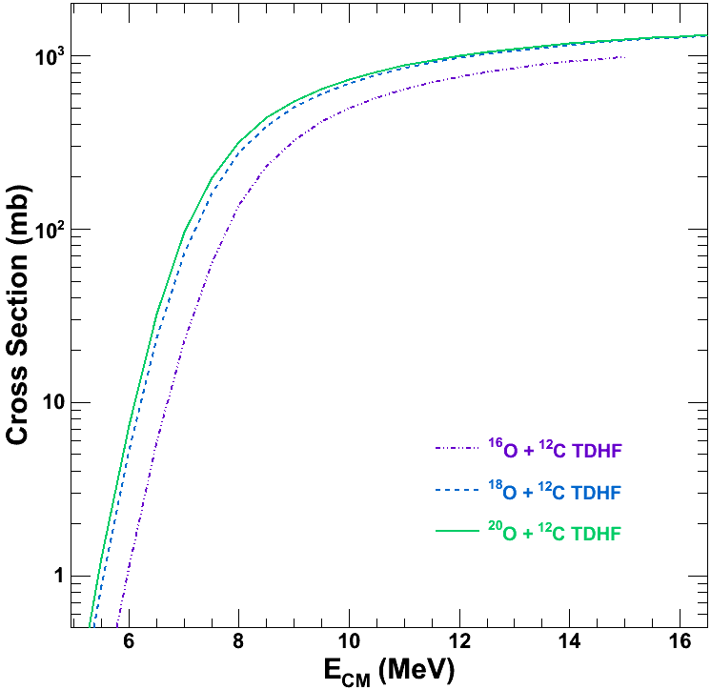

Slide 22
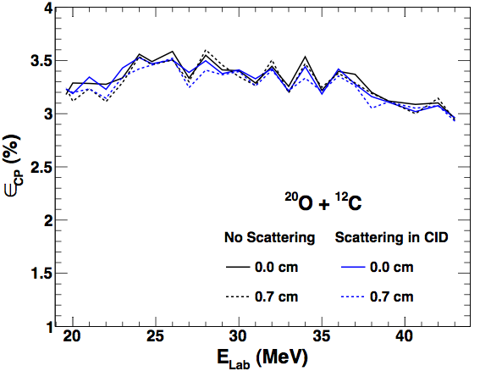
Require charged particle coincidence to eliminate atomic scattering background
select coincidence of charged particle (p,α) in T3 with a residue in T2
M.J. Rudolph et al., Phys. Rev. C85, 024605 (2012).
Romualdo deSouza, IWNDT, College Station 2013

Slide 23
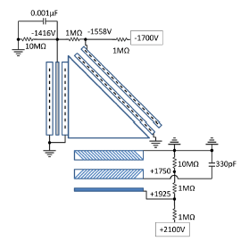
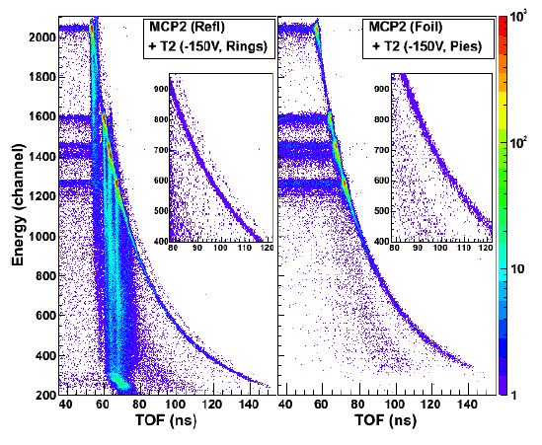
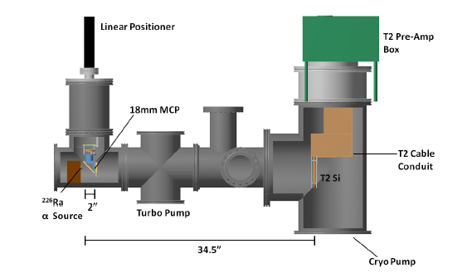
Origin of ghost line
beam
“Ghost” line is due to electrons from carbon foil directly entering the MCP
Romualdo deSouza, IWNDT, College Station 2013

Slide 24
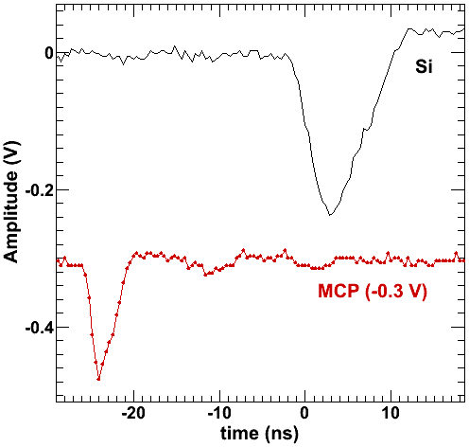
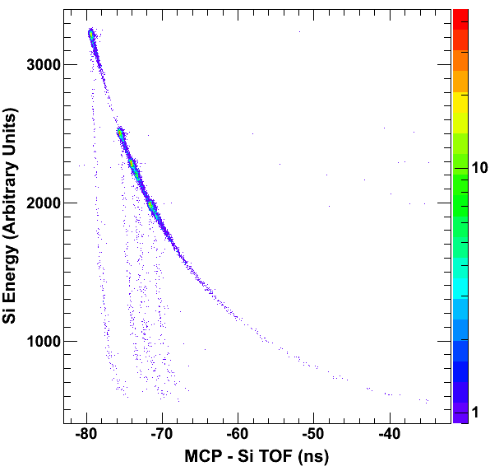
The path forward :
Decreased segmentation of the Si detector
gridless
MCP
TOF
α source
(²²⁶Ra)
Surface barrier Si det.
~5% slit scattering
Si SBD fast rise time 3-4 ns
MCP rise time < 2 ns
Leading edge disc. of Si signal
CFD disc. of MCP signal
~1.5%
Romualdo deSouza, IWNDT, College Station 2013

Slide 25
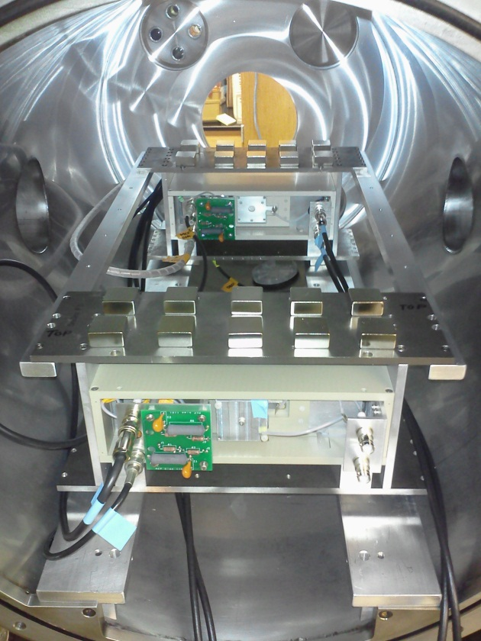
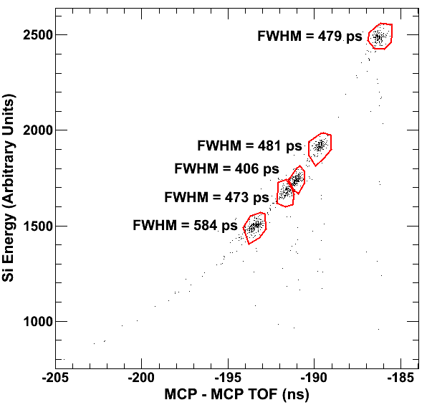
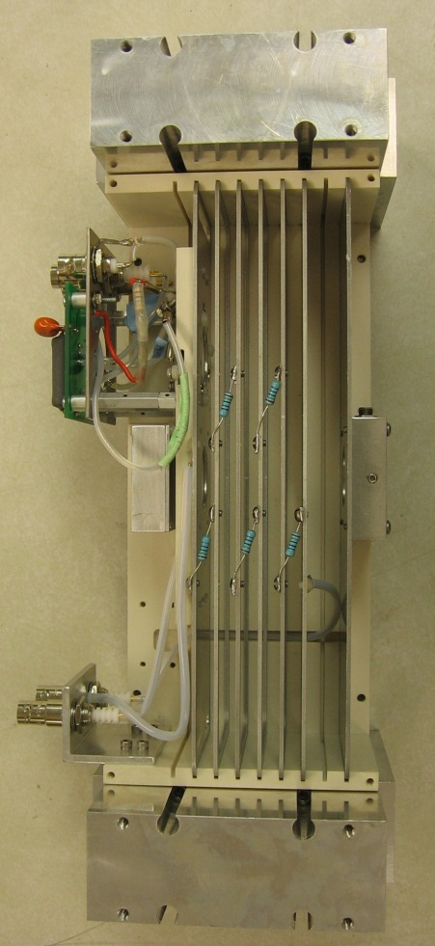
The path forward : Development of a gridless MCP
Crossed E and B field design:
J.D. Bowman et al., NIM 148, 503 (1978).
MCP1
MCP2
MCP
Si detector
α source
TOF
Si
Time resolution for a single MCP ~ 350 ps
More than sufficient for measurement
²²⁶Ra source
Romualdo deSouza, IWNDT, College Station 2013

