Slide 1
New results from neutrino oscillation experiments
Michel Gonin – Ecole Polytechnique – France

Slide 2
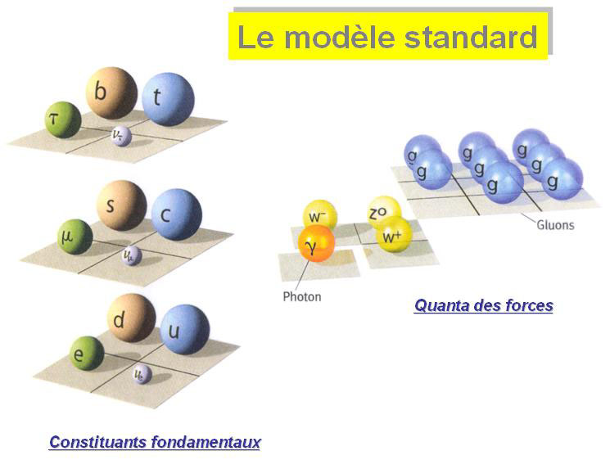
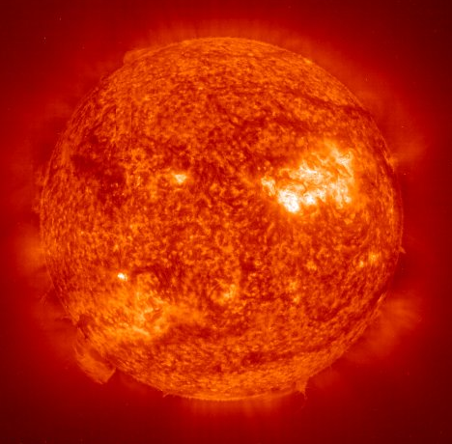
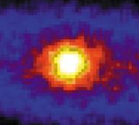
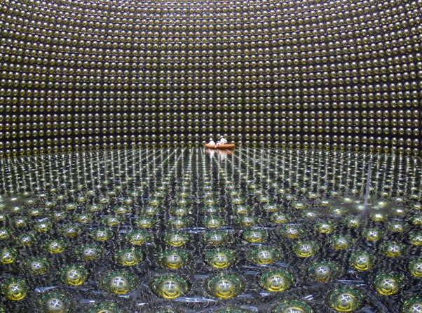
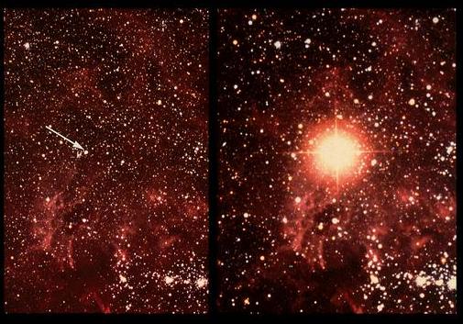
Introduction
neutrino oscillations
mixing matrices
The experiments
New results on Θ₁₃
Perspectives
1987 : SUPER NOVA SN1987A
Super-Kamiokande

Slide 3
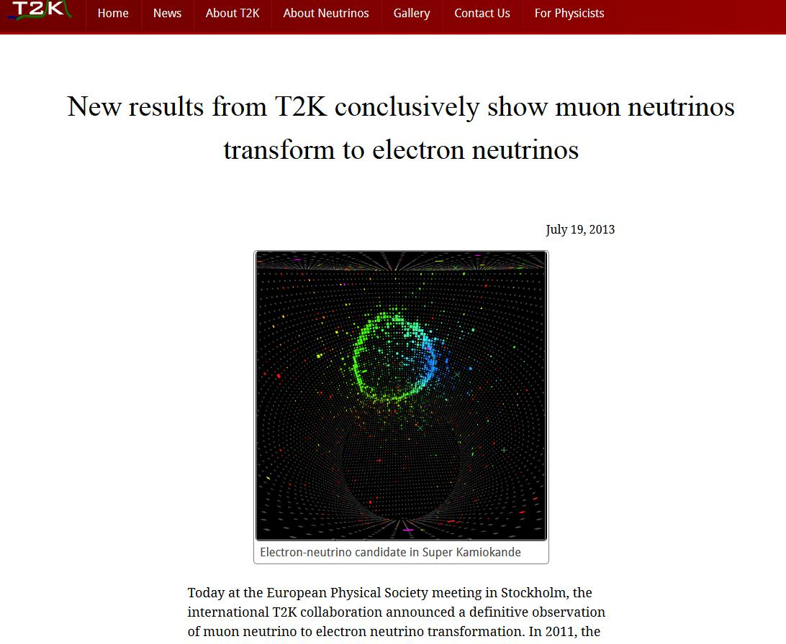
New results on neutrino oscillations

Slide 4
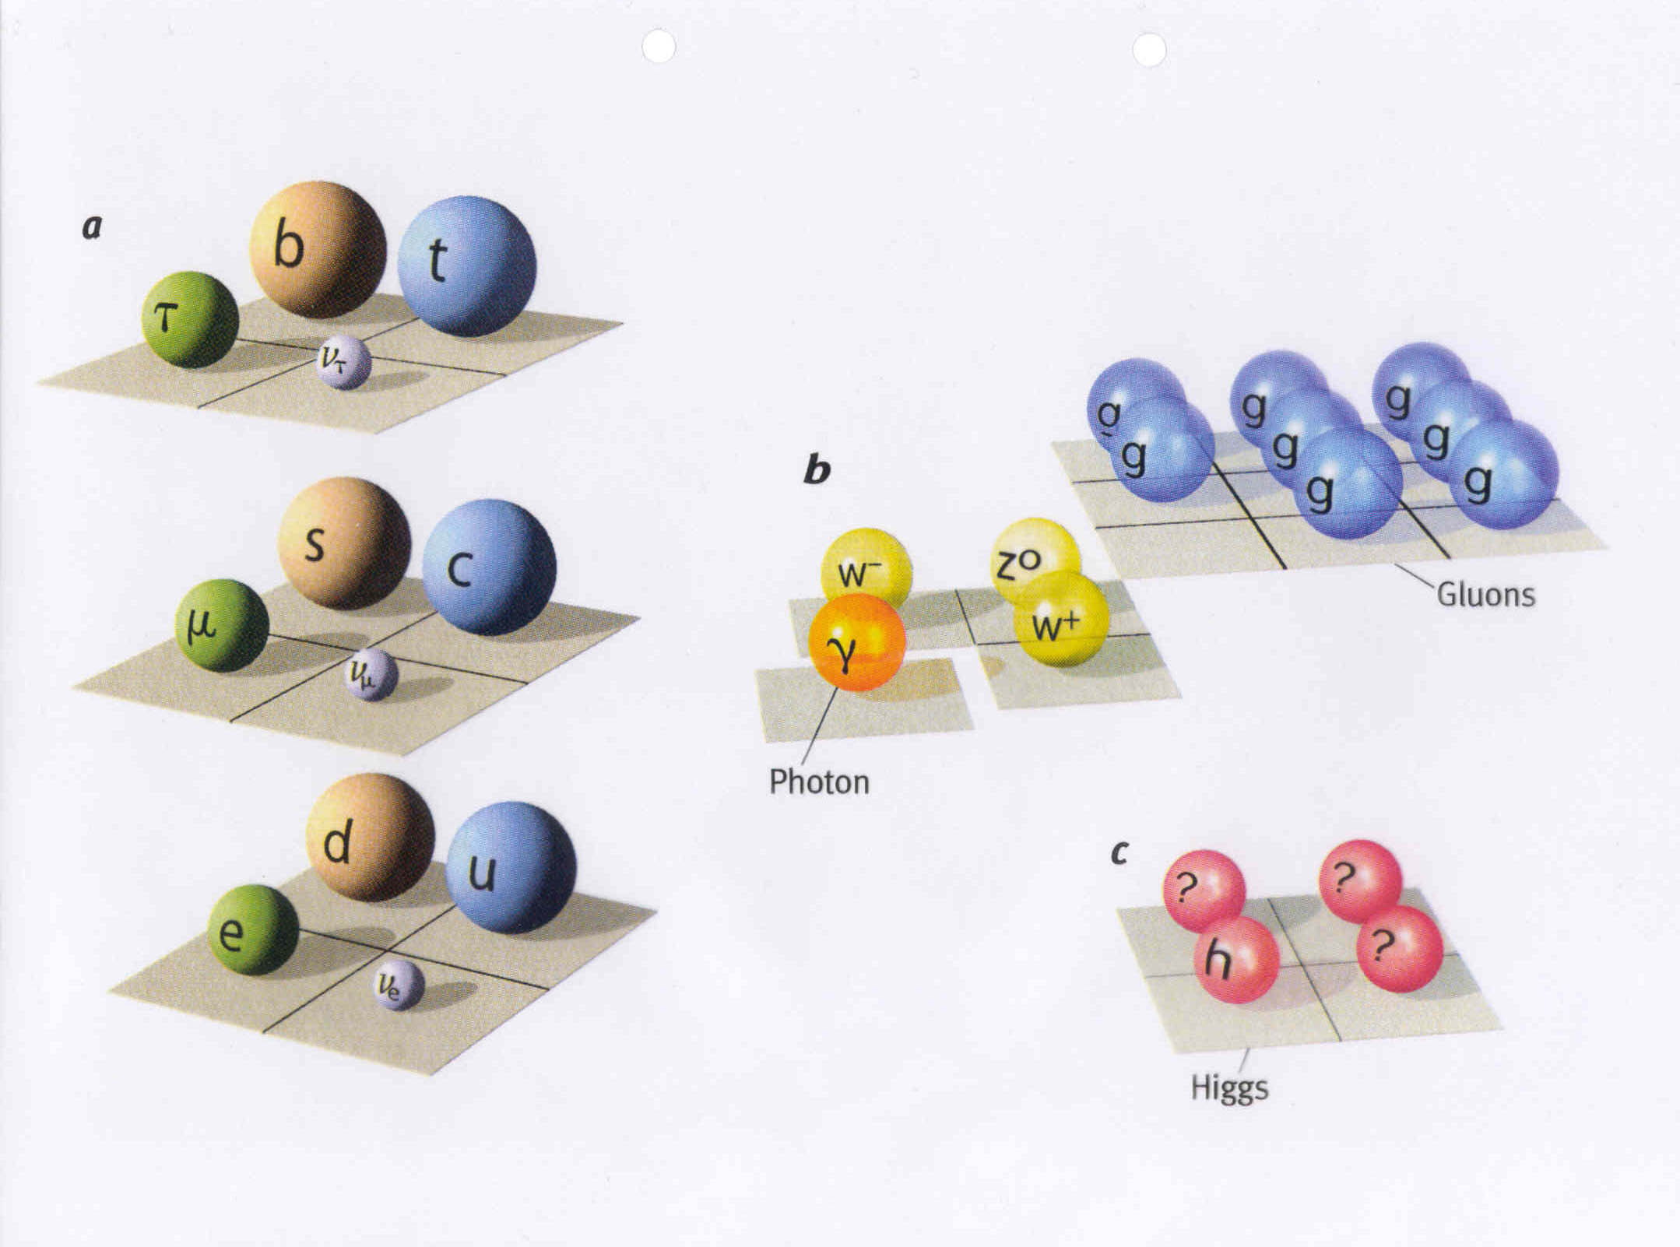
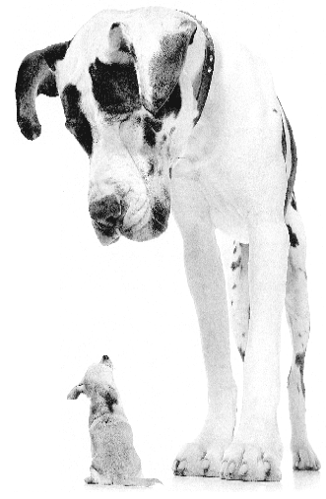

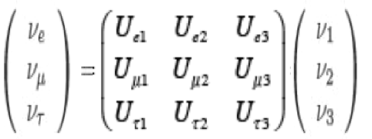
The Standard Model of Particle Physics
26 free parameters including 8 for neutrinos
electron
neutrino

Slide 5
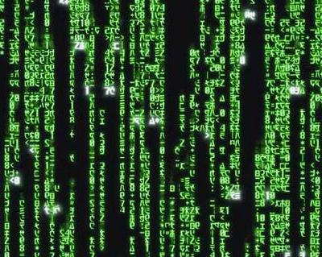
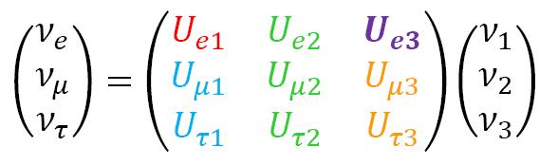
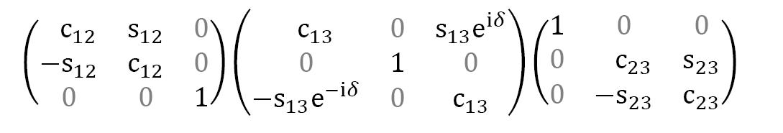
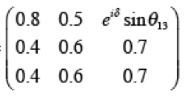
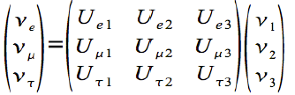
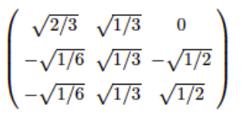

The Mixing Matrix
c = cos s = sin
?
The last mixing angle θ₁₃ was missing before 2012
The complex phase δ is still unknow
≈

Slide 6
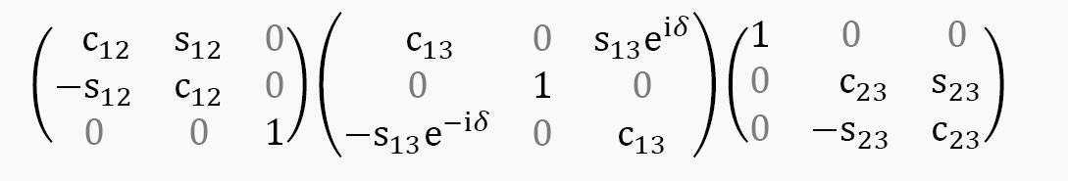
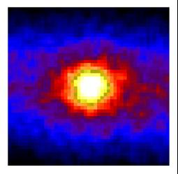
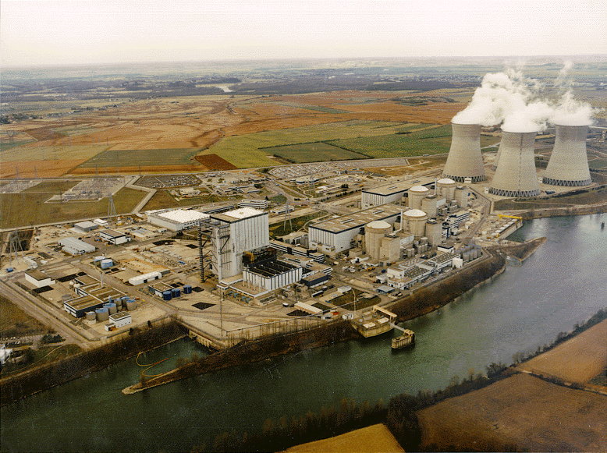
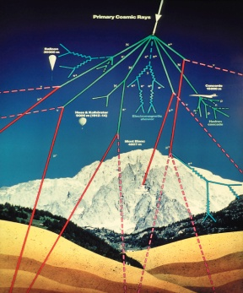
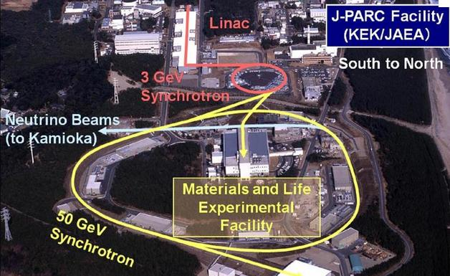
Measurements of the matrix elements
θ₁₂ = 33.6◦ ± 1.0◦
θ₂₃ = 45◦ ± 6◦

Slide 7

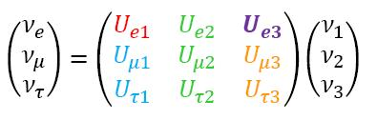
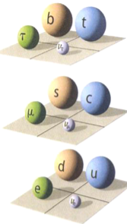
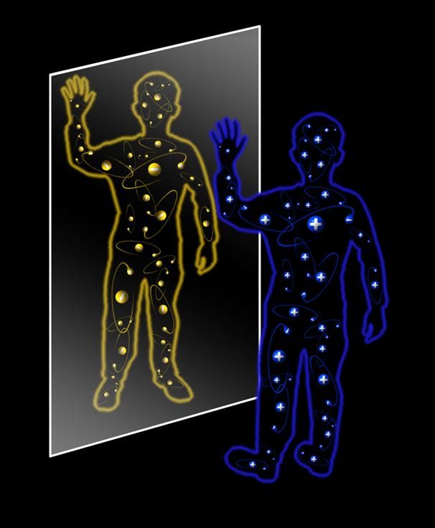
"for the discovery of the origin of the broken symmetry which predicts the existence of at least three families of quarks in nature".
♦ masse states ≠ flavor states
♦ 3 generations of particles
♦ 3 mixing angles, all different from zero.
CP violation δ ≠ 0

Slide 8
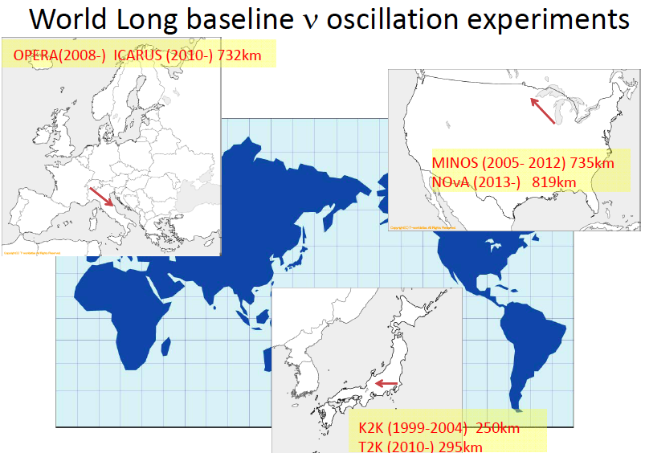
World (new) baseline oscillation experiments

Slide 9
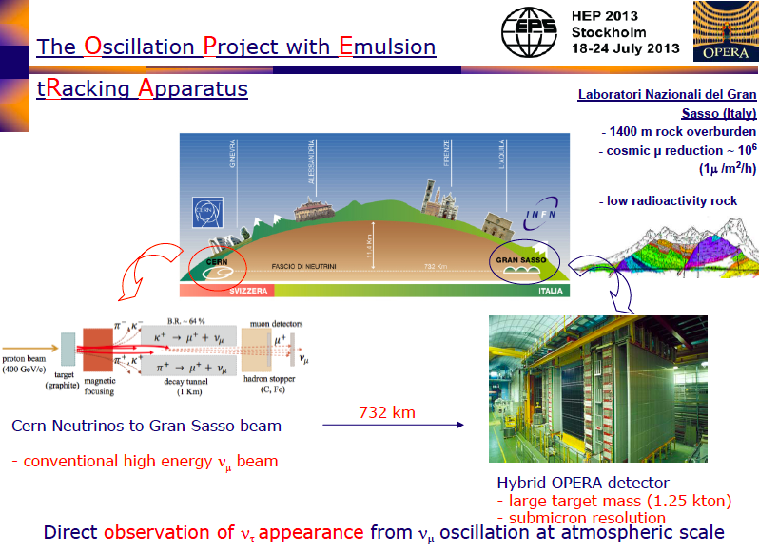

Slide 10
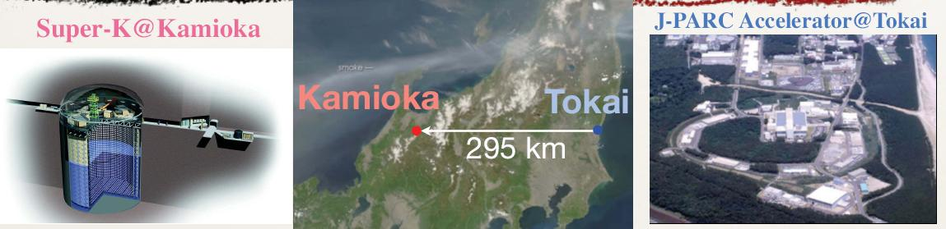
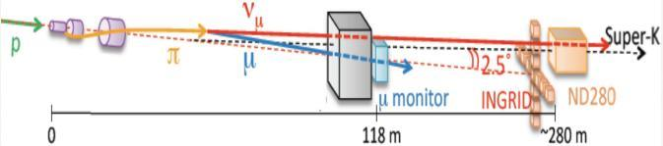
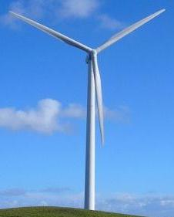
• Huge far detector
• Intense beam
• Near detectors
ν_{μ} beam

Slide 11
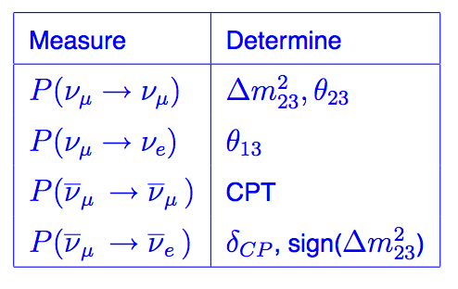
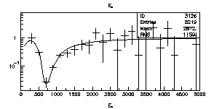
T2K main physics goals
Probe ν_{μ} to ν_{e} oscillations with sensitivity improvement
Precise measurement of the “atmospheric” parameters θ₂₃, Δm₃₂²
sin²2θ₁₃
ν_{μ} disappearance
ν_{e} appearance
sin²2θ₂₃
Δm₂₃²

Slide 12

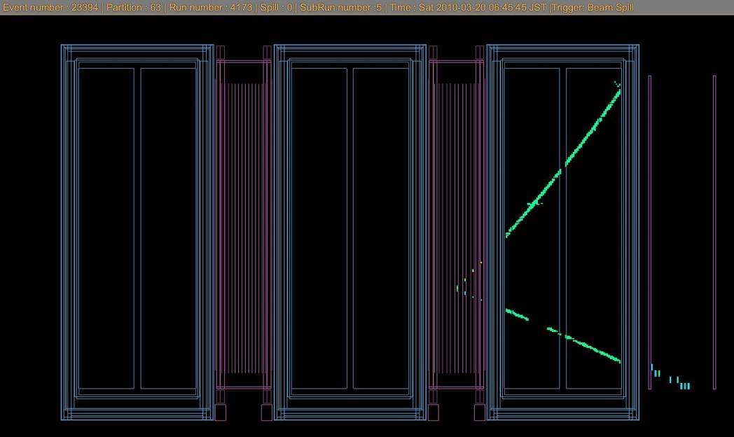
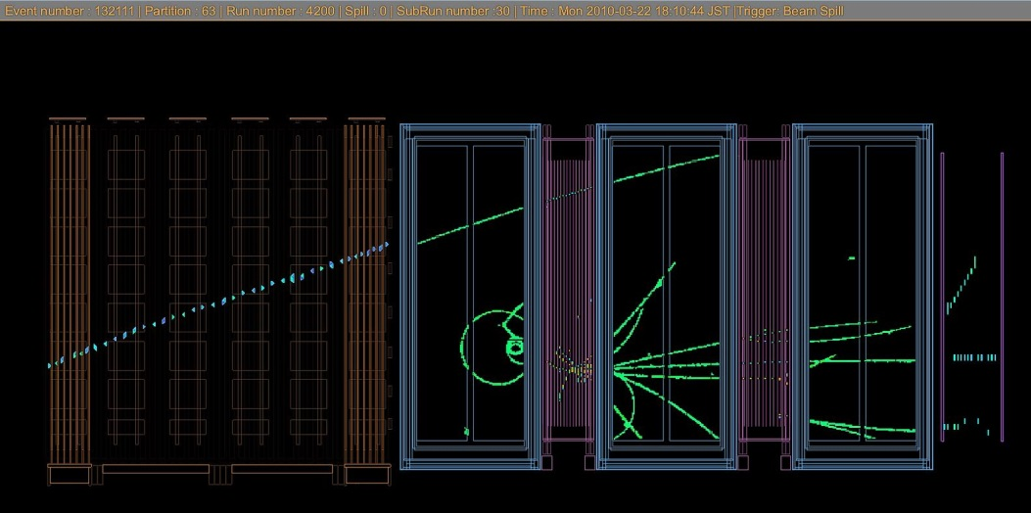
n → p + e + ν_{e}
ν_{e} + n → p + e
How do we detect neutrinos ?
ν_{μ} + n → p + μ
Charge current quasi elastic neutrino interaction
Neutrino interaction with some unrelated muon (“rock muon”)

Slide 13
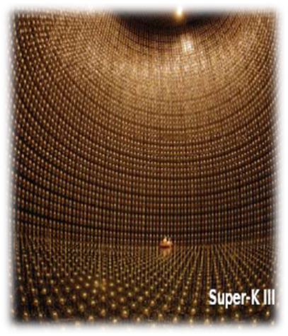
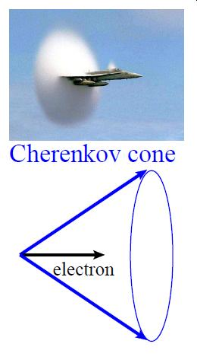
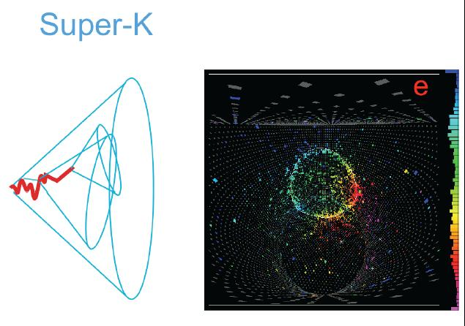
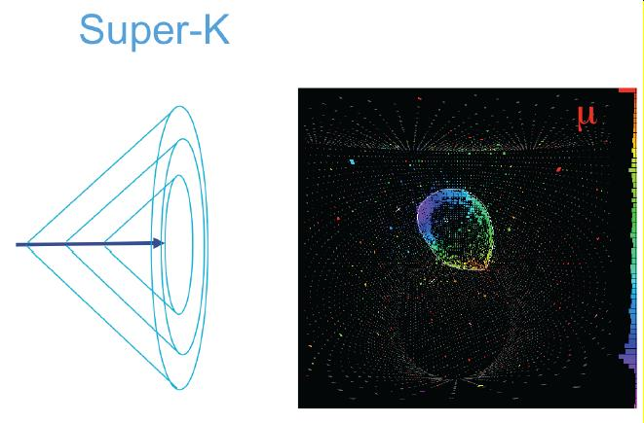
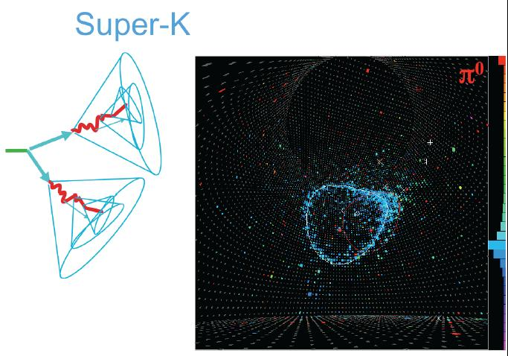

Slide 14
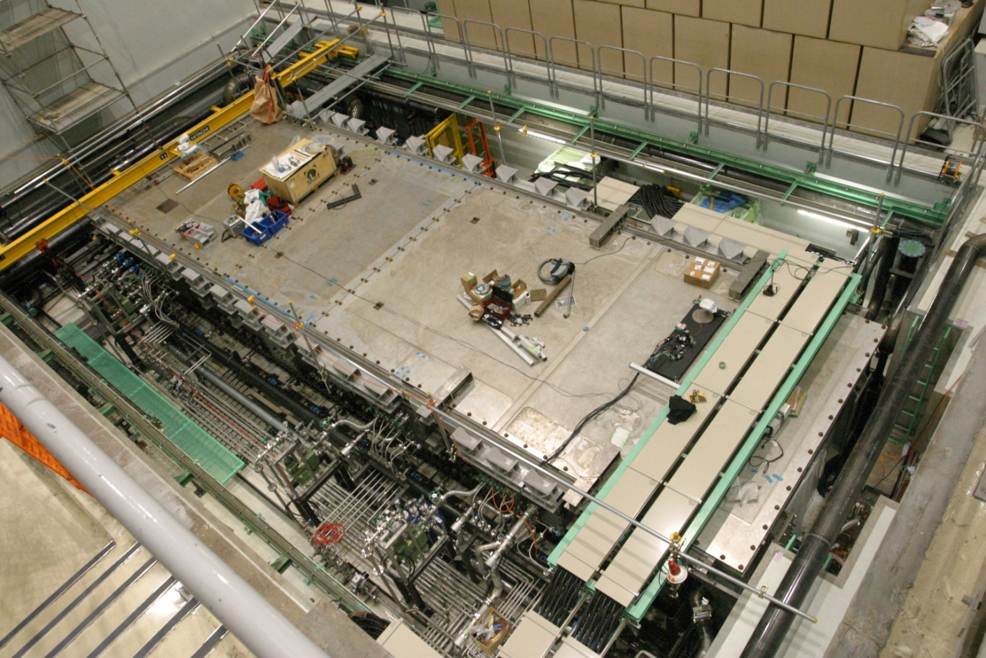
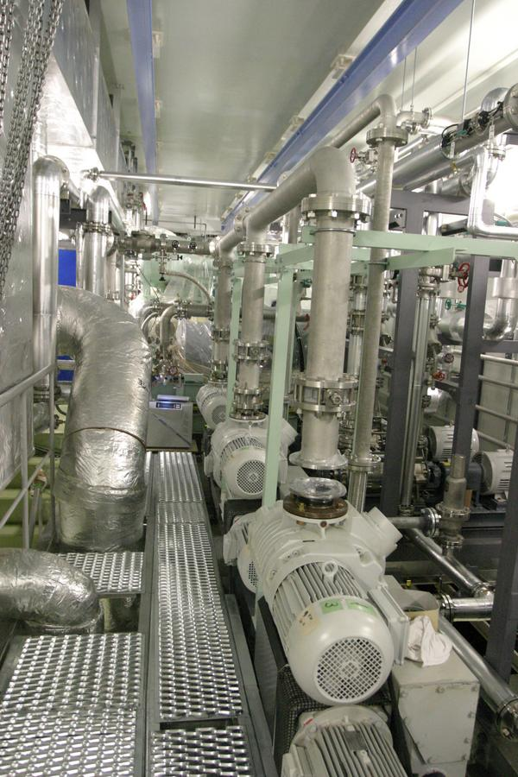
Target Station
Feb. 3, 2009

Slide 15

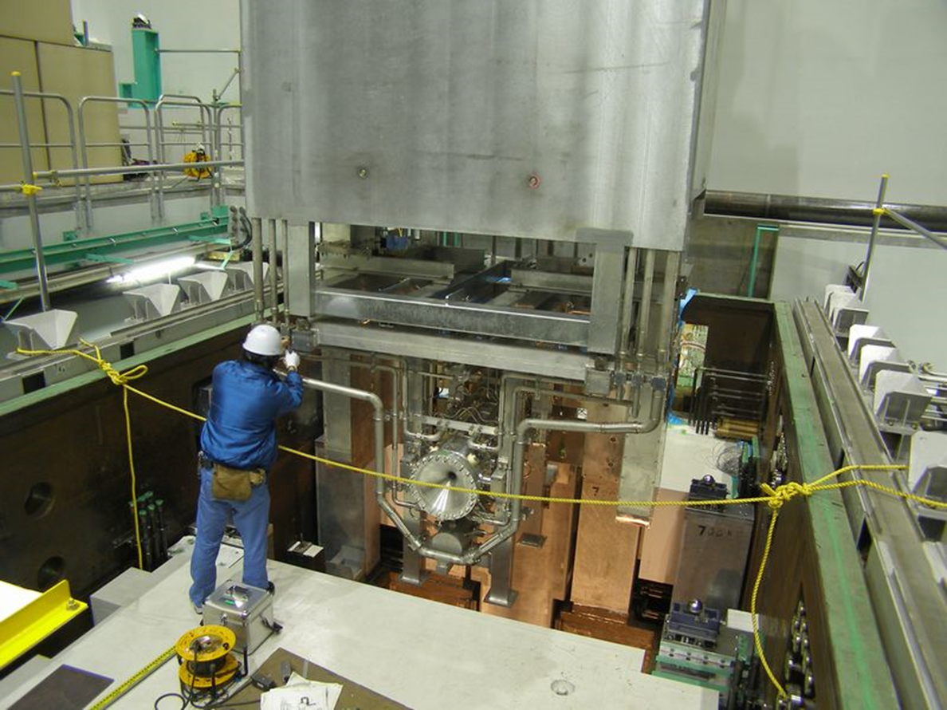
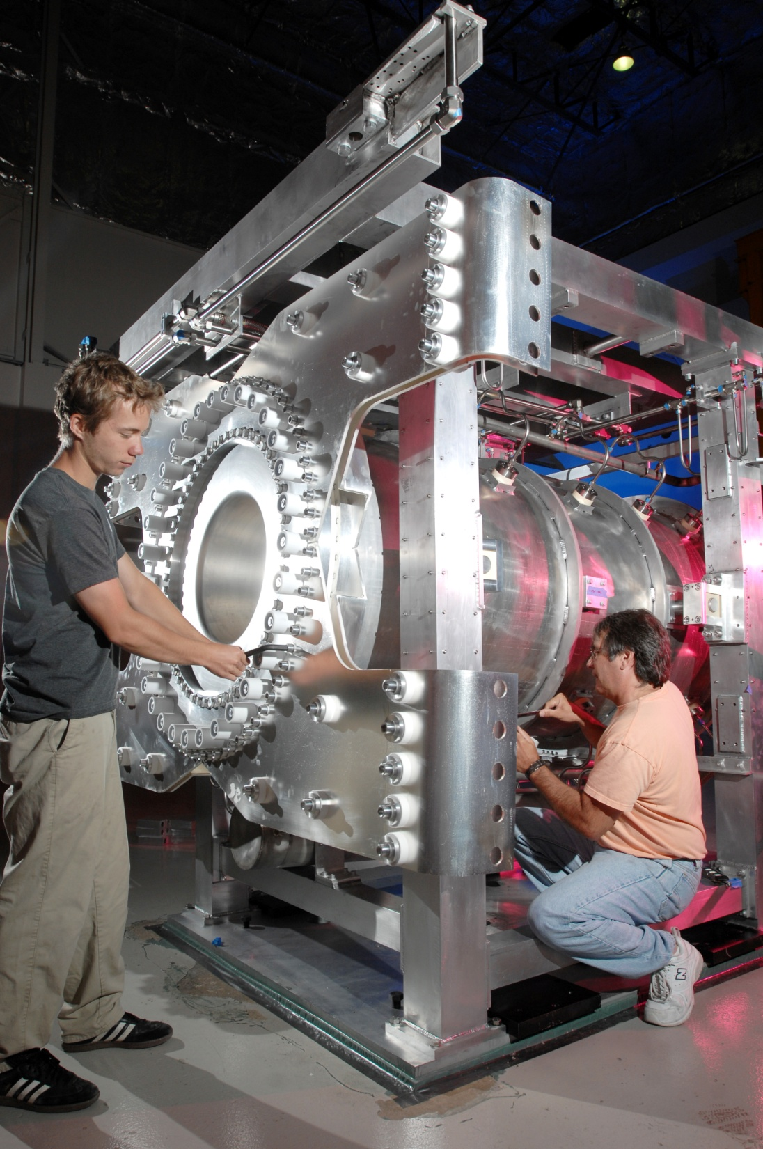
Horns
Feb. 3, 2009

Slide 16
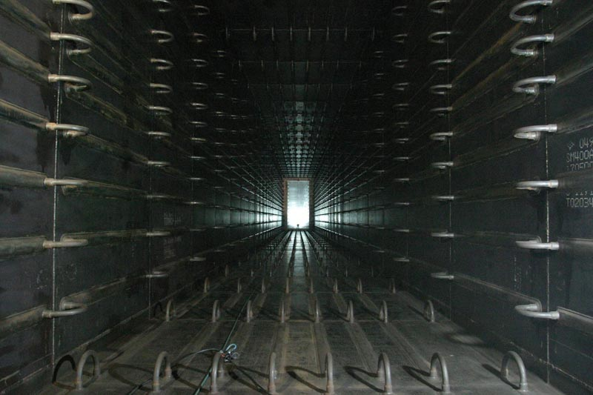
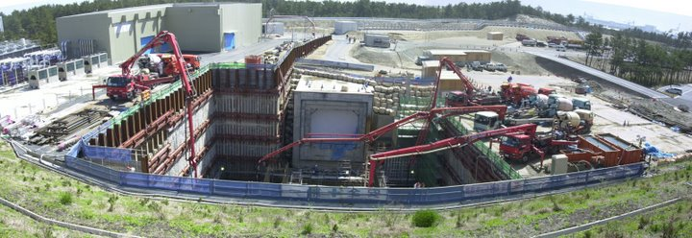
Inside the decay tunnel

Slide 17

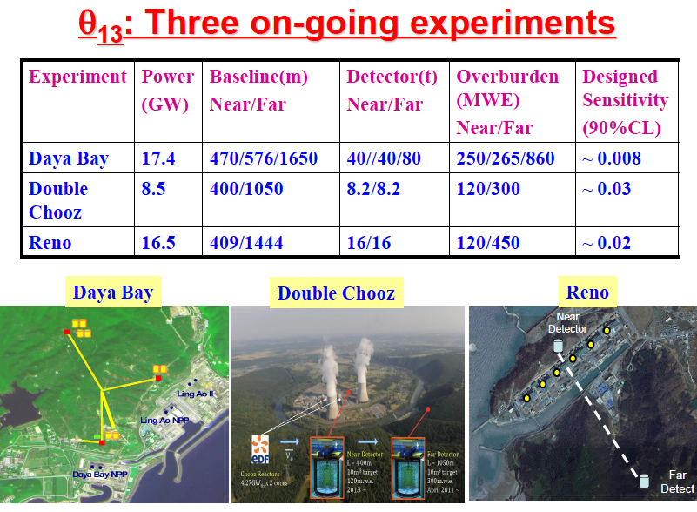
Non accelerator experiments (reactor)

Slide 18
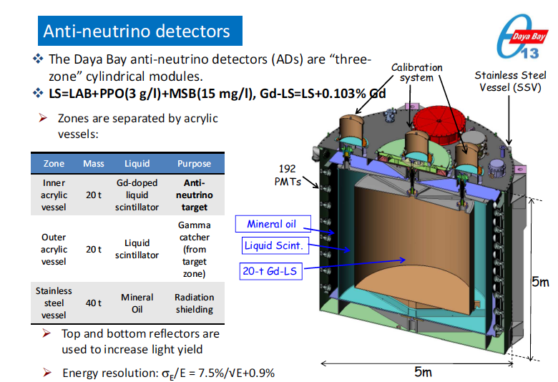
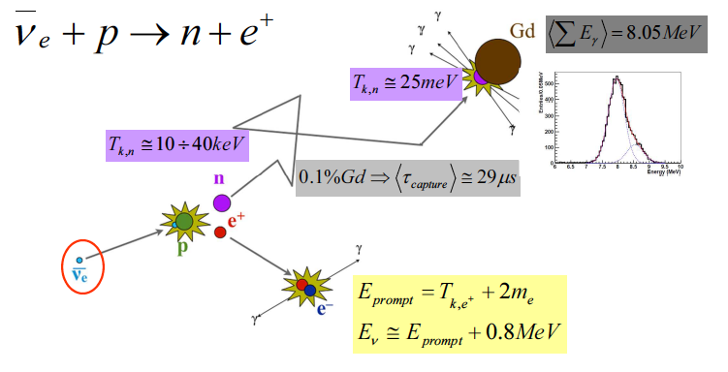

Slide 19
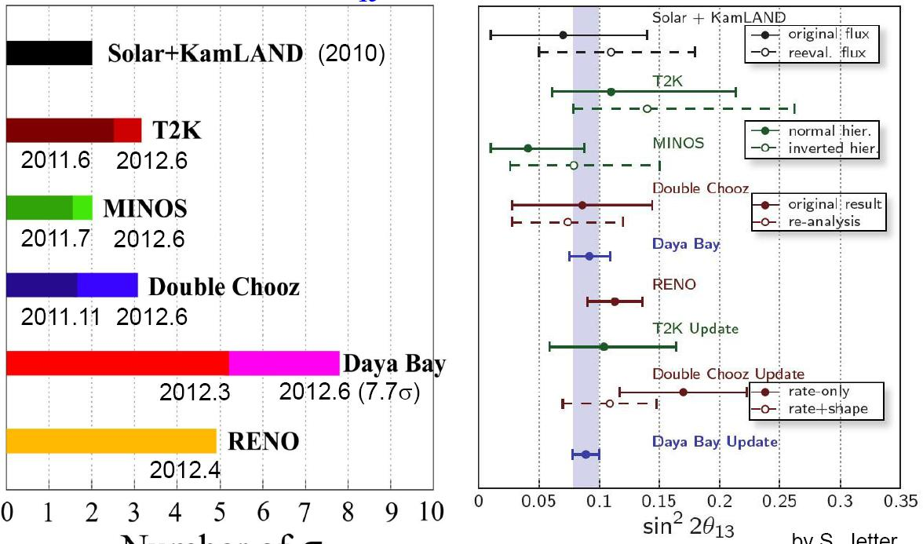
θ₁₃ = 9.1◦ ± 0.6◦ 2010 - 2012
“appearance”
Exclusion for non zero - number of σ
sin²(2θ₁₃)

Slide 20
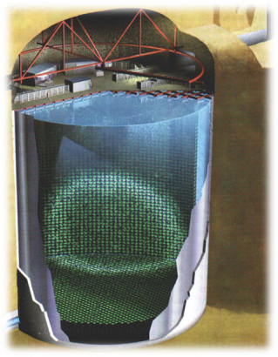
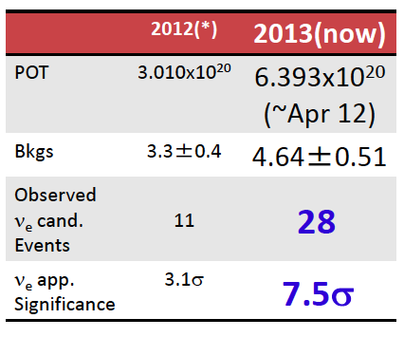
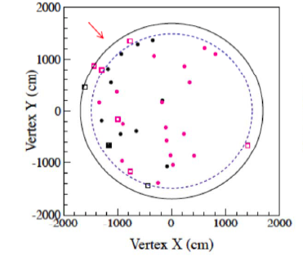

New results
ν_{e} appearance
Discovery of neutrino appearance in flavor oscillations

Slide 21


New results
ν_{e} disappearance

Slide 22


New results 2013

Slide 23

New results 2013
First indication for strong CP violation in the lepton sector ?

Slide 24

Perspectives
CP phase δ
NOVA

Slide 25

Is CP violated “strongly” in neutrino oscillation ?
Is the source of the violation due to complex phase associated with 3 generations ?
Only 3 generations for leptons ? Sterile neutrinos ?
♦ Unitary triangle and physics beyond the standard model

Slide 26

High power accelerator and huge detector needed
Asymmetry of neutrino and anti-neutrino induced by interaction in matter is large

Slide 27





Slide 28



Measurement of θ₁₃
C=cos S=sin

Slide 29




Slide 30



Merci beaucoup Joe !

