Slide 1
In-Medium Cluster Binding Energies and Mott Points in Low Density Nuclear Matter
Clusterization
in
Nuclear Matter
K. Hagel
IWNDT 2013
College Station, Texas
20-Aug-2013

Slide 2
Outline
Experimental Setup
Clusterization and observables in low density nuclear matter.
Clusterization of alpha conjugate nuclei
Summary

Slide 3
Beam Energy: 47 MeV/u
Reactions:⁴⁰Ar + ^{112,124}Sn
Cyclotron Institute, Texas A & M University

Slide 4
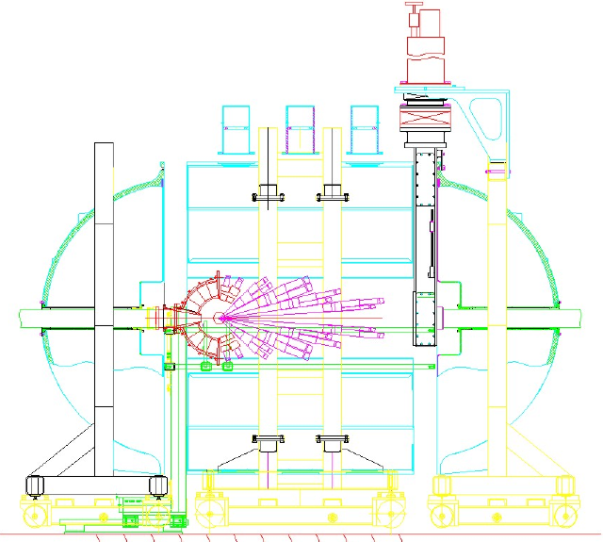
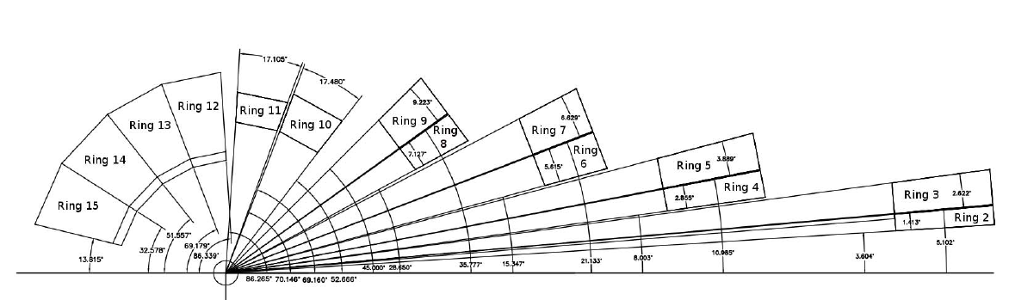
Beam Energy: 47 MeV/u
Reactions:p, ⁴⁰Ar + ^{112,124}Sn
NIMROD
14 Concentric Rings
3.6-167 degrees
Silicon Coverage
Neutron Ball
beam
S. Wuenschel et al., Nucl. Instrum. Methods. A604, 578–583 (2009).

Slide 5
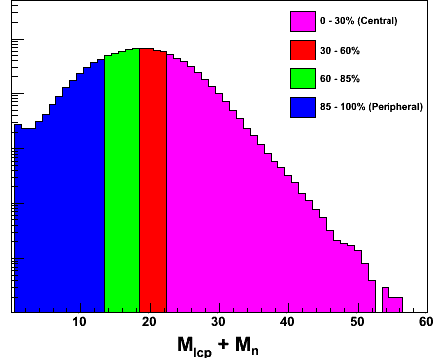
Low Density Nuclear Matter
47 MeV/u ⁴⁰Ar + ^{112,124}Sn
Use NIMROD as a violence filter
  Take 30% most violent collisions
Use spectra from 40º ring
  ~90º in center of mass
Coalescence analysis to extract densities and temperatures
  Equilibrium constants
  Mott points
  Symmetry energy

Slide 6
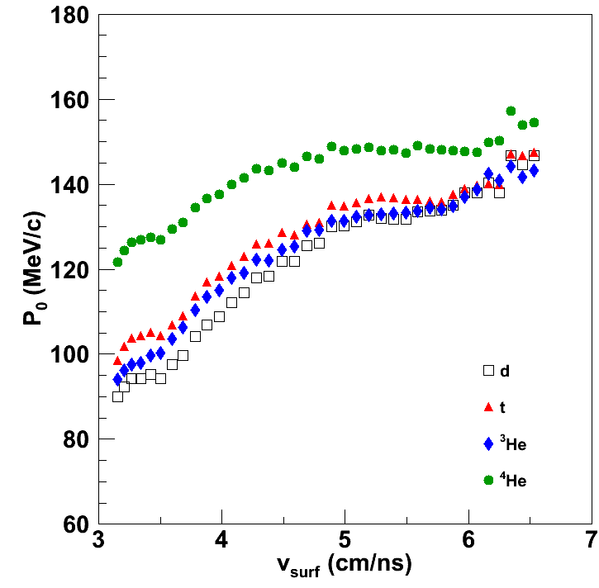
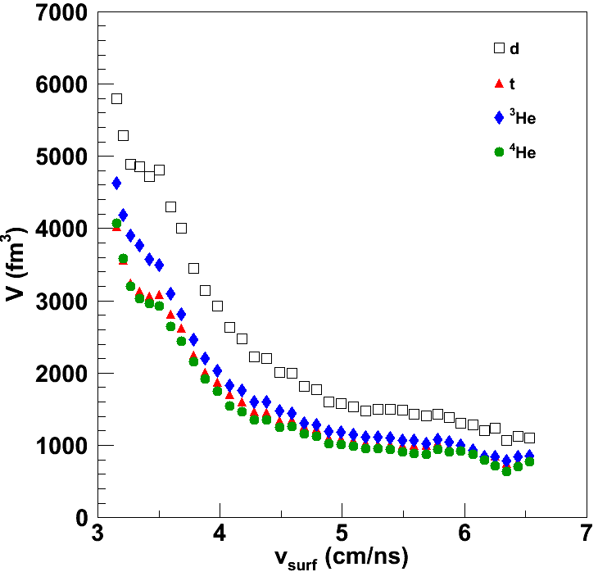
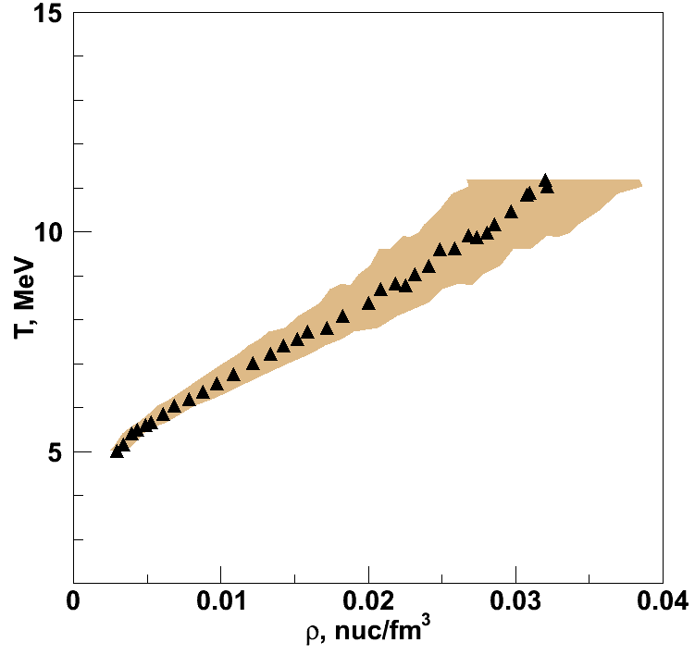
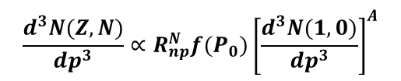
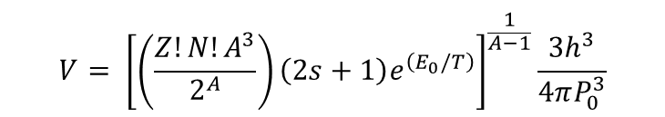


Coalescence Parameters
$$\frac{d^{3}N(Z,N)}{dp^{3}}∝R_{np}^{N}f(P_{0}){\left[\frac{d^{3}N(1,0)}{dp^{3}}\right]}^{A}$$
$$\frac{d^{3}N(Z,N,E_{A})}{dE_{A}dΩ}=R_{np}^{N}\frac{A^{−1}}{N!Z!}{\left\{\frac{\frac{4π}{3}P_{0}^{3}}{{\left[2m^{3}\left(E−E_{c}\right)\right]}^{1/2}}\right\}}^{A−1}{\left[\frac{d^{3}N(1,0,E)}{dEdΩ}\right]}^{A}$$
$$\frac{d^{3}N(Z,N)}{dp^{3}}=R_{np}^{N}\frac{A^{3}\left(2s+1\right)e^{\left(E_{0}/T\right)}}{2^{A}}{\left(\frac{h^{3}}{V}\right)}^{A−1}{\left[\frac{d^{3}N(1,0)}{dp^{3}}\right]}^{A}$$
$$V= {\left[\left(\frac{Z!N!A^{3}}{2^{A}}\right)\left(2s+1\right)e^{\left(E_{0}/T\right)}\right]}^{\frac{1}{A−1}}\frac{3h^{3}}{4πP_{0}^{3}}$$
PRC 72 (2005) 024603

Slide 7
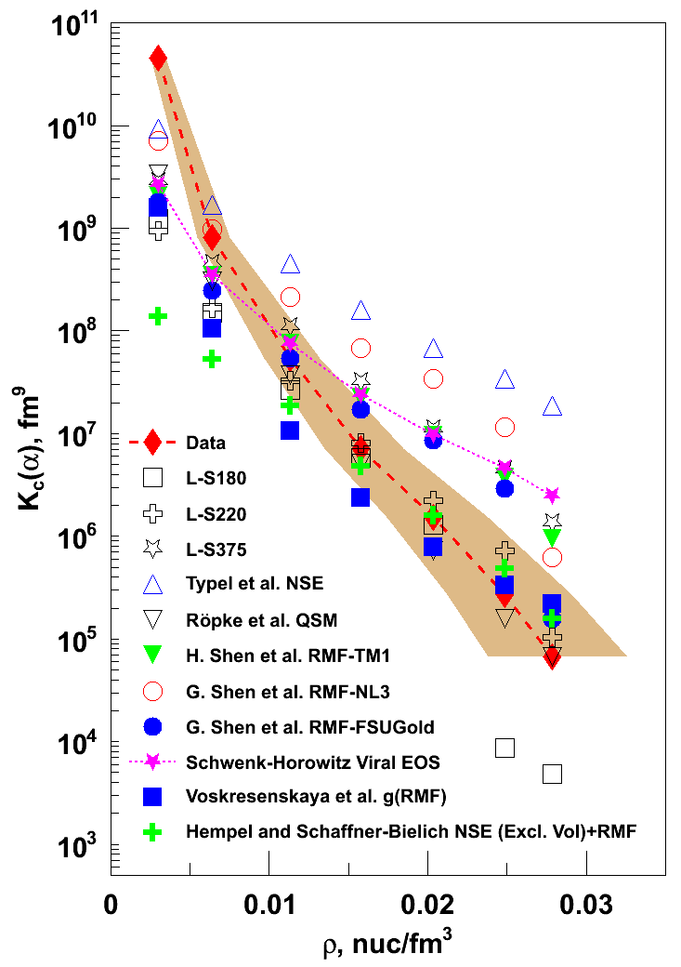
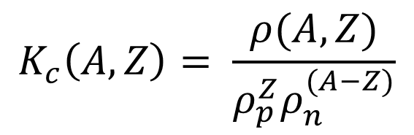
Equilibrium constants from α-particles model predictions
$$K_{c}\left(A,Z\right)= \frac{ρ(A,Z)}{ρ_{p}^{Z}ρ_{n}^{(A−Z)}}$$
Many tests of EOS are done using mass fractions and various calculations include various different competing species.
If any relevant species are not included, mass fractions are not accurate.
Equilibrium constants should be independent of proton fraction and choice of competing species.
Models converge at lowest densities, but are significantly below data
Lattimer & Swesty with K=180, 220 show best agreement with data
QSM with p-dependent in-medium binding energy shifts
PRL 108 (2012) 172701.

Slide 8
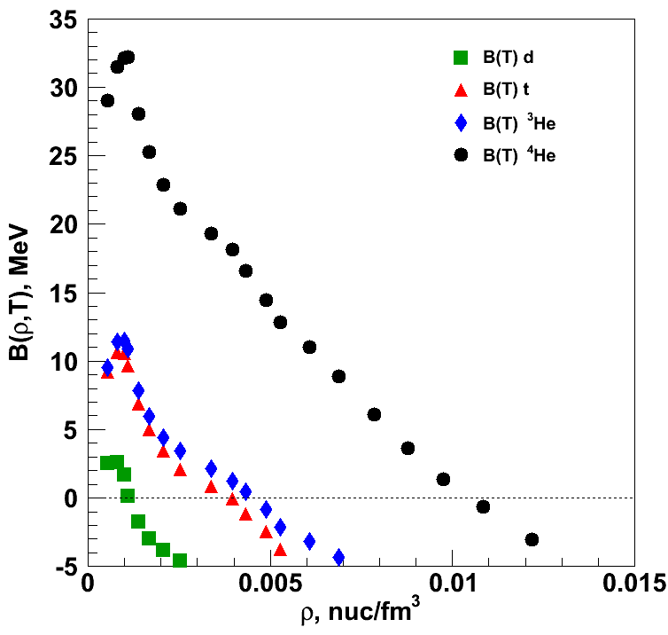
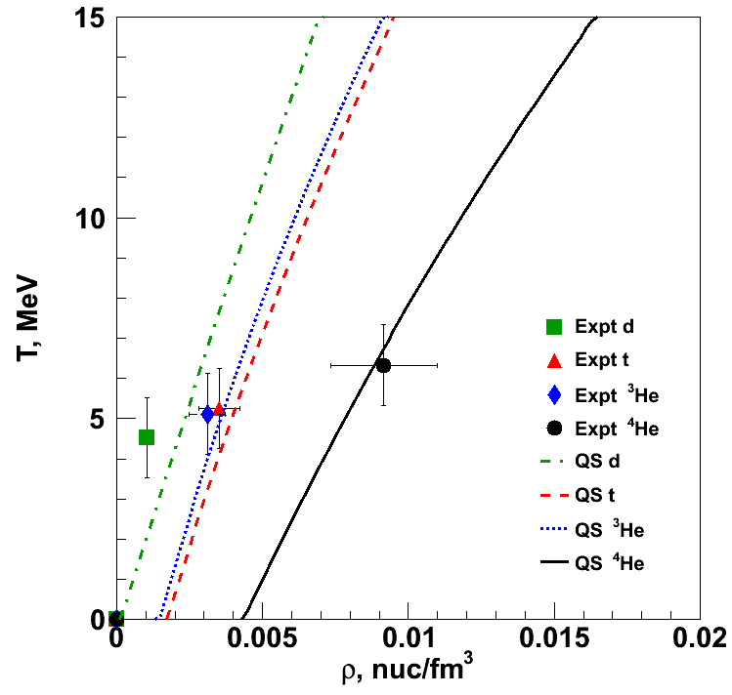

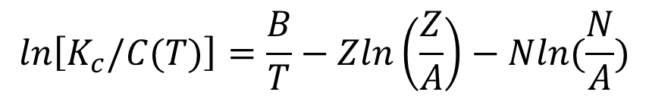
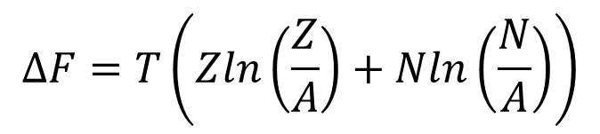
Density dependent binding energies
$$K_{c}(A,Z)=C\left(T\right)e^{\left(\frac{B(A,Z)}{T}\right)}$$
From Albergo, recall that
Invert to calculate binding energies
Entropy mixing term
$$ΔF=T\left(Zln\left(\frac{Z}{A}\right)+Nln\left(\frac{N}{A}\right)\right)$$
$$ln\left[K_{c}/C(T)\right]=\frac{B}{T}−Zln\left(\frac{Z}{A}\right)−Nln(\frac{N}{A})$$
PRL 108 (2012)
062702

Slide 9
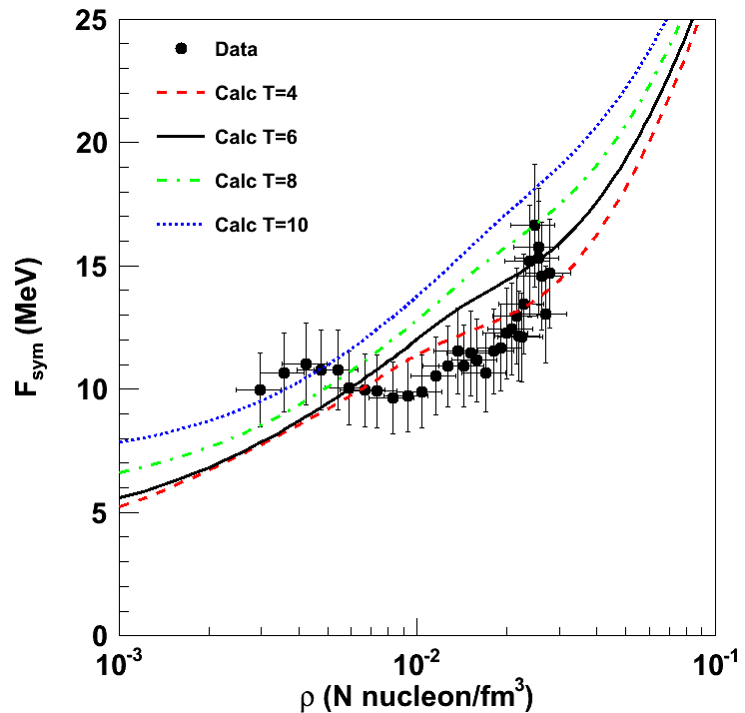
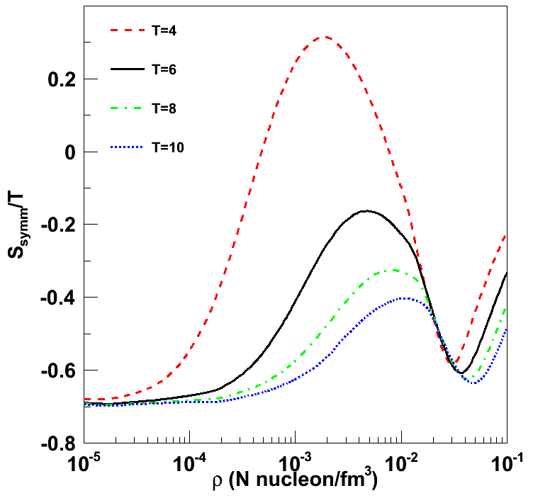
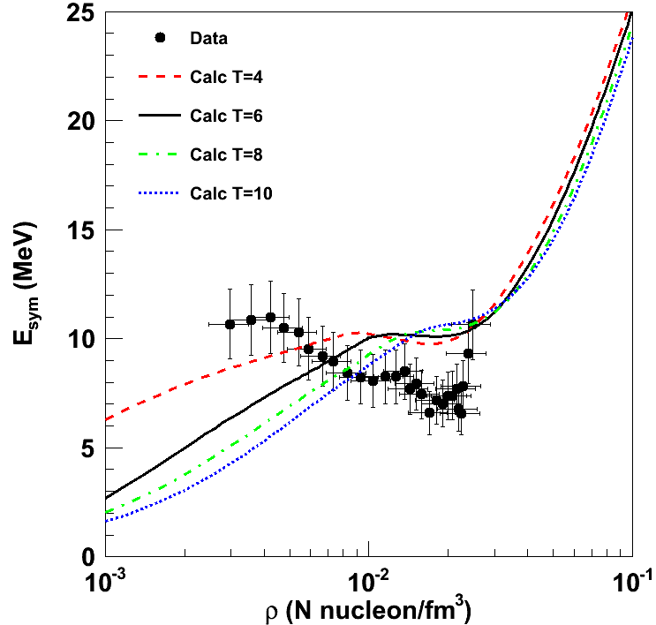
Symmetry energy
S. Typel et al., Phys. Rev. C 81, 015803 (2010).
Symmetry Free Energy
  T is changing as ρ increases
  Isotherms of QS calculation that includes in-medium modifications to cluster binding energies
Entropy calculation (QS approach)
Symmetry energy (E_{sym} = F_{sym} + T∙S_{sym})

Slide 10
Disassembly of alpha conjugate nuclei
Clusterization of low density nuclear matter in collisions of alpha conjugate nuclei
Role of clusterization in dynamics and disassembly.
Data Taken
⁴⁰Ca + ⁴⁰Ca | ²⁸Si + ⁴⁰Ca
⁴⁰Ca + ²⁸Si | ²⁸Si + ²⁸Si
⁴⁰Ca + ¹²C | ²⁸Si + ¹²C
⁴⁰Ca + ¹⁸⁰Ta | ²⁸Si + ¹⁸⁰Ta
10, 25, 35 MeV/u
Focus on 35 MeV/u ⁴⁰Ca + ⁴⁰Ca analysis for now

Slide 11
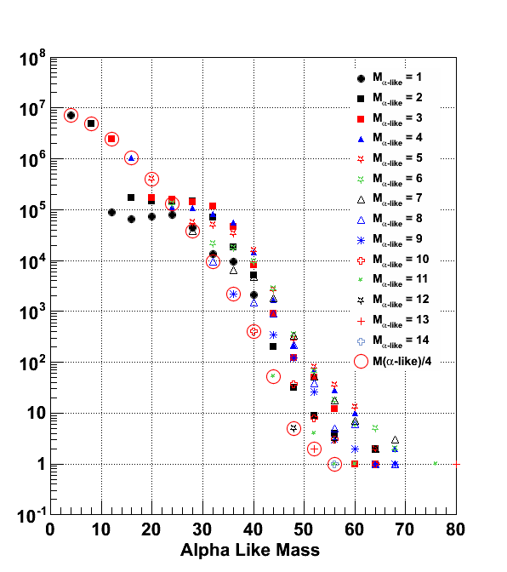
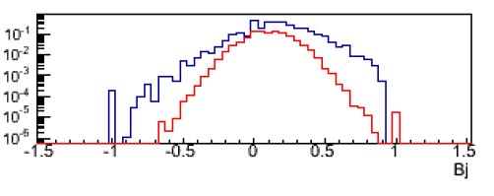
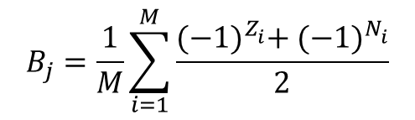
Alpha-like multiplicities
odd-odd
odd-even
even-even
Expt
AMD
B_{j}
$$B_{j}=\frac{1}{M}\sum_{i=1}^{M}{\frac{{(−1)}^{Z_{i}^{}}+ {(−1)}^{N_{i}^{}}}{2}}$$
Large number of events with significant alpha conjugate mass
Larger contribution of alpha conjugate masses than AMD would predict.

Slide 12
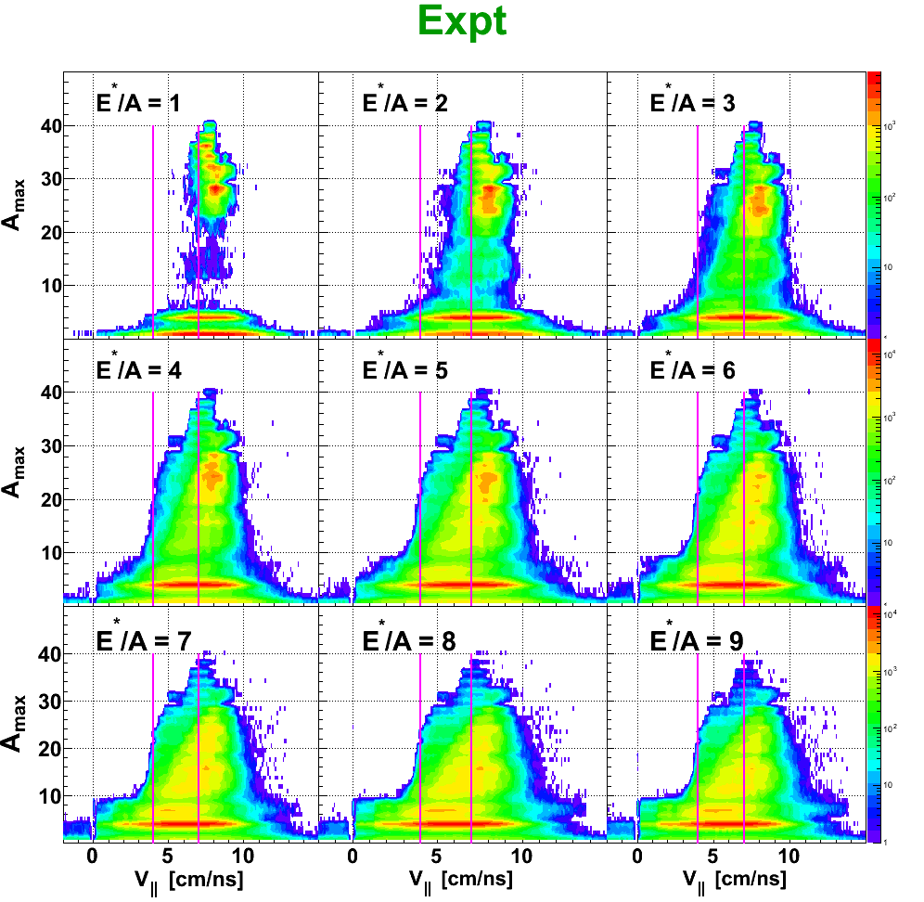
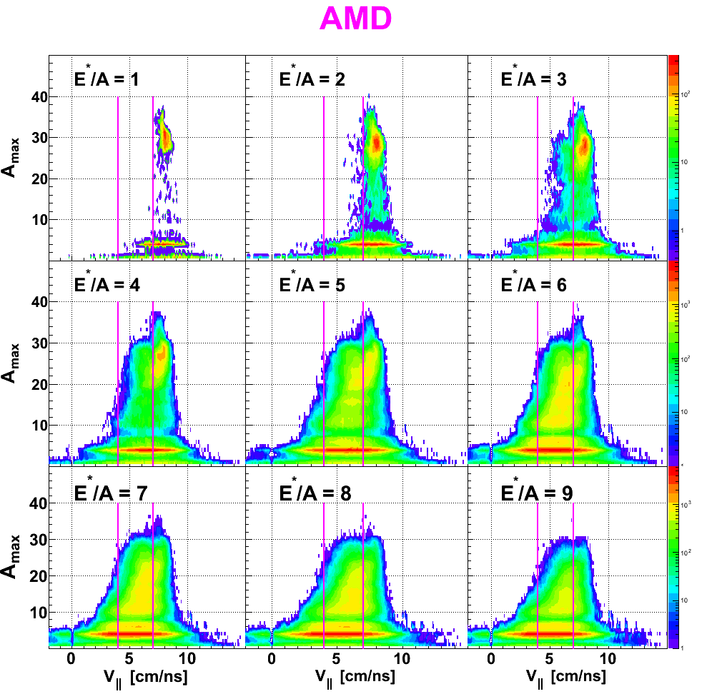
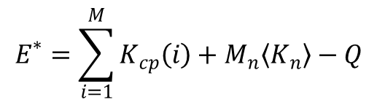
Vparallel vs Amax
$$E^{∗}=\sum_{i=1}^{M}{K_{cp}\left(i\right)+M_{n}〈K_{n}〉−Q}$$
Observe mostly PLF near beam velocity for low E*
More neck (4-7 cm/ns) emission of α-like fragments with increasing E*

Slide 13
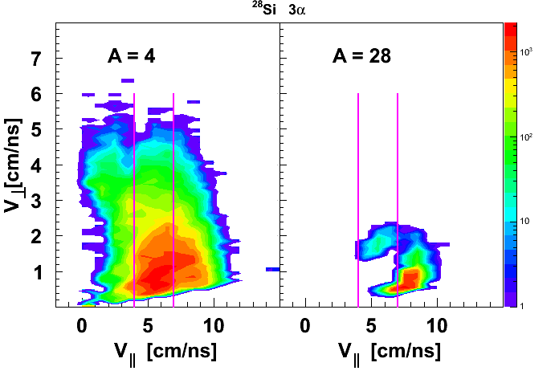
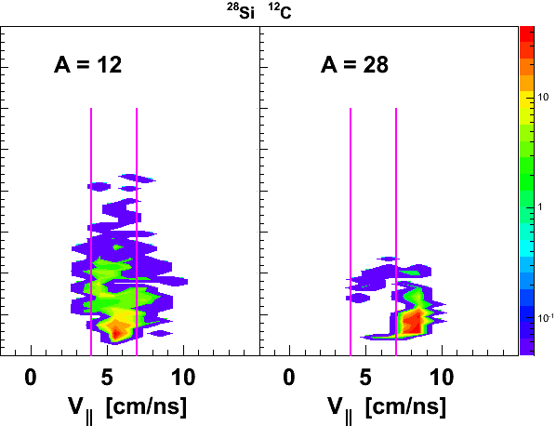
²⁸Si is near beam velocity
Partners (alphas and ¹²C) result from neck emission

Slide 14
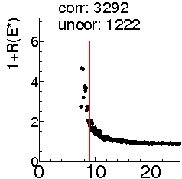
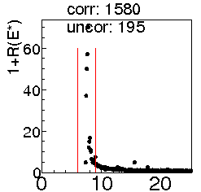
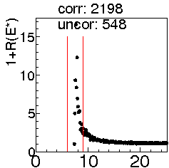
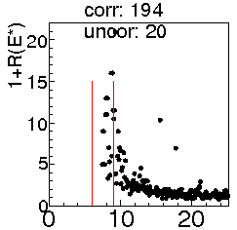
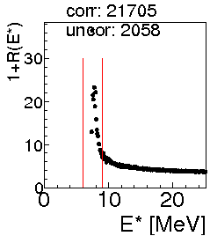
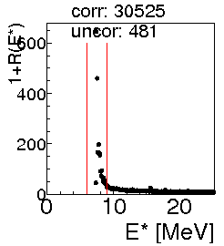

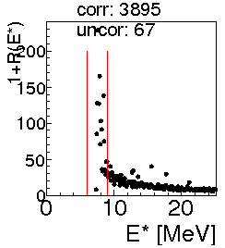

Correlation Functions
3α events
Neck
PLF
Expt
AMD
Expt
AMD
Nα events
1+R($x$) = $\frac{Y_{corr}(x)}{Y_{uncorr}(x)}$
Correlation functions exhibit peak near Hoyle state of 7.64 MeV.

Slide 15
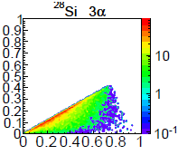
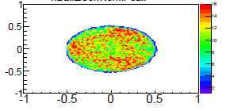
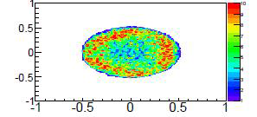
Effects of neck geometry and/or proximity effects
Neck
PLF
Rod-like
Coplanarity
Sphericity
Sphericity analysis shows significant rod like emission patterns
3α Energy Dalitz plot shows difference depending on whether emission from neck or PLF.

Slide 16
Summary
Clusterization in low density nuclear matter
  In medium effects important to describe data
  Equilibrium constants
  Density dependence of Mott points
  Symmetry Free energy -> Symmetry Energy
Clusterization of alpha conjugate nuclei
  Large production of α-like nuclei in Ca + Ca
  Neck emission of alphas important
  Proximity and geometry effects

Slide 17
Outlook and near future
Low density nuclear matter
  We have a set of 35 MeV/u ⁴⁰Ca+¹⁸¹Ta and ²⁸Si+¹⁸¹Ta
Disassembly of alpha conjugate nuclei
  Analysis on ⁴⁰Ca+⁴⁰Ca continues
  ²⁸Si+²⁸Si is calibrated and ready to analyze
  Several other systems nearly calibrated

Slide 18
Collaborators
J. B. Natowitz, K. Schmidt, K. Hagel, R. Wada,
S. Wuenschel, E. J. Kim, M. Barbui, G. Giuliani, L. Qin, S. Shlomo, A. Bonasera, G. Röpke, S. Typel, Z. Chen, M. Huang, J. Wang, H. Zheng, S. Kowalski, M. R. D. Rodrigues,
D. Fabris, M. Lunardon, S. Moretto, G. Nebbia, S. Pesente, V. Rizzi, G. Viesti, M. Cinausero, G. Prete, T. Keutgen,
Y. El Masri, Z. Majka, and Y. G. Ma

