Slide 1
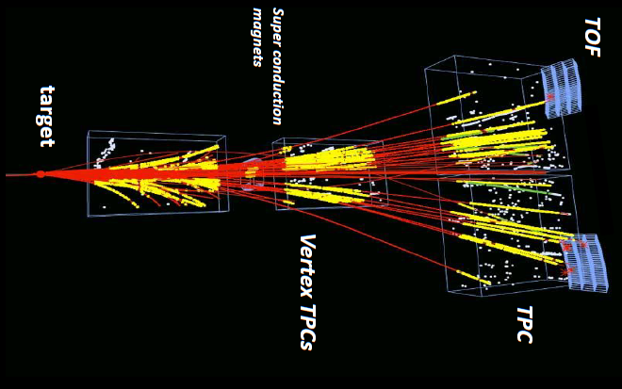
NA61/SHINE experiment at the CERN SPS
Seweryn Kowalski
for NA61/SHINE Collaboration

Slide 2
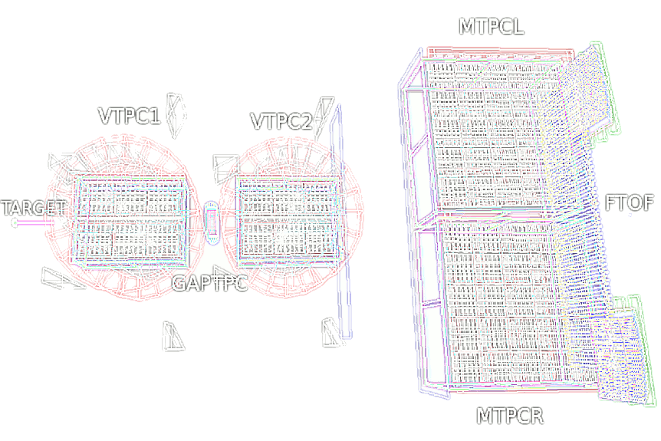
NA61/SHINE – few facts
Located at the CERN SPS (North Area, H2 beam line)
Fixed target experiment on primary (ions) and secondary (ions, hadrons) beams
Proposal November 2006, pilot run 2007, first physics run 2009
NA61 is the second largest non-LHC experiment at CERN
TPC read-out channels (181k) = 40% of ALICE TPC
139 physicists from 28 institutes and 15 countries
Rich physics program covering:
heavy ion physics,
hadron-production measurements for neutrino experiments,
hadron-production measurements for cosmic ray experiments.

Slide 3
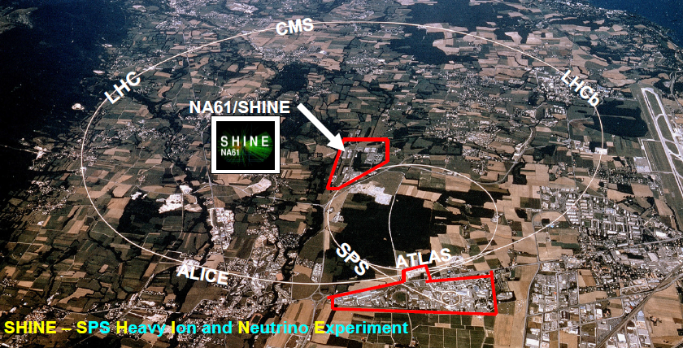
NA61 SHINE

Slide 4
The Device

Slide 5
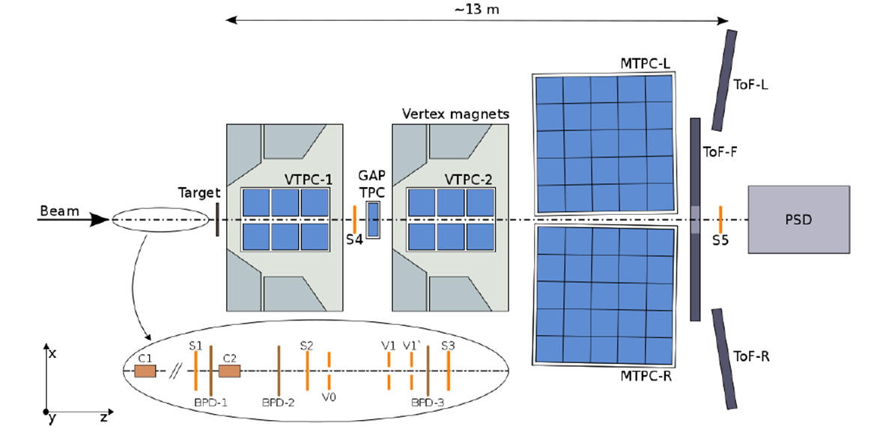
NA61/SHINE
Upgrades completed for the 2011
Projectile Spectator Detector (PSD),
Z-detectors
A-detector
Low Momentum Particle Detector (LMPD)
He beam pipes
2007: Forward ToF wall constructed (ToF acceptance extend to p ≈ 1 GeV/c)
2008: TPC read-out (increase of event rate by factor of 10 in comparison to NA49)

Slide 6
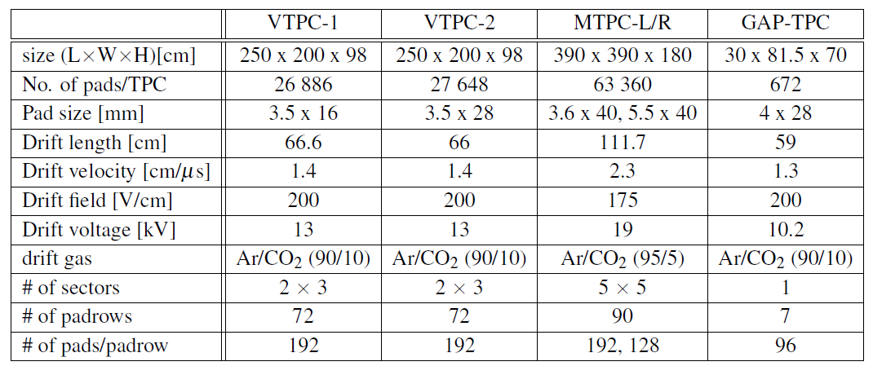
TPC
The main tracking devices for NA61/SHINE,
Five TPC’s (four large volume, one small volume),
Two (VTPC1, VTPC2) in magentic field,
Two (MTPC-L, MTPC-R) are positioned down- stream of the magnets symmetrically to the beam-line
One small TPC (GAP-TPC) is mounted between the two VTPCs, centered on the beam-line for measuring particles with the smallest production angles
These detectors allow reconstruction of over 1000 tracks in a single Pb+Pb interaction

Slide 7
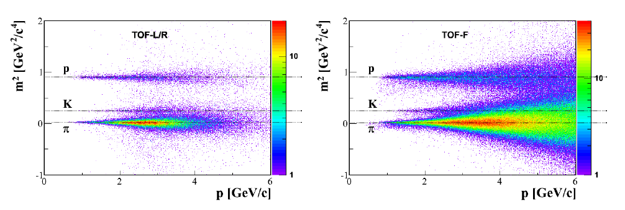
TOF
ToF-L(eft) and ToF-R(ight),
4.4 m² total surface are placed behind MTPCs
flight path of particles produced in the target of about 14 meters.
891 individual scintillation detectors with rectangular scintillators, each having single photo-multiplier tube glued on.
time resolution (σ=60ps for Pb+Pb, σ=120ps for p+p)
ToF-F(orward)
particle identification in a phase space region which is not covered by the ToF-L/R
80 scintillator (120x10x2.5 cm³) bars vertically oriented
total active area of 720x120 cm²
Time resolution σ=110ps
Notes:
NA49 results where, due to high multiplicity, additional event-by-event corrections were possible) while in proton-proton collisions standard deviation is around 120 ps. This value of the to f resolution includes all contributions to the to f measurement, i.e. the resolution of start time measured by the S1 counter, particle path length and momentum measured by the TPCs and finally the stop time measured by the ToF-L/R system.

Slide 8
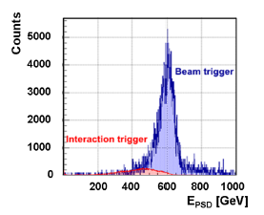
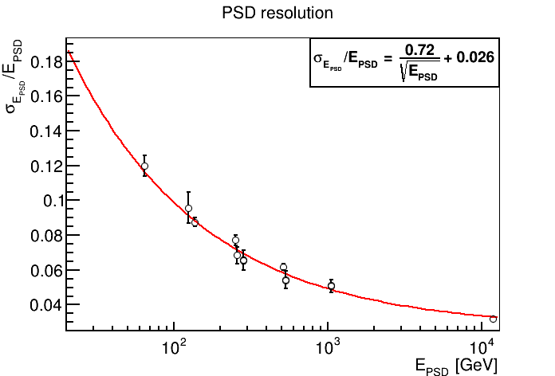
Projectile Spectator Detector
Measurement of the energy of projectile spectators:
trigger level centrality selection
event-by-event fluctuations
reconstruction of the reaction plane
Features:
High energy resolution (resolution of 1 nucleon in the studied energy range)
High granularity
60 Lead/Scintillator sandwich
Modular design – transverse uniformity of resolution, flexible geometry, simplicity.
Notes:
The PSD energy distributions for the secondary ion beam at 75A GeV/c (left) with and without selection of the 7Be ions by the Z-detector. Spectra are shown for the beam trigger (blue) and for the interaction trigger (red)i events.

Slide 9
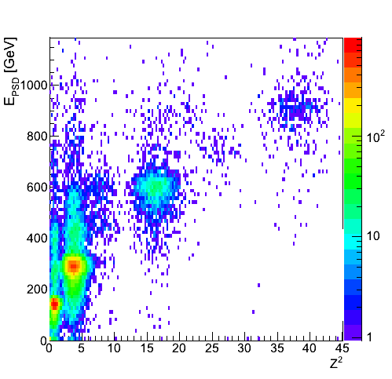
Secondary Beryllium beam
Fragmentation target length optimized to maximize the needed fragment production
Double magnetic spectrometer separate fragments according to the selected magnetic rigidity
Degrader, Cu plate where ions lose energy allows to reach required beam purity
⁷Be
Correlation of PSD energy versus Z-det
Secondary beam
http://cerncourier.com/cws/article/cern/49354

Slide 10
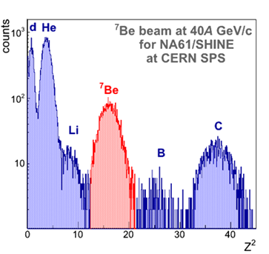
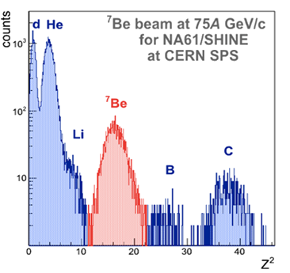
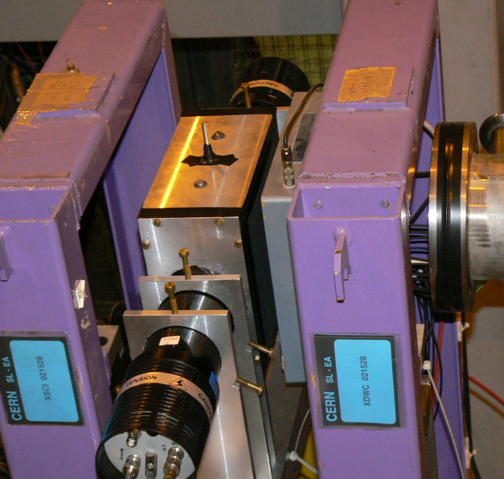
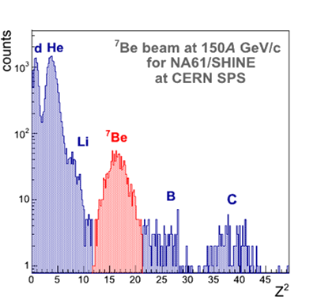
Z - detector
Measure charge of ions in secondary ion beams
The Quartz Detector (QD) with a quartz (GE214P) plate 160x40x2:5[mm] as the radiator is equipped with two photo- multipliers (X2020Q) attached to both sides of the quartz plate
A large refraction index of the quartz radiator of about 1.458
Very low Cherenkov threshold momentum on the level of 0.88 GeV/c per nucleon.
The measured width to mean value ratio for ⁴He peak was on the level of 18-19 %

Slide 11
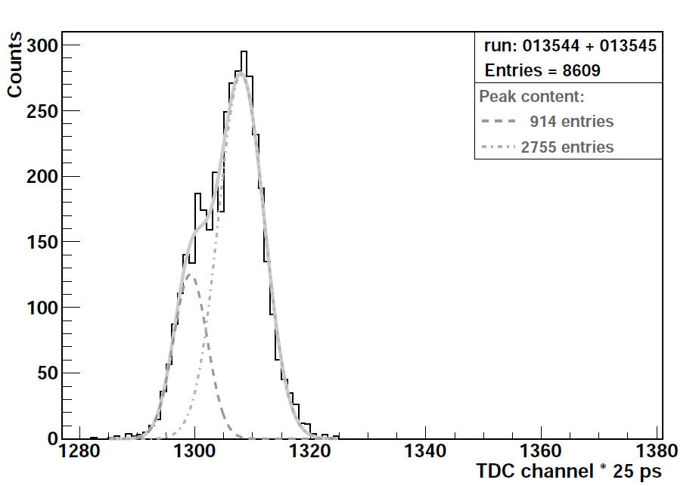
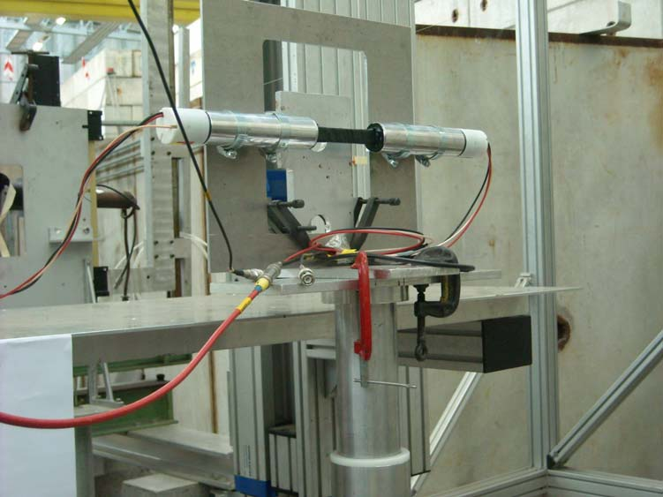
A - detector
Measures mass (TOF, 140 [m]) of ions in secondary ion beams
Plastic scintillator bar BC-408 150 x 5 x 15 [mm] with light readout from opposite sides of scintillator by two fast PMTs - EMI 9133
The time resolution of about 80 [psec] has been obtained for this A-detector during the test with pion beam
¹¹C
¹²C
σ(tof) ≅ 100 ps

Slide 12
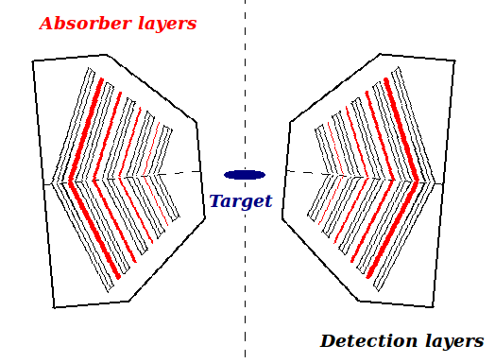
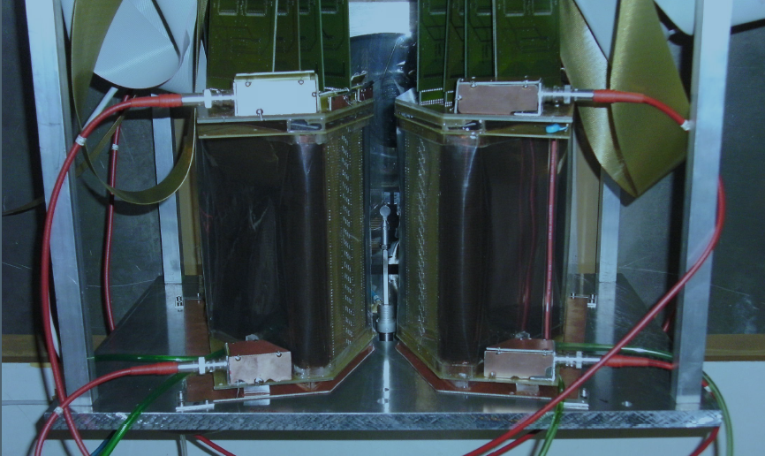
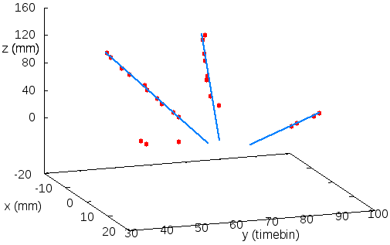
Low Momentum Particle Detector
Measures low momentum protons (“target spectators”)
Two small size TPCs with 4 absorber and 5 detection layers each

Slide 13
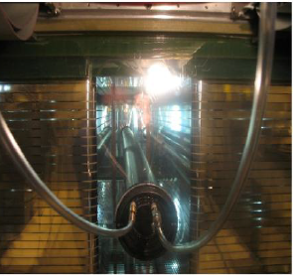
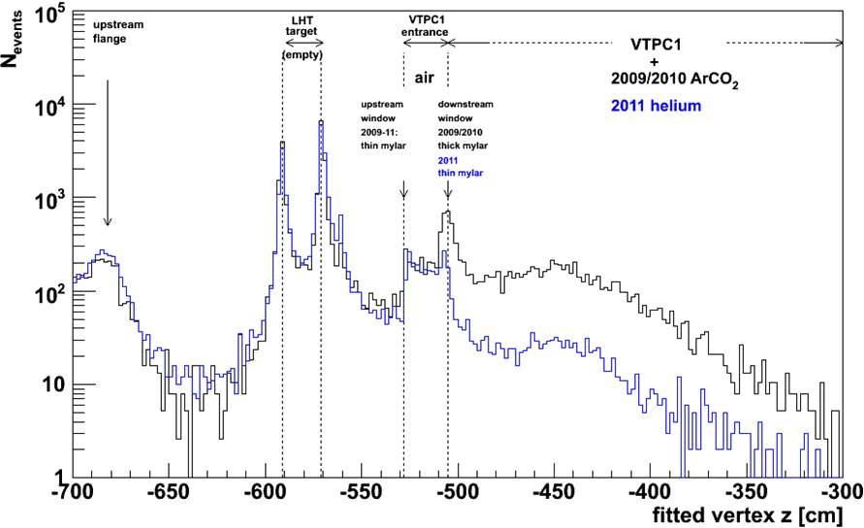
He beam pipes
Reduces number of δ-electrons and beam/spectator interactions in VTPC
double wall He beam pipes placed inside both Vertex TPCs
significant background reduction
Longitudinal position of
of the reconstructed
interaction vertex
(p+p 30 GeV)
w/o He beam pipe
w/ He bem pipe

Slide 14
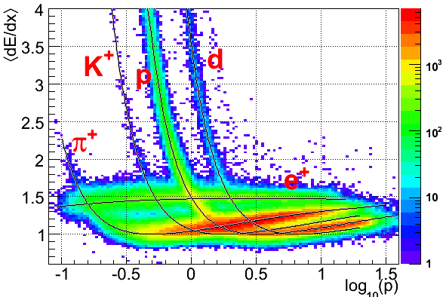
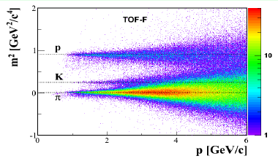
Device performance
Large acceptance spectrometer::
Acceptance » 50%
Extended ToF acceptance at low momenta (» 1 GeV/c)
σ(FTOF) ~ 120ps
σ(TOF L/R) ~ 60ps
High momentum resolution σ(p)/p² ~10⁻⁴ (GeV/c)⁻¹ (at full B=9 T∙m)
Good particle identification σ(dE/dx)/ <dE/dx> ~ 0.04
High detector efficiency > 95%
Event rate: 70 events/sec

Slide 15
Software
The ''old'' software upgrades
The Shine software development
Port the legacy multi-language, multi-process reconstruction chain to a single process C++ code, with significant reuse of the working parts of the legacy chain
United language and data format:
United programming language,: C++, ROOT-based, event data model
New design:
The new software should use the framework ideology, in particular the skeleton of Offline Software Framework of the Pierre Auger Observatory
Integration of legacy software
New offline algorithms:
The software virtualization
Data preservation:
Preserving data and software is not enough
Virtualization may preserve operating environment
Production reconstruction
On-demand virtual clusters
Web interface for bookkeeping

Slide 16
NA61/SHINE Physics Program

Slide 17
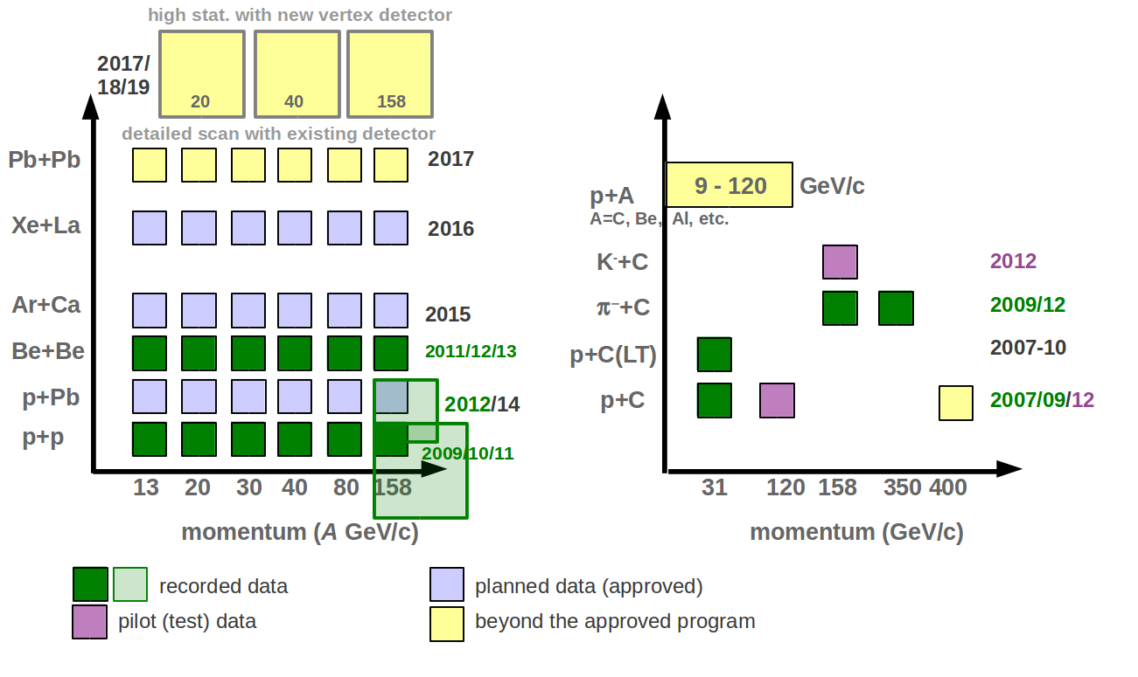
Status of the NA61 data taking
Status of the NA61 data taking
within the heavy ion program
Status of the NA61 data taking
within the neutrino and CR programs

Slide 18
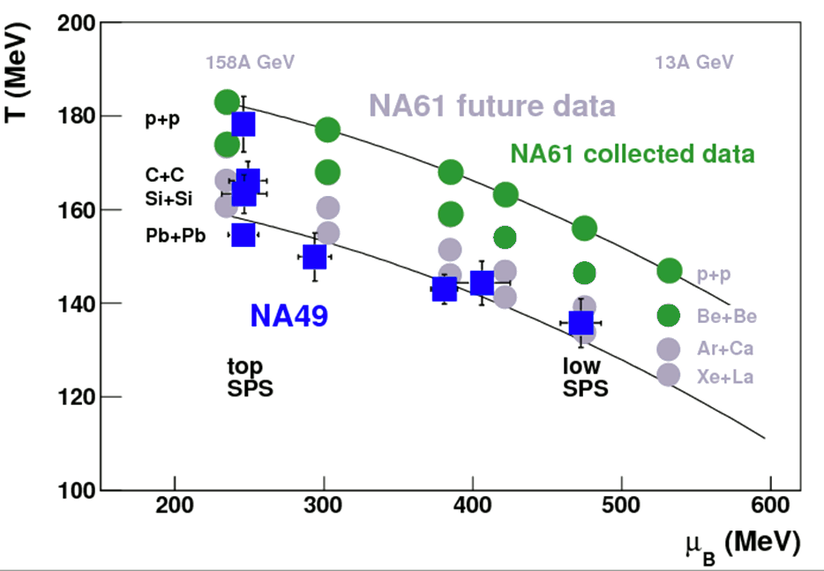
Ion program
The most interesting region of the phase diagram is accessible at the SPS
NA49 evidence of deconfinement near 30A GeV
C. Alt et al., PRC77,024903 (2008)
Critical point of strongly interacting matter should be located in the SPS energy range
Example of the theoretical calculation:
(T,μ_{B})=(162 ± 2,360 ± 40) MeV Fodor and Katz JHEP 404 050 (2004)
μ_{B}=360 MeV E≈50A GeV Beccatini, Manninen, Gazdzicki PRC 73 044905 (2006)
Comprehensive scan in the whole SPS energy range (13A-158A GeV) with light and intermediate mass nuclei
Search for the Critical Point
Search for a maximum of CP signatures: fluctuations of N, average p_{T} , etc., intermittency, when system freezes out close to CP
Study of the properties of the Onset of Deconfinement
Search for the onset of the horn/kink/step in collisions of light nuclei; additional analysis of fluctuations and correlations (azimuthal, particle ratios, etc.)

Slide 19
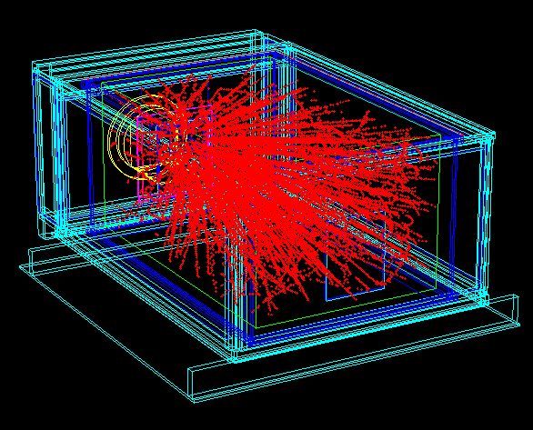
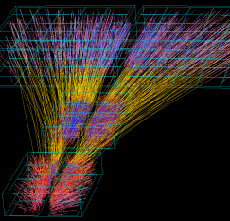
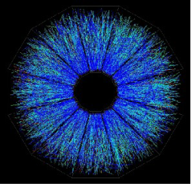
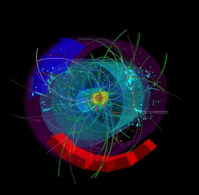
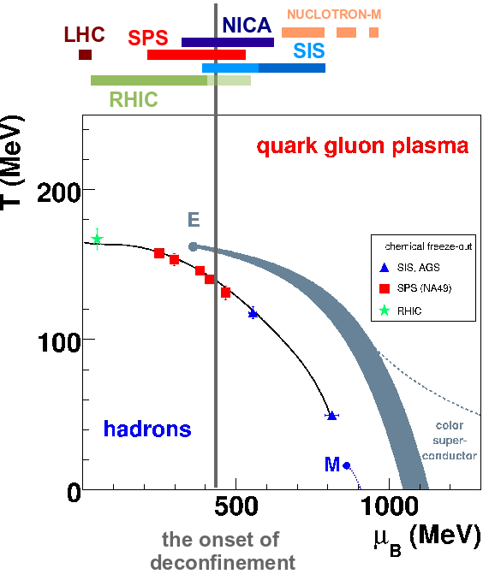
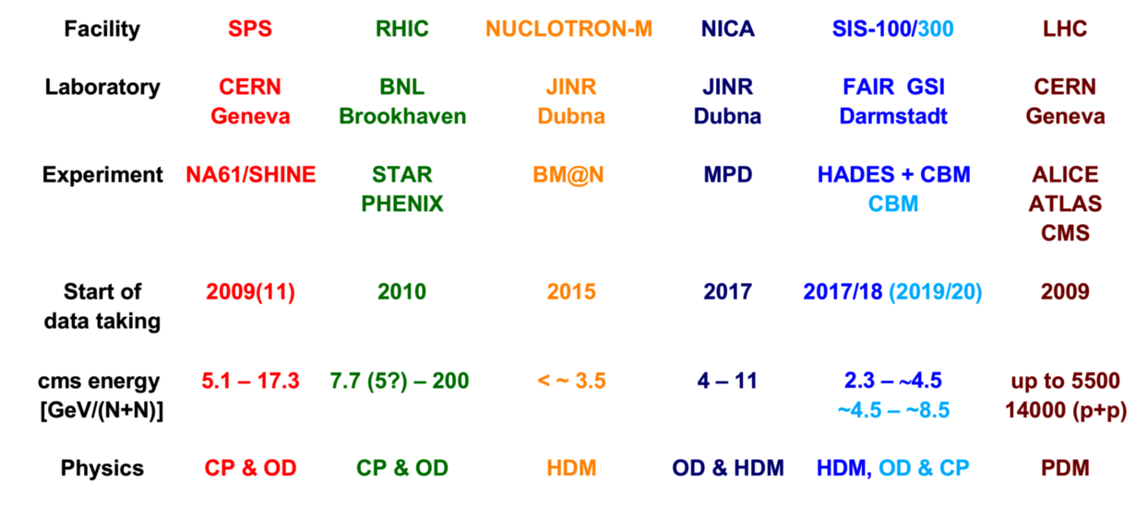
Scan of the phase diagram world status
Observation of the phase transition
BNL AGS CERN SPS BNL RHIC CERN LHC
Notes:
CP – critical point
OD – onset of deconfinement, mixed phase, 1st order phase transition
HDM – hadrons in dense matter
PDM – properties of deconfined matter

Slide 20
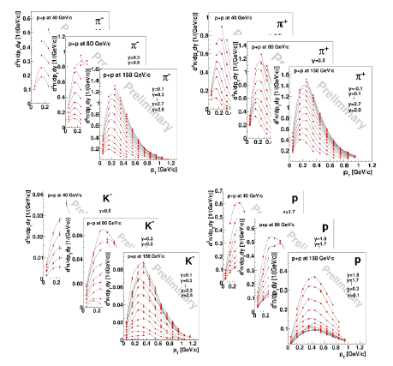
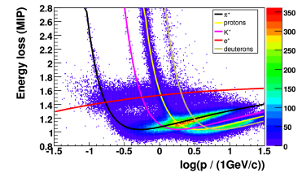
Spectra p+p interactions
h- analysis – majority of negatively charged particles are p- mesons
dE/dx based on the energy loss information in the TPC
π⁻ (from h⁻) π⁺ (from dE/dx) K⁻ (from dE/dx) p (from dE/dx)
Notes:
method – majority of negatively charged particles are p- mesons. Contribution of other particles is subtracted using VENUS and EPOS models.
The results are corrected for particles from weak decays (feed-down) and the detector effects using simulations. Out of target interactions are subtracted using events recorded with empty liquid hydrogen target.

Slide 21
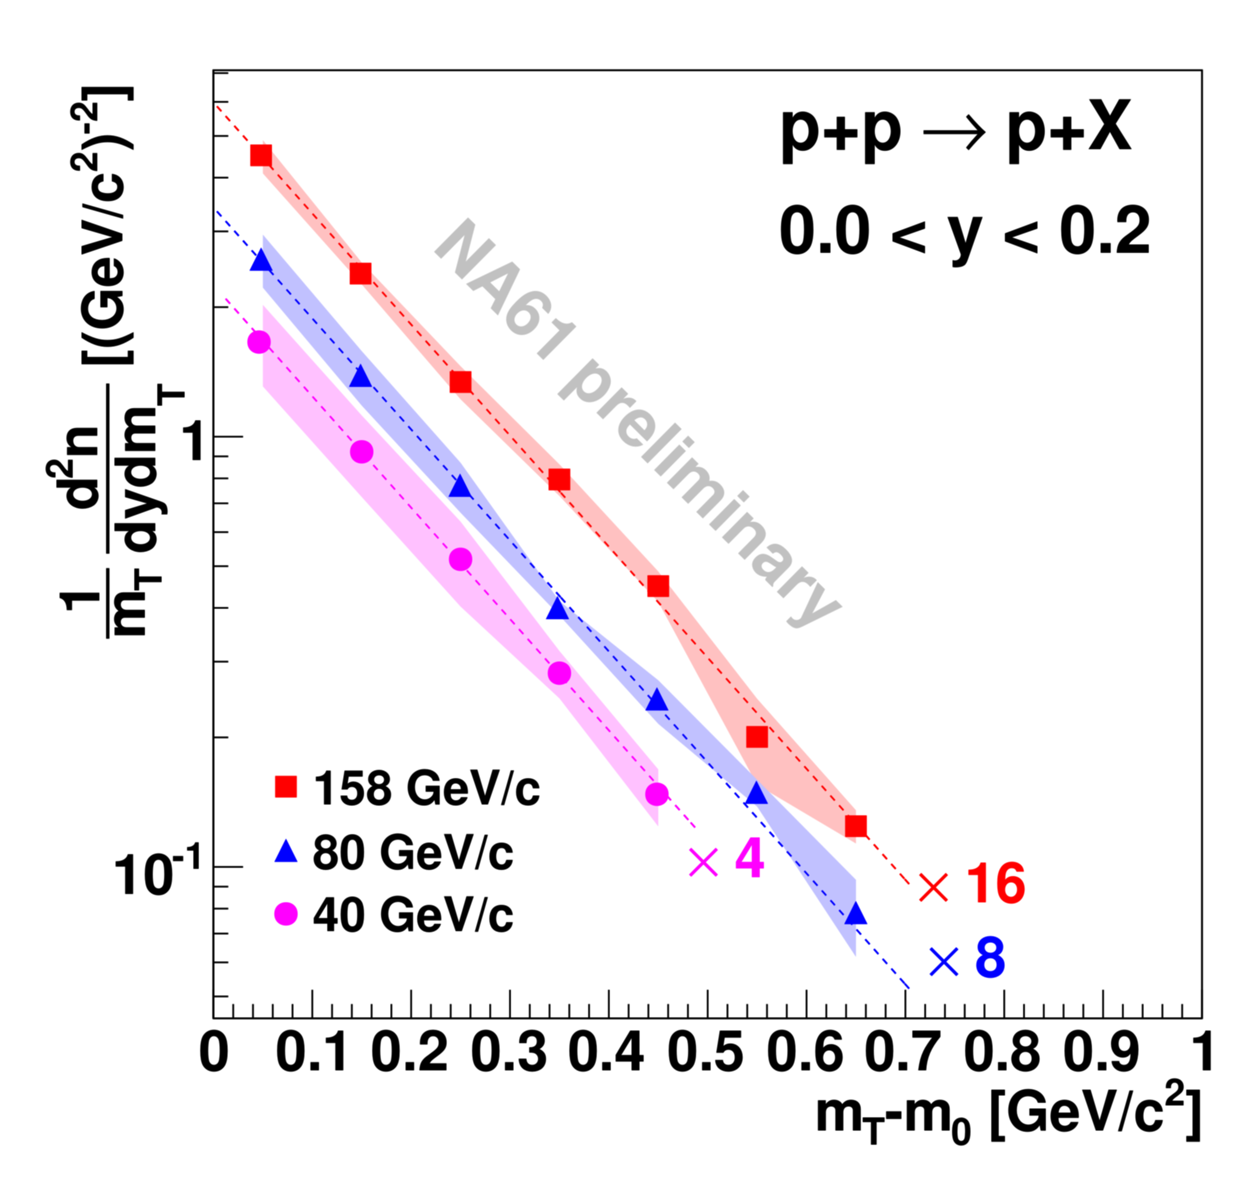
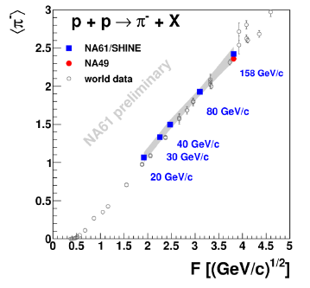
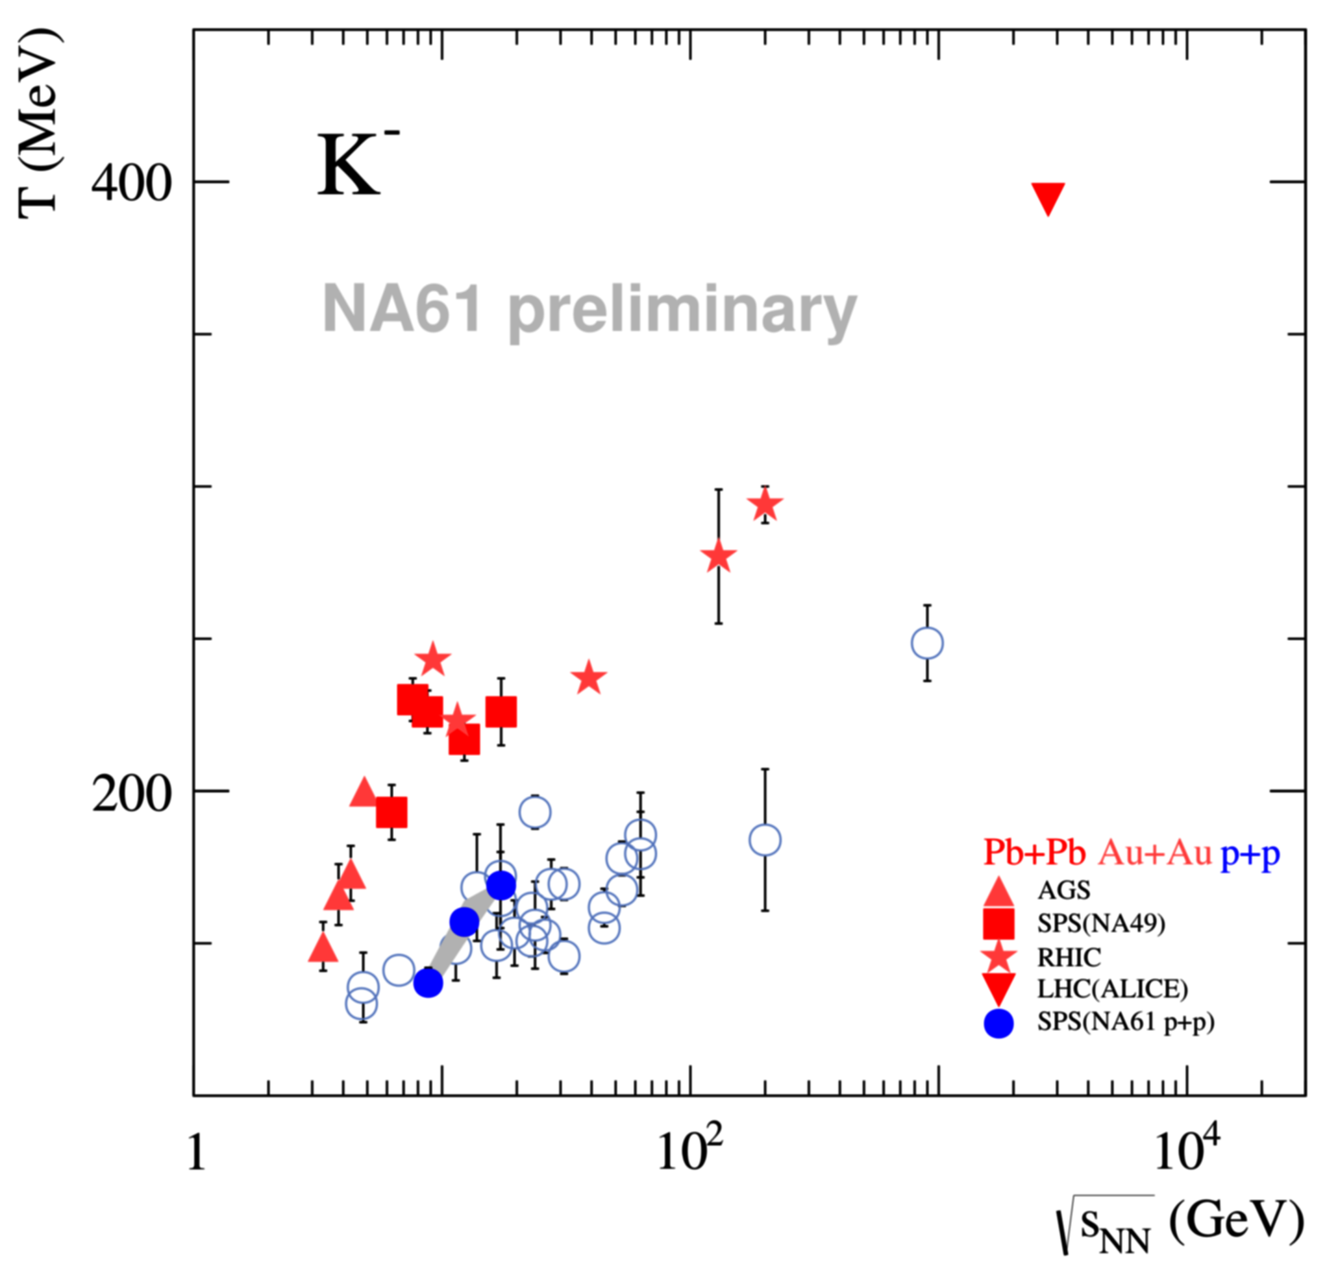
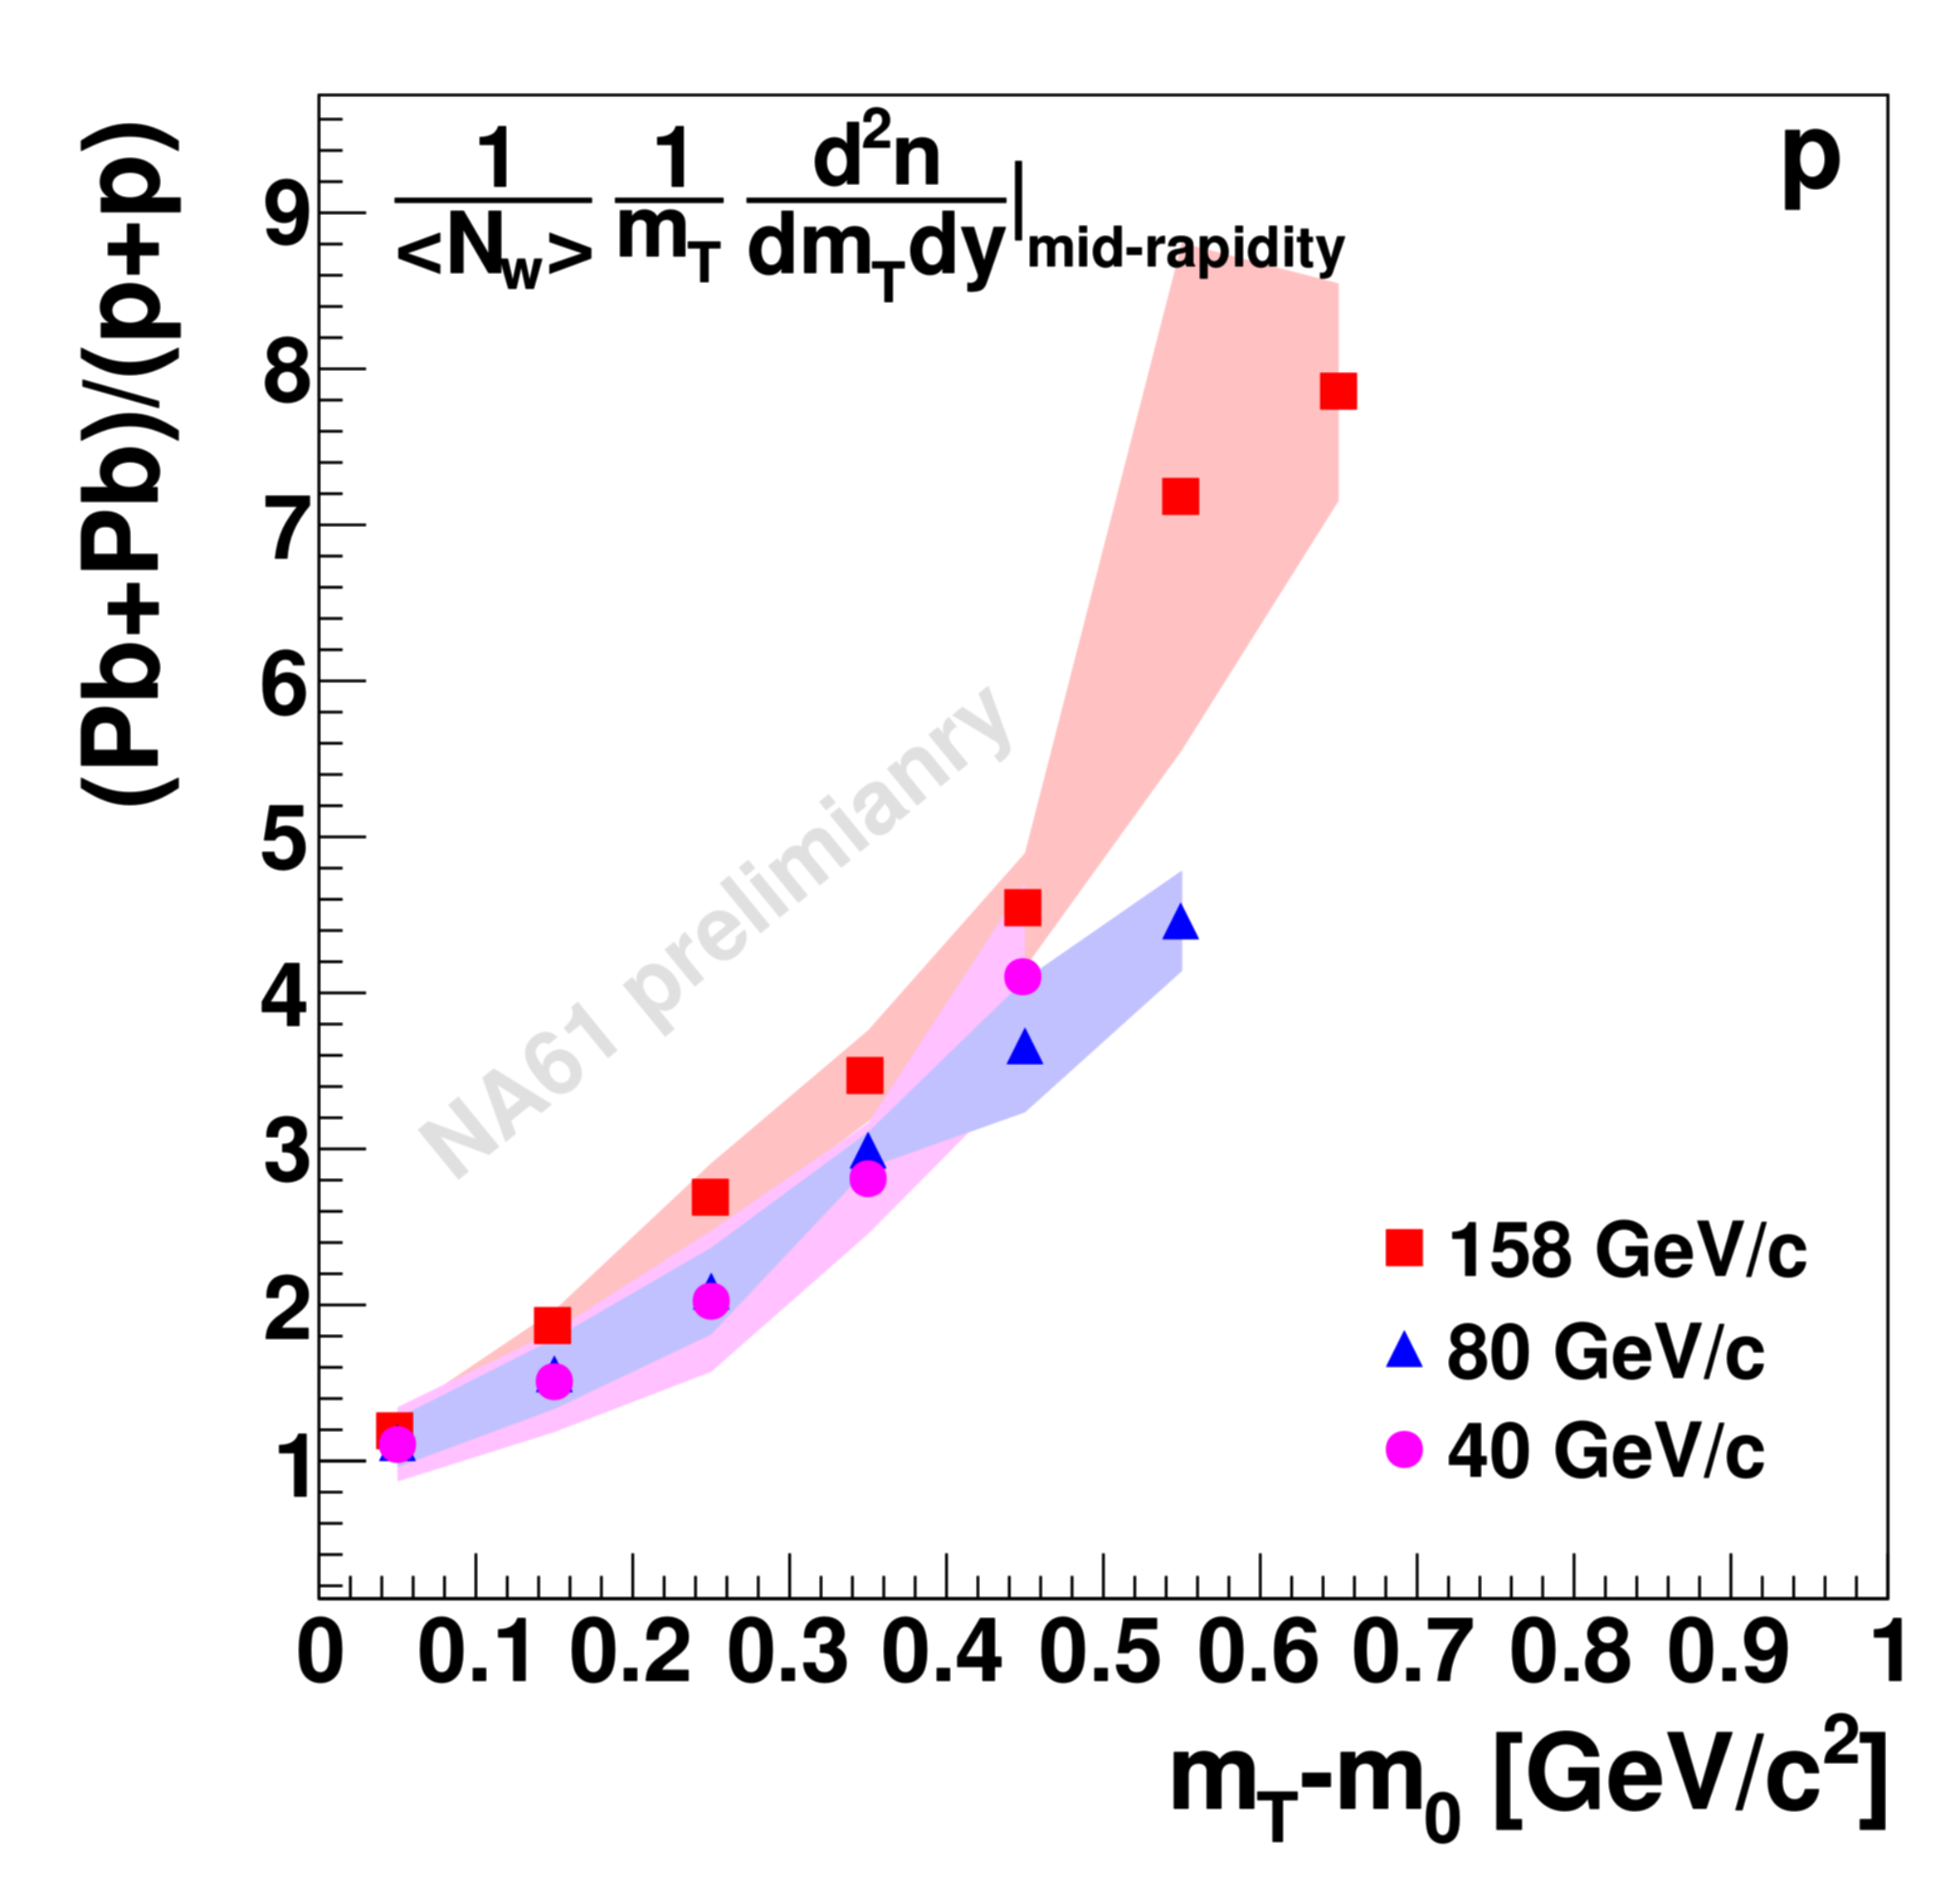
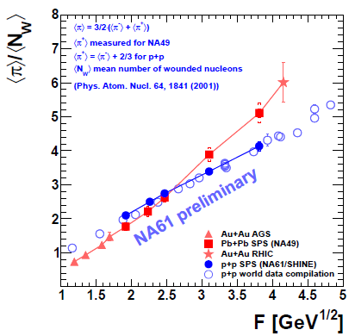
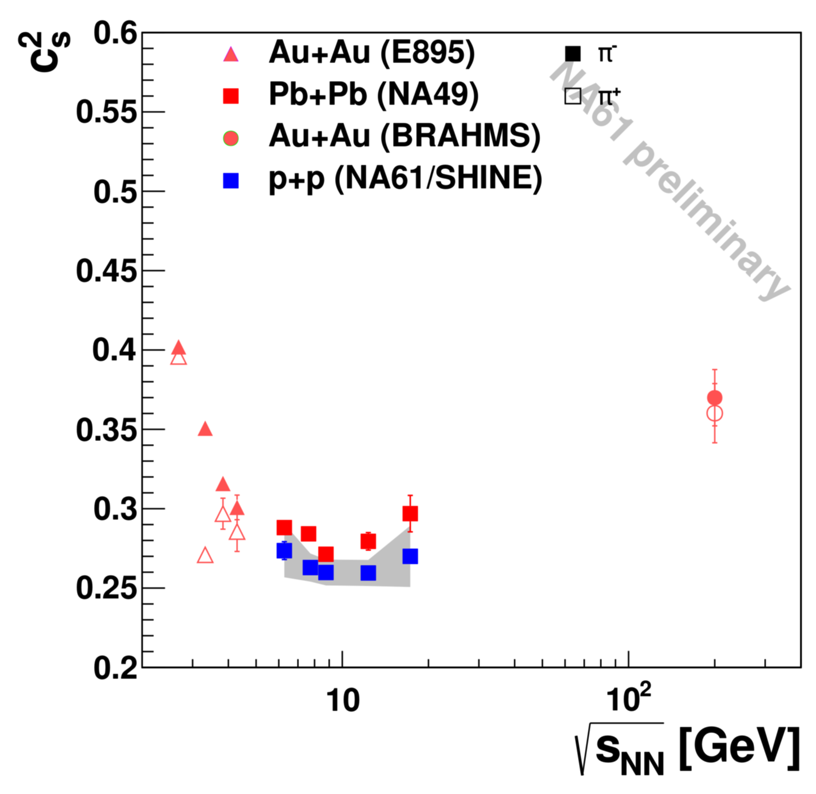
π⁺⁻, K⁻, p from p+p collisions
Significant shape-difference between p+p and central (7%) Pb+Pb, independent of beam energy
NA61 results agree with the previous measurements
π multiplicity at the SPS energies increases faster in central Pb+Pb than in p+p (“kink”)
The two dependences cross each other at about 40A GeV/c
Inverse slope parameters T of m_{T} spectra at the SPS energies show different behavior in central Pb+Pb (step) than in p+p (smooth increase)
The dale appears to be present also in p+p reactions
NA61 precision sufficient to study properties of the onset of deconfinement

Slide 22
Neutrino physics
Precision measurements of hadron production for the prediction of ν-fluxes at T2K

Slide 23
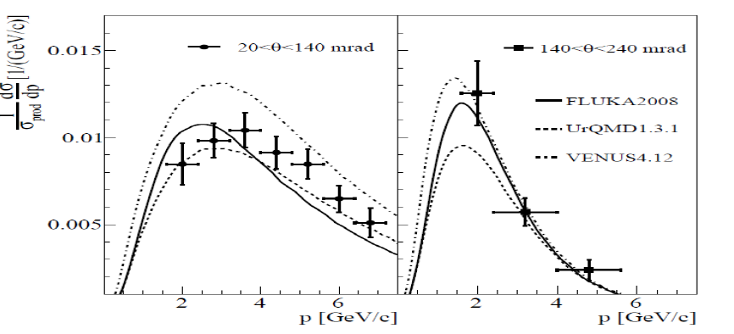
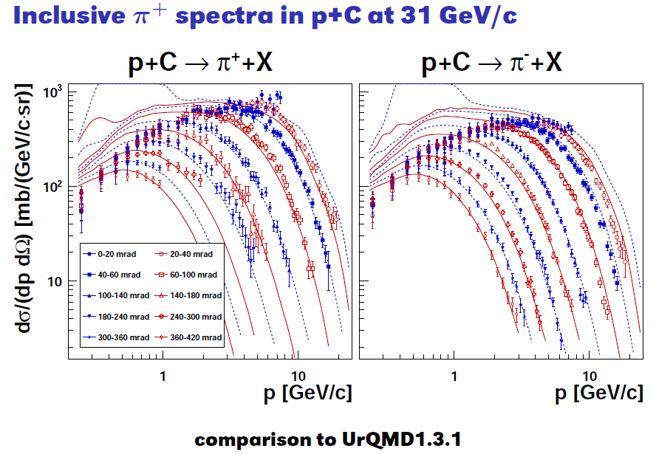
Analysis for T2K
Pion spectra in p+C interactions at 31 GeV/c are published:
Phys. Rev. C84 (2011) 034604
They are used to improve beam neutrino flux predictions
Adjust models (UrQMD 1107.0374, Fritiof 1109.6768) used in neutrino and cosmic-ray experiments
K+ spectra normalized to the mean multipicity in production interactions as a function of the laboratory momentum in bins of the polar angle
Phys. Rev. C 85 (2012) 035210

Slide 24
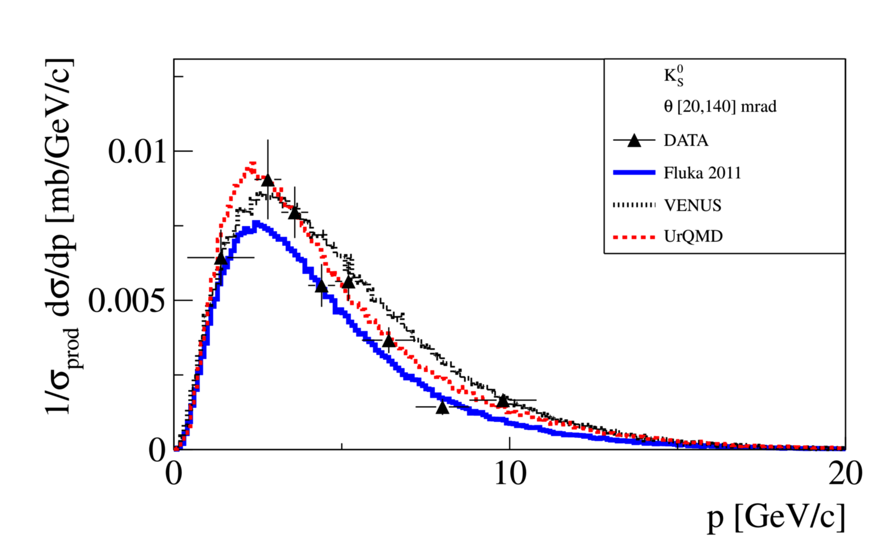
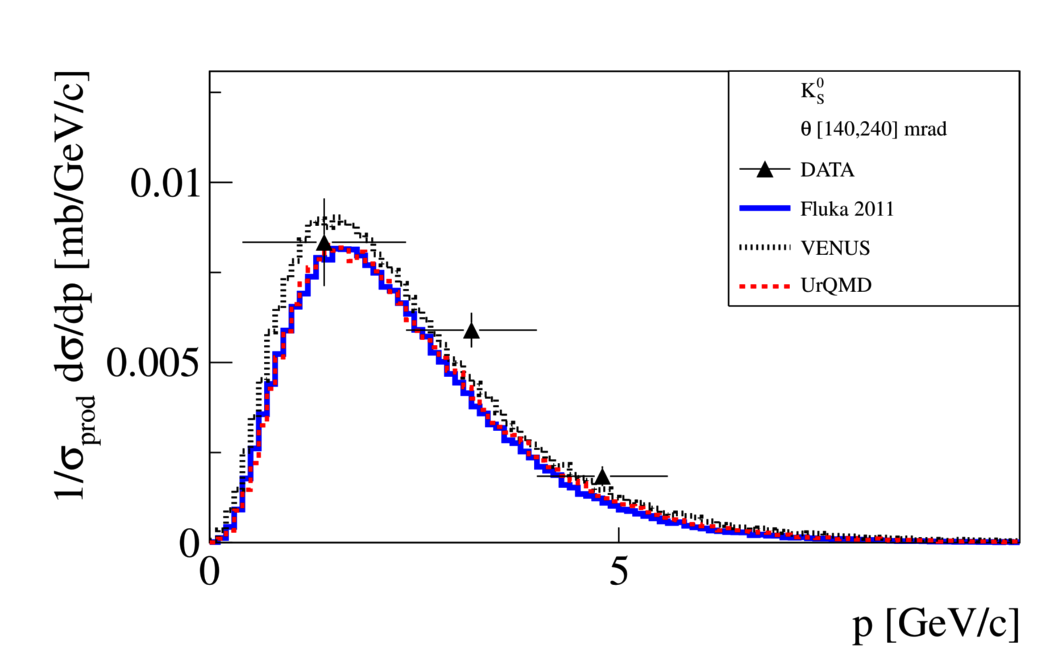
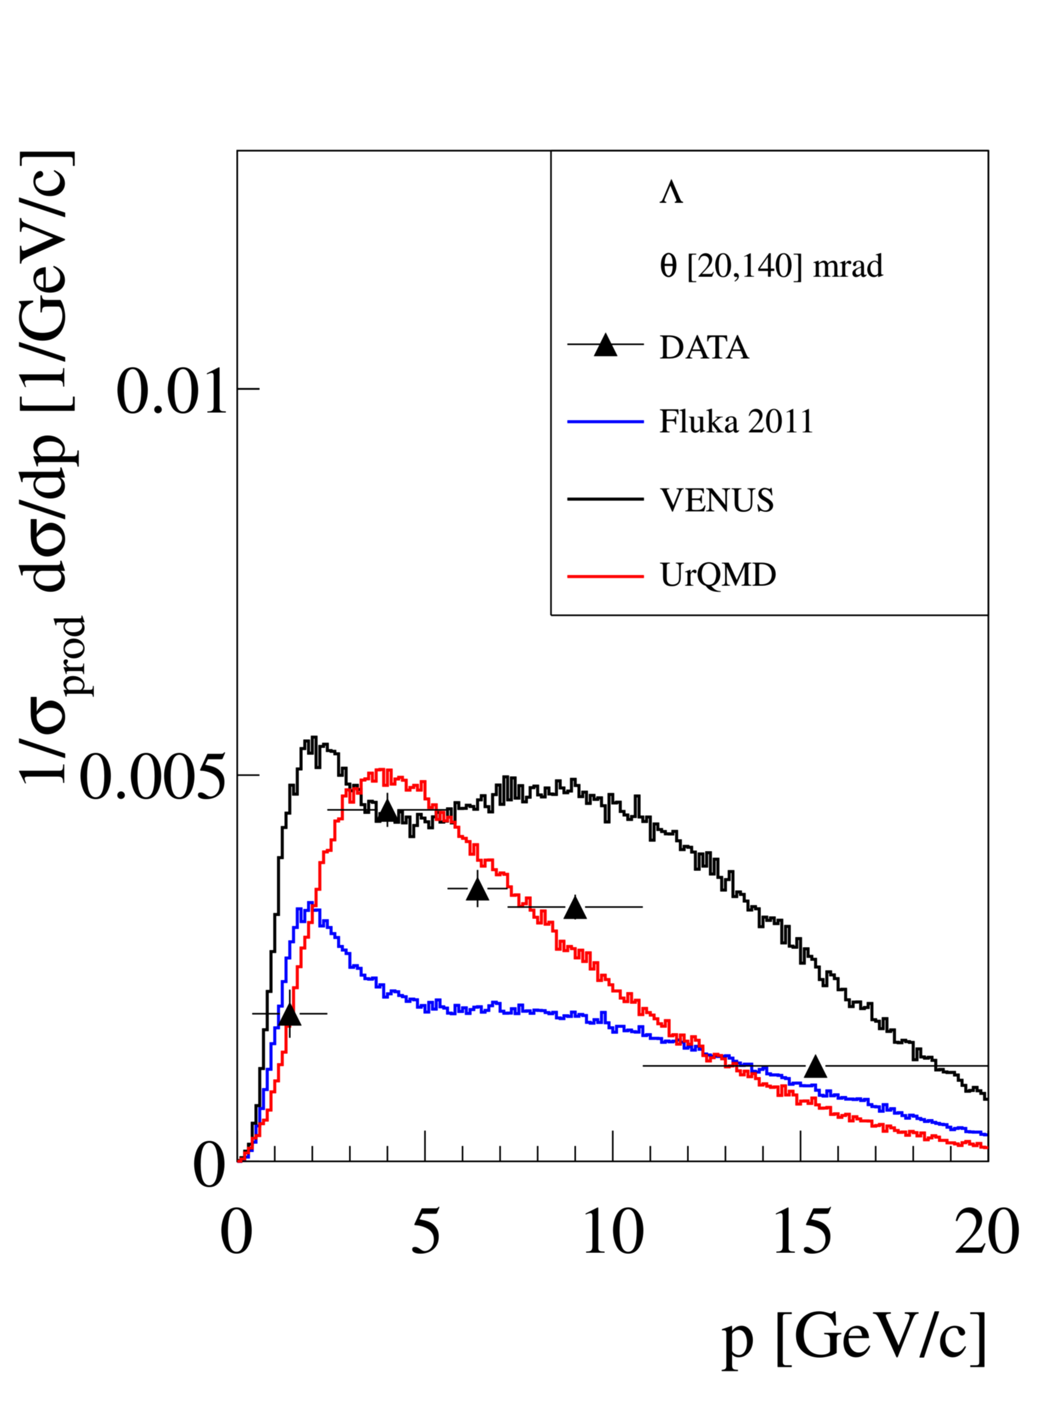
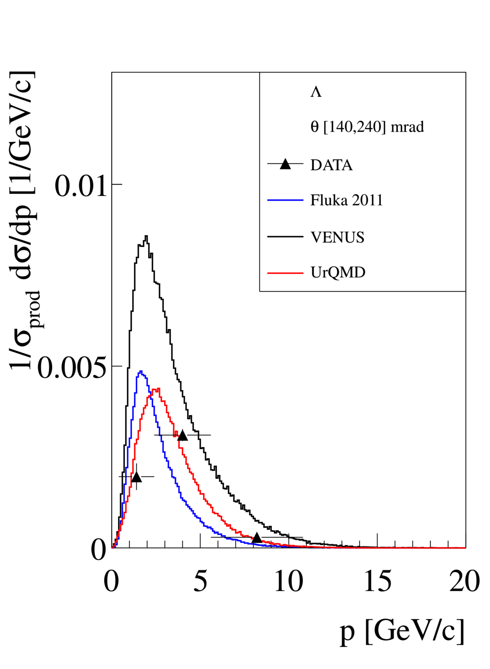
Analysis for T2K
K⁰_{S} and Λ spectra in p+C at 31 GeV/c
K⁰_{S} production measured to better constrain the ν_{e} and ν_{e} flux at high momenta, and to reduce model dependence of feed-down correction (π⁻ from Λ and K⁰_{S})

Slide 25
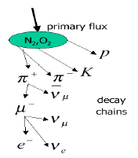
Measuring cosmic-ray composition
Measurement of particle production spectra
Special ’cosmic runs’: π−-C at 158 and 350 GeV/c
p-C at 31 GeV/c
p-p scan from 13 to 158 GeV/c
Cosmic ray composition
of central importance for
understanding sources,
kink, ankle...
Modern detector installations:
high statistics/quality data
Indirect measurement
(extensive air showers):
simulations needed
Strong model dependence: due mainly
to simulation of μ production
μ production related to hadronic
interactions at fixed-target energies

Slide 26
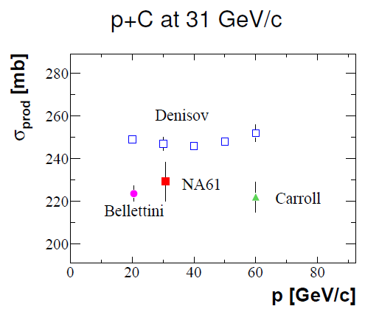
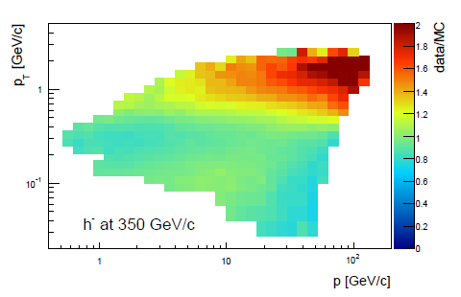
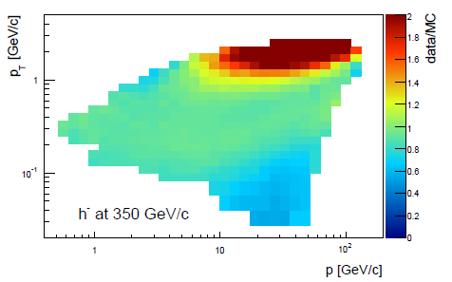
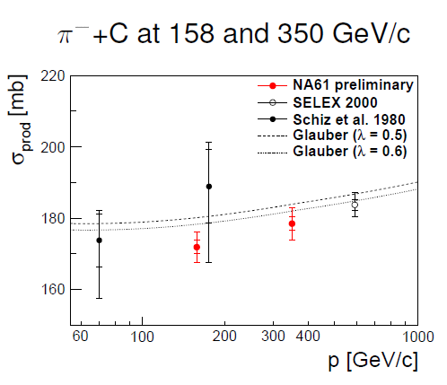
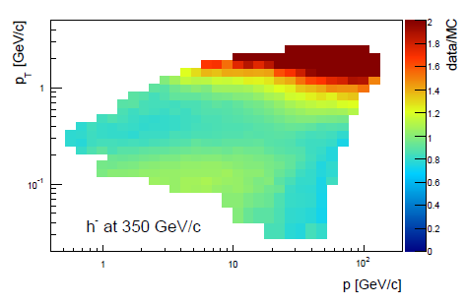
Measuring cosmic-ray composition
Comparison to:
EPOS1.99
UrQMD1.3.1
Input for validation/tuning of Monte Carlo generators
Fluka2011

Slide 27
Future anD PLANS

Slide 28
Future measurements for neutrino experiments
US Interest in NA61/SHINE
Includes ~22 people at 8 US institutions
FNAL, LANL. University of Texas at Austin, TX, University of Colorado, Boulder, CO, Northwestern, IL, University of Pittsburgh, PA, University of Rochester, NY, William and Mary, VA
These institutions listed are interested in precise neutrino flux constraints for NuMI experiments (MINOS, NOvA, Minerva) and the future (LBNE).
Neutrino oscillation experiments require an understanding of the unoscillated neutrino spectrum.
For cross-section experiments the hadron production uncertainties directly impact the final answer.
Both redundancy and over-constraining hadronic production modeling through measurements will be useful in reducing all sorts of backgrounds and systematic
Using NA61 is an opportunity to do it relatively fast and in a cost effective way and mutually beneficial.
On May 2 2012 US funding agencies' (DOE and NSF) have been informed of our plans:
Submitted Letter of Intent (LOI)
On May 3 2012 the NA61 Collaboration Board and Spokesperson accepted the limited membership of the US groups in NA61.
First test run during 2012 summer
demonstrate feasibitly of full plan and for US groups
gain experience with the NA61 detector
Several weeks of running during 2014
LAGUNA – LBNO: hadroproduction studies required for the future long baseline neutrino oscillation experiment in Europe

Slide 29
Future: Pb+Pb collisions
Measurement of open charm production
Open charm production measurement possible at NA61 experiment. With 50M 60A GeV Pb+Pb: 5M D⁰ expected
D⁰ meson detection in NA61 – 10μm resolution vertex detector
Precise measurements on production of multi-strange particles
Detailed Ω⁻ production measurement in Pb+Pb possible at NA61 experiment
Existing measurements: low statistics, only for 40A and 158A GeV, only low p_{T}.
NA61 can improve x10-100 in statistics, can add further collision energies
Extension of intermediate p _{T} charged pion spectra in Pb+Pb at SPS energies
Charged pion p _{T} spectra at midrapidity has been measured by NA49 up to 4.5GeV/c transverse momentum.
Can be potentially extended by NA61 experiment up to about 6 GeV/c p _{T}
For protons up to 6.5-7GeV/c p _{T}.

Slide 30
SUMMARY

Slide 31
The Collaboration
KFKI Research Institute for Particle and Nuclear Physics, Budapest, Hungary
The Universidad Tecnica Federico Santa Maria, Valparaiso, Chile
Faculty of Physics, University of Warsaw, Warsaw, Poland
Faculty of Physics, University of Sofia, Sofia, Bulgaria
Karlsruhe Institute of Technology, Karlsruhe, German
Joint Institute for Nuclear Research, Dubna, Russia
Warsaw University of Technology, Warsaw, Poland
Fachhochschule Frankfurt, Frankfurt, Germany
Jan Kochanowski University in Kielce, Poland
University of Geneva, Geneva, Switzerland
University of Belgrade, Belgrade, Serbia
Jagiellonian University, Cracow, Poland
University of Silesia, Katowice, Poland
University of Athens, Athens, Greece
ETH, Zurich, Switzerland
University of California, Irvine, USA
University of Bern, Bern, Switzerland
University of Bergen, Bergen, Norway
University of Wrocław, Wrocław, Poland
Rudjer Boskovic Institute, Zagreb, Croatia
University of Frankfurt, Frankfurt, Germany
Institute for Nuclear Research, Moscow, Russia
State University of New York, Stony Brook, USA
LPNHE, University of Paris VI and VII, Paris, France
National Center for Nuclear Studies, Warsaw, Poland
St. Petersburg State University, St. Petersburg, Russia
Institute for Particle and Nuclear Studies, KEK, Tsukuba, Japan
Laboratory of Astroparticle Physics, University Nova Gorica, Nova Gorica, Slovenia

Slide 32
Summary
NA61/SHINE ion program explore the phase diagram of strongly interacting matter
NA61/SHINE gives unique opportunity to discover the critical point of strongly interacting matter and study properties of the onset of deconfinement
NA61/SHINE performs precision measurements for neutrino (T2K) and cosmic-ray (PAO) physics
The heavy-ion program of NA61/SHINE is complemented at present by other international projects: CBM at SIS (FAIR GSI), MPD at NICA (JINR), STAR and PHENIX at RHIC (BNL)"

Slide 33
THANK YOU seweryn.kowalski@us.edu.pl

Slide 34
BACKUP SLIDES

Slide 35
Ion program
critical point
1st order phase transition

Slide 36
2D scan (energy, system size)
Comprehensive scan in the whole SPS energy range (13A-158A GeV) with light and intermediate mass nuclei

Slide 37
Study of the onset of deconfinement
Statistical Model of the Early Stage (SMES)
1st order phase transition to QGP between top AGS and top SPS energies
Constant temperature and pressure in mixed phase
Number of internal degrees of freedom increases HG ➔ QGP
Total entropy and total strangeness are the same before and after hadronization (cannot decrease QGP ➔ HG)
Mass of strangeness carriers decreases HG ➔ QGP (m_{Λ, K, ...}> m_{s})
“kink” “horn” “step”
QGP
HG
QGP
QGP
HG
HG
HG
HG
mixed
phase
mixed
phase
Gaździcki, Gorenstein, Acta Phys. Polon. B30, 2705 (1999)

Slide 38
Study of the onset of deconfinement
“dale”
NA49 evidence of deconfinement near 30A GeV
C. Alt et al., PRC77,024903 (2008)
Horn:
decrease of strangeness carrier masses and the number ratio of strange to non-strange degrees of freedom
K/π yields ratio at high energy approach a constant level as expected for deconfined matter
Step:
constant T and p in mixed phase
Hard to explain by statistical and dynamical models that do not include phase transition between HG and QGP
“horn”
“step”

Slide 39
Study of the onset of deconfinement NA61/SHINE
Start of the 2D (energy/system size) scan of phase diagram
Notes:
Expectation for energy and system size scan: similar structures (kink, horn, step); vanishing for small systems
In particular the ''horn'' like structure is expected to be similar for Ar+Ca and Pb+Pb collisions and then rapidly disappear for smaller systems

Slide 40
Search for the critical point
SPS covers the most important region of the Phase Space diagram
Critical point of strongly interacting matter should be located in the SPS energy range
Example of the theoretical calculation:
(T,μ_{B})=(162±2,360 ± 40) MeV
Fodor and Katz JHEP 404 050 (2004)
μ_{B} =360 MeV E≈50A GeV Beccatini, Manninen, Gazdzicki PRC 73 044905 (2006)
Critical point should be searched in collisions with energy higher than energy of the onset of deconfinement (EOD ~ 30A GeV).
Fodor, Katz, JHEP 0404, 050 (2004)
Alt et al., PRC77, 024903 (2008)

Slide 41
Search for the critical point NA61/SHINE
Search for the hill of fluctuations
Notes:
Increase of critical point signal (multiplicity and average p_{T} fluctuations, intermittency, etc.) for system freezing-out near the critical point Non-monotonic dependence of critical point signal on control parameters (energy, centrality, ion size) can help to locate the critical point

Slide 42
π⁻ study of the onset of deconfinement
NA61 results agree with the previous measurements
π multiplicity at the SPS energies increases faster in central Pb+Pb than in p+p (“kink”)
The two dependences cross each other at about 40A GeV/c
NA61 precision sufficient to study properties of the onset of deconfinement

Slide 43
Measuring cosmic-ray composition
Corsika simulation

