Slide 1
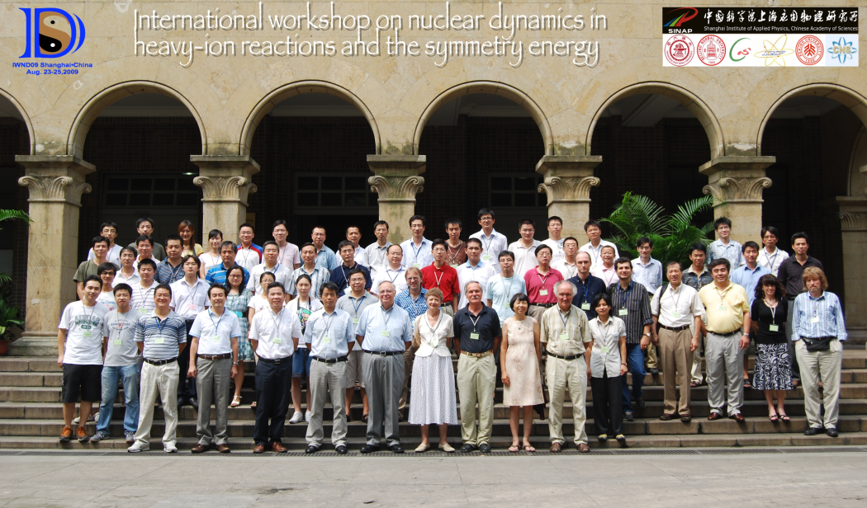

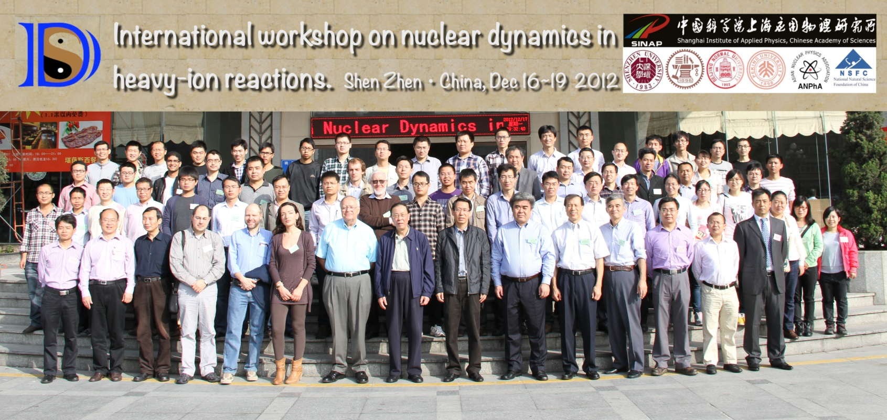
Congratulations and Thanks, Joe!

Slide 2

The density curvature parameter and high density behavior of the symmetry energy
Lie-Wen Chen (陈列文)
Department of Physics and Astronomy, Shanghai Jiao Tong University
(lwchen@sjtu.edu.cn)
The symmetry energy Esym and its current constraints
Systematics of the density dependence of the Esym
Information on the density curvature K_{sym} and the high density Esym from constraints at subsaturation densities
Summary
“International Workshop on Nuclear Dynamics and Thermodynamics”, in Honor of Prof. Joe Natowitz, TAMU, College Station, USA, August 19-22, 2013

Slide 3
Outline
The symmetry energy Esym and its current constraints
Systematics of the density dependence of the Esym
Information on the density curvature K_{sym} and the high density Esym from constraints at subsaturation densities
Summary

Slide 4
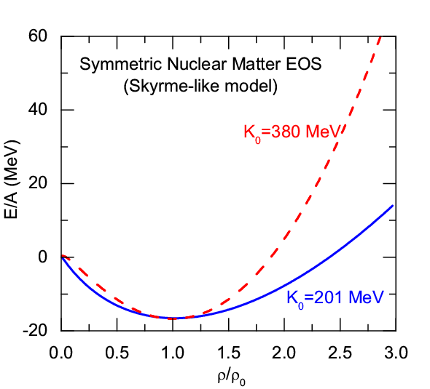
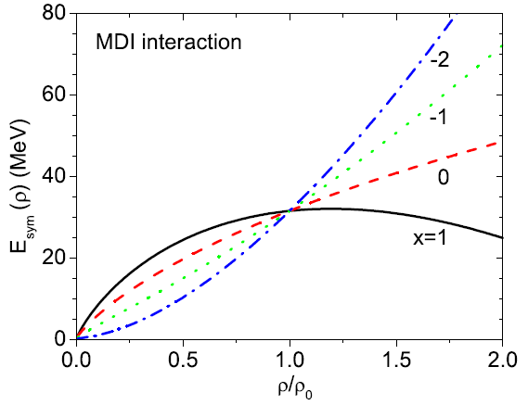
The Symmetry Energy
EOS of Isospin Asymmetric Nuclear Matter
(Parabolic law)
Symmetric Nuclear Matter
(relatively well-determined)
Isospin asymmetry
Symmetry energy term
(poorly known)
The Nuclear Symmetry Energy
p. 1

Slide 5
Facilities of Radioactive Beams
Cooling Storage Ring (CSR) Facility at HIRFL/Lanzhou in China (2008)
up to 500 MeV/A for ²³⁸U
http://www.impcas.ac.cn/zhuye/en/htm/247.htm
Beijing Radioactive Ion Facility (BRIF-II) at CIAE in China (2012)
http://www.ciae.ac.cn/
Radioactive Ion Beam Factory (RIBF) at RIKEN in Japan (2007)
http://www.riken.jp/engn/index.html
Texas A&M Facility for Rare Exotic Beams -T-REX (2013)
http://cyclotron.tamu.edu
Facility for Antiproton and Ion Research (FAIR)/GSI in Germany (2016)
up to 2 GeV/A for ¹³²Sn (NUSTAR - NUclear STructure, Astrophysics and Reactions )
http://www.gsi.de/fair/index_e.html
SPIRAL2/GANIL in France (2013)
http://pro.ganil-spiral2.eu/spiral2
Selective Production of Exotic Species (SPES)/INFN in Italy (2015)
http://web.infn.it/spes
Facility for Rare Isotope Beams (FRIB)/MSU in USA (2018)
up to 400(200) MeV/A for ¹³²Sn
http://www.frib.msu.edu/
The Korean Rare Isotope Accelerator (KoRIA-RAON(RISP Accelerator Complex) (Starting)
up to 250 MeV/A for ¹³²Sn, up to 109 pps
……
p. 2

Slide 6
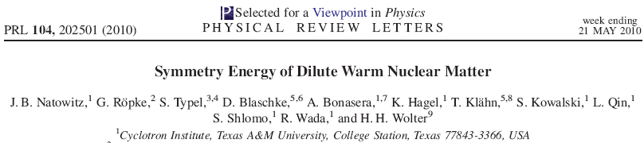
E_{sym} at low densities: Clustering Effects
p. 3
Notes:
6

Slide 7
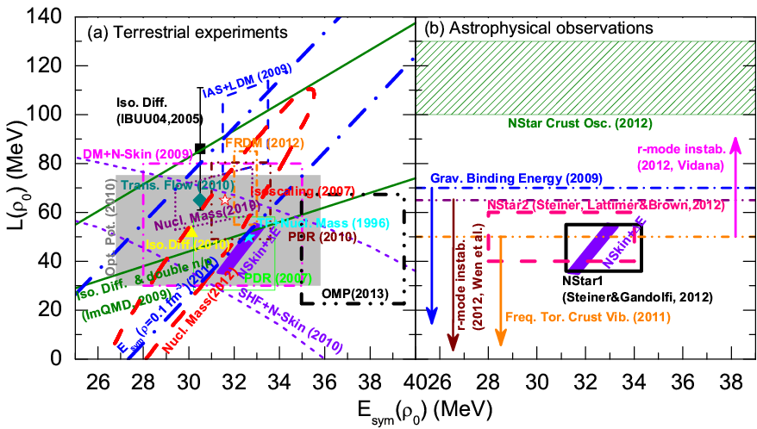
E_{sym}：Around saturation density
Current constraints (An incomplete list) on E_{sym} (ρ₀) and L from
terrestrial experiments and astrophysical observations
E_{sym}(ρ₀) = 32.5±2.5 MeV, L = 55±25 MeV
L.W. Chen, arXiv:1212.0284
B.A. Li, L.W. Chen, F.J. Fattoyev, W.G. Newton, and C. Xu, arXiv:1212.1178
p. 4

Slide 8
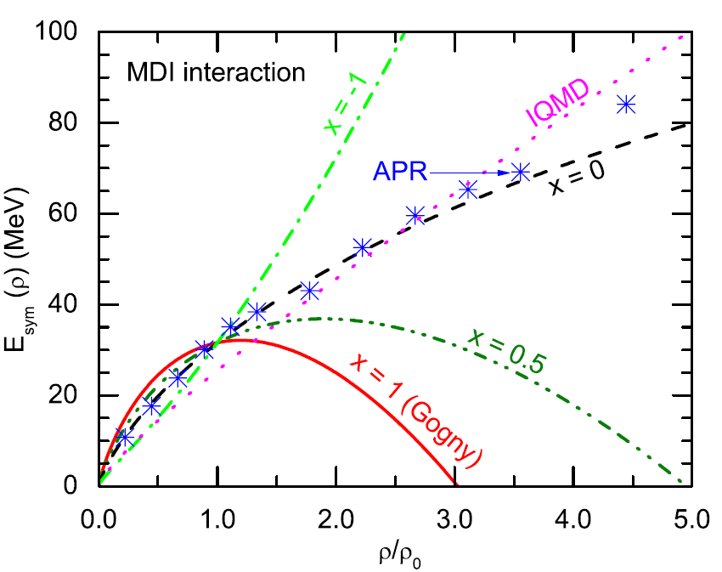
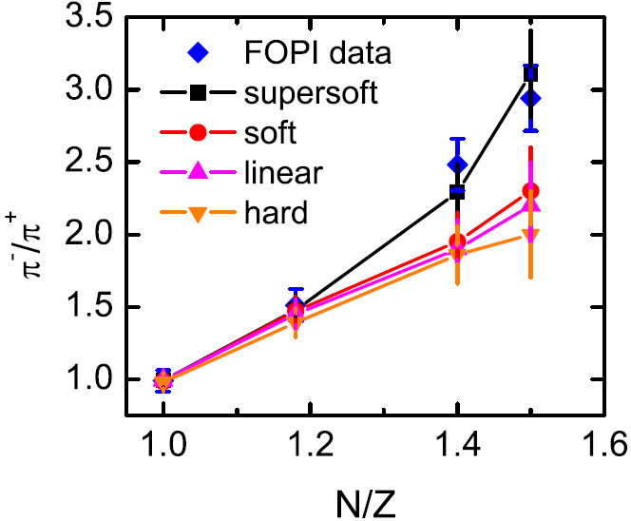
High density E_{sym}: pion ratio
A Quite Soft Esym at supra-saturation densities ???
ImIBLE, Xie/Su/Zhu/Zhang,
PLB718,1510(2013)
IBUU04, Xiao/Li/Chen/Yong/Zhang, PRL102,062502(2009)
Softer
Softer
Stiffer
Pion Medium Effects?
Xu/Ko/Oh
PRC81, 024910(2010)
Threshold effects?
Δ resonances?
……
ImIQMD, Feng/Jin, PLB683, 140(2010)
p. 5

Slide 9
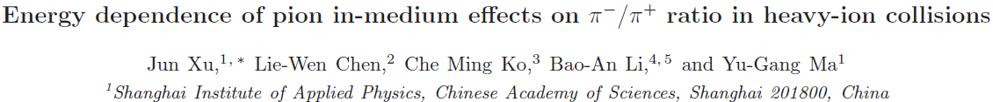
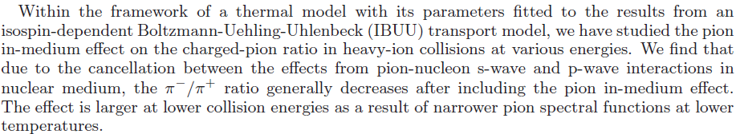
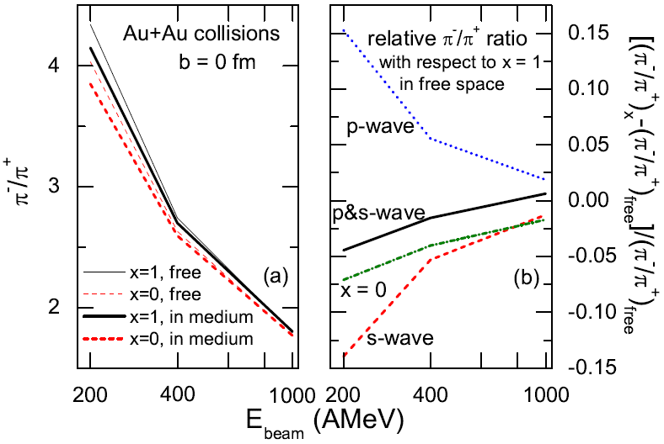
High density E_{sym}: pion ratio
PRC87, 067601 (2013)
The pion in-meidum effects seem comparable to Esym effects in the thermal model !!!
But how about in more realistic dynamical model ???
How to treat self-consistently the pion in-medium effects in transport model remains a big challenge !!!
p. 6

Slide 10


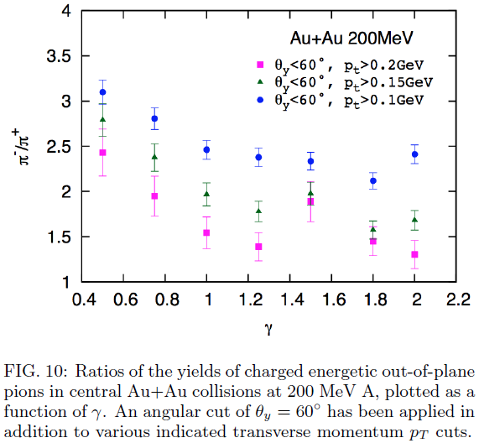
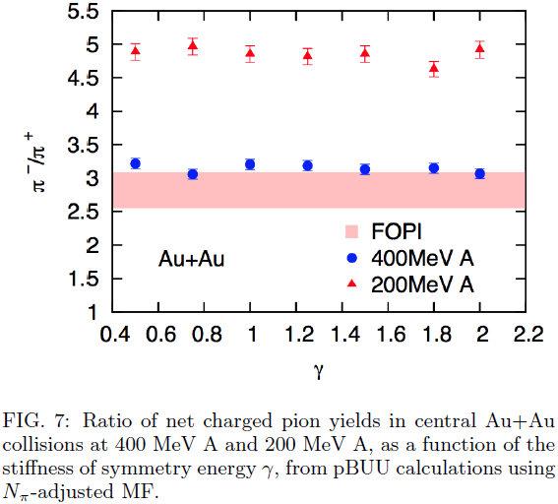
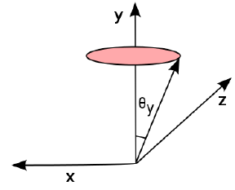
High density E_{sym}: pion ratio
J. Hong and P. Danielewicz, arXiv:1307.7654
No Esym effects !
Esym effects show up for
squeeze-out pions !
p. 7

Slide 11
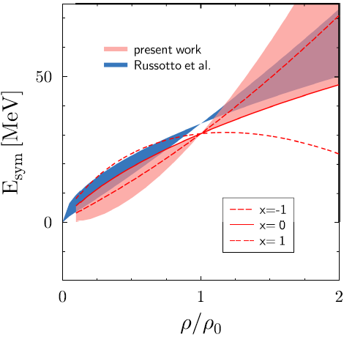
High density E_{sym}: n/p v2
A Soft or Stiff Esym at supra-saturation densities ???
P. Russotto,W. Trauntmann, Q.F. Li et al.,
PLB697, 471(2011) (UrQMD)
M.D. Cozma, W. Trauntmann, Q.F. Li et al.,
arXiv:1305.5417 (Tubingen QMD - MDI)
Moderately stiff to roughly linear density dependence !
p. 8

Slide 12
E_{sym}：at supra- and saturation density
At very low density (less than about ρ₀/10), the clustering effects are very important, and the mean field model significantly under-predict the symmetry energy.
Cannot be that all the constraints on E_{sym} (ρ₀) and L are equivalently reliable since some of them don’t have any overlap. However, all the constraints seem to agree with:
E_{sym}(ρ₀) = 32.5±2.5 MeV
L = 55±25 MeV
All the constraints on the high density Esym come from HIC’s, and all of them are based on transport models. The constraints on the high density Esym are elusive and controversial for the moment !!!
p. 9

Slide 13
Outline
The symmetry energy Esym and its current constraints
Systematics of the density dependence of the Esym
Information on the density curvature K_{sym} and the high density Esym from constraints at subsaturation densities
Summary

Slide 14
Esym systematics and high density E_{sym}
So far (most likely also in future), essentially all the constraints on Esym have been obtained based on some energy density functionals or phenomenological parameterizations of Esym. Are there some universal laws (systematics) for the density dependence of Esym within these functionals or parameterizations?
While more high quality data and more reliable models are in progress to constrain the high density Esym, can we find other ways to get some information on high density Esym?
Can we get some information on high density Esym from the knowledge of Esym around saturation density?
p. 10

Slide 15
Systematics of the densiy dependence of E_{sym}
L.W. Chen, Sci. China Phys. Mech. Astron. 54, suppl. 1, s124 (2011) [arXiv:1101.2384]
p. 11

Slide 16
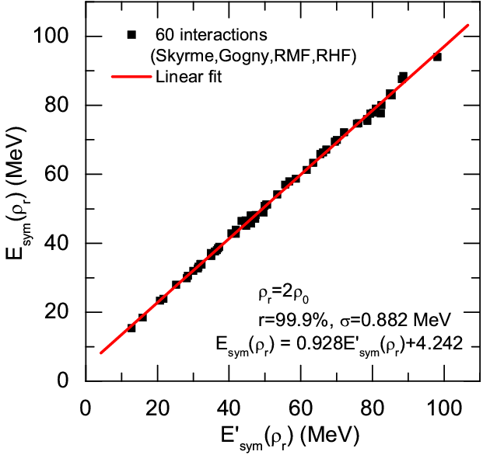
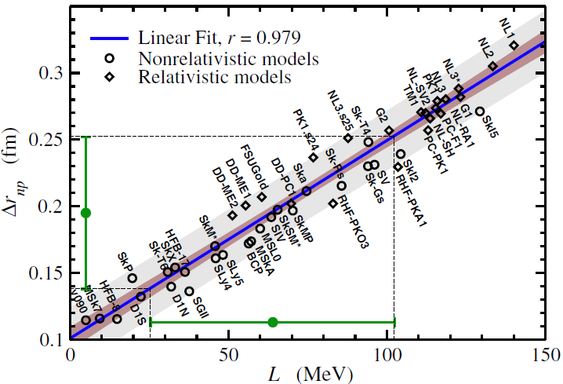
Systematics of the densiy dependence of E_{sym}
Roca-Maza et al., PRL106, 252501 (2011)
46 interactions +BSK18-21+MSL1+SAMi +SV-min+UNEDF0-1+TOV-min+IU-FSU
+BSP+IU-FSU*+TM1* (Totally 60 interactions in our analysis)
p. 12

Slide 17
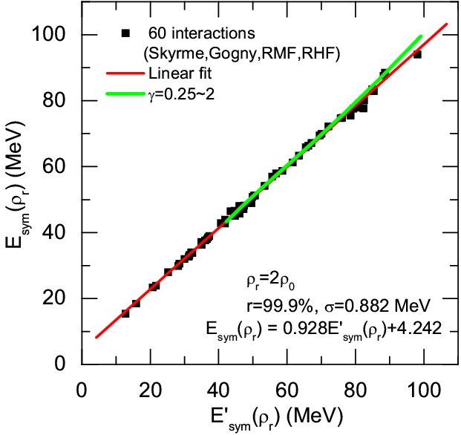
Systematics of the densiy dependence of E_{sym}
Phenomenological parameterizations in transport models for HIC’s
p. 13

Slide 18
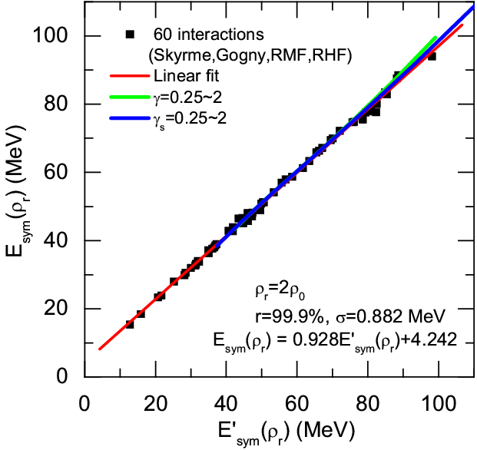
Systematics of the densiy dependence of E_{sym}
Phenomenological parameterizations in transport models for HIC’s
p. 13

Slide 19
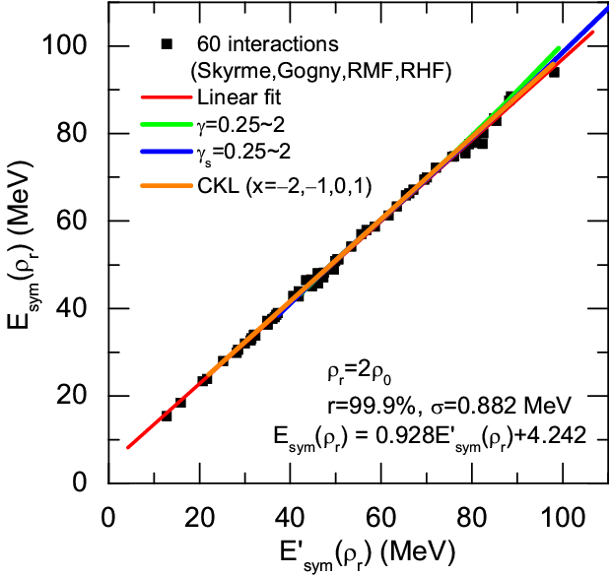
Systematics of the densiy dependence of E_{sym}
Phenomenological parameterizations in transport models for HIC’s
p. 13

Slide 20
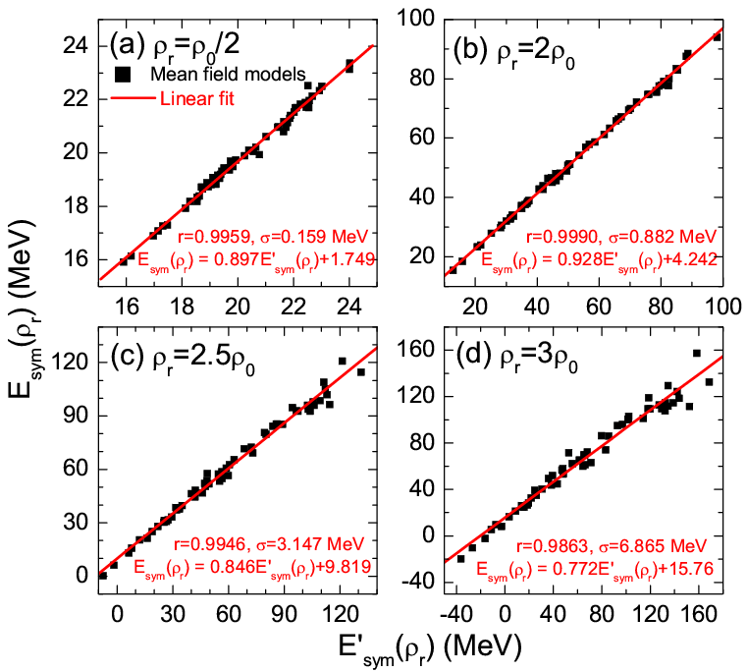
Systematics of the densiy dependence of E_{sym}
Linear correlation at different densities
p. 14

Slide 21
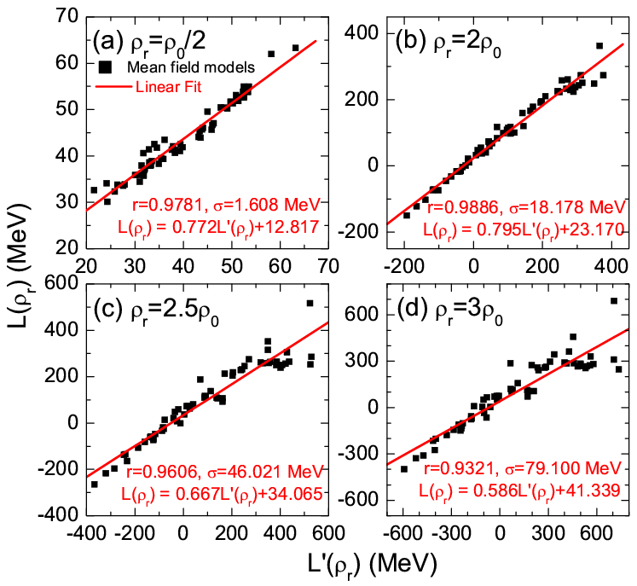
Systematics of the densiy dependence of E_{sym}
Density slope L:
Linear correlation at different densities
p. 15

Slide 22
Systematics of the densiy dependence of E_{sym}
p. 16

Slide 23
Outline
The symmetry energy Esym and its current constraints
Systematics of the density dependence of the Esym
Information on the density curvature K_{sym} and the high density Esym from constraints at subsaturation densities
Summary

Slide 24
Three values of E_{sym}(ρ) and L(ρ)
E_{sym}(ρ_{c}) at ρ_{c} =0.11 fm⁻³
Binding energy difference of heavy isotope pair
L(ρ_{r}) at ρ_{r} =0.11 fm⁻³
The neutron skin of heavy nuclei
E_{sym}(ρ_{c}) at ρ_{c} = ρ₀
Binding energy
p. 17

Slide 25
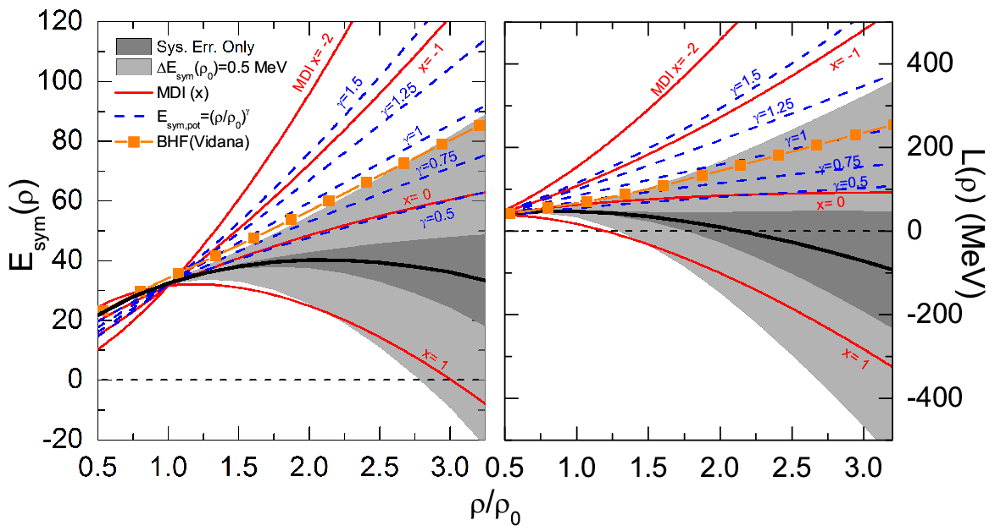
High density E_{sym} and K_{sym} parameter
p. 18

Slide 26


The value of K_{sym} from SHF
L.W. Chen,
PRC83, 044308(2011)
Based on SHF !
Esym systematics:
K_{sym}= -167.1±185.3 MeV
L.W. Chen, Sci. China Phys. Mech. Astron. 54, suppl. 1, s124 (2011) [arXiv:1101.2384]
p. 19

Slide 27
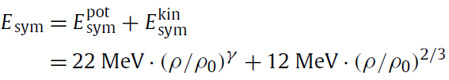
High density E_{sym} : E_{sym}(2ρ₀) from HIC’s
P. Russotto,W. Trauntmann, Q.F. Li et al., PLB697, 471(2011)
p. 20

Slide 28
Outline
The symmetry energy Esym and its current constraints
Systematics of the density dependence of the Esym
Information on the density curvature K_{sym} and the high density Esym from constraints at subsaturation densities
Summary

Slide 29
Summary
The symmetry energy E_{sym}(ρ) and its density slope L(ρ) from sub- to
supra-saturation density can be essentially determined by three
parameters defined at saturation density, i.e., E_{sym}(ρ₀), L(ρ₀) , and
K_{sym}(ρ₀) , implying that three values of E_{sym}(ρ) or L(ρ) can essentially
determine E_{sym}(ρ) and L(ρ).
Using E_{sym} (0.11 fm⁻³) =26.65±0.2 MeV and L(0.11 fm⁻³) =46.0±4.5
MeV extracted from isotope binding energy difference and neutron
skin of Sn isotopes, together with E_{sym}(ρ₀) =32.5±0.5 MeV extracted
from FRDM analysis of nuclear binding energy, we obtain:
L(ρ₀) =46.7±13.4 MeV and K_{sym}(ρ₀) = -167.1±185.3 MeV
favoring soft to roughly linear density dependence of E_{sym}(ρ).
Accurate determination of E_{sym}(ρ) and L(ρ) around saturation density
can be very useful to extract information on high density E_{sym}(ρ).
p. 21

Slide 30
谢 谢！
Thanks!

Slide 31
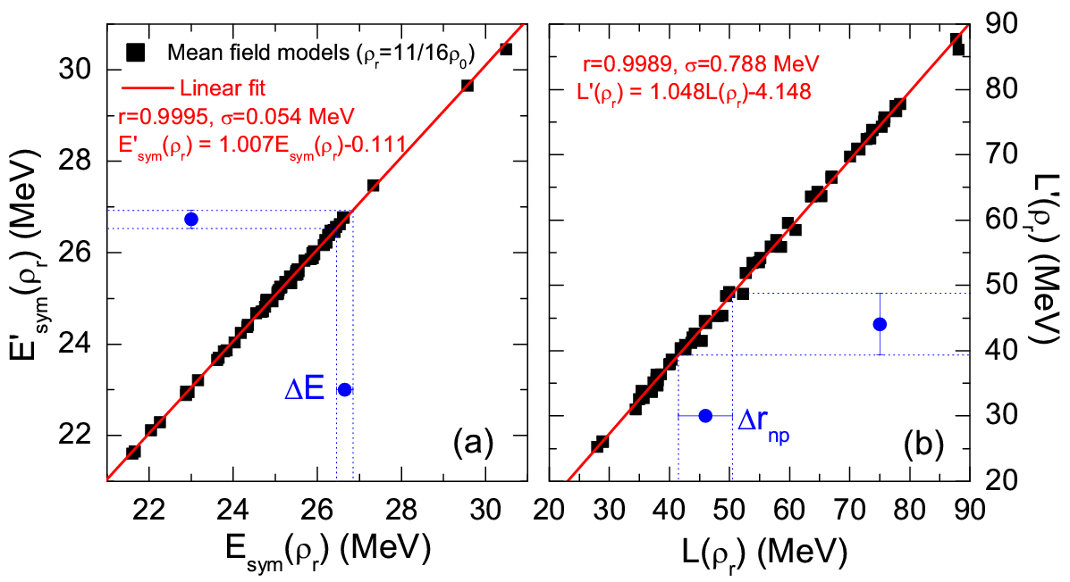
Three values of E_{sym}(ρ) and L(ρ)
E_{sym}(ρ_{c}) and L(ρ_{c}) at ρ_{c} =0.11 fm⁻³

Slide 32
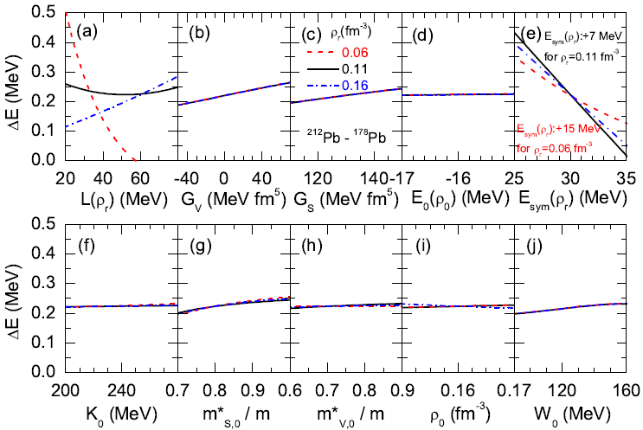
What really determine ΔE?
Zhen Zhang and Lie-Wen Chen ,
arXiv:1302.5327
Skyrme HF calculations with MSL0
ΔE always decreases with E_{sym}(ρ_{r}) , but it can increase or decrease with L(ρ_{r}) depending on ρ_{r}
When ρ_{r} =0.11 fm⁻³, ΔE is mainly sensitive to E_{sym}(ρ_{r}) !!!
Binding energy difference of heavy isotope pair
E_{sym}(ρ_{c}) at ρ_{c} =0.11 fm⁻³

Slide 33
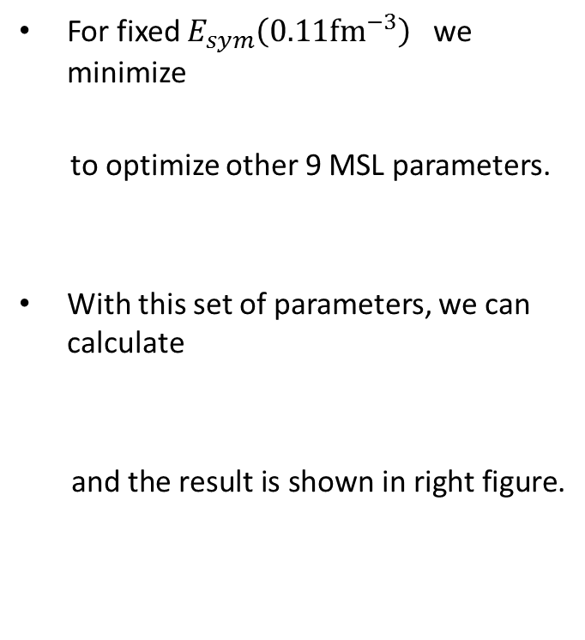
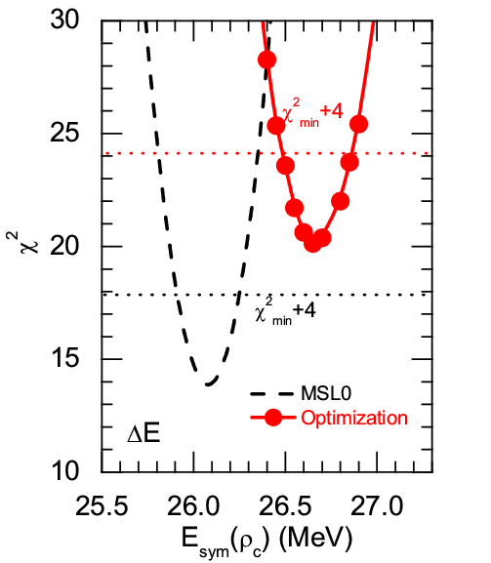
Determine E_{sym}(0.11 fm⁻³) from ΔE
19 data of Heavy Isotope Pairs
(Spherical even-even nuclei)
Zhen Zhang and Lie-Wen Chen ,arXiv:1302.5327

Slide 34

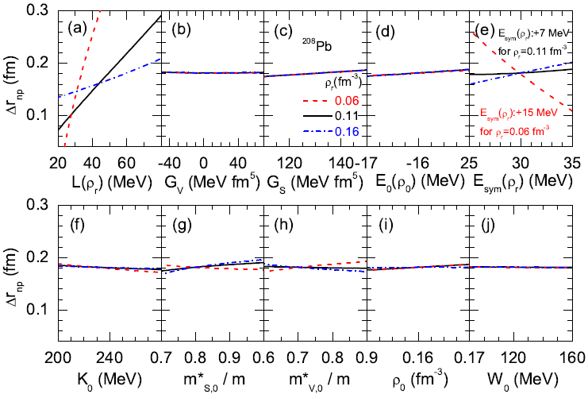
What really determine NSKin?
Zhen Zhang and Lie-Wen Chen ,arXiv:1302.5327
Skyrme HF calculations with MSL0
Neutron skin always increases with L(ρ_{r}) , but it can increase or decrease with E_{sym}(ρ_{r}) depending on ρ_{r}
When ρ_{r} =0.11 fm⁻³, the neutron skin is essentailly only sensitive to L(ρ_{r}) !!!
The neutron skin of heavy nuclei
L(ρ_{r}) at ρ_{r} =0.11 fm⁻³

Slide 35
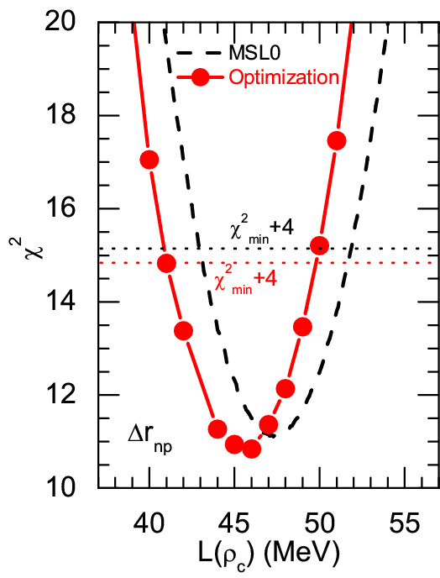
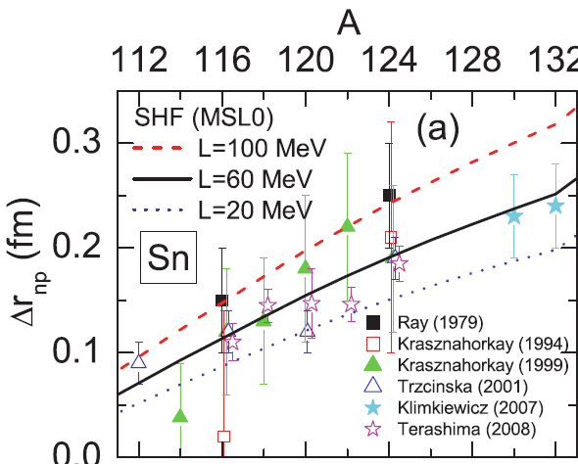
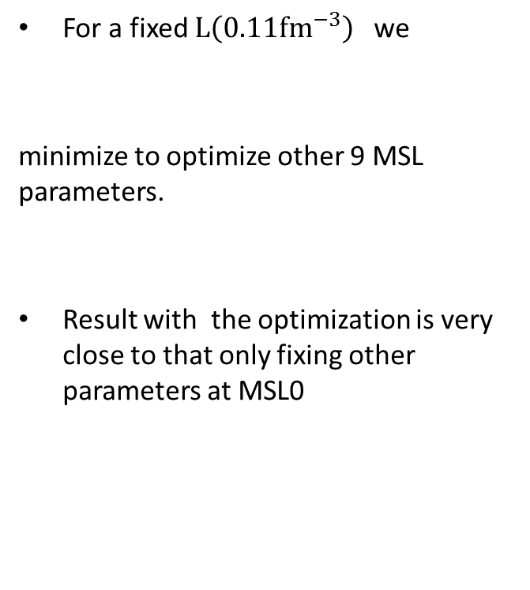
Determine L(0.11 fm⁻³) from NSkin
Zhen Zhang and Lie-Wen Chen ,arXiv:1302.5327
21 data of NSKin of Sn Isotope
p-scattering, IVGDR, IVSDR,
pbar Atomic, PDR, p-elastic scattering

Slide 36
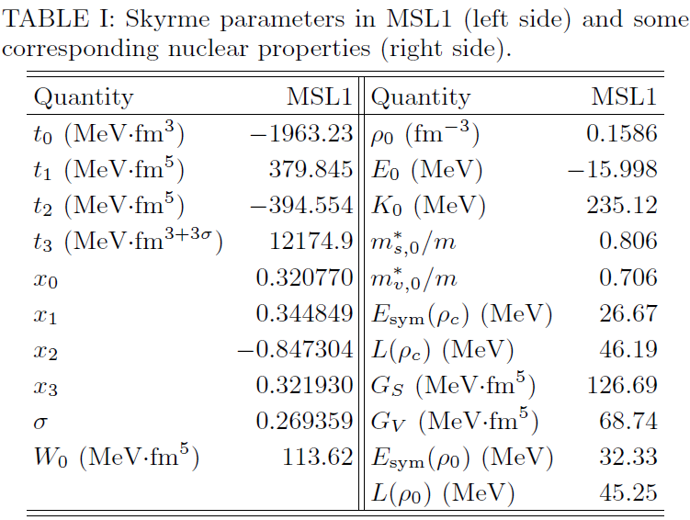
Symmetry energy around 0.11 fm⁻³
The globally optimized parameters (MSL1)
Binding energy difference of heavy isotope pairs
The neutron skin of Sn isotopes
Zhen Zhang and Lie-Wen Chen
arXiv:1302.5327

Slide 37
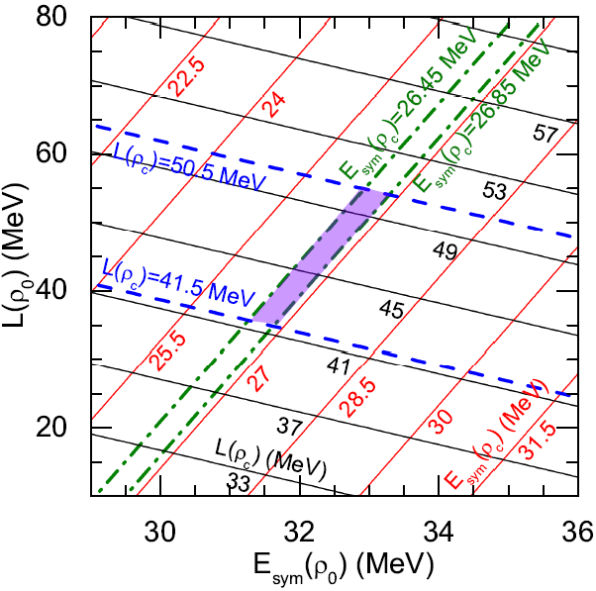
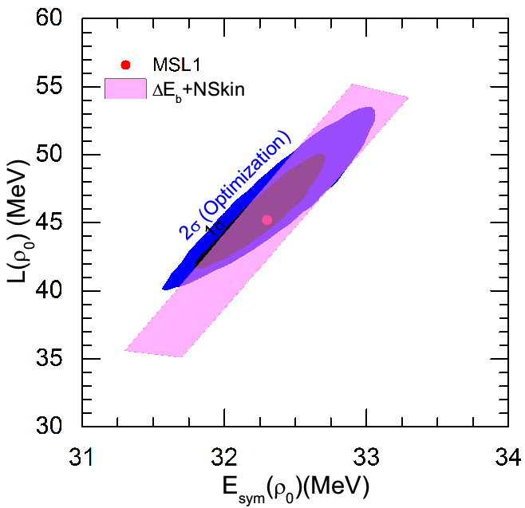
Extrapolation to ρ₀
A fixed value of E_{sym}(ρ_{c}) at ρ_{c} =0.11 fm⁻³ leads to a positive E_{sym}(ρ₀) -L correlation
A fixed value of L(ρ_{c}) at ρ_{c} =0.11 fm⁻³ leads to a negative E_{sym}(ρ₀) -L correlation
Zhen Zhang and Lie-Wen Chen, arXiv:1302.5327
Nicely agree with the constraints from IAS+NSKin by P. Danielewicz; IsospinD+n/p by Y Zhang and ZX Li

Slide 38
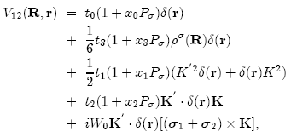
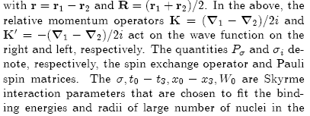
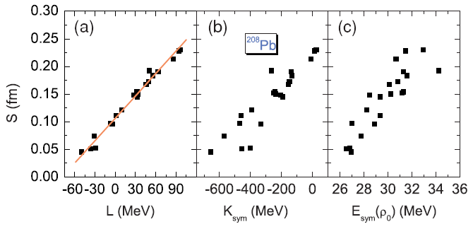

Correlation analysis using macroscopic quantity
input in Nuclear Energy Density Functional
Standard Skyrme Interaction:
There are more than
120 sets of Skyrme-
like Interactions in
the literature
Agrawal/Shlomo/Kim Au
PRC72, 014310 (2005)
Yoshida/Sagawa
PRC73, 044320 (2006)
Chen/Ko/Li/Xu
PRC82, 024321(2010)
_________
9 Skyrme parameters:
9 macroscopic nuclear properties:

Slide 39
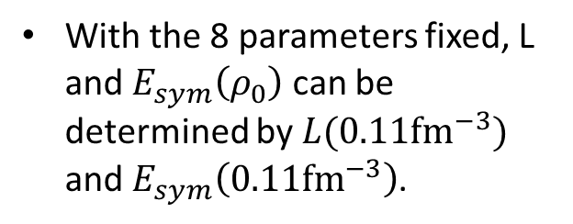
Extrapolation to ρ₀
A fixed value of E_{sym}(ρ_{c}) at ρ_{c} =0.11 fm⁻³ leads to a positive E_{sym}(ρ₀) -L correlation
A fixed value of L(ρ_{c}) at ρ_{c} =0.11 fm⁻³ leads to a negative E_{sym}(ρ₀) -L correlation
Zhen Zhang and Lie-Wen Chen
arXiv:1302.5327
Nicely agree with the constraints from IAS+NSKin by P. Danielewicz; IsospinD+n/p by Y Zhang and ZX Li

Slide 40
Nuclear Matter EOS: Many-Body Approaches
The nuclear EOS cannot be measured experimentally, its determination thus depends on theoretical approaches
Microscopic Many-Body Approaches
Non-relativistic Brueckner-Bethe-Goldstone (BBG) Theory
Relativistic Dirac-Brueckner-Hartree-Fock (DBHF) approach
Self-Consistent Green’s Function (SCGF) Theory
Variational Many-Body (VMB) approach
Green’s Function Monte Carlo Calculation
V_{lowk} + Renormalization Group
Effective Field Theory
Density Functional Theory (DFT)
Chiral Perturbation Theory (ChPT)
QCD-based theory
Phenomenological Approaches
Relativistic mean-field (RMF) theory
Quark Meson Coupling (QMC) Model
Relativistic Hartree-Fock (RHF)
Non-relativistic Hartree-Fock (Skyrme-Hartree-Fock)
Thomas-Fermi (TF) approximations

Slide 41
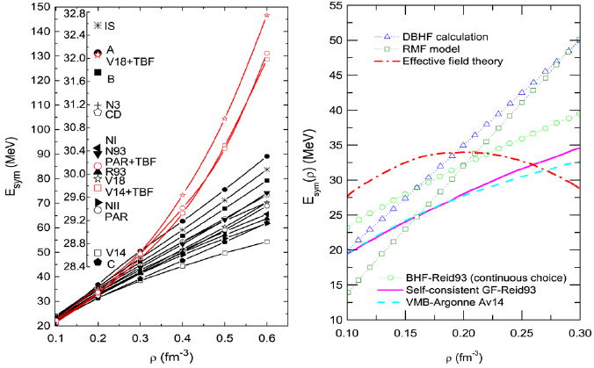
Nuclear Matter Symmetry Energy
Chen/Ko/Li, PRC72, 064309(2005)
Chen/Ko/Li, PRC76, 054316(2007)
Z.H. Li et al., PRC74, 047304(2006)
Dieperink et al., PRC68, 064307(2003)
BHF
Notes:
41

Slide 42
Transport model for HIC’s
Isospin-dependent BUU (IBUU) model
Solve the Boltzmann equation using test particle method (C.Y. Wong)
Isospin-dependent initialization
Isospin- (momentum-) dependent mean field potential
Isospin-dependent N-N cross sections
a. Experimental free space N-N cross section σ_{exp}
b. In-medium N-N cross section from the Dirac-Brueckner
approach based on Bonn A potential σ_{in-medium}
c. Mean-field consistent cross section due to m*
Isospin-dependent Pauli Blocking
EOS

Slide 43
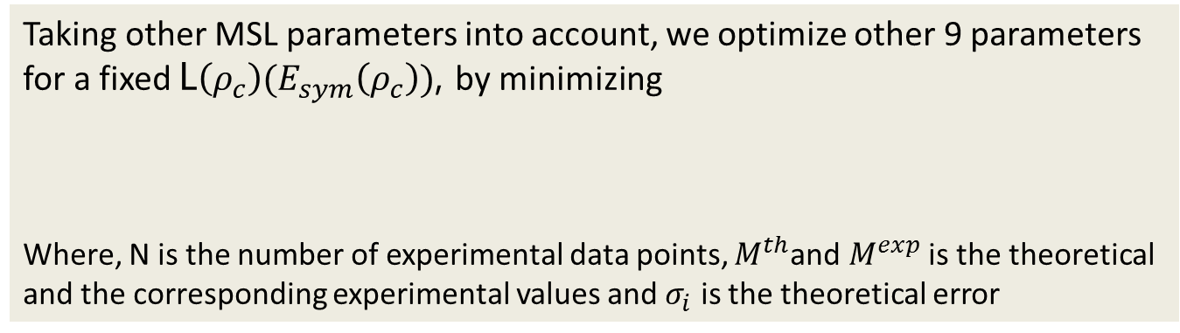
Optimization
The simulated annealing method (Agrawal/Shlomo/Kim Au, PRC72, 014310 (2005))
Experimental data
Binding energy per nucleon and charge rms radius of 25 spherical even-even nuclei (G.Audi et al., Nucl.Phy.A729 337(2003), I.Angeli, At.Data.Nucl.Data.Tab 87 185(2004))

Slide 44
Optimization
Constraints:
The neutron 3p_{1/2}-3p_{3/2} splitting in ²⁰⁸Pb lies in the range of 0.8-1.0 MeV
The pressure of symmetric nuclear matter should be consistent with constraints
obtained from flow data in heavy ion collisions
The binding energy of pure neutron matter should be consistent with
constraints obtained the latest chiral effective field theory calculations with
controlled uncertainties
The critical density ρ_{cr}, above which the nuclear matter becomes unstable by
the stability conditions from Landau parameters, should be greater than 2 ρ ₀
The isoscalar nucleon effective mass m*_{s0} should be greater than the isovector
effective mass m*_{v0}, and here we set m*_{s0} − m*_{v0} = 0.1m (m is nucleon mass in
vacuum) to be consistent with the extraction from global nucleon optical
potentials constrained by world data on nucleon-nucleus and (p,n) charge-
exchange reactions and also dispersive optical model for Ca, Ni, Pb
P. Danielewicz, R. Lacey and W.G. Lynch, Science 298, 1592 (2002)
I. Tews, T. Kruger, K. Hebeler, and A. Schwenk, PRL 110, 032504 (2013)
C. Xu, B.A. Li, and L.W. Chen, PRC82, 054607 (2010); Bob Charity, DOM (2011)

Slide 45
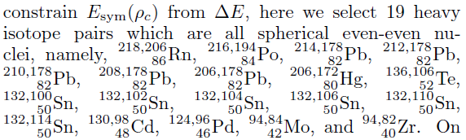
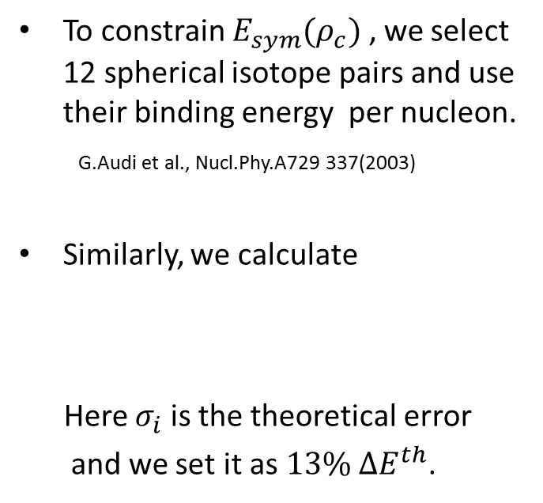
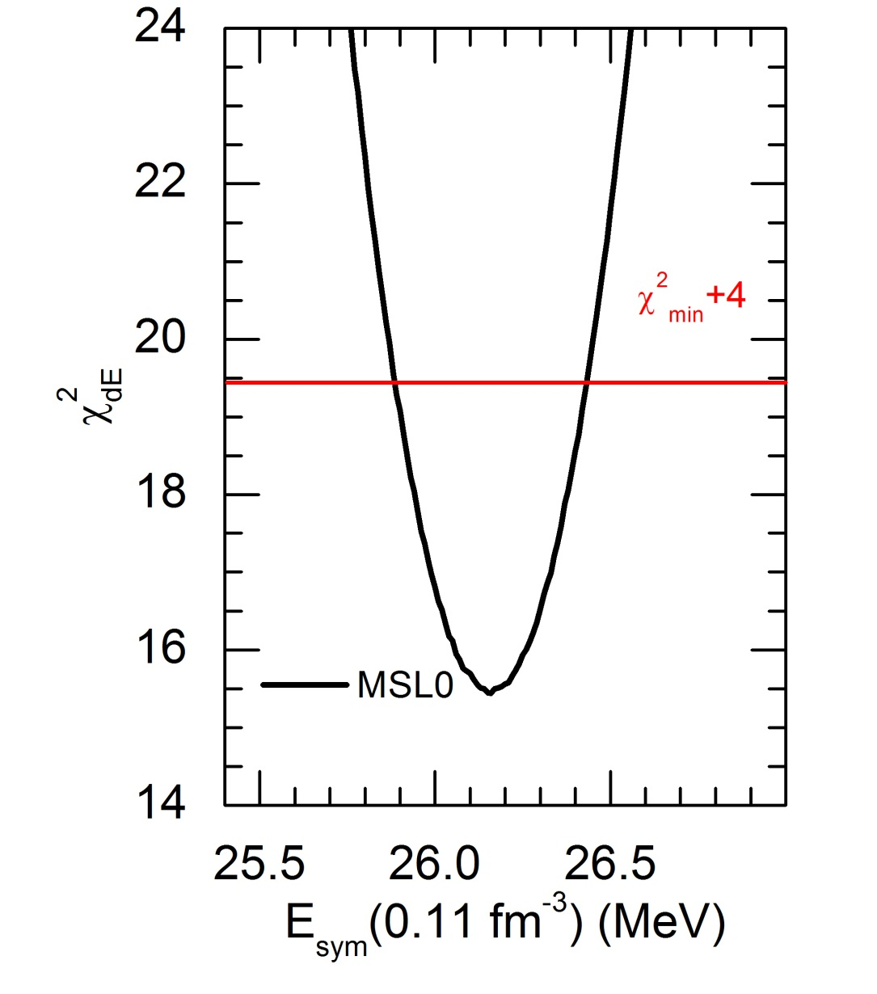

Determine E_{sym}(0.11 fm⁻³) from ΔE
19
23%

