Slide 1
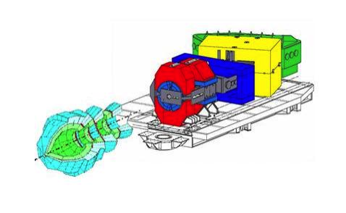
Exploring the symmetry energy with the
^{40,48}Ca+^{40,48}Ca systems
Abdou Chbihi
GANIL

Slide 2
Accessing the symmetry energy outline
From the isotopic distributions
  SMF predictions: rely isovector variance to Esym
  AMD predictions: how to extract Esym
  Experiments ^{40,48}Ca+^{40,48}Ca @ E/A = 35 MeV (INDRA-VAMOS)
  Reconstruction of primary fragments
    Distribution of primary Z
    Distribution of primary isotopes ? Aprimary - neutrons
  Esym extracted from PLF and reconst. Frag.
Conclusions

Slide 3


Probing symmetry energy with isovector variance
SMF predictions
freeze-out
T = 3 MeV, Density: ρ₁ = 0.025 fm⁻³ , 2ρ₁ , 3ρ₁
Full SMF simulations in a box for unstable matter allows the fragment formation
Analysis for local density at the freeze-out:
  The isovector variance for cells having the same density
  if the equilibrium is obtain F will corresponds to the symmetry energy.
ρ
F’ ~ T / σ
Maria Colonna, PRL 2013
Notes:
Maria Colonna demonstrated that the isovector variance is related to the symmetry energy term od the EOS. She did this within schastic mean field approach.
Let’s consider this variable F
From the fig locally we reach the equilibrium

Slide 4
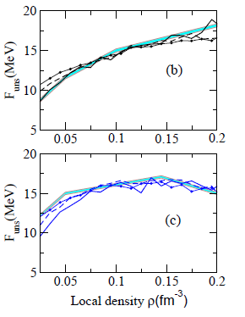
Accessing the symmetry energy from isotopic distribution
SMF predictions
  The Esym increases with density and the trend is more pronounced with stiff,
  In general, low density ->low sym ener -> large variance
  we should see this feature in the isotopic distribution of the fragment as well as in the LP.
stiff
soft
F’ follows the local equilibrium value !

Slide 5
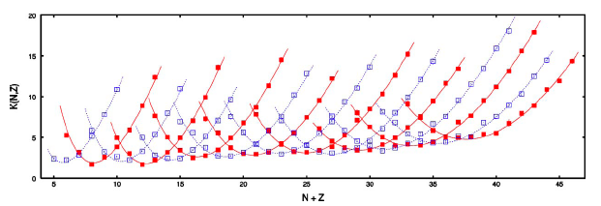
Accessing the symmetry energy
From isotopic distributions…
AMD simulations: ⁴⁰Ca+⁴⁰Ca,⁴⁸Ca+⁴⁸Ca,⁶⁰Ca+⁶⁰Ca,⁴⁶Fe+⁴⁶Fe
E/A=35 MeV and b=0 Primary fragment distributions
A. Ono et al., Phys. Rev. C70, 041604(R) (2004)
K(N,Z) : a global isotopic distribution constructed
by combining all yield of the frag. obtained in the 4 sys

Slide 6

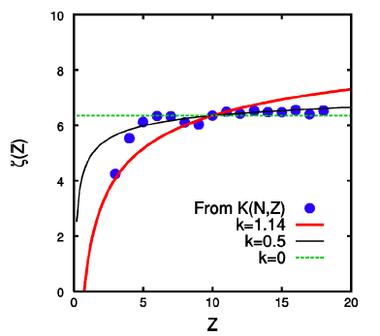

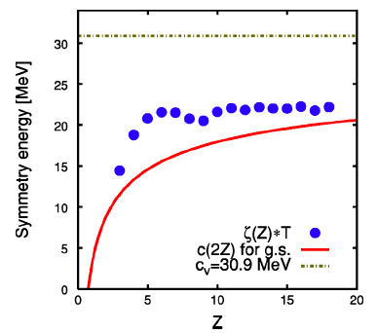
Accessing the symmetry energy
A. Ono et al., Phys. Rev. C70, 041604(R) (2004)
statistical treatment
- ζ(Z) independent of Z (negligible surface effect)→ symmetry energy of INM
- Probe density dependence of C_{sym}(ρ) at subsaturation densities ρ<ρ₀
Notes:
Within the statistical treatment we can relate the symmetry energy of the frag to the z(Z)

Slide 7
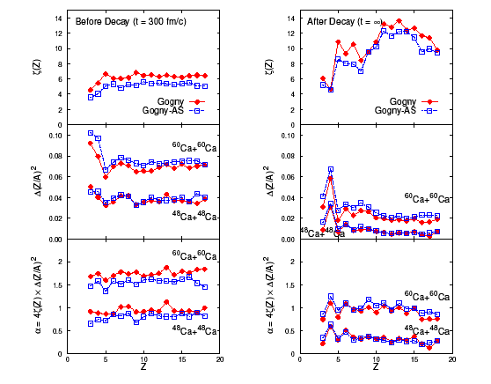
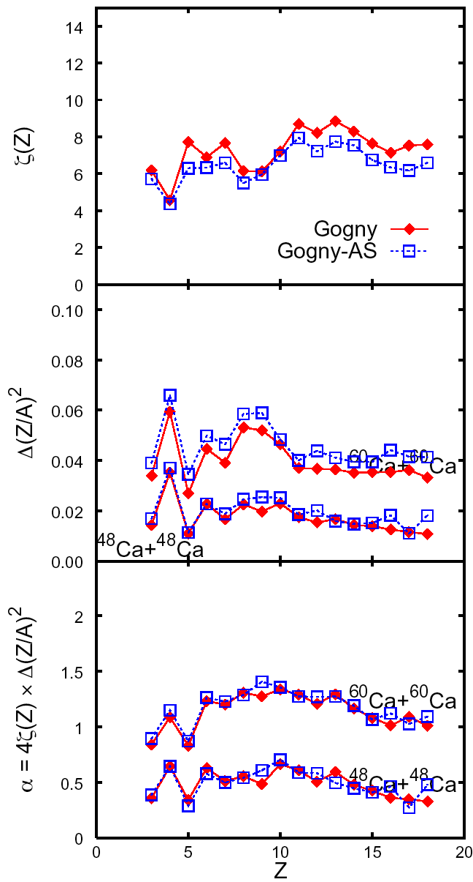
Effects of secondary decays
Primary
Secondary a=A/8
Secondary a=A/16
ζ(Z)
ζ(Z)
ζ(Z)
5
10
15
5
10
15
5
10
15
Z
Z
Z
A. Ono, Acta Physica Hungarica A - Heavy Ion Physics, in press
Secondary decays need to be taken into account for comparison to experimental data
Statistical model : main ingredient is the level density parameter. But what is isospin dependence of a ?
Or/and : experimentally provide the primary distributions

Slide 8
Experiments coupling
INDRA-VAMOS
Symmetry energy experiments
⁴⁰Ca + ⁴⁰Ca @ E/A = 35 MeV
⁴⁰Ca + ⁴⁸Ca @ E/A = 35 MeV isospin diffusion
⁴⁸Ca + ⁴⁰Ca @ E/A = 35 MeV isospin diffusion
⁴⁸Ca + ⁴⁸Ca @ E/A = 35 MeV
For Bρ (Tm)= 2.2 , 2.12 , 1.957 , 1.80 , 1.656 , 1.523 , 1.401 , 1.289 , 1.186 , 1.091 , 1.004 , 0.923 , 0.849 , 0.782 , 0.719 , 0.661
Isospin dependence of level density experiments (N. Le Neindre)
⁴⁰Ar + ⁶⁴Ni @ E/A = 12.7 MeV (¹⁰⁴Pd)
⁴⁰Ar + ⁶⁰Ni @ E/A = 12.7 MeV (¹⁰⁰Pd)
³⁴Ar + ⁵⁸Ni @ E/A = 13.5 MeV (⁹²Pd)
³⁶Ar + ⁵⁸Ni @ E/A = 13.3 MeV (⁹⁴Pd)
³⁶Ar + ⁶⁰Ni @ E/A = 13.3 MeV (⁹⁶Pd)

Slide 9
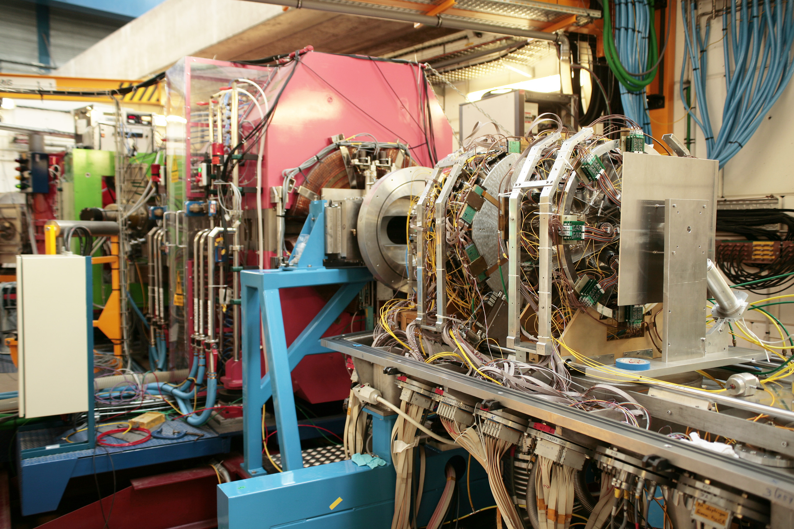
Q2
  VAMOS
  PLF (E503) or residues (E494s)
  High Isotopic Resolution
Dipole
Q1
detection
INDRA
beam
  INDRA in coincidence LCP /IMF
  event characterization
  (b, excitation energy)

Slide 10
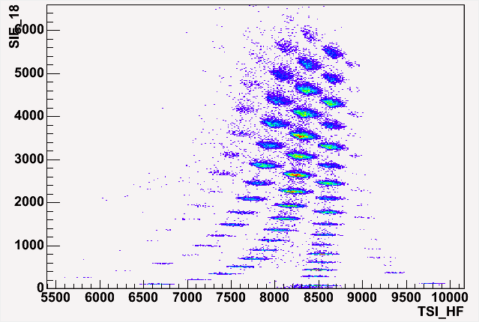
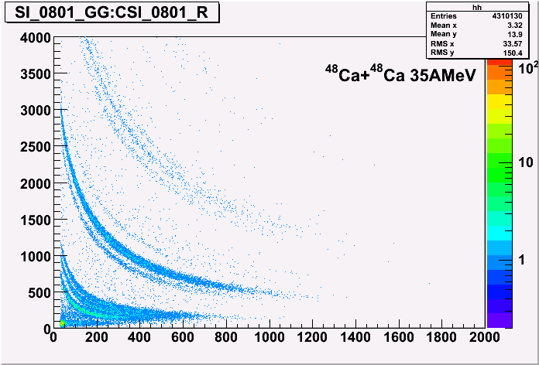
Result @ given Bρ
and for a given Si detector
⁴⁰Ca + ⁴⁸Ca @ 35 MeV/A
Z=N
Ca
K
Ar
Cl
S
P
Si
Al
Na
Mg
F
Ne
INDRA
N
O
Li
Be
B
C
VAMOS Spectrometer

Slide 11
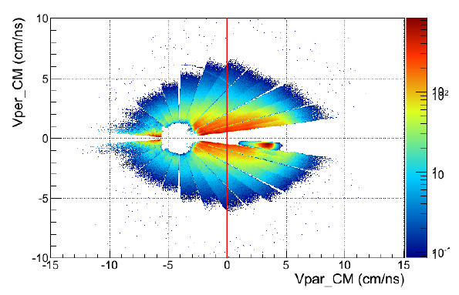
INDRA-VAMOS
INDRA :
all charged products, 7°<Θ<176°, M_{INDRA}≥1
Z, Θ, Φ, E_{k} and A for Z<5
Impact parameter and excitation energy estimation.
VAMOS Spectrometer:
2°<Θ<7°, M_{VAMOS} = 1
PLF : A, Z, Θ, Φ, velocity, Q etc.
Full trajectory reconstruction.

Slide 12
Global view of the reaction products
(INDRA)
(VAMOS)

Slide 13
Isotopic distributions of PLF
Broad A_{PLF} distributions (more than 13 isotopes)
Sensitive to the n-richness of the system
N/Z up to 1.58 (11% N/Z ⁴⁸Ca) very exotic

Slide 14
Reaction mechanism at fermi energy
Peripheral collisions :
  a few nucleons exchanges
  The PLF/TLF can be moderately excited and decay by a few LP
Semi-peripheral collisions :
  P and/or T breackup into two or more fragments (see Udo Schroeder’ talk)
  The fragments can be moderately excited and decay by a few LP
Central collisions : production of fragments (multifragmentation)

Slide 15
Characteristics of LCP emitted in coincidence with the PLF
Z_{PLF} = 20
proton
alpha
Two components drawing coulomb rings:
One centered on the PLF velocity (origin)
Second centered on the TLF.
Velocity selection to associate LCP and PLF emitted from the same PLF
V_{CM}>0

Slide 16
Toward the primary fragment reconstruction
Combining PLF and LCP information
Small multiplicities
proton and alpha up to 1.5
Moderate Ex*
Trend in agreement
with n-richness of the system
for p, t, 3He and 6He
Trend for d, alpha
same number of n, p

Slide 17
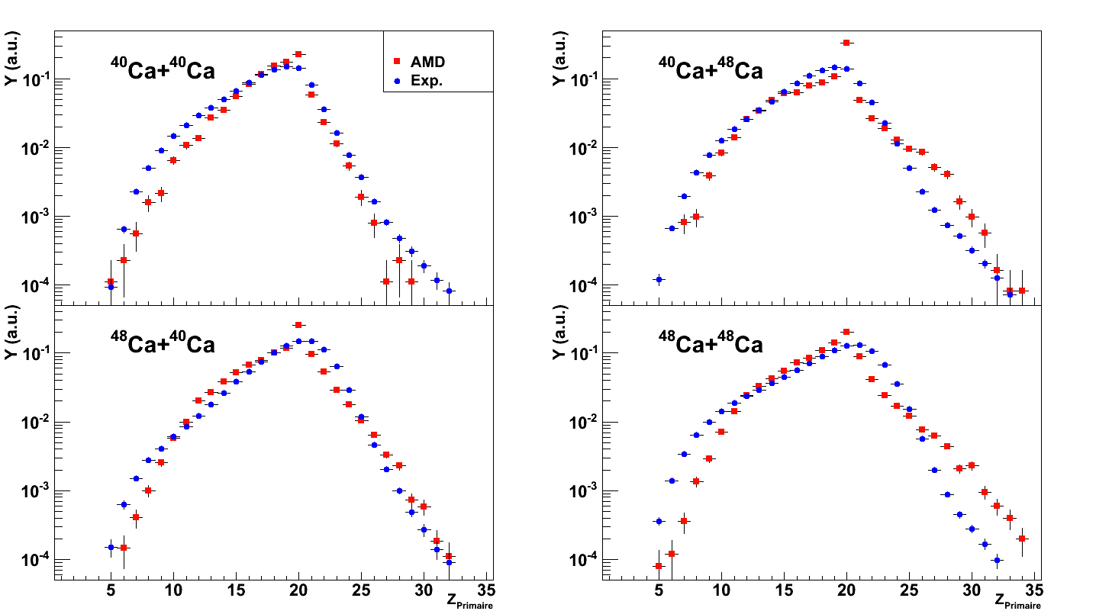
Experimental primary charge distributions:
Comparison with AMD
evt/evt
Z_{primary}
AMD reproduces very well the primary charge of the frag
for the 4 systems.
Notes:
Here are the reconstructed charge distributions for the four systems compared to AMD calculations. AMD reproduces very well the primary charges

Slide 18
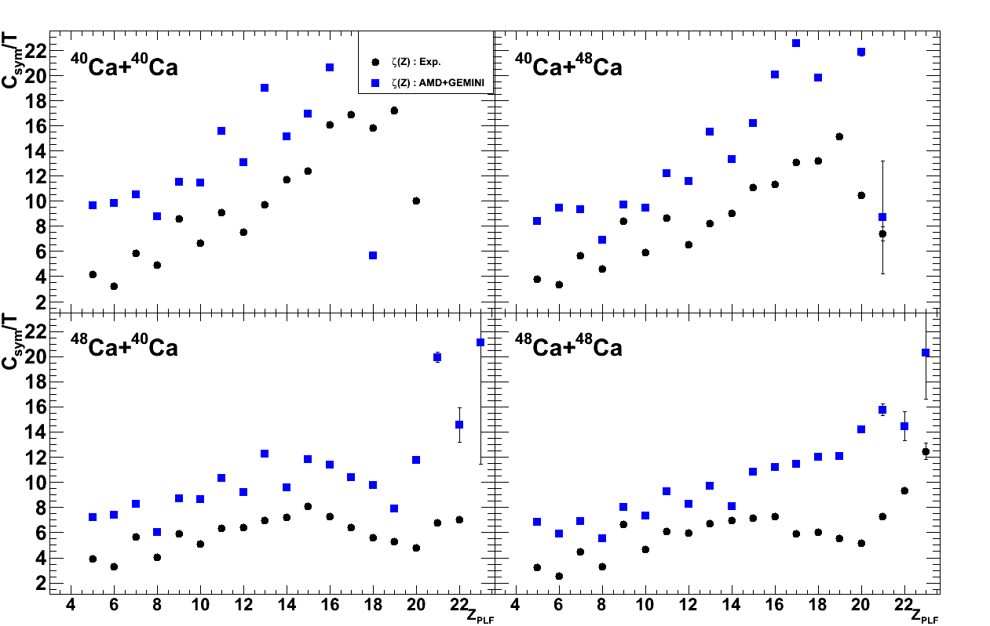
AMD + GEMINI
The trend is reproduced but not the absolute values
Need to change the level density parameter ?

Slide 19
How to obtain A_{primary} distributions ?
Neutrons : not measured → problem
When detected their efficiency is poor, only average values can be measured.
No way to get Aprimary in event/event basis
Two alternatives :
  Simulation with statistical model (GEMINI R. Charity), back-tracing method (see R. Wada talk) :
    For each measured Zprimary -> mapping of (Aprimary, E*, level density parameter)
    Fit -> Weight to each Zprimary, Aprimary, E* which reproduce Z_{PLF}, A_{PLF}, M_{LCP}, Ek LCP
  Use Aprimary – neutron, and simulate the effect of neutron emission on the width of the distribution

Slide 20
Toward primary mass of the fragments
Z_{primary} = 20
Z_{primary} = 18
is not measured
Z_{primary} = 16
Z_{primary} = 12
Can be used as an observable
Notes:
Up to now, all quatities were built in event by event basis

Slide 21
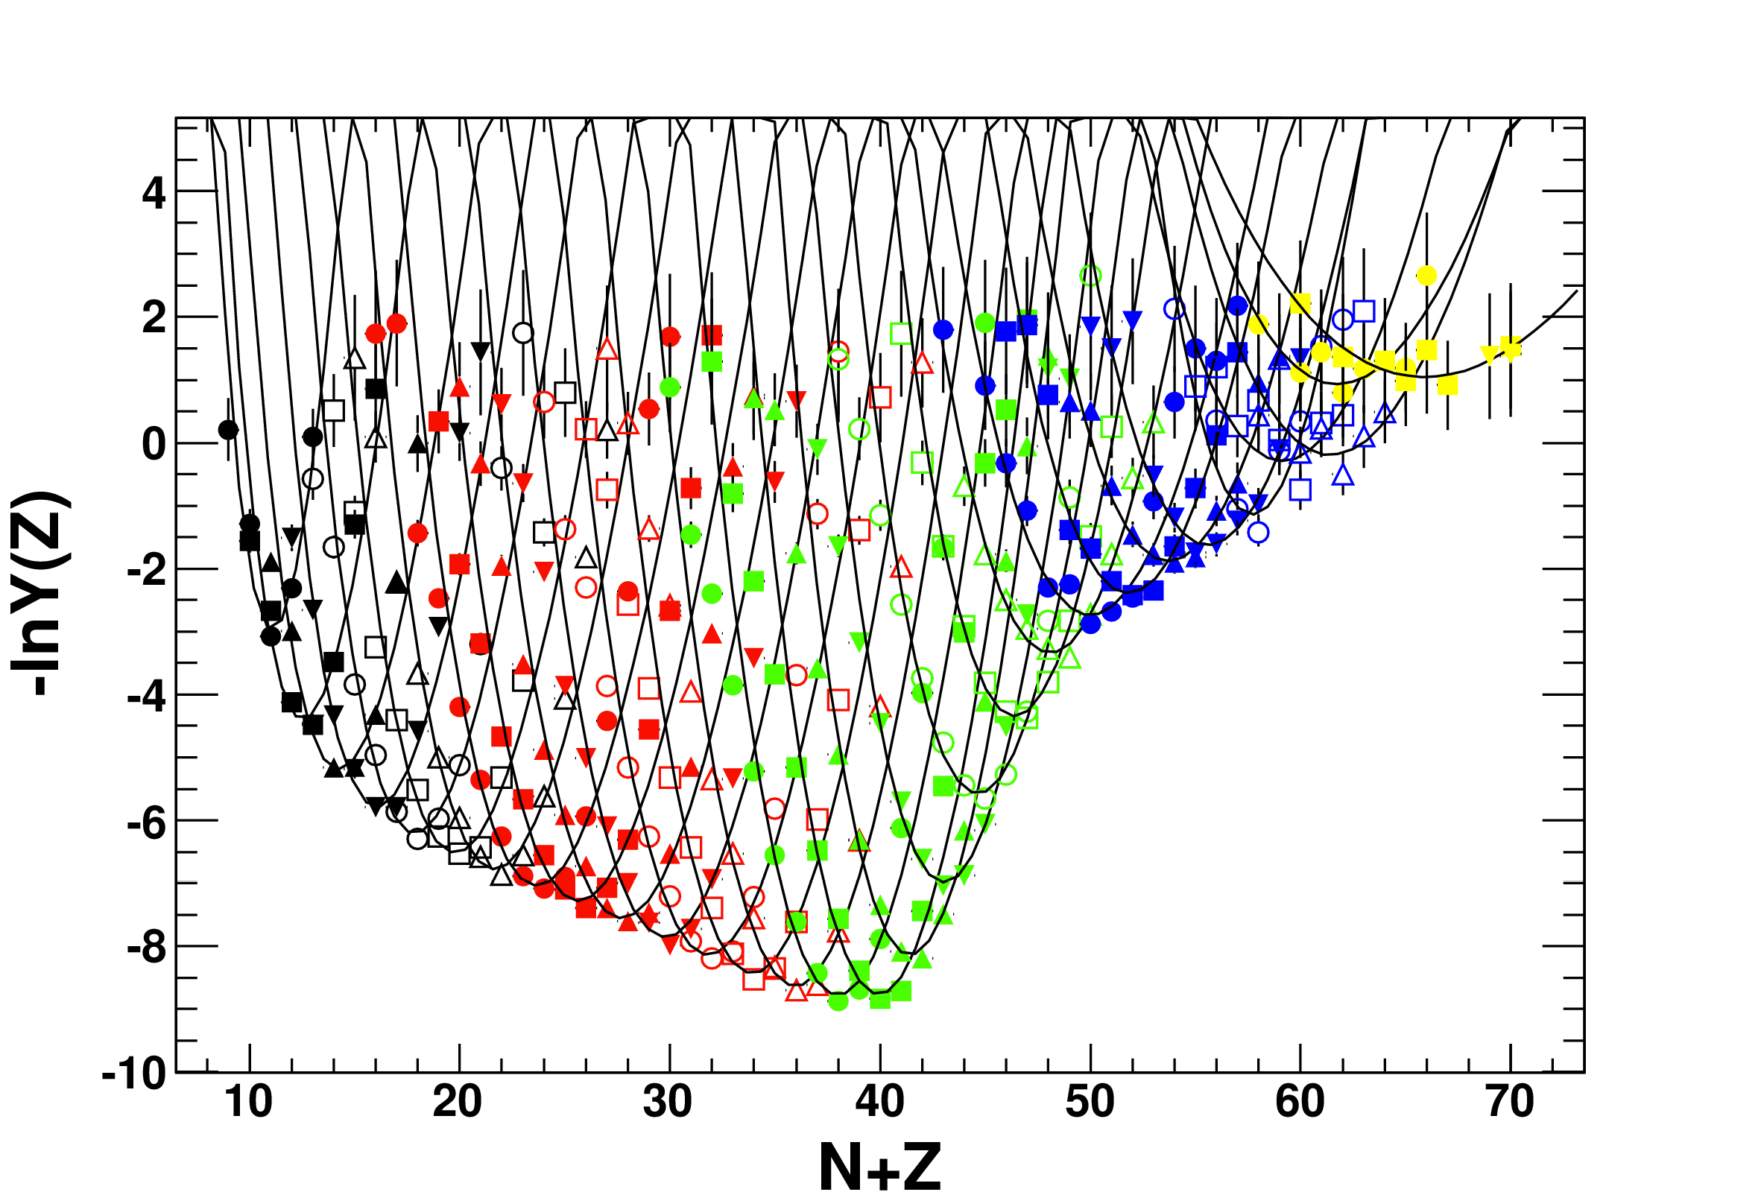
Symmetry energy from primary fragments

Slide 22
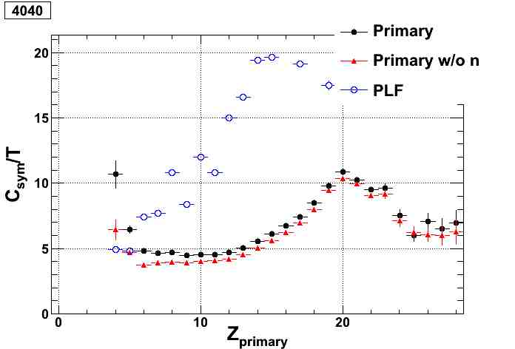
Preliminary results on
Symmetry energy
Esym/T for Apr and Apr-Nn
are similar; for 40Ca+40Ca
As expected different for A_{PLF}
Esym/T = 10, Zpr = 20
is compatible with Esym=27 MeV
if one assumes T=2.5 MeV, and
density close to the saturation
Need to estimate the
temperatures for the other Zpr
from Ek of LCP or other thermom

Slide 23
Production cross section of exotic nuclei beyond the p-drip line
⁴⁰Ca+⁴⁰Ca
PLF
primary
Decay modes
CP, n, γ… spectroscopy

Slide 24
Production cross section of exotic nuclei beyond the drip lines
PLF
⁴⁸Ca+⁴⁸Ca
primary

Slide 25
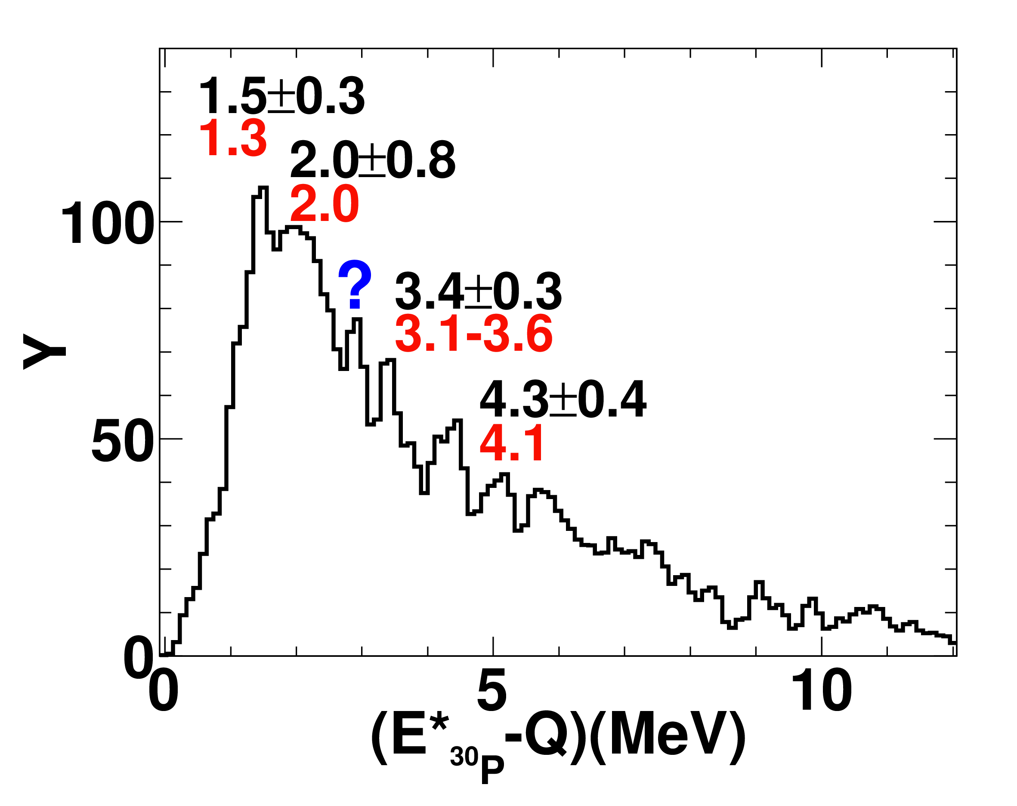
Spectroscopy of ²⁹Si
²⁹Si(p,γ)³⁰P
²⁹Si*
Experimental reconstruction
(correlation techniques)
Study excited states of exotic nuclei
Study cluster states in nuclei
(in progress)
³²P->p+³¹Si*
->n+ ³⁰Si*
->²⁹Si*+n

Slide 26
Summary and Conclusions
Exploration of E_{sym}(ρ) with HI-Collisions
Observable : isotopic distribution of frag supported by SMF and AMD calculations
Accessing the symmetry energy
  Take into account the secondary effects → isospin dependence of level density parameter should be studied. →conclusion of Esym depends on level density parameter
  Primary experimental isotopic distributions
    Zprimay distributions were reconstructed experimentally
    Aprimary – neutrons distributions reconstructed exp. but need to take into account the effect of neutron emission on the Apr – neutrons distributions
Esym was extracted for ⁴⁰Ca+⁴⁰Ca : work is in progress for the n-rich systems
Spectroscopy of exotic nuclei beyond the drip lines

Slide 27
A. Chbihi, G. Verde, J.D. Frankland, J. Moisan, B. Sorgunlu, F. Rejmund, M. Rejmund, J.P. Wieleczko,
Sarmishtha Bhattacharya, P. Napolitani
GANIL, CEA, IN2P3‑CNRS, FRANCE
INFN, Catania, ITALY
E. Bonnet, B. Borderie, E. Galichet, N. Le Neindre, M.F. Rivet
IPN Orsay, IN2P3‑CNRS, FRANCE
R. Dayras, L. Nalpas, C. Volant
DAPNIA/SPhN, CEA Saclay, FRANCE
D. Guinet, P. Lautesse
Institut de Physique Nucléaire, IN2P3‑CNRS et Université, Caen Cedex, FRANCE
R. Bougault, O. Lopez, B. Tamain, E. Vient
LPC. IN2P3‑CNRS. ENSICAEN et Université, Caen Cedex, FRANCE
A. Ono
Department of Physics, Tohoku University, Sendai, JAPAN
R. Roy
Université de Laval, Quebec, CANADA
W. Trautmann, J. Lukasik
GSI, D-64291 Darmstadt, GERMANY
E. Rosato, M. Vigilante
Dipartimento di Scienze Fisiche, Un. Federico II, Napoli, ITALY
M. Bruno, M. D’Agostino, E. Geraci, G. Vannini
INFN and Dipartimento di Fisica, Bologna ITALY
L. Bardelli, G. Casini, A. Olmi, S. Piantelli, G. Poggi
INFN and Dipartimento di Fisica, Firenze,ITALY
F. Gramegna, G. Montagnoli
INFN, Laboratori Nazionali di Legnaro, ITALY
U. Abbondanno
INFN, Trieste, ITALY
M. Parlog, G. Tabacaru
National Institute for Physics and Nuclear Engineering, Bucarest‑Maguerele, ROMANIA
Saila. Bhattacharya, G. Mukherjee
Variable Energy Cyclotron Centre, 1/AF Bidhan Nagar, Kolkata, INDIA
Paola Marini, Mark Boisjoli

