Slide 1
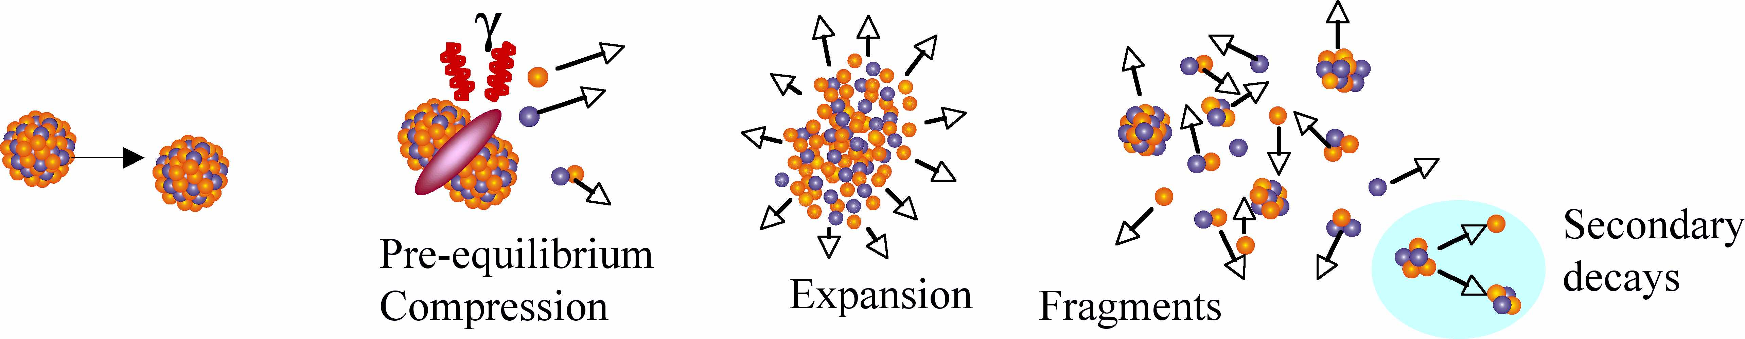
Joe (Bao-An?): “Why nuclear science was and is still so interesting to me”
Dynamics/Thermodynamics (EoS, Asy-EoS)
Spectroscopy of unbound states: multi-particle decays, cluster states
Producing a large variety of nuclear systems and study their properties…
…a well equipped laboratory
G. Verde, INFN

Slide 2
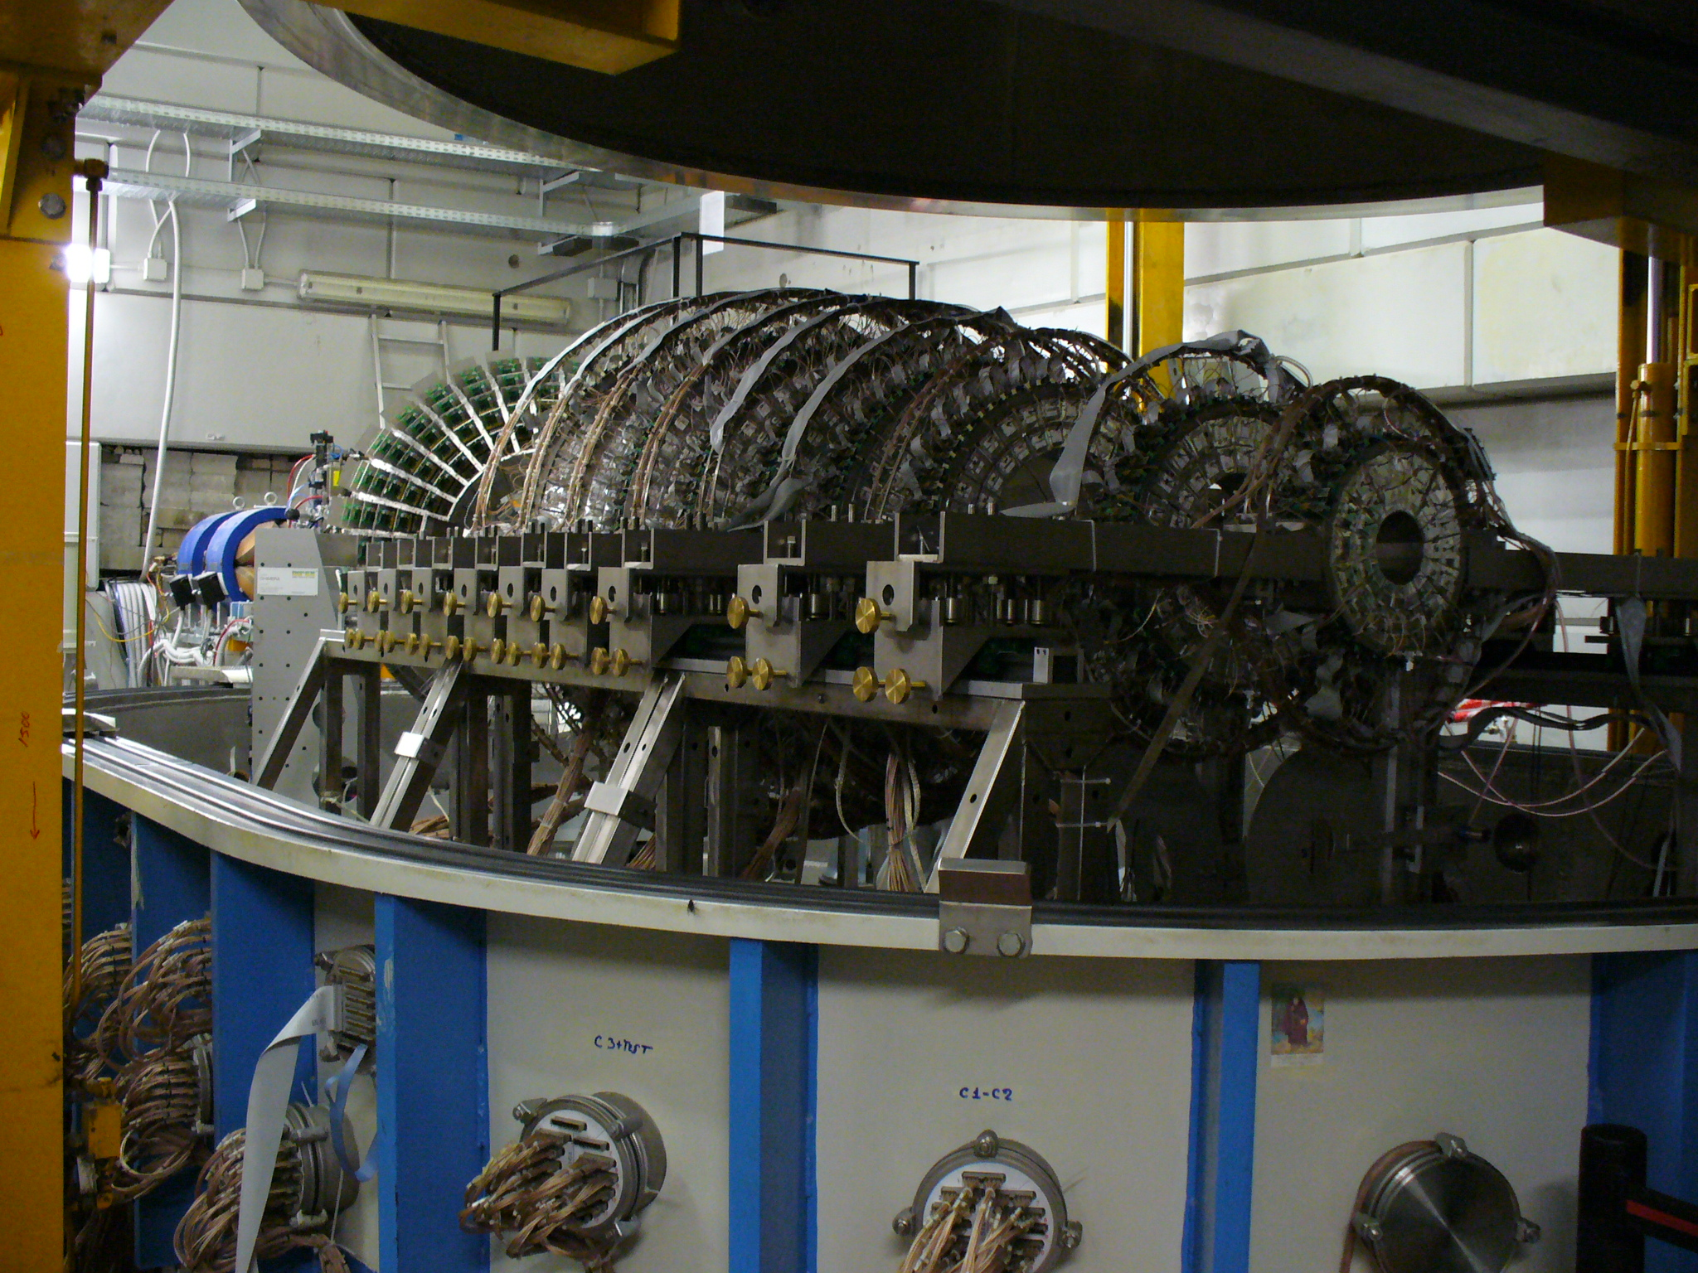
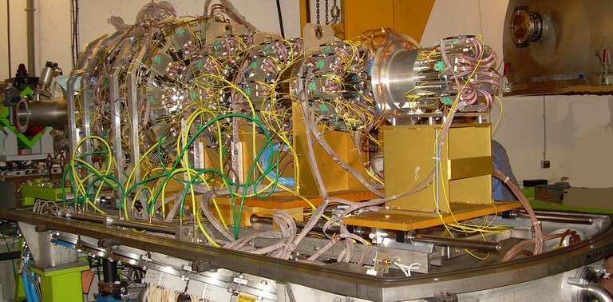
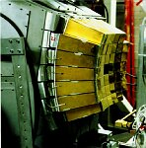
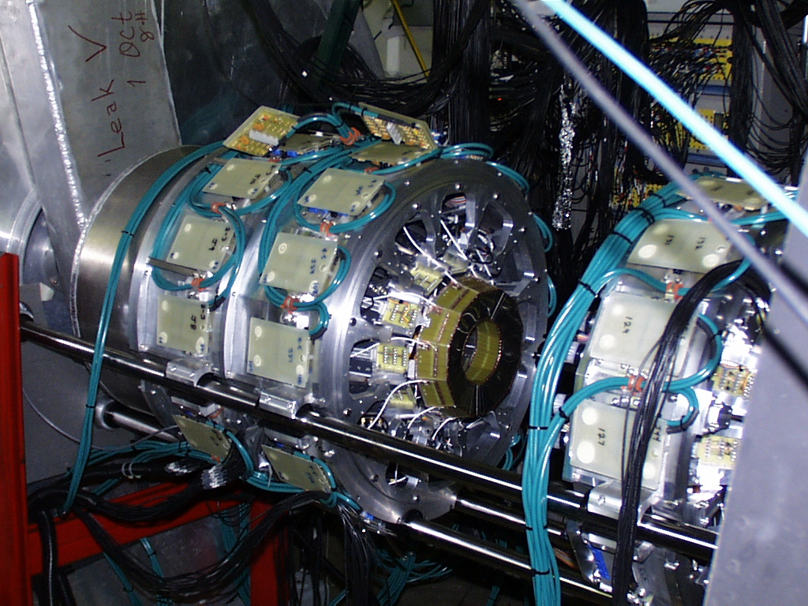
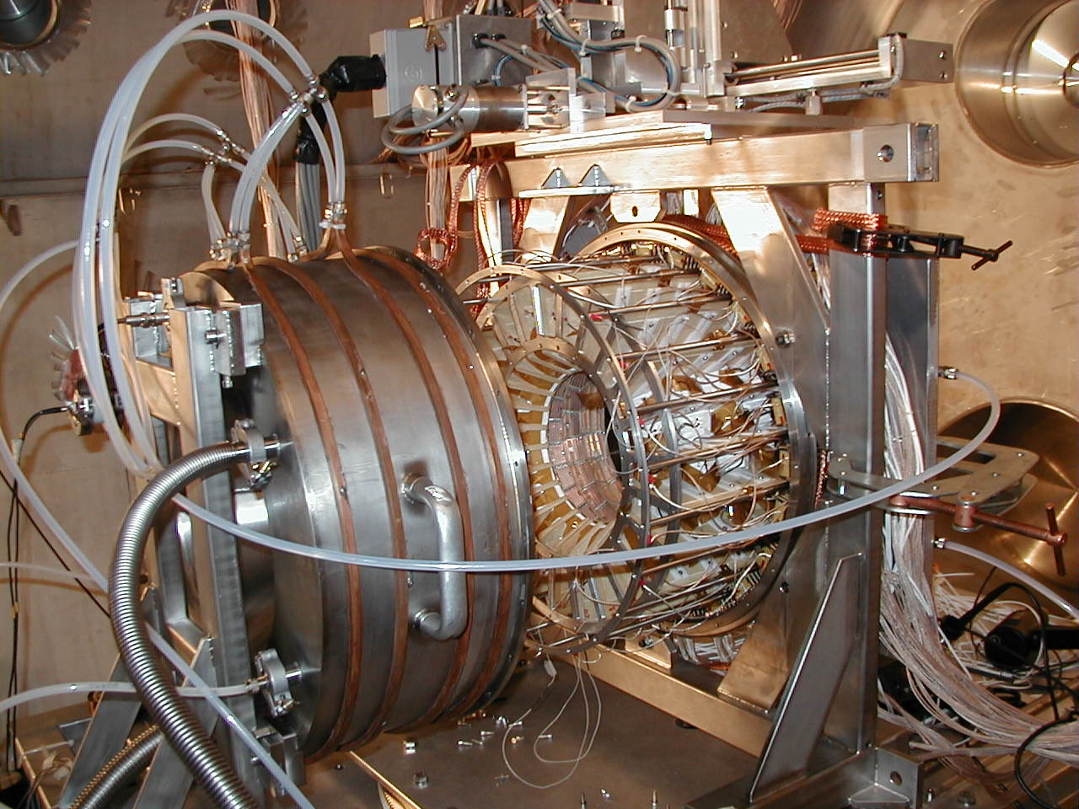
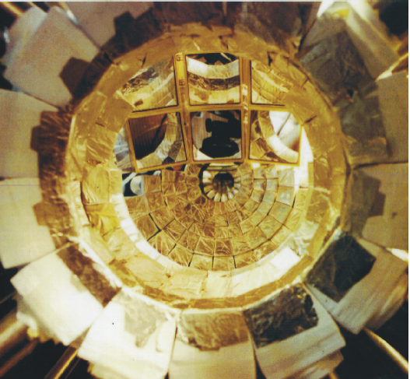
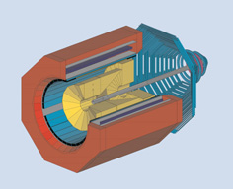
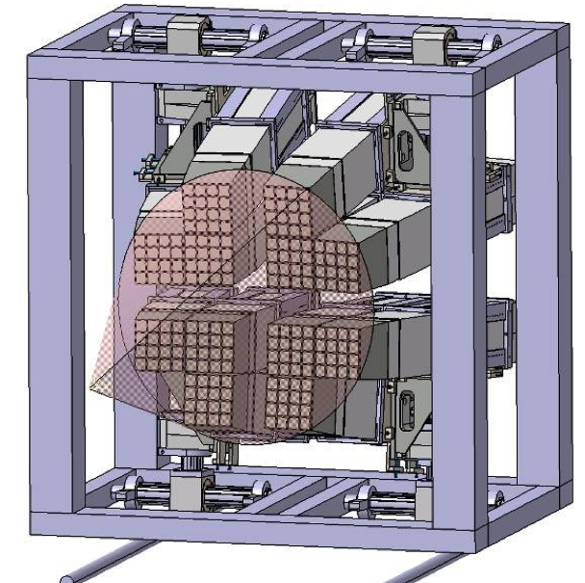
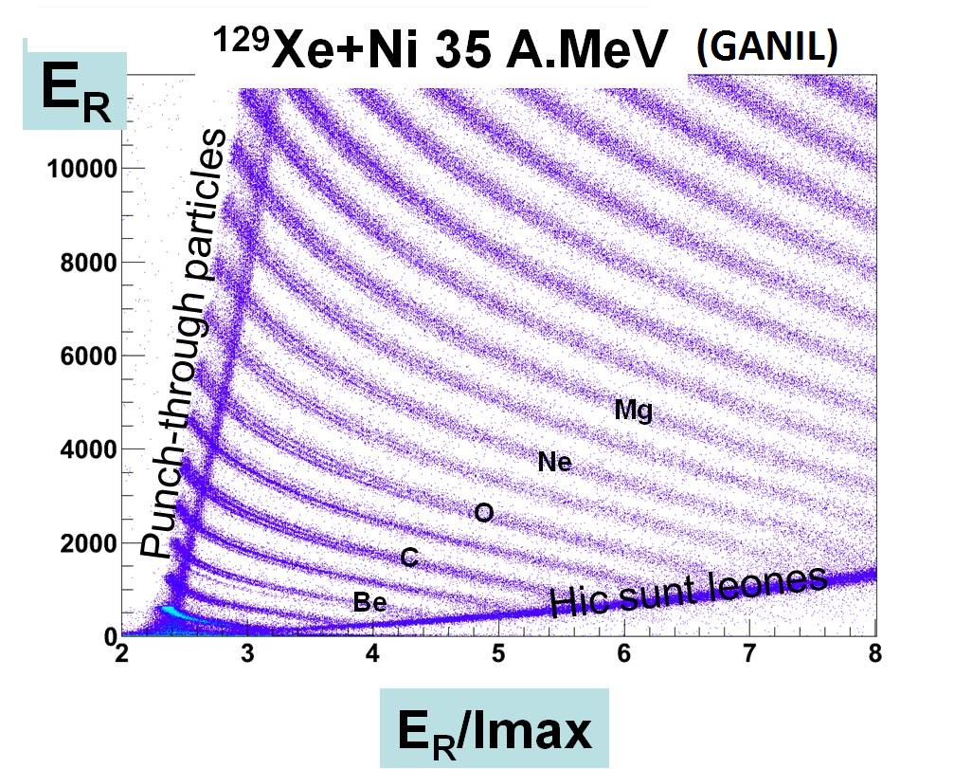
4π and high resolution detectors
Chimera @ LNS
Indra @ GANIL, GSI
Multics @ MSU,LNL,LNS
NIMROD @ TAMU
Garfield @ LNL
Lassa + Miniball @ MSU
FOPI @ GSI
Fazia @ LNL, LNS, GANIL

Slide 3
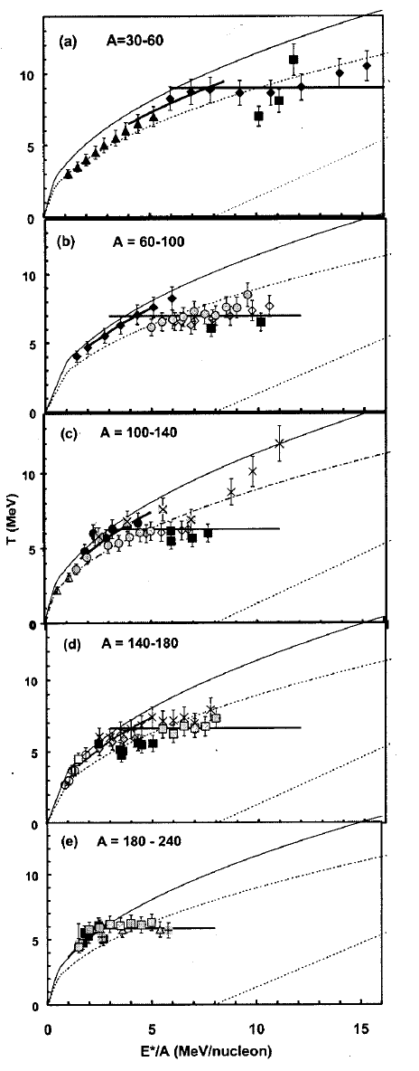
Mass Dependence of caloric curves
A=30-60
Natowitz et al., PRC65 (2002)
most cited Joe’s paper
“…With radioactive beams it should be possible to employ caloric curve measurements to determine the critical parameters for quite asymmetric nuclei, thus testing the isospin dependence of the equation of state … and of nucleon-nucleon interaction…“ Natowitz et al., PRC65 (2002)
A=60-100
A=100-140
T (MeV)
What about N/Z dependence?
…Inspiration for one of the best experiments performed with Chimera: “Limiting”
A=140-180
A=180-240
^{40,48}Ca +^{40,48}Ca,⁴⁰Ca,⁴⁶Ti E/A = 25 MeV
I. Lombardo et al., Chimera Coll.
E*/A (MeV)

Slide 4
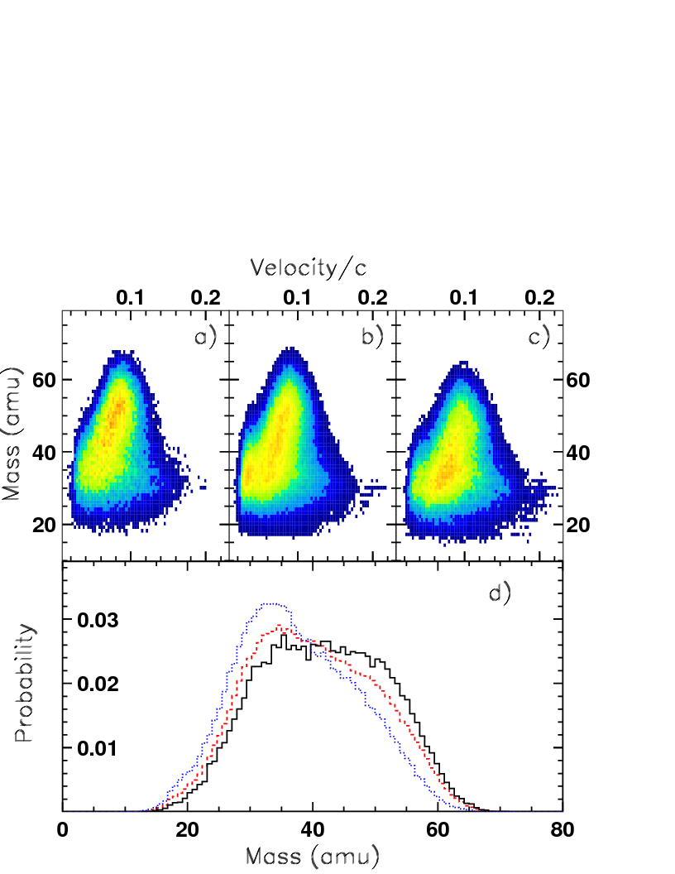
Inspiration for “Limiting” experiment
⁴⁰Ca + ⁴⁸Ca,⁴⁰Ca,⁴⁶Ti E/A = 25 MeV
model
γ=1.5
⁴⁰Ca + ⁴⁸Ca
⁴⁰Ca + ⁴⁰Ca
data
γ=0.5
⁴⁰Ca + ⁴⁰Ca
(N/Z=1)
⁴⁰Ca + ⁴⁸Ca
(N/Z=1.2)
HR
γ=1
⁴⁰Ca + ⁴⁶Ti
(N/Z=1.05)
ΔM = (M₁-M₂)/M_{TOT}
M1 = Largest frament Mass
F. Amorini et al., Phys. Rev Lett. 102 112701 (2009)

Slide 5
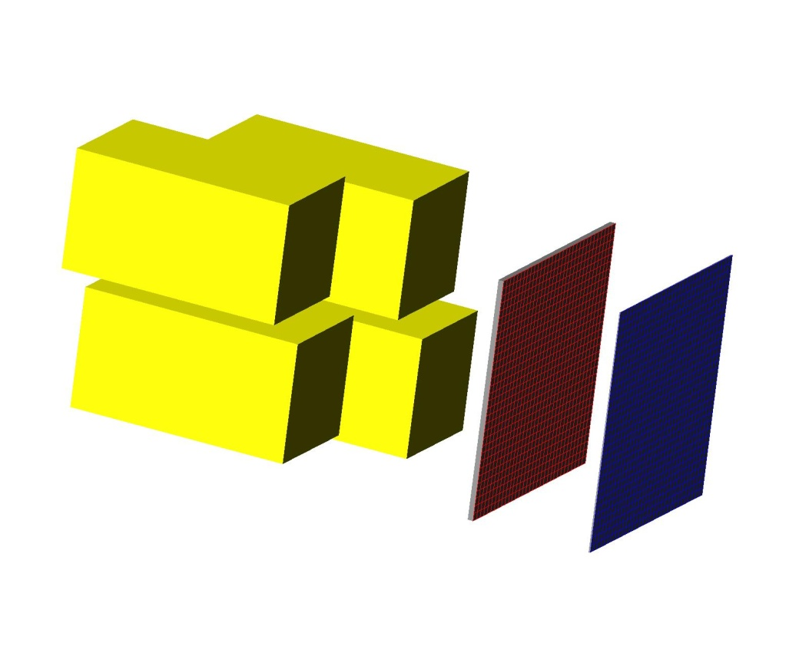
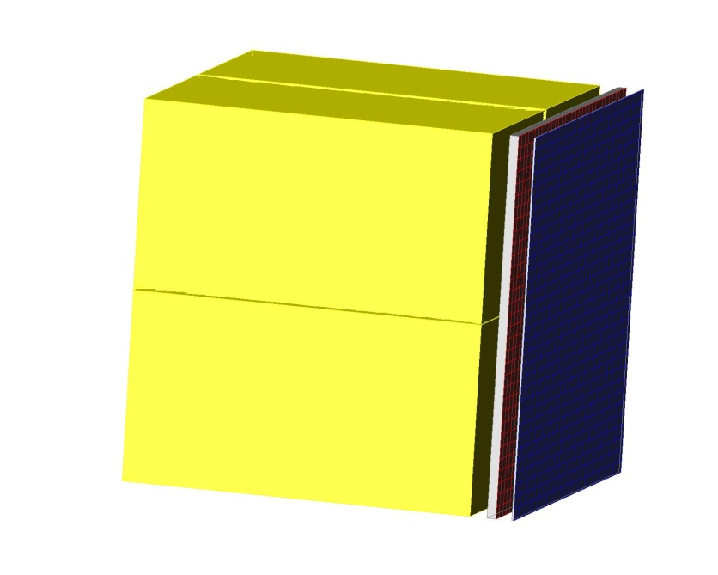
FARCOS PROJECTS @ INFN-CATANIA
Based on (62x64x64 mm³) clusters
1 square (0.3x62x62 mm³) DSSSD 32+32 strips
1 square (1.5x62x62 mm³) DSSSD 32+32 strips
4 60x32x32 mm³ CsI(Tl) crystals
4 CsI(Tl) crystals (3rd stage)
DSSSD 1500 μm (2nd stage)
Assembly
cluster
DSSSD 300 μm (1st stage)
132 channels by each cluster
Fully reconfigurable: more Si layers, → neutron detection to come…

Slide 6
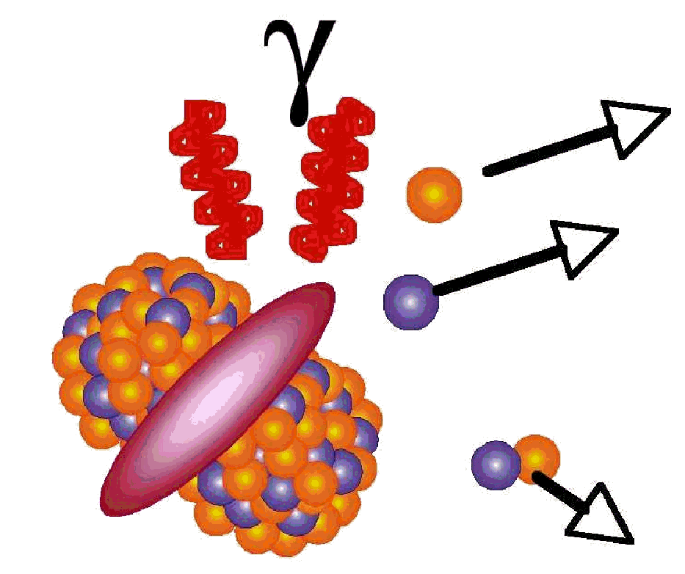
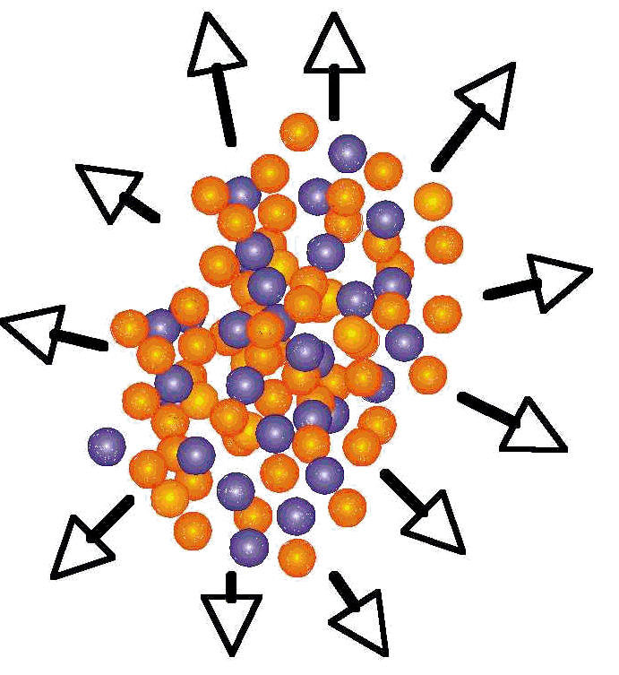
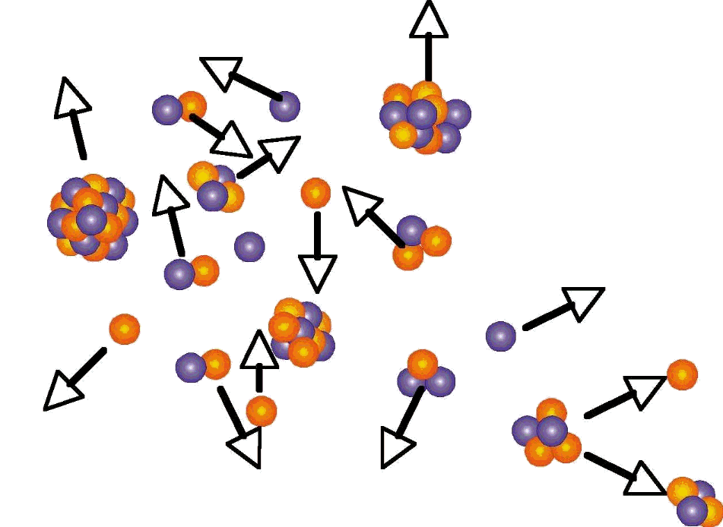
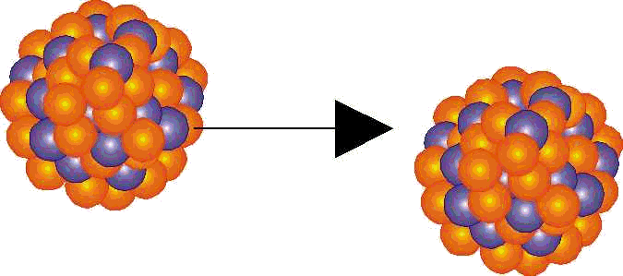
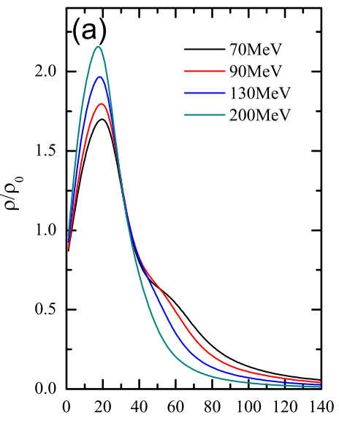
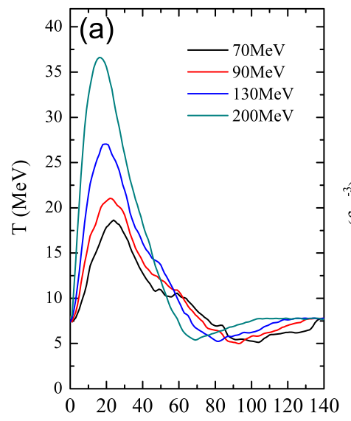
Dynamics in compressing and heating nuclear matter
Projectile
Target
Secondary decays
Pre-equilibrium, stopping, compression
Fragmentation
Flow, expansion
Au+Au
Au+Au
ρ/ρ₀
Temperature
QMD
time (fm/c)
time (fm/c)
Short-lived excited systems (10⁻²³s-10⁻¹⁶s): need reconstruction of all reaction and space-time probes → 4π detectors and correlators (angular and energy resolution)

Slide 7
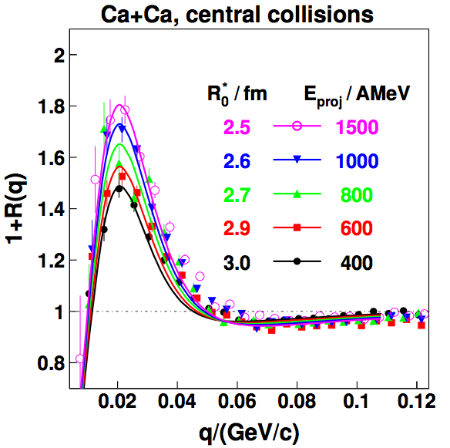
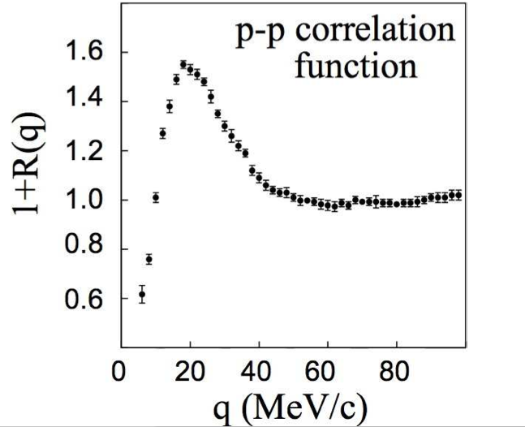
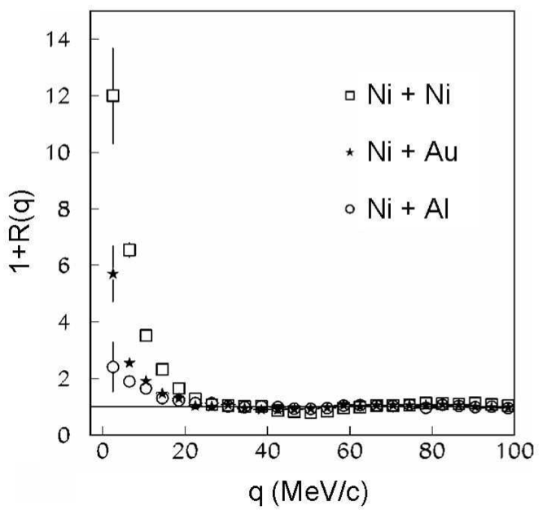
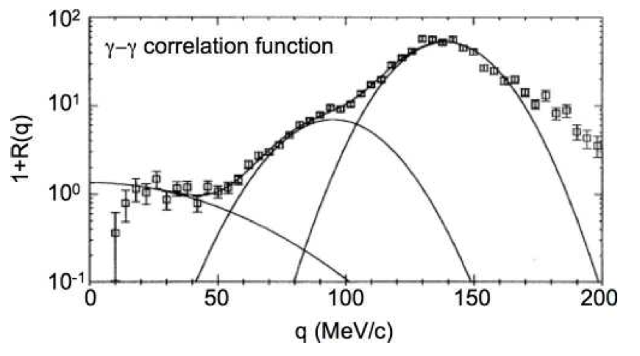
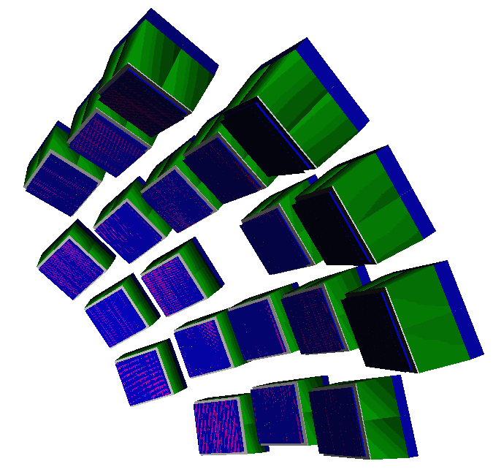
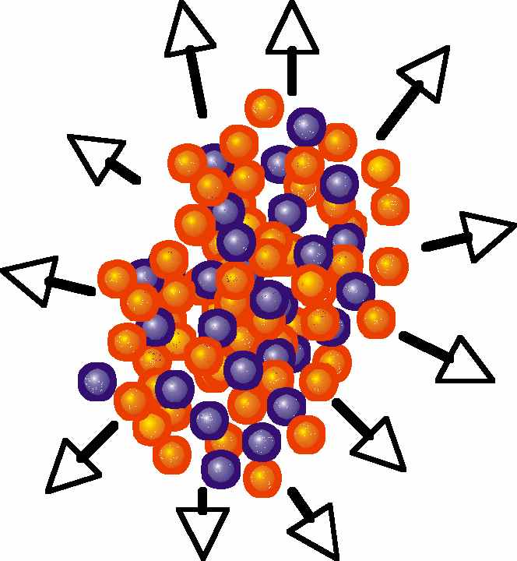
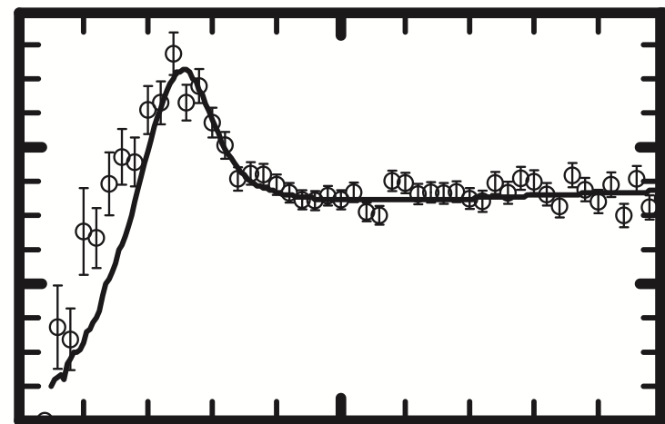
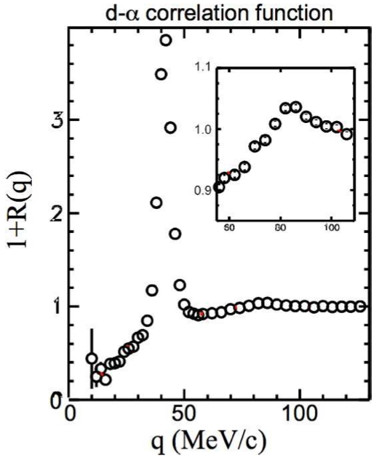
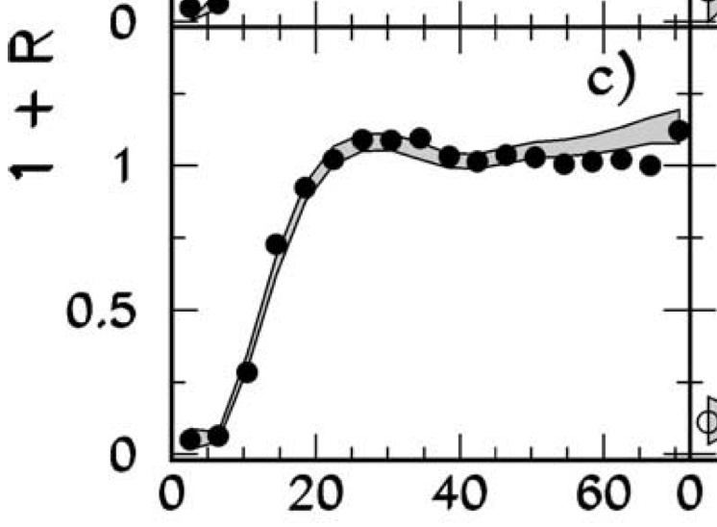
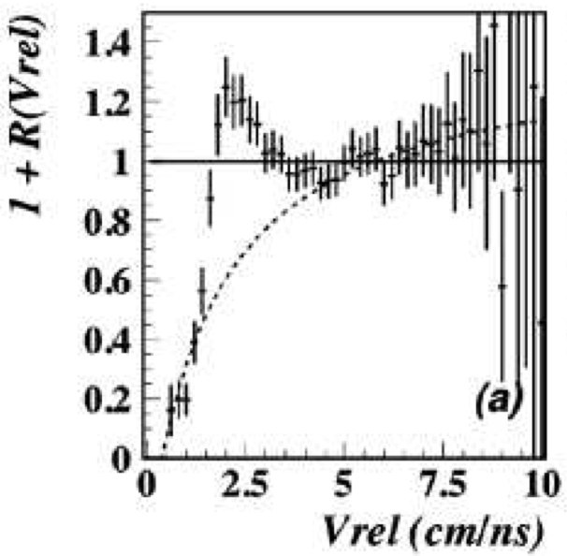
Space-time probes needed: Femtoscopy
FOPI@ GSI
Hodo56 @ NSCL
EDEN @ LNS
n-n
MEDEA@ GANIL
γ-γ
p-p
p-p
HODOCT/Aladin @ GSI
1.2
1+R(q)
Lassa @ NSCL
0.6
p-α
Chimera @ LNS
INDRA @ GANIL
0
100
200
0
q (MeV/c)
IMF-IMF
d-α
LCP-IMF

Slide 8
Space-time probes of dynamics and Asy-EoS – G. Verde (INFN)
Femtoscopy with two-proton correlations
Probing the symmetry energy with NN correlations → Improving comparisons to transport models
Preliminary results from dynamically emitted protons in Xe+Au at 50 MeV/u
Status of the Farcos project @ INFN

Slide 9
WPCF 2013: IX Workshop on Particle Correlations and Femtoscopy
Acireale (Sicily), November 5-8, 2013
Femtoscopy in Heavy-ion collisions at relativistic and intermediate energies
Spectroscopy with multi-particle correlations
N/Z effects on elliptic flow
You are all welcome!
Registration and abstract submission open until September 30th

Slide 10
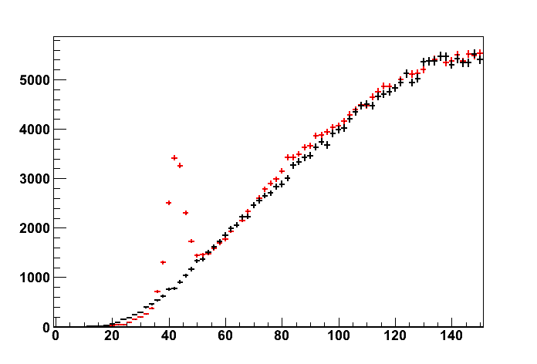
Correlation functions and femtoscopy
Final-state interactions
Deuteron-Alpha correlations
+ Coincidence pairs
Y₁₂ (q)
+ Uncorrelated pairs
q (MeV/c)
Nuclear FSI: correlation at q=42 and 84 MeV/c
1+R(q)
Coulomb FSI: anti-correlation at small q values
⁶Li
deuteron-alpha
High angular resolution required:
→ Low q and resonances
q (MeV/c)

Slide 11
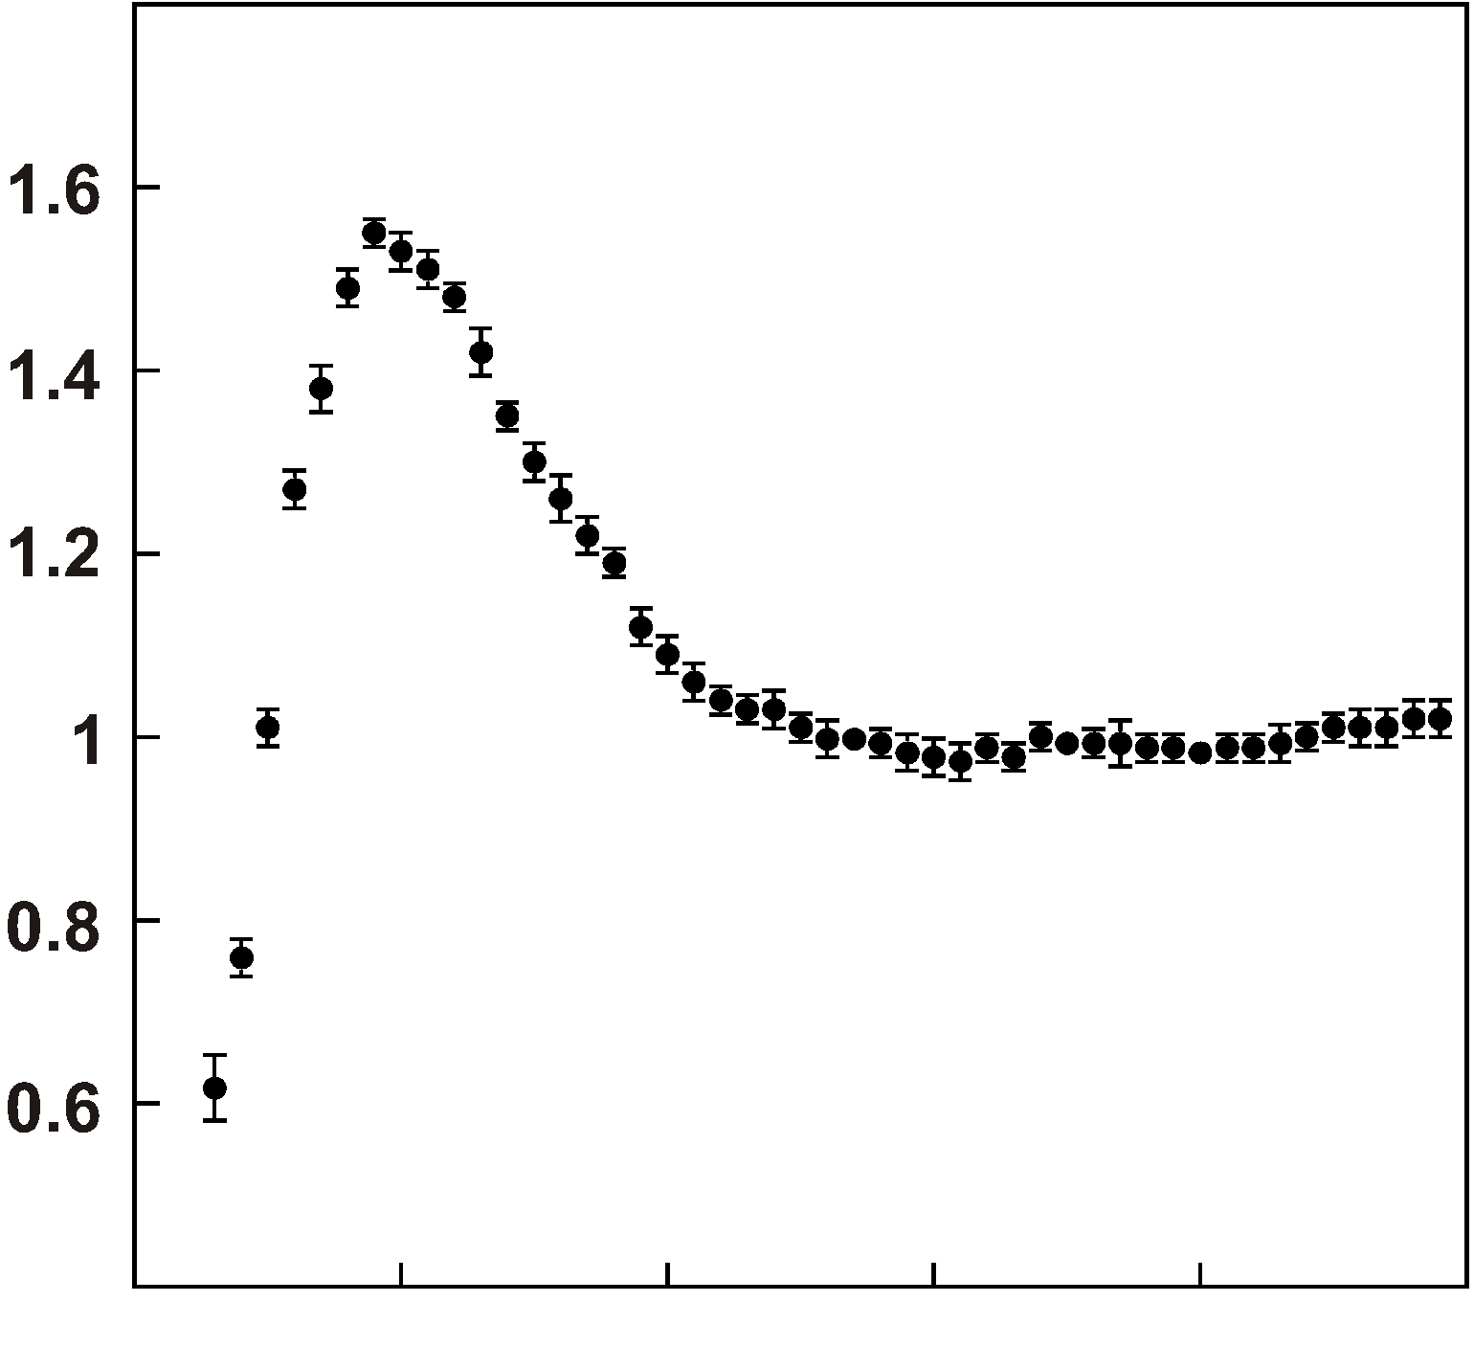
Imaging correlation functions
P. Danielewicz
D.A. Brown
G. Verde et al., PRC65, 069604 (2002)
Input
Output
Data
Source function
1+R(q)
S(r)
p-p
0
20
40
60
80
100
q (MeV/c)
“Size”
0
4
6
8
0
r (fm)
Integral of S(r) I = fraction of proton pairs from early dynamical emissions (NN collisions and EoS effects)
S(r) profile: probing AsyEoS and σNN in transport models

Slide 12
HIC at Fermi energies: E/A<100 MeV
Pre-equilibrium emission
Flow
Multifragmentation
b=central
b=mid-peripheral
Isospin diffusion & drift
Neck fragments
PLF
TLF
b=peripheral
Isospin diffusion & drift
PLF
TLF

Slide 13
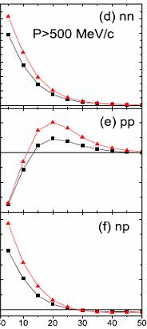
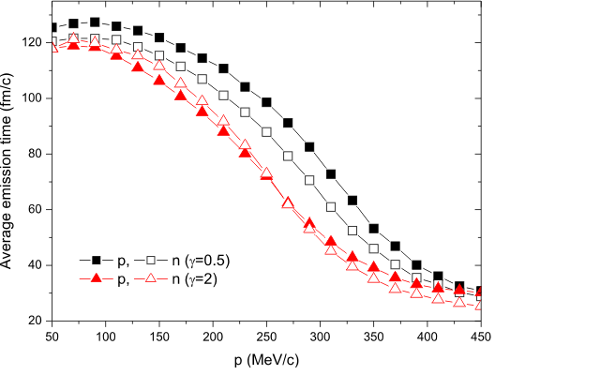
Space-time probes at dynamical stage
IBUU simulations
⁵²Ca+⁴⁸Ca E/A=80 MeV Central collisions
Correlation functions
neutron-neutron
7
Asy-soft
5
3
1
Asy-stiff
1.5
1+R(q)
1.0
proton-proton
0.5
0.0
4
3
proton-neutron
Lie-Wen Chen et al., PRL (2003); PRC(2005)
2
Correlations with dynamically emitted protons and neutrons
→How to perform comparisons to transport models (EoS, Asy-EoS, σ_{NN})
1
q (MeV/c)

Slide 14
Imaging and transport models
Ar+Sc central
Imaged S(r) vs BUU S(r)
BUU cannot handle properly long-lived secondary emissions…
Renormalize BUU sources using imaged S(r)
E/A=120 MeV
Imaging Data
Models
S(r) (fm⁻³)
BUU red σ_{NN}
BUU free σ_{NN}
Handzy et al., MSU
Handzy, Lisa (1994)
r (fm)
Source shape sensitive to σ_{NN}
q
e
G. Verde et al., Phys. Rev. C67, 034606 (2003)

Slide 15
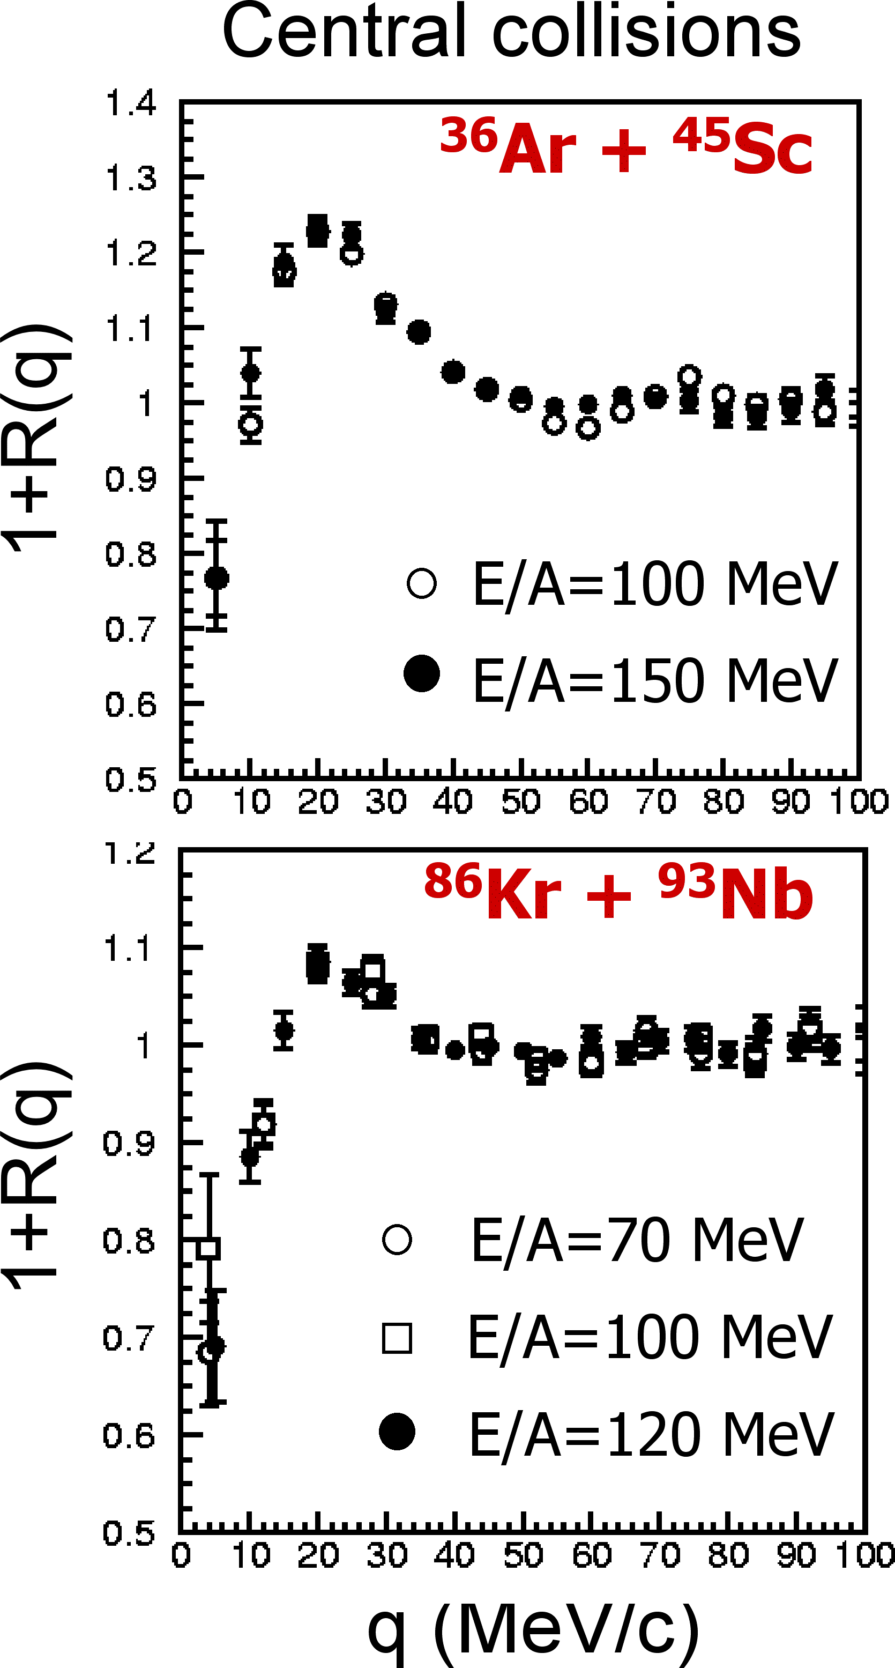
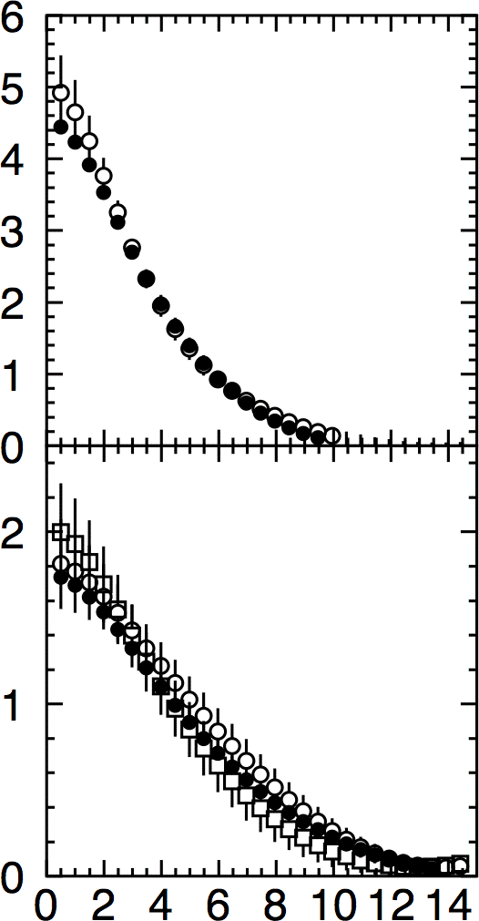
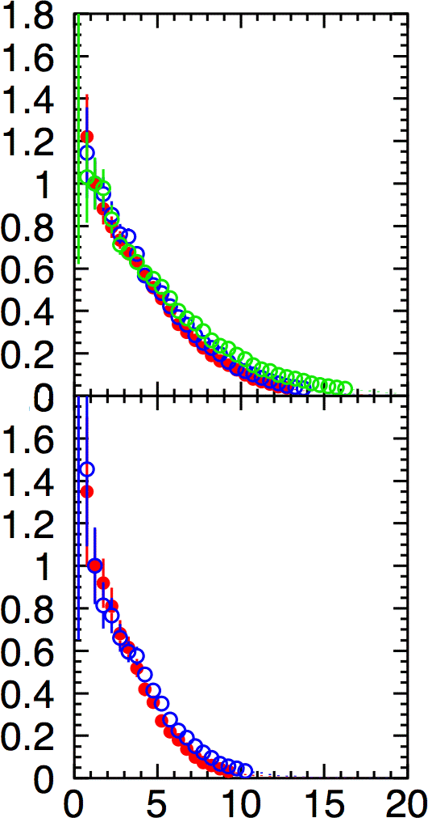
pp systematics in central collisions
Experimental Data
BUU simulations
Kr+Nb BUU
Imaged sources
E/A=120 MeV
100 MeV
70 MeV
S(r)
Ar+Sc BUU
E/A=150 MeV
100 MeV
S(r)
r (fm)
Source size does not charge with E_{beam}: probing the dynamical stage?

Slide 16
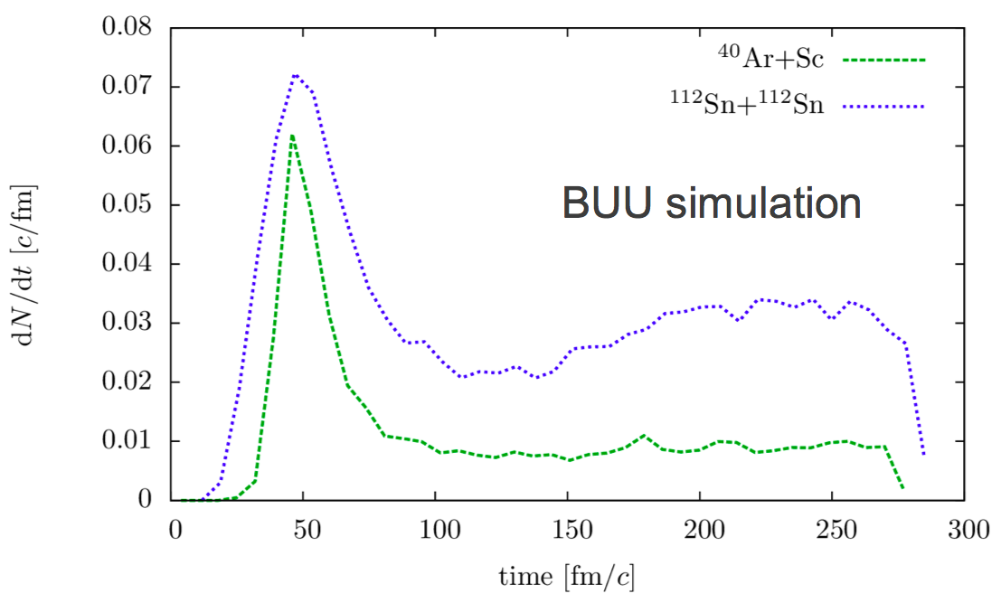
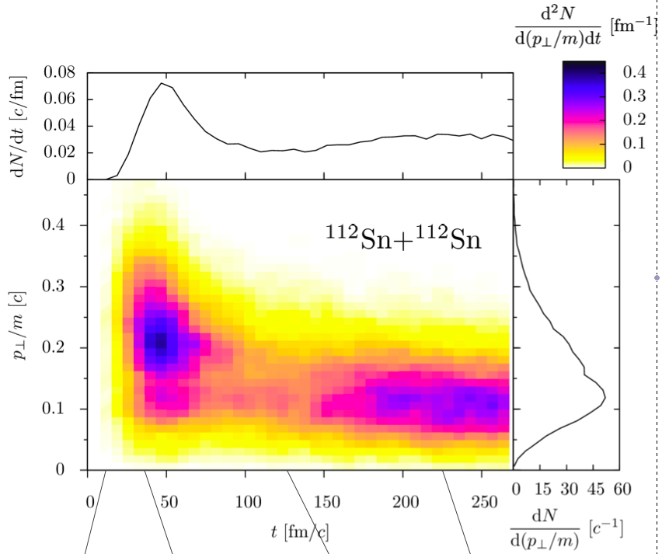
Proton emissions in BUU
Can we find a measurable quantity that would allow us to isolate protons emitted at the early dynamical stage?
If yes:
→ reduce contaminations by long-lived emissions
→ improve comparisons to transport models: relevant to E_{sym}(ρ) and σ_{NN}
Central
early
Emission rate
late
Transverse Momentum
Time (fm/c)
Time (fm/c)
B. Barker, NSCL PhD Thesis

Slide 17
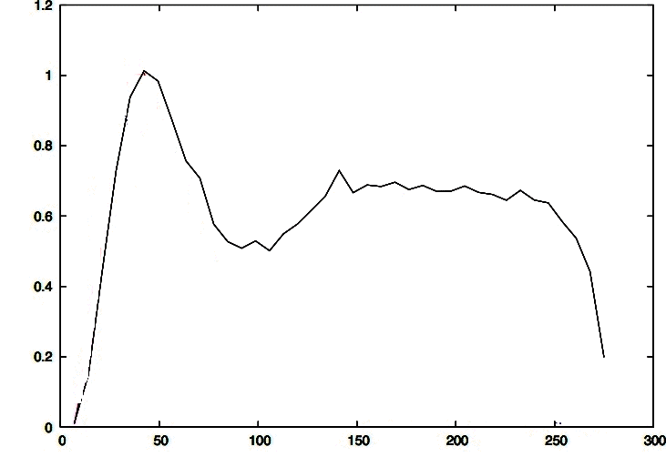
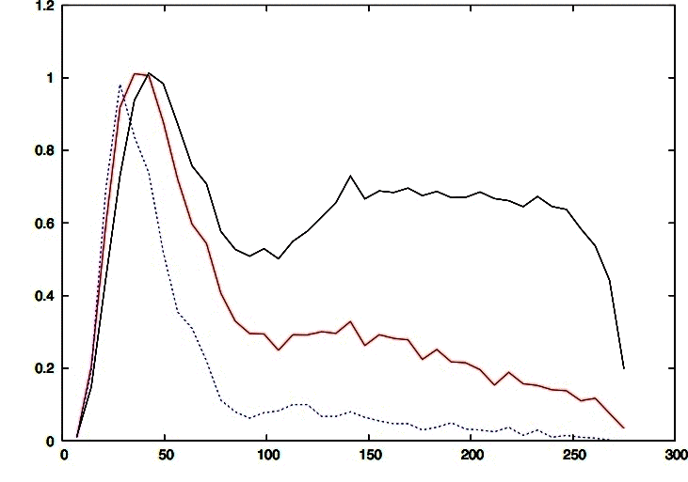
Protons emission time and transverse momentum
Sn+Sn E/A=50 MeV b_{red}=0-0.4
Early
B. Barker et al.
¹¹²Sn+¹²⁴Sn E/A=50 MeV b_{red}=0-0.4
Late
dN/dt
P_{T}/m > 0.2
P_{T}/m > 0.3
time (fm/c)

Slide 18
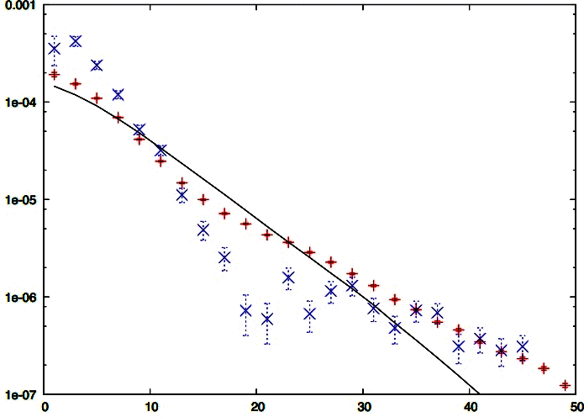
pp sources
P_{T}=p_{T}/m
P_{T} > 0.3
Early pp emitting source
P_{T} > 0.2
No P_{T} gate
S(r) (fm⁻³)
r (fm)
High P_{T} gate to reduce late emissions in BUU and isolate early dynamical emissions
→ improving pp correlation comparisons and tests of AsyEoS?

Slide 19
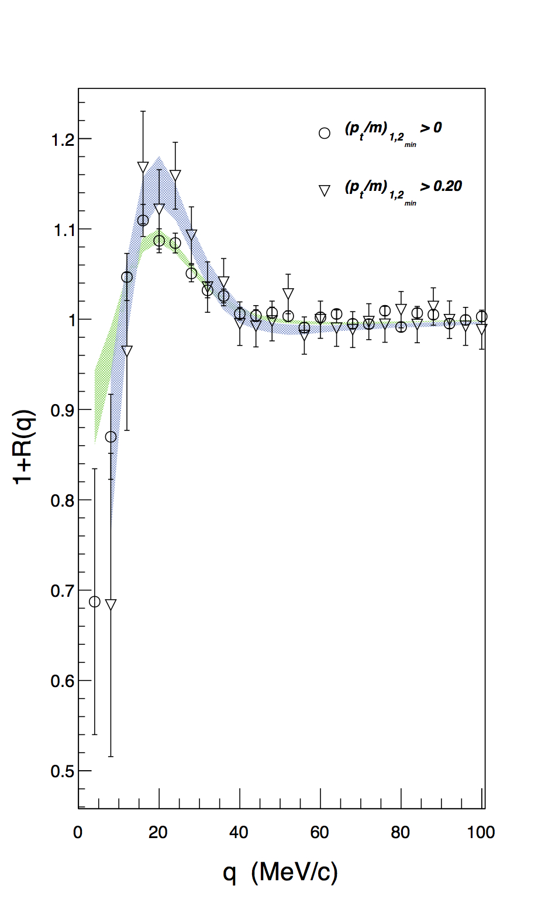
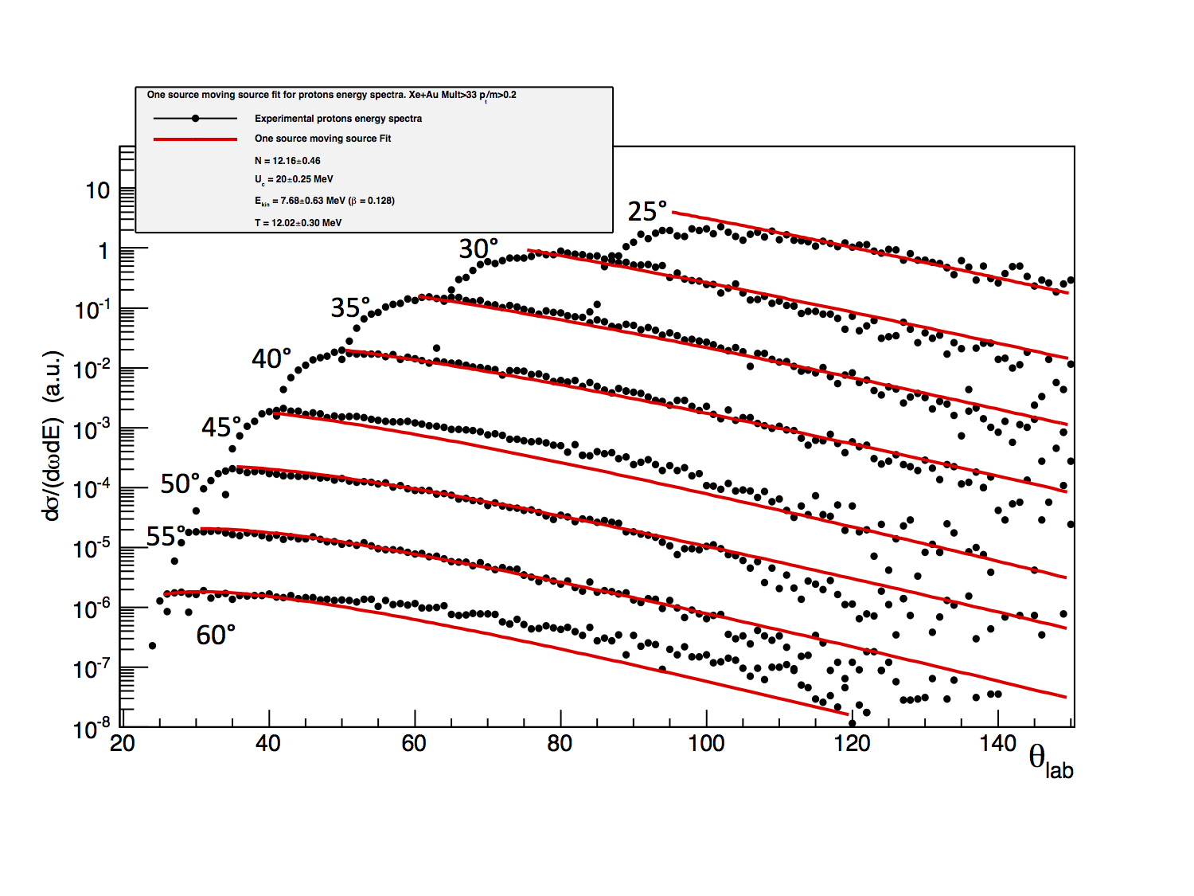
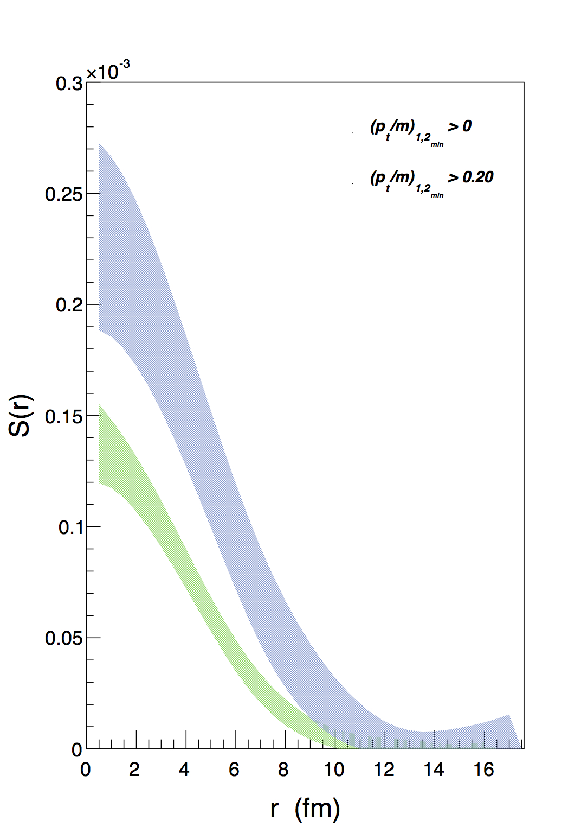
Experimental data (preliminary)
Xe+Au E/A=50 MeV MCP=36 (~b_{red}<0.3)
Lassa@MSU
P_{T}/m > 0.2
Proton energy spectra with p_{T} > 0.15
No P_{T} gate
pp correlations
Source functions
Moving source fit: single-particle emitting source moving with v ~ v_{NN}
E.V. Pagano
T. Minniti, G. Verde, et al., in progress

Slide 20
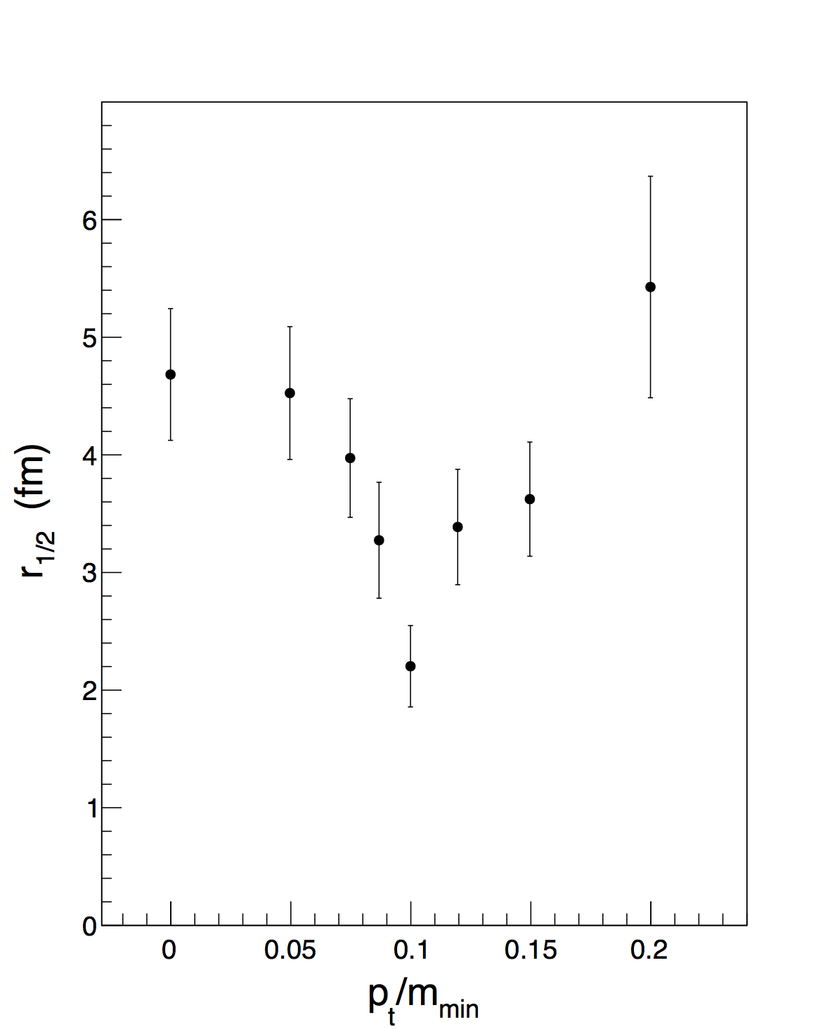
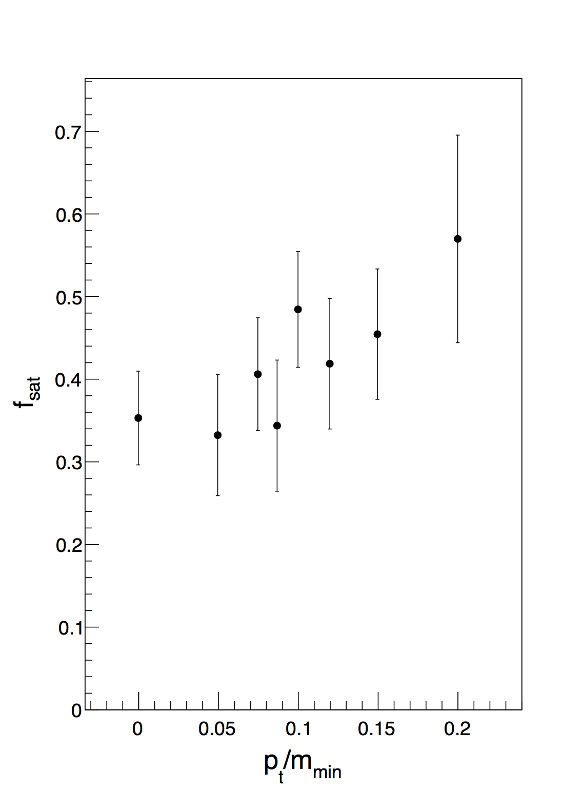
Effects of p_{T} gates on pp correlations
Preliminary
Xe+Au E/A=50 MeV b_{red}<0.3
Fraction of dynamically emitted protons (%) - f_{dynamical}
Source function size – r_{1/2}
r_{1/2} (fm)
f_{dynamical}
T. Minniti, G. Verde, et al., in progress
(p_{T}/m)_{min}
(p_{T}/m)_{min}
Consistent with increasing importance of dynamical sources at high P_{T}
Trend at high P_{T} of source size need more understanding… Work in progress

Slide 21
FARCOS TELESCOPE – phase 1
Based on (62x64x64 mm³) clusters
1 square (0.3x62x62 mm³) DSSSD 32+32 strips
1 square (1.5x62x62 mm³) DSSSD 32+32 strips
4 60x32x32 mm³ CsI(Tl) crystals
4 CsI(Tl) crystals (3rd stage)
DSSSD 1500 μm (2nd stage)
Assembly
cluster
DSSSD 300 μm (1st stage)
132 channels by each cluster
Fully reconfigurable (more Si layers, neutron detection, …)

Slide 22
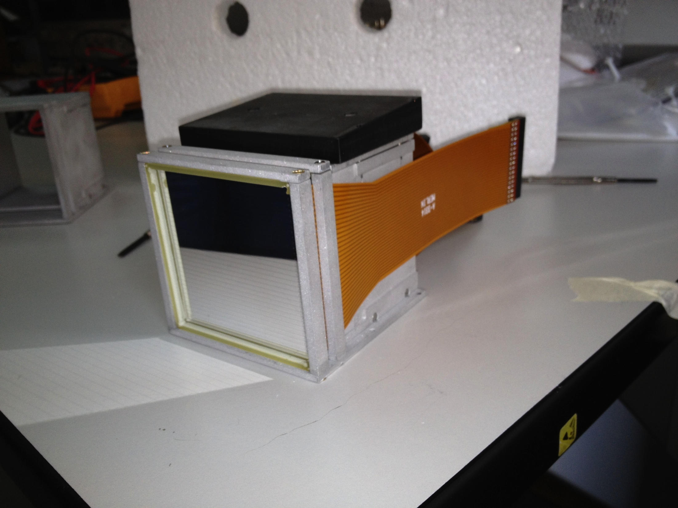
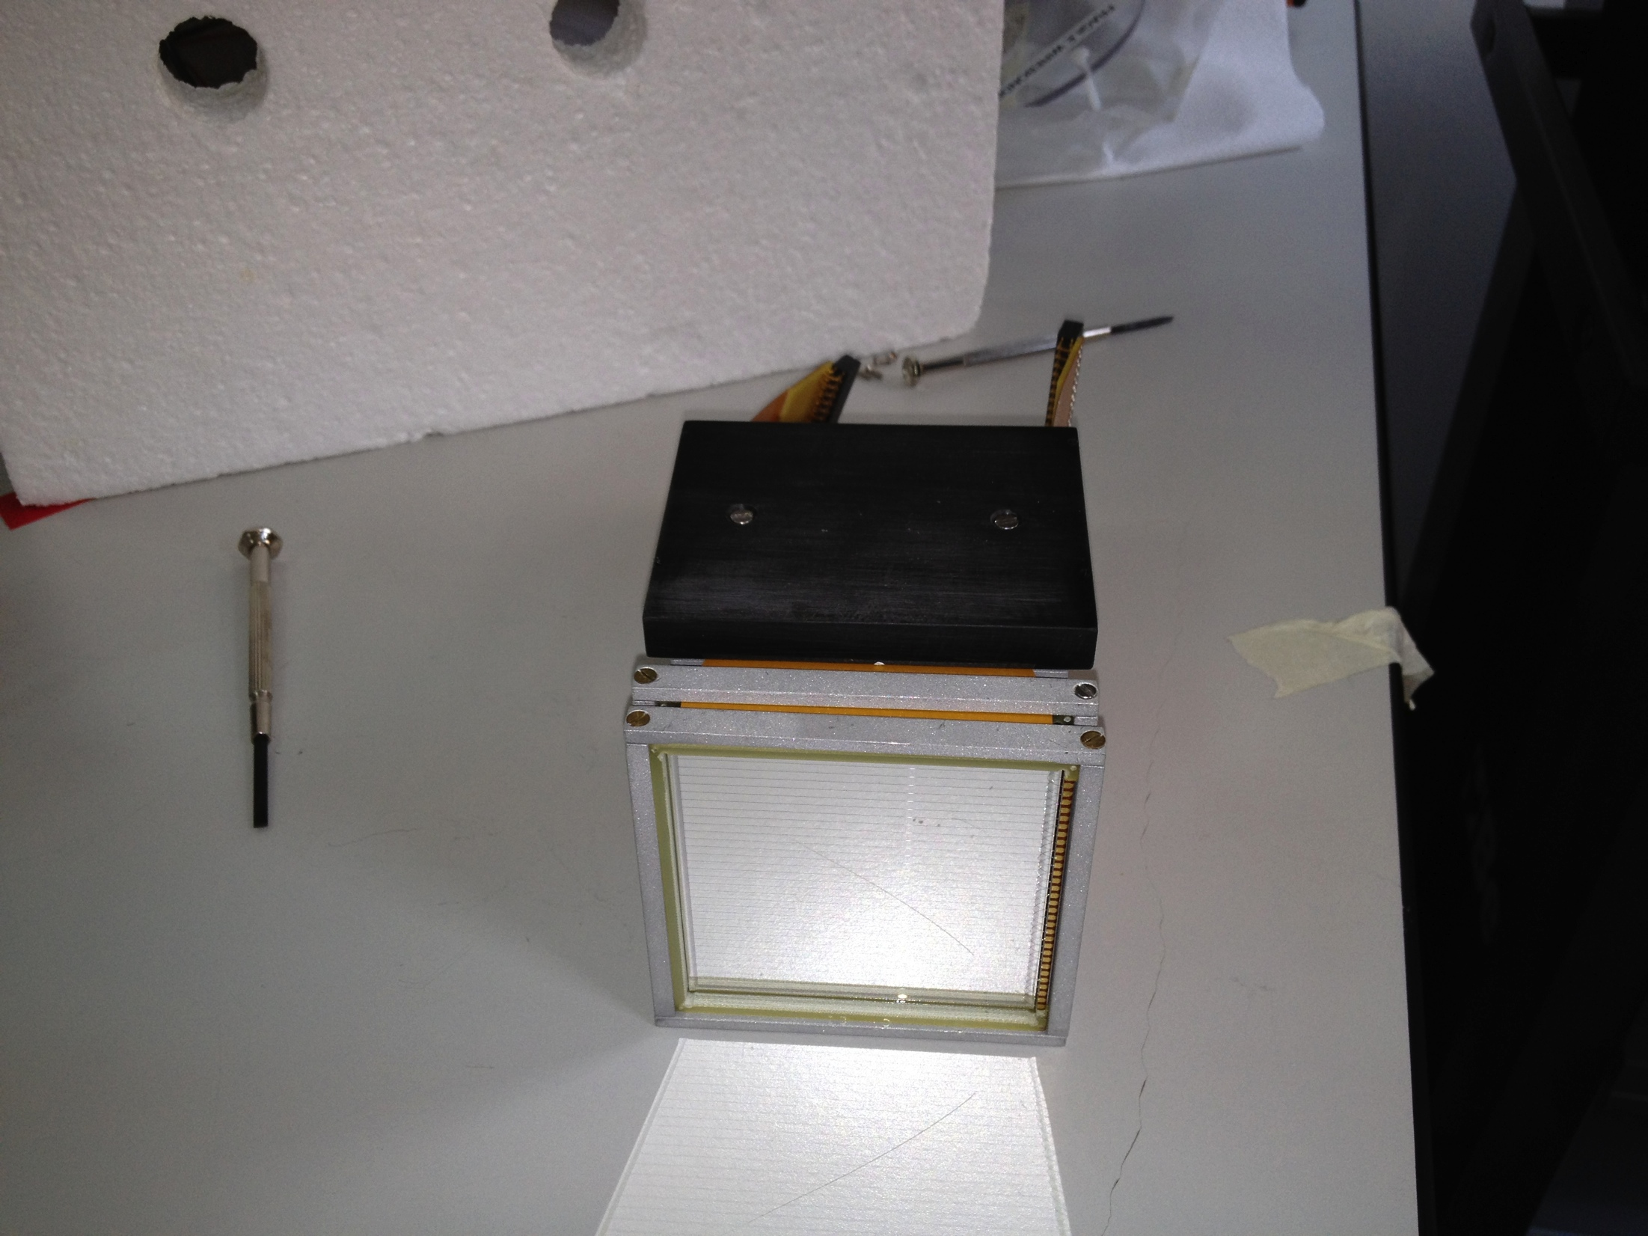
4 prototype modules built
First test experiments in 2012 and 2013
March-April 2012

Slide 23
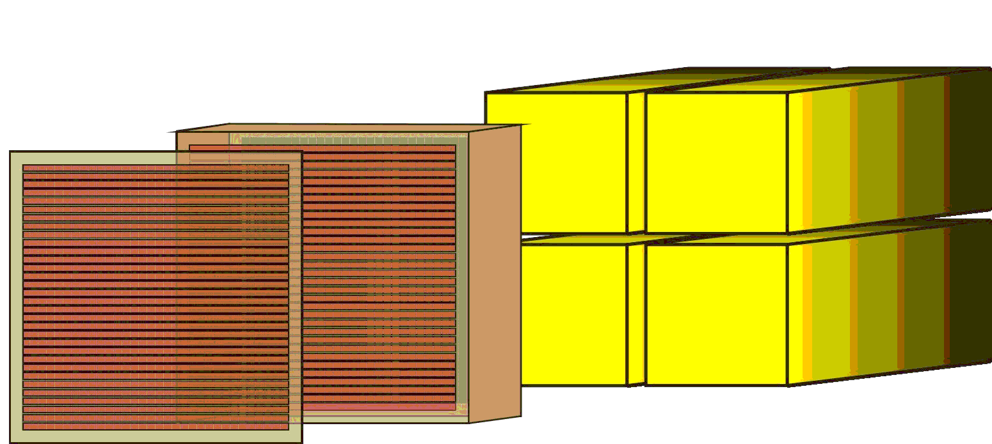
Identification Techniques
Charge
E_{Si}-RT
for ions stopping in Silicon
Charge (isotopic)
ΔE_{Si}-E_{CsI}
for ions stopping in CsI(Tl)
Si
CsI(Tl)
Isotopic (LCP)
Fast-Slow
for ions stopping in CsI(Tl)
Superconducting Cyclotron
Reference Signal
Mass
E_{Si}-ToF
for ions stopping in Silicon

Slide 24



Compact preamplifiers – Phase 1
32 channels Hybrid charge preamplifiers in a volume of
about 8cm x 10cm x 2mmm
Low power consumption: ~750 mW pwe 32 channels (simplify cooling operations)
Rise-Time (pulser): ~ 3-7 nsec for C_{input}=0-100pF
Energy resolution (pulser) ~ 4-5 KeV for C_{input}=0-100pF
Energy resolution 1500μm (alpha source) ~0.5% for E=5.48 MeV peak
Available with several sensitivities (5, 10, 45, 100 mV/MeV…)
INFN, Milano – C. Boiano, R. Bassini

Slide 25


CsI-response uniformity
α+Pb at E/A=62 MeV
Light response: less than 0.5% non-uniformity

Slide 26



Silicon strips @ Labec (INFN-FI)
INFN and Politecnico of Milan and Farcos collaboration
Fast pulsed beamline DEFEL: variable and controllable number of particles/pulse
Energy changed between 1 and 6 MeV
Position resolution: 100μm x 100μm: scanning of strips and inter-strip regions
Digitalization of silicon signals with commercial VME SIS 3301
100 MHz – 14bit
8 channels/module
Opt. Link to PCI

Slide 27


n-proton injection and resolution
Proton bunch multiplicity (deposited energy)
Resolution: 0.5% Front - 1.2% Back
Test of linearity for
Silicon+Preamplifier system
INFN and Politecnico, Milano for Farcos Collaboration

Slide 28



Interstrip energy sharing
Back injection + Back strip/interstrip spanning
Front injection + Back strip/interstrip spanning
Front injection + Back interstrip spanning
Data analysis under way:
Study of energy sharing between neighboring strips
Collect data important for design of ASIC front-end electronics with digitalization
(Collaboration with GET project)
INFN and Politecnico, Milano

Slide 29






First experiment with 4-telescope prototype
May 2013
DE-E (300-1500 µm) T2 Farcos
E/A=35 MeV
FAST-SLOW T4 Farcos

Slide 30


Experiments in 2014 @ LNS
CLIR: Clustering in Light Ion Reactions
16C + 12C→ 10Be + 6He
→ 12Be + 4He
16C from tagged FRIBS projectile fragmentation → 120 kHz
I. Lombardo, G. Verde
FARCOS
SIKO: α-gas state in 28Si
16O + 12C→ 28Si → 7-α
E/A=10-25 MeV
T. Kokalova, G. Verde

Slide 31
Under study: integrate neutron detection
“Transparency” of materials and electronics boards to incoming neutrons
Secondary stages for neutron detection – under study at the moment… (????)
Electronics
P
P
P
P
P
CsI(Tl)
…..
CsI(Tl)
DSSSD1
DSSSD2
Si

Slide 32
Neutron-proton emission chronology
Time delay between emissions Δt≠0 - Example: p emitted first
V_{p} > V_{n}
V_{p} < V_{n}
p
p
p
p
n
n
Interaction attenuated
Stronger interaction
“particle catch-up”

Slide 33

Lednicky recipe: p-n correlations
p first -100 fm/c
n first +50 fm/c
n first +100 fm/c
1+R₊(q)
Nuclear FSI
1+R₋(q)
Ratio +/-
R. Lednicky et al., Phys. Lett. B373, 30 (1996)
p-n
p-n
p-n
q (MeV/c)
q (MeV/c)
q (MeV/c)
Ratio R+/R- tells us which is emitted first

Slide 34
Conclusions
Relevance of femtoscopy and space-time probes
Understading two-proton correlations and dynamical emission stages in heavy-reaction systems
Attempts to isolate dynamical emissions by means of measurable observables: protons at high P_{T}
First tests with Farcos and future plans

