Slide 1
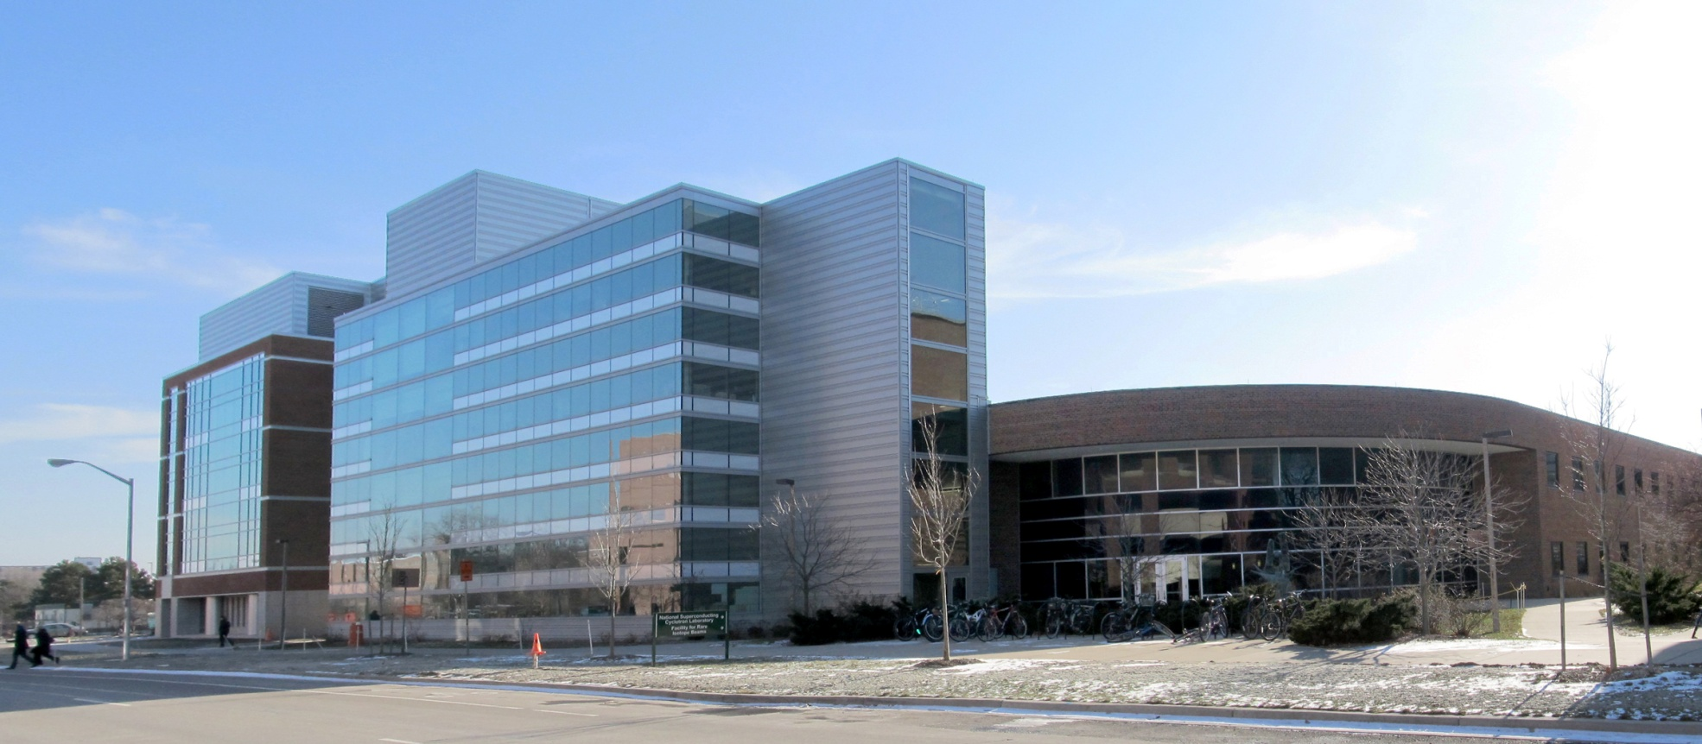
Probing the symmetry energy of neutron-rich matter
IWNDT in Honor of Prof. Joe Natowitz
Texas A&M University, College Station, Texas, USA August 19-22, 2013
Betty Tsang, NSCL/MSU

Slide 2
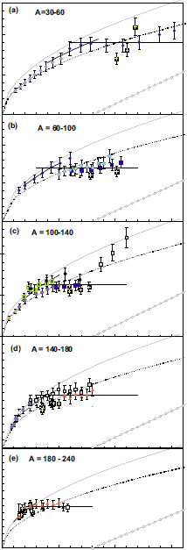
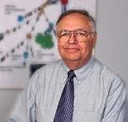
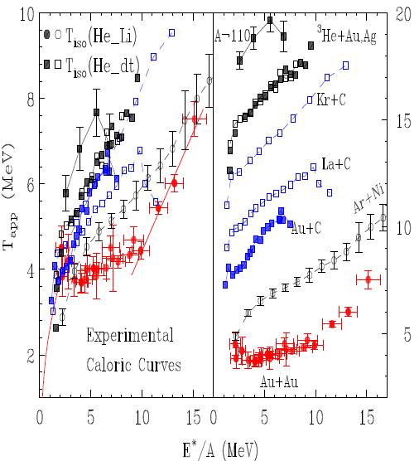
A=30-60
What a mess !
A=60-100
A=100-140
Temperature
Natowitz et al, PRC65 034618 (2002)
A=140-180
Adv. Nucl. Phys. 26, 91 (2001)
A=180-240
E*/A

Slide 3
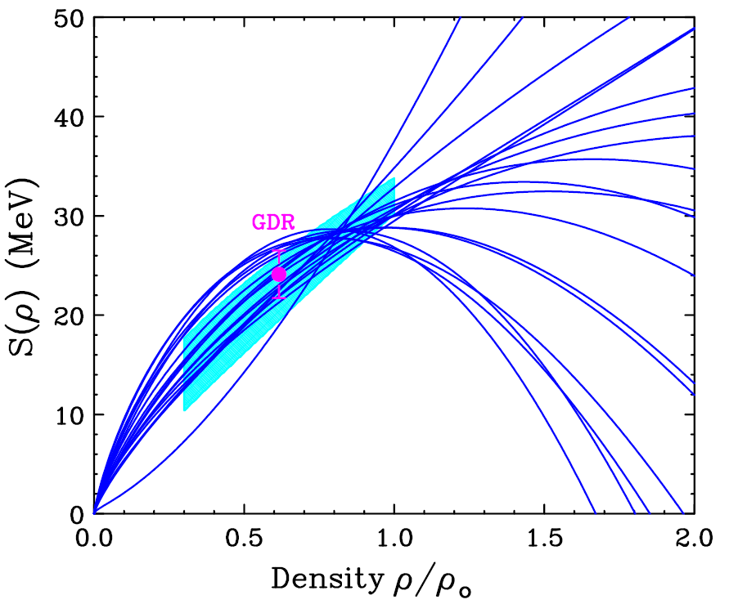
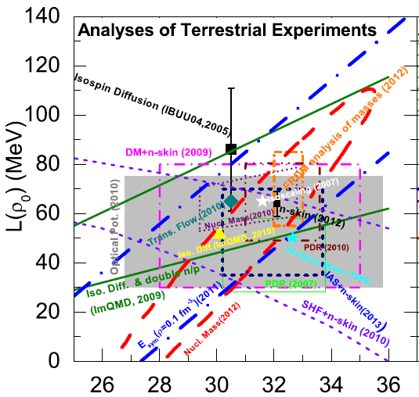

B.A. Li, out of context

Slide 4
Probing the symmetry energy of neutron-rich matter
Introduction
Summary of ICNT workshops and NuSYM13.
  Updates of constraints on symmetry energy
  New results from workshop relevant to HIC program
A way forward for high energy HIC:
Theoretical challenges
    Theoretical errors
    Transport models
Heavy Ion Collisions at high energy; E/A>100 MeV
    π ⁻ /π⁺ ratios and flow; charge particles n/p yield ratios and flow – new detectors
  Summary and Outlook

Slide 5
Nuclear Equation of State of asymmetric matter
E/A (ρ,δ) = E/A (ρ,0) + δ²⋅S(ρ)
δ = (ρ_{n}- ρ_{p})/ (ρ_{n}+ ρ_{p}) = (N-Z)/A
Density dependence of symmetry energy

Slide 6
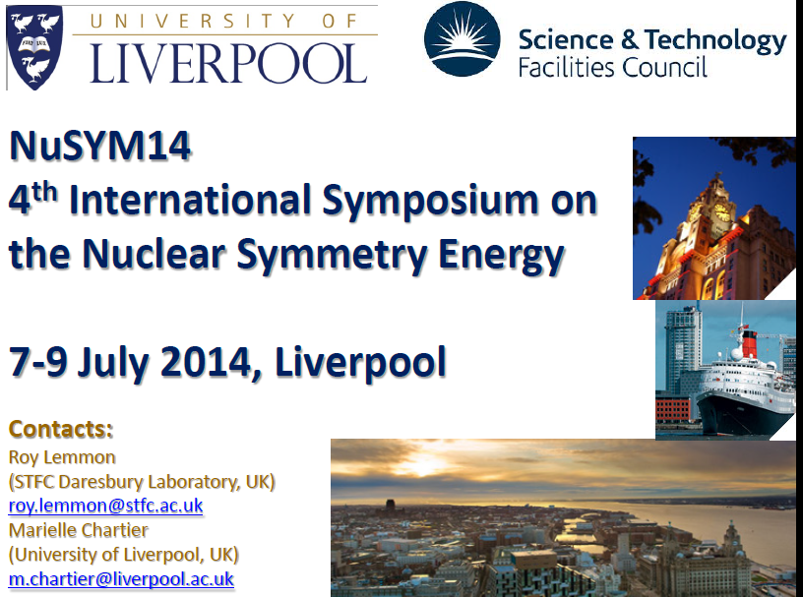
NuSYM13—International Symposium on in Nuclear Symmetry Energy
NSCL/FRIB, East Lansing, MI July 22-26, 2013
http://www.nucl.phys.tohoku.ac.jp/nusym13/index.html
NuSYM10:
RIKEN,
July 26-28, 2010
NuSYM11:
Smith College,
July 26-28, 2011
NuSYM13:
NSCL/FRIB,
July 22-26, 2013
NuSYM14: Liverpool,
July 7-9, 2014

Slide 7
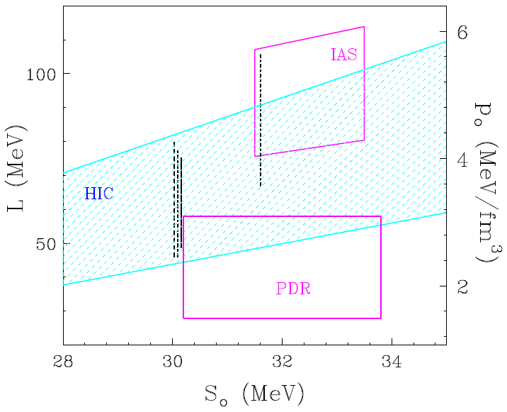
NuSYM10
B.A. Li, out of context

Slide 8
Consistent Constraints on Symmetry Energy from different experiments→ HIC is a viable probe
Isobaric Analogue States
NPA 818, 36 (2009)
heavy ion collisions
PRL 102,122701(2009)
Finite Droplet Range Model
PRL108,052501(2012)
p elastic scattering
PRC82,044611(2010)
neutron-star radius
PRL108,01102(2012)
Pygmy Dipole Resonances
PRC 81, 041304 (2010)
Tsang et al. C 86, 015803 (2012)
NuSYM11

Slide 9
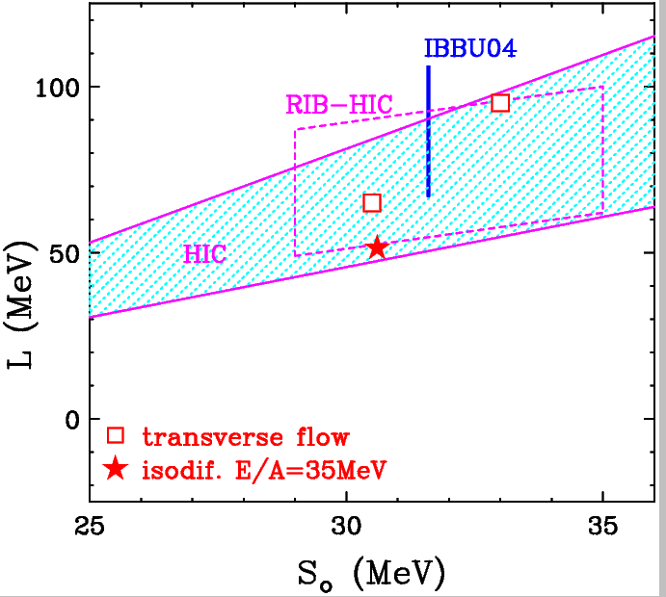
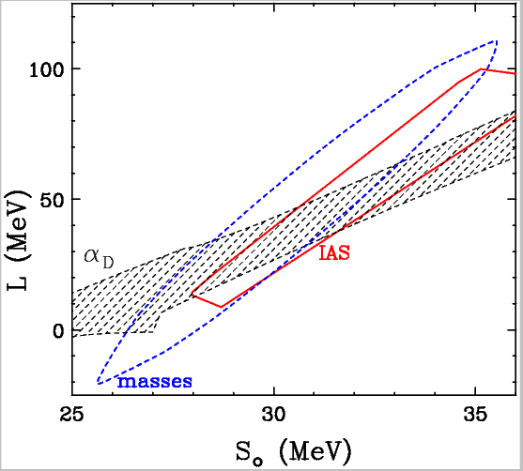
NuSYM13
Constraints from reactions
Constraints from structure

Slide 10
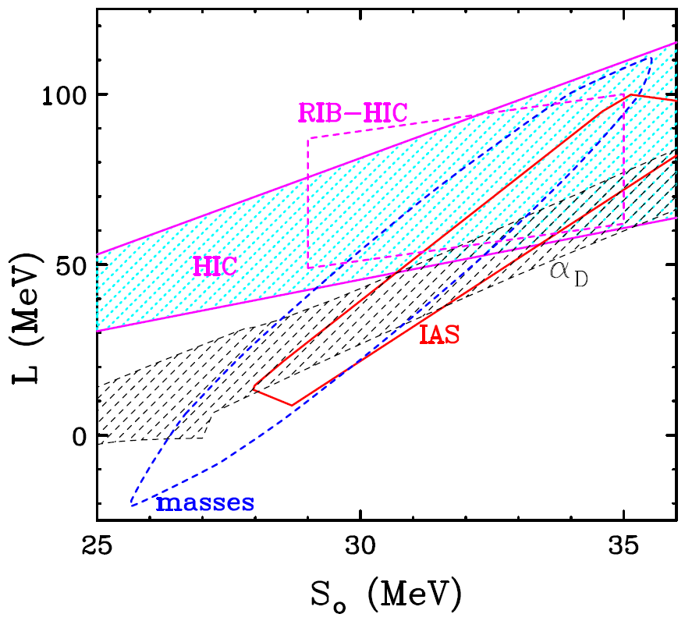
Updated Constraints from NuSYM13
(in progress)

Slide 11
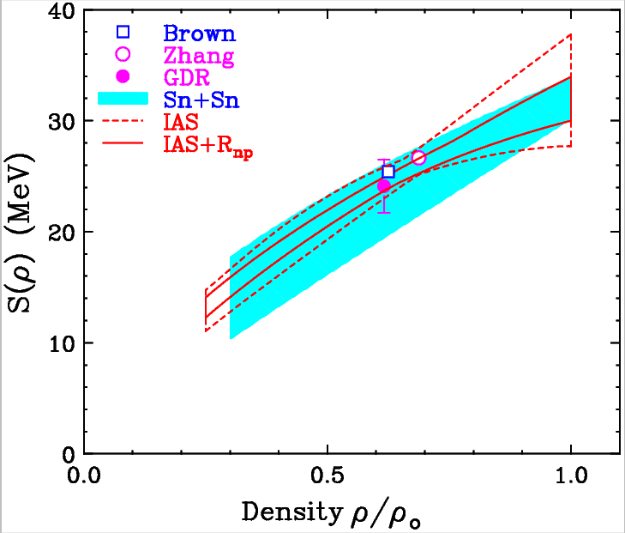
Updated Constraints from NuSYM13
(in progress)
NuSYM10
NuSYM13

Slide 12
Updated Constraints from NuSYM13
(in progress)

Slide 13
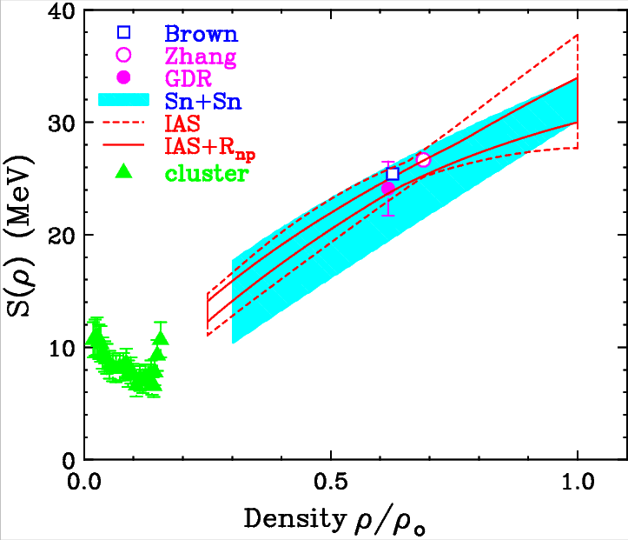
Updated Constraints from NuSYM13
(in progress)

Slide 14
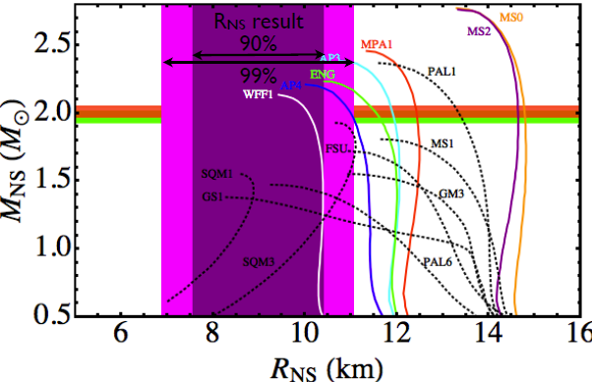
Astrophysics and Nuclear Physics
Neutron star
Skyrme interactions
Observation:
M_{NS} ~ 2M_{sun}
R_{NS} ~ 9 km
Equation of State
stiff EoS at high ρ
softening EoS at ρ∼2ρ₀

Slide 15
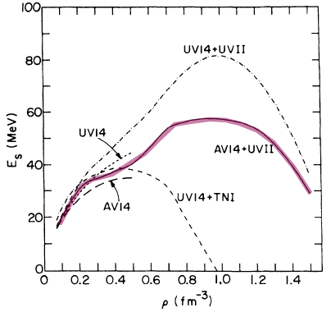
Astrophysics and Nuclear Physics
Neutron star (Rutledge, Gulliot)
AV14+UVII
Wiringa, Fiks, & Fabrocini 1988
HIC
Observation:
M_{NS} ~ 2M_{sun}
R_{NS} ~ 9 km
Equation of State
softening EoS at ρ∼ 2ρ₀
stiff EoS at high ρ

Slide 16
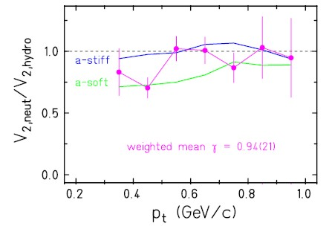
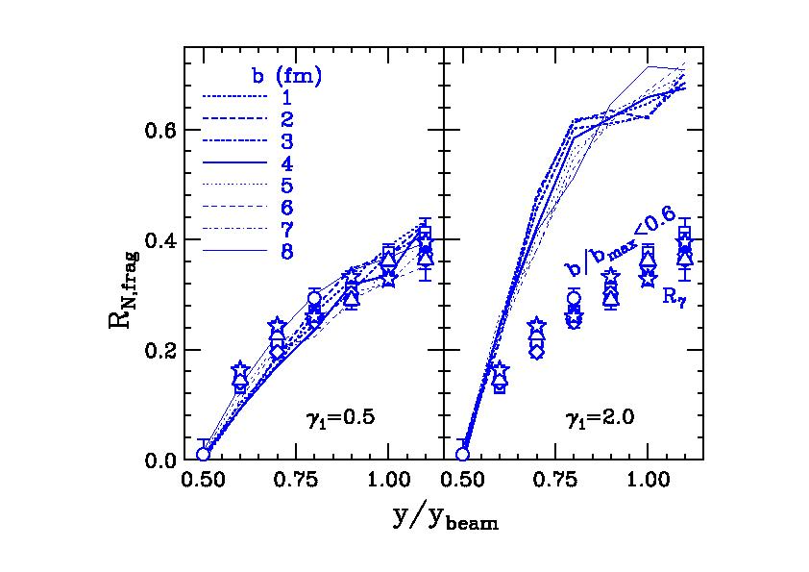
Constraints on the density dependence of symmetry energy
n,p squeeze-out
Isospin Diffusion
Au+Au
π⁺/π⁻ ratios

Slide 17
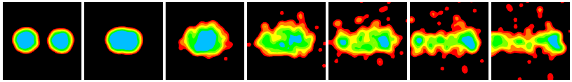
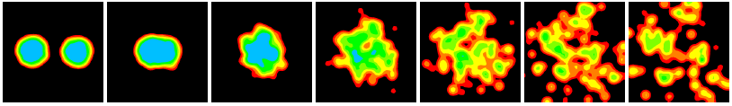
Problems at high density
Transport Model:
Different codes/models predict different outcomes (flow vs. pions →stiff vs super-soft)
Transport input parameters need to be better determined
Cluster formation affects reaction dynamics (and the observables)
Problems also exists in LE
Antisymmetrized Molecular Dynamics (AMD)
Without cluster correlations
Xe + Sn;
E/A=50 MeV
Akira
Ono
NuSYM11
With cluster correlations

Slide 18
A Way Forward – Transport models
Transport Model:
Different codes/models predict different outcomes (pion vs. flow→stiff vs super-soft)
Transport input parameters need to be better determined
Cluster formation affects reaction dynamics (and the observables)
Problems also exists in LE
Transport workshop (China) :
Comparison of codes – clarify the differences between versions of codes
Comparison of models
Effects of transport input parameters should be studied systematically
Establishment of benchmark tests and benchmark data
Implementation of better cluster formation in transport models
Antisymmetrized Molecular Dynamics (AMD)
Without cluster correlations
Xe + Sn;
E/A=50 MeV
With cluster correlations

Slide 19
A Way Forward – Data
Data (Current Status)
Au+Au experiments were performed in 90’s to study the symmetric matter EOS
Data – Ratio observables from RIB :
Choose observables that are less sensitive to the assumptions of the transport models
New observables (π⁺/π⁻ ratios) requires new detectors
π⁺/π⁻ ratios
n,p squeeze-out

Slide 20
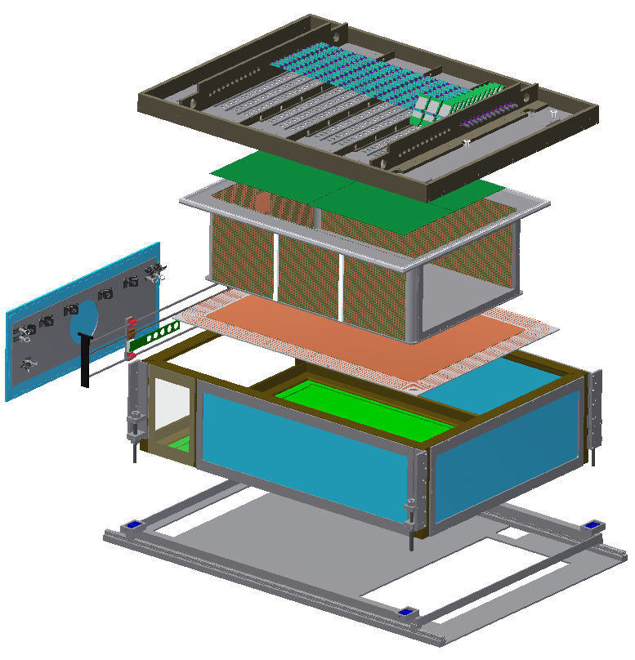
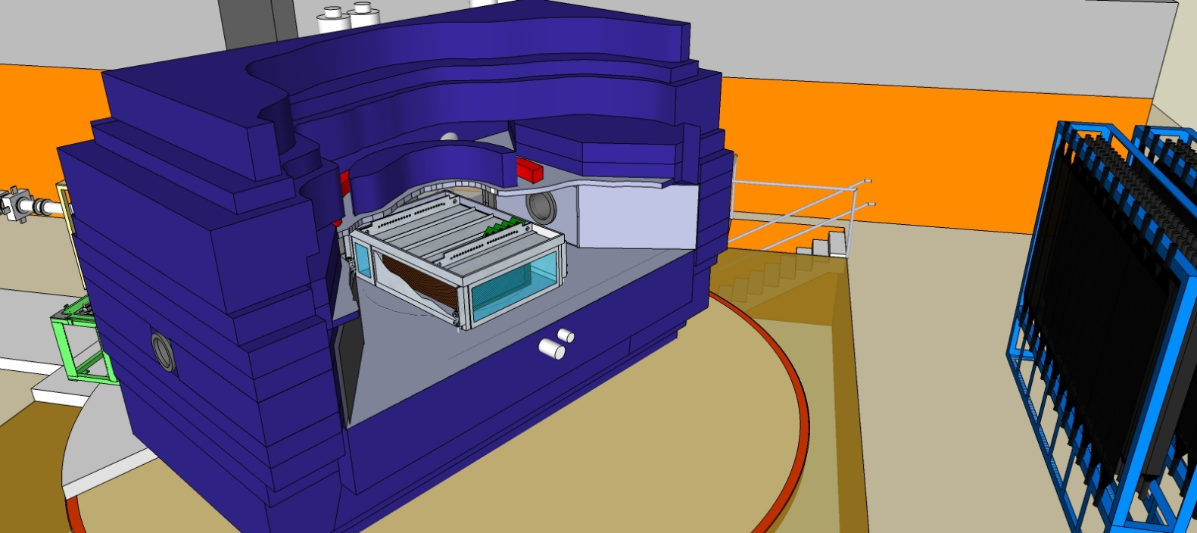
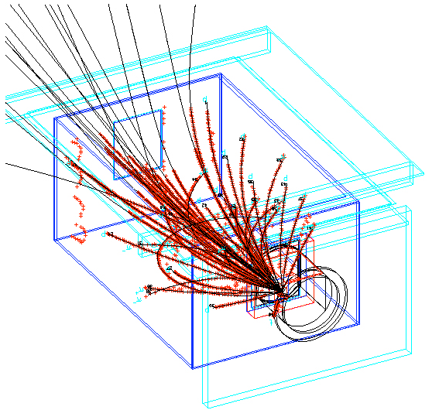
MSU-TAMU-RIKEN-Kyoto initiative: Time Projection Chamber to detect pions, charged particles at ρ∼2ρ₀
chamber

Slide 21
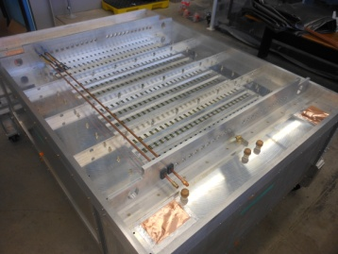
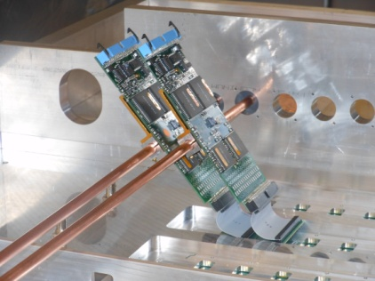
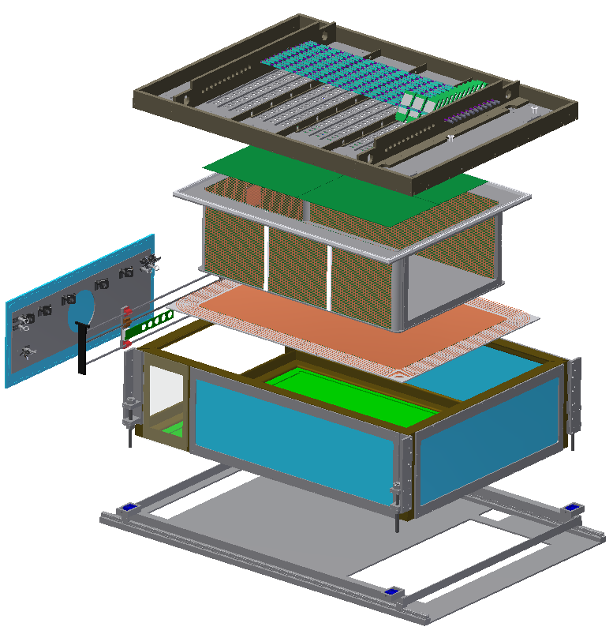
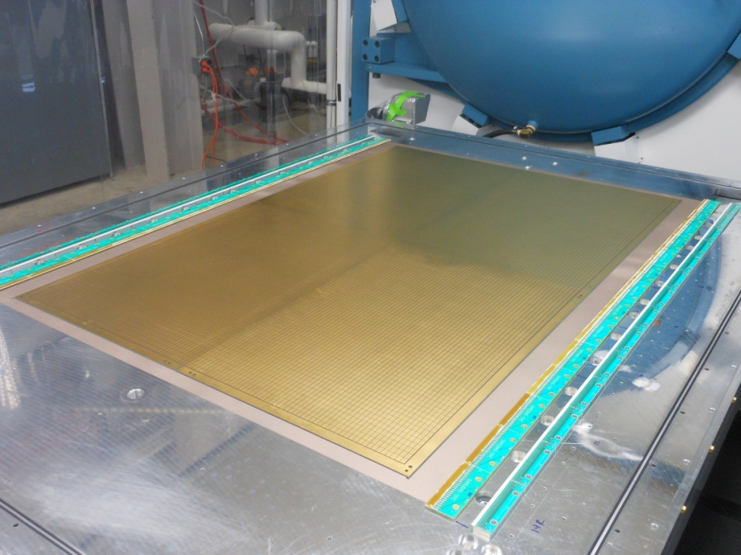
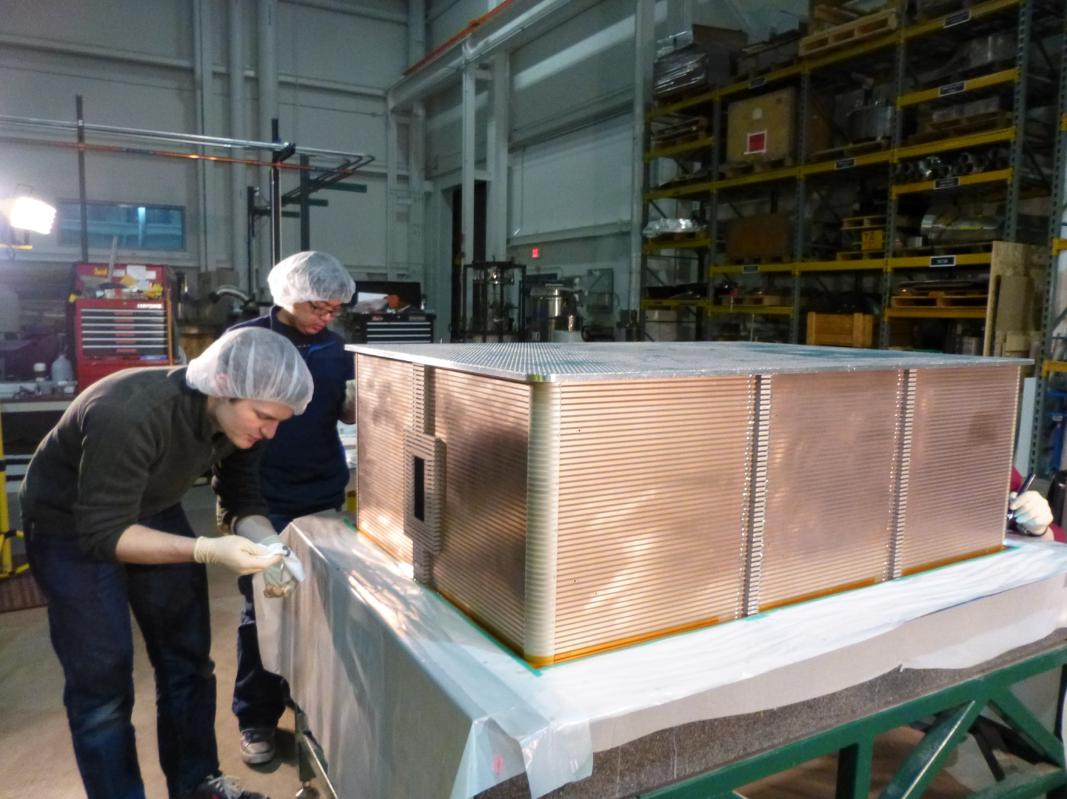
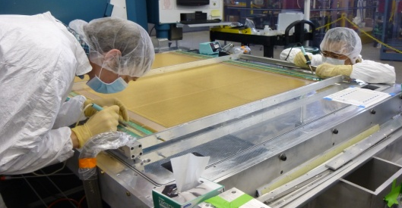
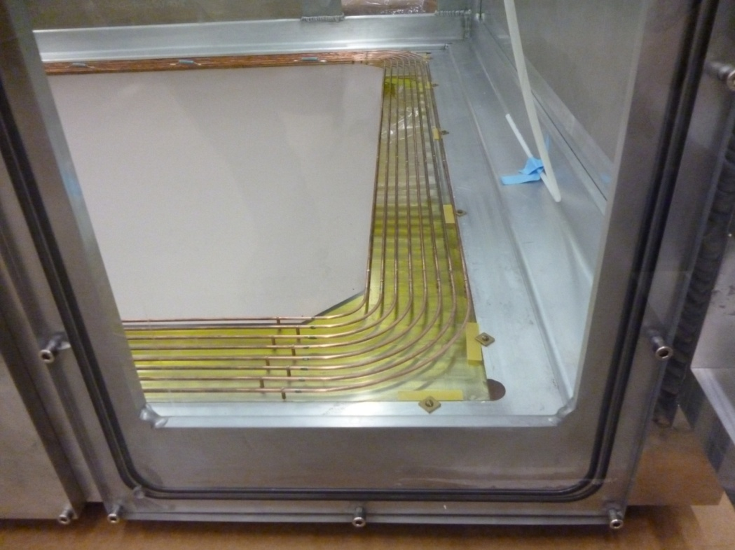
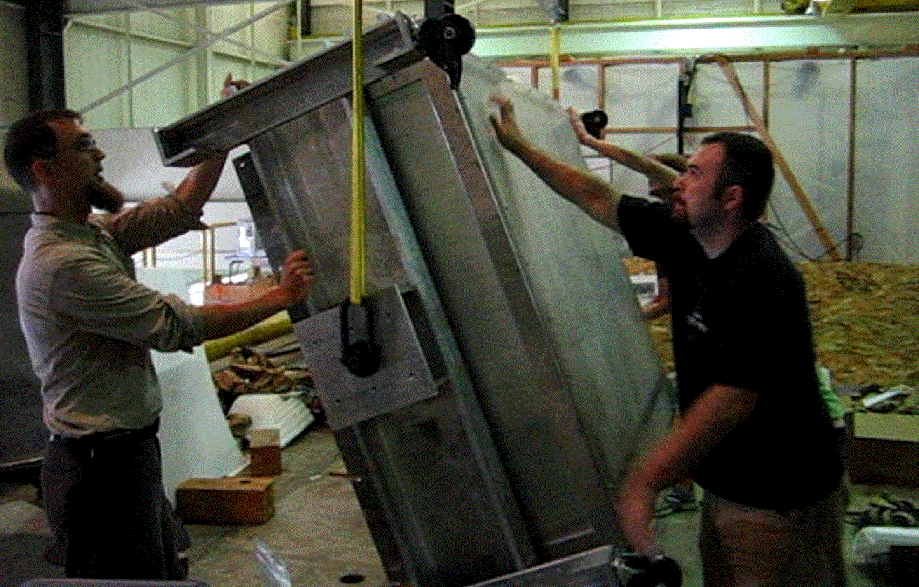
SAMURAI TPC: Exploded View
Rigid Top Plate
Primary structural member,
reinforced with ribs.
Holds pad plane and wire planes.
Front End Electronics
STAR FEE for testing,
ultimately use GET
Pad Plane
Mounted to bottom of
top plate. Used to measure particle ionization tracks
Field Cage
Defines uniform electric field.
Contains detector gas.
Wire Planes
Mounted below pad plane.
Provide signal multiplication and gate for unwanted events
Beam
Calibration Laser Optics
Target Mechanism
Voltage Step-Down
Prevent sparking from cathode (20kV) to ground
Thin-Walled Enclosure
Protects internal
components, seals
insulation gas volume, and supports pad plane while allowing particles to continue on to ancillary detectors.
Rails
For inserting TPC into SAMURAI vacuum chamber

Slide 22
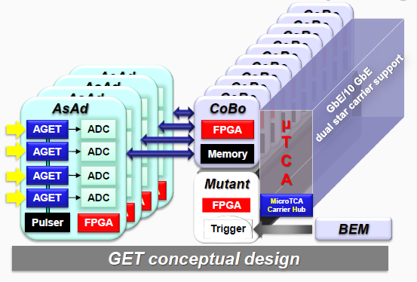
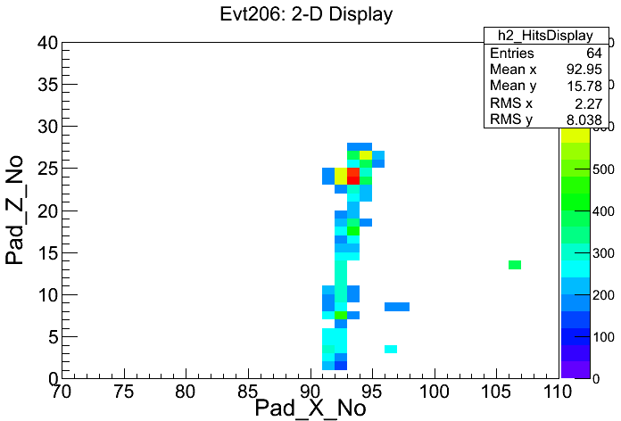
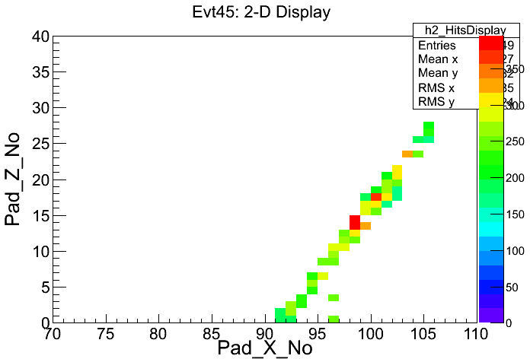
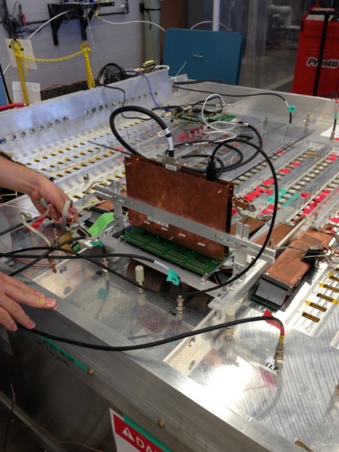
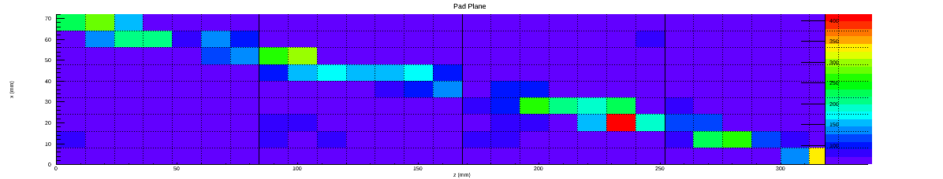
Cosmic ray tracks
10.5 bit dynamic range
1KHz – 10Gb/s
STAR electronics (1024 channels): 5/15/13
Figure courtesy of GET collab.
GET electronics (256 channels): 7/27/13
Cosmic Event 0: July 24th, 2013 @NSCL

Slide 23
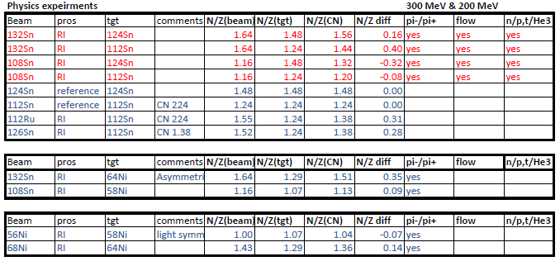
Heavy Ion Collisions at high density with RIB
Old data: Au+Au, E/A=150 to 1500 MeV
New Experiments at RIB facilities
6.5 days approved by June RIKEN PAC

Slide 24
SUMMARY
Consistent constraints on the symmetry energy at sub-saturation densities with different experiments suggest that heavy ion collisions provide a good probe at high density..
Astronomical observations suggests the importance of probing ~2ρ₀ region.
At high & low densities: transport workshop is being organized to examine the transport codes.
Experiments to measure constraints on the symmetry energy above saturation densities have started with n/p ratios and will continue with pion and flow measurements with the TPCs at RIKEN and FRIB.

Slide 25
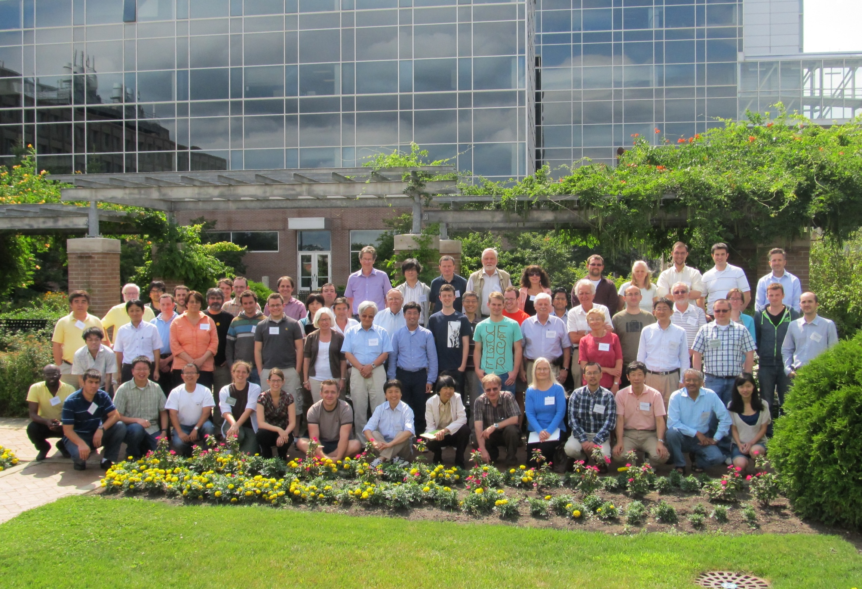
NuSYM13, July 22-26, 2013, East Lansing, USA

Slide 26






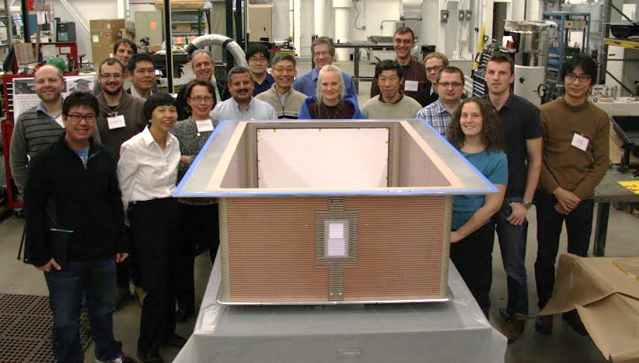
SPiRIT TPC: Status and experimental program
SAMURAI Pion-Reconstruction and Ion-Tracker TPC
R. Shane, for the S-TPC collaboration

Slide 27
ICNT—International Collaborations in Nuclear Theory
http://frib.msu.edu/content/ICNT
Topical Theory Programs complement to INT and ECT*
MSU, GSI, & RIKEN directors contribute $50k/year to host 10-20 theorists get together for 2-4 weeks.
In Nov. 2012, the ICNT board recommended 3 proposals
NSCL/FRIB -- Chuck Horowitz: Symmetry-energy in the context of new radioactive beam facilities and astrophysics
GSI -- Lucas Platter: Halo Physics at the Neutron Drip Line... (approved by the EMMI PAC in May)
RIKEN -- Michael Famiano: Element Genesis and Cosmic Evolution (delayed due to lack of funding at RIKEN)

Slide 28
ICNT—International Collaborations in Nuclear Theory
http://frib.msu.edu/content/ICNT
Topical Theory Programs complement to INT and ECT*
MSU, GSI, & RIKEN directors contribute $50k/year to host 10-20 theorists get together for 2-4 weeks.
In Nov. 2012, the ICNT board recommended 3 proposals
NSCL/FRIB -- Chuck Horowitz: Symmetry-energy in the context of new radioactive beam facilities and astrophysics
Week I (July 15 - 19): Symmetry energy at low nuclear densities
Week II (July 22 - 26): NuSYM13
Week III (July 29 – Aug 2): Symmetry energy at high densities including astrophysical environment.
Week IV (Aug 5 - 9): Future Directions
Deliverable: Write-up of a document (what have we (Horowitz, Danielewicz, Li, Onishi, Ono, Tsang) done with Konrad’s $50k?)

Slide 29
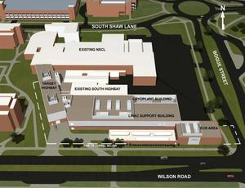
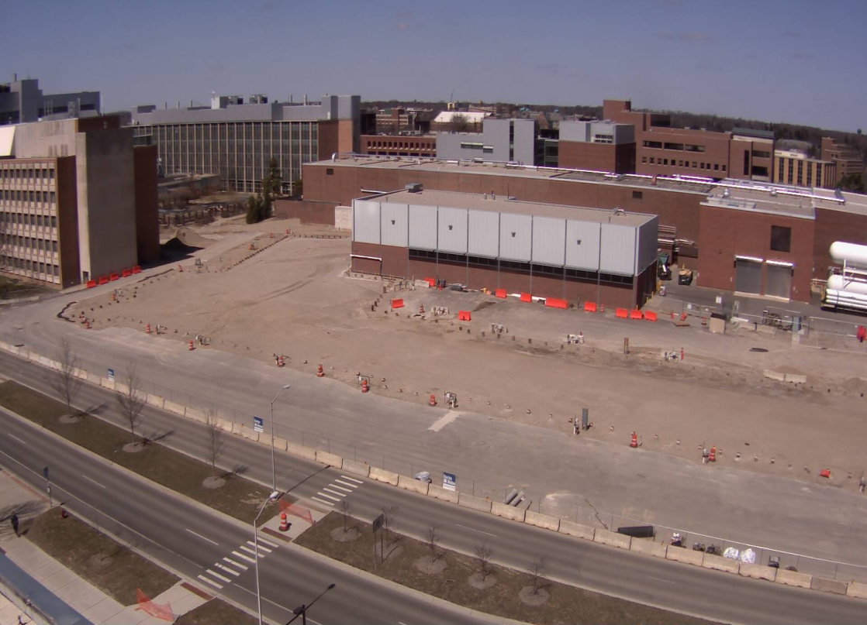
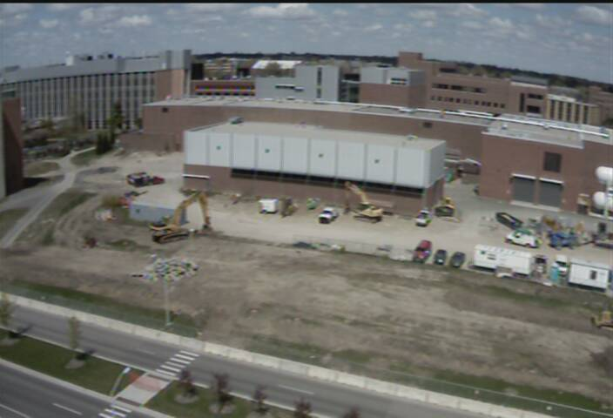
Facility for Rare Isotope Beams (FRIB)
FRIB will provide intense beams of rare isotopes (that is, short-lived nuclei not normally found on Earth). FRIB will enable scientists to make discoveries about the properties of these rare isotopes in order to better understand the physics of nuclei, nuclear astrophysics, fundamental interactions, and applications for society.

